Slide 1
Wastewater remediation issues
Bára Babánková, Veronika Dubová, Tereza Lichnovská

Slide 2
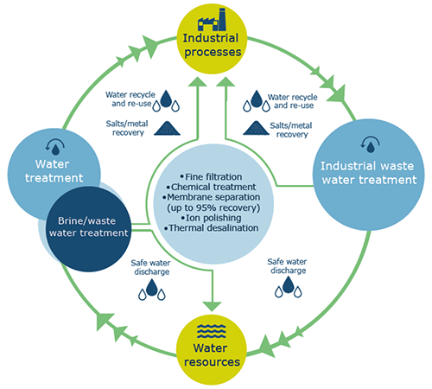
Introduction
Water is necessary for all known life forms
Water pollution and enviromental degradation are on the rise
As result of globalization, industrialization, population increase and urbanization, water contamination has become major issue
The use of reclaimed wastewater for irrigation has become an attractive alternative water resource

Slide 3
Introduction
However, there are several potential environmental- and health-related risks associated with this practice
One significant issue associated with wastewater treatment is the presence of antibiotic residues. Antibiotics are commonly used in healthcare, agriculture, and livestock farming
When these antibiotics enter wastewater through various sources like hospitals, pharmaceutical manufacturing, or agricultural runoff, they can persist through the treatment process and end up in the treated effluent
The presence of antibiotic residues in wastewater is concerning due to its potential environmental and public health impacts. Antibiotics in treated wastewater can contribute to the development of antibiotic-resistant bacteria in the environment
Addressing antibiotic residue problems in wastewater treatment requires improved treatment processes, proper disposal of expired or unused medications

Slide 4
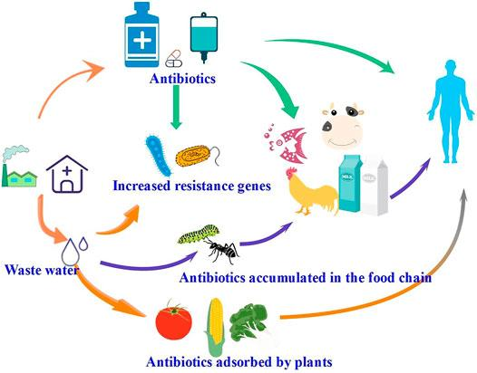
What can antibiotic residues in nature cause?
Antibiotic resistant development
Ecotoxicity (residues in water bodies can be toxic to organisms. Even at low concentrations, antibiotics may negatively impact the growth, development, and survival of aquatic organisms)
Disruption of microbial communities (This can affect nutrient cycling, decomposition processes, and other essential ecosystem functions, leading to imbalances in the ecosystem)
Persistence in the environment (some antibiotics are persistent in the environment, meaning they do not easily break down = accumulation)
Transfer through food chains (residues can enter the food chain, which potentially leads to unintended exposure)

Slide 5
Antibiotics metabolism
After distribution in the tissues and body fluids, metabolising enzymes in the body may degrade the ATB
The liver is the principal organ of metabolism, although any biological tissue can metabolised drugs
By metabolic processes, the drug is inactivated and converted into more readily excreted substance
Not all ATB are converted to metabolites and, on occasion, the metabolites may retain activity

Slide 6
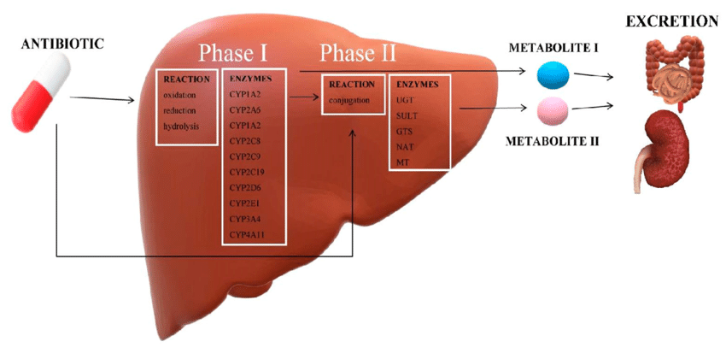
Antibiotics metabolism
Unchanged ATB and ATB metabolites are removed from the body by excretion pathways
Excresion as urine from the kidneys are the major route of drug elimination
Excresion into the bile from the liver is another

Slide 7
Issues of ATB removal from water – avaible methods
Various technologies based on physical, chemical and biological techniques, such as flocculation and coagulation, membrane filtration, advanced oxidation process and bioremediation method, have been used for wastewater treatment.
Unfortunately, the currently available methods do not allow cleaning from all antibiotic residues

Slide 8
Photocatalytic degradation
Water is one of the most important components of life
In past few years, the concern towards contaminants like pharmaceutical compounds (PCs) has increased due to their impacts on the ecosystem
Amoxicilin (AMX) is primarily used as semi-synthetic penicillin which belongs to the β-lactam group of antibiotics
AMX is responsible for obstruction of bacterial cell wall synthesis
Advanced Oxidation Processes (AOPs) are reported as the most effective technique to treat recalcitrant compounds like PCs

Slide 9
Photocatalytic degradation
Ptohocatalysis is based on the degradation of highly oxidizing hydroxyl radicals (•OH)
•OH are strong oxidizing agents which transform pollutants to non-toxic end products like CO₂ and H₂O
Heterogenous photocatalysis is found to be the most efficient method to degrade complex pollutants like ATB
Photocatalysis initiates when semiconductor photocatalyst is exposed to light (IR, VIS, UV)
Various photocatalysts have been used
TiO₂ is most effective as it represents nontoxicity, photo-reactivity, high photostability, chemical and biological inertness and low prize

Slide 10
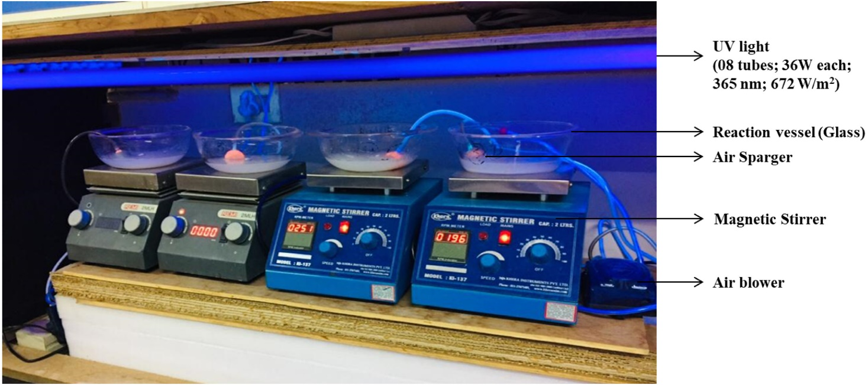
Experimental procedure of photocatalysis
The experiments for photocatalytic degradation were preformed at initial AMX concentration of 10, 30, 50 mg/l in 200 ml aqueous solution
The pH of the solution was adjusted to 3, 7, 11 (using H₂SO₄, NaOH)
Thereafter, varying dosages of TiO₂ (300, 450, 600 mg/l) and H₂O₂ were added
The real industrial wastewater of AMX producing batch was collected from pharmaceutical industry located in India

Slide 11
Results of photocatalysis
To observe the degradation of AMX, experiments were performer using photocatalysis with H₂O₂, without H₂O₂ and sono-photocatalysis
Maximum degradation for AMX was obtained using photocatalysis with H₂O₂ at AMX 30 mg/l, TiO₂ 450 mg/l, H₂O₂ 150 mg/l and pH 7
The result revealed that there was no significant improvement in maximal degradation when photocatalysis was amended with H₂O₂

Slide 12
Results of photocatalysis in pharmaceutical wastewater
Within 10 min of reaction time it was achieved 50 % of degradation in sono-catalysis and solar sono-catalysis
After 30 min, more than 80% degradation was found in sono-catalysis and solar sono-catalysis and more than 50% degradation in photocatalysis and solar-photocatalysis

Slide 13
Microbial biofilm reactors
The biological approach for wastewater treatment is not only a widely used technology, but it is also an environmentally safe and user-friendly approach over physical and chemical-based treatment methods
Biofilms: are dynamic, structurally complex systems having characteristics of multicellular animals and multiple ecosystems – so biofilm have a different physiology than planktonic cells
Biofilm reactors may be traced all the way back to the beginnings of modern water sanitation.
Researchers used a biofilm-covered media dosed with a steady trickle flow.
More research is still needed

Slide 14
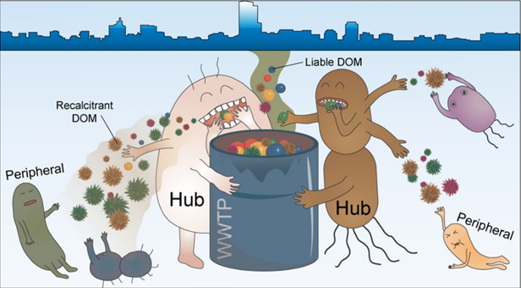
How it works
Biofilm system is a well-developed approach where solid medium is introduced to suspended growth reactors to create adherence sites for biofilms, hence increasing microbial concentration and pollutant breakdown rates
Biofilms can accumulate, degrade and break down pollutants, including antibiotic residues
Degradation and decomposition in concentrations of up to several hundred ng g⁻¹
After the pollutants have been removed, the area will be treated and biofilter’s water is either discharged into the environment or utilized for agriculture etc.

Slide 15
The mechanism by which biofilms contribute to the removal of antibiotic residues in wastewater
Adsorption: Biofilm matrices can adsorb and physically trap antibiotic molecules. The EPS produced by microorganisms in the biofilm can act as a sorbent, capturing antibiotics as they pass through the reactor
Microbial degradation: Within the biofilm, diverse microbial communities can thrive. Some of these microorganisms possess the ability to biodegrade or transform antibiotics into less harmful compounds. Microbial metabolism can break down complex organic molecules, including antibiotics, through enzymatic reaction
Sorption to microbial biomass (accumulation): Antibiotics can be sorbed into the biomass of microorganisms within the biofilm. Microbes can act as carriers for the antibiotics, facilitating their removal from the water
Biological transformation: Certain bacteria in the biofilm may have the capability to enzymatically degrade or transform antibiotics into less toxic forms, reducing their environmental impact

Slide 16
Advantages of biofilm reactors
Increased residence time of biomass
Environmental resistance
Low space requirements
Flexibility of operation, and hydraulic retention time is reduced
It improved capacity to digest refractory substances as well as a slower pace of microbial growth, results in less production of sludge
Availability - because they are found everywhere in nature and in manmade systems
Offers sustainable wastewater treatment
But…
Effectiveness can vary depending on factors such as the specific antibiotic, the composition of the biofilm, and the overall wastewater treatment process. Integration of biofilm reactors with other treatment technologies, such as activated sludge processes or advanced oxidation methods, may be necessary to achieve comprehensive removal of antibiotic residues from wastewater

Slide 17
Membrane technologies
Biological treatment is a potential solution, the high cost limits its use in large plants
The effectiveness is related to the solute and membrane properties (size of membrane pores)
Fabricating negatively charged membranes can reduce the total cost of the filtration process
A combination of membrane processes with advanced oxidation processes (AOPs), adsorption, and biological treatments - right solution for perfect removal

Slide 18
Types of membrane technologie
Microfiltration (pores 0.1-10µm) – removes bacteria, particles, microorganisms with some kinds of antibiotics
Ultrafiltration (pores 0,001 to 0,1µm) – removes bacteria, viruses, organic substances including antibiotics
Nanofiltration (nanometres pores) – removes organics, ions and some types of antibiotics
Reverse osmosis – effective for removing a wide range of contaminants, including antibiotics, removing molecules with high molecular weight

Slide 19
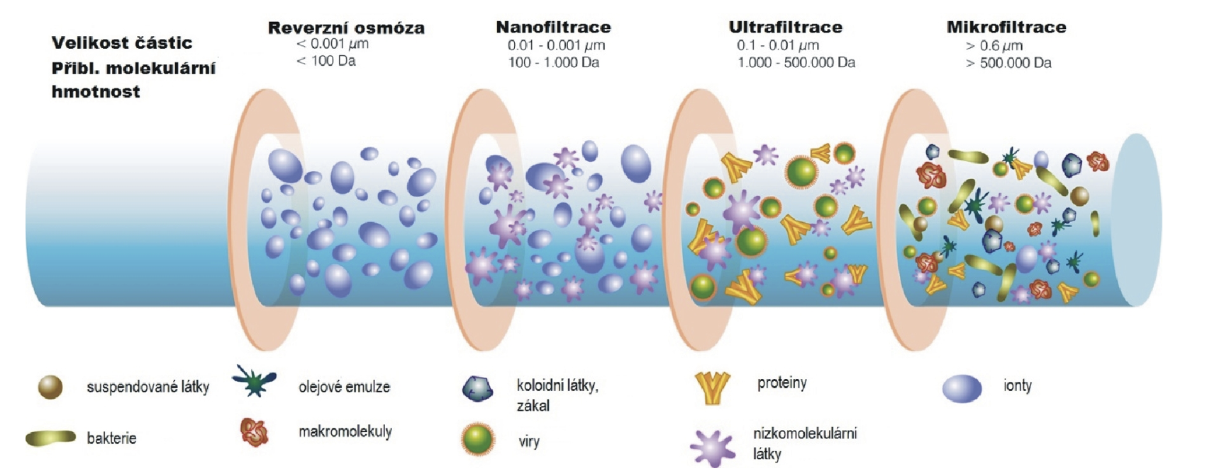

Slide 20
How it works
An original fact about membrane is the division of the feed into two streams, which are permeate and retentate where both streams may be important
In water treatment permeate is the main product of process
Membrane is able to transfer one component of the feed stream easier than others because of the special properties and different relationships between the membrane and permeating components

Slide 21
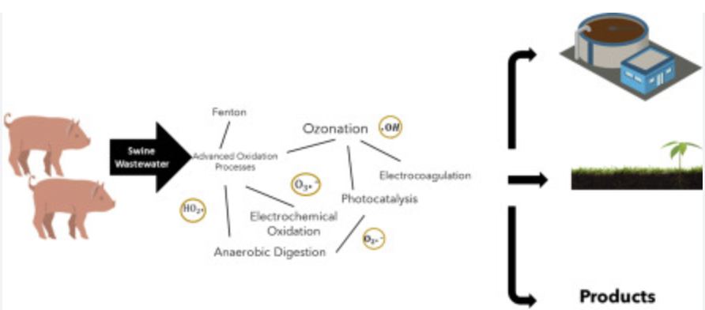
Experient
One of the main sources
of ARGs is the swine wastewater treatment plant
Increases the efficiency of NF and RO in ARGs elimination from swine wastewater
Conventional biological treatment did not reduce the high abundance of ARGs in raw wastewater
NF and RO were effective processes to remove ARGs
Advanced membrane technologies could remove different kinds of ARGs efficiently

Slide 22
Promising methods for the future
A combination of different technologies can provide a more efficient approach
Removal of antibiotics and relative toxic compounds can be used as energy generation plants to reduce WWTP costs in future
Development of advanced oxidation processes - photo-oxidation, Fenton reactions (catalytic oxidation of hydrogen peroxide) ozonation - using oxidation processes to break down organic substances, including antibiotics.

Slide 23
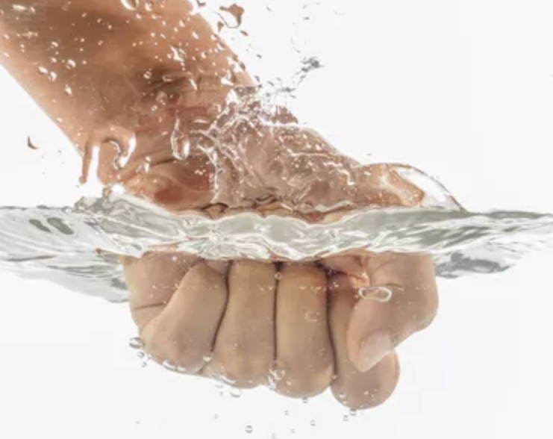
Techniques for the removal of antimicrobial resistance uses advanced technologies - anaerobic or aerobic treatment reactors, constructed wetlands, chemical disinfection, coagulation, biochar, and more recently, nanotechnology

Slide 24
Nanotechnology
Metal oxide nanomaterials such as TiO2 are among the promising nanocatalysts that were tested successfully for their antimicrobial activity.
Nanoparticles act as delivery systems for the established antimicrobials by transporting them to the target sites
Examples of this include silica nanocarriers, liposomes, polymeric nanocarriers, micellar nanocarriers and many more
Silver-based nanomaterials, Titanium dioxide based nanomaterials, Carbon based nanomaterials

Slide 25
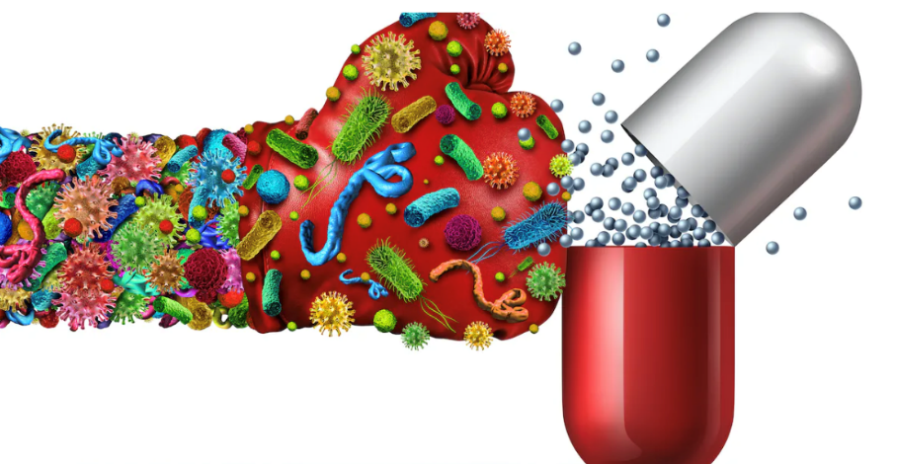
Materials only kill the cell wall of these resistance organisms and failed to penetrate into the nucleus of the cell (does not destroy the nucleic acid)
Surface of nucleic acids is negatively charged, the development of a nanoparticle with a positive surface charge will effectively remove this substance from wastewater by electrostatic interaction

Slide 26
Conclusion
Photocatalysis with TiO₂ is a potential and effective method for degradation of AMX in pharmaceutical wastewater
Since solar-photocatalysis produced promising results, it may be regarded as sustainable, low-cost, viable, and efficient green technology for the treatment of residual ATB in wastewater
Microbial biofilm reactors are a sustainable and efficient solution, especially in combination with other methods
Nanotechnology holds great promise for the future due to its ability to disrupt cell wall of resistant pathogenic microorganisms

Slide 27
Thank you for your attention!

Slide 28
Questions
What can antibiotic residues in the environment cause?
Increase the biodiversity of mikroorganisms
They are toxic for humans
They contribute to the spred of antibiotic resistence
Answer: They contribute to the spred of antibiotic resistence

Slide 29
Questions
What are the mechanism by which biofilms help in wastewater treatment?
Completely decompose antibiotics
They leach antibiotics from the water
They don´t help in any way
Answer: They leach antibiotics from wastewater

Slide 30
Questions
Why is the use TiO₂ suitable for photocatalysis degradation?
Easy and quick
Nontoxicity, low prize
Scientists are lazy
Answer: Nontoxicity, low prize

Slide 31
Questions
Which method seems applicable for the treatment of pharmaceutical wastewater?
Solar-photocatalysis
Photodegradation
Osmosis
Reverse osmosis
Answer: Solar-photocatalysis

Slide 32
Questions
How does nanotechnology kill microorganims?
They don´t kill them and they are beneficial for microorganisms
They disrupt the cell wall
They interfere with nucleic acid
Answer: They disrupt the cell wall

Slide 33
Questions
What are the advantages of biofilm reactors?
Allow complete elimination of antibiotic residues
They have no side risks
They are affordable and sustainable
Answer: They are affordable and sustainable

Slide 34
Questions
Can organs other than the liver metabolise drugs?
Only liver and brain
Only liver
Any biological tissue can metabolised drugs, but liver is major
Answer: Any biological tissue can metabolised drugs, but liver is major

Slide 35
Questions
Do current methods allow complete degradation of antibiotics from wastewater?
Yes
No, only experimentally
No, there are no methods to degrade antibiotics
Answer: No, only experimentally

Slide 36
Questions
Would it be appropriate to combine methods for wastewater treatment in the future or would it be better to focus on one particular method?
Multiple methods will make wastewater treatment ineffective
It doesn´t matter, because wastewater treatent is worthless
Combining methods is the hope for the future
Answer: Combining methods is the hope for the future

