Slide 1
Killing tumor-associated bacteria with a liposomal antibiotic generates neoantigens that induce anti-tumor immune responses
Menglin Wang , Benoit Rousseau , Kunyu Qiu, Guannan Huang, Yu Zhang , Hang Su, Christine Le Bihan-Benjamin, Ines Khati, Oliver Artz , Michael B. Foote , Yung-Yi Cheng , Kuo-Hsiung Lee, Michael Z. Miao, Yue Sun, Philippe-Jean Bousquet , Marc Hilmi, Elise Dumas, Anne-Sophie Hamy, Fabien Reyal, Lin Lin, Paul M. Armistead, Wantong Song, Ava Vargason1 , Janelle C. Arthur, Yun Liu, Jianfeng Guo , Xuefei Zhou, Juliane Nguyen , Yongqun He, Jenny P.-Y. Ting, Aaron C. Anselmo1 & Leaf Huang

Slide 2
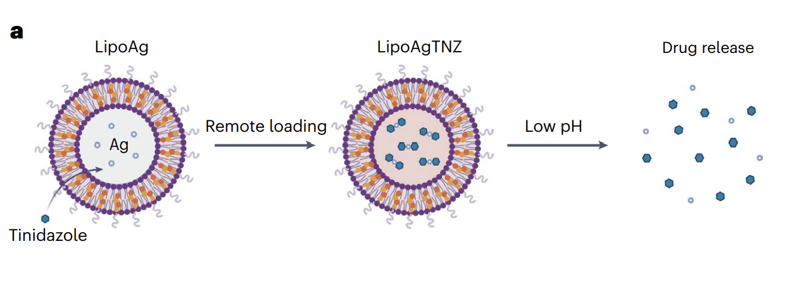
Indroduction
tumor microbiota can infuence cancer progression
design an antibiotic silver-tinidazole complex encapsulated in liposomes (LipoAgTNZ)
mouse models with colorectal cancer responded to LipoAgTNZ therapy, allowing more than 70% survival for a long period of time

Slide 3
The release of T-cell immunity to elicit anti-tumor immune responses has led to important clinical advances in the fight against cancer, including checkpoint inhibitors, cancer vaccines, and chimeric antigen receptor T-cell therapies
Elimination of the intracellular bacteria in the tumor will reveal microbial epitopes and produce neoantigens linked to cancer from different sources.

Slide 4
RESULTS
Antibiotics targeting anaerobes improved cancer survival
selective targeting of oncogenic bacteria associated with cancer
nitroimidazol and lincomycin
database – resected patients with these antibiotic classes vs receiving other antibiotics vs no antibiotics
improved disease-free survival (DFS)??
2012-2014 36 105 patients with colorectal cancer (CRC)
4 413 received antibiotic treatment 6 months before/12 months after resection
hazard ratio (HR) was lower for antibiotics targeting anaerobes than without antibiotics among patients with CRC
before resection of the tumor – protective effect
tumor is a target lesion – reduce risk of recurrence or death by 25.5%

Slide 5
Antibiotics targeting anaerobes improved cancer survival
specific role of tumor primary -> patients with breast cancer -> protective effect not found
-> specific to CRC and its microbiota
antibiotics targeting anaerobes vs other antibiotics ->DFS improved (no effect in breast cancer)
hypothesis – specific antibiotics have the potential to reduce the risk of recurrence of CRC with an effect that may be as important as chemotherapy, which usually reduces the risk of recurrence by 32% or death by 26% after resection in combination with adjuvant treatments

Slide 6
Bacteria invaded tumor cells in response to low oxygen level
gram-negative and anaerobic bacteria Fusobacterium nucleatum
tumor hypoxia – 1% or 20% oxygen for 24h
F. nucleatum was able to invade hypoxic tumor cells with higher signals
F. nucleatum was able to invade inside the cytoskeleton in response to hypoxia
F. nucleatum has a stronger correlation with larger tumors with hypoxic regions
Spontaneous invasion to hypoxic tumor cells was also found in the facultative anaerobic probiotic strain Escherichia coli Nissle -> bacteria preferentially invade hypoxic tumors

Slide 7
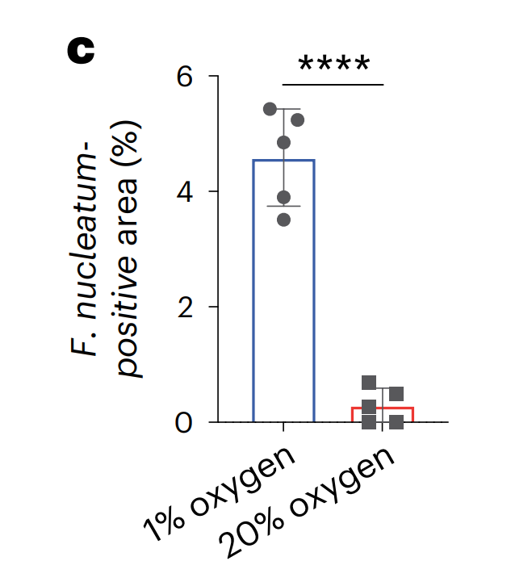
Quantification of the F. nucleatum-positive area by CFSE fluorescence. n = 5 experiments. Data are the mean ± s.d. ****P < 0.0001.

Slide 8
Bacteria invaded tumor cells in response to low oxygen level
CRC in Balb/C mice infected with F. nucleasum - higher tumor growth ratio compared to uninfected controls
F. nucleatum infection considerably promoted tumor metastasis in proximal lymph nodes and distal metastasis
transmission electron microscopy (TEM) images of F. nucleatum infected CRC tumors – intracellular in vivo in the tumor region
fluorescence in situ hybridization (FISH) with RNA probe specific for the 16S ribosomal RNA (rRNA) – F. nucleatum near the cell nuclei in the CRC tumor

Slide 9
Liposomal antibiotics eliminated Bacteria in the tumor
Ag⁺ - antibacterial agents used in various forms as antibiotics for centruries interaction with sufur and phosphorus – enzymes and DNA
silver nanoparticles – ability to adhere and penetrate the bacteria cell wall
cancer cells metabolized pyruvate into lactate and ethanol
↓ pH of hypoxic tumors – elevated levels of lactic acid – drug release in anaerobic bacteria residing in the region of the tumor
metal ions can by trapping agents for loading nitroimidazol into liposomes
loading of TNZ into silver-containing liposomes was efficient – more than 80% encapsulation efficiency

Slide 10
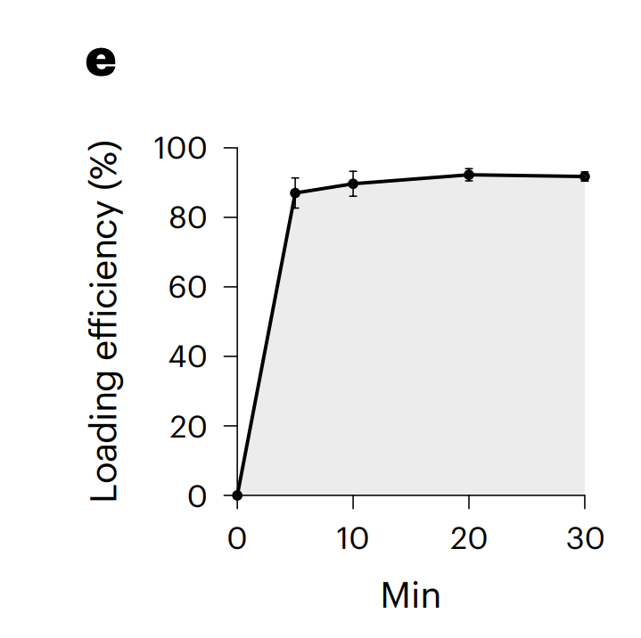
liposomes – localized in tumor and liver – DiD fluorescence
mice were injected with free drugs and liposomes – tinidazol encapsulated in liposomes mainly accumulated in the tumor 24h after injection – succes of tumor targetting
toxicity biomarkers were assessed – no obvious alternations in serum biomarkers were observed compared to the untreated mice
Loading kinetics of LipoAgTNZ. n = 3 experiments.

Slide 11
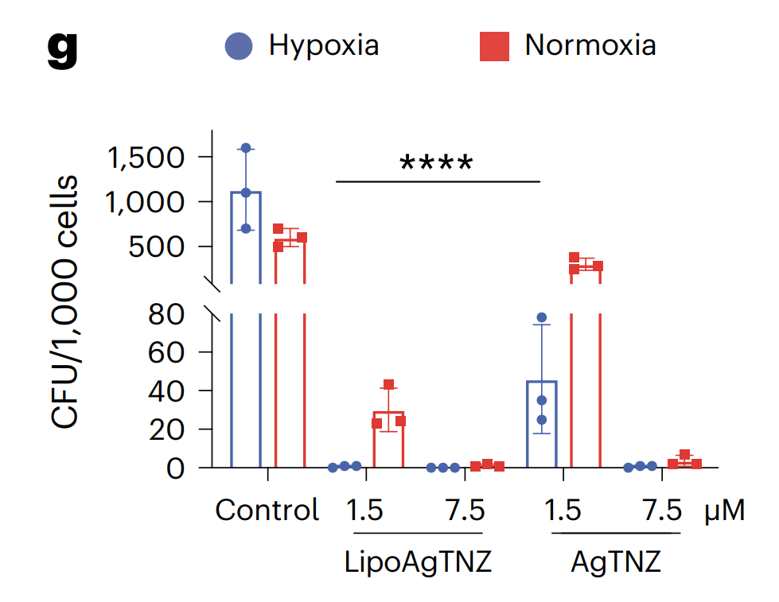
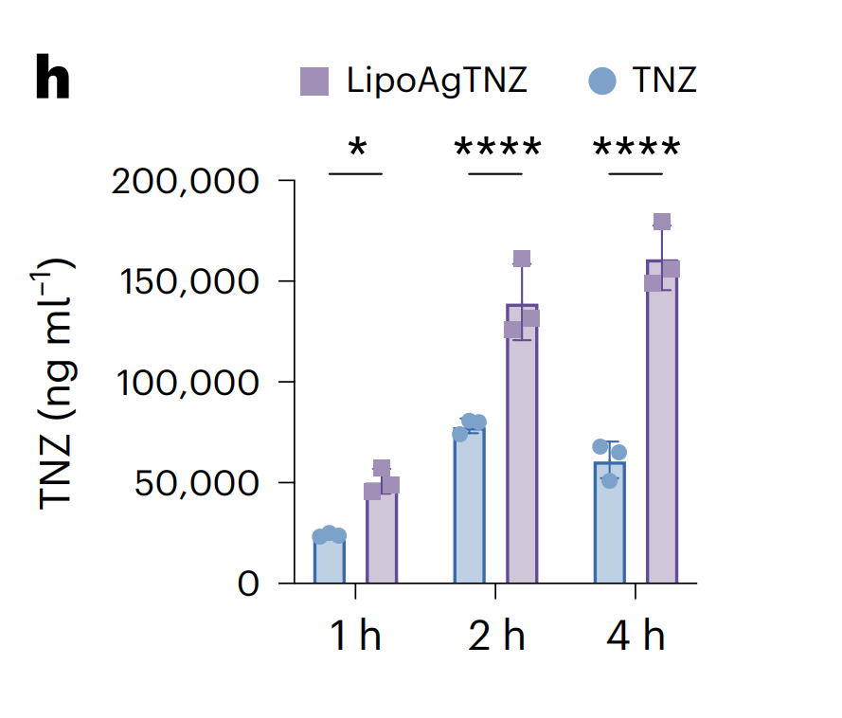
Intracellular F. nucleatum killing by free AgTNZ and LipoAgTNZ under normoxia and hypoxia. n = 3 experiments. Data are the mean ± s.d. ****P < 0.0001
In vitro cell uptake of liposomes and free drug at 1 h, 2 h and 4 h. n = 3 experiments. Data are the mean ± s.d. *P < 0.05; ****P < 0.0001.
Both LipoAgTNZ and free AgTNZ showed higher antimicrobial efficacy in hypoxia.

Slide 12
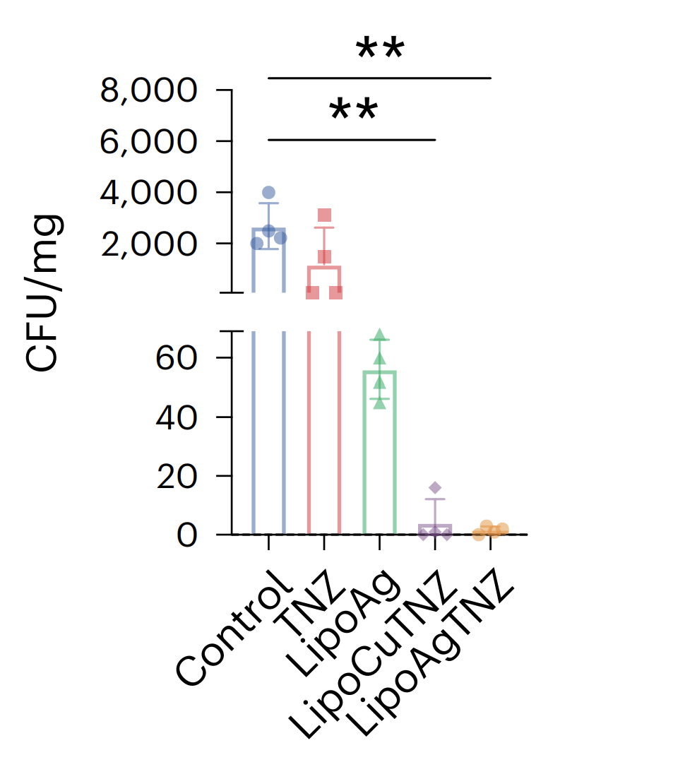
Killing intracellular bacteria improved immune surveillance
CRC mouse model was used to test the therapeutic efficacy of the antibiotic liposomes (infected with F. nucleatum or E. coli Nissle)
The primary organs of the mice given LipoAgTNZ treatment did not show any signs of bacterial colonization

Slide 13
FISH signals revealed that LipoAgTNZ effectively reduced the F. nucleatum burden in CRC tumors.
TUNEL assay was performed and showed increased apoptotic cells after treatment

Slide 14
Determination of gut microbiota: high-throughput gene sequencing analysis of 16S rRNA in fecal bacterial DNA
bacterial communities of survivors and controls were similar
Idea: specific gut microbiota homeostasis was protected by using LipoAgTNZ treatment

Slide 15
Liver metastasis: most common distant metastasis in colorectal cancer,70% of patients
LipoAgTNZ liposomes: effective destruction of bacteria in liver metastases and production of anti-tumor effects

Slide 16
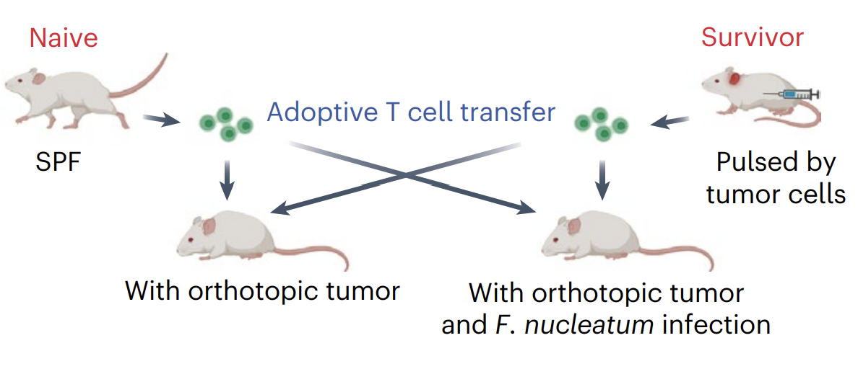
T cells from long-term survivors showed specificity to both infected and unifected tumors
Comparison of T cells from survivor mice to age-matched, naive, uninfected mice - to study T cell specificity to bacterial infection
The data again suggest that survivor T cells recognized both infected and uninfected tumor cells in vivo in the recipient mice

Slide 17
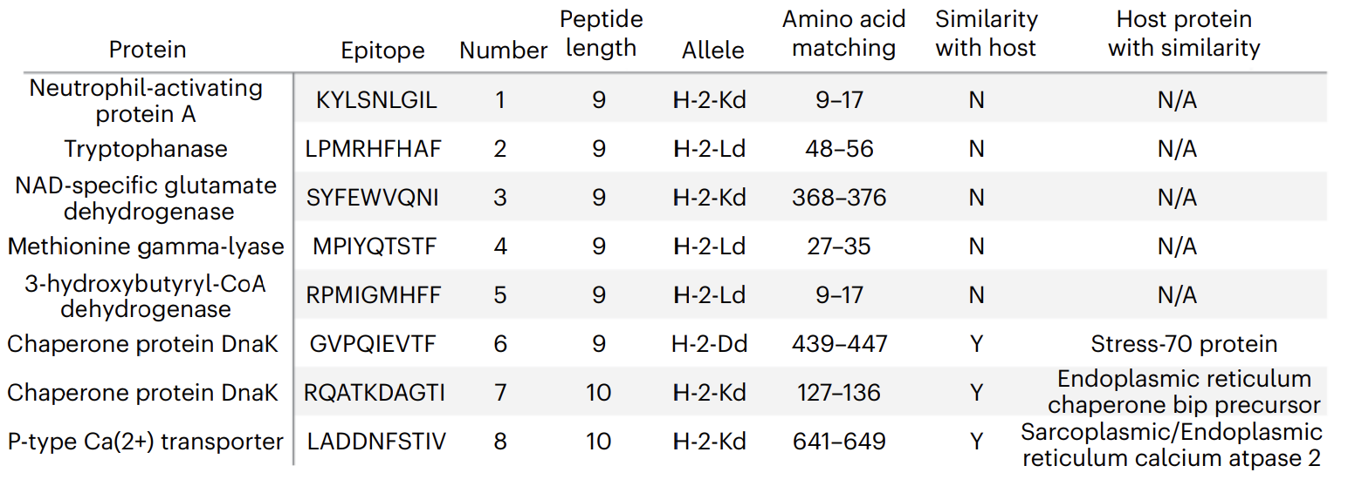
Host T cells specifically targeted bacterial epitopes after antibiotic treatment
Prediction of binding peptides (MHC-I H-2Kd, H-2Dd, and H2Ld ) to estimated the potential neoepitopes
selection of the epitopes - the most abundant cytoplasmic proteins were chosen
peptides 1 through 5 - neoantigens derived from bacteria that do not share any sequence similarities with mice
the homologous epitopes peptides 6–8 are shared by mice and bacteria

Slide 18
T cells from survivors established long-term anti-tumor efficacy compared to T cells from naive mice
While CD4+ T cells in response to class II MHC antigens have been shown to produce either cytotoxicity or tolerance, they primarily examined bacteria-induced CD8+ T cells in response to class I MHC antigens which is the cytotoxic T cell phenotype for anti-tumor efficacy

Slide 19
Conclusion
Killing of tumor-associated bacteria may contribute a new source of neoantigens to facilitate homologous and neoepitope-mediated cellular immunity against CRC
Antibiotics targeting anaerobic bacteria extended the DFS of patients with CRC and infected mice
CRC patients – the benefit derived from antibiotics was limited to pre-resection intake
Quantity of intratumoral bacteria to prime immunity may be crucial to succes
Anti-tumoral immune response relies on the ability of immune cells to recognize and eliminate tumor-derived antigens
Mutation-derived neoantigens are recognized as a major determinant to benefit from immunomodulating strategies

Slide 20
Conclusion
The developed liposomes remotely loaded with antibiotics to target the CR tumors
They performer adoptive T cell transfer and T cell epitope studies to investigate the function of the immune system after bacterial removal
Homologous epitopes also showed anti-tumor efficacy, which may result in an immune response to uninfected tumors
Killing of tumor-associated Bacteria can turn an immunologically cold tumor into a hot tumor and prime the immune system to recognize both infected and uninfected tumor cells

Slide 21
For the last time ☺
The researchers used a liposomal antibiotic to target Fusobacterium nucleatum, a bacterium that has been associated with colorectal cancer, and tested the effects of this treatment on both bacterial load and immune response in vitro and in vivo. The study also aimed to identify potential biomarkers of response to the treatment and to explore the mechanisms underlying the observed effects.

Slide 22
Thank you for your attention

