Slide 1
Macromolecular crystallography
Pavel Plevka

Slide 2
Development of crystallography
Waves and radiation
Diffraction
Solution of phase problem
Model building and structure validation

Slide 3
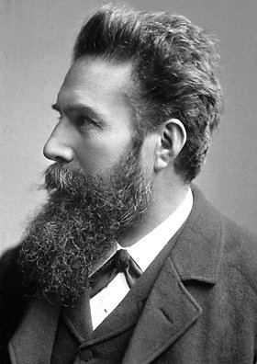
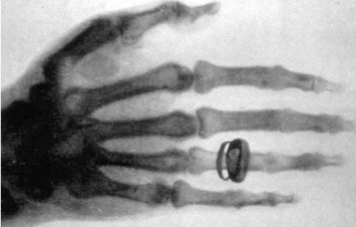
WILHELM CONRAD RÖNTGEN (1845-1923)
1901 Nobel Laureate in Physics
discovery of the remarkable rays subsequently named after him.

Slide 4
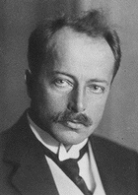
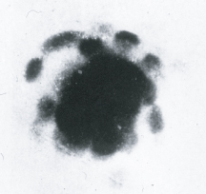
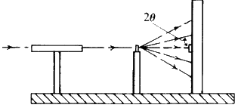
MAX VON LAUE
(1879-1960)
1914 Nobel Laureate in Physics
for his discovery of the diffraction of X-rays by crystals
Friedrich and Knipping

Slide 5
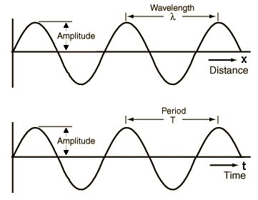
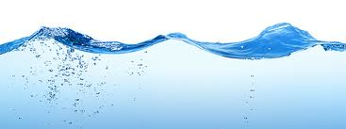
Waves

Slide 6
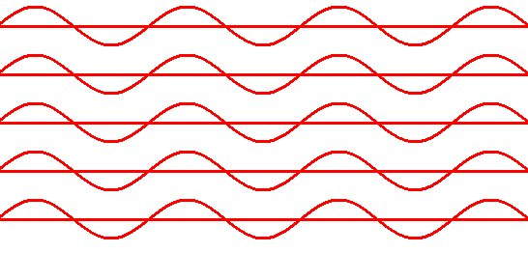
Coherent beam

Slide 7
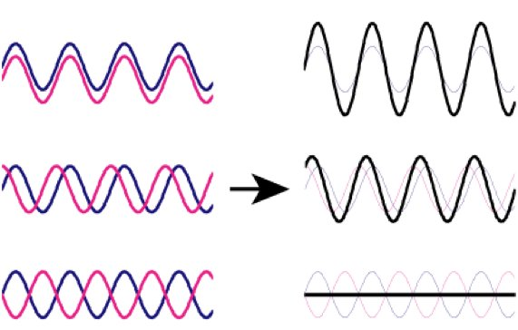
Addition of waves

Slide 8
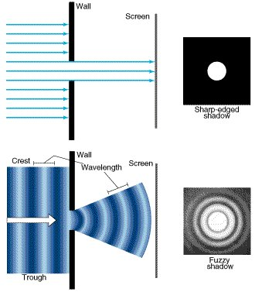
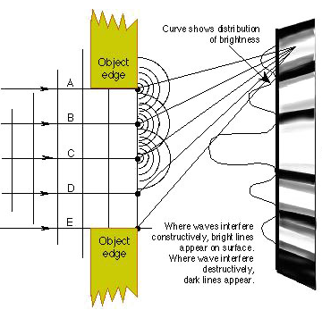
Particles & waves

Slide 9
MAX VON LAUE
(1879-1960)
1914 Nobel Laureate in Physics
for his discovery of the diffraction of X-rays by crystals
Friedrich and Knipping

Slide 10
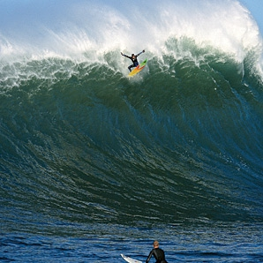
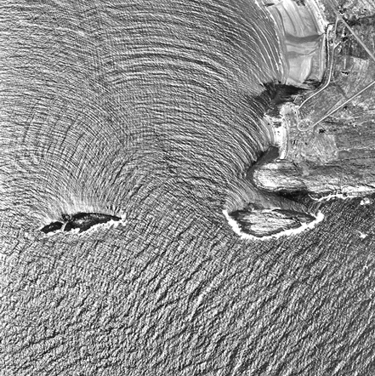
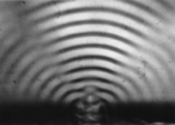
Wavelength and diffraction

Slide 11
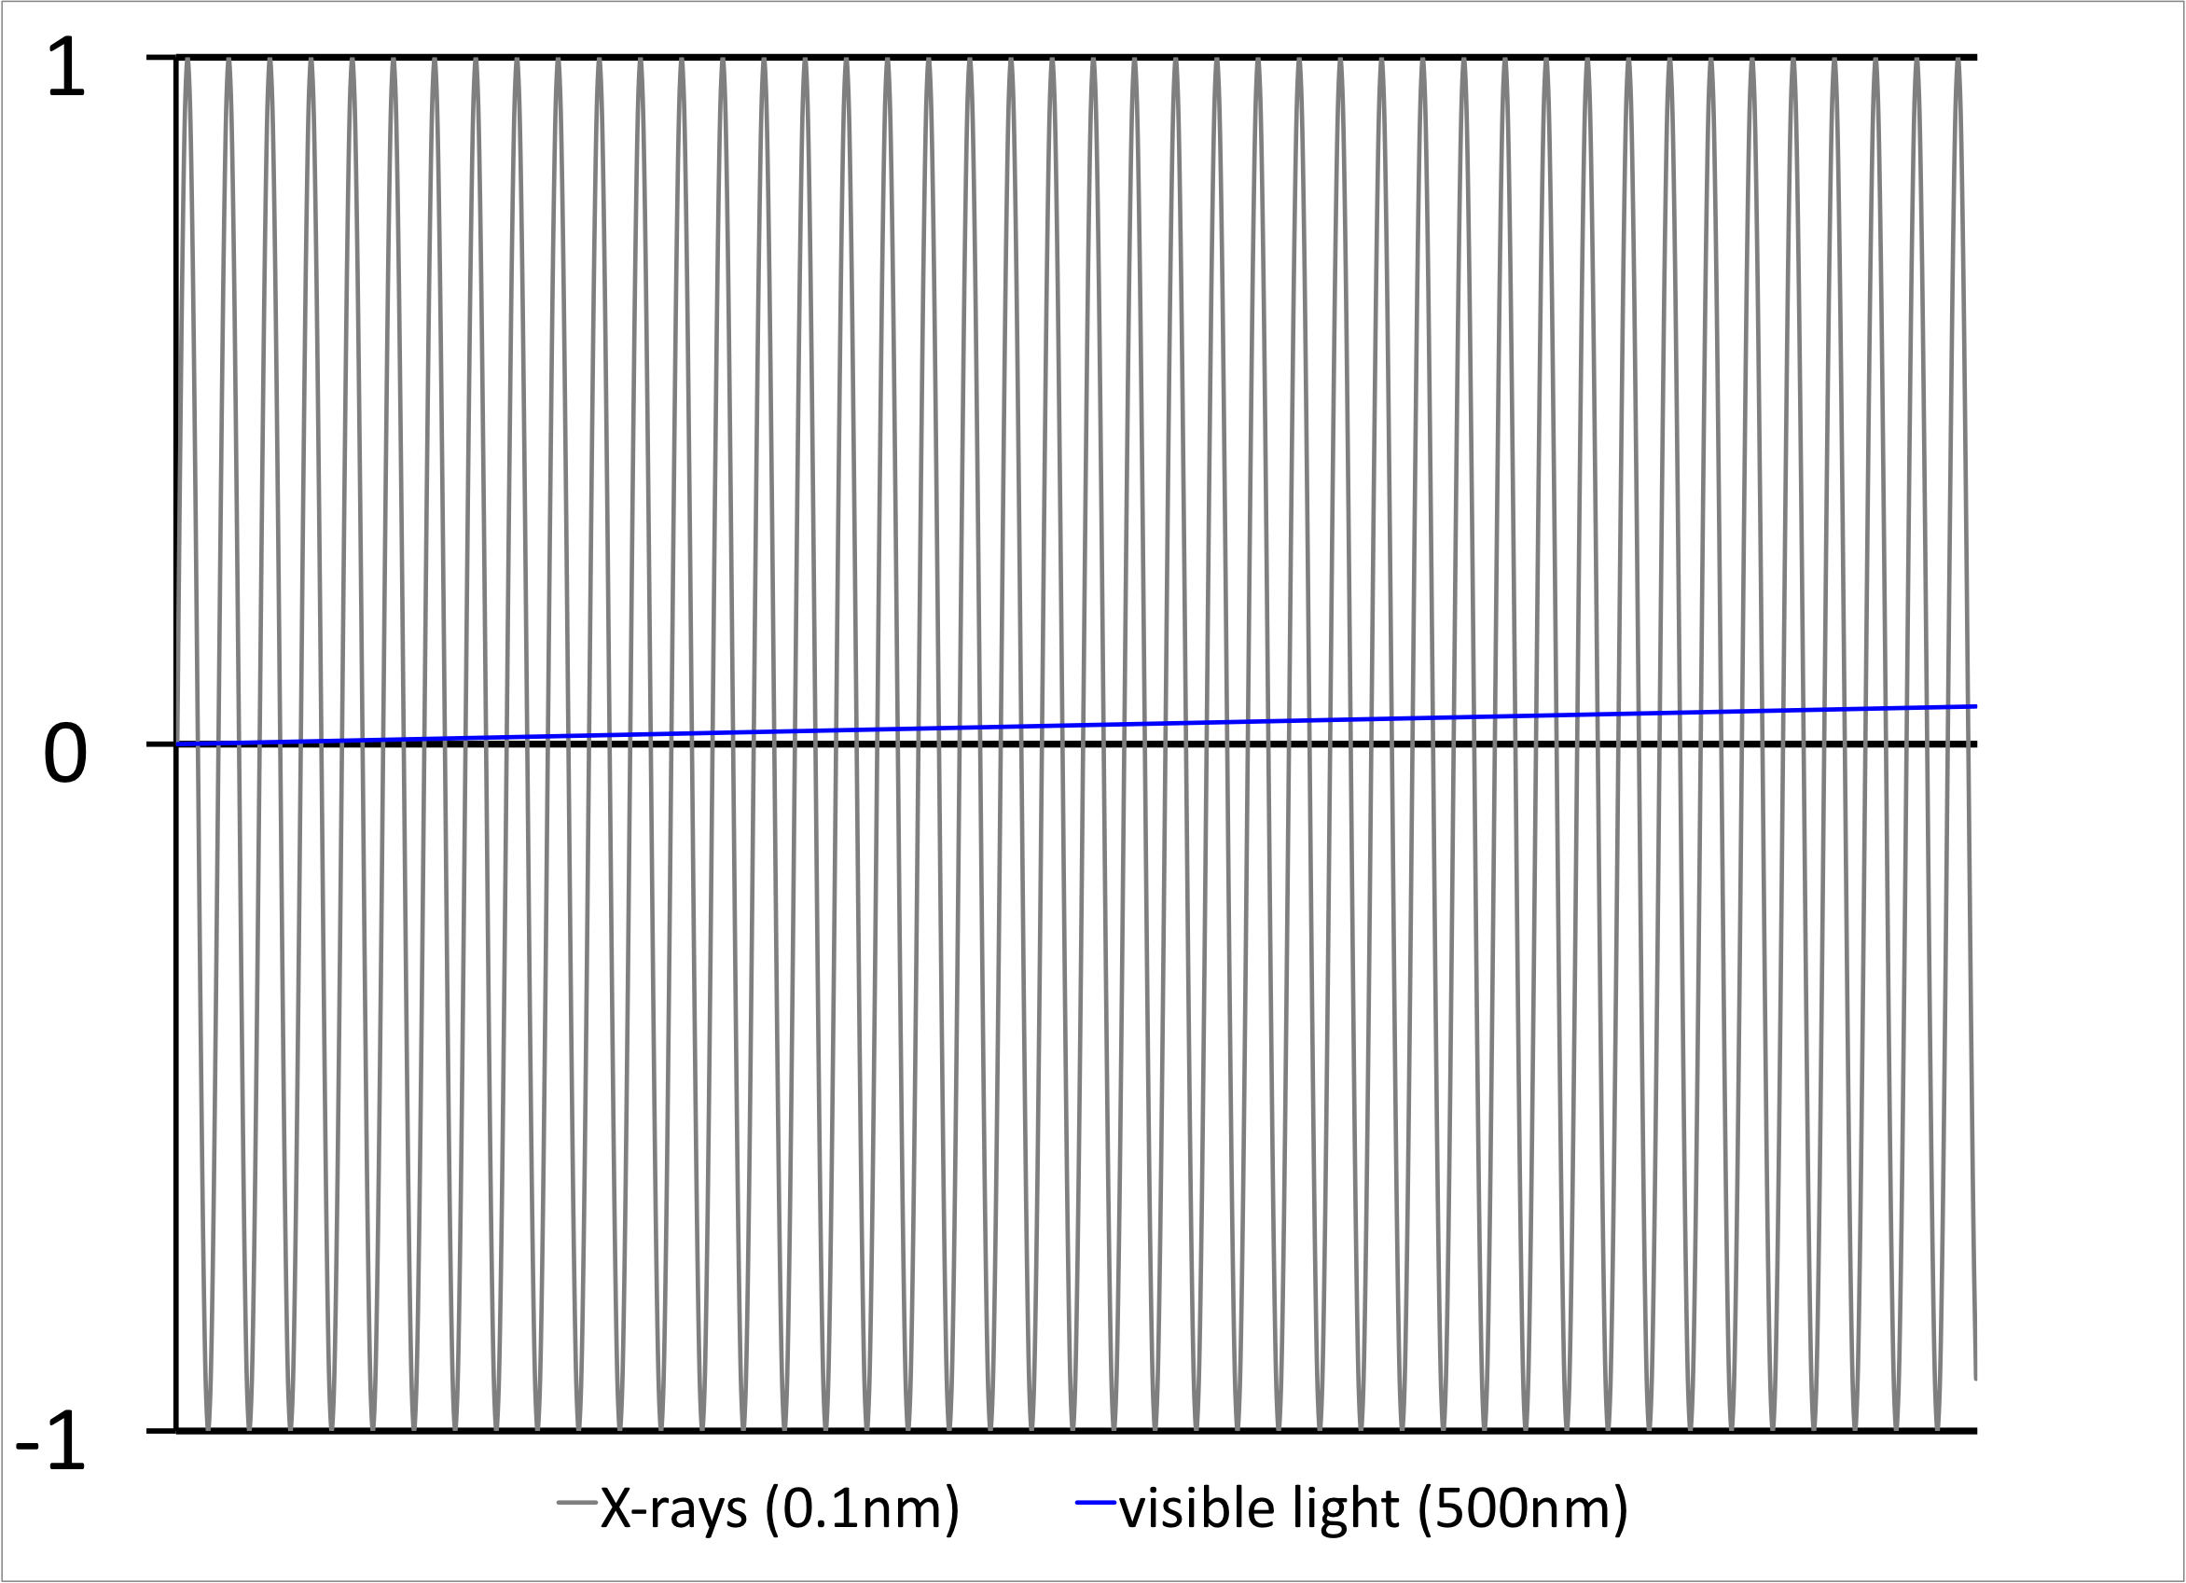
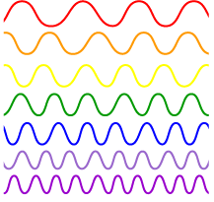
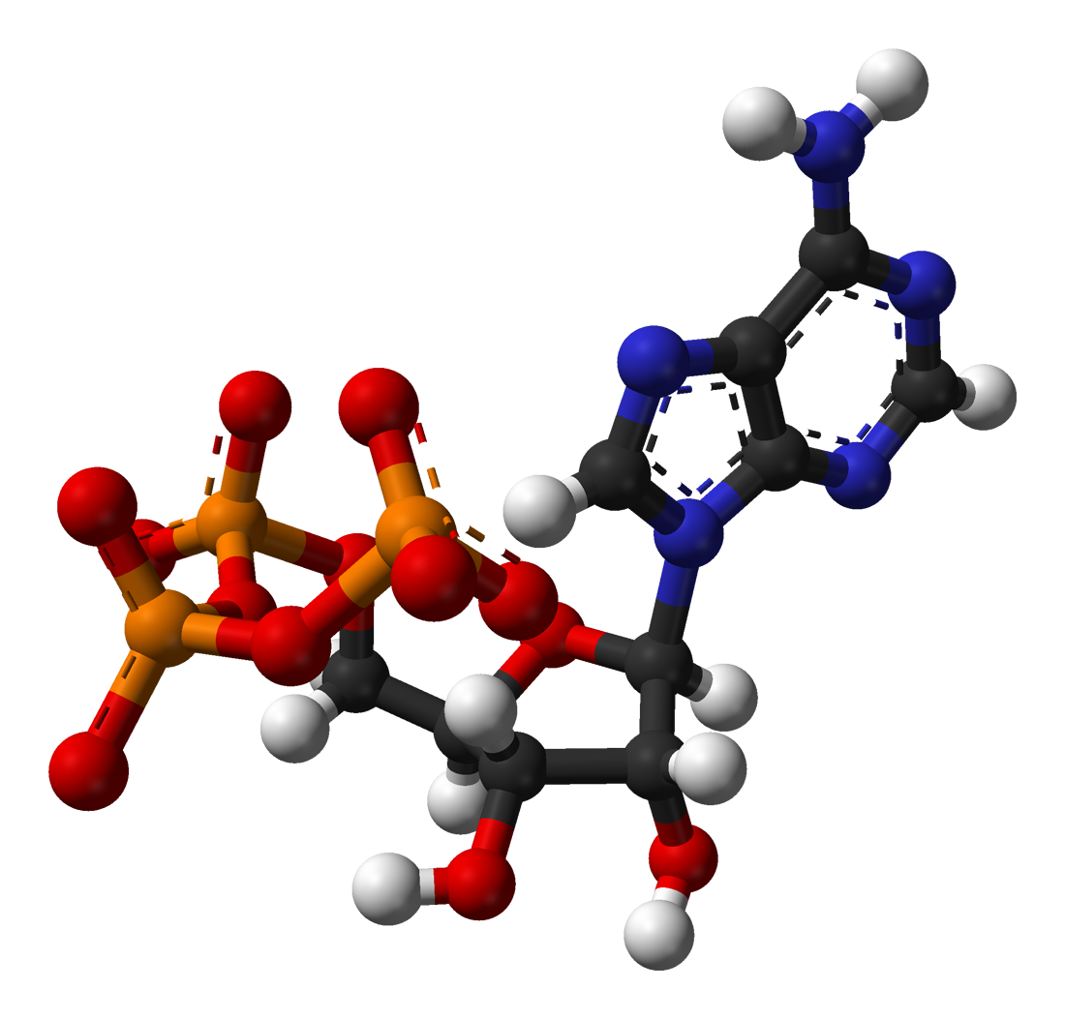
Wavelength comparison of X-rays and visible light
38λ

Slide 12
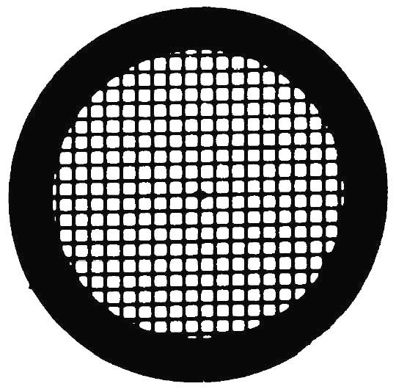
70μm

Slide 13
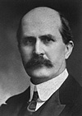
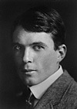
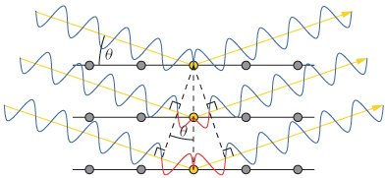
WILLIAM HENRY BRAGG (1862-1942)
WILLIAM LAWRENCE BRAGG (1890-1971)
1915 Nobel Laureates in Physics
for the analysis of crystal structure by means of X-rays
nλ = 2d sinθ

Slide 14
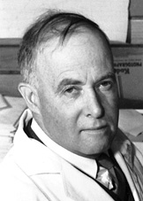
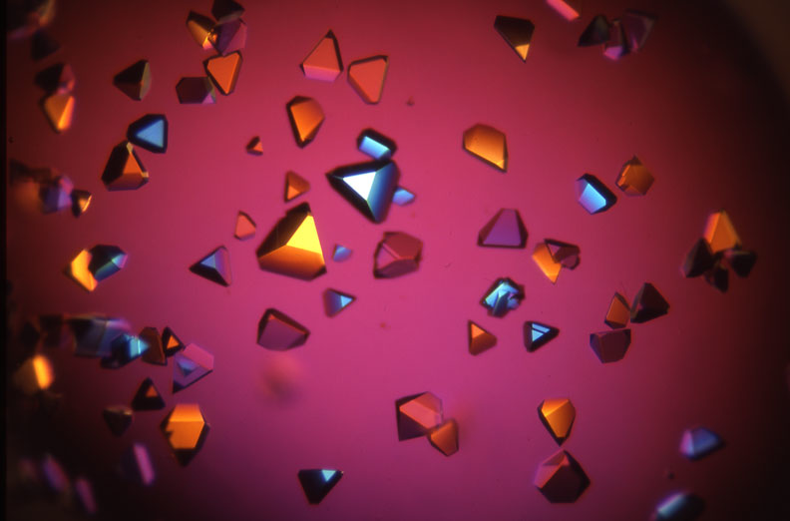
James Batcheller Sumner
(1879-1960)
1946 Nobel Laureate in Chemistry
for his discovery that enzymes can be crystallized

Slide 15
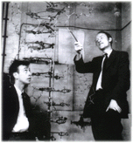
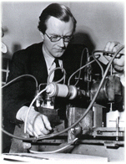
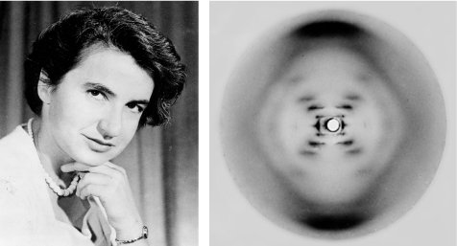
FRANCIS HARRY COMPTON CRICK (1916-2004)
JAMES DEWEY WATSON (1928)
MAURICE HUGH FREDERICK WILKINS (1916-2004)
1962 Nobel Laureates in Physiology and Medicine
for their discoveries concerning the molecular structure of nuclear acids and its significance for information transfer in living material.
James Watson
and Francis Crick
Maurice Wilkins
Rosalind Franklin

Slide 16
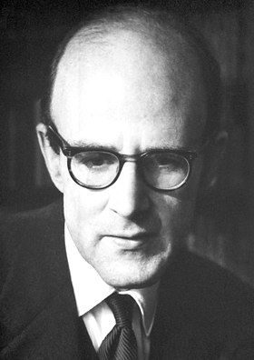
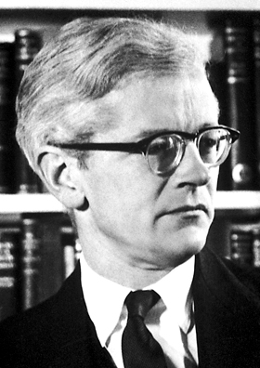
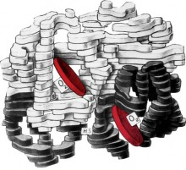
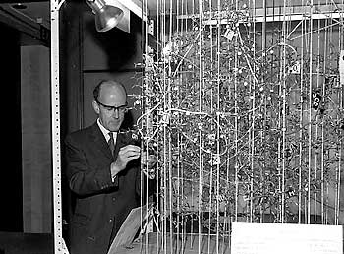
Max Ferdinand Perutz (1914 – 2002)
John Cowdery Kendrew (1917 – 1997)
1962 Nobel Laureates in Physics
for their studies of the structures of globular proteins

Slide 17
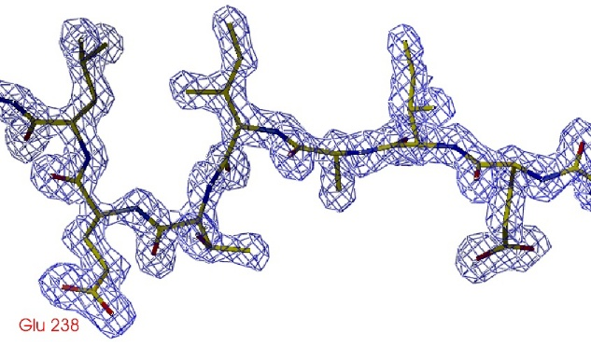
Information from X-ray diffraction experiment
y
z
x
[0;0;0]

Slide 18
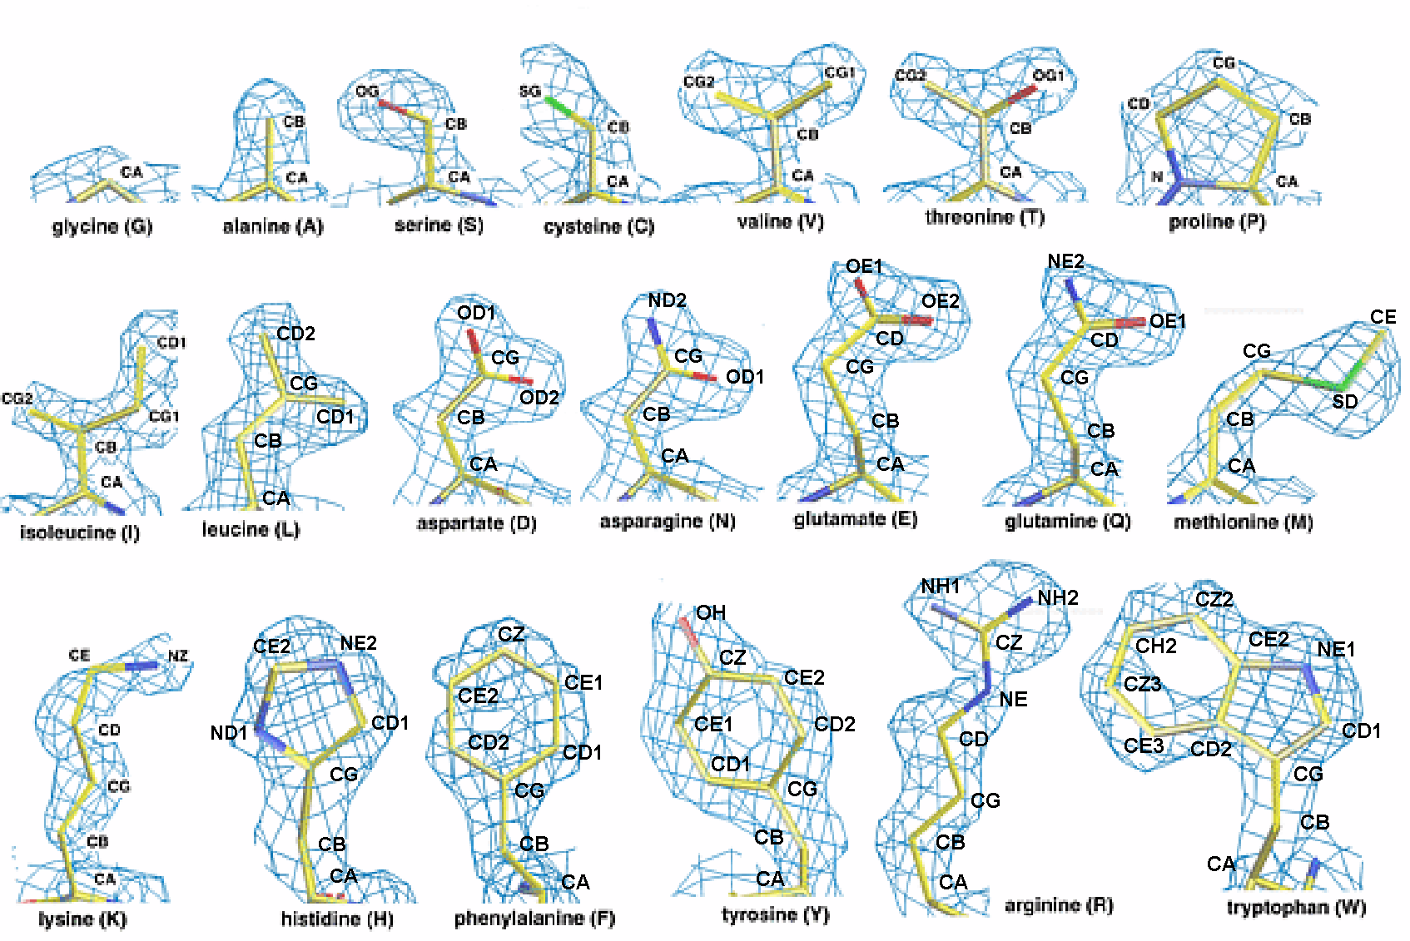
Representative electron density for amino acid side chains
Electron density maps calculated at 1.5 Angstrom resolution.

Slide 19
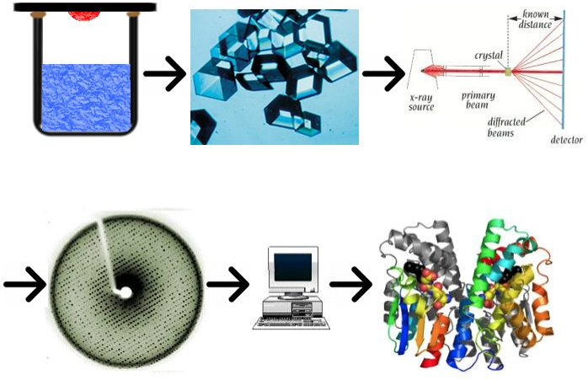

Slide 20
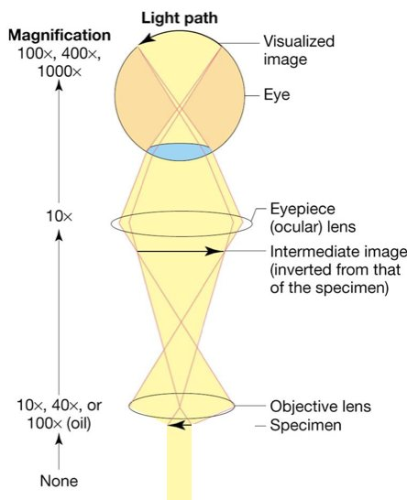
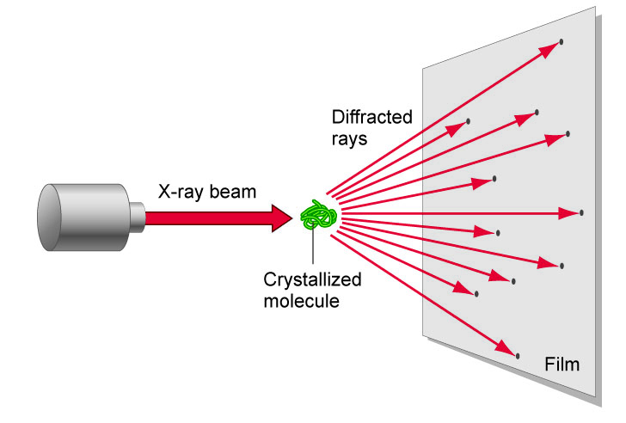
Comparison of microscope and diffraction

Slide 21
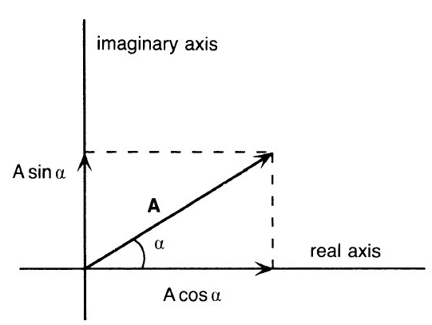
Wave as a vector
Imaginary axis
A
A- wave amplitude
α- wave phase
A
F
α
Real axis
F=Acosα+iAsinα
F=Aexp(iα)

Slide 22
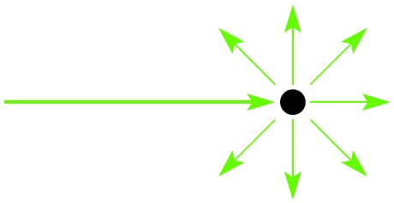
X-rays scatter from electrons in all directions
Primary beam
Secondary beams

Slide 23
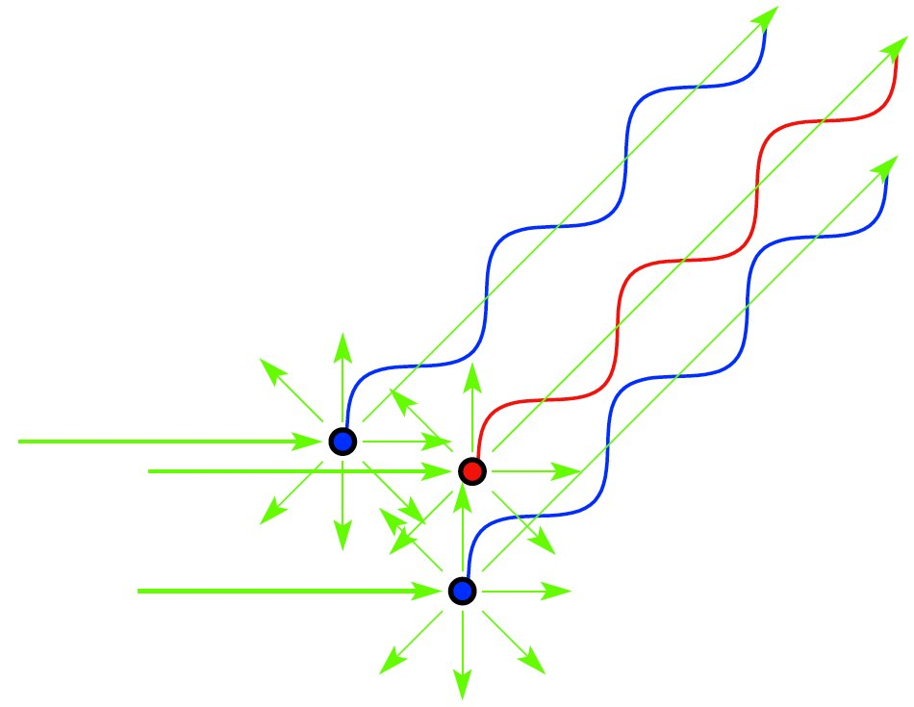
X-ray scattering from several electrons
Primary beam
When electrons scatter X-rays in phase waves add constructively.
Notes:
Molecule is composed of many electrons
Each electron will scatter secondary radiation uppon exposure to x-rays
The scattered secondary beams will interact and cause interference
The scattering from a molecule is dependent on number of and distances between electrons
In other words, scattering from molecule is dependent on its structure
If we would know the amplitudes and phases of scattered molecule, we could calculate the structure of molecule...

Slide 24
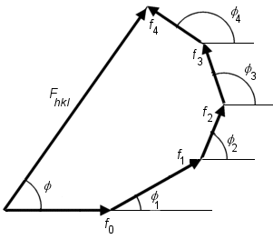
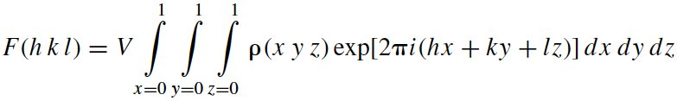

Adition of waves
F=Acosα+iAsinα

Slide 25
Scattering from a single molecule is not detectable
If molecules are all oriented in the same way, the scattering from individual molecules will add in certain directions
      Which directions?

Slide 26
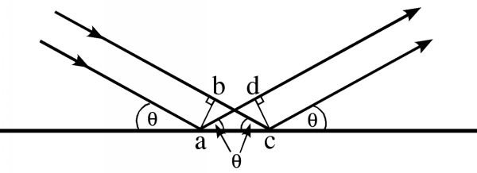
There is no path and PHASE DIFFERENCE when rays reflect from a plane

Slide 27
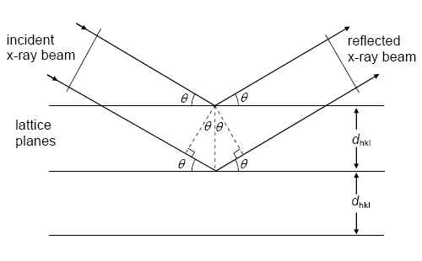
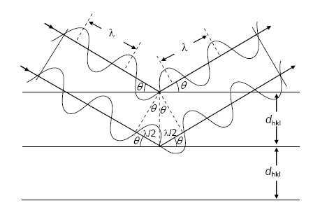
There is NO PHASE DIFFERENCE if the path differences are equal to whole number multiplies of wavelength.
Bragg’s law:
nλ = 2d sinθ
w
sinθ = w/d
2w = nλ

Slide 28
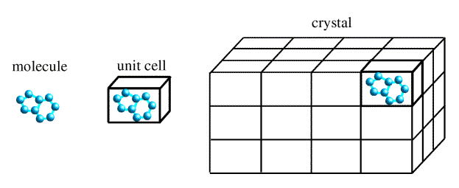

Slide 29
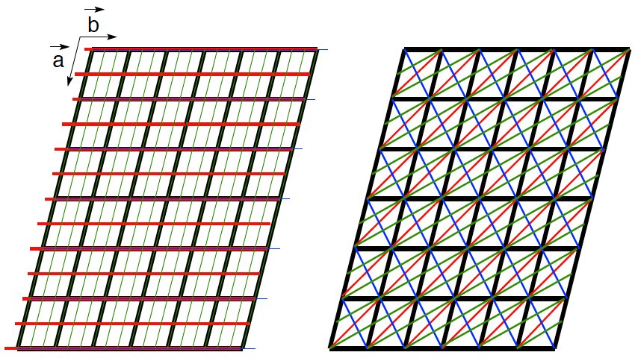
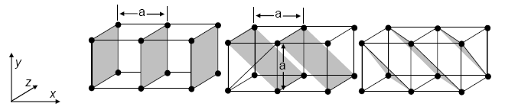
(h, k, l)

Slide 30
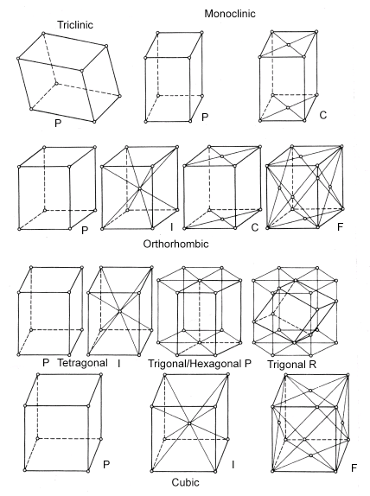
14 Bravais Lattices

Slide 31
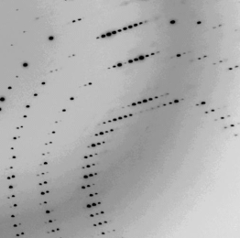
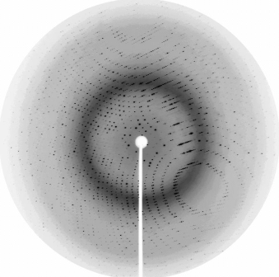
Diffraction pattern from a protein crystal

Slide 32
nλ = 2d sinθ

Slide 33

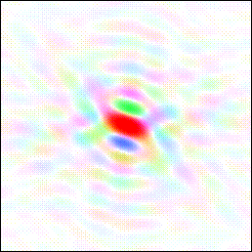




Real space cat
Fourier amplitudes and phases
Fourier transform
Circular rainbow scale of phases
Linear intensity scale of amplitude size
Observed amplitudes

Slide 34
Electron density equation + PHASE PROBLEM

Slide 35

Solving the phase problem by:
Molecular replacement
1. source of initial phases is a model
2. the model is oriented and positioned to obtain the best agreement with the x-ray data
3. phases are calculated from the model
4. The calculated phases are combined with the experimental data
Molecular Replacement was invented by
Michael Rossmann

Slide 36



Unknown structure,
unknown orientation
Observed amplitudes Phases unknown!
Diffraction experiment
Cat
Fourier cat
Known structure
Calculated amplitudes and phases
Fourier transform
Manx cat
FT of Manx cat
Wrong orientation!

Slide 37

Known structure
Observed amplitudes Phases unknown!
Manx cat
Fourier cat
Fourier transform,
try different orientations
Calculated amplitudes and phases
FT of Manx cat
Wrong orientation!

Slide 38


Observed amplitudes (tailed cat), calculated phases (Manx cat)
Inverted Fourier transform
Even the tail becomes visible!

Slide 39




Model Bias
Duck
Fourier transform of duck
Fourier transform
Duck amplitudes + cat phases
Looks like a cat!!
Inverted Fourier transform

Slide 40
Solving the phase problem by:
Multiple/Single Isomorphous Replacement (MIR/SIR)
source of phases – intensity differences between data from native and derivative (heavy atom containing) crystals
Positions of heavy atoms identified from isomorphous difference Patterson maps

Slide 41
Solving the phase problem by:
Multiple/Single-wavelength anomalous diffraction (MAD/SAD)
source of phases – intensity differences between structure factors due to the presence of atom that specifically interacts with X-rays of a given wavelength
Positions of heavy atoms identified from anomalous difference Patterson maps

Slide 42


Model building & refinement

Slide 43

Model building & refinement

Slide 44

Model building & resolution
Notes:
Fitting of protein sequence in the electron density
Easy in molecular replacement
More difficult if no initial model is available
Unambiquous if resolution is high enough (better than 3.0 Å)
Can be automated, if resolution is close to 2Å or better

Slide 45
Validation
Assesment of model quality:
Is the model in agreement with experimwntal data?
How the geometry of amino acids look like?
Are atoms far / close enough from each other?
Are residues “happy” in their environment?
Are the hydrogen donors/acceptors satisfied?

Slide 46




R-factor, R_{free}factor
R-factor
R_{free} factor

Slide 47


Ramachandran plot
ω
Ψ
Ψ
φ
φ

Slide 48



Geometry and stereochemistry
Bond lengths
Dihedral angles

Slide 49

Real-space fit

Slide 50


Data deposition
Protein Data Bank (PDB)
Some structures are wrong!

Slide 51
Summary
1. X-rays have suitable wavelength for study of molecular structures
2. Crystals allow measurement of useful diffraction data because they diffract strongly in certain directions
3. Our goal is to obtain three-dimensional distribution of electron density, because it shows the shape of a molecule
4. Diffraction experiments provide only amplitudes of structure factors => Phase problem
5. Solution of the phase problem:
Molecular replacement
Isomorphous replacement
Anomalous diffraction
6. Model building, refinement, validation, deposition

Slide 52

X-ray crystallography
First method to determine structure of molecules with atomic resolution
As of November, 2022 there were almost 200,000 structures available from Protein Data Bank (170,000 by X-ray)
Macromolecular structures are crucial for our understanding of life at the molecular level
28 Nobel prizes

Slide 53



Deformed wing virus
Honeybee colonies in US
DWV infected pupae

Slide 54

Deformed wing virus

Slide 55



Slide 56
Thank you!

Slide 57
1.) Jakou část strukturního faktoru můžeme změřit v difrakčním experimentu:
a) amplitudu (ve formě intensity)
b) fázi
2.) Nejčastější metoda pro získání fází je:
a) molekulární nahrazení (molecular replacement)
b) isomorfní nahrazení
c) anomální diffrakce
3.) Ramachandran plot ukazuje:
a.) distribuci úhlů v hlavním řetězci proteinu
b.) vzdálenosti mezi atomy
c.) konformace postranních řetězců aminokyselin

Slide 58
1. Rentgenové paprsky se používají ke studiu makromolekulárních struktur protože:
A.) Mají vlnovou délku podobnou meziatomovým vzdálenostem.
B.) Jako jediné elektromagnetické záření interagují s biologickým materiálem.
C.) Byly objeveny v době intenzivního zájmu o strukturu makromolekul a z historických důvodů se používají dodnes.
2. To, že makromolekuly tvoří krystaly znamená že:
A.) Mají enzymatickou aktivitu
B.) Jsou součástí kostry buňky (cytoskeletu)
C.) Mají stabilní strukturu.
3. Mapa elektronové hustoty, která je výsledkem rentgenové analýzy krystalů:
A.) Ukazuje tvar molekul, které tvoří krystal
B.) Má vždy bílou barvu
C.) Ukazuje tvar molekuly po denaturaci

