Slide 1
BIOMARKERS AND TOXICITY MECHANISMS
02 – MECHANISMS OVERVIEW
Luděk Bláha, PřF MU, RECETOX
www.recetox.cz

Slide 2
Different categorizations of MoA
According to target molecules (next slide)
  Mechanisms primarily targeting different
    BIOLOGICAL MACROMOLECULES
      i.e. PROTEINS and/or NUCLEIC ACIDS and/or PHOSPHOLIPIDS
    SMALL BIOLOGICAL (ORGANIC) MOLECULES
      E.g. Antioxidants or scavengers (vit.E, GSH)
According to INTERACTION between toxicant/target (next slide)
  Non-covalent interactions
    Partitioning (v d Waals, H-bonds, hydrophobic interactions) → [1] below
    Partitioning with specific steric fit → [3] below
  Formation of covalent bonds
    ... with proteins / DNA-RNA / P-lipids / small molecules → [2] below
According to “STERIC SPECIFICITY” of the interaction
  NON-SPECIFIC MECHANISMS
    the interaction between the toxicant and the target occurs “generally” with any target of certain general properties (e.g. toxicant is able to bind to ANY protein having e.g. SH- group), it does not require specific steric (structural) properties of the target
      mechanisms [1] and [2] below
  SPECIFIC MECHANISMS
    the toxicant interacts only with certain and specific structural properties (e.g. specific binding of a pesticide into the active site of enzyme acetylcholinesterase)
      mechanism [3]

Slide 3
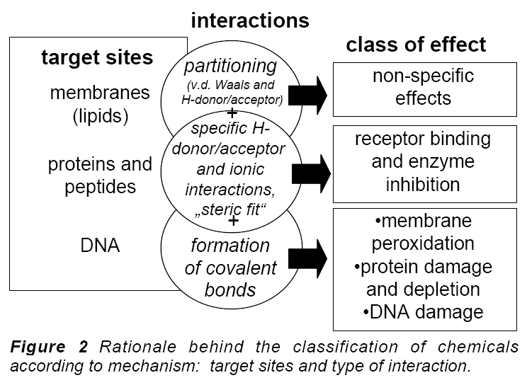
Target (receptor) in MoA / toxicodynamic = BIOMOLECULE
[1]
[3]
[2]

Slide 4
Possible categorizations of MoA
[1] non/specific membrane toxicity
  Involves ALL ORGANIC compounds
  Affinity to non-polar environment (membrane phospholipids)
  Two types can be discriminated
    nonpolar basal / narcotic toxicity (
      effects observed at relatively high concentrations, depends on hydrophobicity (Kow)
    polar narcosis
      more polar compounds may affect also membrane proteins (effects at lower concentrations than expected from Kow)
[2] nonspecific reactive toxicity
  some compounds with “reactive” properties may directly modify biological macromolecule (lipids, proteins, nucleic acids) causing thus toxic effects
  reactive chemicals are mostly „electrophiles“ (reacting with „nucleophiles“ in cells – i.e. electrone-rich sites - nucleotides, -NH2, -SH and others)
[3] specific steric interactions
  only certain specific compounds selectively affect specific targets
  E.g. enzyme inhibitions (drugs, insecticides); receptor interactions (e.g. Estrogens)
  Can be non-covalent as well as covalent
  Effects at very low concentrations
All organics
→ membranes
Specific interactions
Reactive

Slide 5
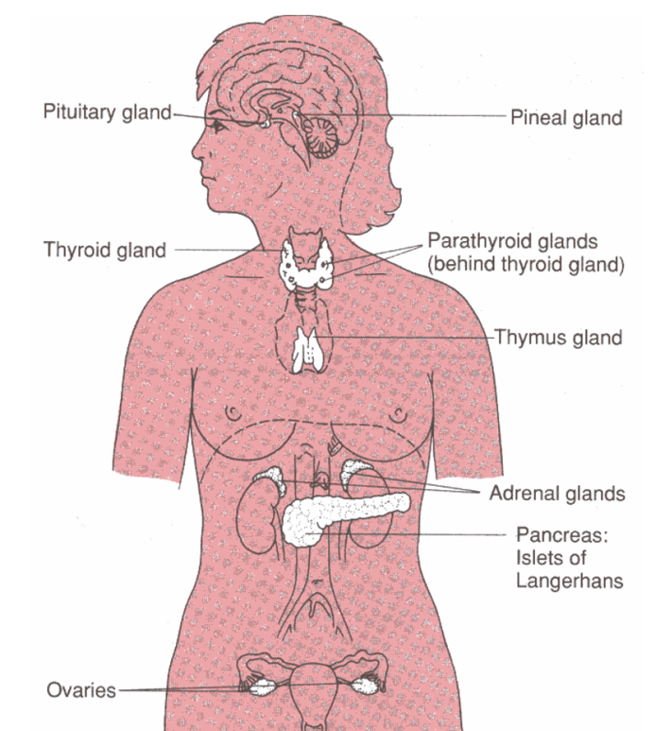
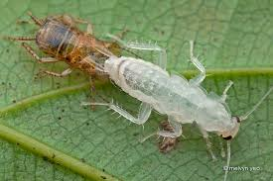
Possible categorizations of MoA
Species-specific mechanisms, examples
  photosynthetic toxicity (only in plants) vs. teratogenicity (only in vertebrates)
  Endocrine disruption
    different hormonal systems in invertebrates vs vertebrates
    → different toxicity mechanisms
Growth in humans
several hormones
Growth in invertebrates
ecdysis (moulting) - ecdysteroids

Slide 6
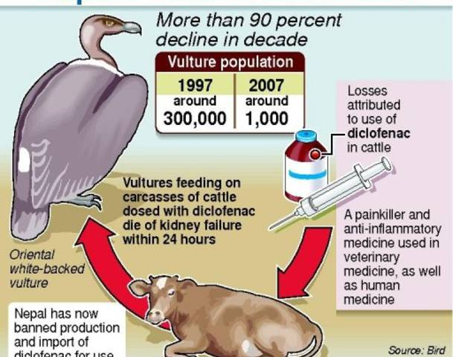
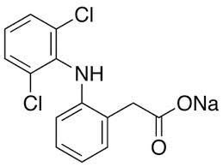
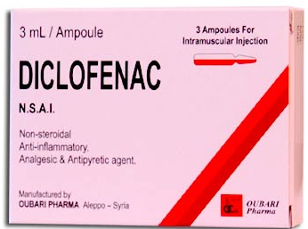
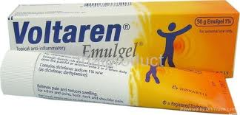
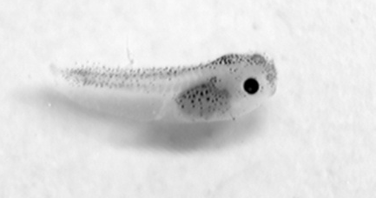
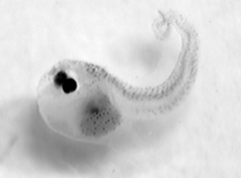
Possible categorizations of MoA
- Tissue-specific mechanisms (& effects)
- hepatotoxicity; neurotoxicity; nefrotoxicity; haematotoxicity
- toxicity to reproduction organs;
- immunotoxicity
Developmental stage-specific mechanisms
- embryotoxicity/teratogenicity: toxicity to cell differenciation processes
Thalidomide
Cyanobacterial metabolites
Malformations in frog tadpoles

Slide 7
Keywords to remember and understand
What is it MoA?
Can you give examples of species-specific MoA?
What are the biological targets for toxicants? How can they be classified?
What are the possible interactions between toxicants and biological targets?
What is it specific and non-specific toxicity mechanism?
What biological molecules are likely to be affected (usually at relatively high concentrations) by ALL ORGANIC COMPOUNDS?
.... and now let’s look in detail on major MoAs
and their toxic consequences

Slide 8
Toxicity mechanisms - overview
Student is expected to know principles and some examples of the following main types of toxicity mechanisms
Proteins and inhibition of enzymatic activities
Mitotic poisons & microtubule toxicity
Ligand competitions – receptor mediated toxicity
Membrane nonspecific toxicity (narcosis)
Toxicity to membrane gradients (also includes proteins)
DNA toxicity (genotoxicity)
Complex mechanisms
  Oxidative stress – redox toxicity
  Defence processes as toxicity mechanisms and biomarkers - detoxification and stress protein induction
  Toxicity to signal transduction

