Slide 1
BIOMARKERS AND TOXICITY MECHANISMS
04 – Mechanisms @membranes
Luděk Bláha, PřF MU, RECETOX
www.recetox.cz

Slide 2
Major mechanisms (modes of action) to be discussed in detail
Proteins and inhibition of enzymatic activities
Mitotic poisons & microtubule toxicity
Membrane nonspecific toxicity (narcosis)
Toxicity to membrane gradients
DNA toxicity (genotoxicity)
Complex mechanisms
  Detoxificiation
    defence processes as toxicity mechanisms
  Oxidative stress – redox toxicity
  Toxicity to signal transduction
  Ligand competition – receptor mediated toxicity

Slide 3
Cell membrane
Key functions for life
Primary barrier / separation of „living“ inside from „abiotic“ outside
Semipermeability for nutrients / signals
Reception of chemical signals & regulatory molecules
Keeping gradients necessary for life
  H+ - ATP synthesis(mitochondria / bacterial emambrane)
  K+/Na+ - neuronal signals
Proteosynthesis (ribosomes) depends on membranes
Many other enzymes bound to membranes (e.g. signaling, detoxification, post-translational modifications)
Etc….

Slide 4
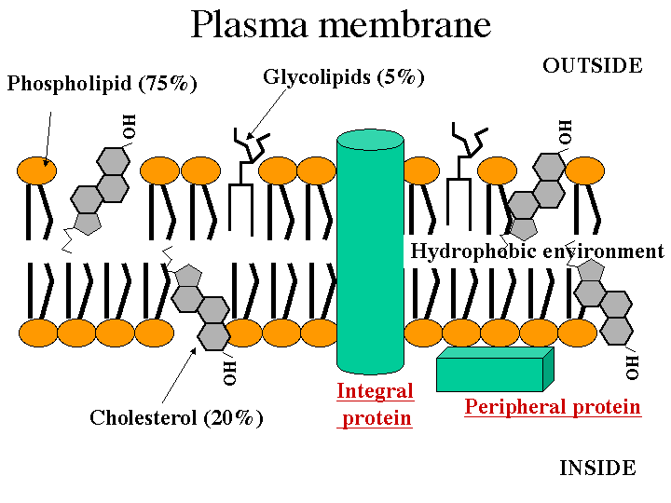
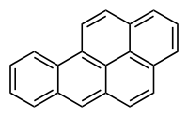
Note: cholesterol – structural/size similarity to toxic
organics e.g. Benzo[a]pyrene

Slide 5
Nonspecific (basal, narcotic) toxicity
- All organic compounds tend to accumulate in membranes, being “narcotic” at relatively "high“ concentrations
- Compounds then affect membranes
→ nonspecific disruption of fluidity
→ and/or disruption of membrane proteins
- Related to lipophilicity (Kow): tendency of compounds to accumulate in body lipids (incl. membranes)
E.g. narcotic toxicity to fish: log (1/LC50) = 0.907 . log Kow - 4.94
- The toxic effects occur at the same "molar volume" of all narcotic compounds (volume of distribution principle)

Slide 6
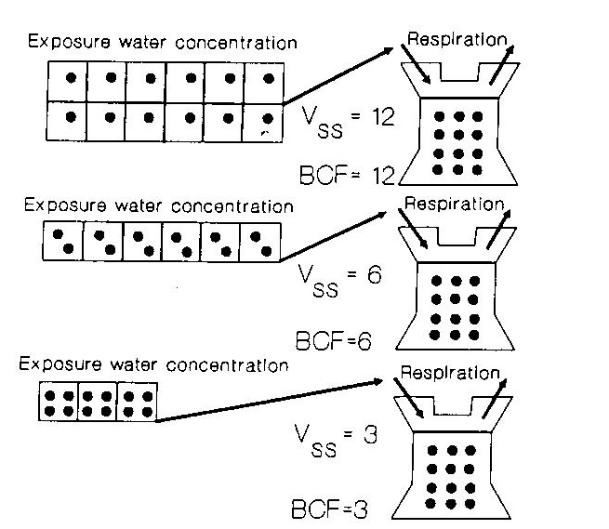
Volume of distribution principle
BCF – bioconcentration factor
* Depends on hydrophobicity
(i.e. Kow)
* Higher BCF
→ lower concentration is
sufficient for bioconcentration
to the same “tissue concentration”
→ lower external concentration
(IC50) will induce toxic effect
* Confirmed by chemical analyses
(same molar concentrations of
different compounds accumulated
in membranes)

Slide 7
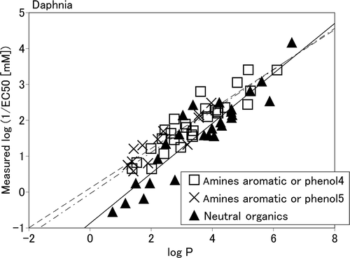
Narcotic toxicity in ecotoxicology
Acute basal toxicity
Direct correlations between logKow (=logP) and EC50 for aquatic organisms (e.g. Daphnia magna)
Example:
Neutral organics
  Nonpolar narcosis
Amines, phenols
  Polar narcosis
  (similar logP → higher toxicity, i.e. higher
  Values of 1/EC50 in comparison to
  neutral organics)
  More specific ... In addition
  to membrane accumulation, direct
  interactions with proteins
  are anticipated

Slide 8
Disruption of membrane gradients

Slide 9
Toxicity to membrane gradients and transport
Semipermeability is essential for membranes key functions
- cytoplasmic membrane:
signalling, neural cells Na+/K+ gradient
- mitochondrial membrane:
electrone flow → ATP synthesis
- endoplasmatic reticulum
Ca²⁺ signalling
Disruptions can be either through nonspecific narcotic toxicity (above) or via specific effects of toxicants → discussion further

Slide 10
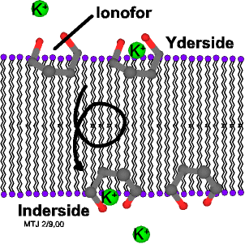
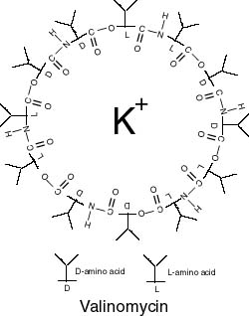
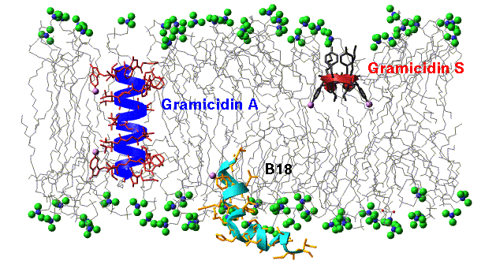
Direct membrane gradient disruption
Ion transfer ("ionofores")
e.g. antibiotics
(K+, Ca2+, Mg2+)

Slide 11
Mitochondrial membrane

Slide 12
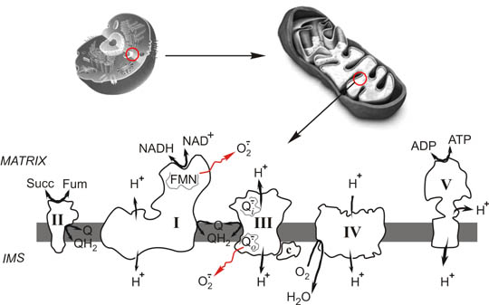
Mitochondria (= energy metabolism!)
-- membrane processes: H+ formation --

Slide 13
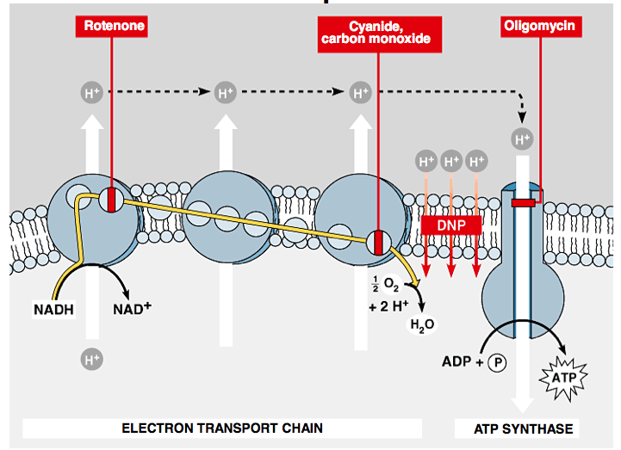
Role of membrane: gradient of H+ → ATP generation & its disruption

Slide 14
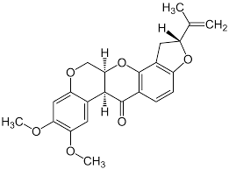
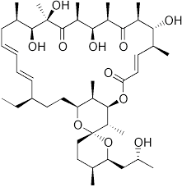
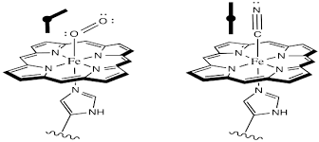
Gradient of H+ → ATP generation & its disruption
Rotenone
Oligomycin
CO (carbon monoxide)
CN (cyanide)
→ Binding to haem structures

Slide 15
Receptors/Channels & membrane gradients

Slide 16
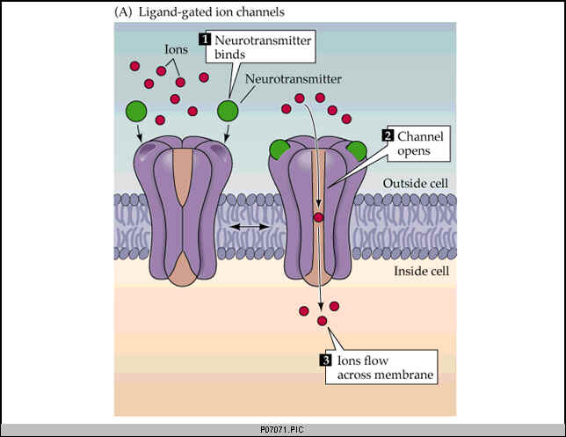
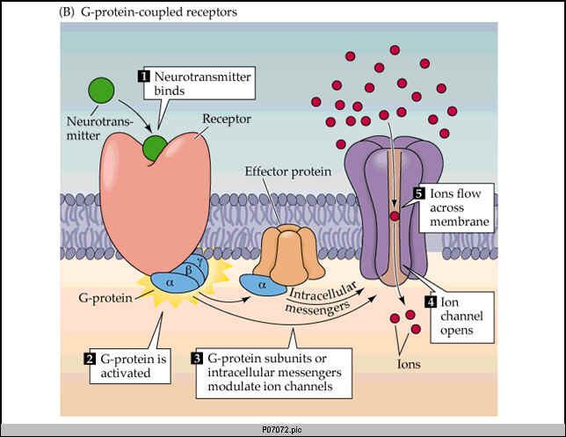
Principal types of channel activation

Slide 17

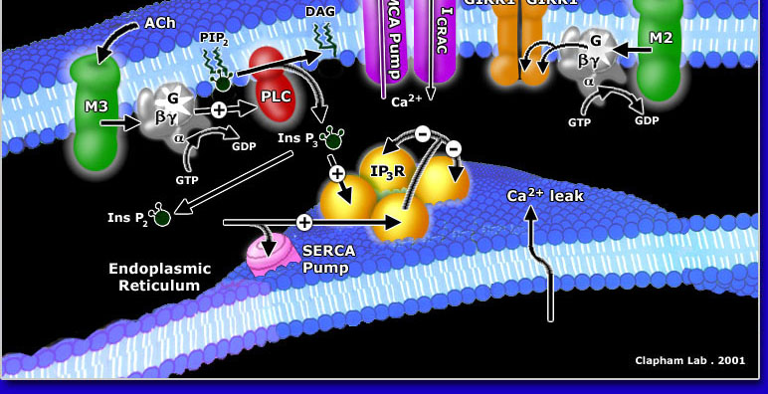
Various membrane channels - examples

Slide 18
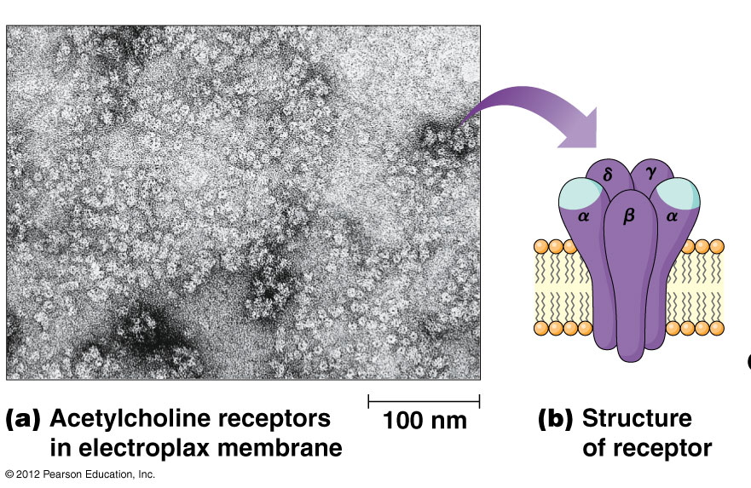
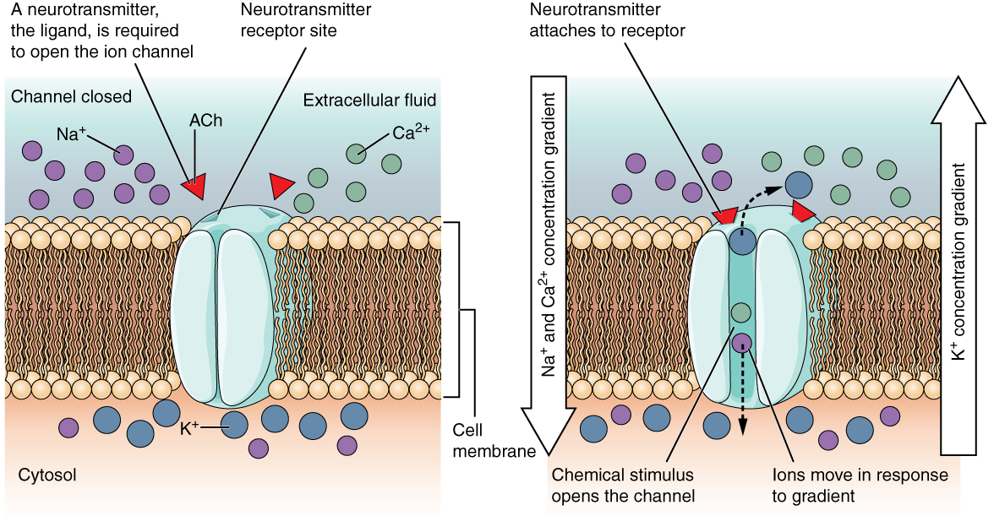
Activation of AcChol
receptors
→ Disruption
of membrane gradients
Reminder:
AcCholEsterase & inhibition by OPs is another related toxicity mechanism

Slide 19
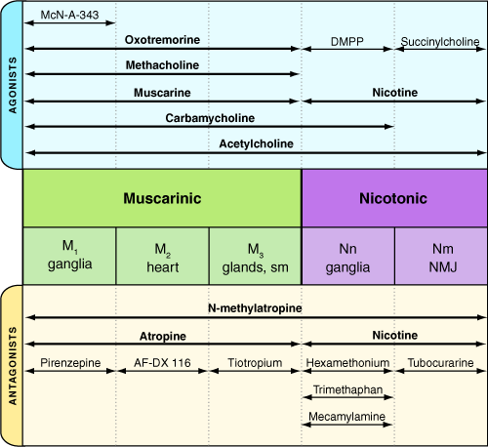
Activation / inhibition of ligand-gated channels
Agonist vs Antagonist
Concentration-dependent
action

Slide 20
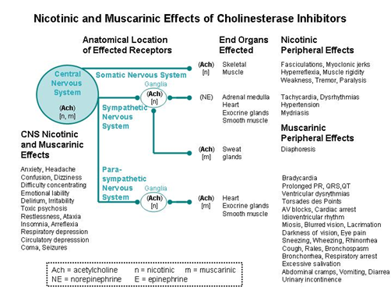
EXAMPLE: related biological effects

Slide 21
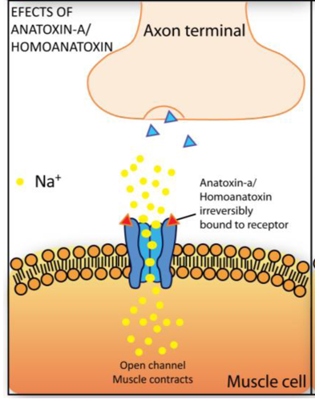
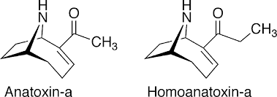
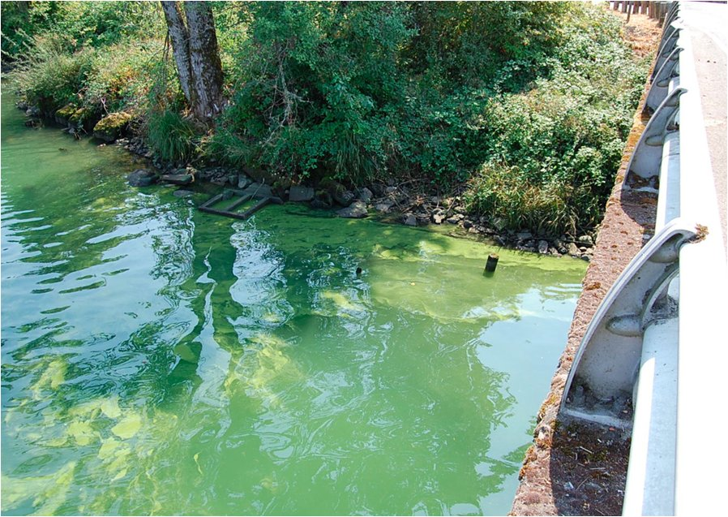
Environmentally relevant toxins - ion channel activators
Neurotoxins (cyanobacterial)

Slide 22
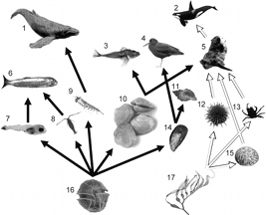
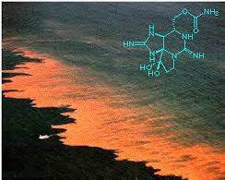
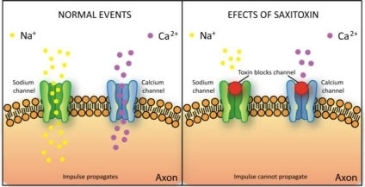
Environmentally relevant toxins - ion channel activators
SAXITOXINS
Produced by dinoflagelates and cyanobacteria
(toxic blooms, „red tides“)

Slide 23
Roles of membranes in the release of neurotransmitters

Slide 24
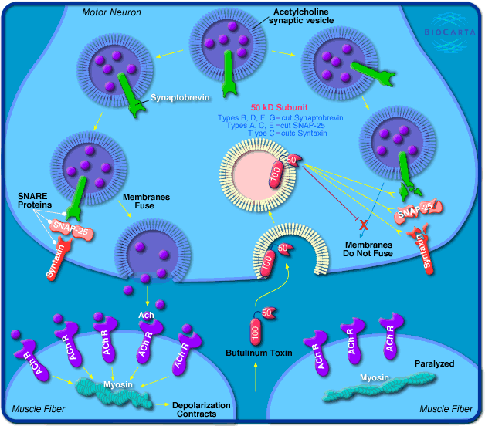
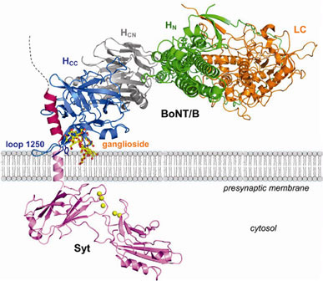
Botulinum and Tetanus toxins
(Clostridium botulinum, Clostridium tetani)
((Complex MoA - mediated through both proteins and membranes))
Toxins = enzymes - proteases (!)
- direct cleavage
of proteins involved
in vesicle formation
- selective inhibition of
neutrotransmitter release
BOTULINISM
→ neurotoxicity (paralysis)

Slide 25
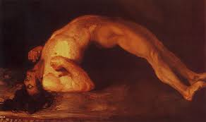
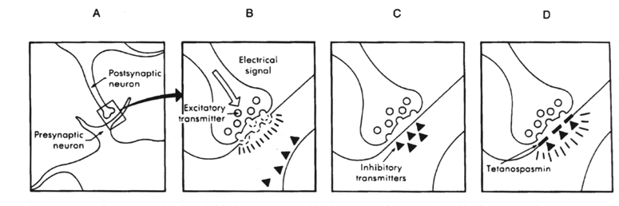
Botulinum and Tetanus toxins
(Clostridium botulinum, Clostridium tetani)
TETANUS TOXIN (tetanospasmin)
blocks release of INHIBITORY NEUROTRANSMITERS
(γ-aminobutyric acid (GABA) in CNS
→ neurotoxicity – permanent muscle contraction

