Slide 1
BIOMARKERS AND TOXICITY MECHANISMS
08 – Mechanisms
Signalling and regulation
Luděk Bláha, PřF MU, RECETOX
www.recetox.cz

Slide 2
Cell communication & regulation: a target for toxicants
… especially sensitively regulated processes are highly susceptible to toxicants
→ toxicity to REGULATIONS & SIGNALLING
Hierarchy in signalling
- systems: neuronal ←→ endocrine
- cell-to-cell
hormonal & neuronal signal transmission
contact channels
- intracellular signal transduction

Slide 3
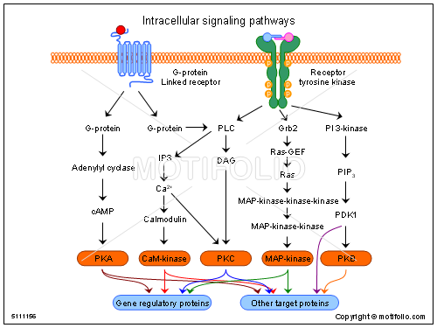
INTRACELLULAR signals

Slide 4
Intracellular signal transduction: target of toxicants
- Regulation of cell life = control of major cell functions
- metabolism
- proliferation
- differentiation
- death (apoptosis)
- Regulation controlled by complex signalling
- "network" of general pathways
- similar in all cells / different cell-specific effects

Slide 5
Intracellular signal transduction: target of toxicants
- Consequences of signalling disruption
- unwanted changes in „homeostatic“ rates among
proliferation / differentiation / apoptosis
  → cell transformation (carcinogenicity)
  → embryotoxicity
  → immunotoxicity
  → reproduction toxicity
  .... and other chronic types of toxicity

Slide 6
Signal transduction - principles
Two major signalling processes
– protein-(de)phosphorylation
ProteinKinases - PKs, ProteinPhosphatases - PPases
- secondary messengers
cAMP / IP3, PIP2, DAG, Ca2+, AA
Three major types of signalling
  1: Membrane receptors (G-protein, kinases)
  → activation of protein kinase A (PKA):
  major messenger: cAMP, MAPKs
  2: Membrane receptors
  → activation of membrane lipases → and later proteinkinase C
  IP3, PIP2, DAG, Ca2+, AA
  3: Cytoplasmic (nuclear) receptors (discussed in detail in other sections)

Slide 7
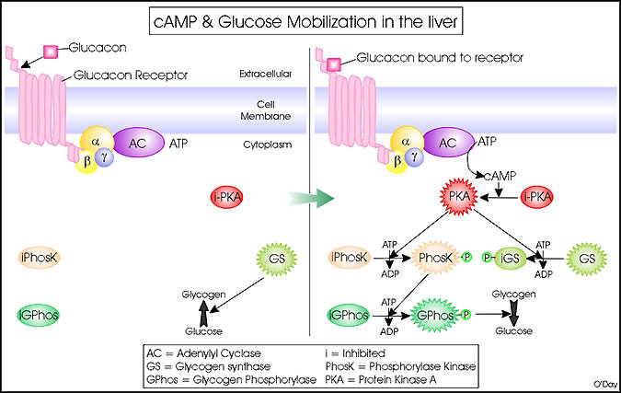
Signalling mechanism 1
→ Activation of adenylate cyclase → cAMP → PKA

Slide 8
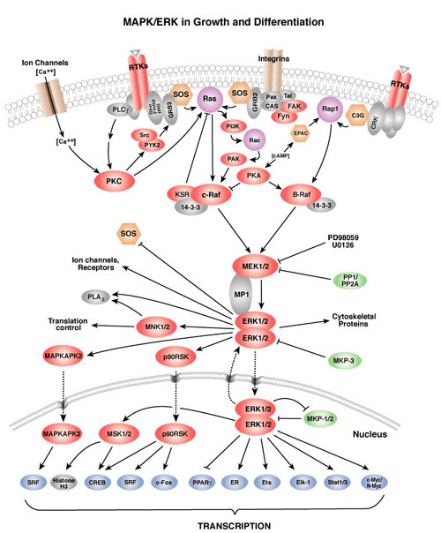
←PKA is central to
a number of signalling
events and following
effects
←Including modulation
of “MAPKs”
← Including modulation
of Transcription (i.e.
control of transcription
factors)

Slide 9
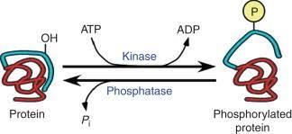
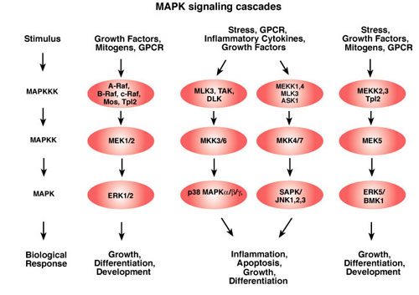
Mitogen Activated Protein Kinases (MAPKs)
& dependent effects

Slide 10
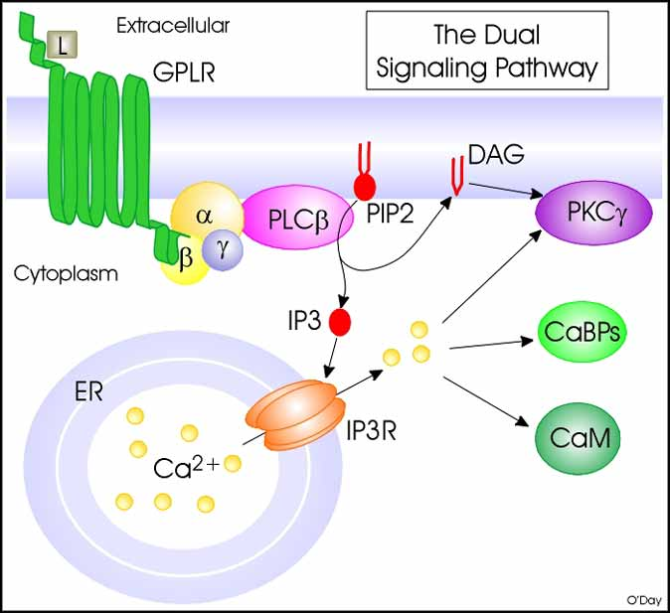
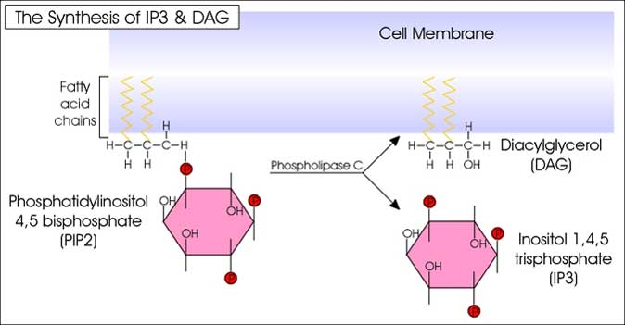
Signalling mechanism 2
Activation of Phospholipase C
→ release of PIPs → DAG → PKC / arachidonic acid
+ IP3 → activation of Ca²⁺ signalling

Slide 11
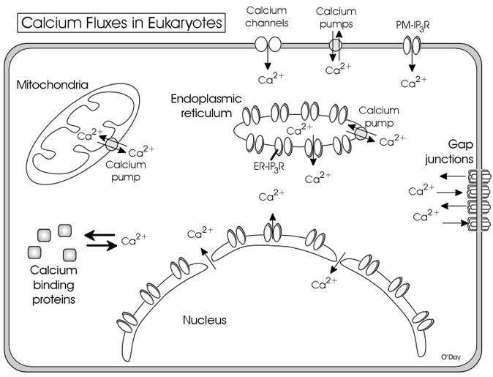

Slide 12
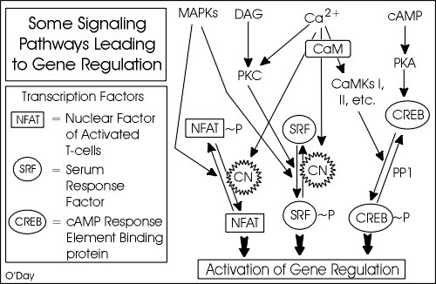
Different signalling crosstalks → networks

Slide 13
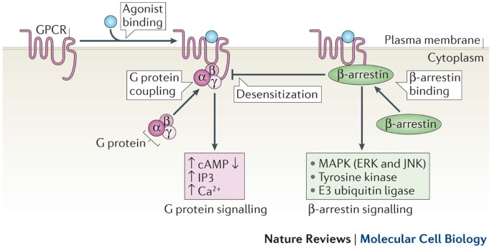
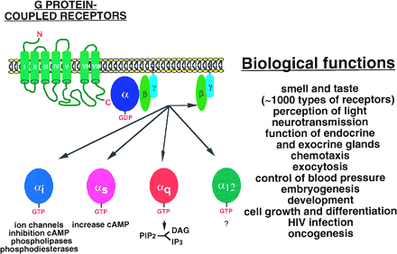
G-proteins & G-protein coupled receptors – GPCRs
Involved in many functions → triggering multiple downstream events & networks

Slide 14
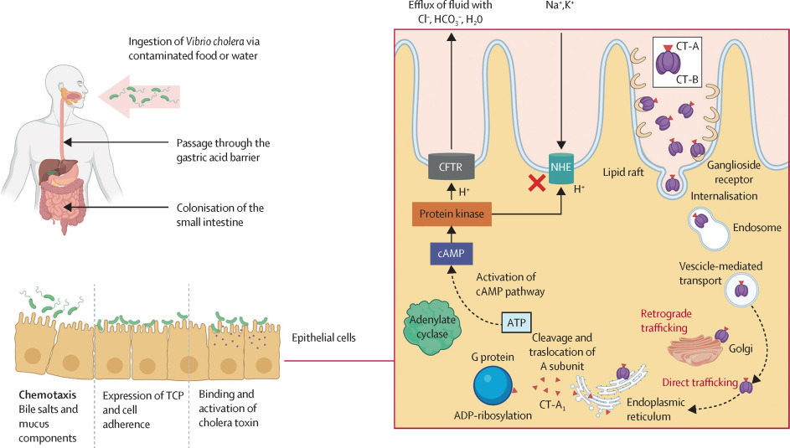
Disruption of intracellular signaling - EXAMPLES
Cholera toxin (from Vibrio cholerae )
CT acts as adenylate cyclase enzyme
increasing cAMP levels
TOXICITY (diarrhea)

Slide 15
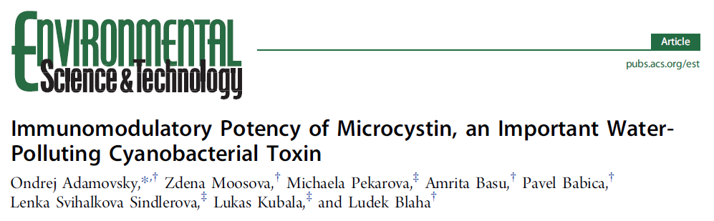
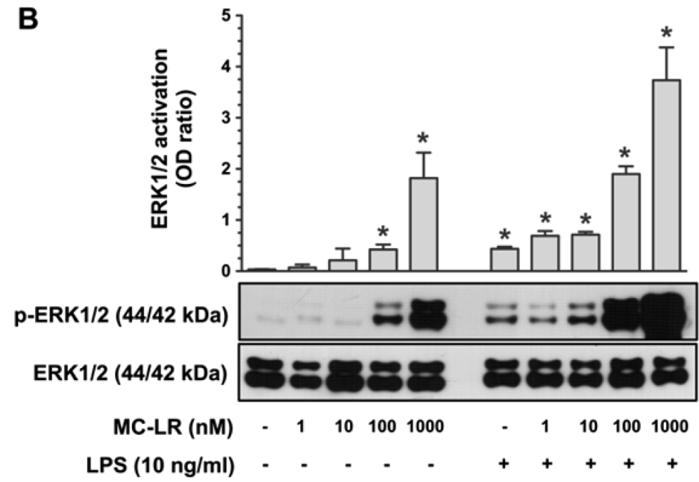
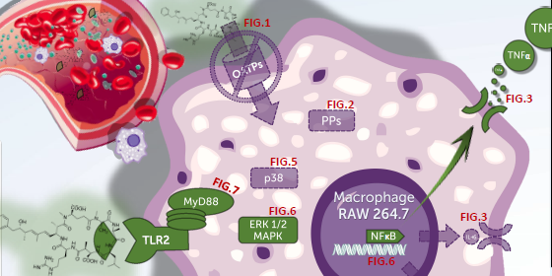
DOI: 10.1021/acs.est.5b02049
Environ. Sci. Technol. 2015, 49, 12457−12464

Slide 16
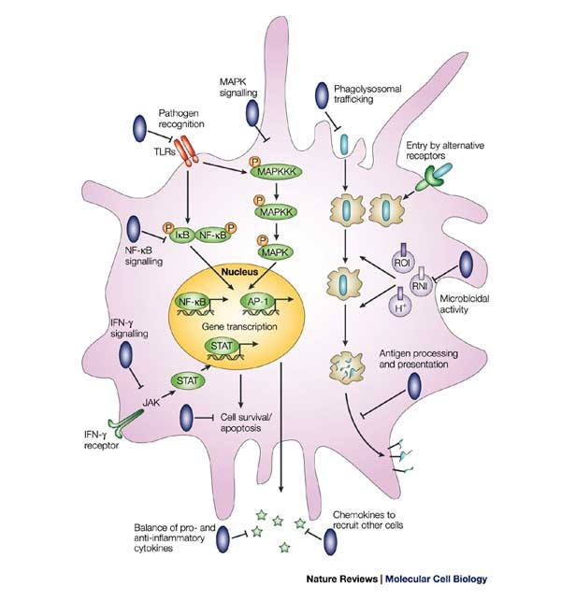
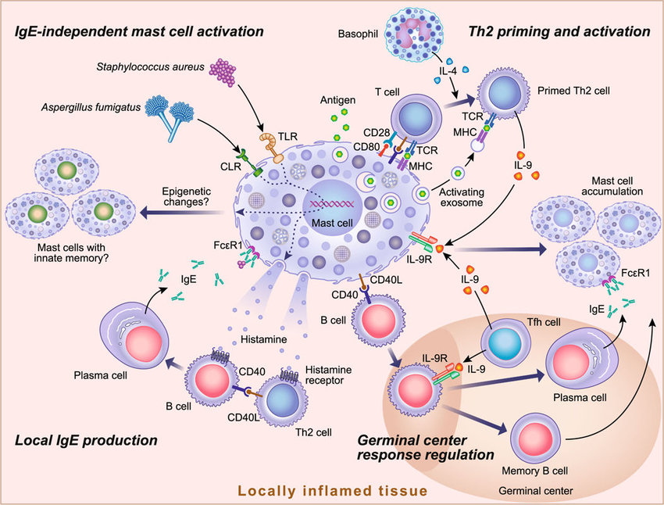
Example: Lipopolysaccharides & exogenous agents inducing immune pathologies – allergies, auto-immune diseases
→ hyperactivation of intracellular signals → immunotoxicity

Slide 17
INTER-cellular signals
Overview

Slide 18
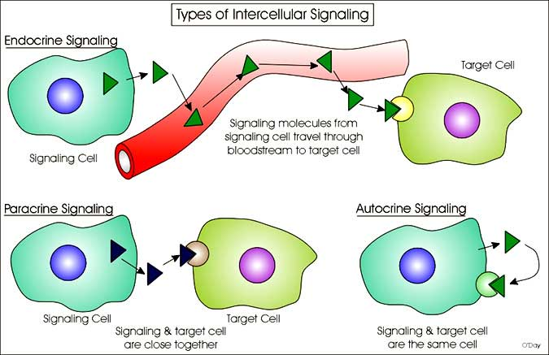
Cell to cell communication & regulation: a target for toxicants

Slide 19
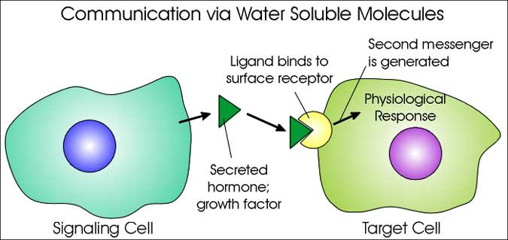
Cell to cell communication (1)

Slide 20
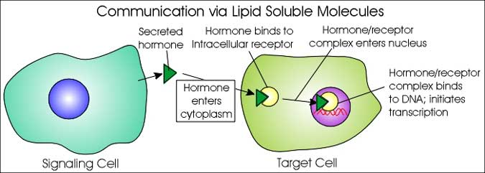
Cell to cell communication (2)

Slide 21
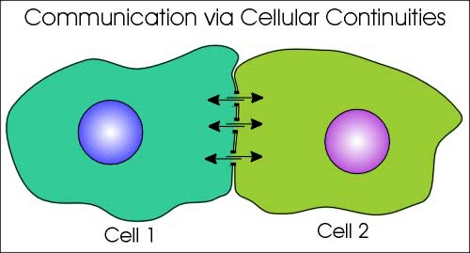
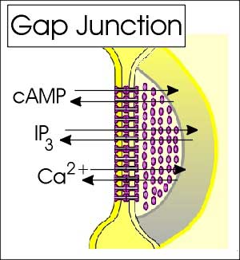
Cell to cell communication (3)

Slide 22
INTER-cellular signals
Hormones

Slide 23
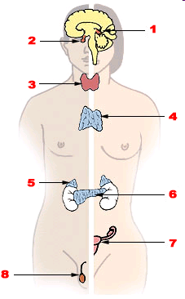
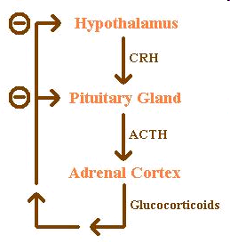
Endocrine system:
1. Pineal gland, 2. Pituitary gland, 3. Thyroid gland, 4. Thymus, 5. Adrenal gland, 6. Pancreas, 7. Ovary, 8.Testis
Example: feedback loop

Slide 24
FUNCTIONS OF HORMONES
* stimulation or inhibition of growth
* mood swings
* induction or suppression of apoptosis
(programmed cell death)
* activation or inhibition of the immune system
* regulation of metabolism
* preparation for fighting, fleeing, mating …
* preparation for a new phase of life
  (puberty, caring for offspring, and menopause)
* control of the reproductive cycle
…. etc.
Chemicals interfering with
various hormonal functions
→ diverse impacts (effects)

Slide 25
System regulation = HORMONES & ENDOCRINE SYSTEM
FATE OF HORMONES: target for toxicants
Toxic compounds can affect “hormone signalling” at various levels (highligted):
1. Biosynthesis of a particular hormone in a particular tissue
2. Storage and secretion of the hormone
3. Transport of the hormone to the target cell(s)
4. Recognition of the hormone by an associated cell membrane or intracellular receptor protein.
5. Relay and amplification of the received hormonal signal via a signal transduction process -> cellular response.
6. The reaction of the target cells is recognized by the original hormone-producing cells (negative feedback loop)
7. Degradation and metabolism of the hormone
More details will be discussed
in the lectures dedicated to
nuclear receptors

Slide 26
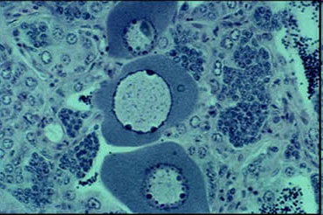
Toxicity to hormone regulation = ENDOCRINE DISRUPTION
ED & EDCs (endocrine disrupting compounds)
= major problem in environmental toxicology
Effects at all levels of hormonal action have been demonstrated
→ synthesis, transport, site of action ….
- Multiple effects due to ED (! Not only „xenoestrogenicity“ & feminization)
→ immunotoxicity, developmental toxicity
(ED - WILL ALSO BE DISCUSSED FURTHER)
Example of ED - Intersex roach testis
containing both oocytes and spermatozoa,
caused by exposure to environmental oestrogens

Slide 27
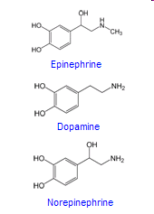
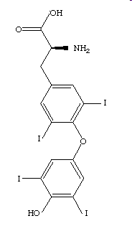
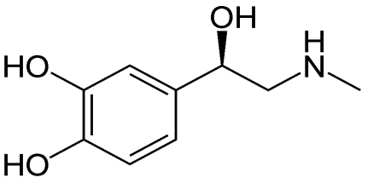
Types of hormones in vertebrates
Amine-derived hormones
structure: derivatives of the amino acids tyrosine and tryptophan.
Examples - catecholamines and thyroxine.
(small molecules - similar to organic toxicants → TOXIC EFFECTS)
Adrenalin
Thyroxin

Slide 28
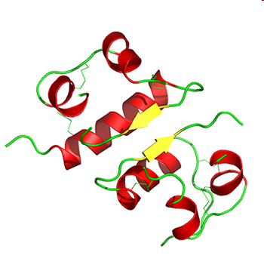
Types of hormones in vertebrates
Peptide hormones
structure: chains of amino acids.
- small peptides: TRH and vasopressin;
- large proteins: insulin, growth hormone, luteinizing hormone, follicle-stimulating hormone and thyroid-stimulating hormone etc.
Large molecules;
receptors on surfaces of the cells
(Interactions with toxic chemicals less likely)
Example - insulin

Slide 29
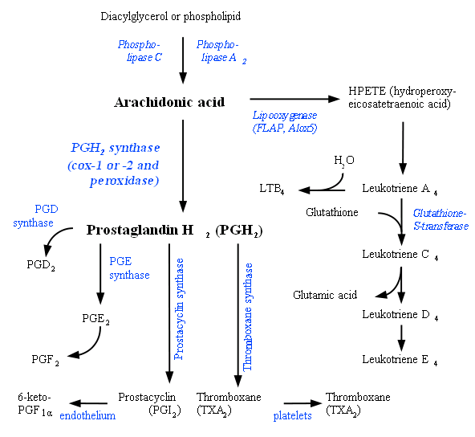
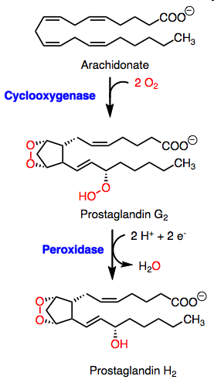
Types of hormones (signal molecules) in vertebrates
Lipid derived “hormones” (1) - from linoleic acid, arachidonic acid
- prostaglandins

Slide 30
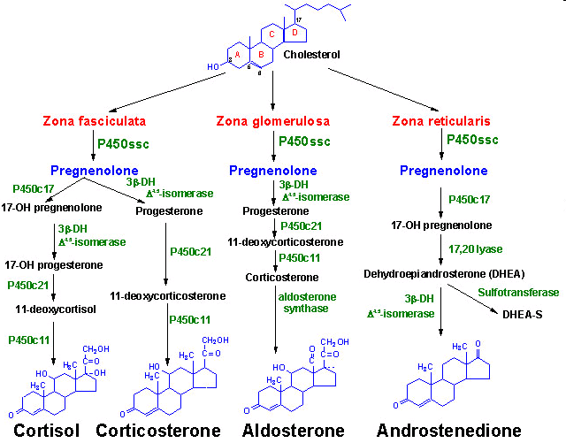
Types of hormones in vertebrates
Lipid derived hormones 2 - steroid hormones
* Small molecules - similar to organic toxicants:
→ several compounds interfere with steroid hormones → toxicity !!!
Derived
from cholesterol
Examples:
testosterone,
cortisol,
estradiol …

