Slide 1
BIOMARKERS AND TOXICITY MECHANISMS
09b –Nuclear Receptors
AHR – Arylhydrocarbon Receptor
Luděk Bláha, PřF MU, RECETOX
www.recetox.cz

Slide 2
AhR (Arylhydrocarbon receptor)
AhR structure
2,3,7,8-TCDD
(dioxin) bound to AhR

Slide 3
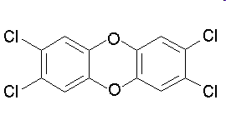
AhR
Also known as „dioxin-receptor“ (and its modulation leads to so called „dioxin-like“ activity or toxicity)
Ligand-activated transcription factor
  Similar to all NRs
AhR has effects on many different genes
important mediator of toxicity of POPs – primary target of planar aromatic substances
  regulator of xenobiotic metabolism and activation of promutagens
Crossactivation/crosstalk with other NRs
Strongest known ligand - TCDD
  (not endogeneous !)

Slide 4
AhR regulated genes
Many genes contain xenobiotic response elements (XRE) or dioxin responsive elements (DRE) in their promoter region:
  Detoxification genes phase I enzymes (CYP 1A1, CYP 1A2, CYP 1B1) and phase II enzymes (UDP-glucuronosyltransferase, GST-Ya, NADP(H):oxidoreductase)
    → Detoxification after toxicant exposure
    … also with possible toxic consequences (oxidative stress, activation of promutagens accelerated clearance of hormones)
  Other genes - regulation of cell cycle and apoptosis
    Bax (apoptosis control), p27Kip1, Jun B (MAP-kinase), TGF-b (tumor growth factor)
    → Various adverse toxic effects

Slide 5
Physiological role of AhR
Physiological role for AhR still not known completely (?)
  Most likely – “protection” against toxicants → induction of detoxification
Many adverse effects documented in AhR-deficient mice
  significant growth retardation;
  defective development of liver and immune system;
  retinoid accumulation in liver;
  abnormal kidney and hepatic vascular structures.
  resistant to BaP-induced carcinogenesis and TCDD-induced teratogenesis;
  no inducible expression of CYP 1A1 and 2.
→ this implies presence of natural endogeneous ligand(s)
(not only exogeneous toxicants can bind AhR)

Slide 6
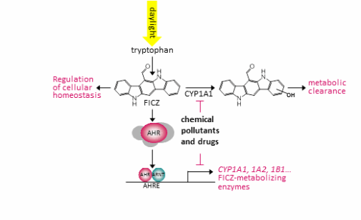
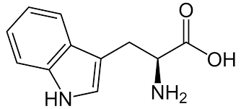
What is the natural (endogenous) physiological ligand of AhR ?
Potential candidate: 6-formylindolo[3,2-b]carbazole (FICZ)

Slide 7
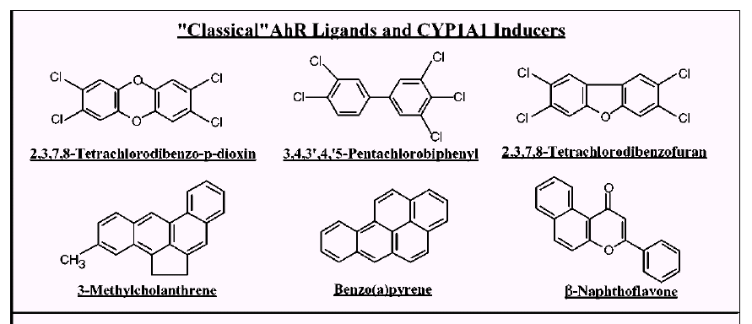
Classical and “non-classical” AhR ligands
Classical = planar structures → direct binding to AhR
Denison & Nagy, Annu. Rev. Pharmacol. Toxicol. 43:309

Slide 8
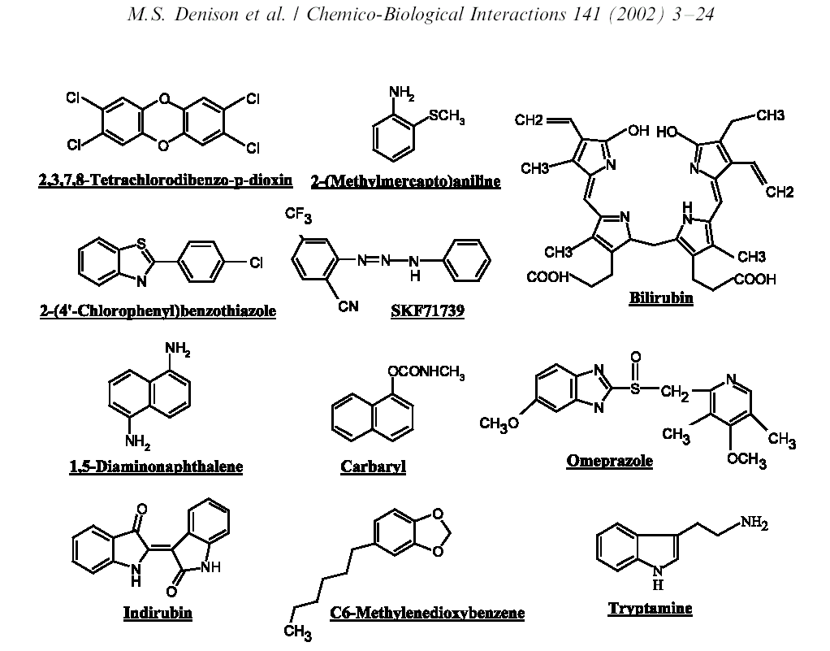
„Non-classical“ AhR ligands – various structures
“Classical” ligand

Slide 9
Biological responses to TCDD & AhR ligands
Schmidt & Bradfield, Annu. Rev. Cell Dev. Biol. 12:55

Slide 10
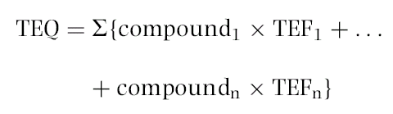
Toxic equivalency factors (TEF)/TEQ concept
Toxicity of compounds with similar toxicological properties as TCDD (activating AhR) may be evaluated by TEF/TEQ concept
  TEF = Toxic Equivalency Factor (“characteristic” of the Chemical)
  TEQ = Toxic Equivalent (sum of TEFs x concentrations)
TEFs are consensus values based on REPs (relative potencies) across multiple species and/or endpoints.
  TEFs are based upon a number of endpoints, from chronic in vivo toxicity to in vitro toxicity with the former having the greatest importance in determining overall TEF.
TEQs provide a simple, single number that is indicative of overall toxicity of a sample (water, sediment, food) containing a mixture of dioxins and dioxin-like compounds.
The total potency of a mixture can be expressed in TCDD TEQ concentration
  i.e. TEQ = concentration corresponding to the effect that would be induced by TCDD

Slide 11
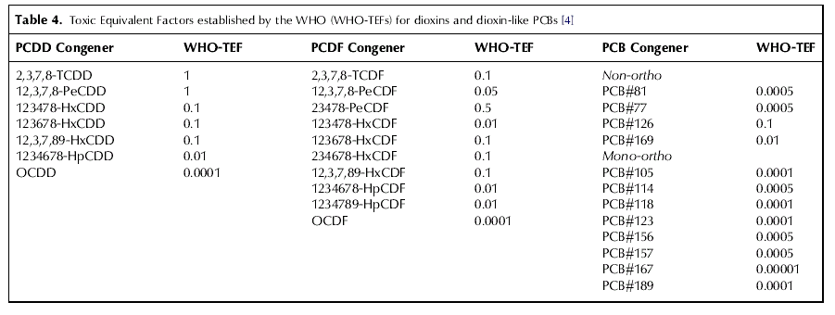
Toxic equivalency factors for PCDDs, PCDFs and PCBs:
Eljarrat & Barceló, Trends Anal. Chem.22: 655
Final concentration is expressed as „Equivalents of TCDD“
(e.g. ng TEQ / kg = ng TCDD / kg)

Slide 12
Biomarkers/bioanalytical methods for AhR toxicity
In vivo studies
  liver enlargement, reduction of thymus weight, wasting syndrome, reproductive and developmental disorders
In vivo biomarkers
  EROD activity, CYP 1A1 and 1B1 expression
  (discussed in biomarker section)
in vitro assessment of chemical potencies
  EROD (ethoxyresorufin-O-deethylase activity) in cell cultures;
  CALUX/CAFLUX assays
  (luciferase expression – reporter gene assays)
  GRAB assay (AhR-DNA binding)
  yeast bioassay;
  immunoassays;
  detection of CYP1A mRNA (qPCR) or AhR protein (western blotting)

Slide 13
In vitro CALUX/CAFLUX assays
CALUX – Chemical Assisted Luciferase Expression
DR-CALUX (Dioxin Responsive CALUX)
(i.e. Luciferase Reporter Gene Assay with H4IIE.luc cells)

Slide 14
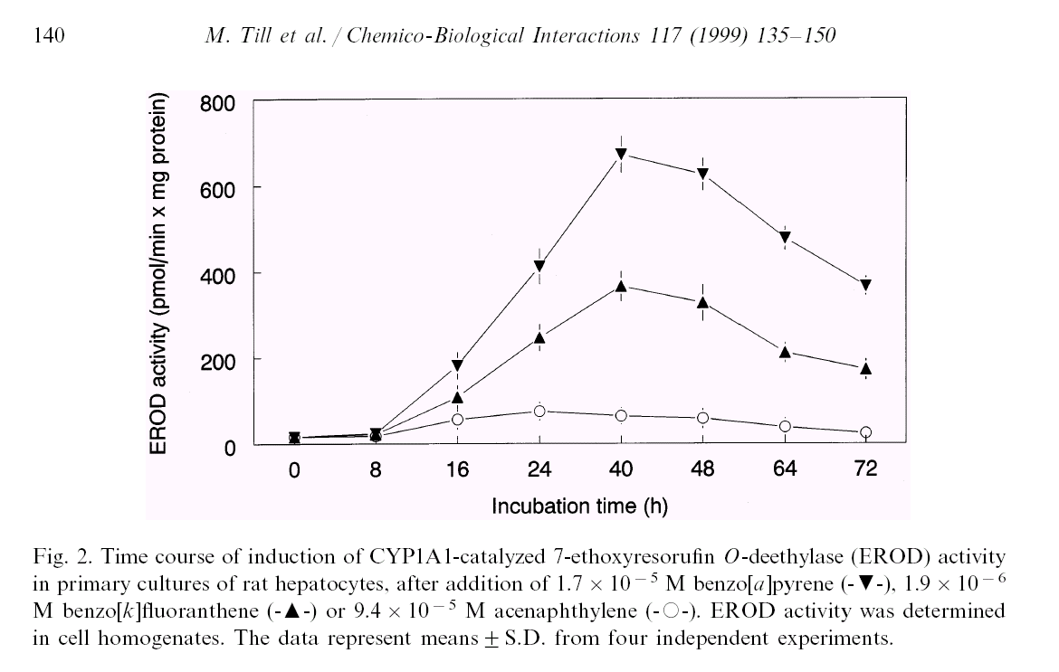
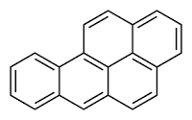

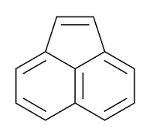
DETECTION of EROD activity - example

Slide 15
Comparing toxicity of compounds → Application in Risk Assessment
Quantification of effects (EC₅₀)
Comparison with the effect of reference toxicant (2,3,7,8-TCDD)
  → relative potencies (REPs) to TCDD
    (= in vitro “Toxic Equivalency Factors” ~ TEFs)
TCDD: IC₅₀
PAH: IEC₅₀
Relative Potency (REP)
= Induction Equivalency Factor
IEF = IC₅₀ / IEC₅₀
REP interpretation: How many times is the compound "weaker" inducer than TCDD ?
120
TCDD
B[a]P
B[e]P
4´-OH-PCB 79
4´-OH-PCB 3
100
80
AhR-mediated activity (%TCDD-max)
60
40
IEC50 = 2
m
M
20
IC50 = 10 pM
0
1.E-07
1.E-04
1.E-01
1.E+02
concentration (
m
M)

Slide 16
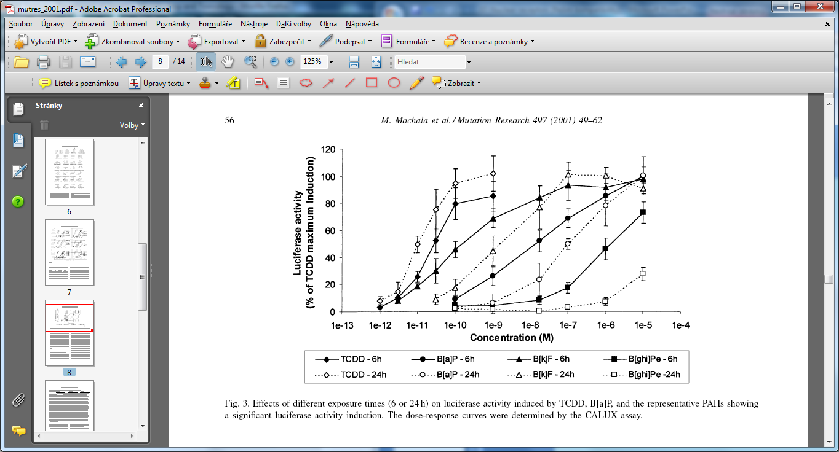
Example - relative potencies of PAHs (two exposure periods)
„CALUX“ assay
Longer period: lower induction due to (partial) metabolization of PAHs (CYPs, oxidation) to products less potent to AhR

Slide 17
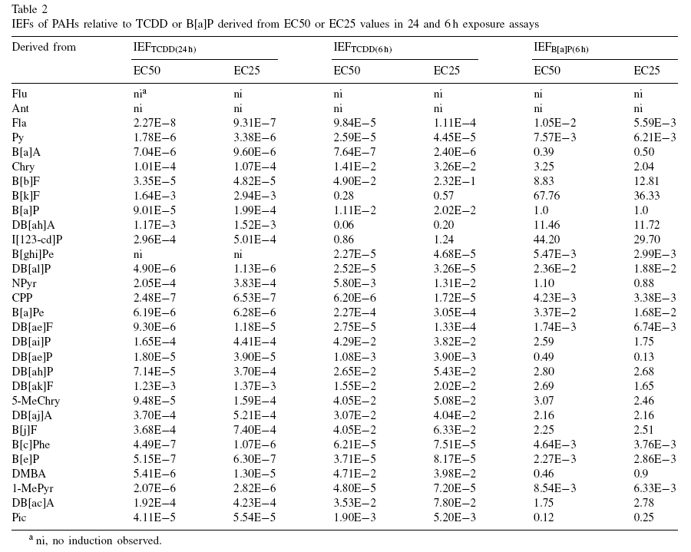

Slide 18
Summary – Nuclear receptors
Important physiological functions,
Important roles in pathologies and chemical toxicity (ENDOCRINE DISRUPTION)
NRs with well studied roles in toxicity: ER and AhR
  Other NRs (AR, RAR/RXR, ThR) – important but less explored
All NRs share similar structure and mechanisms of action
  Act as direct transcription factors on DNA
Natural ligands of NRs are small lipophilic hormones
  steroids, thyroids, retinoids
  Various regulatory functions
  Role in toxicity: NR interact with structurally similar xenobiotics
Various mechanisms beyond the toxicity
  Adverse are both STIMULATIONS and INHIBITIONS directly at the receptor site (e.g. “anti-androgenicity)
  Additional mechanisms –in blood (Thyroids), metabolism (Thyroids) clearance (Retinoids), heterodimerization and transport of hormones, “crosstalk” of different NRs
Other key information to remember
  REPORTER GENE ASSAYS (principle, use, what is CALUX?)
  Characterization of chemical “toxic potentials”
    General concept of “REPs” (valid for activation of all NRs)
    Specifically for AhR - concept of TEFs / TEQs

