Slide 1
Ecotoxic effects
- Introduction –
Luděk Bláha, PřF MU

Slide 2
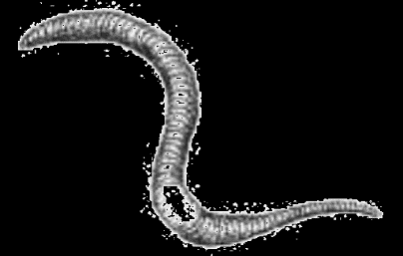
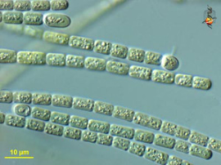
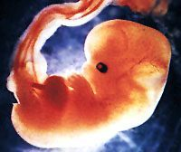
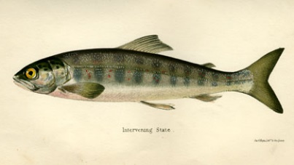
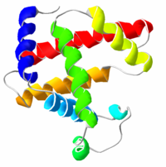
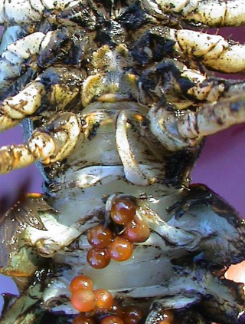
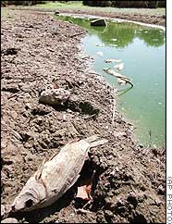

CHEMICAL ENTERS THE ENVIRONMENT
CHEMICAL ENTERS THE ORGANISM
biomonitoring
LEVELS, FATE, PROCESSES
Toxicokinetics
biotransformation
bioactivation
excretion / sequestration
Bioavailable fraction
Target site
“EFFECT”
toxicodynamics
“EXPOSURE”
acute
chronic

Slide 3
WHAT IS LIFE ?
Characteristics & properties of a living entity ?
- Structure
- Functioning

Slide 4
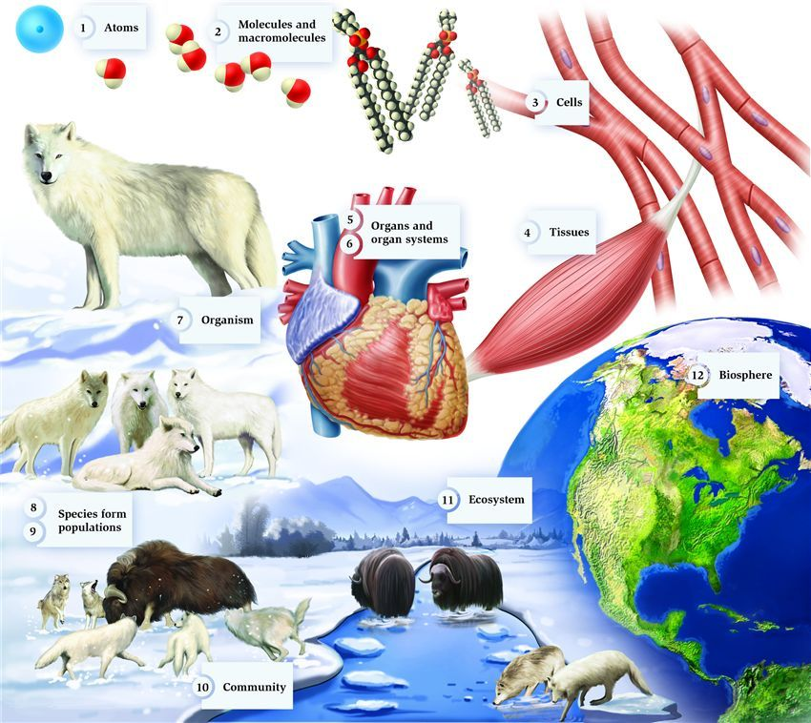
pinterest.com

Slide 5
WHAT IS LIFE ?
WHAT IS ECOTOXIC EFFECT ?

Slide 6



Energy
hv
food
Losses
heat
faeces
Life
(maintenance)
Metabolism
Control,
Interactions
with environment
Defence
against pathogens
predators …
Defence against
toxicants
Growth
to sexual
maturity
Reproduction
Chemical
stress

Slide 7
Chemical stress
→ energy re-allocation
→ „insufficient“ resourses elsewhere
Energy
hv
food
Losses
heat
faeces
Life
(maintenance)
Metabolism
Control,
Interactions
with environment
Defence
against pathogens
predators …
Defence against
toxicants
Growth
to sexual
maturity
Reproduction
Chemical
stress

Slide 8
Chemical stress
+ ... another stress
(food scarcity)
Energy
hv
food
Losses
heat
faeces
Life
(maintenance)
Metabolism
Control,
Interactions
with environment
Defence
against pathogens
predators …
Defence against
toxicants
Growth
to sexual
maturity
Reproduction
Chemical
stress

Slide 9
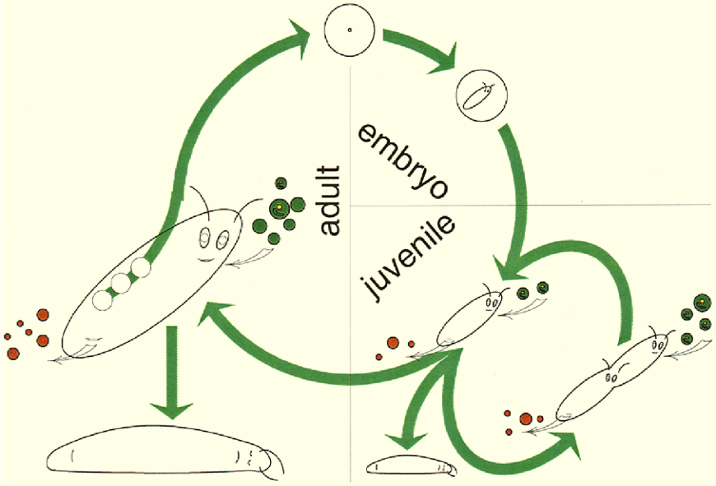
Effects at different levels - ORGANISM
Ecotoxicologicological effects (see also Bioassays)
  Effects on structure
  Effects on metabolism (maintenance)
  Effects on regulation
    Changes in functions (e.g. hormones, EE2)
    Repair, survival, growth
    Death (lethality)
    Proliferation = Reproduction
3 key apical endpoints
(reflected e.g. in regulations)

Slide 10
WHAT IS LIFE ?
WHAT IS ECOTOXIC EFFECT ?
WHAT HAPPENS „BEFORE“ EFFECT MANIFESTATION ?
WHAT ARE THE CONSEQUENCES OF THE EFFECT ?

Slide 11
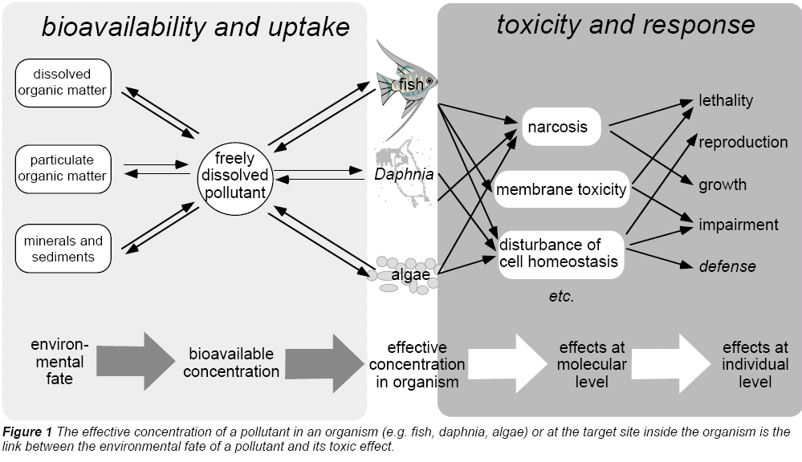
Exposure → TK → TD → Effects
Escher, B. I., Behra, R., Eggen, R. I. L., Fent, K. (1997), "Molecular mechanisms in ecotoxicology:
an interplay between environmental chemistry and biology", Chimia, 51, 915-921.

Slide 12
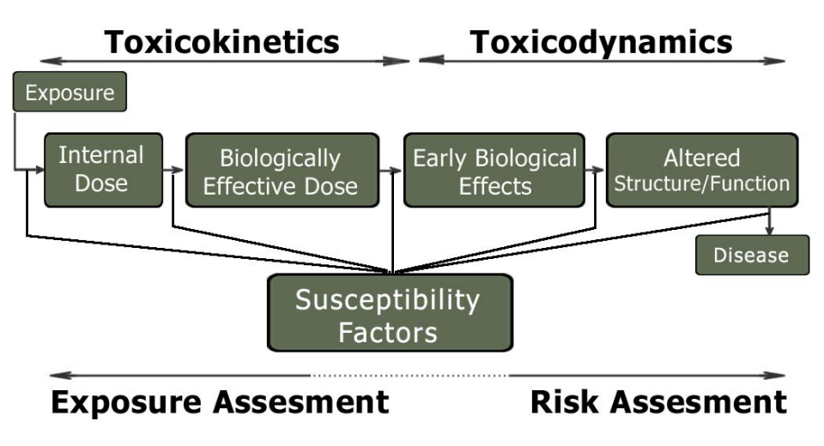
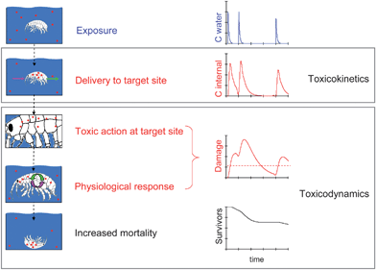
Toxicokinetics → ToxicoDYNAMICS
TARGETS = macromolecules
(DNA/RNA, proteins, membrane lipids)
MoA
... and measurable
EFFECTS

Slide 13
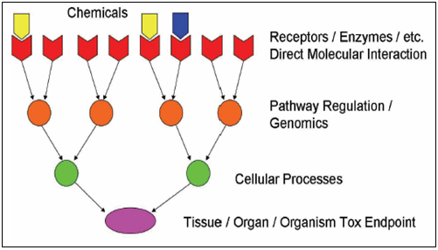
Target sites = molecules
MECHANISMS OF TOXICITY

Slide 14
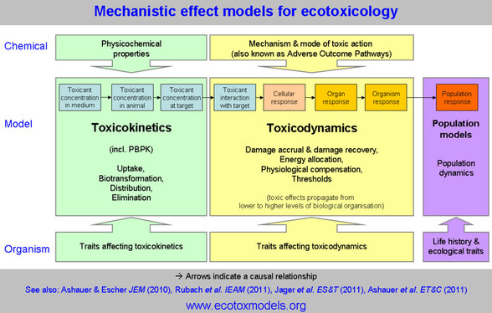
From molecules to individuals → to populations
ADVERSE OUTCOME PATHWAYS

Slide 15
It all starts with MoA = Mechanisms of Action (MoA)
According to target molecules (next slide)
  Mechanisms primarily targeting different
    BIOLOGICAL MACROMOLECULES
      i.e. PROTEINS and/or NUCLEIC ACIDS and/or PHOSPHOLIPIDS
    SMALL BIOLOGICAL (ORGANIC) MOLECULES
      E.g. Antioxidants or scavengers (vit.E, GSH)
According to INTERACTION between toxicant/target (next slide)
  Non-covalent interactions
    Partitioning (v d Waals, H-bonds, hydrophobic interactions) → [1] below
    Partitioning with specific steric fit → [3] below
  Formation of covalent bonds
    ... with proteins / DNA-RNA / P-lipids / small molecules → [2] below
According to “STERIC SPECIFICITY” of the interaction
  NON-SPECIFIC MECHANISMS
    the interaction between the toxicant and the target occurs “generally” with any target of certain general properties (e.g. toxicant is able to bind to ANY protein having e.g. SH- group), it does not require specific steric (structural) properties of the target
      mechanisms [1] and [2] below
  SPECIFIC MECHANISMS
    the toxicant interacts only with certain and specific structural properties (e.g. specific binding of a pesticide into the active site of enzyme acetylcholinesterase)
      mechanism [3]

Slide 16
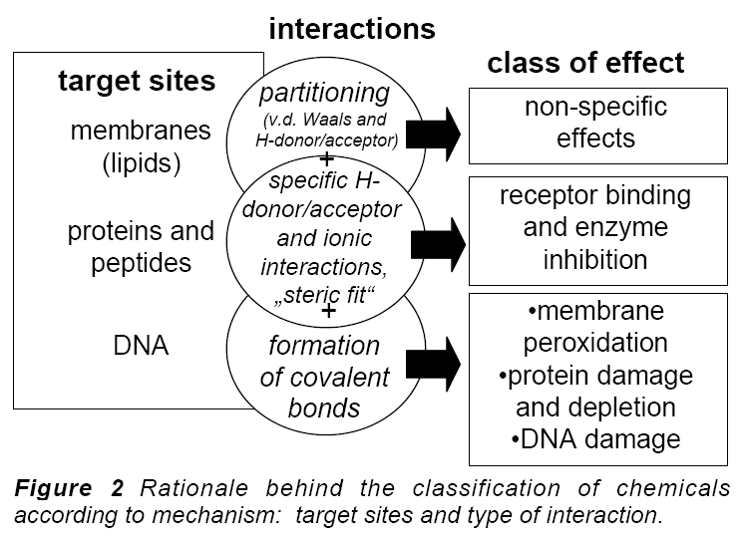
Target (receptor) in MoA / toxicodynamic = BIOMOLECULE
[1]
[3]
[2]

Slide 17
Categorizations of MoAs
[1] non/specific membrane toxicity
  Involves ALL ORGANIC compounds
  Affinity to non-polar environment (membrane phospholipids)
  Two types can be discriminated
    nonpolar basal / narcotic toxicity
      effects observed at relatively high concentrations, depends on hydrophobicity (Kow)
    polar narcosis
      more polar compounds may affect also membrane proteins (effects at lower concentrations than expected from Kow)
[2] nonspecific reactive toxicity
  some compounds with “reactive” properties may directly modify biological macromolecule (lipids, proteins, nucleic acids) causing thus toxic effects
  reactive chemicals are mostly „electrophiles“ (reacting with „nucleophiles“ in cells – i.e. electrone-rich sites - nucleotides, -NH2, -SH and others), and also toxic (heavy) metals
[3] specific steric interactions
  only certain specific compounds selectively affect specific targets
  E.g. enzyme inhibitions (drugs, insecticides); receptor interactions (e.g. Estrogens)
  Can be non-covalent as well as covalent
  Effects at very low concentrations
All organics
→ membranes
Specific interactions
Reactive

Slide 18
MoA(s) - toxicity mechanisms - overview
Student is expected to know principles and some examples of the following main types of toxicity mechanisms
Membrane nonspecific toxicity (narcosis)
Proteins and inhibition of enzymatic activities
Ligand competitions – receptor mediated toxicity
DNA toxicity (genotoxicity)
Complex mechanisms
  Oxidative stress – redox toxicity

Slide 19
The molecular and cellular effects propagate → ORGANISM
WHAT (types of) „ORGANISMS“
can be affected by ecotoxicants ?

Slide 20
WHAT (types of) „ORGANISMS“
can be affected by ecotoxicants ?
- Structure = TAXONOMY
- Functioning = ECOPHYSIOLOGY

Slide 21
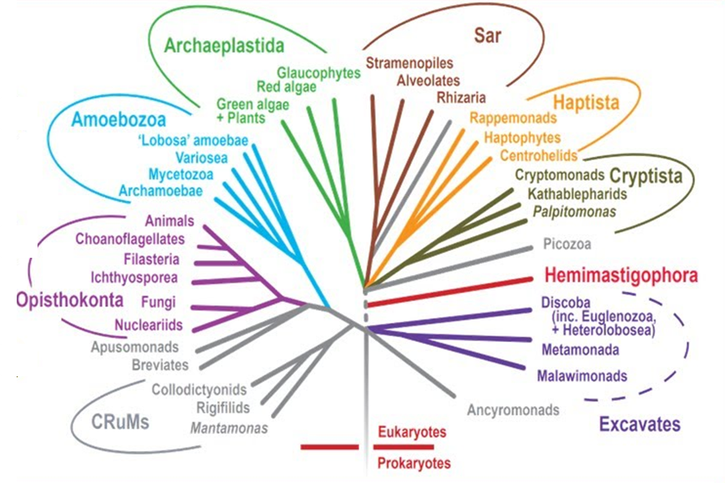
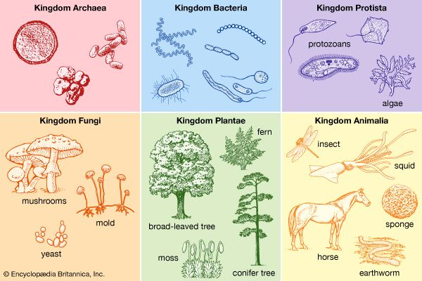

Slide 22
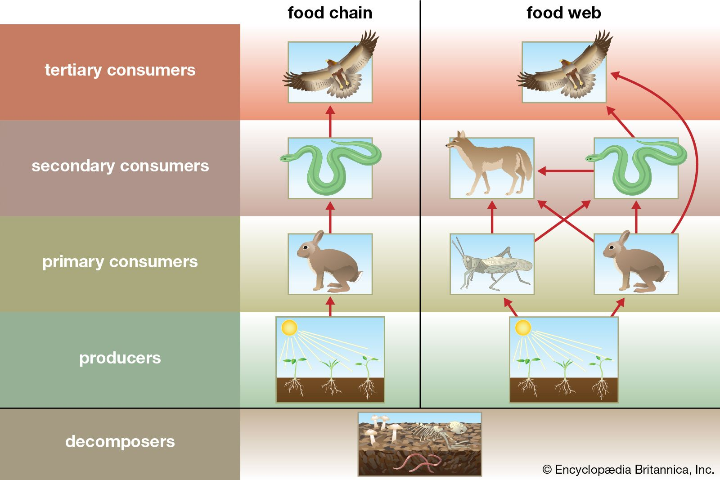

Slide 23
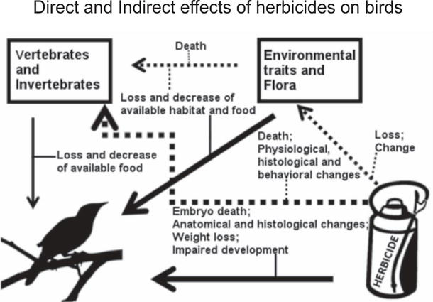
Ecotoxicity of glyphosate-based herbicide (GBH) to aquatic birds. Direct (continuous arrows) and indirect (dashed arrows) effects of GBH on birds.
https://www.intechopen.com/books/biochemical-toxicology-heavy-metals-and-nanomaterials/ecotoxicology-of-glyphosate-based-herbicides-on-aquatic-environment

Slide 24
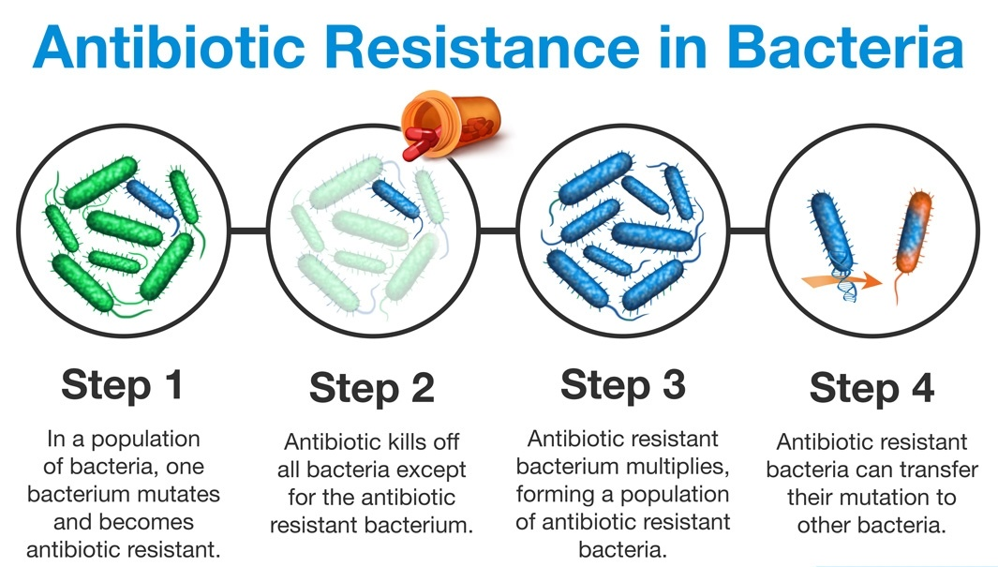

Slide 25
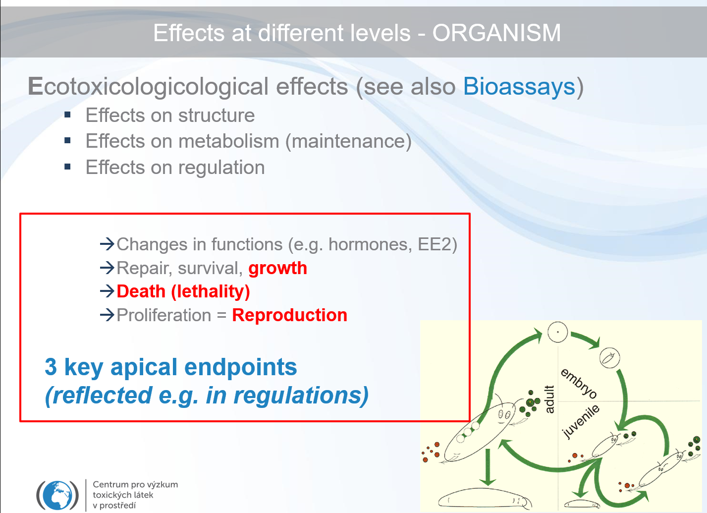
WRAP UP = TAKE HOME MESSAGE
Ecotoxicology aims to understand effects of stressors (chemicals) in biological systems
→ Be aware of life (biological systems) in all types and dimensions
(Eco)toxicological effects are captured (organized) in Adverse Outcome Patways – from Exposures to TK to MoA to „in vivo“ (and beyond)
The 3 most important biological endpoints in vivo (apical endpoints) reflected in pragmatic approaches (biotesting) are …

