Slide 1
Bi5444 Analysis of sequencing data
Lesson 2 - General information and introduction
Notes:
Introduce yourself.
Point out course language – the official language is English (also written in the IS). The reason is to open this course also to non-Czech/Slovak speaking students and to teach local students to listen and work in English. Current system at the university is very “old school” and doesn’t “force” students to work in English which is necessary for further work in the field and science in general. Also all study materials and papers are in English and also most of the expressions are not possible to translate into English (or they won’t make much sense).
Point out office and contact information and possible consultations in the future.
1

Slide 2
General introduction

Slide 3

Teachers
Dr. Eva Budinska – guarantor, teacher – RECETOX, MU
Assoc. prof. Marek Mraz, MD – teacher - Univ. hosp. Brno & Fac. of Medicine & CEITEC MU
Ing. Vojtěch Bartoň – teacher, RECETOX MU
Each will take care of different part of the course and at the end everything will be “merged” together
Notes:
Introduce teachers
Mention they are experts in the field and that is is a nice combination of biologists, statisticians and bioinformaticians
3

Slide 4
Are you familiar with the field?
Do you work with the data somehow?
Do you receive any outputs from the analysis?
Do you plan to work with it?
Do you want to understand the outputs?
Lets get to know each other…

Slide 5
The course itself

Slide 6
The course is addressed to everyone who already works with or plans to work with the NGS data, wants to learn something new from the field or wants to understand the data/outputs
The lectures will explain you the basics and show you examples
You will need to study/exercise some extra to get better understanding of the process
During the course, there will be possibility to you can discuss your own data analysis (if any)
Main objective:
Notes:
6

Slide 7
Know the latest NGS methods (next and third generation sequencing), their use and the type of data they produce
Be able to distinguish the type of method based on the data
Know the basic scheme of data analysis
Able to work with Linux, Bash and R at a level sufficient for analysis of NGS data – partially
Know how to select tools for data processing and apply them to real data
Be able to analyze NGS data starting from quality control over alignment to the detection of deferentially expressed genes (in RNA-Seq), variants (CNV with SNP), genome assembly, etc.
After the course you should…

Slide 8
We will not cover all topics in the NGS field –simply there is not enough time
We will provide you with solid basics of NGS data analysis that will allow you to easily extend to almost any NGS application and data types and to work with the data
We will give you hints where to look, what to look for, what to study and how to think about the data
At the beginning we will cover the biology background and also do the revision of your knowledge in the biology/molecular biology field – necessary for correct understanding of the NGS
Content of the course

Slide 9
Course content
1. Introduction to NGS technologies: a brief introduction to biology, sequencing, history, NGS technologies and their applications, sample extraction, library preparation, basic glossary. Course requirements and schedule.
2. Pitfalls of NGS and the consequences for data analysis.
3. Data sources. The basic scheme of data analysis: how the data look like, definition of general steps in NGS data analysis, basic differences in dependence on the application (eg. variant calling vs RNA-Seq …).
4. Introduction to software for data analysis: a brief introduction to work with Linux, Bash and R, data formats and the differences between them.
5. Data preprocessing and quality control: tools for quality control, Phred score, examples on sample data.
6. Alignment and post-processing: reference genome databases, annotations, the differences between them and application, explanations of alignment algorithms, differences between spliced/non-spliced ​​tools and their application, alignment quality control, alignment visualization.
7. Analysis of RNAseq data - differentially expressed genes
8. Variant calling – targeted sequencing, methods for calling, specific QC steps
9. Metagenomics (16S, ITS, WMGS) / algorithms for taxonomy and functional assignment
10. Statistics and visualisation
11 and 12. Project defense

Slide 10
Knowledge of molecular biology
At least a basic knowledge of work with Linux system
Basic knowledge of R and statistics is an advantage
Basic programming knowledge is an advantage
Let’s check the prerequisites
Notes:
10

Slide 11
Study materials
There are plenty of study materials available online
But the whole field changes very quickly – try to look for the latest information
Few years old materials are most likely not very useful any more or the are already surpassed
Presentations from the lectures will be available online
There will be always a link to some interesting papers during the course where possible
It is never a bad idea to ask!

Slide 12
Other recommended courses
C2110 UNIX and programming
Bi7560 Introduction to R
Bi7420 Modern methods for genome analysis
Bi7528 Analysis of genomic and proteomic data
Bi7527 Data Analysis in R
Bi7492 DNA Sequence Analysis
Bi5010 Detection of biomarkers from omics experiments
You can also see the study catalogues of Mathematical Biology and Biomedicine (direction Biomedical Bioinformatics) or Chemoinformatics and bioinformatics degrees for the recommended courses

Slide 13
Online courses - examples
Linux/Unix
http://www.ee.surrey.ac.uk/Teaching/Unix/, …
BioLinux
http://nebc.nerc.ac.uk/nebc_website_frozen/nebc.nerc.ac.uk//support/training/course-notes/past-notes/intro-bl7, …
R
http://www.r-tutor.com/r-introduction, http://ww2.coastal.edu/kingw/statistics/R-tutorials/text/quick&dirty_R.txt, …
Other interesting courses
https://www.coursera.org/, http://online.stanford.edu/courses, https://www.edx.org/, http://www.codecademy.com/, http://ocw.mit.edu/index.htm, http://www.rna-seqblog.com/, …
Questions & Answers
http://seqanswers.com/, https://www.biostars.org/, http://stackoverflow.com/, …
Blogs & Other
www.linkedin.com, www.researchgate.net, http://core-genomics.blogspot.cz/, http://nextgenseek.com/, https://twitter.com/, …
Introduction to Next Generation Sequencing
https://www.ebi.ac.uk/training/course/introduction-next-generation-sequencing, …
Notes:
Courses cover statistics, programming, work with R, work with NGS, …
13

Slide 14
Work with the computer
We will try to cover the basics of work with Linux, bash, R, … BUT the course is not directly meant to be focused on programming and/or work with Linux system, bash, R, etc.
It will be very helpful (for you) to look into some basics on your own
There are numerous tutorial available online for everything (uncle Google can help you very well)
There are also several very helpful online courses organized by top universities all over the world

Slide 15
Evaluation and grading

Slide 16
During the semester - Group project (2-3 persons) – max 20 points – finished before the start of the exam period
Aim: Analysis of NGS data from raw data to interpretation
Data: Downloaded from databases or your own
The projects will be defended last two weeks of the semester
The project has to score minimum 10 points
PROJECTS MUST BE SELECTED before 13.10.2023
Group project

Slide 17
To successfully finish the project you have to:
Prepare and handout a document with description of the project:
  Title, background and hypothesis
  Data description (number of samples, platform, sequencing details)
  Methods description
  Results
Handout a commented and organized code
Project

Slide 18
Type of samples:
  Bacteria/fungi/mouse/human/plant/metagenome
Type of sequencing:
WGS, WMGS, RNAseq, variant calling, ITS/16S
Possible aims and numbers of samples:
identification of strains (5-10) by WGS – taxonomy/phylogeny
differentially expressed genes (min 10 per group) by RNAseq / functions/pathways
identification of mutations by targeted sequencing of mutations (min 10 per group)
identification of taxonomical composition /functional annotation (min 10 per group)
Project

Slide 19
PROJECT
During the semester - Group project (2-3 persons) – max 20 points – handout before the start of the exam period (22.12.2023)
Project handout is compulsory before entering the exam
To successfully pass you need at least 10 points from the project
EXAM
Written test – 10 questions, 20 points
To pass the exam you need minimally 20 points, of which 10 of the project
Evaluation and grading

Slide 20
The course is structured as 2+1 (lecture + exercise)
The presence on the “exercise” part is compulsory, 1 non-excused absence is allowed
However, due to practical reasons, exercise and presentations are organized on the “as needed basis”
Attendance is compulsory for the defense of the project (13.12 or 20.12)
Every member of the project group has to present results
Attendance

Slide 21
Computational resources

Slide 22
Access to the resources –C4/1.18
You need to get access to WOLF computers (here)
http://wolf.ncbr.muni.cz/
Apply for the account –now:
https://einfra.ncbr.muni.cz/whitezone/root/index.php?lang=en&action=ncbr&show=wolf
To the description what you want to do please put: “Student of E5444 –fall semester 2023”
Access to the computers/resources

Slide 23
MetaCentrum resources
https://metavo.metacentrum.cz/en/index.html
Apply for the account online “Getting an account -> Registration form”
Login with MU identification number & secondary password and ask for account creation
To the description what you want to do please put: “Analysis of the sequencing data” or similar
You can work with you laptop but you would have to install all required tools on your own –contact us if it is your case
Access to the resources - metacentrum

Slide 24
NGS introduction

Slide 25
Next-generation sequencing introduction
Deciphering DNA sequence is essential for all the branches of “biological” research
It has become widely adopted in numerous laboratories all over the world
Next-generation sequencing (NGS) is a new (almost) technology in the sequencing
It helps to overcome the limitations of older techniques such as speed, scalability, throughput and resolution
In this course you will get familiar with NGS as itself, its use and basic data processing

Slide 26
Before we proceed any further
Bioinformatics (and especially the sequencing bioinformatics) is a very new field
No good books, no standards, nothing lasts forever, … almost everything is old and outdated!
Bioinformaticians have to be always looking for new methods, tools, algorithms, … it’s the same when wet-lab people must search for novel methods which for decrease bias, are faster, require less input material, …
The good thing is that there is still a space for improvement – for you!
However, the data analysis is never trivial
Garbage in –garbage out
If you do not understand the whole process you don’t know what the results mean

Slide 27
Very short history
Maxam–Gilbert sequencing 1977 –complex, very radioactive, …
Sanger sequencing 1977 –widely used, dideoxy method, “golden standard” (??), slow, low throughput, …
Next-generation sequencing since 2001
Started with pyrosequencing (1999 in Sweden) – later “rented” by 454 -> Roche, now discontinued
Big leap forward thanks to the Human Genome Project
HGP was launched in 1990 and finished in 2003 by publishing first complete human genome ($2.7 billion) – classic Sanger
They had competition – Celera genomics founded in 1998 and finished in 2003 ($300 million) –shotgun sequencing
But Celera cheated a bit

Slide 28
Year 2010

Slide 29
Year 2023

Slide 31
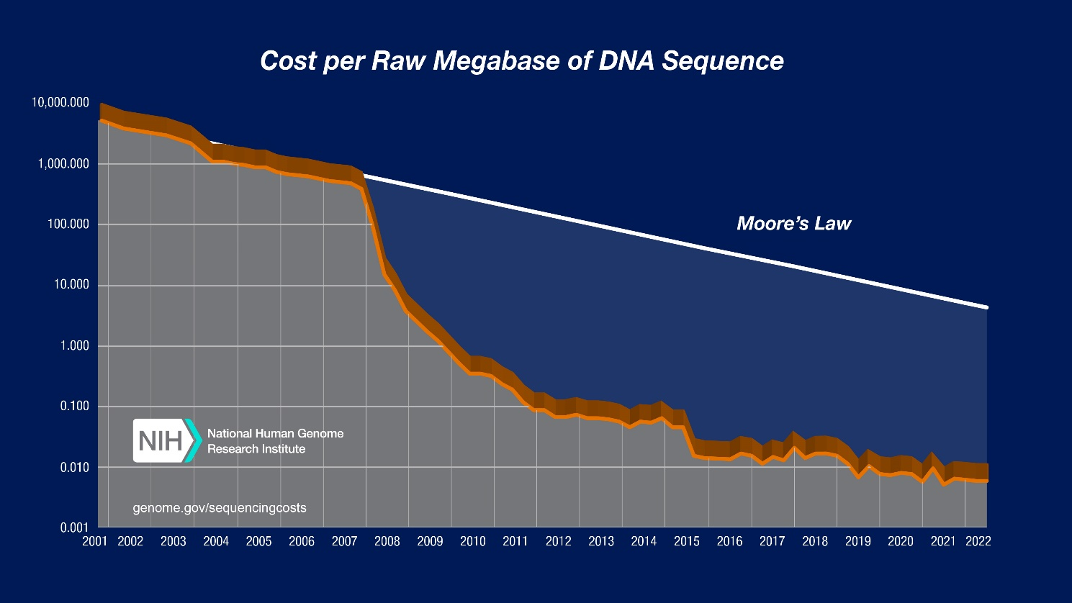
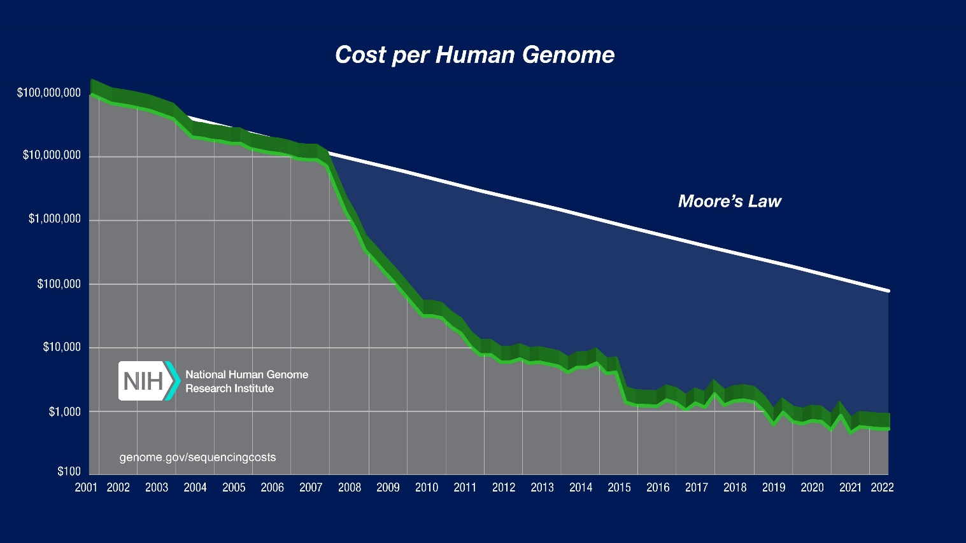
DNA Sequencing Costs: Data (genome.gov)

Slide 32
*Seq things
NGS sequencing has a wide range of use
One of many nice list give you an example of all possible applications
http://enseqlopedia.com/enseqlopedia/
Approximately (on this list) ~200 different techniques…
Another (simple) list of NGS based techniques
https://liorpachter.wordpress.com/seq/

