Slide 1
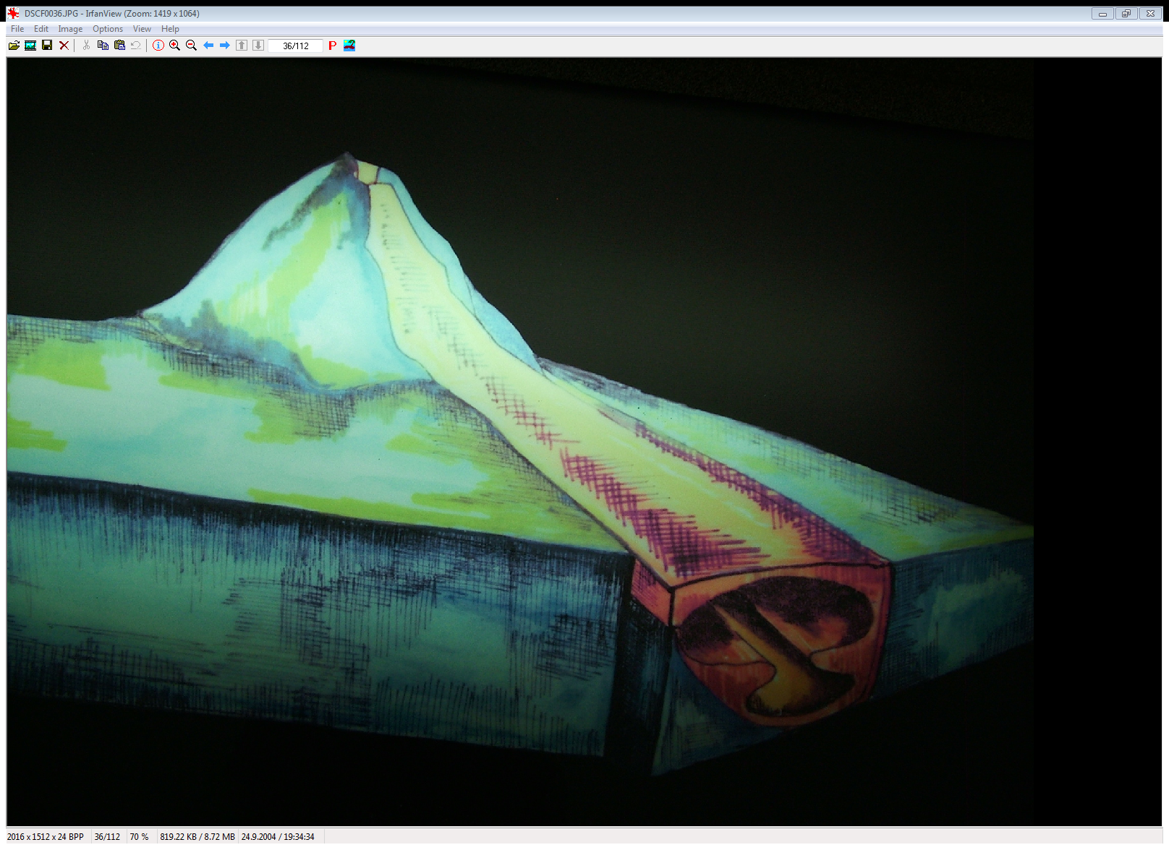
LÁVOVÉ JESKYNĚ
(PYRODUCTS, LAVA TUBES)

Slide 2
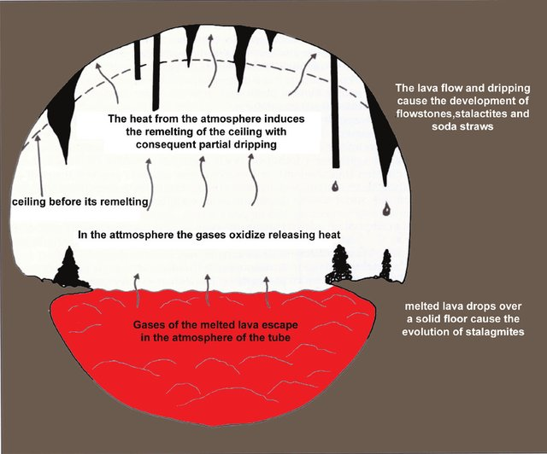
Basalt is erupted at temperatures between 1100 to 1250 ° C. Volcanic rock (or lava) that characteristically is dark in color (gray to black), contains 45 to 53 percent silica, and is rich in iron and magnesium. Basaltic lavas are more fluid than andesites or dacites, which contain more silica.
(Obr. Bogdan Onac)

Slide 3
TYPY LÁVOVÝCH JESKYNÍ (podle Kempe et al. 2017)
Tunely vzniklé podpovrchovým prouděním lávy a následnou erozí směrem dolů
Jeskyně vytvořené splynutím menších chodeb a následující erozí
Jeskyně vytvořené „zastřešením“ lávy plovoucími litoklasty, které se ve žhavém stavu spekly
Kanály, které se překryly krustou akrečně narůstající z boků až do úplného uzavření

Slide 4
GENEZE LÁVOVÝCH JESKYNÍ (Stephan Kempe, 2017)

Slide 5
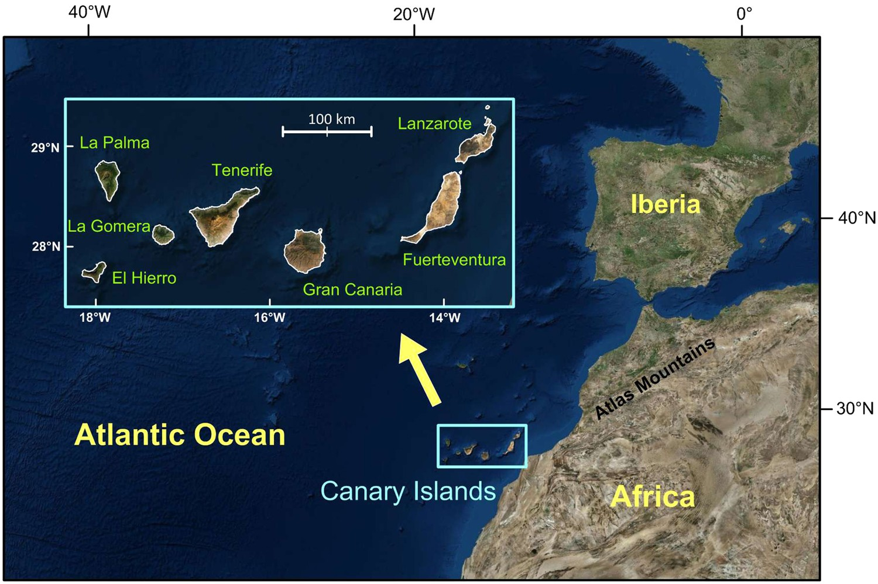
Lávové jeskyně lanzarote

Slide 6
SOPKA CORONA VPRAVO NAHOŘE

Slide 7
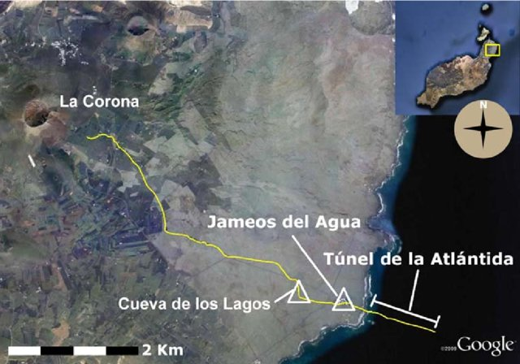
Fig. 2 Schematic cross-section of the anchialine portions of the Corona lava tube. a Cueva de Los Lagos. b Jameos del Agua lagoon ( dotted transversal lines reproccupied by the tourist complex). c Position esent the approximated area of the carpet of diatoms in the lagoon. d Túnel de la Atlántida. e Lago Escondido. f Dome room. g Montaña
This figure was uploaded by Thomas M Iliffe

Slide 8
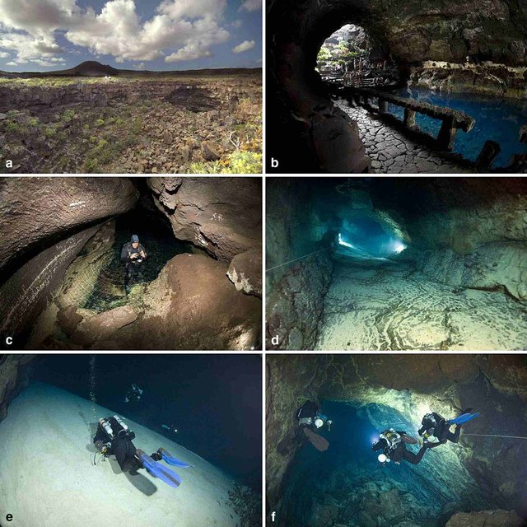

Slide 9
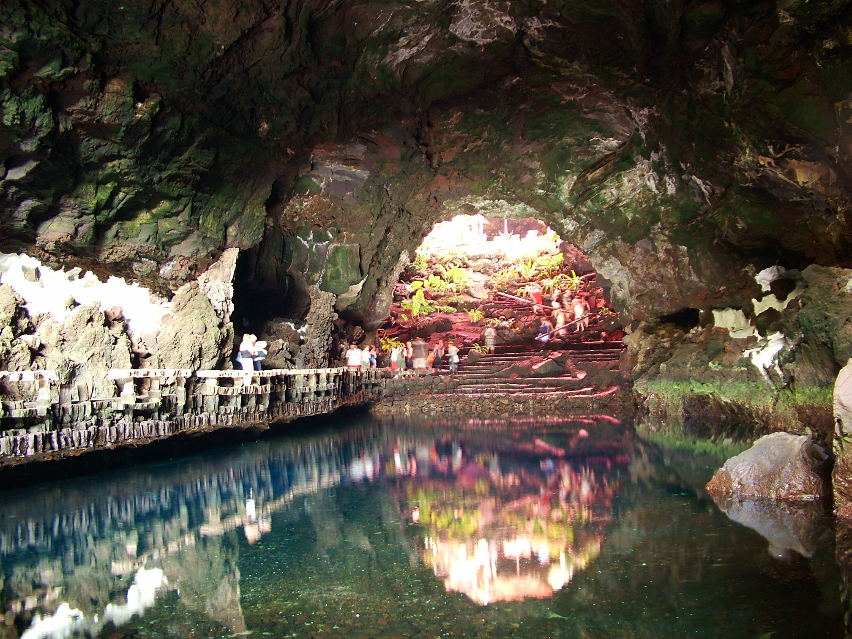
LOS JAMEOS DEL AGUA

Slide 10
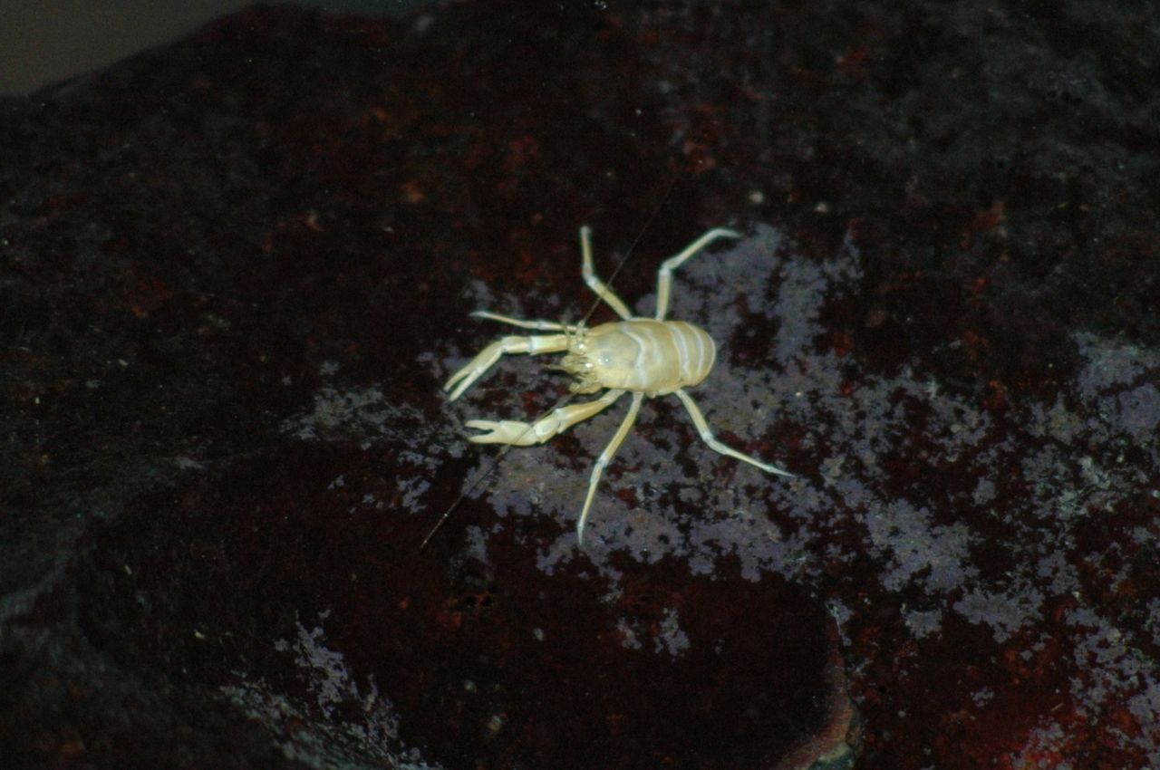
ENDEMIT - slepý krab (Munidopsis polymorpha).

Slide 11
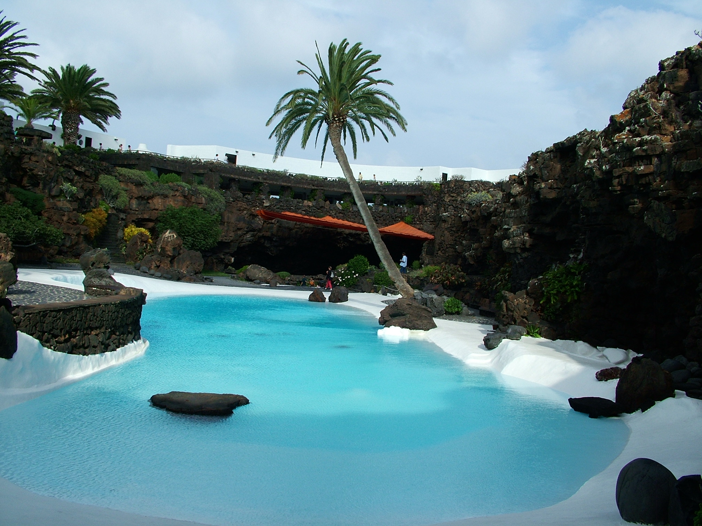
Manrique Cesar, dotvoření přírody

Slide 12
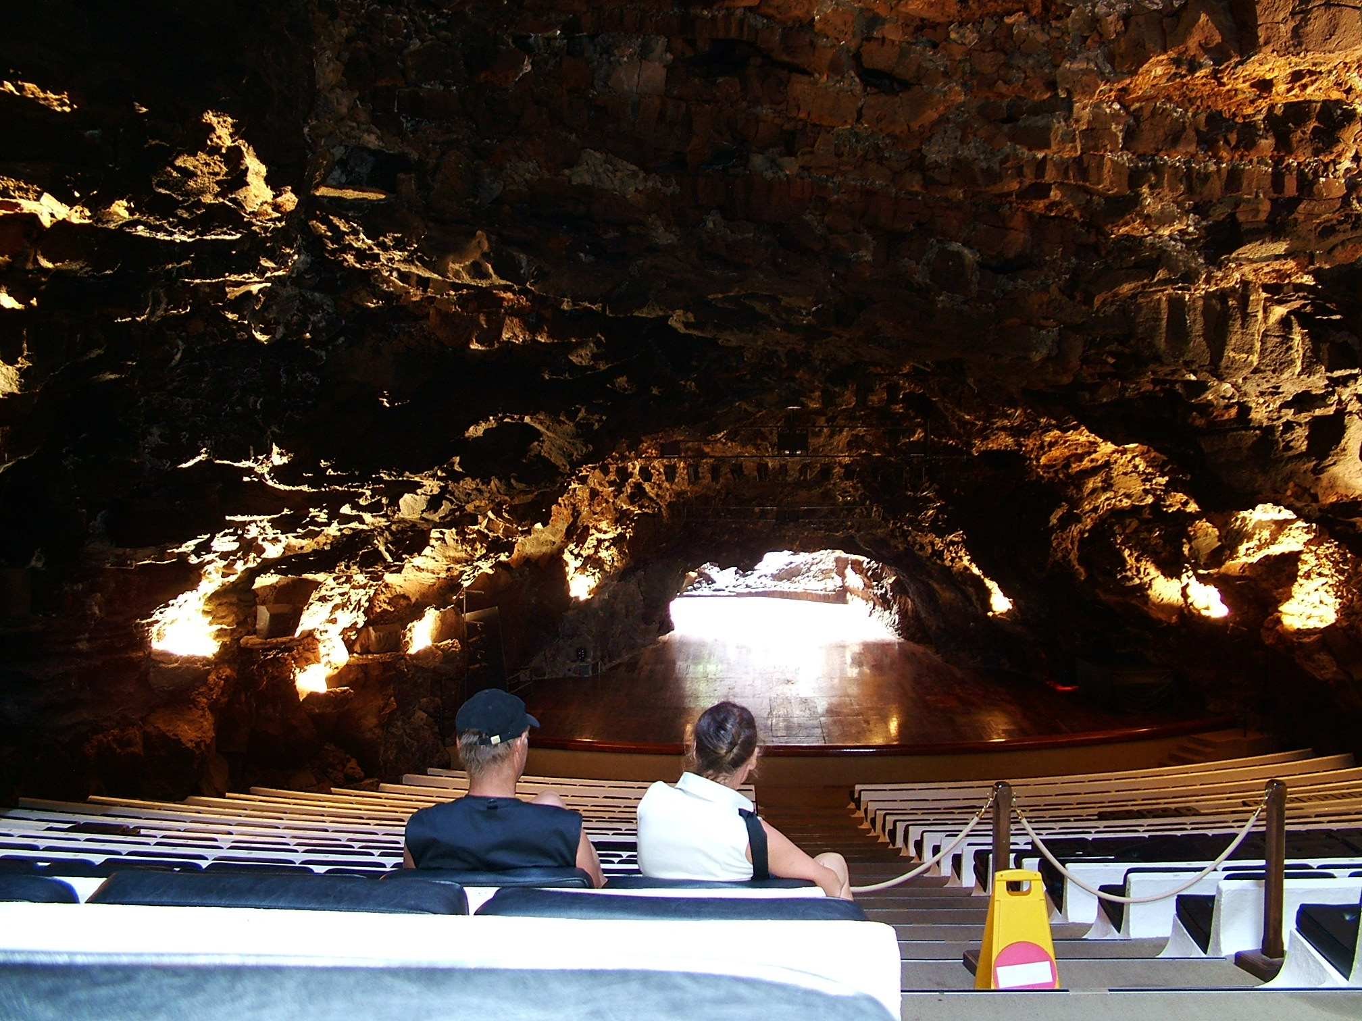
Koncertní sál

Slide 13
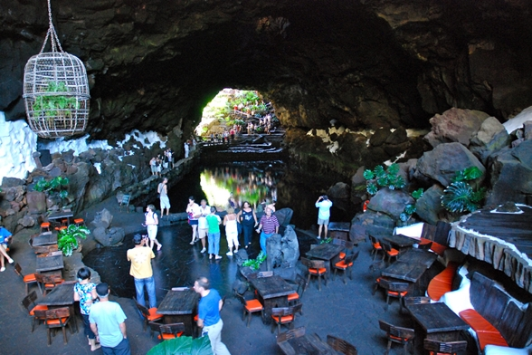
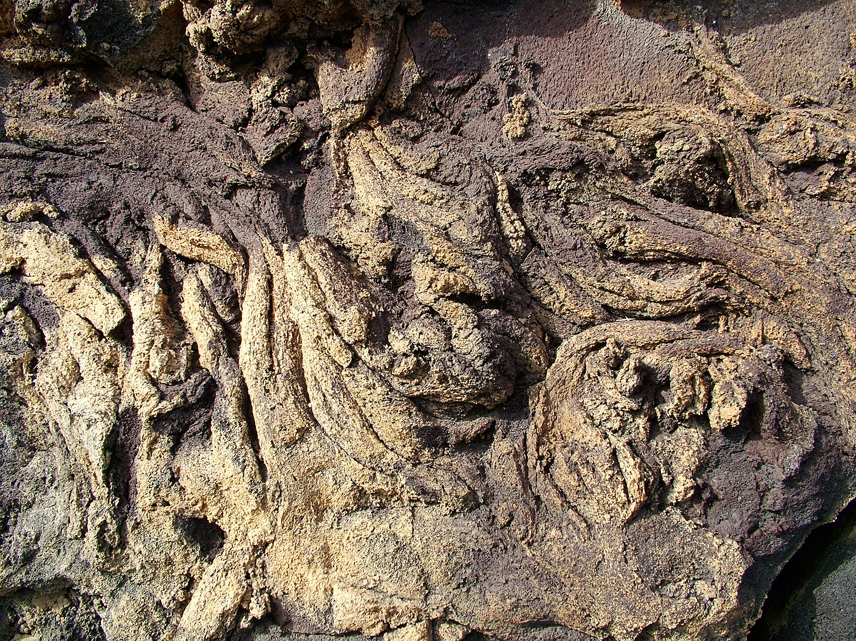
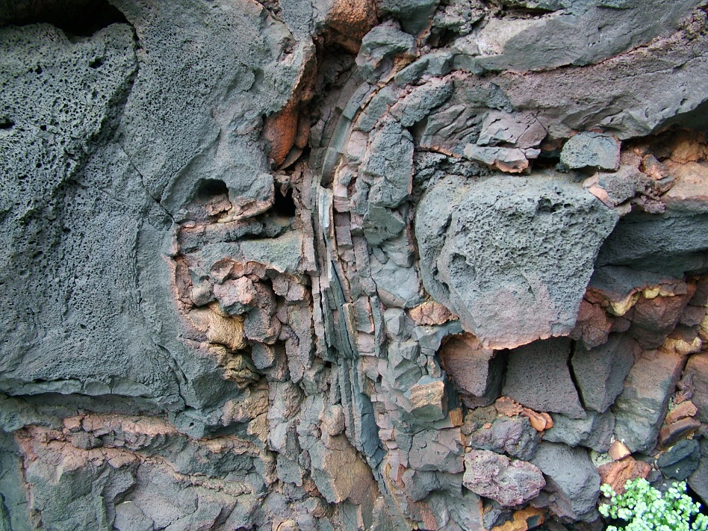
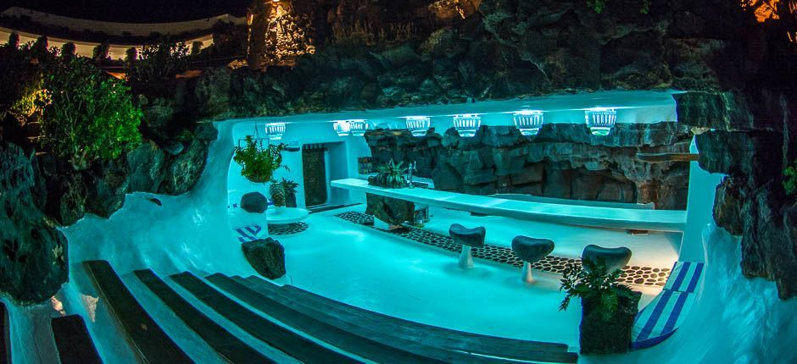

Slide 14
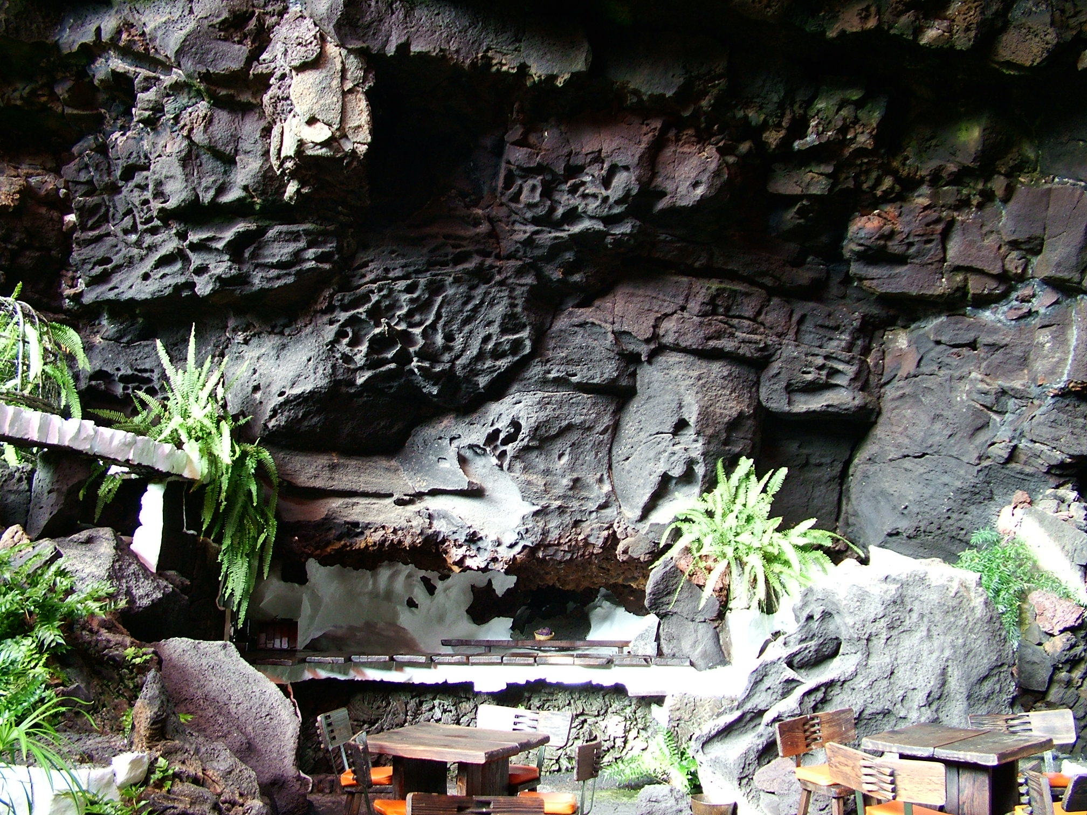

Slide 15
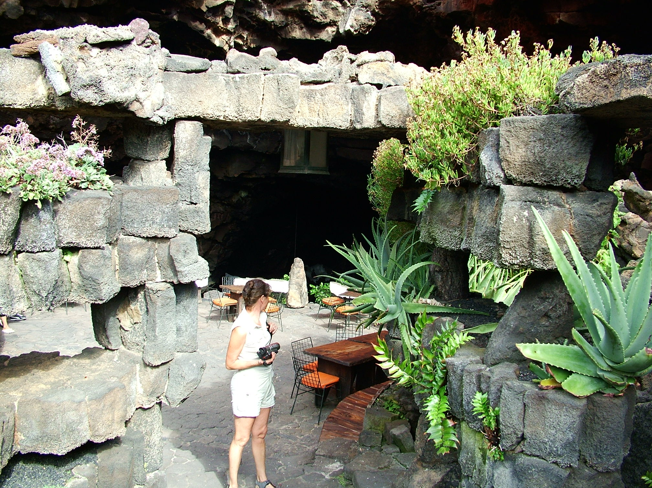

Slide 16
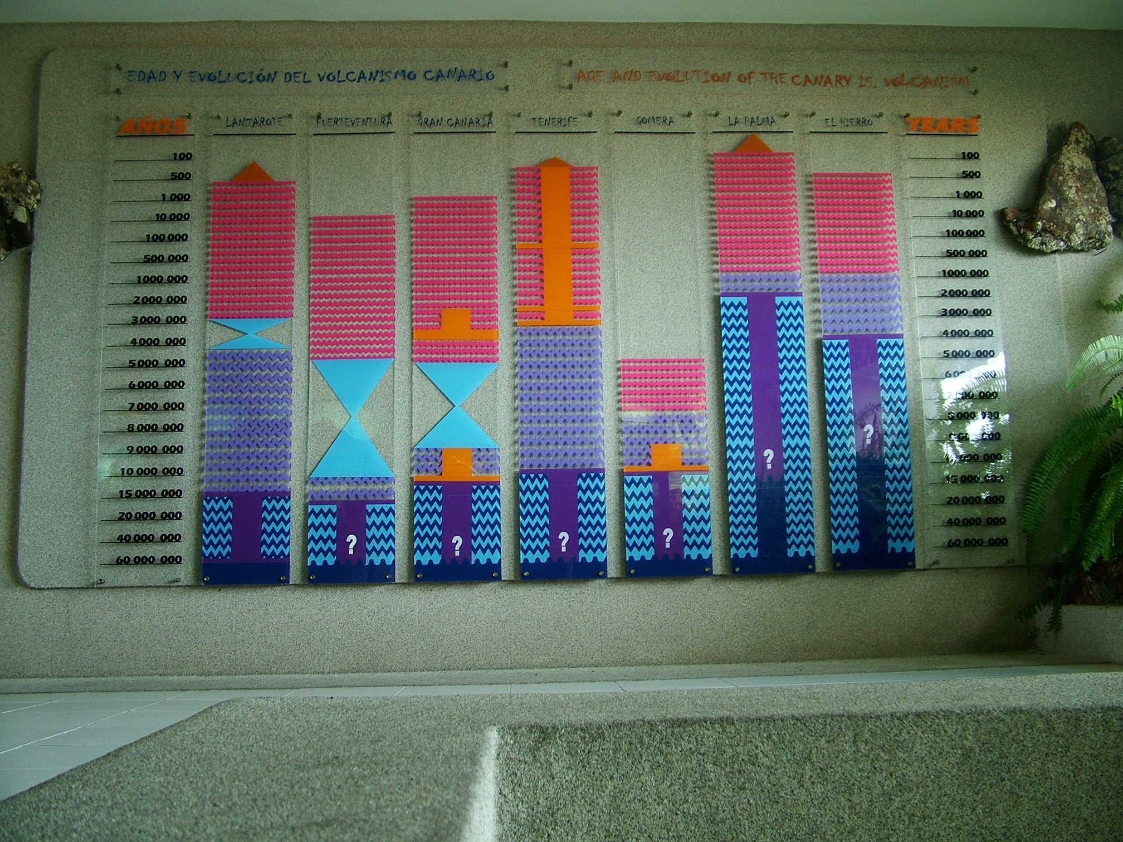
Muzeum vulkanizmu

Slide 17
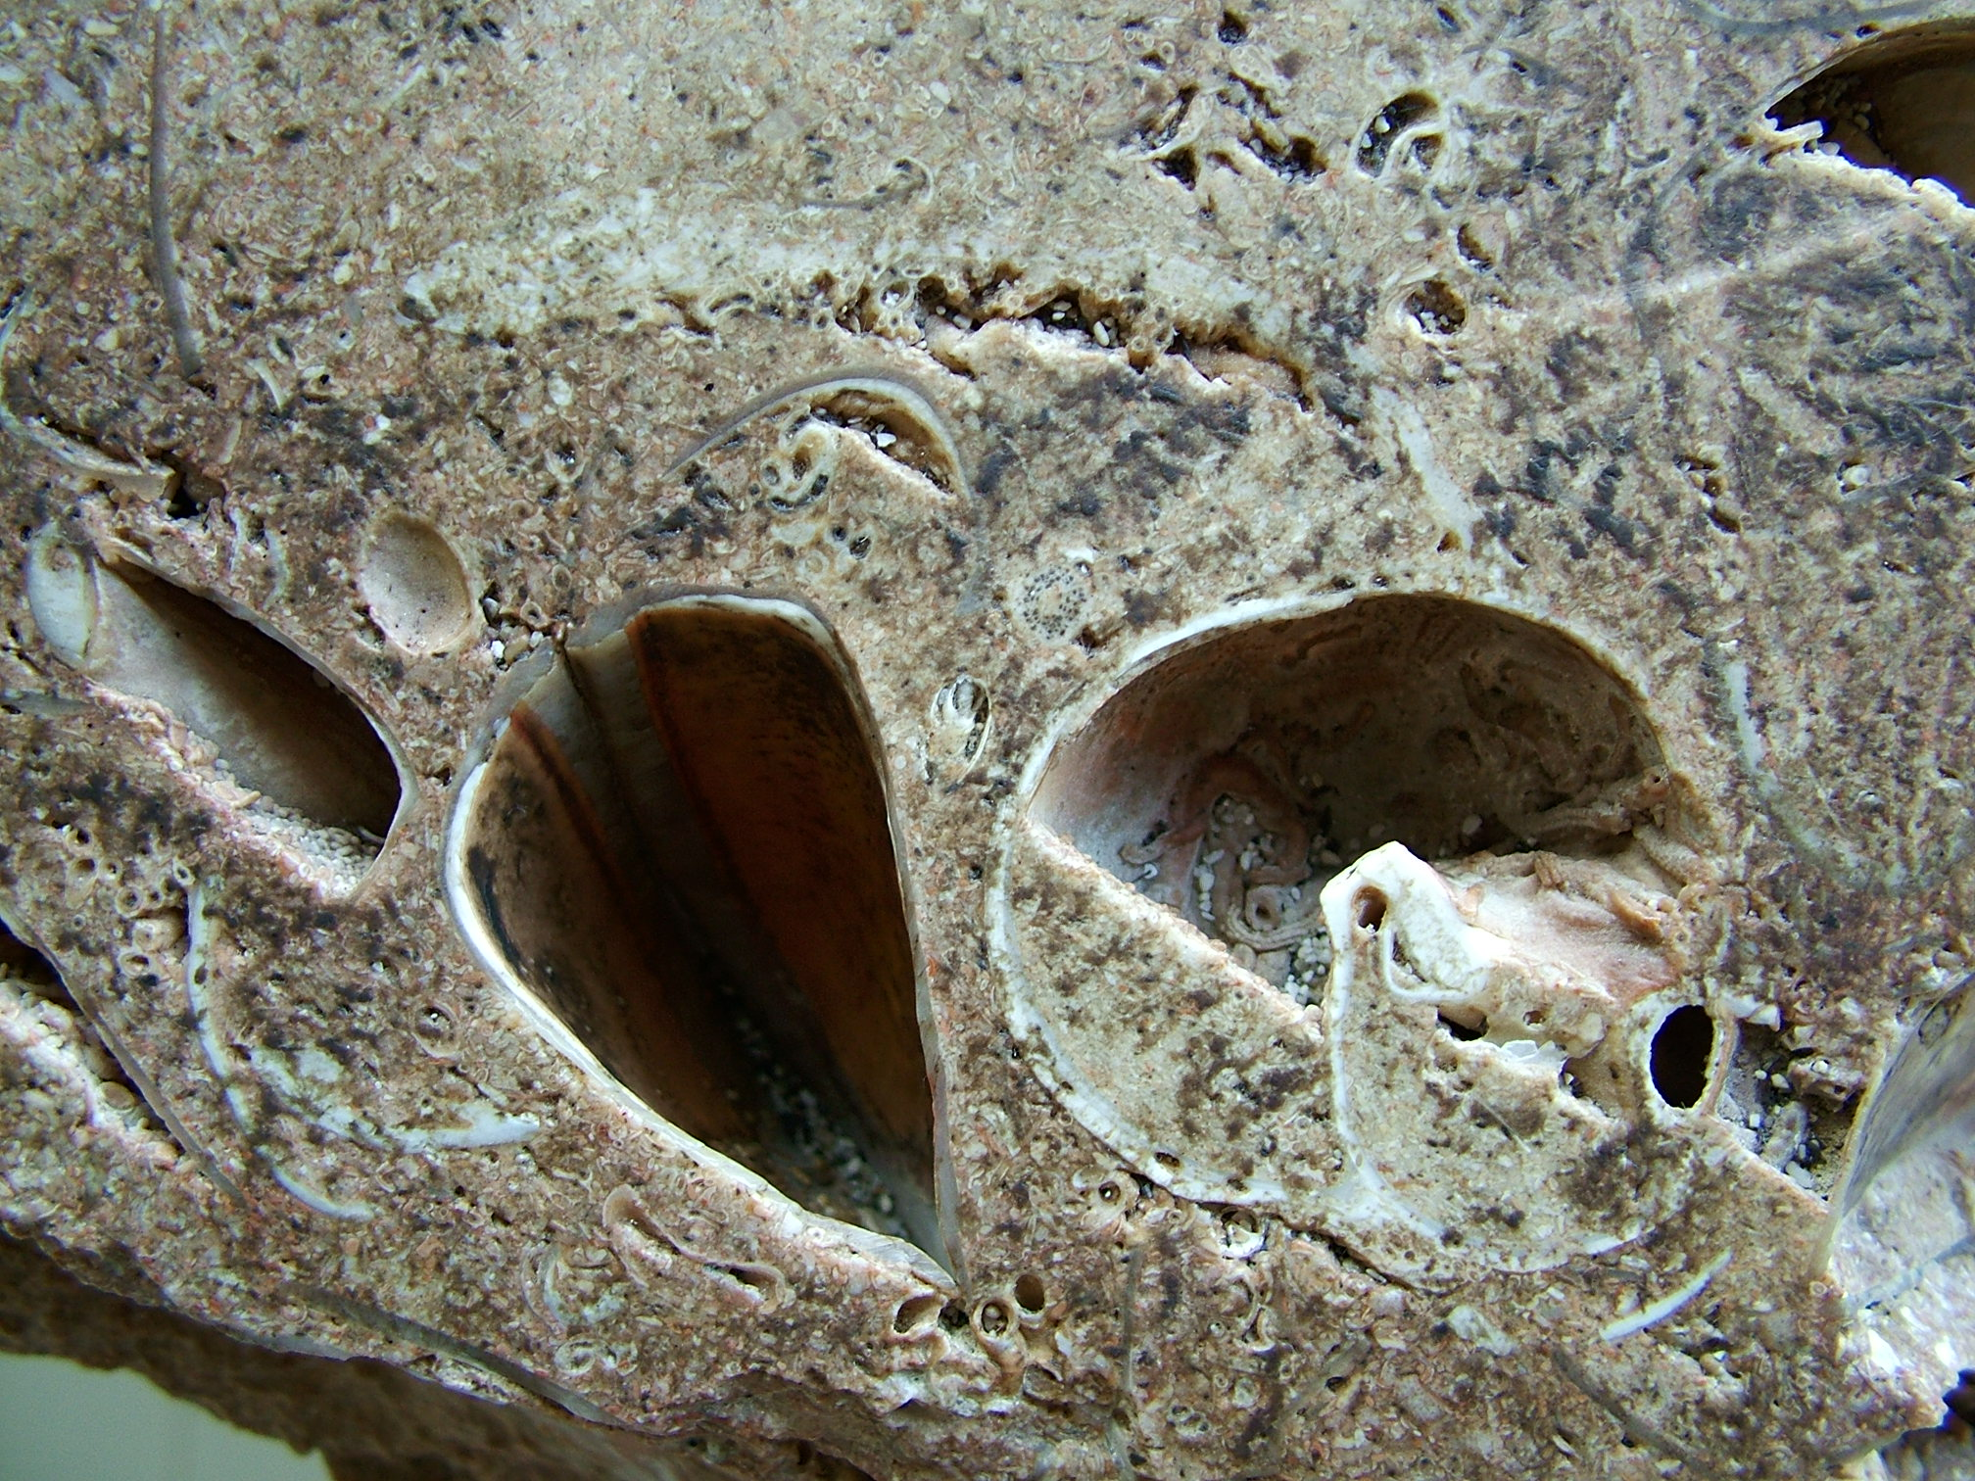

Slide 18
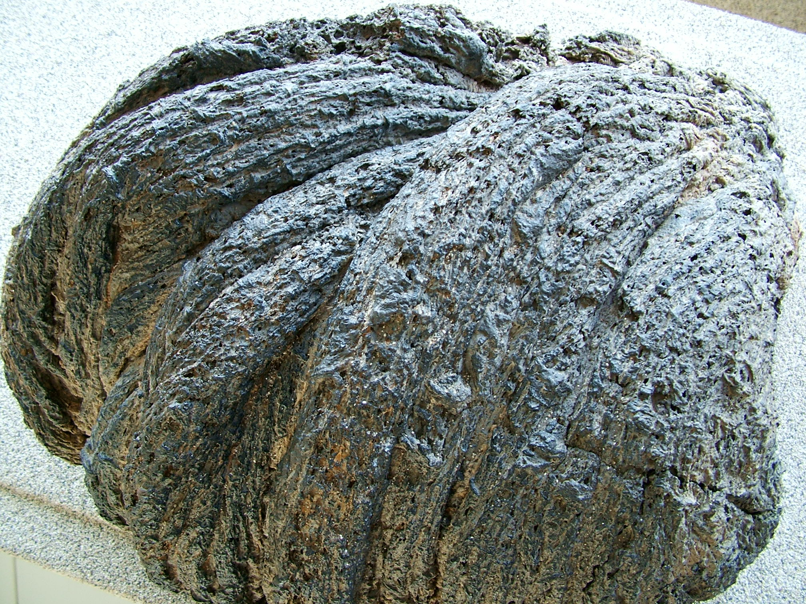

Slide 19
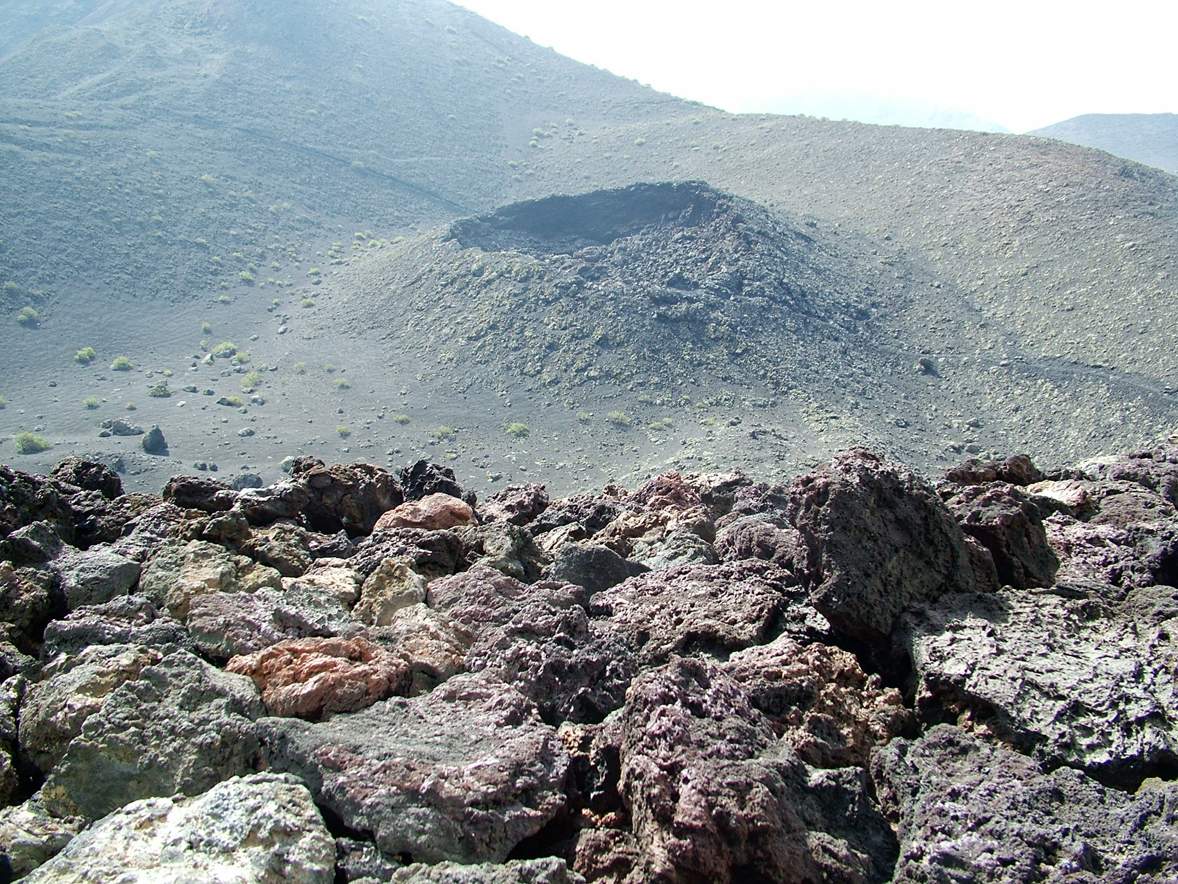
Národní park
Timanfaya

Slide 20
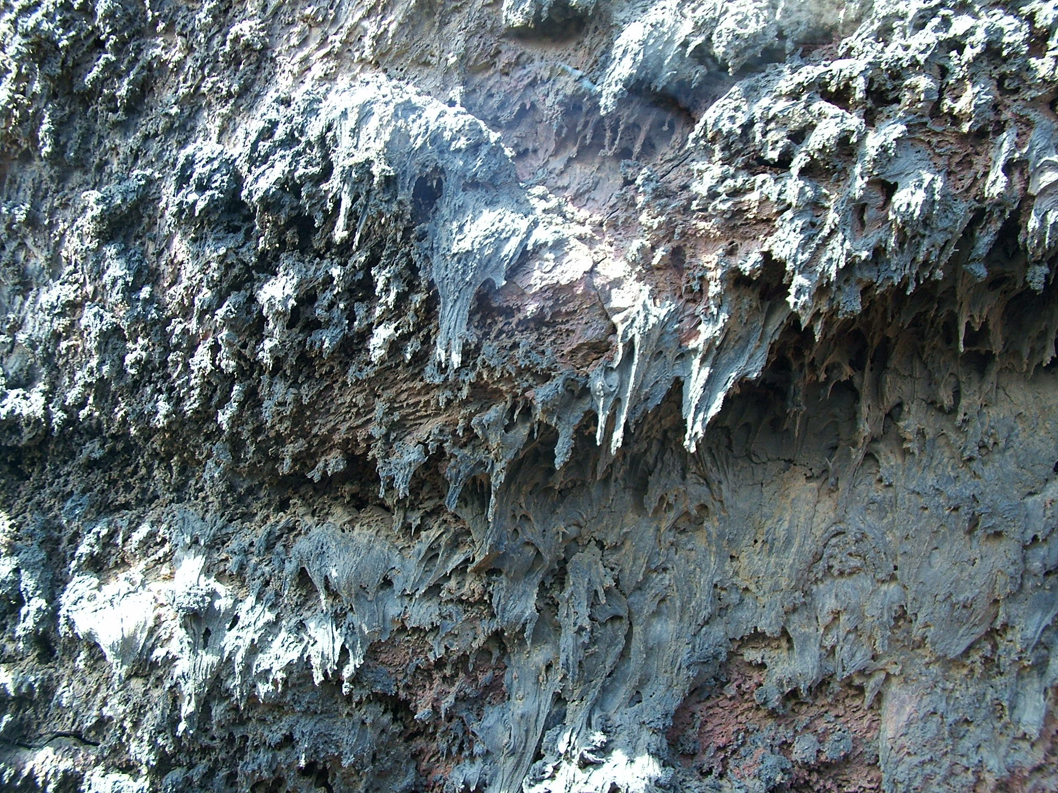
Stalaktity z bazaltové lávy

Slide 21
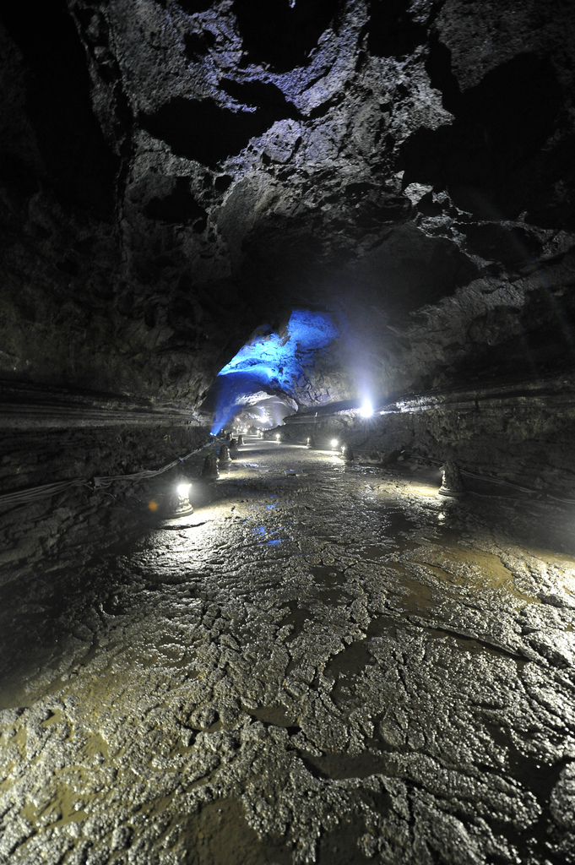
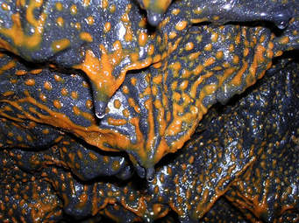
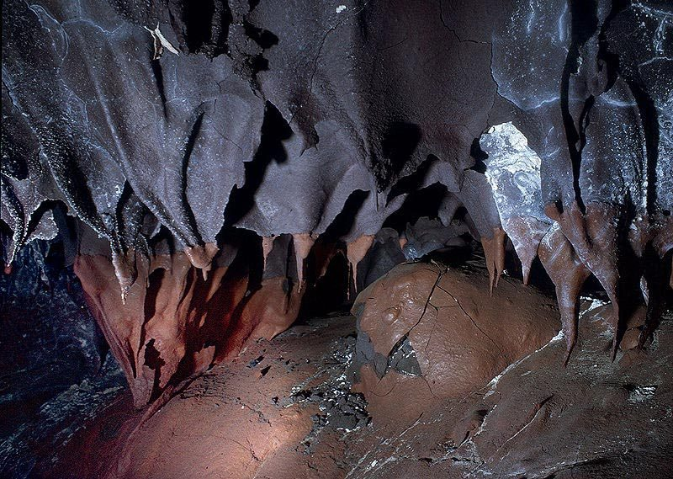

Slide 22
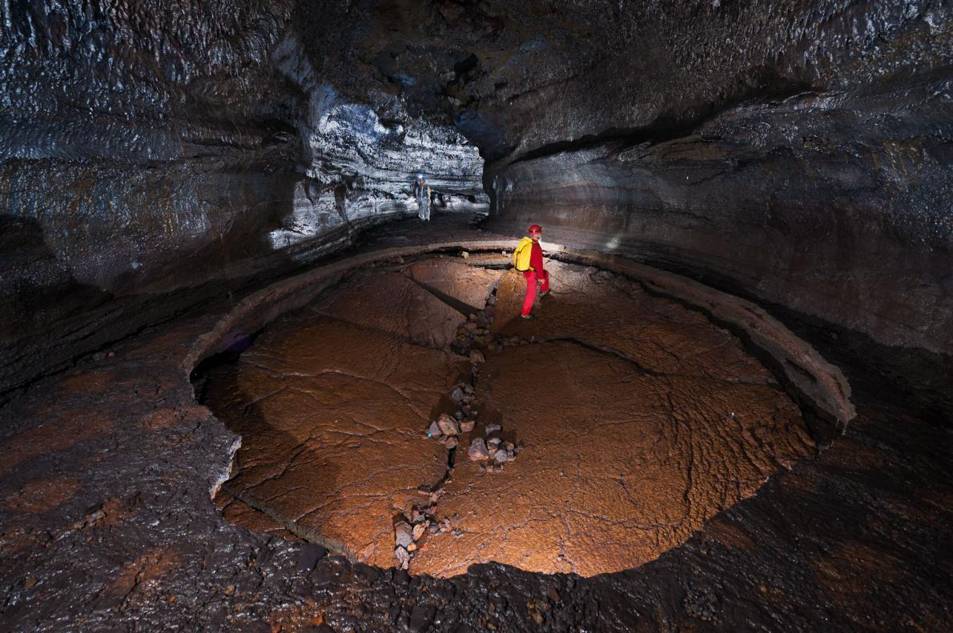
Lávové tunely ve více úrovních

Slide 23
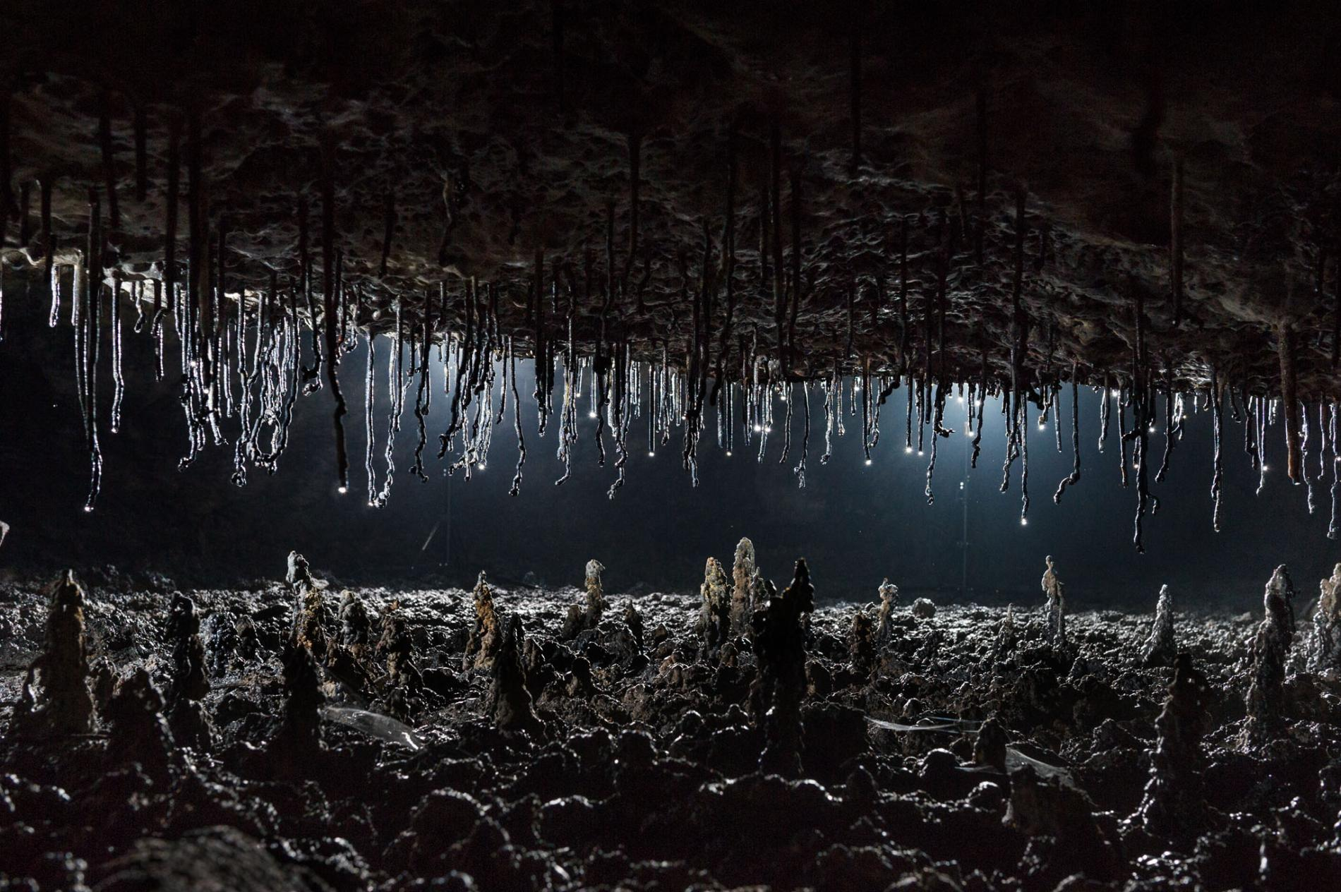
Lavaycles – lávové krápníky

Slide 24
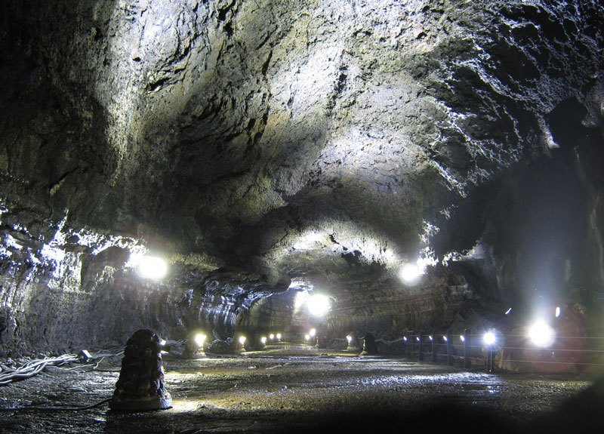
Manjanguul Lava Tube, Jižní Korea, ostrov Jeju

Slide 25
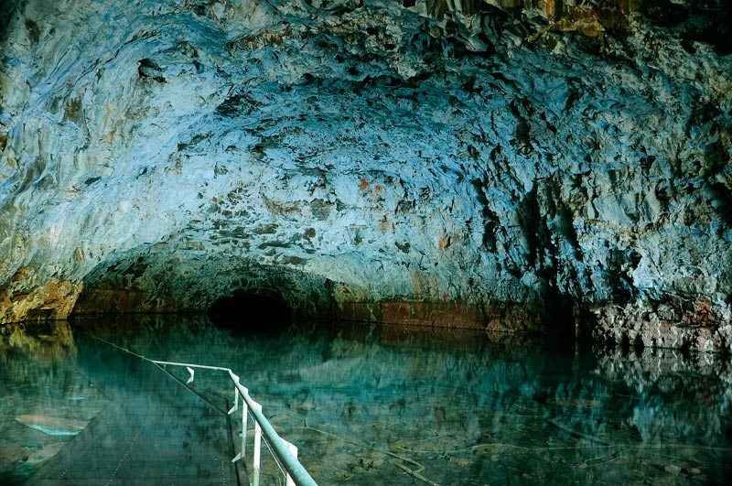
Undara, Queensland, Austrálie

Slide 26
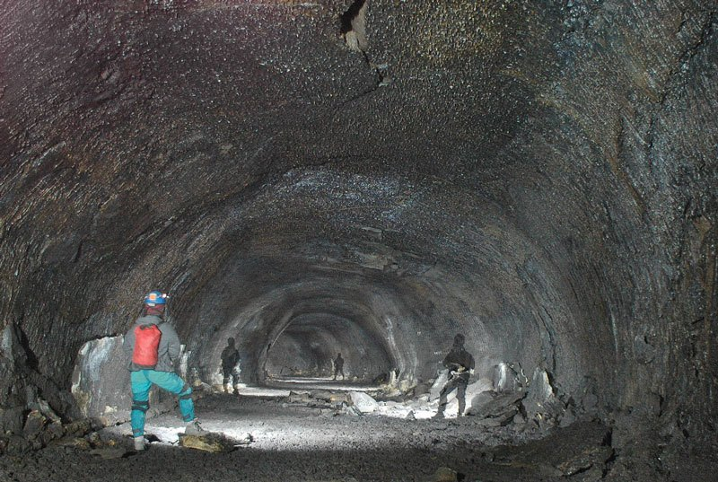
Kalifornie, USA

Slide 27
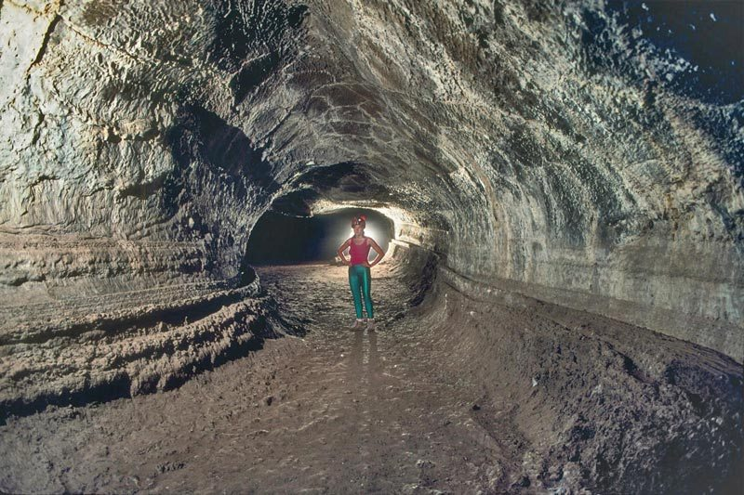
Valentine Cave, California

Slide 28
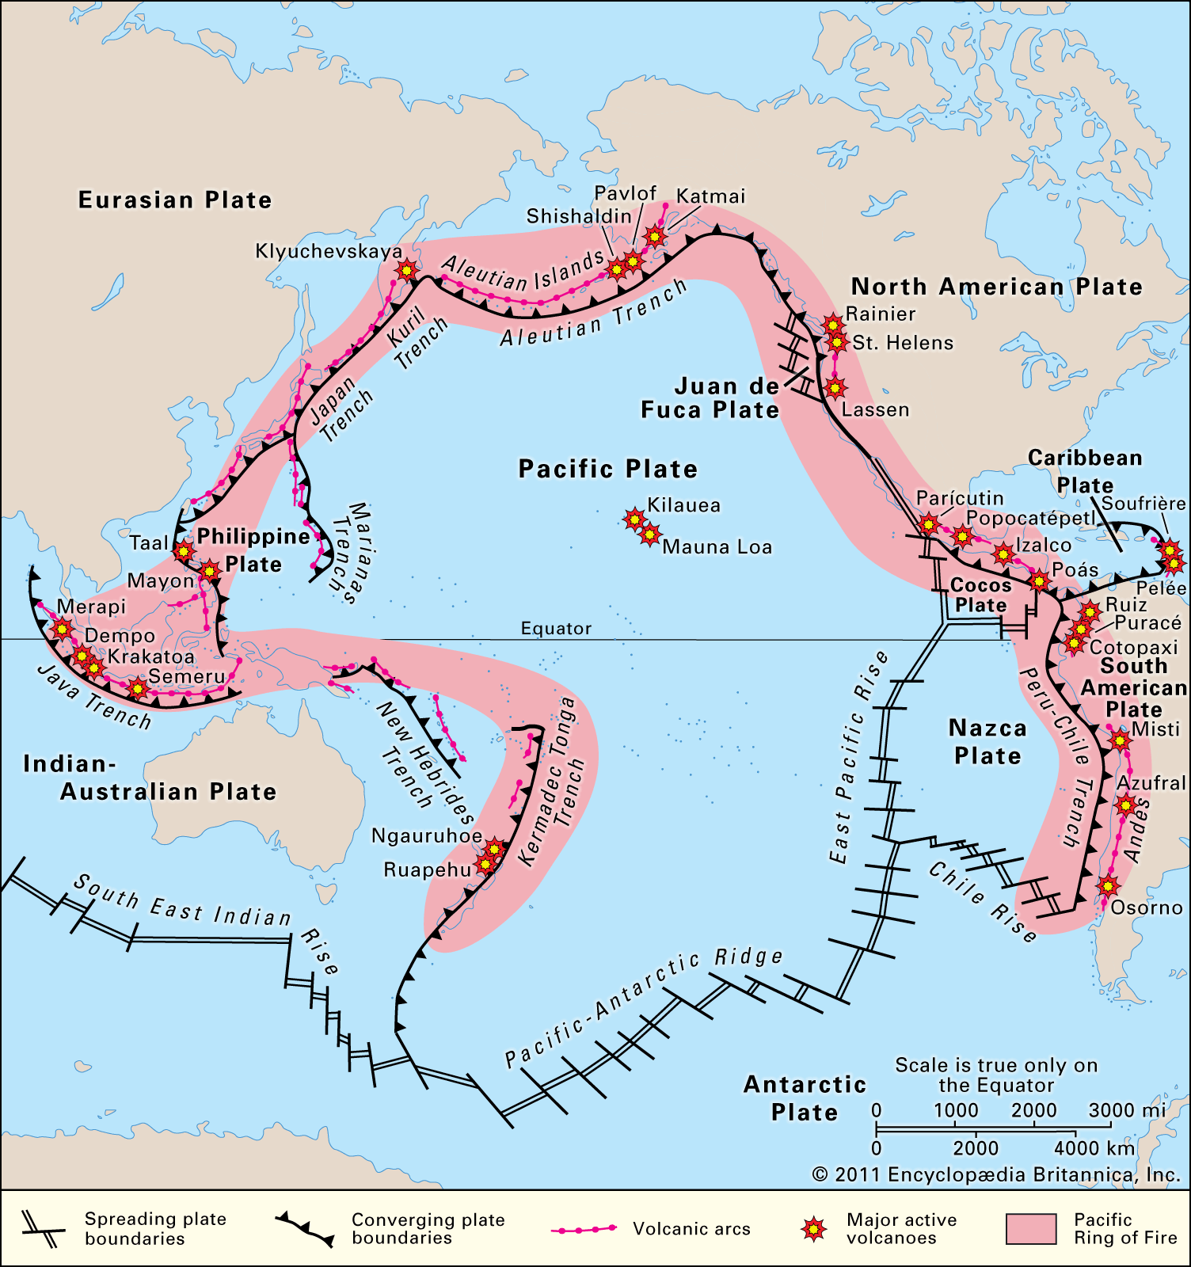

Slide 29
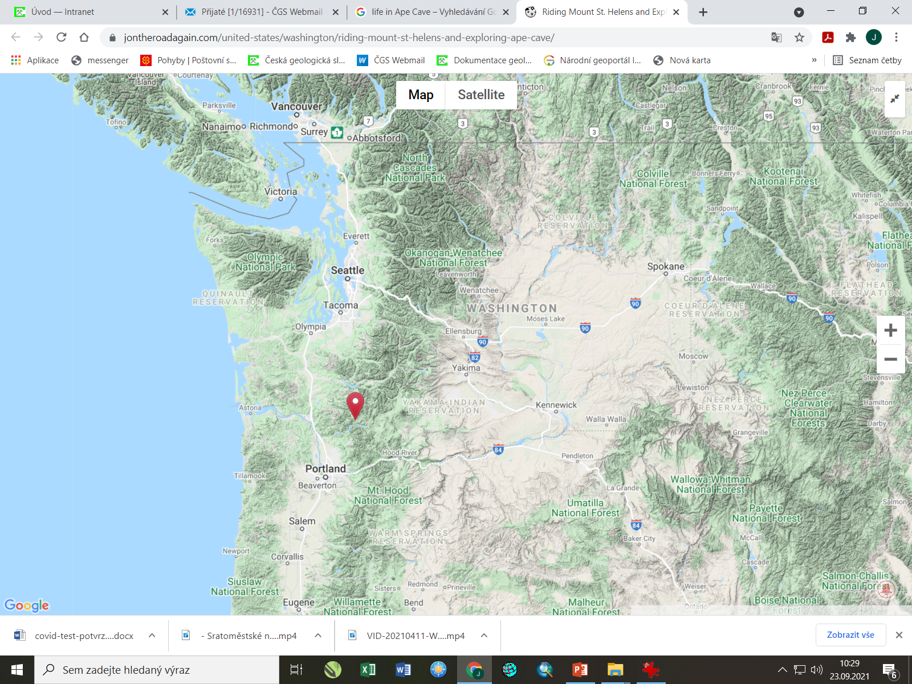

Slide 30
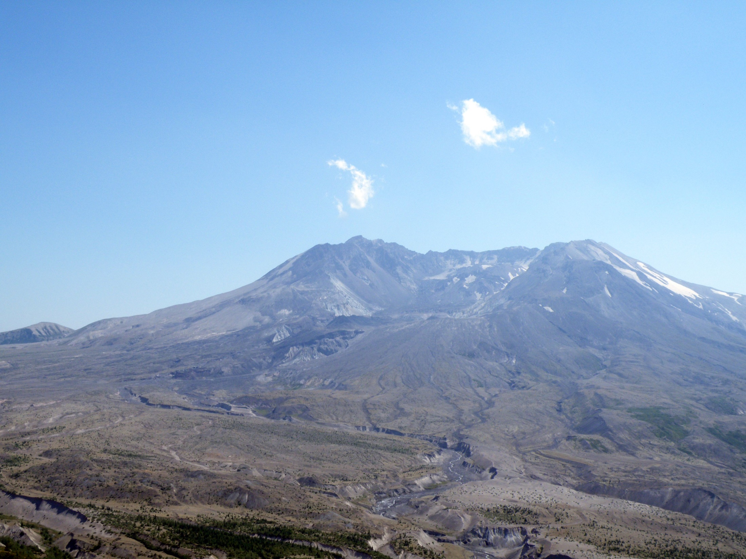
MT. St. Helens, dacitová láva

Slide 31
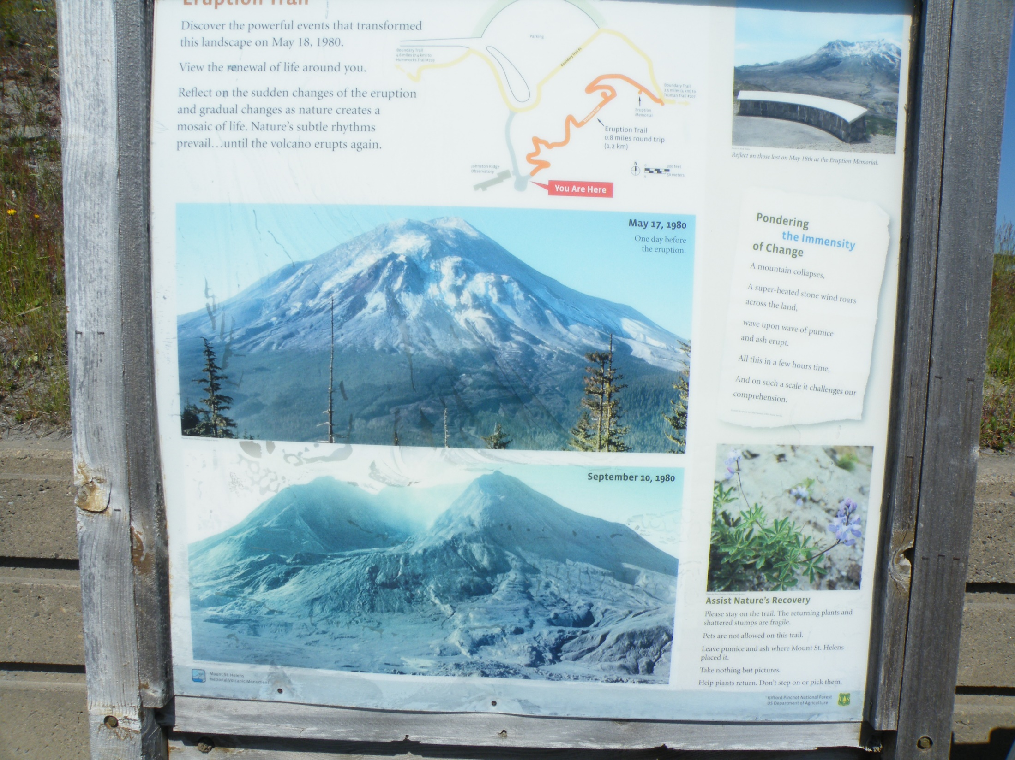

Slide 32
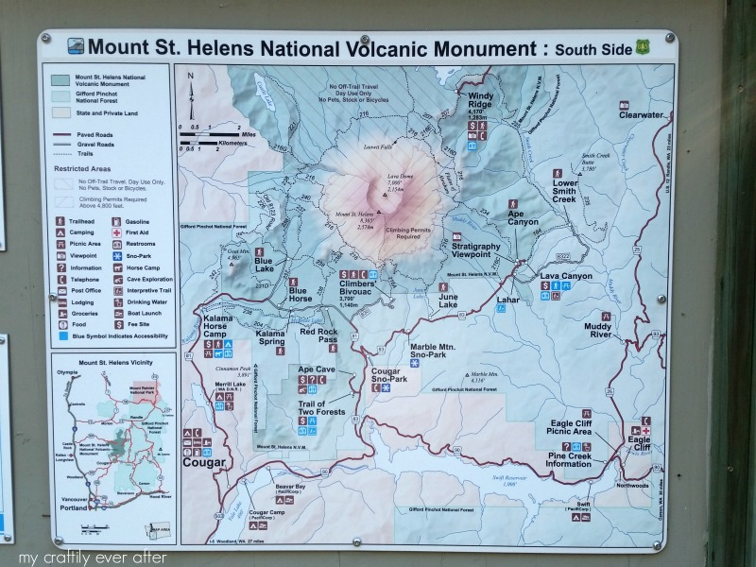
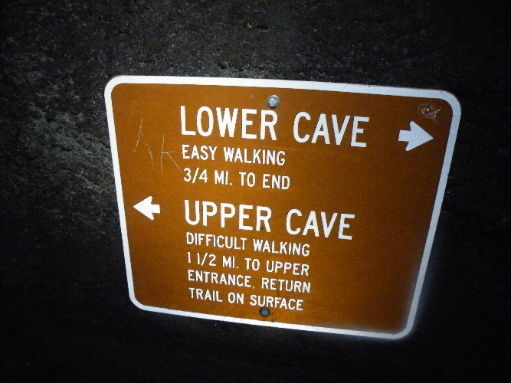
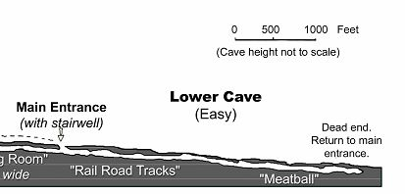

Slide 33
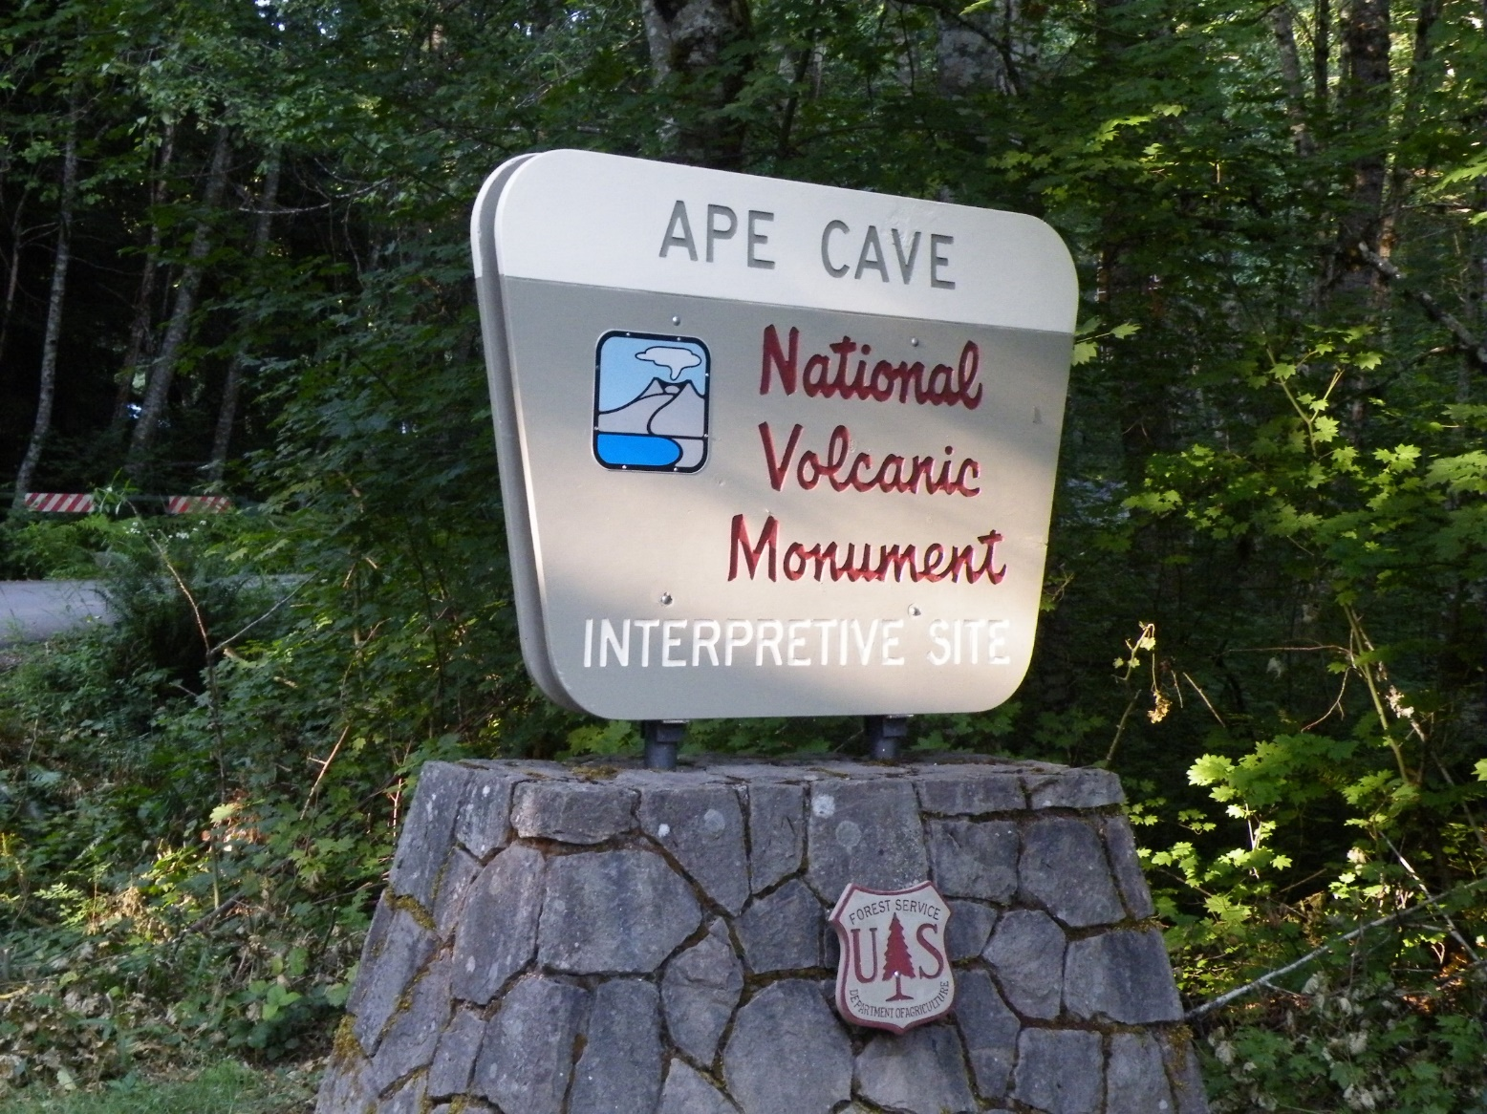
The Third Longest Lava Tube
In North America

Slide 34
Ape Cave was discovered in 1947 by a logger named Lawrence Johnson. However, the cave was not explored until the early 1950's when a scout troop, led by Harry Reese, lowered a team of scouts down a 17-foot overhang to the cave floor. Leaving footprints where no one ever had, these explorers were able to travel through a pristine lava tube full of fragile formations. Ape Cave was named by the Scout Troop in honor of their sponsor, the St. Helens Apes. This local group was made up primarily of foresters. The sponsor’s name, St. Helens Apes, may have come from an old term used for foresters in the area, "brush apes," or from the legend of Bigfoot.
About 2,000 years ago, fluid basaltic lava poured down the southern flank of the volcano. As the lava flowed, chunks of the lava’s surface cooled, crashed and fused together creating a hardened crust. In turn, the crust insulated the molten lava beneath, allowing it to remain fluid and travel down to the Lewis River Valley.
The hot flowing lava began melting into the pre-existing rock and soil. This thermal erosion deepened and widened the channel of the flow. The level of lava in the tube rose and fell as the eruption surged and slowed, contributing to the unique contours of the walls. During this eruptive period, hot fluid lava pulsed through the tube for months, possibly up to a year, until the eruption subsided. As a result of this rare eruption, a spectacular 13,042 foot (3976m) long lava tube, the third longest in North America, was created.

Slide 35
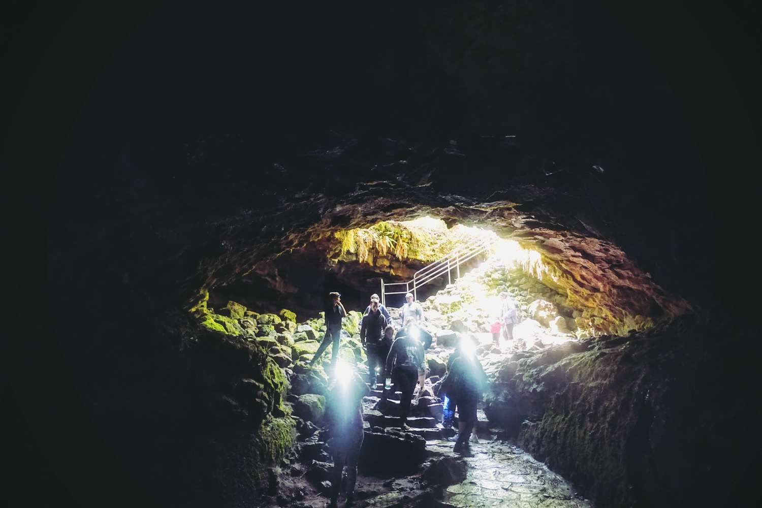

Slide 36
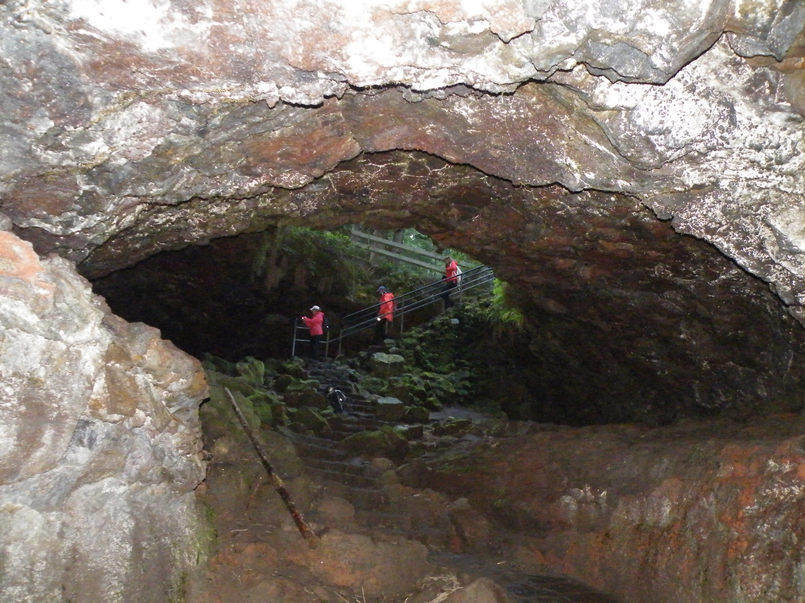

Slide 37
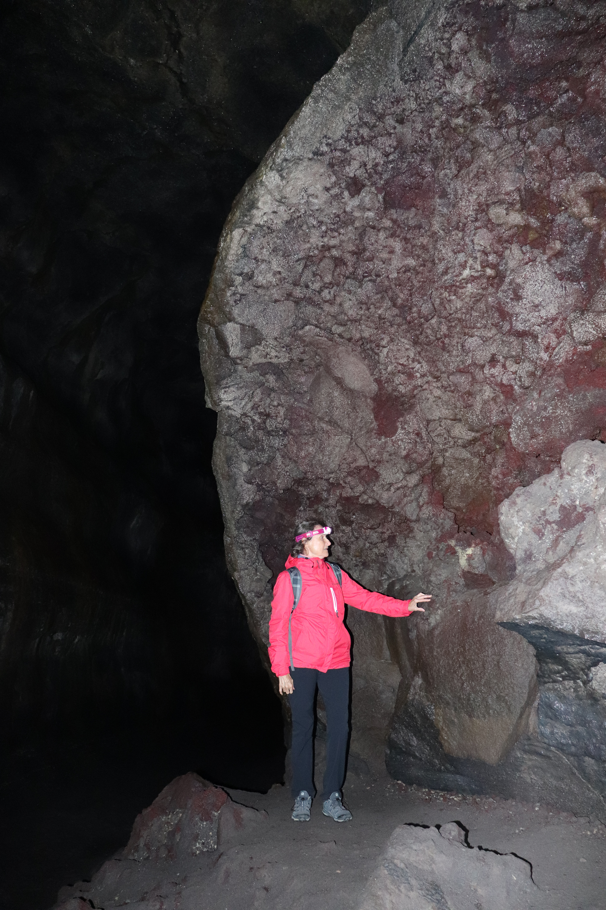
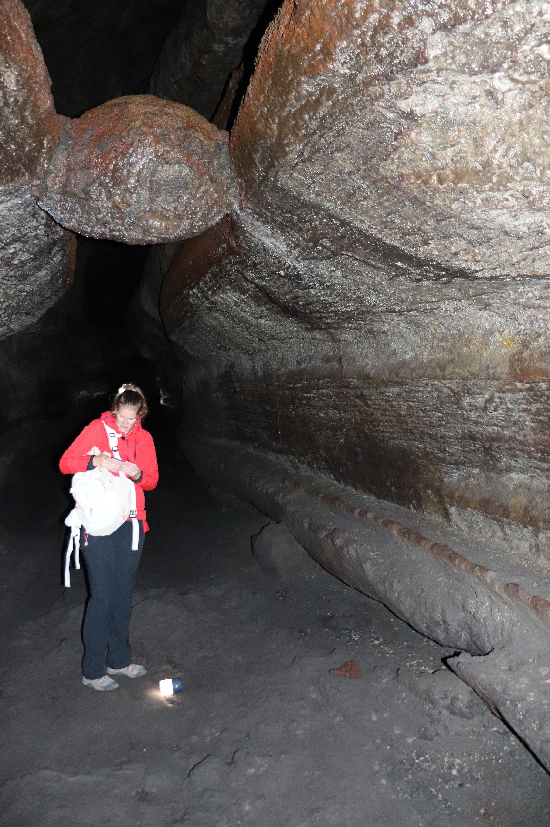
Aglomerátové tufy ve stěnách
Útvar zvaný „meatball“

Slide 38
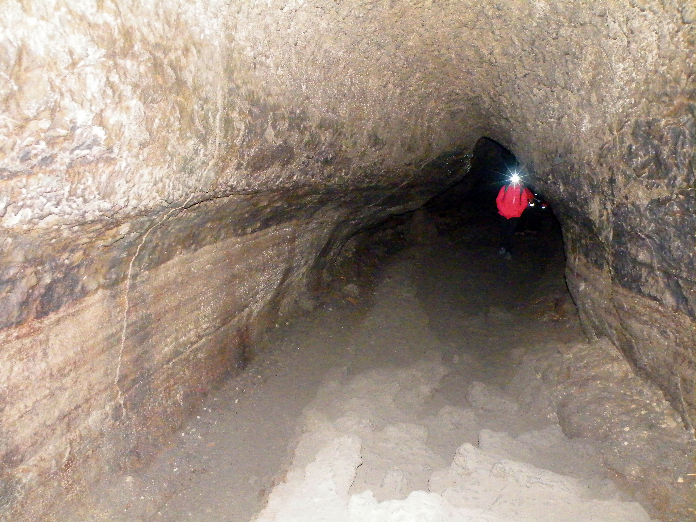
Kontury odrážející pulsování lávy

Slide 40
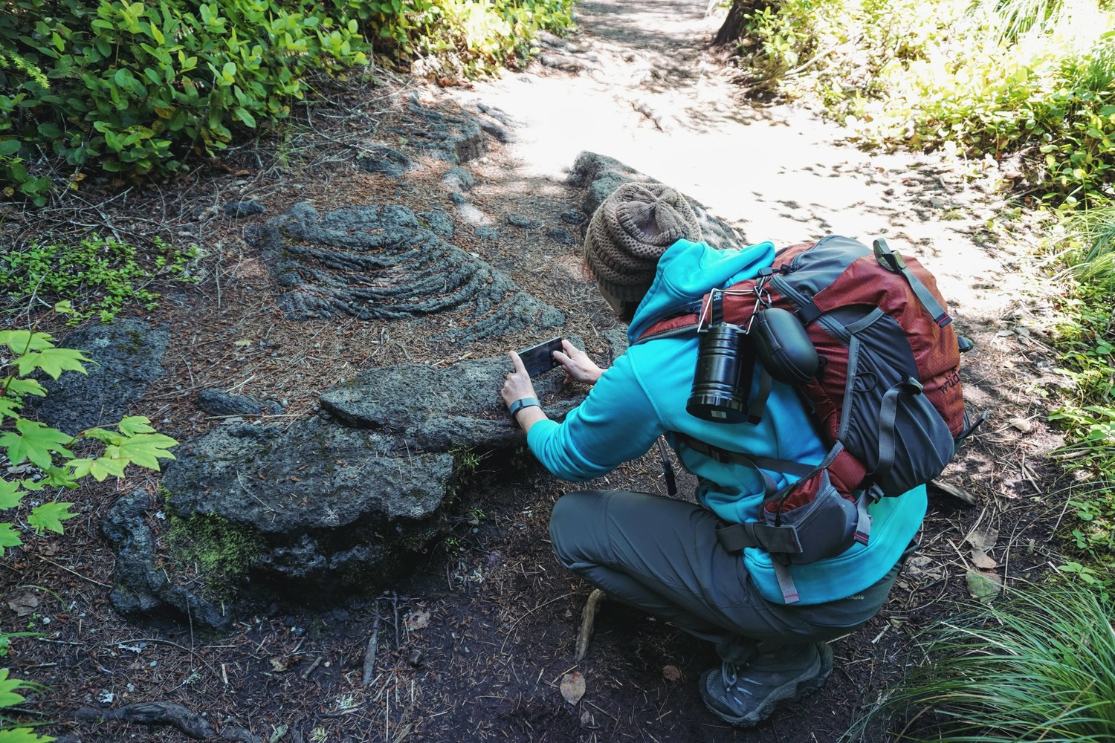

Slide 41
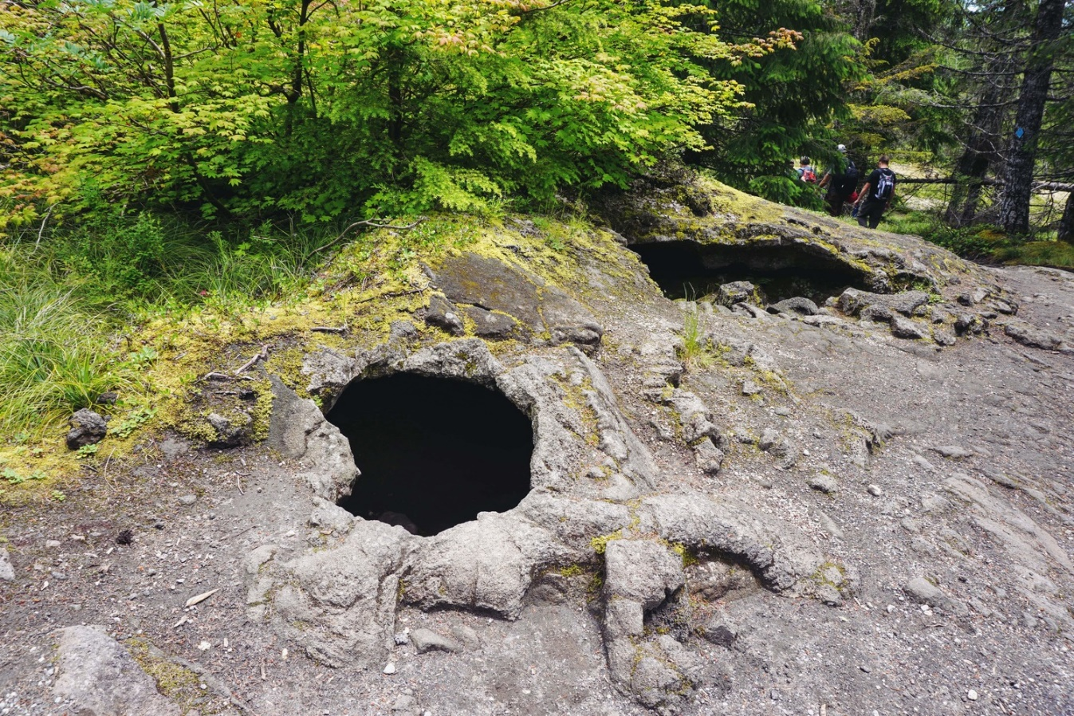
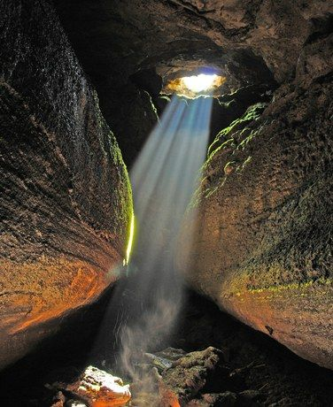

Slide 42
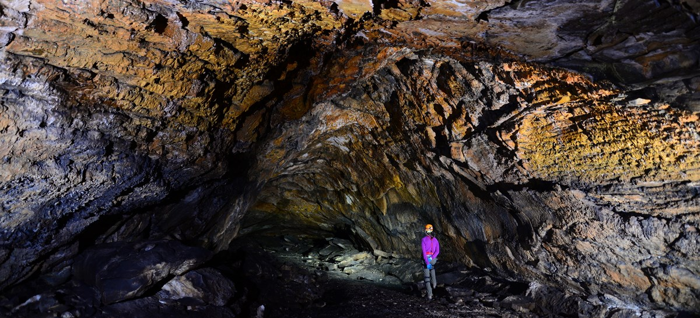
Děkuji za pozornost

