Slide 1
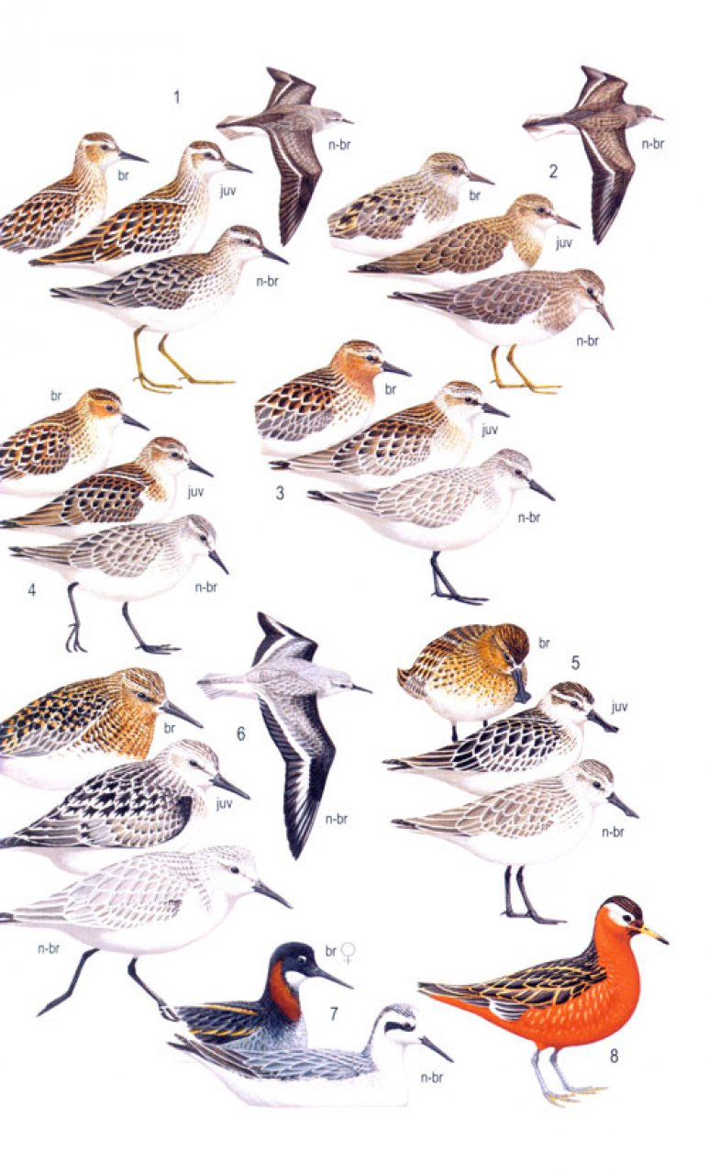


Molecular identification
Species, individual, sex

Slide 2

Identification of individuals
DNA fingerprinting
(DNA profiling)

Slide 3
Identification of individuals – why?
if we do not see the individual
non-invasive genetics – elusive animals, samples from faeces, urines, hairs – can be joined with individual variation of their diet
forensic genetics – identification of DNA in animal products, poachers, etc.
species conservation – e.g. in falconary (confirmation of parentage)

Slide 4
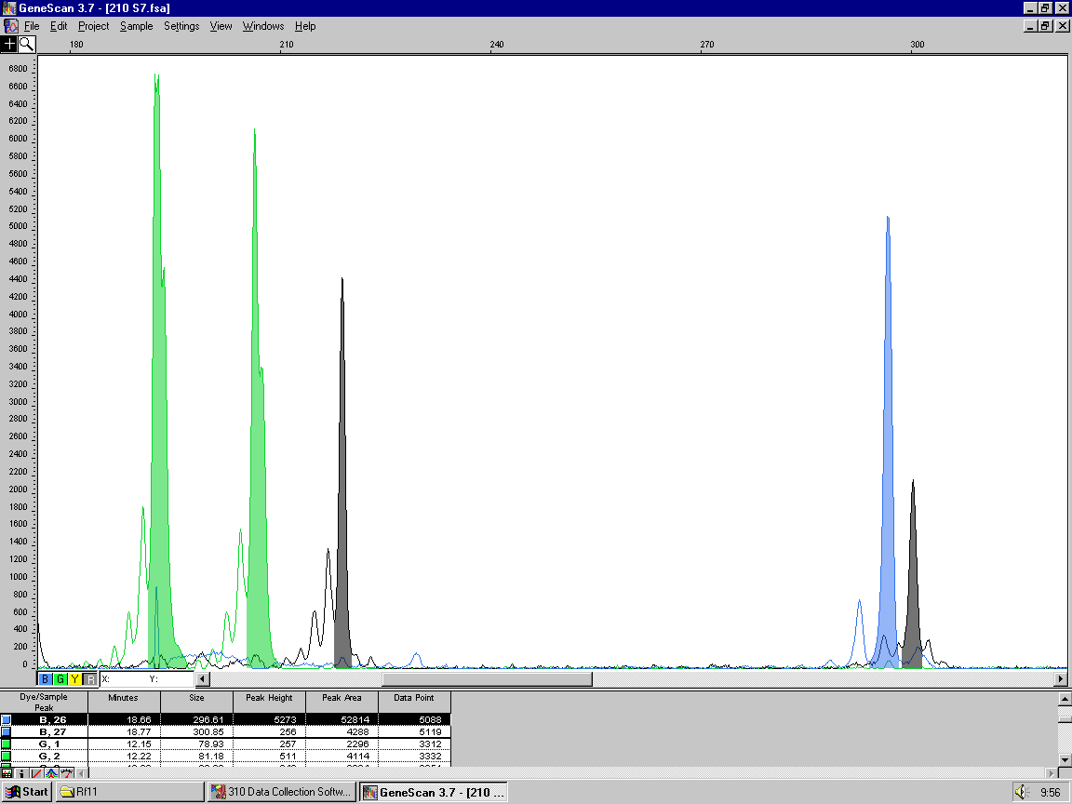
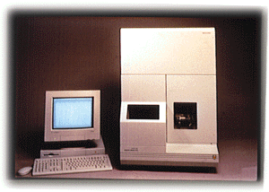
Microsatellites
Tandem repetitions of short motifs
DNA extraction
PCR
Detection of alleles
→ sequencer, fragment analysis
CTTTCTTTCTTTCTTTCTTTCTTTCTTTCTTTCTTT
CTTTCTTTCTTTCTTTC
CTTTCTTTCTTTCTTTCTTTCTTTCTTTCTTTCTTTCTTTCTTTCTTTCTTT
CTTTCTTTCTTTCTTTCTTTCTTTCTTTCTTTCTTT
capillary
detector
laser

Slide 5
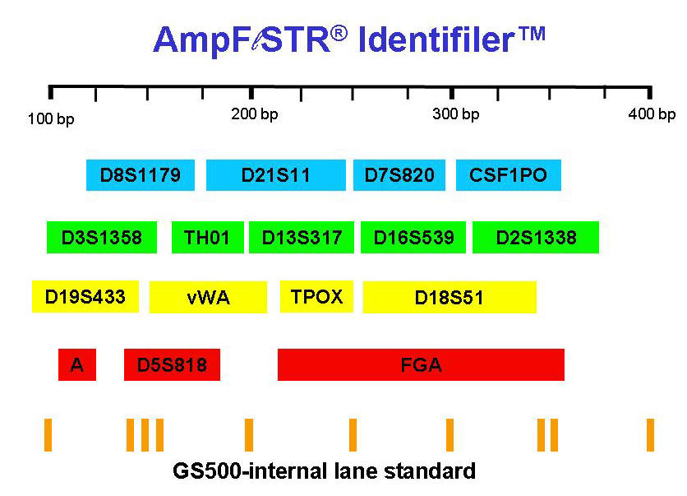
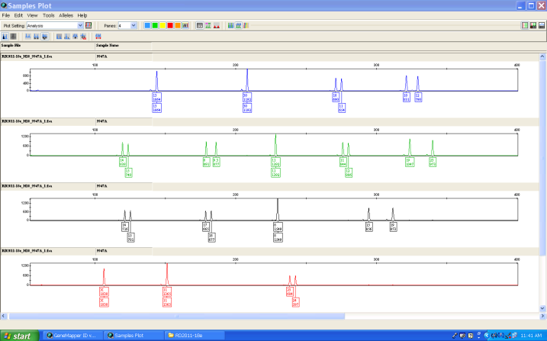

Individual human identification
16 loci = reliable individual identification
(Euro-American population)

Slide 6
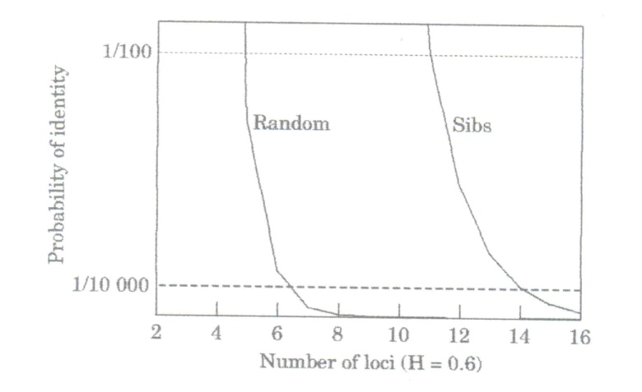
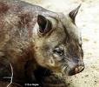
Identification of individuals depends on level of polymorphism
multilocus microsatellite fingerprinting – power estimated as „probability of identity“ (P_{(ID)}) (Waits et al. 2001) – e.g. GenAlex program
Random
Sibs
P_{(ID)}
Number of loci (H=0.6)
pilot studies with tissue samples are required to identify P_{(ID)} in a population studied by e.g. non-invasive methods

Slide 7
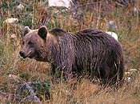

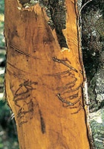
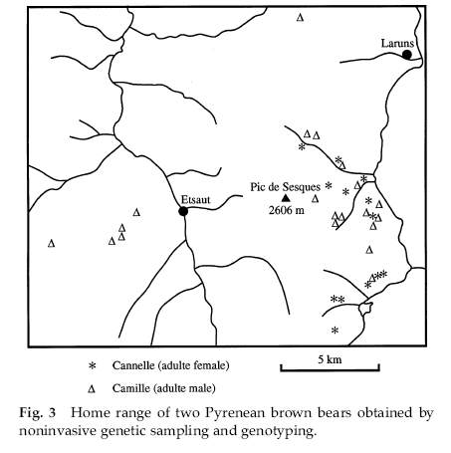
Brown bears in Pyrenees
Taberlet et al. 1997
Faeces and hairs
24 microsatellites
4 males and 1 female with unique multilocus genotypes (more than according footprints and photos)
Multiple-tube approach

Slide 8
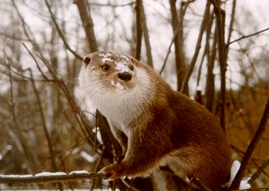
Spatial activity of otters
P. Hájková – PhD thesis (2008)

Slide 9
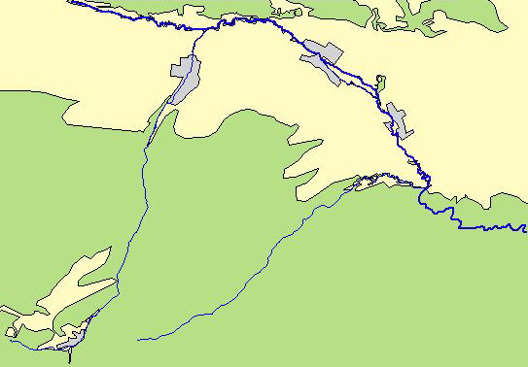
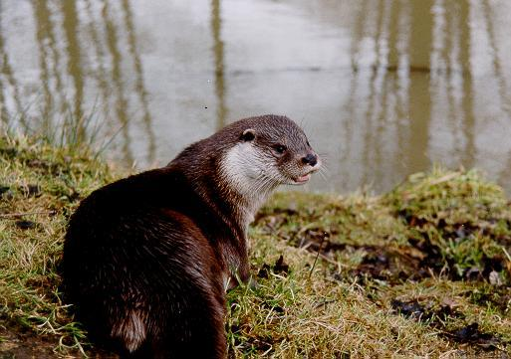
Identified individuals - Hornád, NP Slovenský Raj
SR 1
SR 6
SR 2
SR 7
SR 3
SR 8
SR 4
SR 9
1 km
SR 5
SR 10

Slide 10
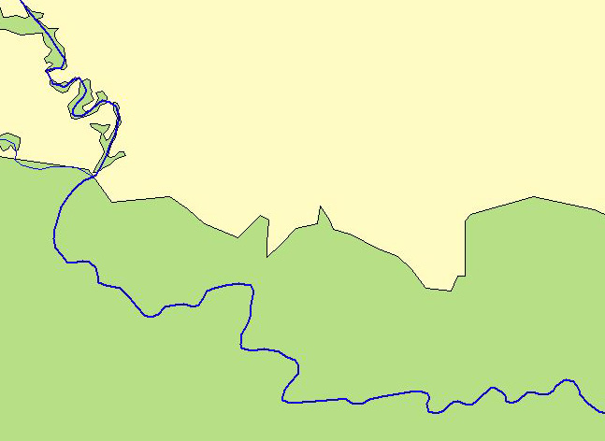

Ind. SR 3
5. 4. 2003
4. 11. 2003
10. 11. 2003
11. 11. 2003
30. 12. 2003
Spatial activity in mountain habitat
Hornad
500 m

Slide 11
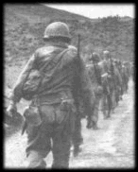
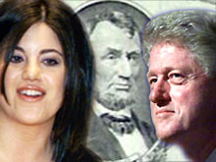
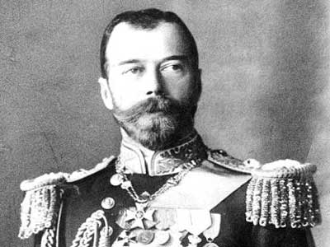
Human forensic genetics
Pozůstatky vojáků z války Vietnam a Korea
Identifikace na základě mtDNA příbuzných osob
(lze jen někdy)
V současnosti: vzorek DNA (krve) při odvodu, jiné markery
Armed Forces Repository of Specimen Samples for the Identification of Remains
Soudní pře
Clinton-Lewinská
Pozůstatky ruského cara Nikolaje II
Kriminalistika
Oběti tragických událostí

Slide 12
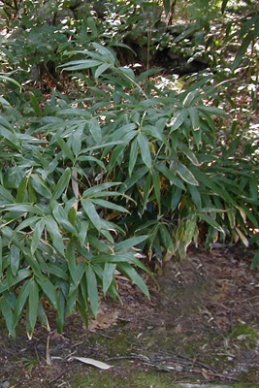
Clones
Bambus Sasa senanensis
Suyama et al. 2000
Sampling at 10 hectares, AFLP genotyping
22 genetic clones
1 clone on the area with 300 m diameter

Slide 13
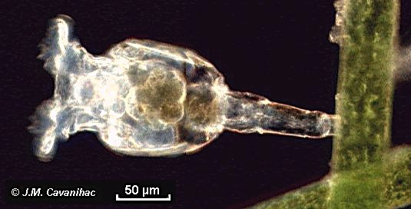
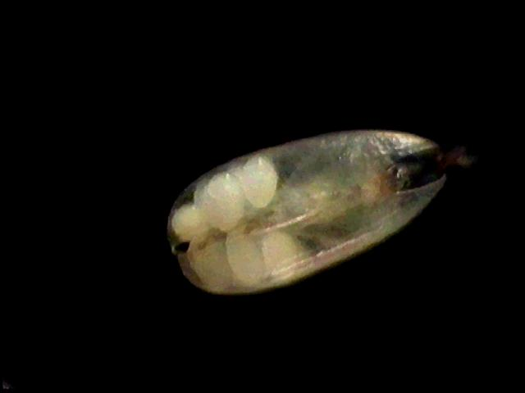
Famous clonal invertebrates
Rotifera – Bdelloidea
Ostracoda (Darwinula)
Parthenogenteic clones of old age
(milions of years)
Darwinula stevensoni

Slide 14
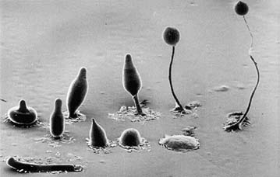
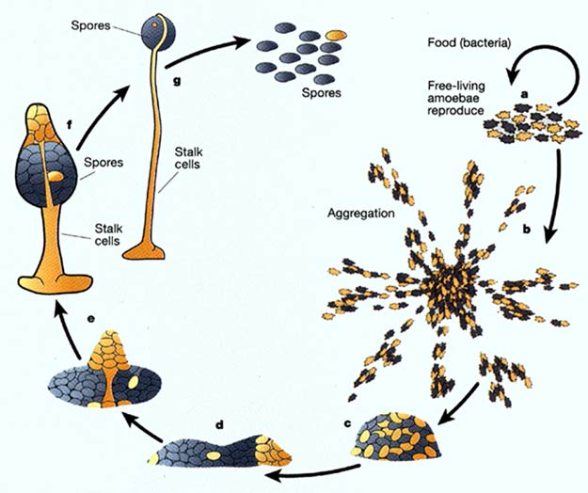
Genetic chimeras
organisms composed from cells with different genotypes
Dictyostelium discoideum
chimerism is a regular part of life cycle

Slide 15
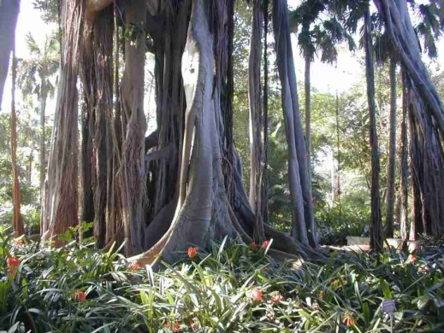
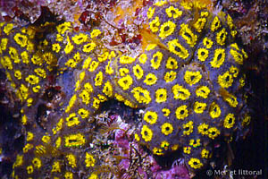
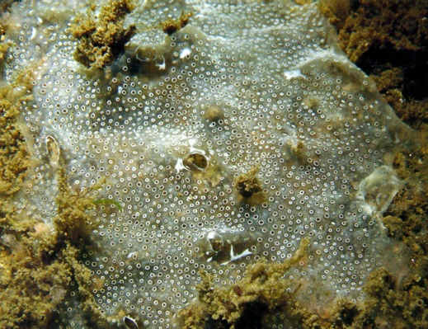
Genetic chimeras
Ficus – already roots from several individuals
ascidians Botryllus schlosseri chimeric colonies from related individuals
Diplosoma listerianum
(even unrelated)

Slide 16
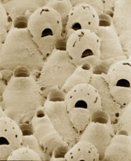
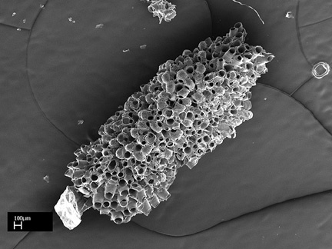
Celleporella hyalina (Bryozoa)
Hughes et al. 2004
Probability of fusion correlates with relatedness
„Histocompatibility“
Better recognition in more developed ontogenetic phases
→ maturation of immunocompetence
Special proteins (spongicans...)

Slide 17
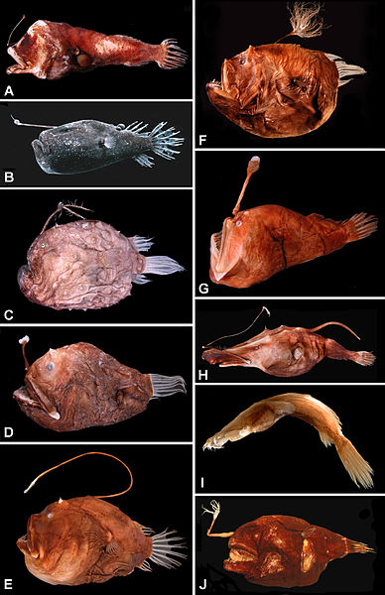
Ceratioid anglerfish
miniature male searches females
skin of a female produces hydrolytic enzymes and a male permanently joins a female
-> hermafroditic chimera

Slide 18
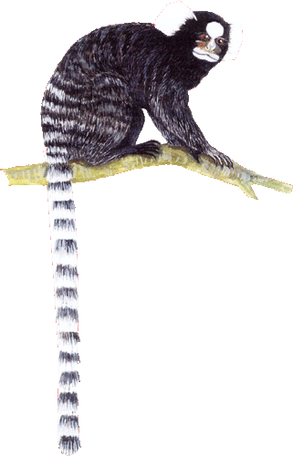
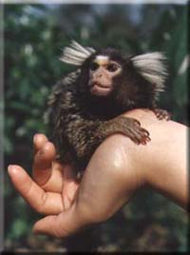
Genetic chimeras – „microchimerism“
common marmosetCallithrix jacchus (probably also genus Saguinus)
dizygotic twins
DNA fingerprinting from blood - hematopoietic chimeras
reciprocal exchange of bone marrow cells during embryonic development
probably it concerns only blood (because the results from non-invasive genotyping, i.e. from hairs and faeces, produced only a single genotype)
embryonic erythroblasts can penetrate placenta also in humans (genetic sex identification of embryo from peripheral blood of mother)

Slide 19
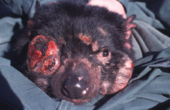
Canine transmissible venereal tumor (CTVT)
Devil facial tumour disease
parasitic cancer
„single cell parasitic wolf“

Slide 20

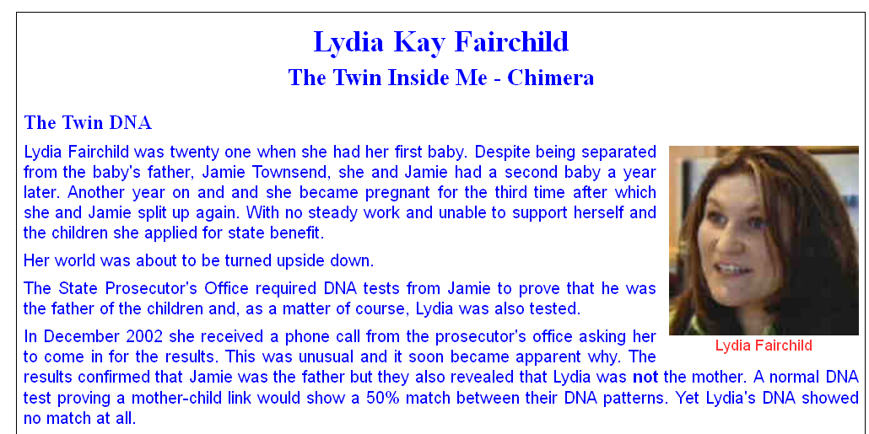
Famous „human chimeras“
Foekje Dillema
46XX/46XY woman
Dutch athlete, champion in 100 and 200 m run
rejected sex identification test
mozaic (chiméra) found postmortem (in 2007)
maternity not confirmed genetically
mother was a genetic chimera

Slide 21
Identification of sex
DNA sexing

Slide 22
Why?
species without sex dimorphism (birds, but also many mammals)
embryos, larvae
non-invasive methods

Slide 23
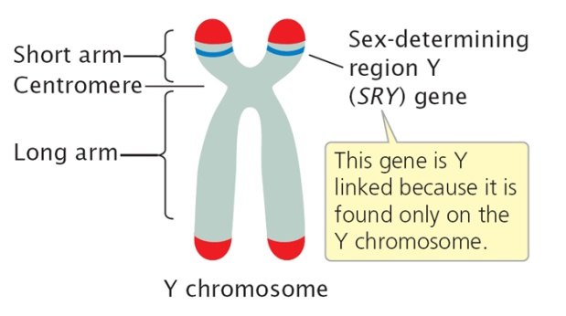
Genetic sex identification
genetic sex determination
birds (♂=ZZ, ♀=ZW)
mammals (♂=XY, ♀=XX)
DNA amplification of W/Y chromosome
W, Y – small chromosomes

Slide 24
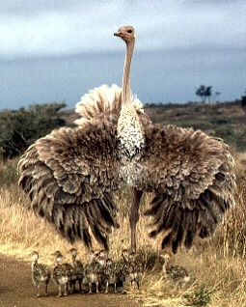

Sex identification – birds
Griffith et al. 1998
♂
♂
♂
♀
♂
♀
♀
CHD1W and CHD1Z, genes at sex chromosomes (chromobox-helicase-DNA-binding gene (CHD) – Griffiths & Tiwari 1995)
Primers amplifying introns of both genes
Introns differ by their length
Up to three primer combinations
Problematic species, e.g. Struthioniformes

Slide 25
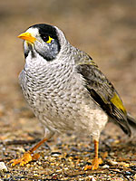
Manorina melanocephala (Meliphagidae) Arnold et al. 2001
Sons = „helpers“
In adults
2,31 males vs. 1 female
Offspring in nests
sex ratio 1:1 (57:57)
Males are hatching first
(in 17 out of 18 nests)
they are bigger and heavier when leaving the nest
medosavka hlučná

Slide 26
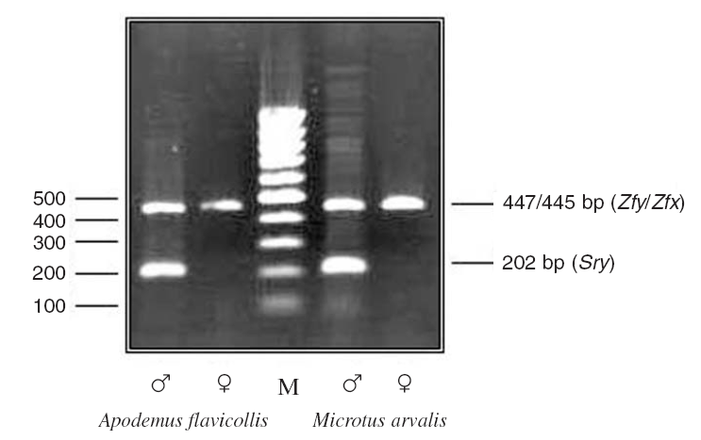
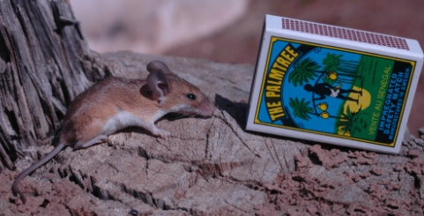

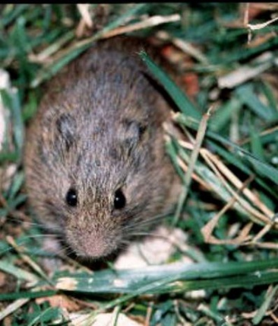
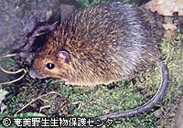
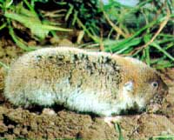
Sex identification - mammals
Amplification of a gene at Y-chromosome (Sry)
(in duplex PCR with X-linked or autosomal fragment)
Microtus cabrerae
Sry at Chr X
Ellobius, Tokudaia
Sry completely missing
Nannomys
Large variability
Bryja and Konečný (2003)
Nannomys
Ellobius
M. cabrerae
Tokudaia osimensis

Slide 27
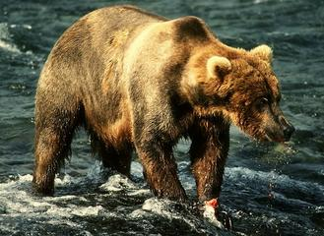

Sex identification - mammals
Amplification of a gene at Y-chromosome (Sry)
(in duplex PCR with X-linked or autosomal fragment)
Bryja a Konečný 2003
Faecal analyses: species-specific primers are required to avoid a cross amplification with species in the diet
Murphy et al. 2003
x

