Slide 1
Species as units of biological diversity
Molecular Ecology, MUNI, 7. 11. 2024

Slide 2
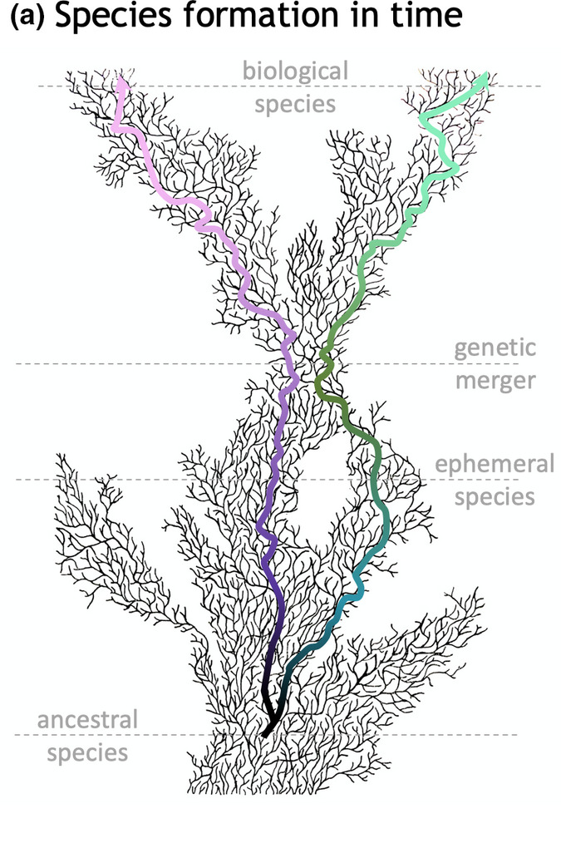
The concept of species
reproductive communities
  colonization, survival
functional groups
  ecosystems, coexistence
species = independent evolutionary lineages
evolutionary lineages are:
  fractal
  possibly ephemeral
Dobzhansky 1958, Pereira & SInghal Mol. Ecol. 2022

Slide 3
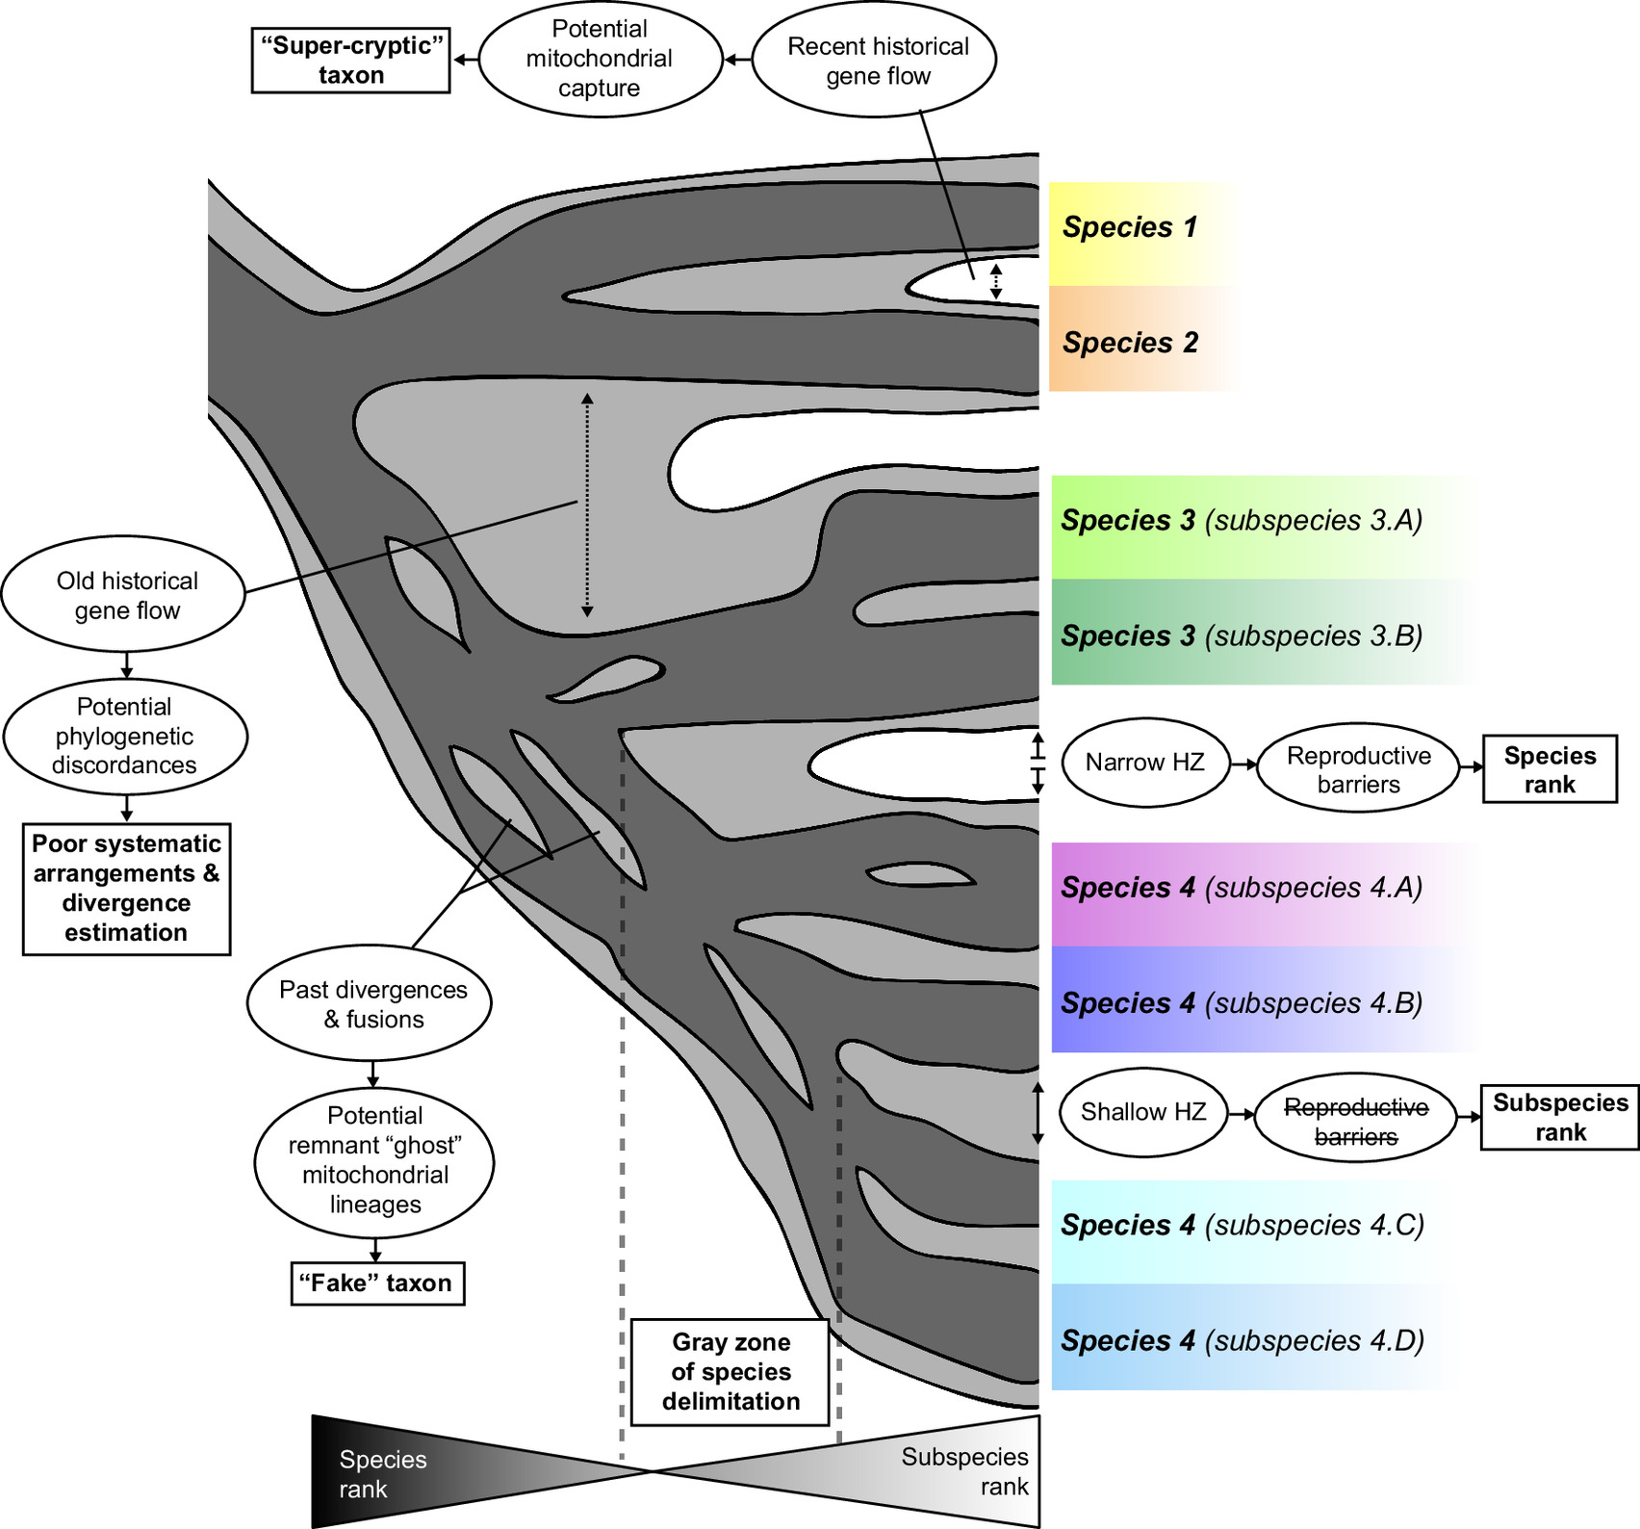
The concept of species
species = independent & persistent evolutionary lineages
evidence:
  experimental – in present
  statistical – from the past
Dufresnes et al. PNAS 2021

Slide 4
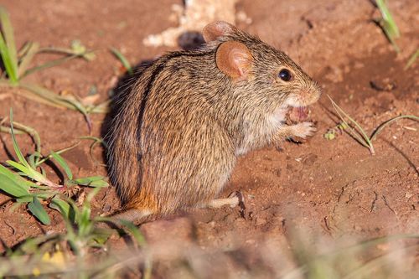
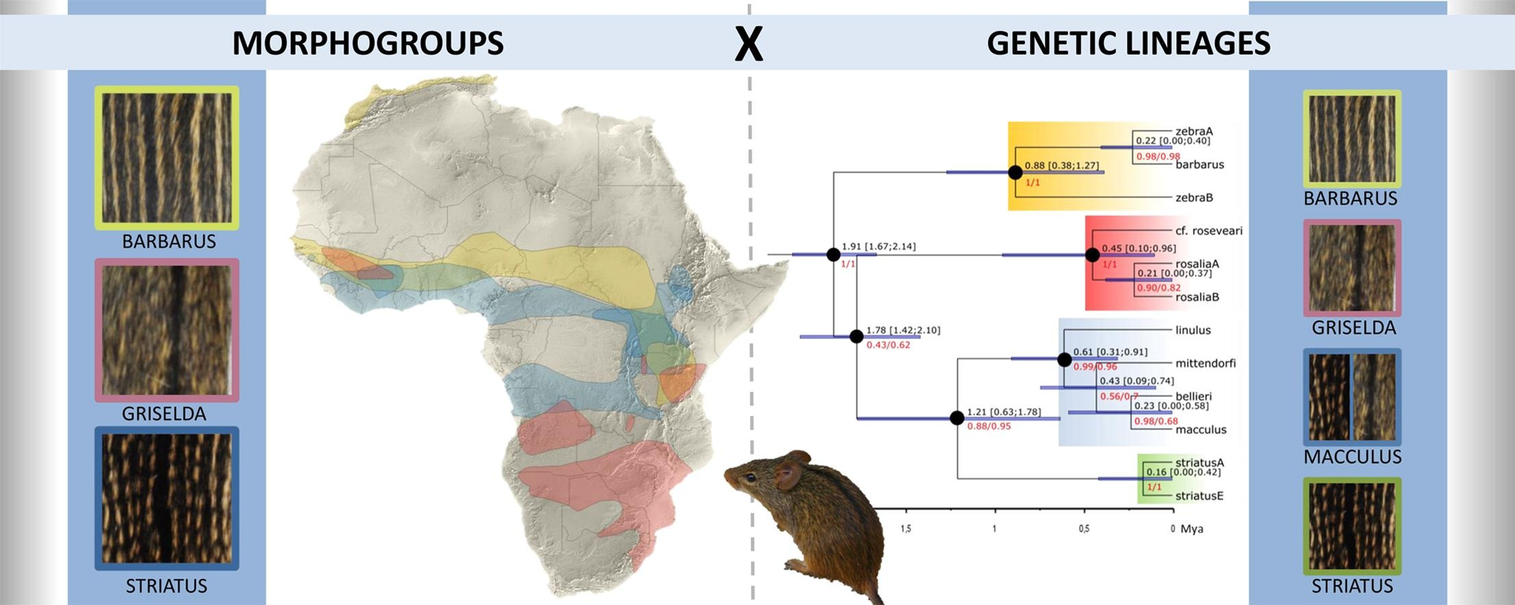
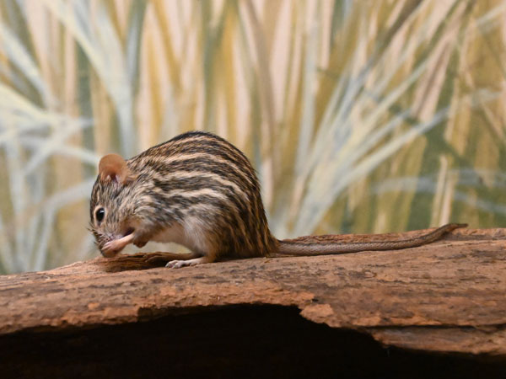
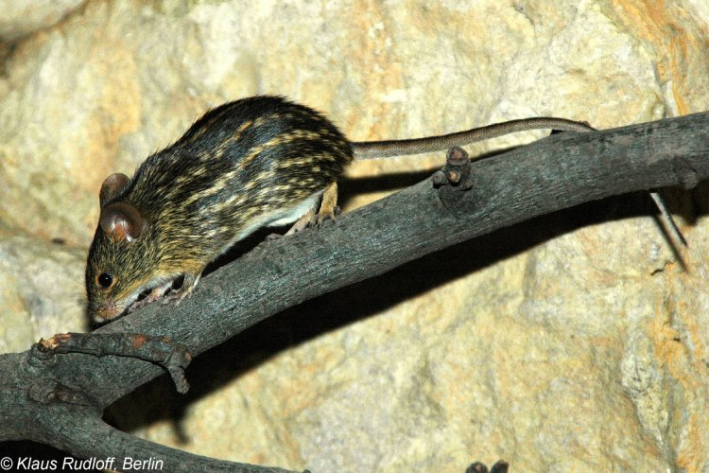
African striped mice: Lemniscomys
Hánová et al. Mol. Phyl. Evol. 2021

Slide 5
Single-locus methods: genetic distances
Matrix of genetic distances
Barcode gap
rule of thumb 2% - 11% (Bradley & Baker 2001) → ASAP (Puillandre et al. 2021)

Slide 6
Single-locus methods: tree structure
mPTP = multi-rate Poisson tree processes
branchcutting

Slide 7
mPTP
tree =
interspecific backbone
+
intraspecific crowns
exponential distributions of branch lengths
Kapli et al. Bioinformatics 2017

Slide 8
branchcutting
tree =
interspecific backbone
+
intraspecific crowns
backbone = structurally important branches

Slide 9
Multi-locus methods
reciprocal monophyly?
gene tree incongruence!

Slide 10
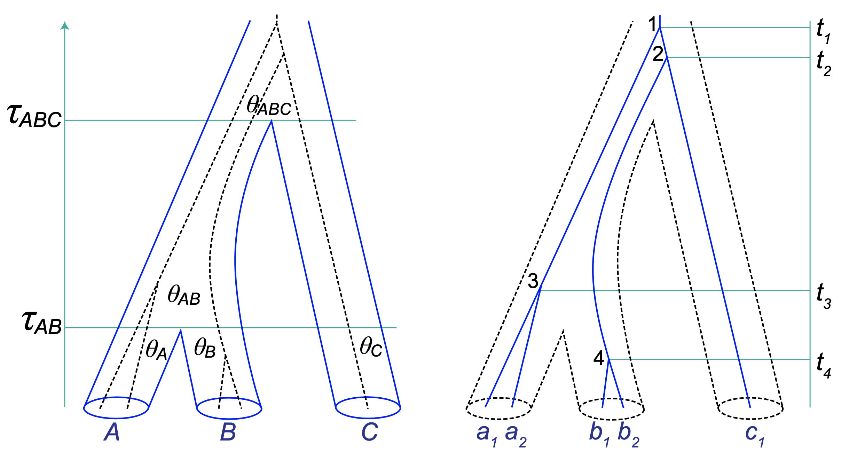
Multi-species coalescent model
Rannala et al. 2020, Fig. 2
Notes:
gene trees vs. species tree

Slide 11
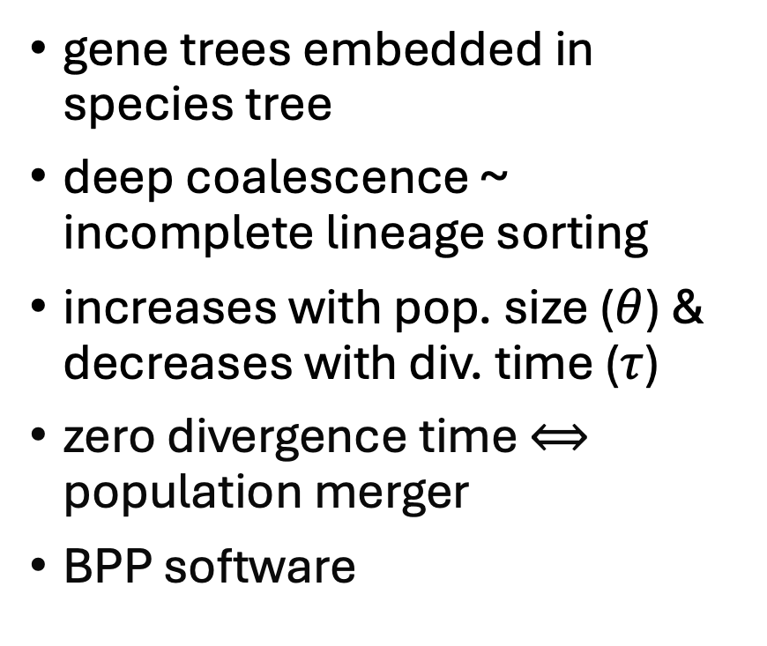
Multi-species coalescent model
gene trees embedded in species tree
deep coalescence ~ incomplete lineage sorting
increases with pop. size ($θ$) & decreases with div. time ($τ$)
zero divergence time $⟺$ population merger
BPP software

Slide 12
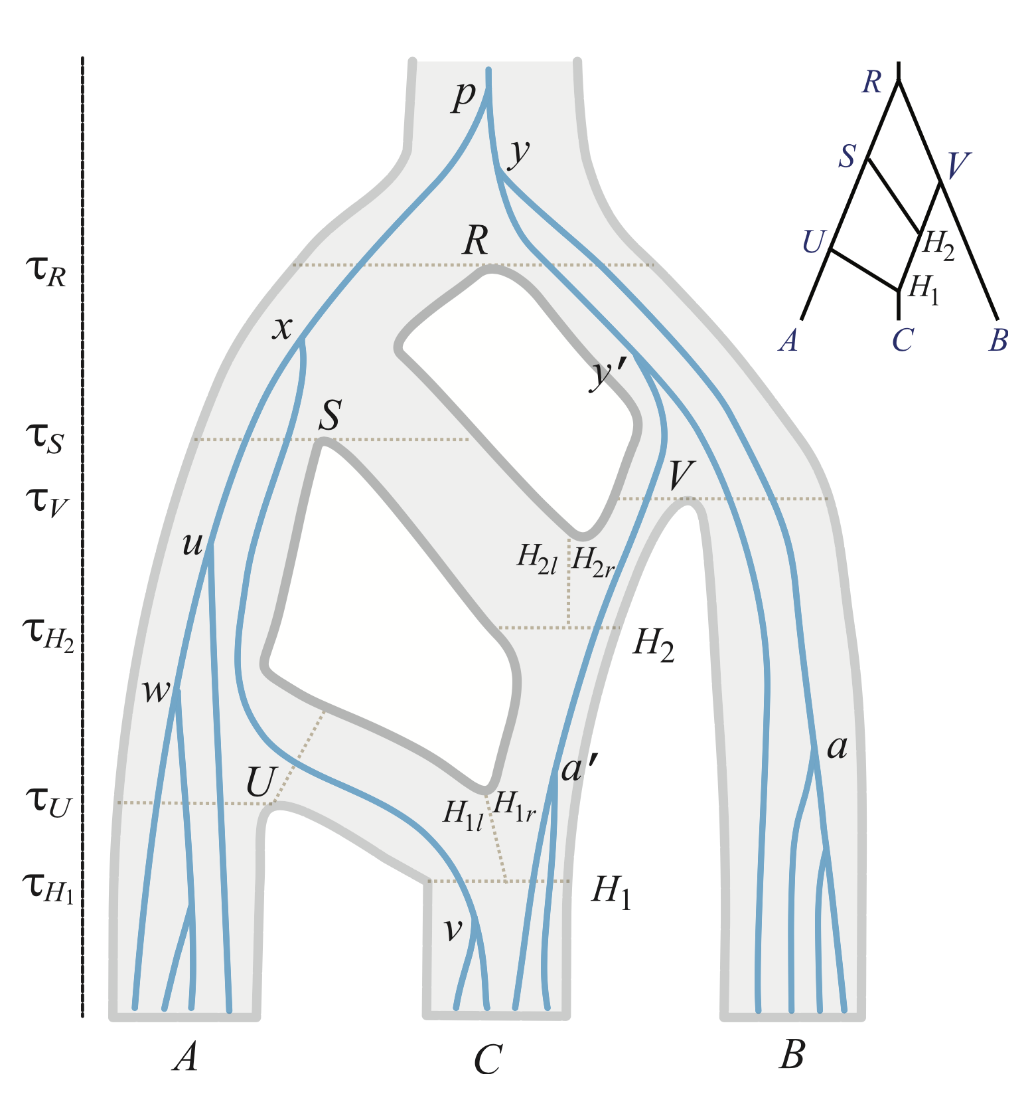
Unended quest
fusions and fissions
post-divergence gene flow
  migration
  introgression
genealogical distinctiveness
  rule of thumb < 0.2, > 0.7
genomic distribution of introgressed loci?
back to experiments?
Flouri et al. Mol. Biol. Evol. 2020, Fig.2

Slide 13
Software & literature
ASAP
  https://bioinfo.mnhn.fr/abi/public/asap/
mPTP
  https://mptp.h-its.org/#/tree
  https://github.com/Pas-Kapli/mptp
branchcutting
  https://github.com/onmikula/branchcutting
BPP
  https://github.com/bpp/bpp
  https://github.com/abacus-gene/hhsd
Open Access Book: Phylogenetics in the Genomic Era
https://inria.hal.science/PGE/

