Slide 1

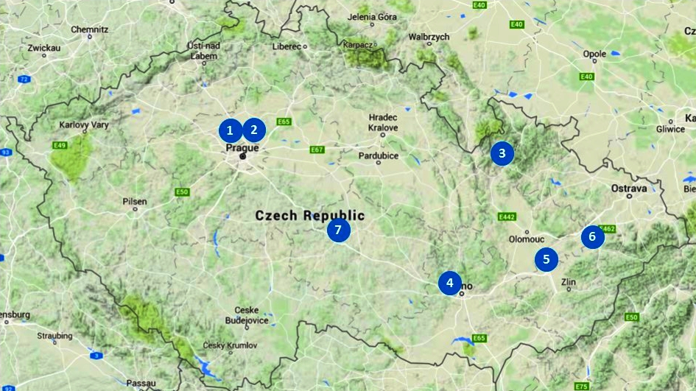
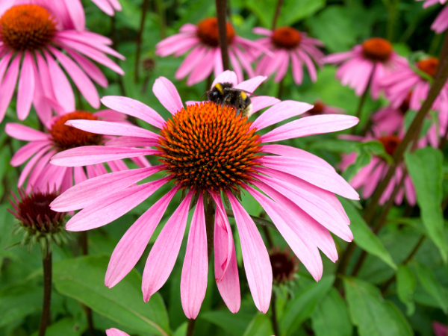
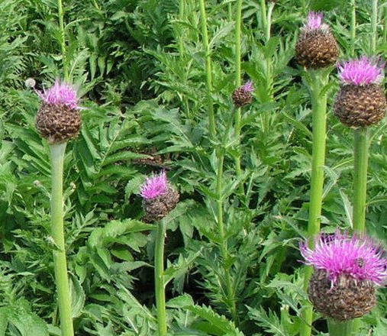
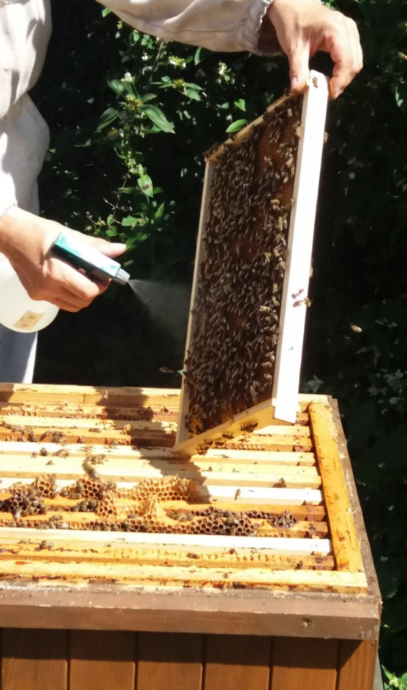
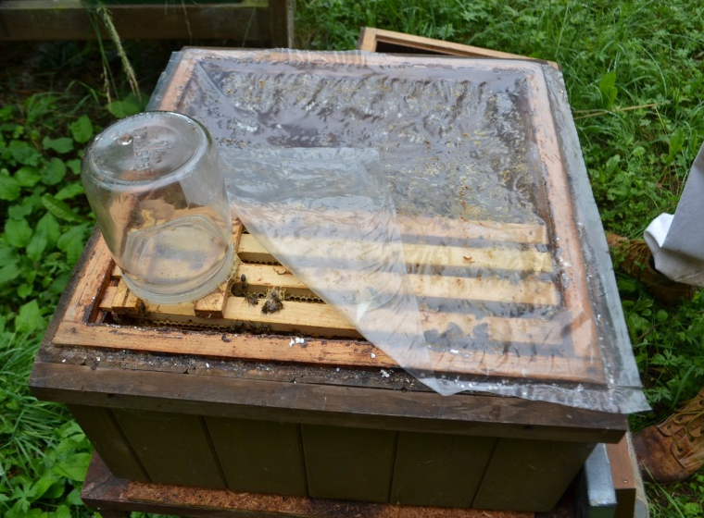
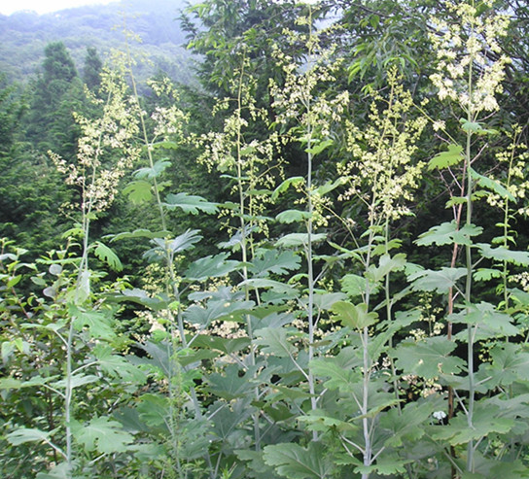
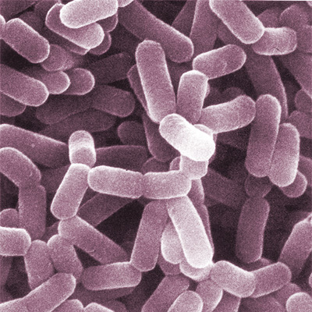
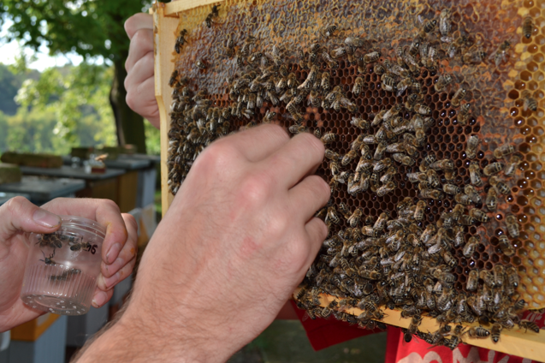
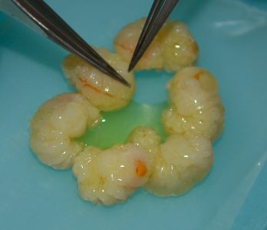
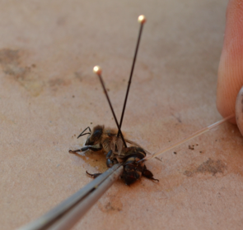
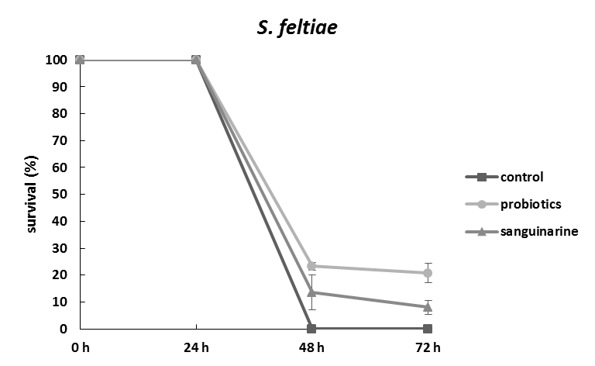
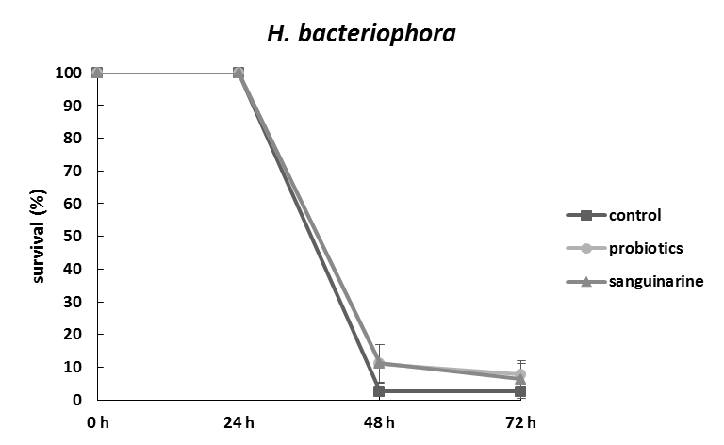

Honey bee immunity:
Its modulation by dietary supplements and probiotics
Pavel Dobeš ¹, Libor Vojtek ¹, Zuzana Hroncová ², Jan Tyl ³, Jiří Killer ⁴,
Peter Černoch ⁵, Pavel Hyršl ¹
¹ Department of Animal Physiology and Immunology, Institute of Experimental Biology, Faculty of Science, Masaryk University, Brno, Czech Republic
² Department of Microbiology, Nutrition and Dietetics, Faculty of Agrobiology, Food and Natural Resources, Czech University of Life Sciences Prague, Prague, Czech Republic
³ Bee Research Institute, Dol, Czech Republic
⁴ Institute of Animal Physiology and Genetics v.v.i., Academy of Sciences of the Czech Republic, Prague, Czech Republic
⁵ Institute of Macromolecular Chemistry, Academy of Sciences of the Czech Republic v.v.i., Prague, Czech Republic
Contact e-mail: pavel.dobes@mail.muni.cz
Honeybee immunity
Bees are used by mankind for several thousand years, but their immune system is still far from being fully understood and moreover we still do not have clear idea about all immune mechanisms, which mediate bees’ response to the pathogens. The immune system of honey bees can be divided to cellular and humoral branch that are complemented by highly developed social behaviour. Detailed knowledge of bee immunity is crucial for successful fight against bee diseases.
Applied dietary supplements and experimental design
4
5
1
2
effect of location (different food sources)
effect of dietary supplements:
extracts from Echinacea sp. (Fig. 1)
extracts from Leuzea sp. (Fig. 2)
alkaloid sanguinarine from Macleaya cordata (Fig. 3)
probiotic bacteria Lactobacillus apis
probiotic bacteria Lactobacillus melliventris
probiotic bacteria Gilliamella apicola
mixture of probiotic bacteria (Fig. 4)
3
4
6
For several years we follow immunocompetence of honey bees from selected beehives located in different parts of Czech Republic. All locations offer unique source of nutrients and were included to describe variability of followed parameters dependent on environment.
We tried to increase immunocompetence of bees by feeding them with selected plant extracts (in dilutions 10x and 100x), plant alkaloid sanguinarine and by administration of probiotic bacterial strains isolated from gut of honey bees. Probiotics and plant extracs were sprayed on experimental combs (Fig. 4) and sanguinarine was administered in sucrose syrup (Fig. 5).
Bees were sampled in selected days before and after experimental treatment (Fig. 6). Haemolymph samples were collected from staged honey bee larvae (Fig. 7) and adult workers (Fig. 8). Date of haemolymph collection was recorded for further analysis of seasonal effect on immune parameters.
We followed several physiological and immune parameters including protein concentration, antimicrobial activity, phenoloxidase activity and antioxidant capacity of haemolymph. Analysis and statistical evaluation are still in progress.
7
8
Results
Effect of plant extracts from Echinacea sp. (ECHI) and Leuzea sp. (MAR) on total protein concentration in haemolymph (left) and antimicrobial activity towards Micrococcus luteus (right). Plant extracts were prepared in two dilutions of acetone (80% and 100%) and administered to the bees in two different dilutions (10x and 100x).
Influence of plant alkaloid sanguinarine on total protein level (left) and antimicrobial activity towards Micrococcus luteus (right) in haemolymph of honey bee larvae.
Differences in total antioxidant capacity of honey bee haemolymph observed among particular beehive locations (marked by numbers and shown on the map above) involved in experiment. Data from three different sample collections are shown.
Influence of probiotics on total protein level (left) and antimicrobial activity towards Micrococcus luteus (right) in haemolymph of honey bee larvae.
Conclusions
higher concentrations of Echinacea extracts are negatively correlated with antimicrobial activity towards gram-positive bacteria in haemolymph of honey bee larvae; the effect on activity against gram-negative bacteria is not known yet
lower sanguinarine concentration can prevent bee larvae from fluctuation in antimicrobial activity
probiotics can have positive influence on survival during natural infections as demonstrated by experimental infection of honey bee larvae with entomopathogenic nematodes
*
**
Time after infection
Time after infection
Survival of honey bee larvae infected with entomopathogenic nematode Steinernema feltiae (left) or Heterorhabditis bacteriophora (right). Bees were treated with the mixture of probiotic bacteria and plant alkaloid sanguinarine. The survival of honey bee larvae were followed for three days upon infection.
Our research is supported by research grants from Ministry of Agriculture of Czech Republic (NAZV-KUS QJ1210047) and Technology Agency of Czech Republic (TA04020318).

