Slide 1
Genetics in animal models; Drosophila melanogaster, mice ..
Liam Keegan,
Liam.Keegan@ceitec.muni.cz
CEITEC A35, Rm 143

Slide 2
Syllabus:
1. History: After Mendel rediscovery; beginnings of Drosophila and rodent genetics. Life cycles, breeding and genetic methods for Drosophila and mice. Visible mutant markers
2. Drosophila Balancer chromosomes; Bar eye, Curly wings and Stubble bristle dominant balancer markers and other markers. Genetic screens in flies, mice and zebrafish
3. Drosophila embryonic development and metamorphosis; The Wieschaus, Nusslein-Vollhard genetic screen for larval segmentation and patterning mutants
4. Other important genetic screens for Drosophila developmental mutants; screens in Daniel St Johnston review.
5. Selected topics in fly and mouse genetics; Homeotic genes, planar cell polarity and organ specification in flies, mice and zebrafish
6. Growth control, cancer and cell death in flies, mice and fish
7. Innate immunity in flies, mice and fish. Ageing.
8. Genetic control of nervous system development in Drosophila, specification of neuronal cell types, motorneuron specification and coordination in flies, mice and fish
9. Genetic control of development in sensory systems, vision, olfaction in flies, mice and fish
10. Genetic investigations of learning, memory, forgetting in flies, mice and fish
11. Genetic investigations of specific behaviours; circadian rhythms, sleep, mating etc. in flies, mice and fish
12. Other model systems, with invited lecturers; C. elegans, Killifish, other rodents maybe
13. Other model systems, with invited lecturers; C. elegans maybe, Killifish, other rodents
14. Other model systems, with invited lecturers; C. elegans maybe, Killifish, other rodents
Literature:

Slide 3
Introduction to Drosophila
Bing Videos

Slide 4
Go to FlyBase.org
FlyBase Homepage for introductory information
FlyBase is maintained at Cambridge, UK and Berkeley, California
Curators read new fly papers and update information on fly genes
Collect information on new fly strains
Go to New to flies? page
Go to Fly Basics page and find links to papers on the next slide

Slide 5
Primers on Drosophila genetics
Genetics on the Fly: A Primer on the Drosophila Model System
KG Hales, CA Korey, AM Larracuente, DM Roberts - Genetics, 2015 - academic.oup.com
Read first half of this. Also history and glossary at the end
The joy of balancers
DE Miller, KR Cook, RS Hawley - PLoS genetics, 2019 - journals.plos.org
Short. Read all of it
How to Design a Genetic Mating Scheme: A Basic Training Package for Drosophila Genetics
J Roote, A Prokop - G3: Genes| Genomes| Genetics, 2013 - academic.oup.com
Look at supplementary files and read early parts. Gets too complicated later.

Slide 6
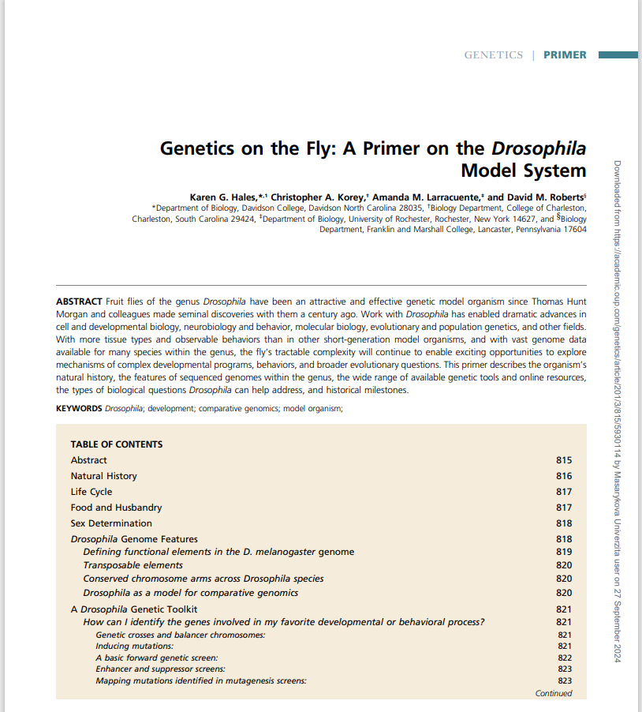

Slide 7
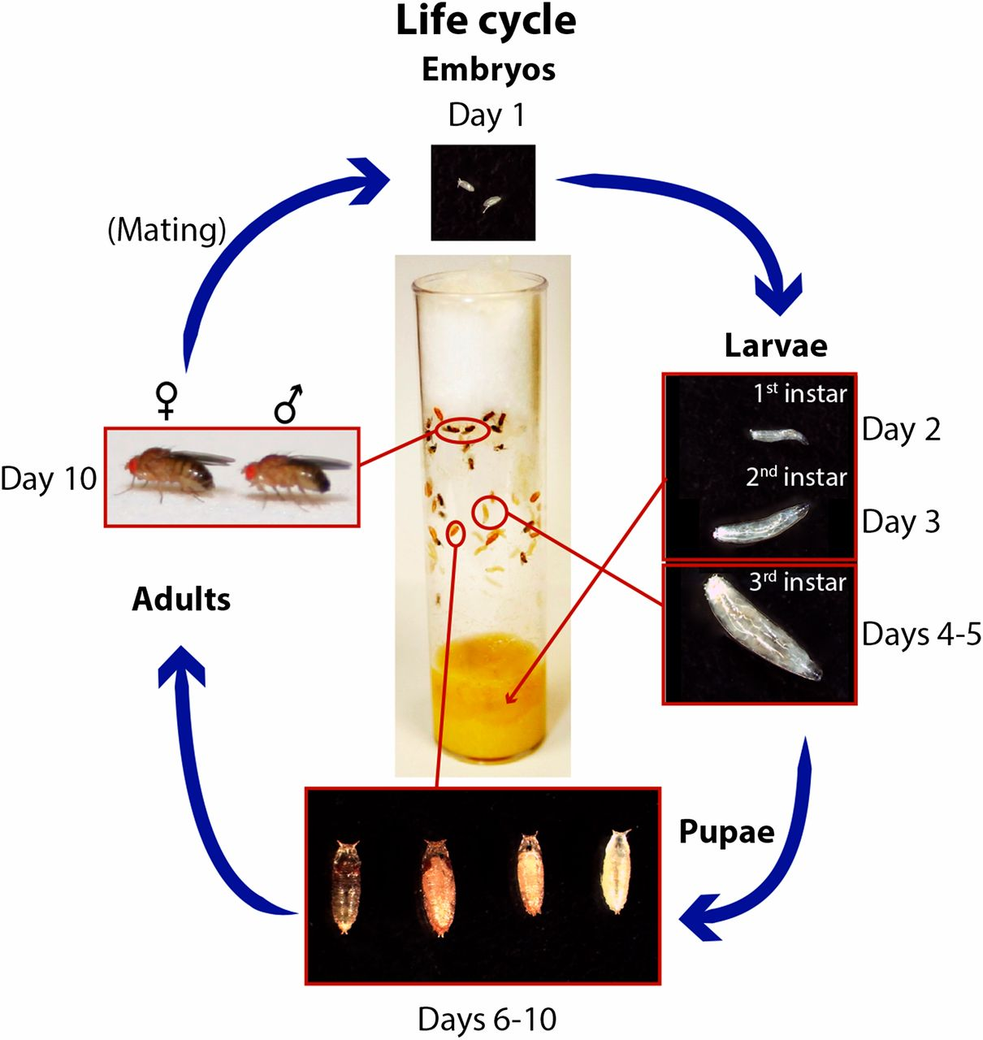

Figure 1 Life cycle of D. melanogaster. D. melanogaster are cultured in vials with food in the bottom and a cotton, ...
Notes:
Figure 1 Life cycle of D. melanogaster. D. melanogaster are cultured in vials with food in the bottom and a cotton, rayon, or foam plug at the top. The pictured vial shows each major stage of the life cycle, which is completed in 9–10 days when flies are maintained at 25°. Embryos hatch from the egg after ∼1 day and spend ∼4 days as larvae in the food. Around day 5, third instar larvae crawl out of the food to pupate on the side of the vial. During days 5–9, metamorphosis occurs, and the darkening wings within the pupal case indicate that maturation is nearly complete. Adult flies eclose from pupal cases around days 9–10.
Unless provided in the caption above, the following copyright applies to the content of this slide: © Genetics 2015This article is published and distributed under the terms of the Oxford University Press, Standard Journals Publication Model (https://academic.oup.com/journals/pages/open_access/funder_policies/chorus/standard_publication_model)

Slide 8
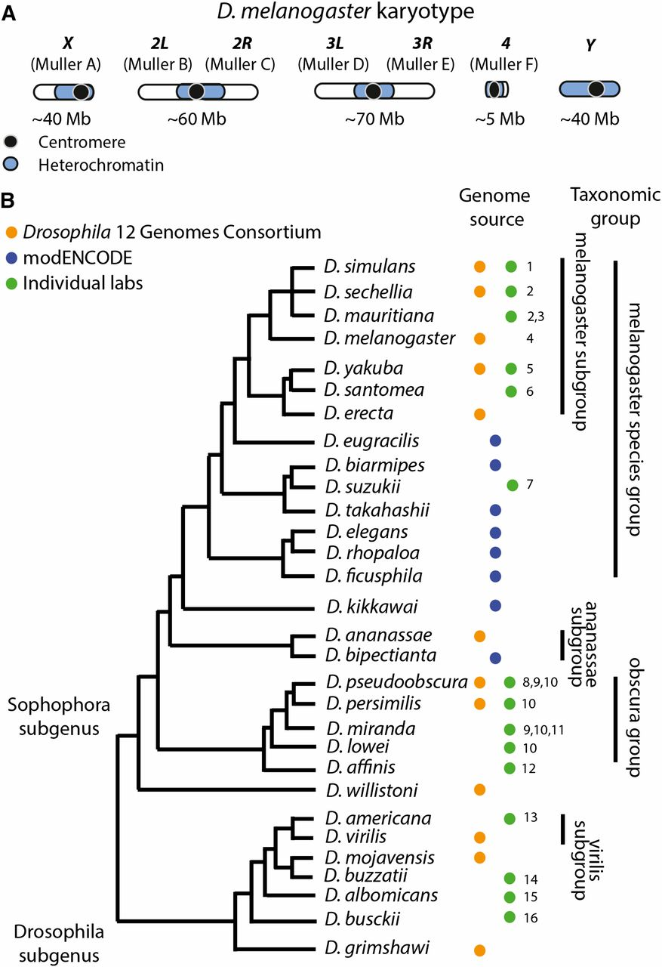
Figure 3 Genome organization and phylogeny. (A) Organization of the Drosophila melanogaster genome. D. melanogaster ...
Notes:
Figure 3 Genome organization and phylogeny. (A) Organization of the Drosophila melanogaster genome. D. melanogaster has two metacentric autosome arms (chromosomes 2 and 3; Muller elements B and C and D and E), a small autosome (chromosome 4; Muller element F) and a pair of sex chromosomes (chromosome X—Muller element A—and chromosome Y). The approximate sizes and division of heterochromatin/euchromatin are shown. (B) Comparative genomics resources. Phylogeny of Drosophila species whose genomes were sequenced either by a large consortium (i.e., Drosophila 12 Genomes Consortium et al. 2007 or modENCODE https://www.hgsc.bcm.edu/drosophila-modencode-project) or other community or individual lab sequencing project. While likely not an exhaustive list, it highlights the power to do comparative genomics in Drosophila. The tree topology is derived from several sources (Drosophila 12 Genomes Consortium et al. 2007; Gao et al. 2007; Seetharam and Stuart 2013), as the phylogenetic relationships between some of these species are not well resolved. The references for each genome are as follows: (1) Hu et al. (2013); (2) Garrigan et al. (2012); (3) Nolte et al. (2013); (4) Adams et al. (2000); (5) Rogers et al. (2014); (6) http://genomics.princeton.edu/AndolfattoLab/Dsantomea_genome.html; (7) Chiu et al. (2013); (8) Richards et al. (2005); (9) Kulathinal et al. (2009); (10) McGaugh et al. (2012); (11) Zhou and Bachtrog (2012); (12) Palmieri et al. (2014); (13) Fonseca et al. (2013); (14) Guillen et al. (2014); (15) Zhou et al. (2012); and (16) Zhou and Bachtrog (2015).
Unless provided in the caption above, the following copyright applies to the content of this slide: © Genetics 2015This article is published and distributed under the terms of the Oxford University Press, Standard Journals Publication Model (https://academic.oup.com/journals/pages/open_access/funder_policies/chorus/standard_publication_model)

Slide 9
Figure 5. Drosophila chromosomes
Cytological images of mitotic Drosophila chromosomes.
Left: Female and male cells contain pairs of heterosomes (X, Y) and three autosomal chromosomes.
Right: Schematic illustration of Drosophila salivary gland polytene chromosomes which display a reproducible banding pattern which can be used for the cytogenetic mapping of gene loci (black numbers); 2nd and 3rd chromosomes are subdivided into a left (L) and right (R) arm, divided by the centrosome (red dot). Detailed descriptions of Drosophila chromosomes can be found elsewhere [52].

Slide 10
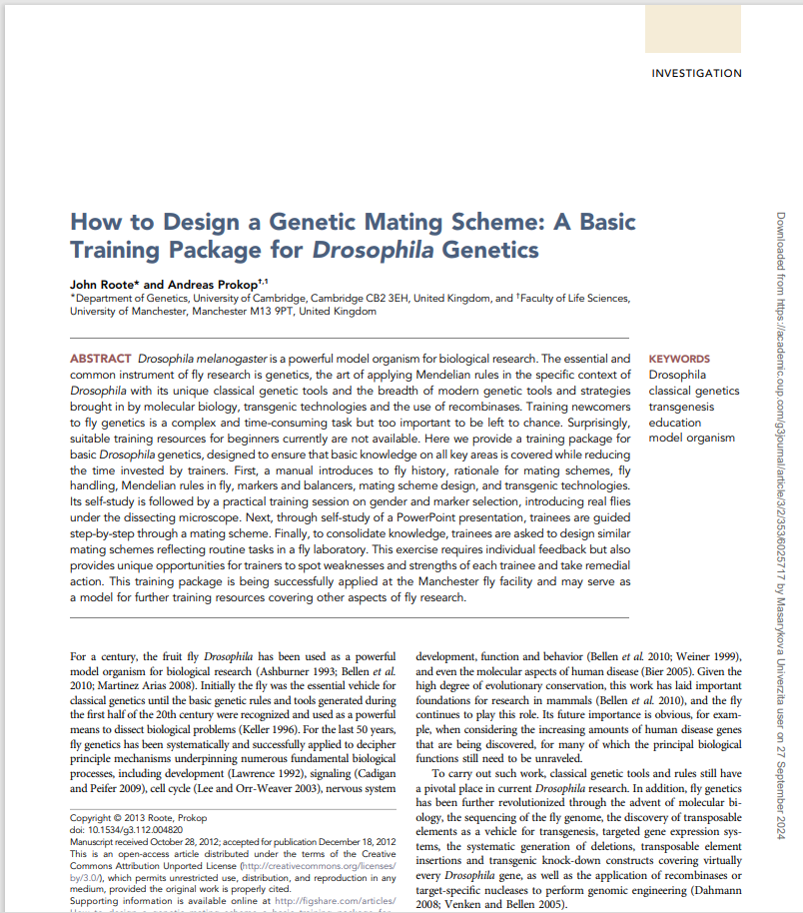

Slide 11
Figure 3. Maintaining and handling flies in the laboratory
A) Fly stocks are stored in large numbers on trays in temperature controlled rooms/incubators1 (the trays shown here each hold two copies of 50 stocks).
B) Each fly stock is kept in glass or plastic vials which contain food at the bottom and are closed with foam, cellulose acetate, paper plugs or cotton wool. Larvae live in the food and, at the wandering stage, climb up the walls (white arrow) where they subsequently pupariate (white arrow head).
C-E) To score for genetic markers and select virgins and males of the desired phenotypes, flies are immobilised on CO2-dispensing porous pads (E), visualised under a dissecting scope (C, D) and then discarded into a morgue or transferred to fresh vials via a paint brush, forceps or pooter / aspirator 2 (C, E). For further information on how a typical fly laboratory is organised see other sources [3,4,5,102] 3.

Slide 12
Figure 4. Criteria for gender selection
Images show females (top) and males (bottom): lateral whole body view (1st column), a magnified view of the front legs (2nd column), dorsal view (3rd column) and ventral view (4th column) of the abdomen.
Only males display sex combs on the first pair of legs (black arrow heads). Females are slightly larger and display dark separated stripes at the posterior tip of their abdomen, which are merged in males (curved arrows). Anal plates (white arrows) are darker and more complex in males and display a pin-like extension in females. The abdomen and anal plate are still pale in freshly eclosed males and can be mistaken as female indicators at first sight. Photos are modified from [1] and [29].
During a very short period after eclosion, flies display a visible dark greenish spot in their abdomen (meconium; not shown) which can be taken as a secure indicator of female virginity even if fertile males are present.

Slide 13
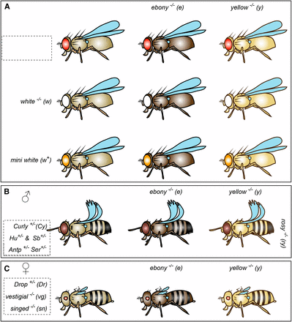
Commonly –used visible markers to follow chromosomes through crosses;
Dominant mutant (Capital letter) and recessive mutant (lower case letter.)
Mouse mutants have to be genotyped by PCR.

Slide 14
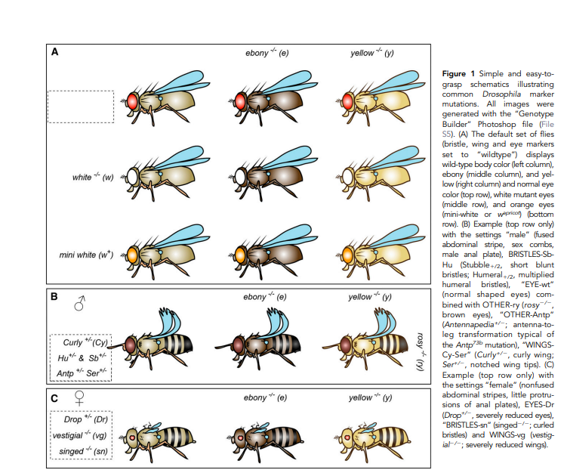

Slide 15
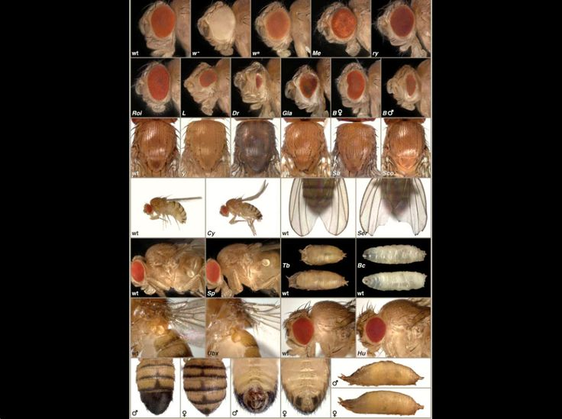
“Learning to fly” poster
Drosophila mutant phenotypes

Slide 16
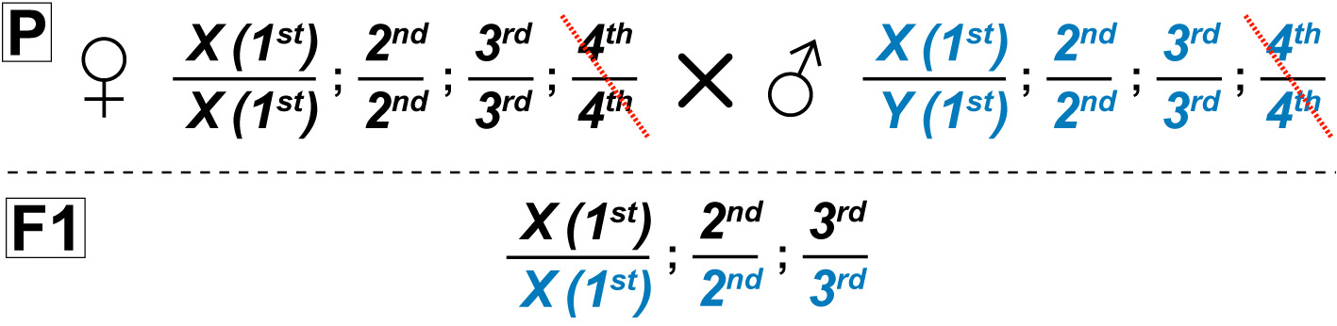
Rules to be used here:
'X' indicates the crossing step; female is shown on the left, male on the right
sister chromosomes are separated by a horizontal line, different chromosomes are separated by a semicolon, the 4th chromosome will be neglected (crossed out)
maternal chromosomes (inherited from mother) are shown above, paternal chromosomes (blue) below separating line
the first chromosome represents the sex chromosome, which is either X or Y - females are X/X, males are X/Y (animals may be indicated as "X / Y or X" if both genders are being used or can be used)
generations are indicated as P (parental), F1, 2, 3.. (1st, 2nd, 3rd.. filial generation)
to keep it simple: dominant markers start with capital, recessive markers with lower case letters (but note that FlyBase nomenclature is more complex)

Slide 17
Some stocks from our lab
yellow, Adar^{5G1}, white / FM7 Bar; ;
yellow, white; (mw⁺)UAS-Adar transgene construct / SM5 Curly;
white; Lobe / SM5 Curly; rosy, ebony / TM3 Stubble
Balancer chromosomes First chromosome multiple inversions FM7, Second multiple SM5, Third multiple TM3

Slide 18
Balancer chromosomes
What balancer chromosomes are.
How we use them to keeps stocks with mutant genes or transgenes.

Slide 19
STEP2: Remind yourself of the basic rules of Drosophila genetics:
law of segregation
independent assortment of chromosomes
linkage groups and recombination (recombination rule)
balancer chromosomes and marker mutations

Slide 20
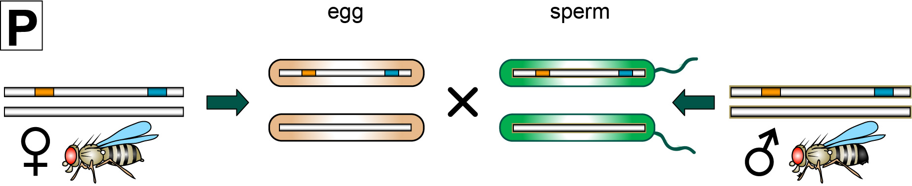
Law of segregation / linkage groups
Homologous chromosmes are separated during meiosis

Slide 21
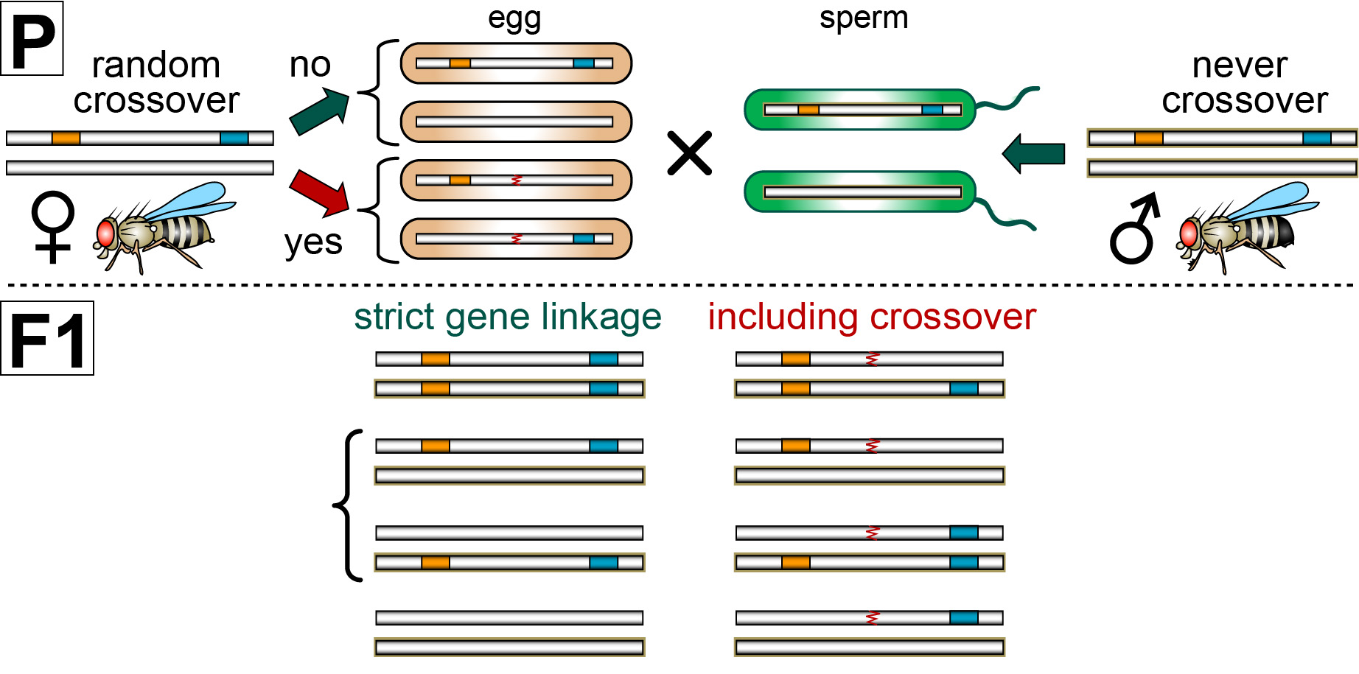
Law of segregation / linkage groups
1
each offspring receives one parental and one maternal chromosome
loci on the same chromsome are passed on jointly (linkage)
2
1
Notes:
21

Slide 22
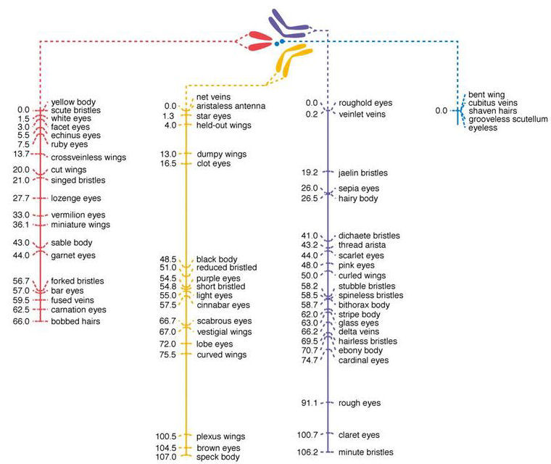
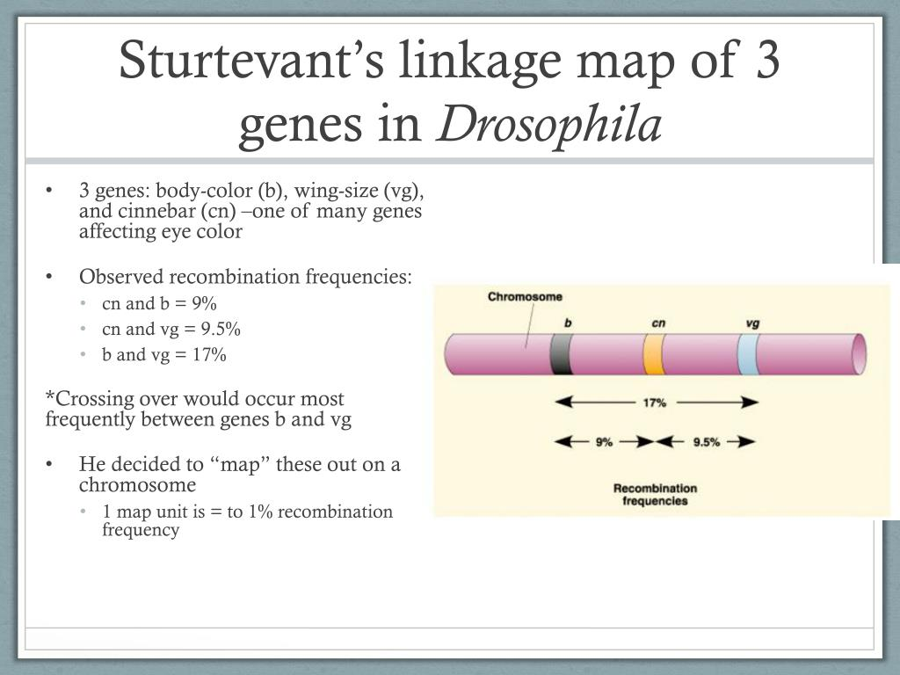
Genes on the same chromosome will recombine

Slide 23
Complication: recombination in females
intra-chromosomal recombination takes place randomly during oogenesis
Recombination rule:
there is no recombination in males (nor of the 4th chromosome)
Notes:
23

Slide 24
Complication: recombination in females
wildtype
heterozygous
homozygous mutant
7 instead of 3 different genotypes
Notes:
24

Slide 25
Balancers and stock keeping
lethal mutations are difficult to keep as a stock; they will gradually be lost (i.e. be replaced by wt alleles in subsequent generations)
If each of the mutant alleles (blue and orange) were lethal in homozygosis, which of these genotypes would fail to survive?”

Slide 26
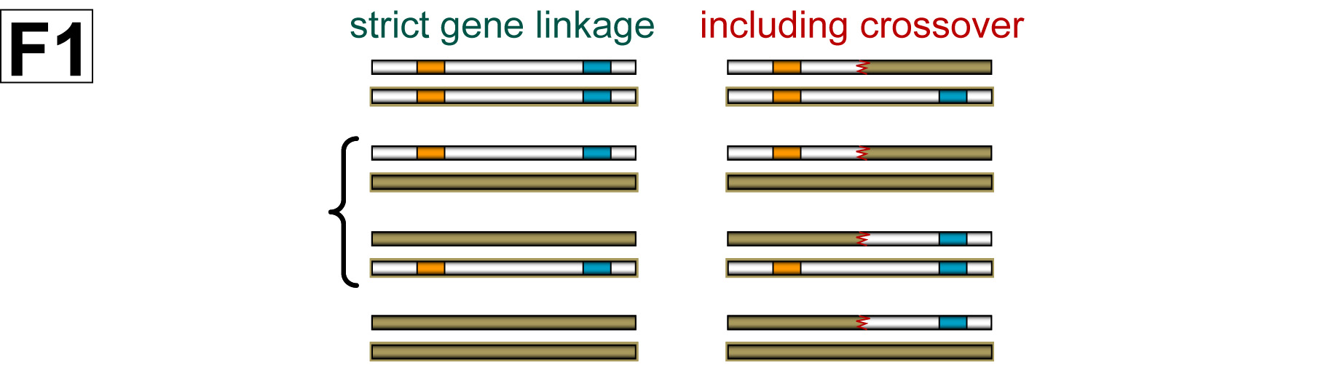
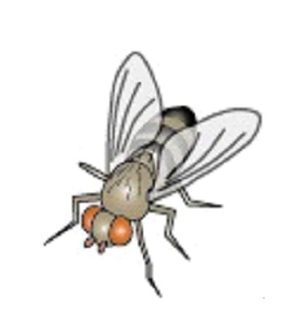
Balancers and stock keeping
lethal mutations are difficult to keep as a stock; they will gradually be lost (i.e. be replaced by wt alleles in subsequent generations)
remedy in Drosophila: balancer chromosomes

Slide 27
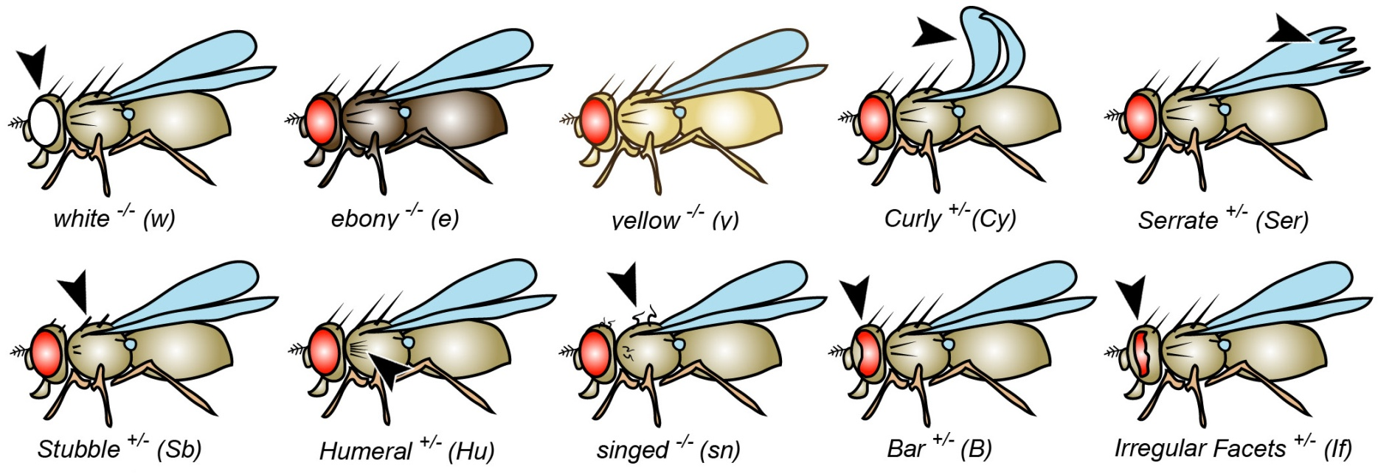
Balancers and stock keeping
balancers carry easily identifiable dominant and recessive markers

Slide 28
Balancers and stock keeping
balancers carry easily identifiable dominant and recessive markers
balancers are homozygous lethal or sterile (red cross)

Slide 29
Balancers and stock keeping
only parental genotypes survive and maintain the stock
balancers carry easily identifiable dominant and recessive markers
balancers are homozygous lethal or sterile (red cross)
recombination of balancers is either suppressed or causes lethality (black cross)
Through using balancers, lethal mutations can be stably kept as stocks.
In mating schemes, balancers can be used to prevent unwanted recombination.
Balancers and their dominant markers can be used strategically to follow marker-less chromosomes through mating schemes.

Slide 30
Box 8. Examples of balancer chromosomes
Numerous balancer stocks are available from Drosophila stock centres (e.g. Bloomington / Balancers):
• Typical standard balancers (most marker mutations explained in Fig. 9):
o FM7a (1st multiply-inverted 7a) - X chromosome - typical markers: y, wa, sn, Bar1 (B1)
o FM7c (1st multiply-marked 7c) - X chromosome - typical markers: y, sc, w, oc, ptg, B1
o CyO (Curly derivative of Oster) - 2nd chromosome - typical markers: Cy (Curly), dp (dumpy; bumpy notum), pr (purple; eye colour), cn2 (cinnabar; eye colour)
o SM6a (2nd multiply-inverted 6a) - 2nd chromosome - typical markers: al, Cy, dp, cn, sp
o TM3 (3rd multiply-inverted 3) - 3rd chromosome - typical markers: Sb, Ubx^{bx-34e}, (bithorax; larger halteres) e, Ser
o TM6B (3rd multiply-inverted 6B) - 3rd chromosome – Tb(Tubby)

Slide 31
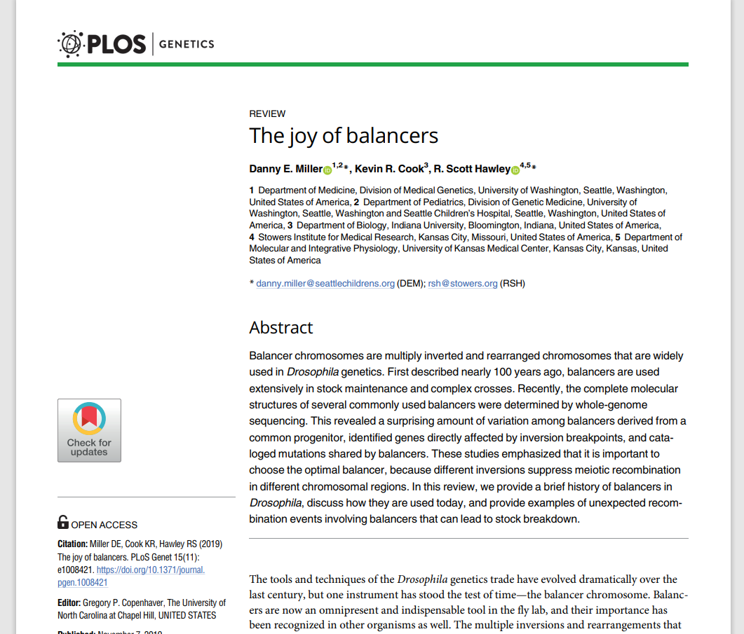

Slide 32
Recombination between two genes D and E was prevented by ‘balancing’ them over an inversion.

Slide 33
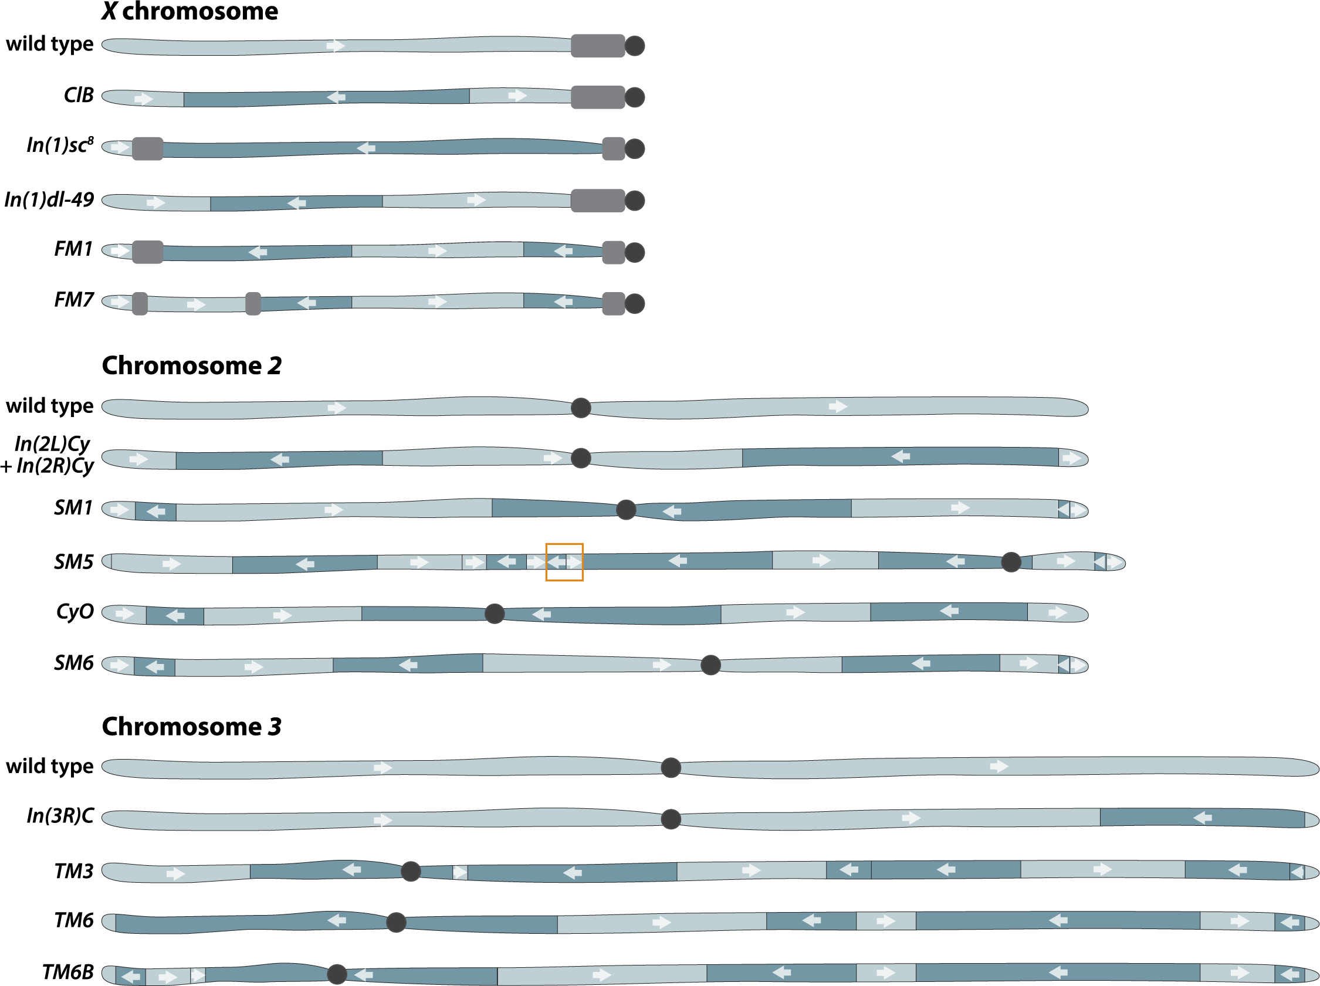

Slide 34
Box 8. Examples of balancer chromosomes
Numerous balancer stocks are available from Drosophila stock centres (e.g. Bloomington / Balancers):
• Typical standard balancers (most marker mutations explained in Fig. 9):
o FM7a (1st multiply-inverted 7a) - X chromosome - typical markers: y, wa, sn, Bar1 (B1)
o FM7c (1st multiply-marked 7c) - X chromosome - typical markers: y, sc, w, oc, ptg, B1
o CyO (Curly derivative of Oster) - 2nd chromosome - typical markers: Cy (Curly), dp (dumpy; bumpy notum), pr (purple; eye colour), cn2 (cinnabar; eye colour)
o SM6a (2nd multiply-inverted 6a) - 2nd chromosome - typical markers: al, Cy, dp, cn, sp
o TM3 (3rd multiply-inverted 3) - 3rd chromosome - typical markers: Sb, Ubx^{bx-34e}, (bithorax; larger halteres) e, Ser
o TM6B (3rd multiply-inverted 6B) - 3rd chromosome – Tb(Tubby)

Slide 35
Primers on Drosophila genetics
Genetics on the Fly: A Primer on the Drosophila Model System
KG Hales, CA Korey, AM Larracuente, DM Roberts - Genetics, 2015 - academic.oup.com
Read first half of this. Also history and glossary at the end
The joy of balancers
DE Miller, KR Cook, RS Hawley - PLoS genetics, 2019 - journals.plos.org
Short. Read all of it. Learn which markers are most used for chromosome 1, 2 and 3 balancers
How to Design a Genetic Mating Scheme: A Basic Training Package for Drosophila Genetics
J Roote, A Prokop - G3: Genes| Genomes| Genetics, 2013 - academic.oup.com
Look at supplementary files and read early parts. Gets too complicated later.

Slide 37
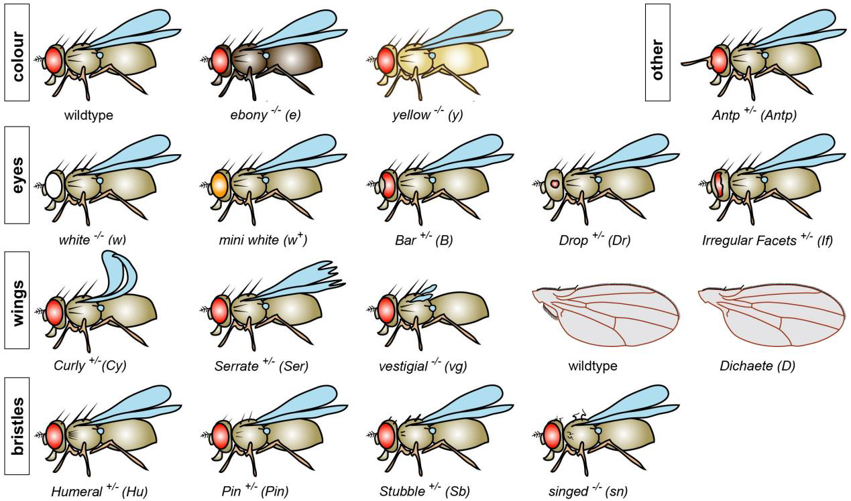

Slide 38
Figure 9. Examples of typical marker mutations used during genetic crosses
Mutations are grouped by body colour (top), eye markers (2nd row), wing markers (3rd row), bristle markers (bottom row), and "other" markers (top right). Explanations in alphabetic order:
o Antennapedia73b (dominant; 3rd; antenna-to-leg transformation)
o Bar1 (dominant; 1st; kidney shaped eyes in heterozygosis, slit-shaped eyes in homo-/hemizygosis)
o Curly (dominant; 2nd; curled-up wings; phenotype can be weak at lower temperatures, such as 18ºC)
o Dichaete (dominant; 3rd; lack of alula, wings spread out)
o Drop (dominant; 3rd; small drop-shaped eyes)
o ebony (recessive; 3rd chromosome; dark body colour)
o Humeral (dominant; 3rd; Antennapedia allele, increased numbers of humeral bristles)
o Irregular Facets (dominant; 2nd; slit-shaped eyes)
o mini-white (dominant in white mutant background, recessive in wildtype background; any chromosome; hypomorphic allele commonly used as marker on transposable elements)
o Pin (dominant; 2nd; short pointed bristles)
o Serrate (dominant; 3rd; serrated wing tips)
o singed (recessive; 1st; curled bristles)
o Stubble (dominant; 3rd; short, blunt bristles)
o vestigial (recessive; 2nd; reduced wings)
o white (recessive: 1st; white eye colour)
o yellow (recessive; 1st; yellowish body colour)
Photos of flies carrying marker mutations have been published elsewhere [29,31] 1.

Slide 39
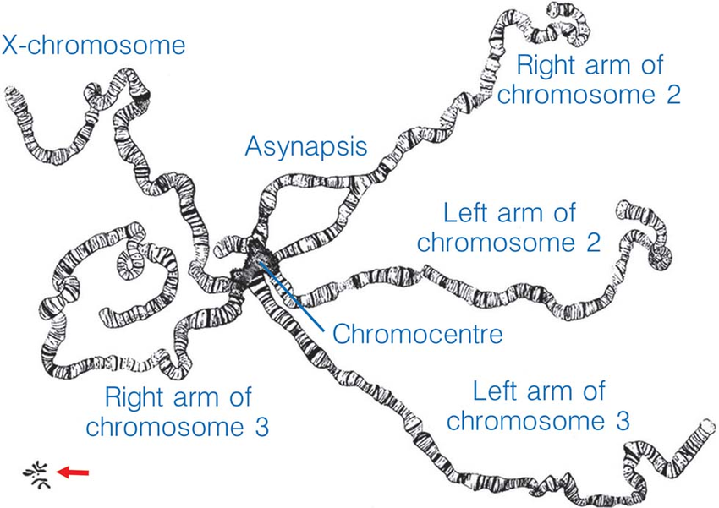
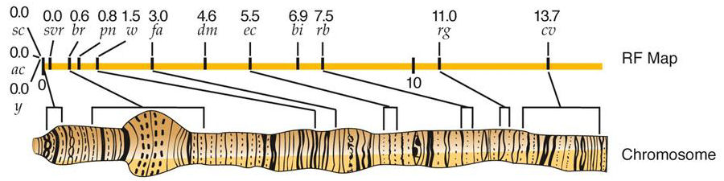
Drosophila larval salivary gland polytene chromosomes

Slide 40
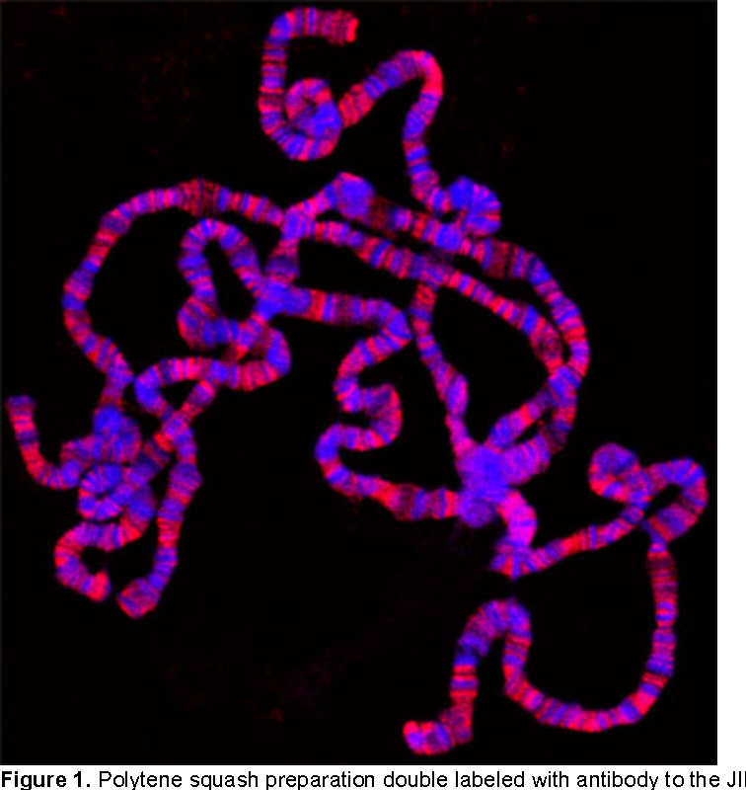
Polytene chromosome squash stained with Hoechst dye and anti-JIL1 histone kinase antibody

Slide 41
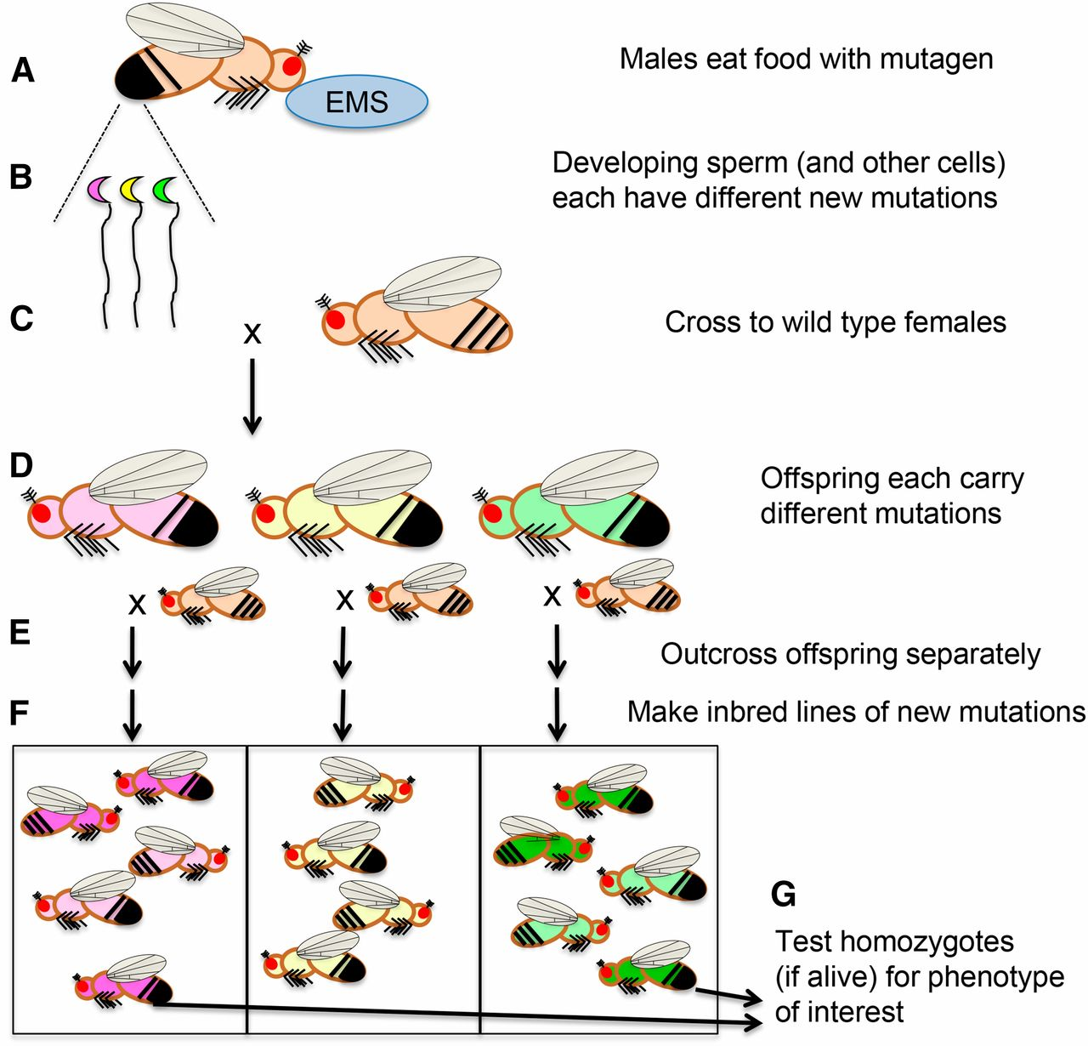
Figure 4 Generalized scheme for a forward genetic screen using chemical mutagenesis. (A) Male flies eat food laced ...
Notes:
Figure 4 Generalized scheme for a forward genetic screen using chemical mutagenesis. (A) Male flies eat food laced with ethane methyl sulfonate (EMS), an alkylating agent which typically causes point mutations. (B) Different mutations occur in each cell of the feeding flies, including sperm (indicated by pink, yellow, and green sperm cells). (C) Outcrossing the mutagenized flies to untreated females yields (D) offspring that each potentially have a different new mutations throughout their bodies, indicated schematically by body colors corresponding to the sperm cells above. (E) Outcrossing these flies individually and (F) inbreeding each set of offspring gives a population of flies for each new mutation. (G) Researchers then test homozygous flies (darker pink and green) for the phenotype of interest. In some cases, adult homozygotes are not viable (as in the yellow population) and so researchers interested in earlier developmental steps may examine embryos and larvae within these populations to find dying homozygotes.
Unless provided in the caption above, the following copyright applies to the content of this slide: © Genetics 2015This article is published and distributed under the terms of the Oxford University Press, Standard Journals Publication Model (https://academic.oup.com/journals/pages/open_access/funder_policies/chorus/standard_publication_model)

Slide 42
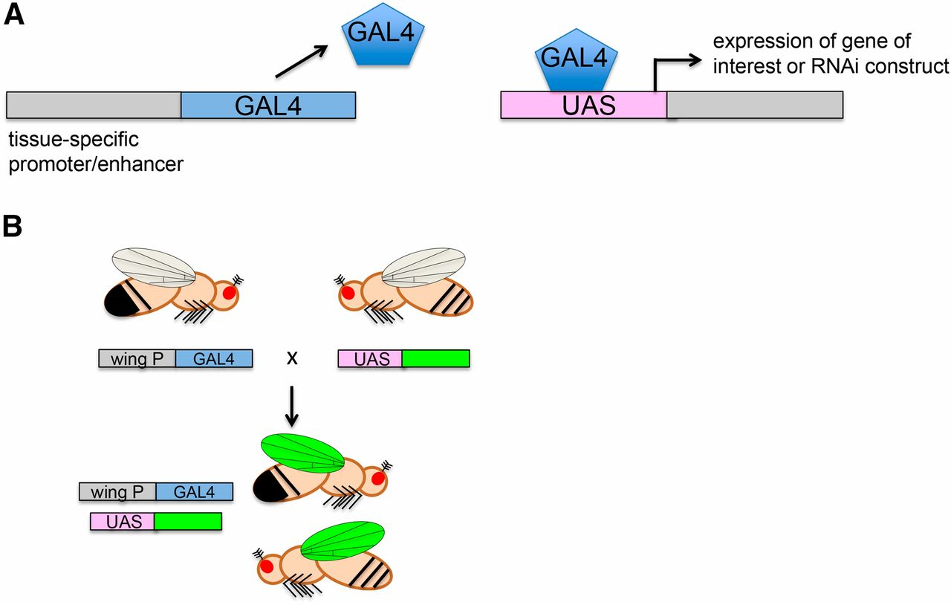
Figure 5 GAL4/UAS system for modular expression of transgenes in specific tissues. To express a transgene or RNAi ...
Notes:
Figure 5 GAL4/UAS system for modular expression of transgenes in specific tissues. To express a transgene or RNAi construct in a particular tissue, one needs flies carrying (A) a “driver” with a tissue-specific promoter/enhancer placed 5′ of the gene encoding the yeast GAL4 transcription factor (left) and (right) the gene of interest placed 3′ of the upstream activating sequence (UAS), which is activated by GAL4. (B) Transgenic flies carrying either of the two constructs alone (top) do not express the gene of interest, but when crossed into the same fly, the tissue-specific promoter (a wing promoter in this example) drives expression of GAL4, which turns on the gene of interest (here indicated by green) in the specified tissue. The system can also be used to express a hairpin RNA to knock down a gene in the target tissue.
Unless provided in the caption above, the following copyright applies to the content of this slide: © Genetics 2015This article is published and distributed under the terms of the Oxford University Press, Standard Journals Publication Model (https://academic.oup.com/journals/pages/open_access/funder_policies/chorus/standard_publication_model)

Slide 43
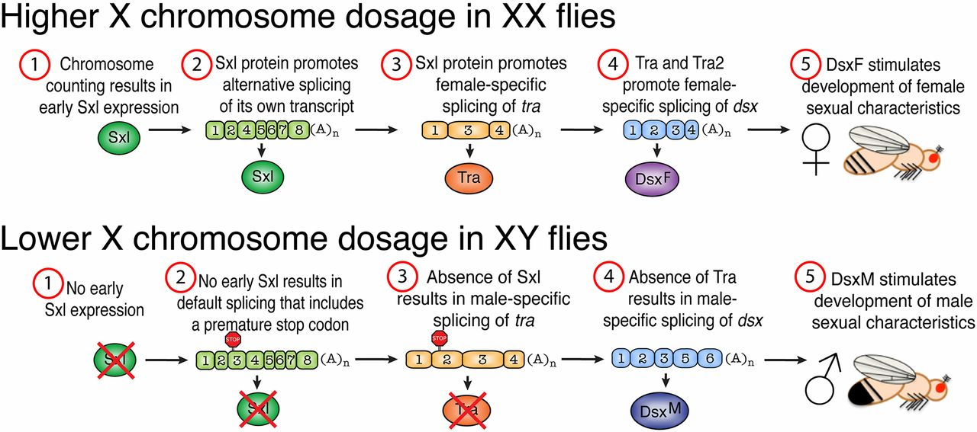
Figure 2 Sex determination. The number of X chromosomes in D. melanogaster is determined by an X chromosome counting ...
Notes:
Figure 2 Sex determination. The number of X chromosomes in D. melanogaster is determined by an X chromosome counting mechanism. In XX females, early expression of the RNA-processing gene Sex lethal (Sxl) later results in female-specific processing of its own transcript. Sxl then begins a cascade of alternative splicing events that ultimately result in generation of the female-specific isoform of Dsx (DsxF). Note that Fru is not shown here for clarity. In males, the absence of early Sxl expression results in default processing of Sxl and tra transcripts that contain an early stop codon. Dsx pre-mRNA is then processed for a male-specific isoform of Dsx (DsxM). These Dsx isoforms then promote expression of downstream genes that govern sex-specific decisions related to morphology and behavior.
Unless provided in the caption above, the following copyright applies to the content of this slide: © Genetics 2015This article is published and distributed under the terms of the Oxford University Press, Standard Journals Publication Model (https://academic.oup.com/journals/pages/open_access/funder_policies/chorus/standard_publication_model)

