Slide 1
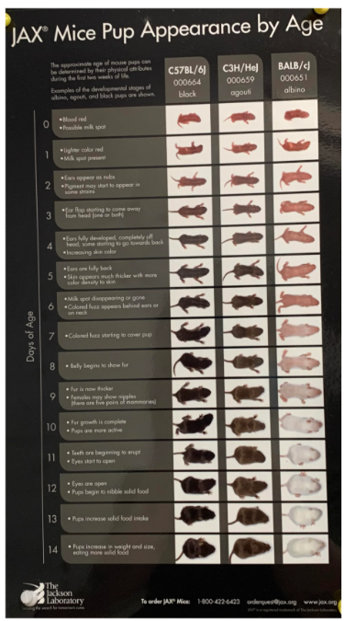
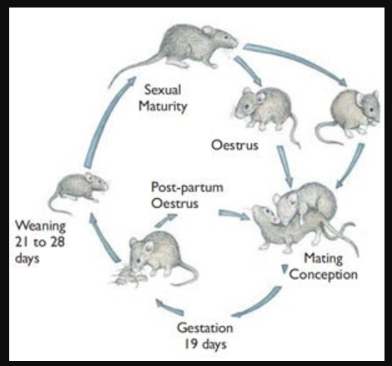
Lecture 12. Vertebrate genetic models and screens

Slide 2
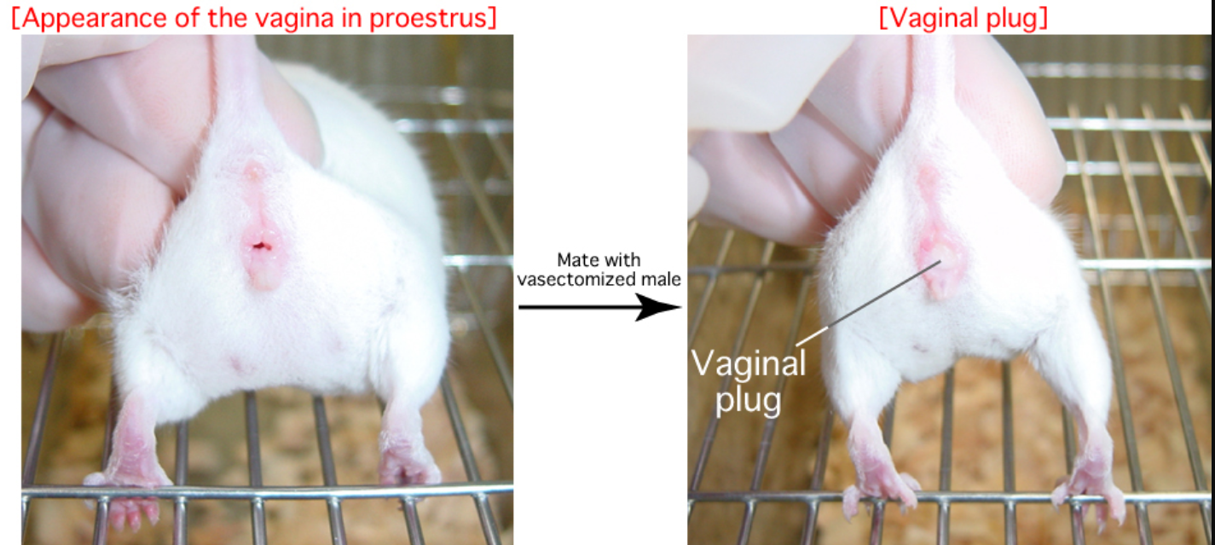

Slide 3
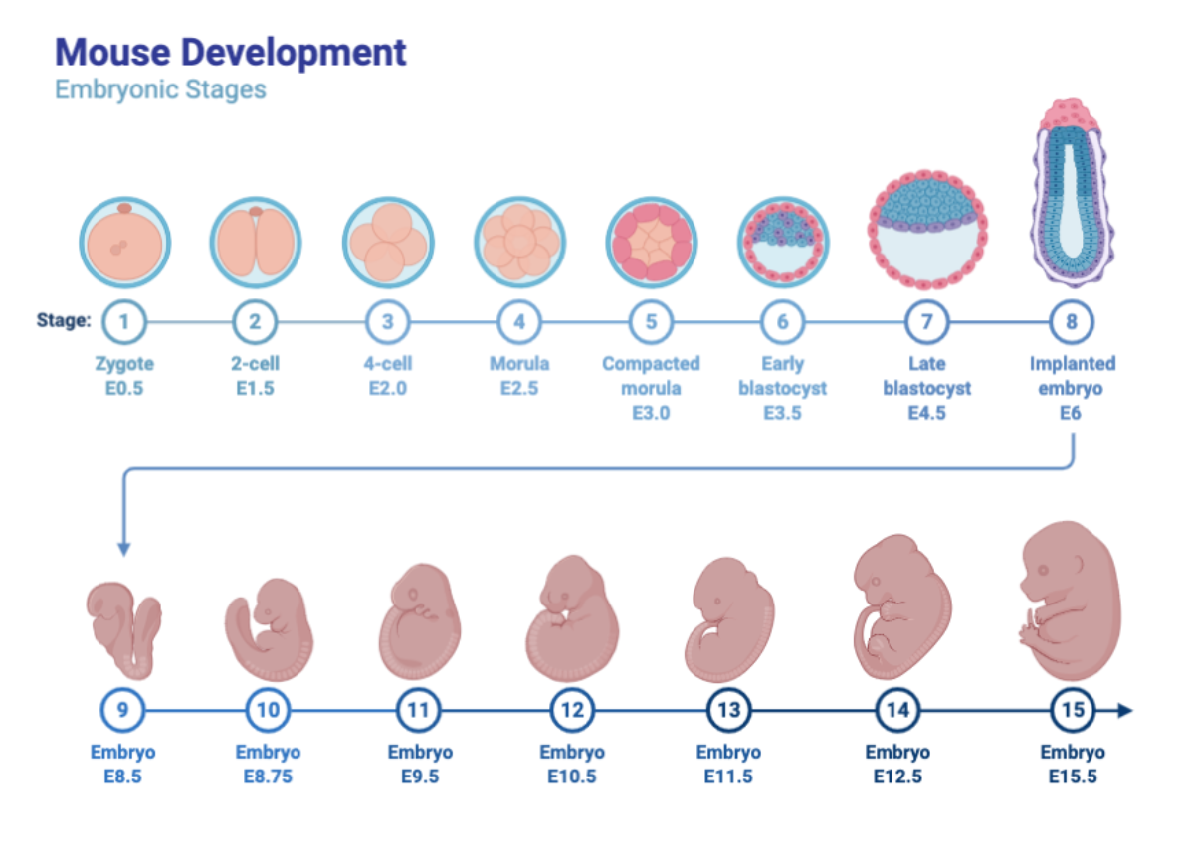

Slide 5
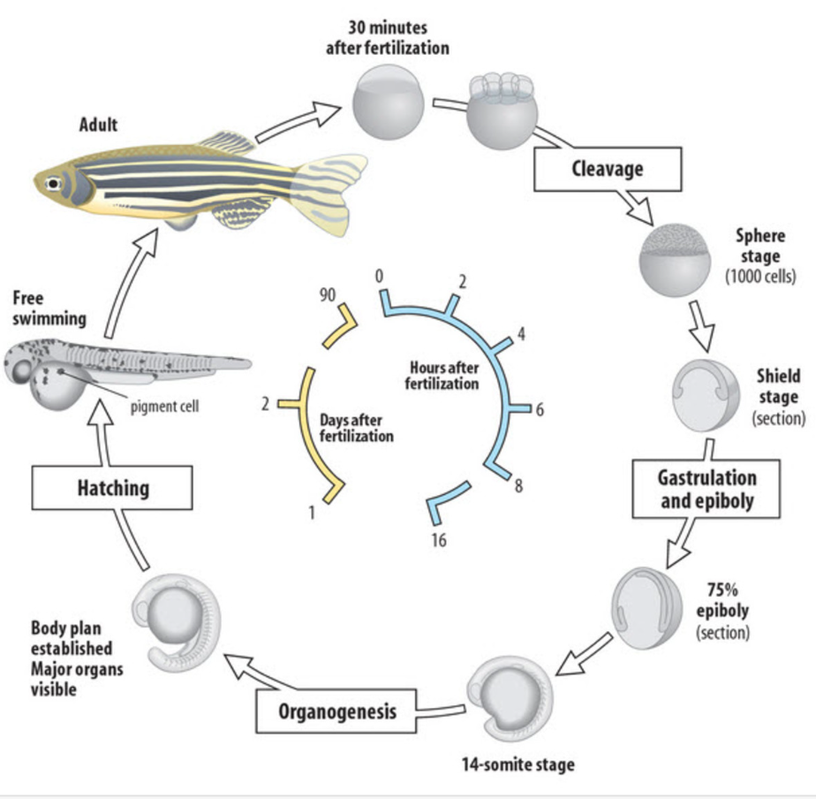
Zebrafish genetic model

Slide 6
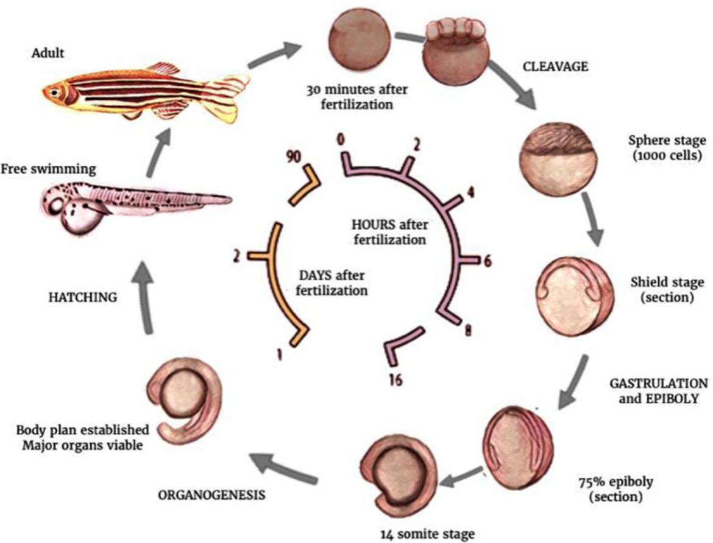

Slide 7
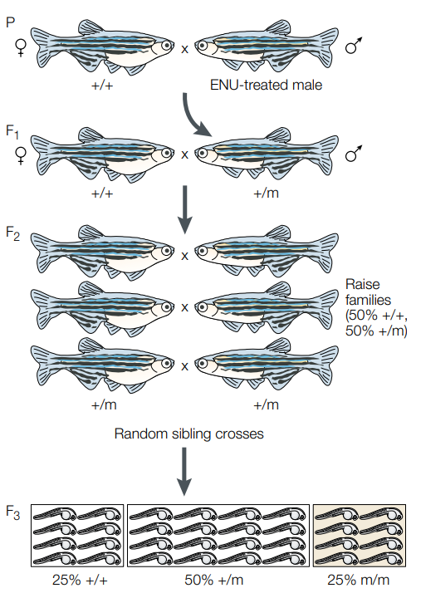
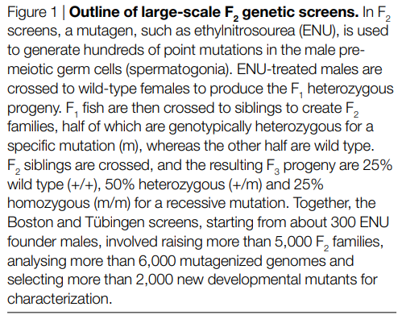

Slide 8
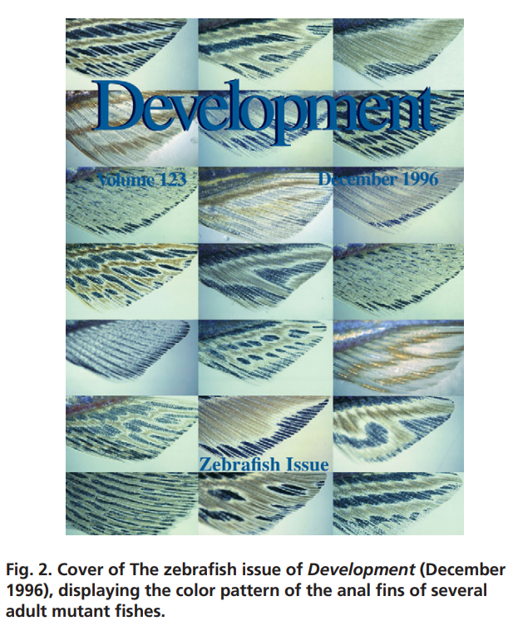
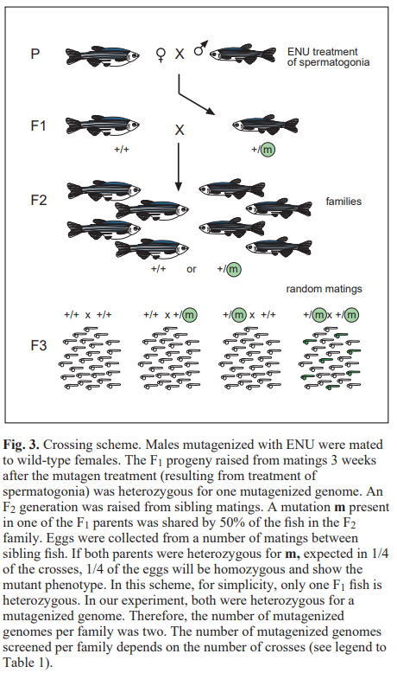

Slide 10
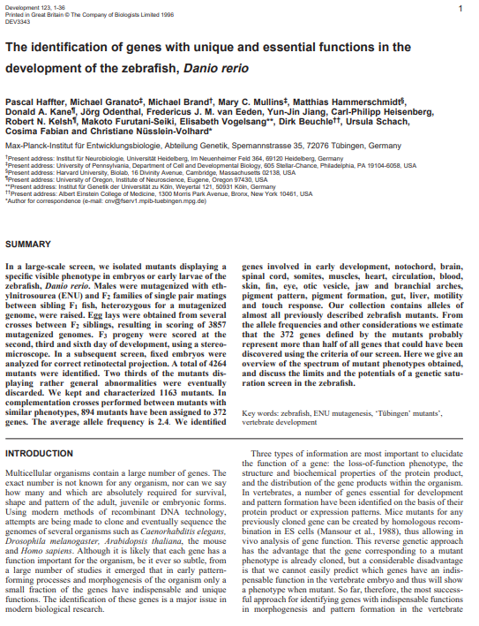

Slide 11
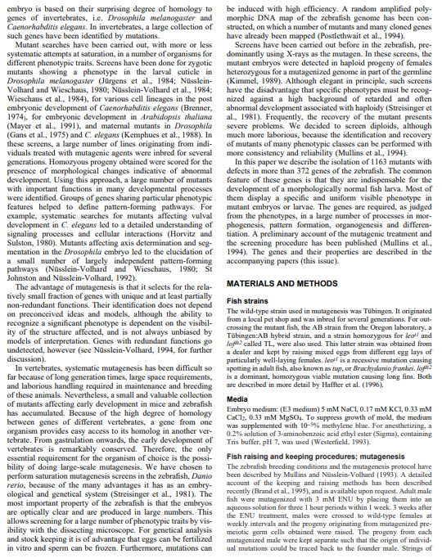

Slide 12
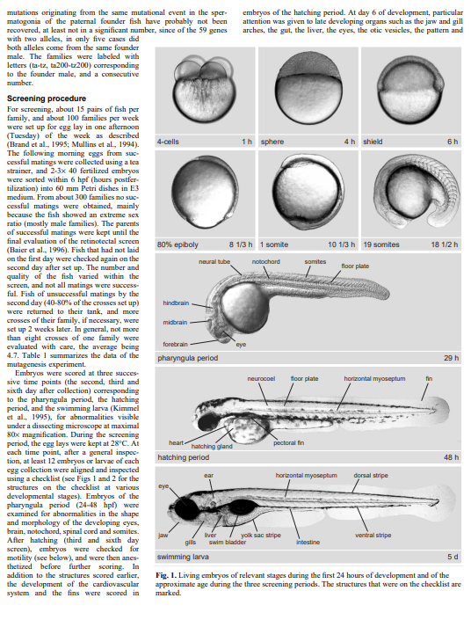

Slide 13
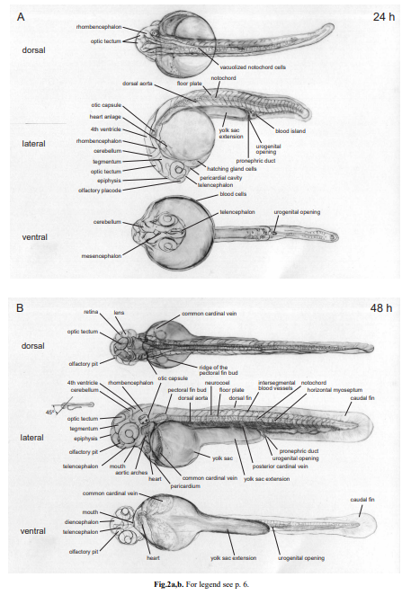
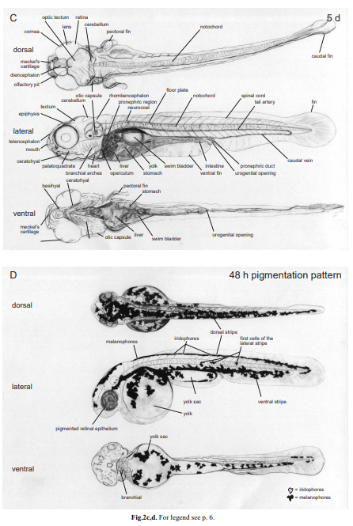

Slide 14
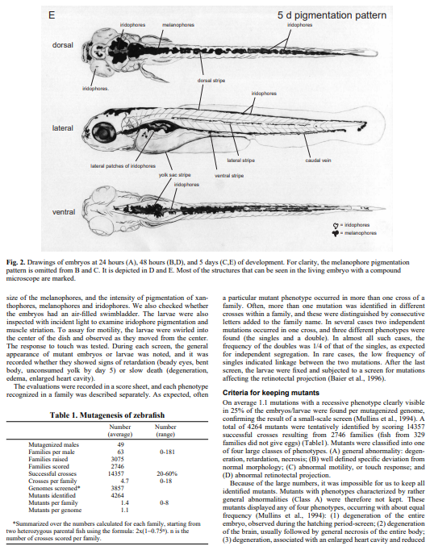

Slide 15
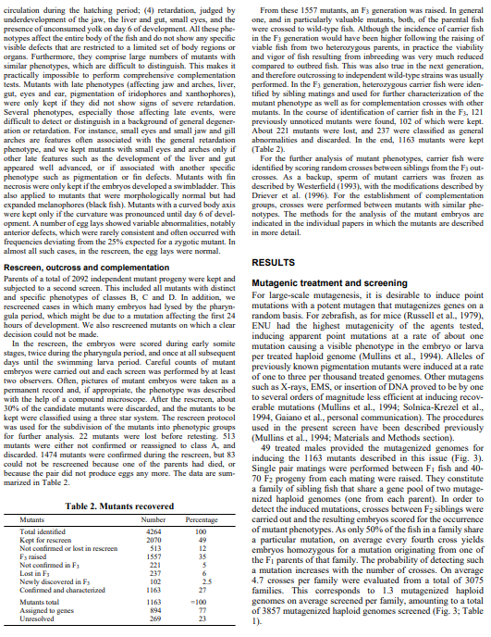

Slide 16
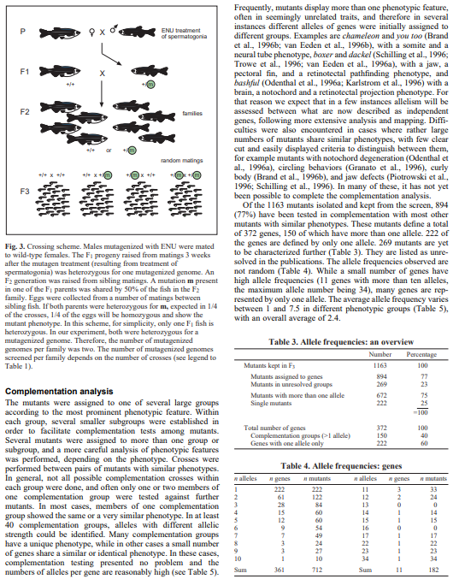

Slide 17
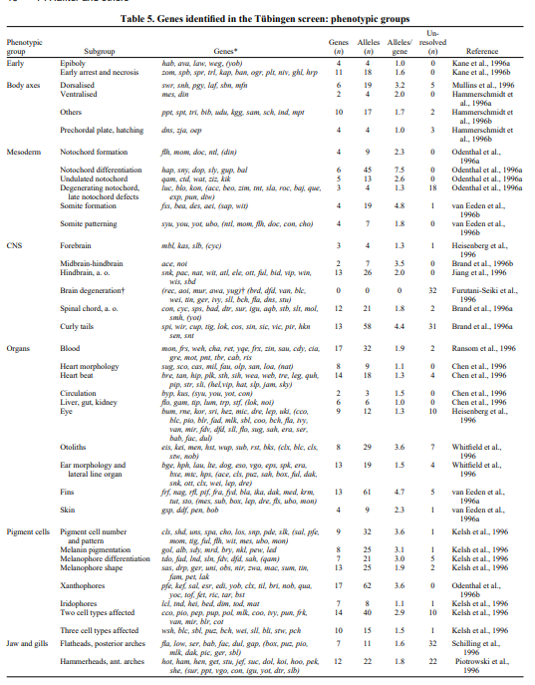
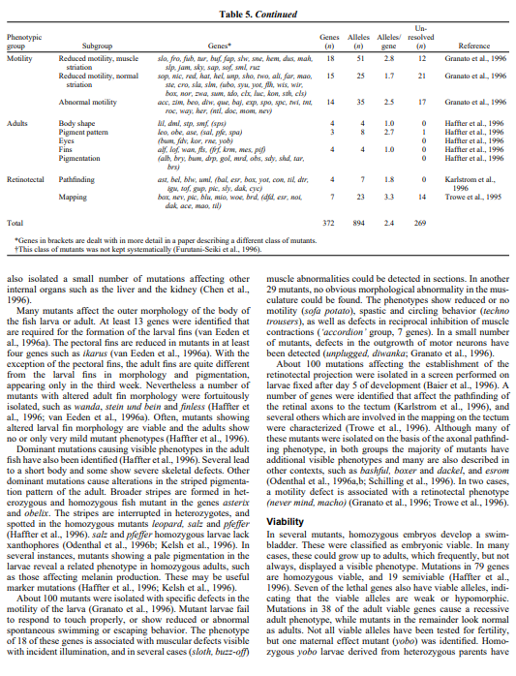

Slide 18
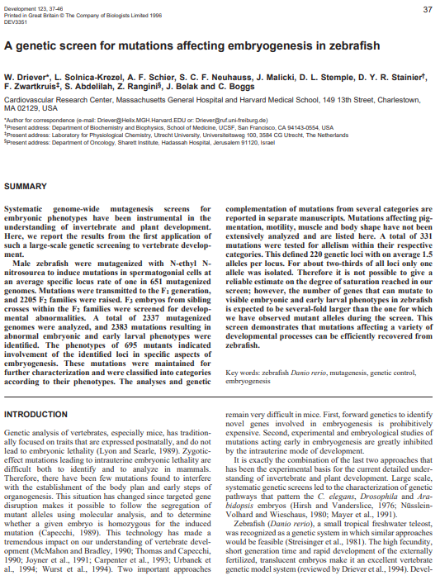

Slide 19
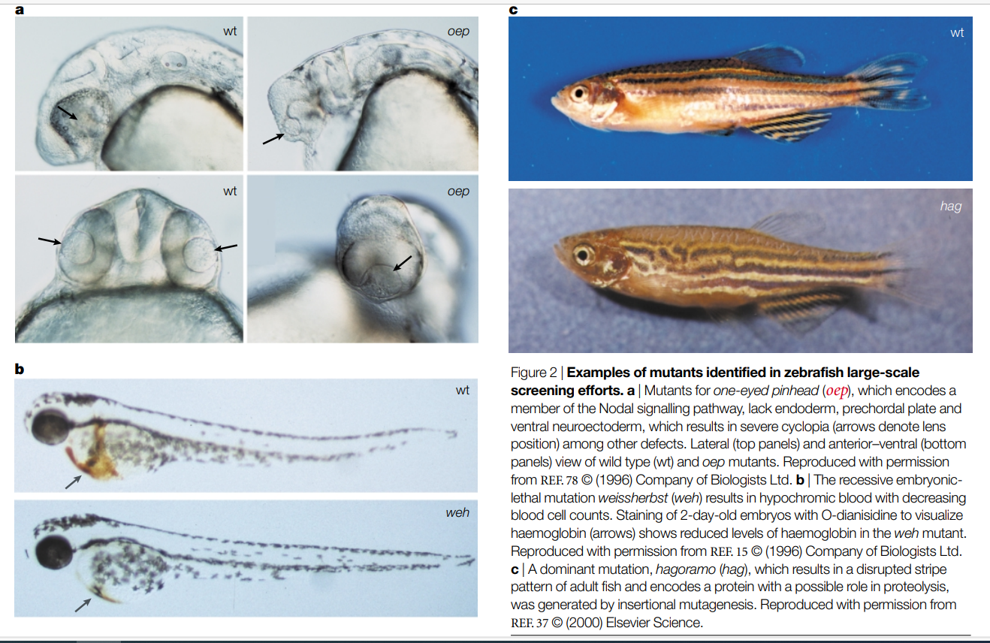

Slide 20
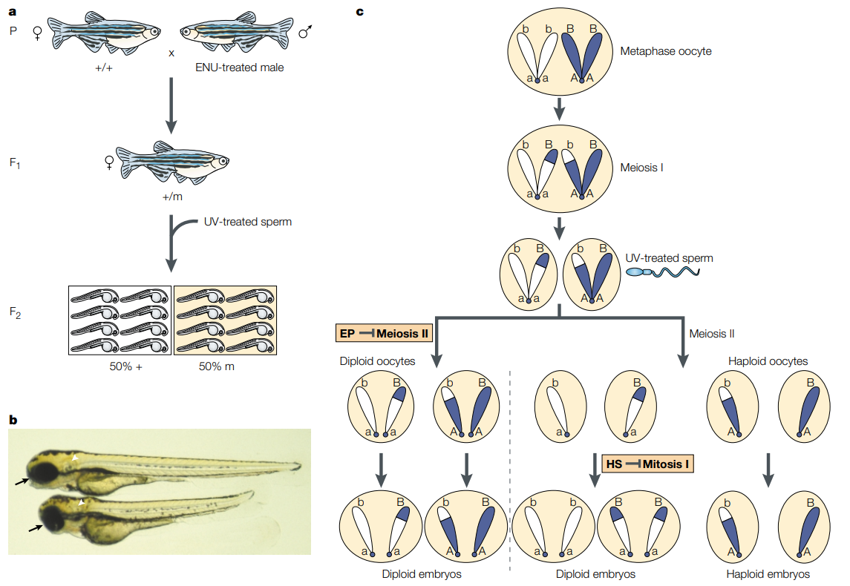

Slide 21
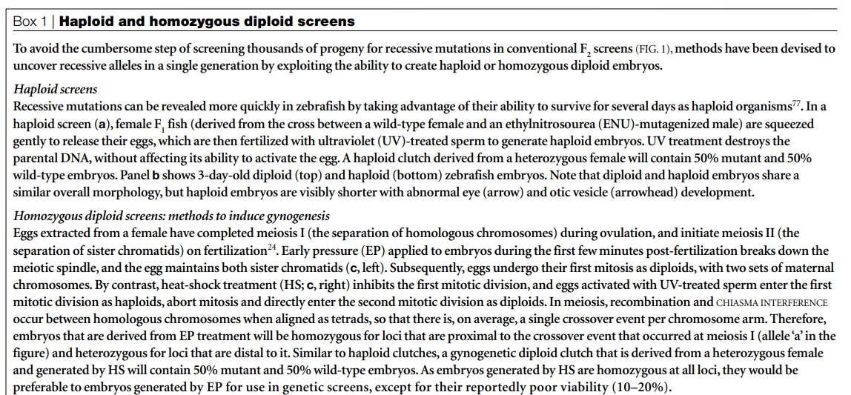

Slide 22
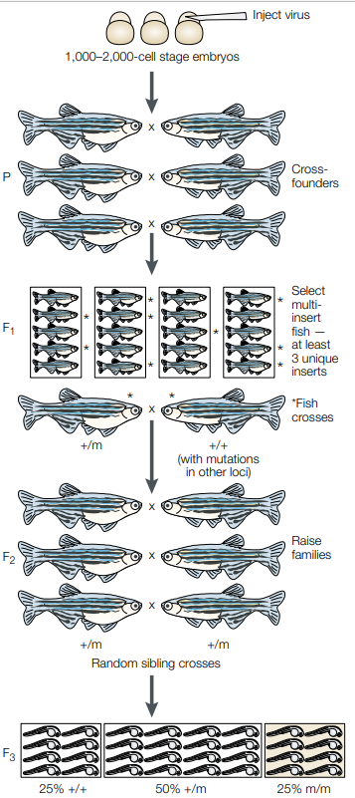
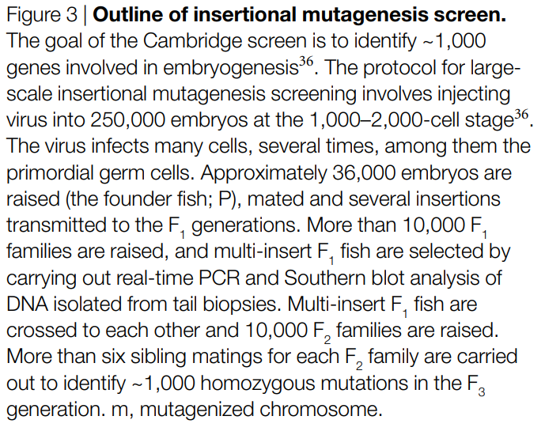

Slide 23
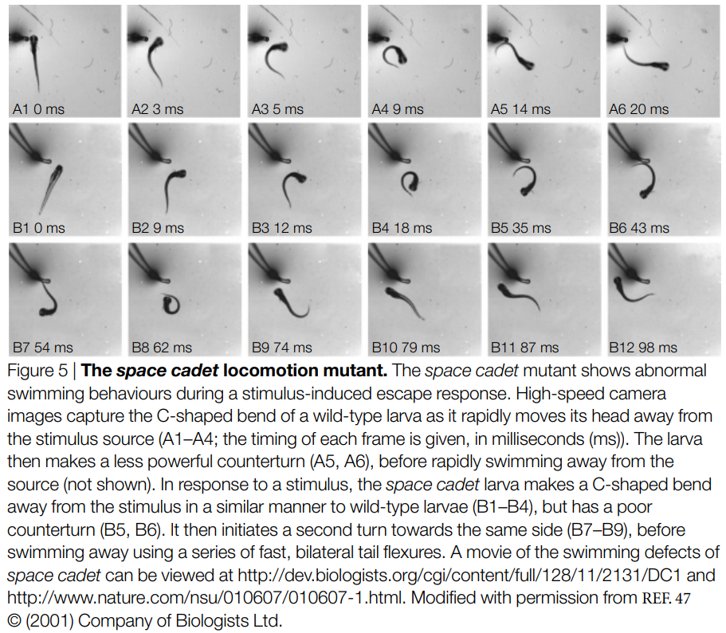

Slide 24
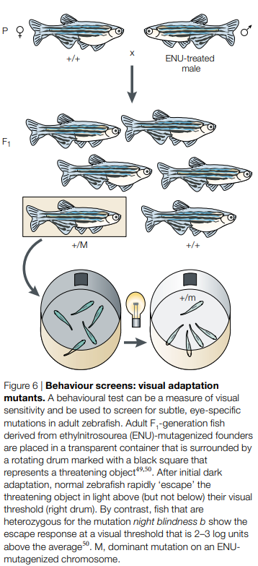

Slide 26
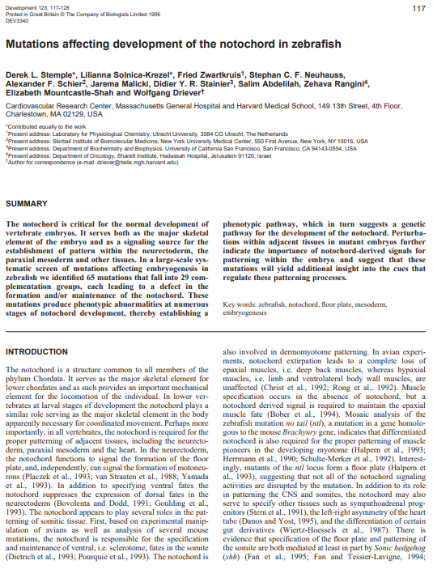

Slide 27
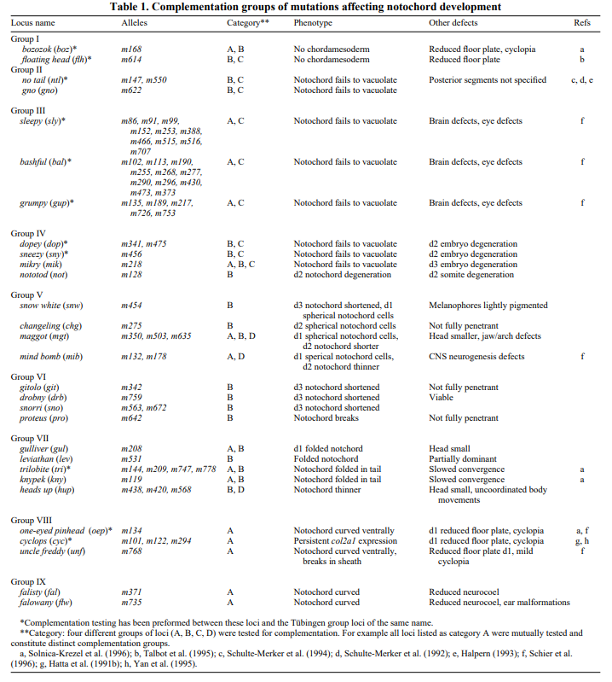
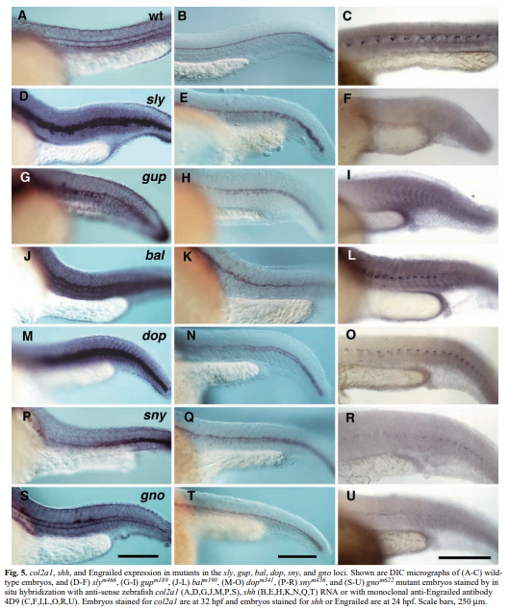

Slide 28
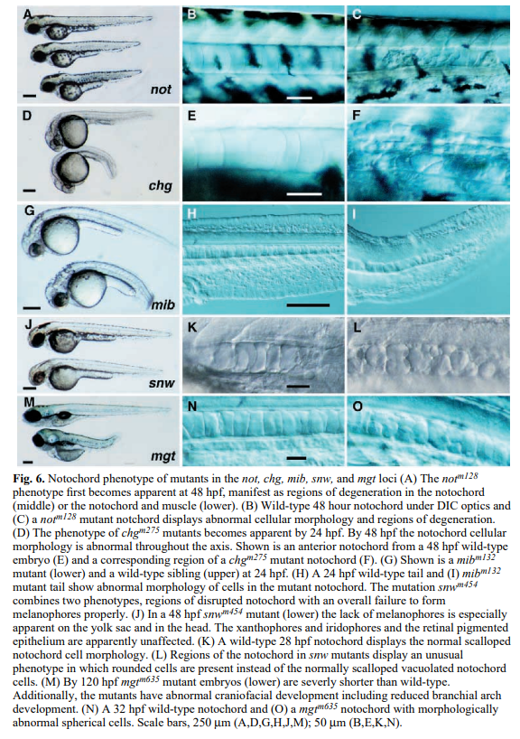
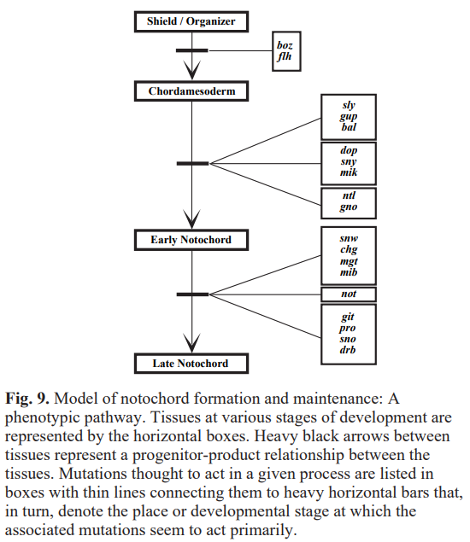

Slide 30
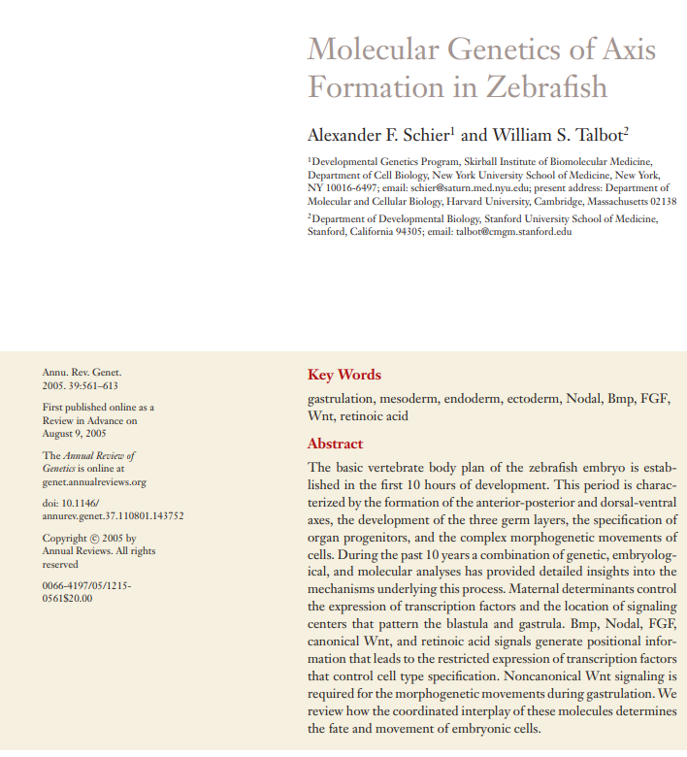
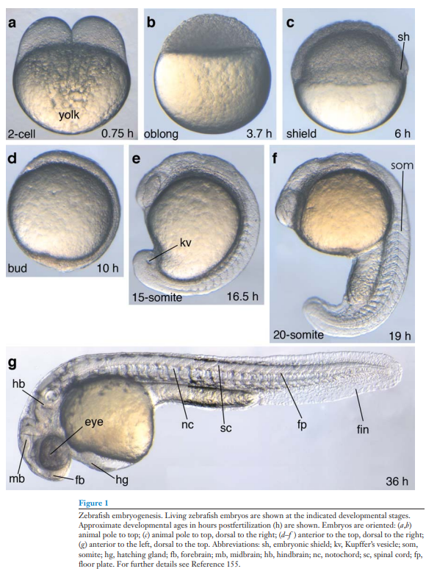

Slide 31
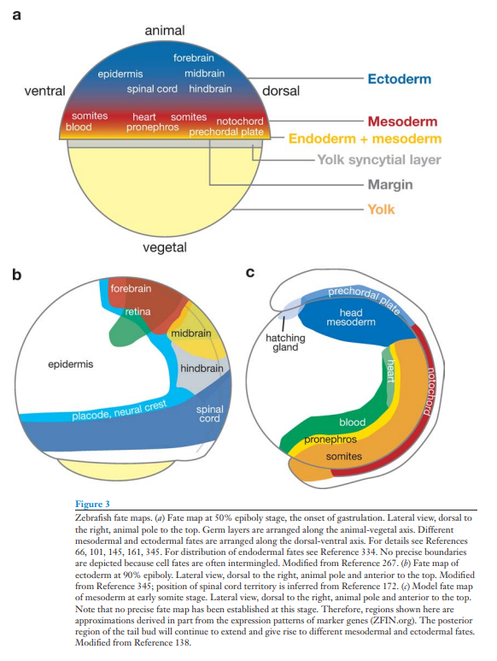
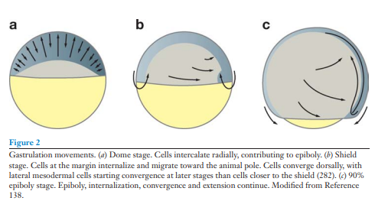
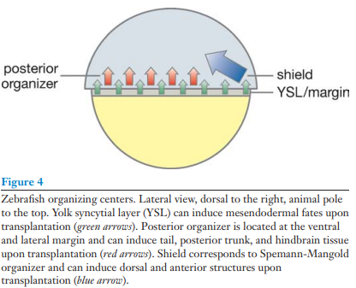

Slide 32
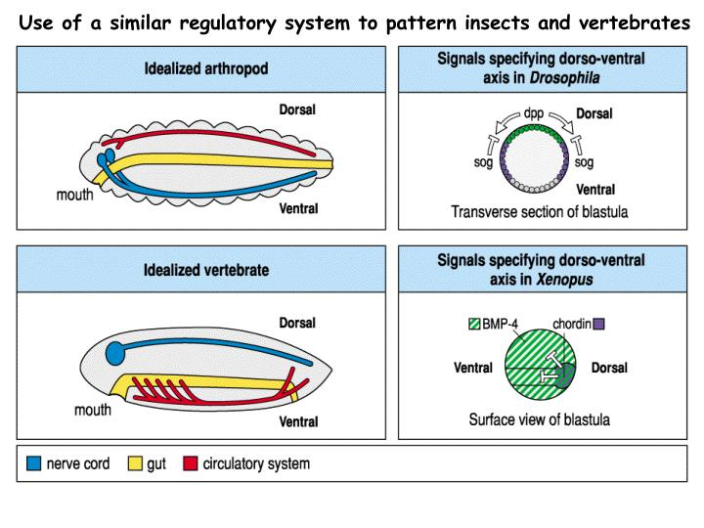
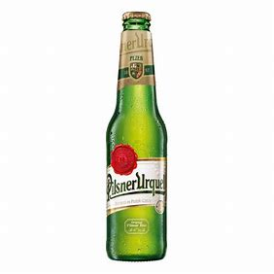
Eddy De Robertis proposed an Urbilaterian shared ancestor. Ur = original

Slide 33
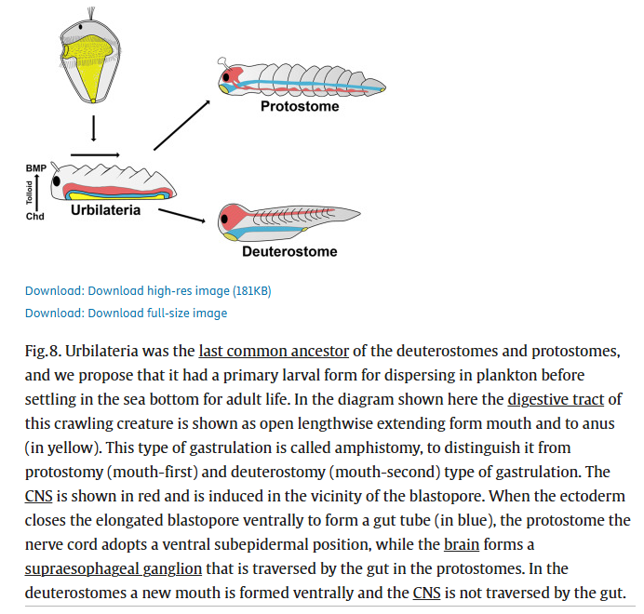
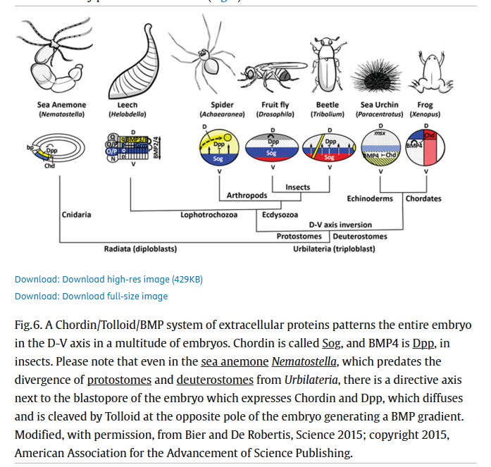

Slide 34
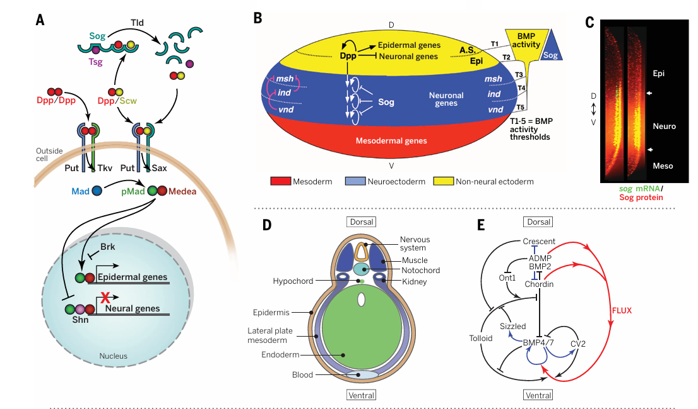
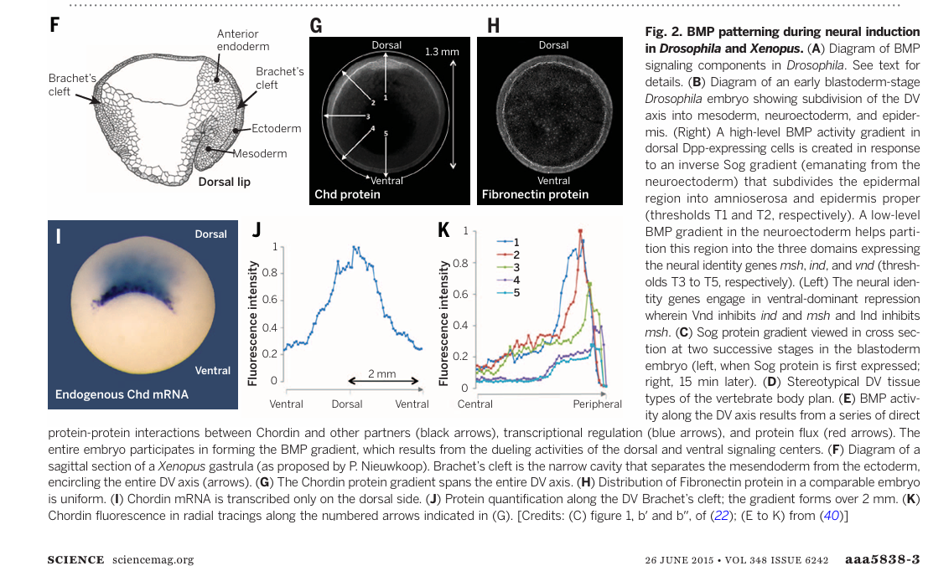

Slide 36
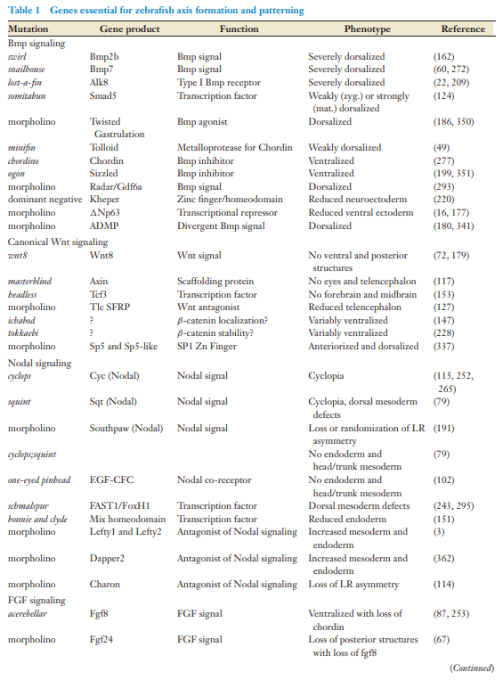
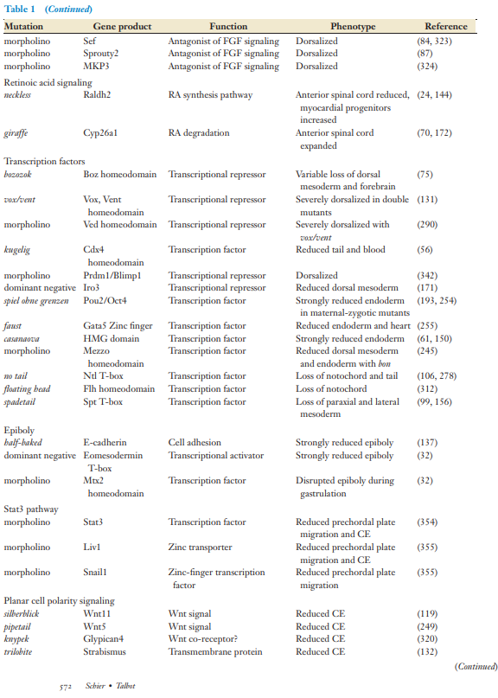

Slide 37
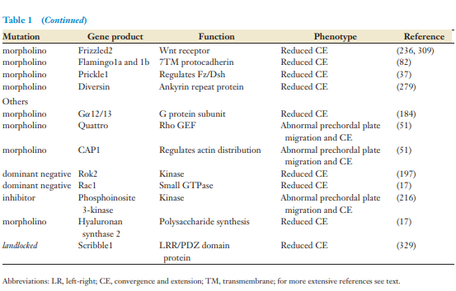

Slide 38
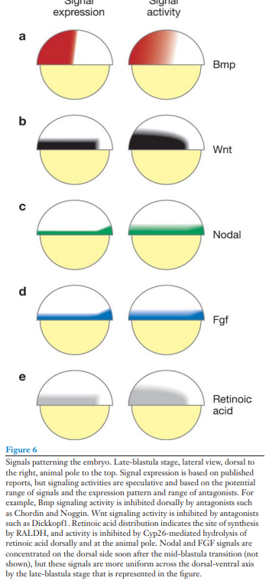

Slide 39
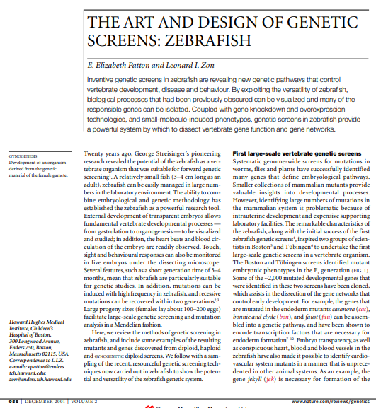
Reading

Slide 42
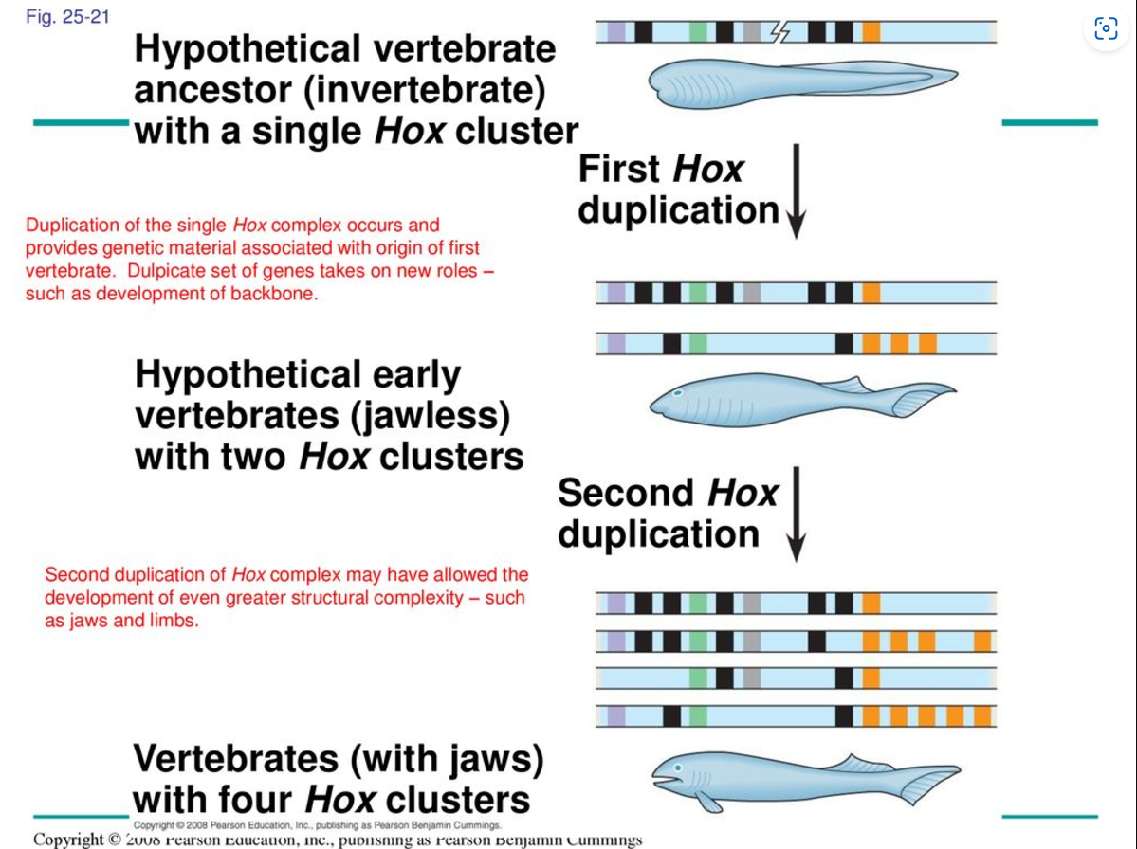

Slide 47
Lecture 12. Early genetic screens and vertebrate genetic screens

Slide 64
A classical model of inducible gene expression in a eukaryote.
GAL1 galactokinase (mutant allele is gal1)
GAL2 galactose permease
GAL7 galactose uridyl transferase
GAL10 galactose-glucose epimerase
GAL4 positive regulator (mutant is gal4)
GAL80 negative regulator (mutant is gal80)

Slide 65
Yeast GAL genes are positively regulated at the level of transcription activation.
A gal4, gal80 double mutant fails to induce expression of galactose enzymes. (gal4 mutation is epistatic to gal80)
Interpretation is that GAL4 targets the structural genes to activate transcription.
GAL80 interacts with GAL4 to control its activity.

Slide 66
Mechanism of transcription activation of the yeast GAL genes.

Slide 67
GAL1-lacZ and GAL10-lacZ fusions used for deletion analysis.
lacZ (β-galactosidase)) plate tests and liquid culture assays for
beta-gal activity units.
ONPG hydrolysis by cells gives a soluble blue product for
spectrophotometric measurement of lacZ (β-galactosidase ) activity units

Slide 68
Deletion analysis of yeast GAL1 upstream region defined an Upstream Activating Site (UAS_{G}).
Four copies of a nearly
symmetric 17 bp GAL4 site.
GAL1-lacZ and GAL10-lacZ fusions used for deletion analysis.
UAS_{G} had many properties of the Enhancer defined in SV40.

