Slide 1
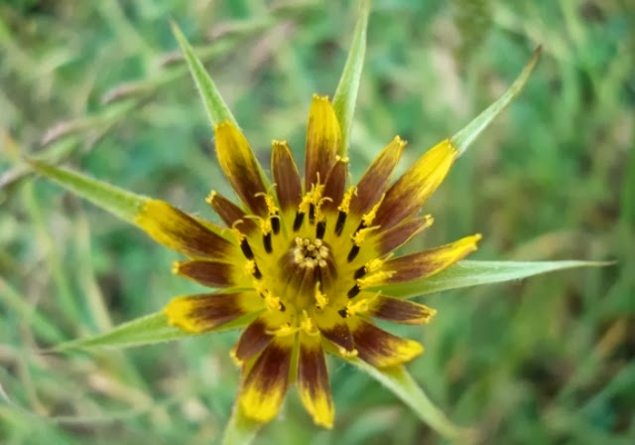
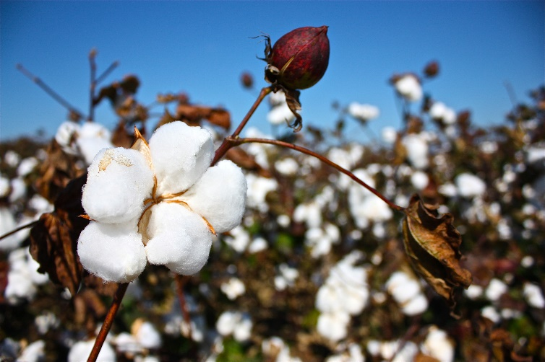
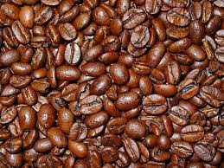
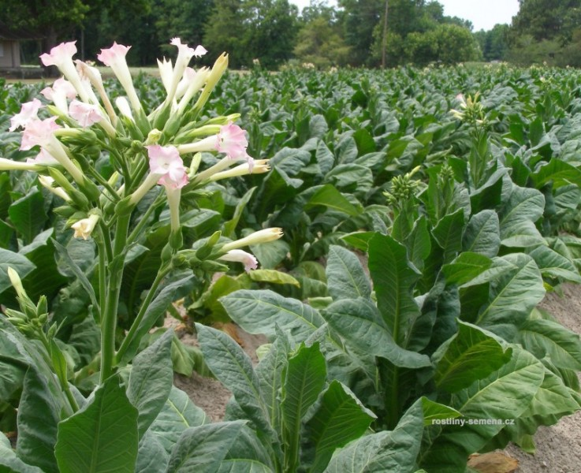
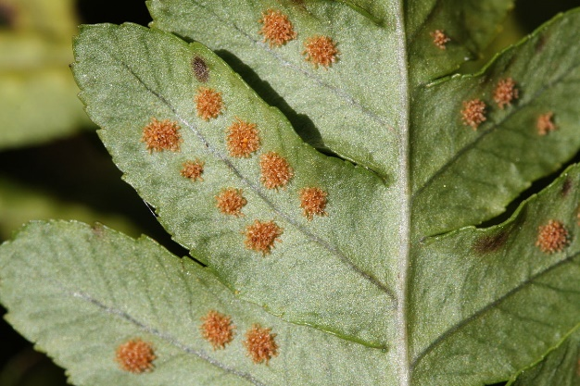
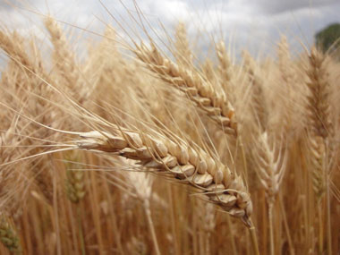
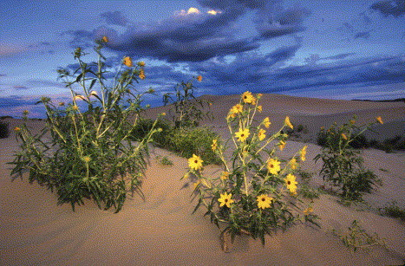
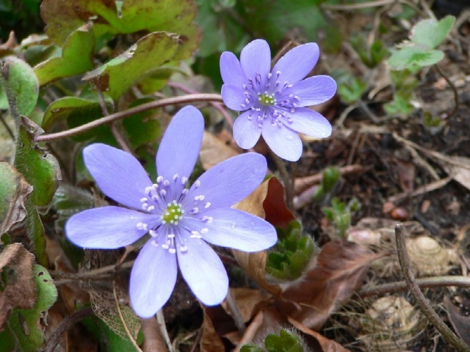
Hybrid speciation
Homoploid and Polyploid

Slide 2
Polyploid hybrid speciation
homoploid hybrid
allopolyploid hybrid
Tolmiea diplomenziesii (2n=14), T. menziesii (2n=28)
Soltis & Soltis (2009) The Role of Hybridization in Plant Speciation. Ann Rev 60: 561-588.
Paun et al. (2009) Hybrid speciation in angiosperms: Parental divergence drives ploidy. New Phytol 182: 507-518.
Otto (2007) The Evolutionary Consequences of Polyploidy. Cell 131: 452-462.
Ramsey & Schemske (1998) Pathways, mechanisms and rates of polyploid formation in flowering plants. Ann Rev 29: 467-501

Slide 3
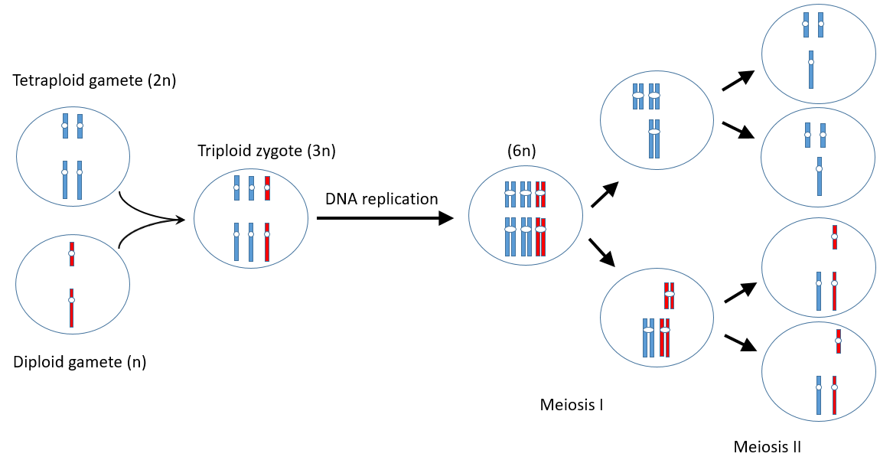
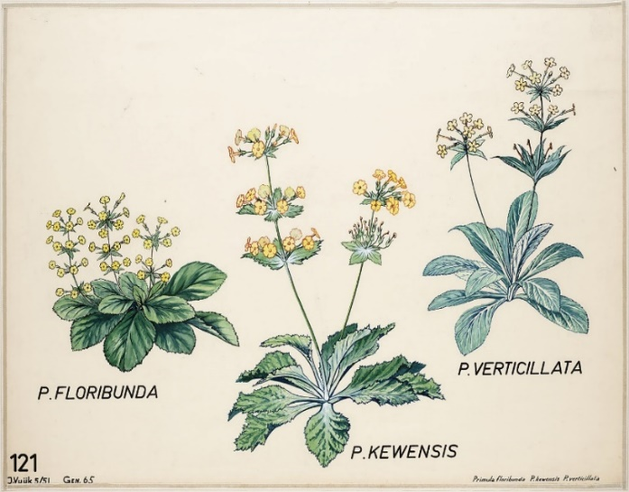
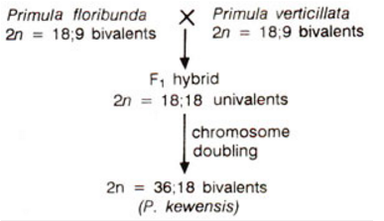
Polyploid hybrid speciation - origin, reproductive isolation
Soltis & Soltis (2009) The Role of Hybridization in Plant Speciation. Ann Rev 60: 561-588.
Riesberg & Willis (2007) Plant Speciation. Science 317: 910-914.
Ramsey & Schemske (1998) Pathways, mechanisms and rates of polyploid formation in flowering plants. Ann Rev 29: 467-501.

Slide 4
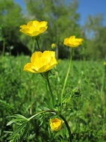
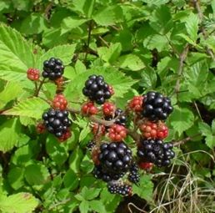
Polyploid hybrid speciation – disadvantages and advantages
Soltis & Soltis (2009) The Role of Hybridization in Plant Speciation. Ann Rev 60: 561-588.
Barringer (2007) Polyploidy and self-fertilization in flowering plants. Am J Bot 94: 1527-1533.
Comai (2005) The advantages and disadvantages of being polyploid. Nature Reviews 6: 837-846.
Barke et al. (2020) The relation of meiotic behaviour to hybridity, polyploidy and apomixis in the Ranunculus auricomus complex (Ranunculaceae). BMC Plant Biol 20: 523.

Slide 5
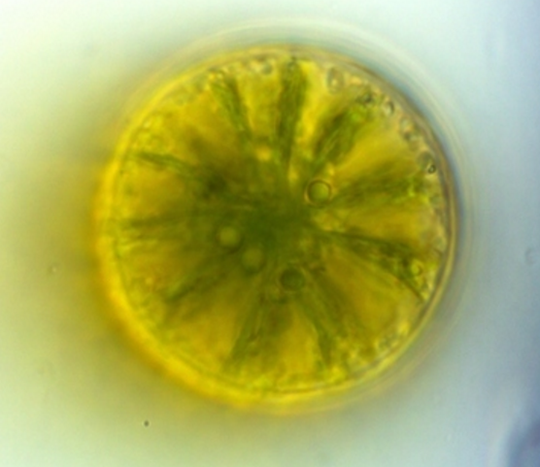
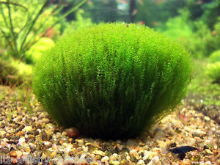
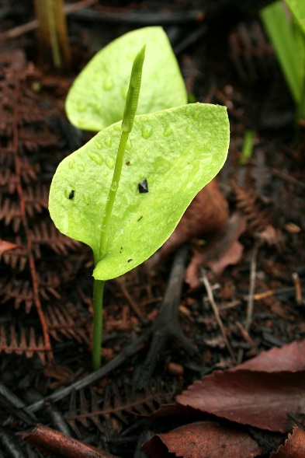
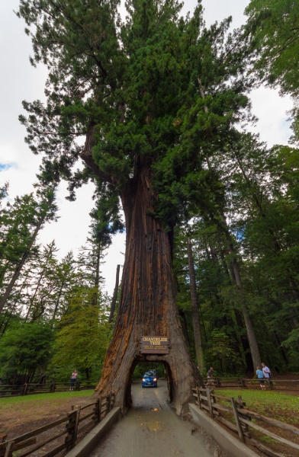
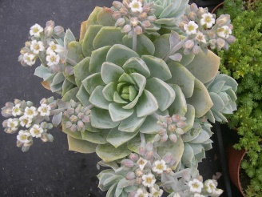
Netrium digitans
Leptodictyum riparium
Ophioglossum
reticulatum
Sequia
sempervirens
Sedum suaveolens
Husband et al. (2013) The Incidence of Polyploidy in Natural Plant Populations: Major Patterns and Evolutionary Processes. In: Plant Genome Diversity Vol. 2, Springer, pp 255-276.

Slide 6
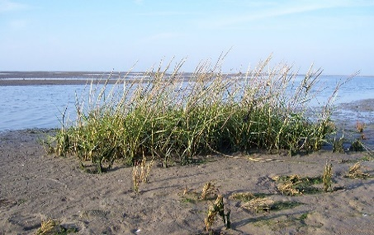
Polyploid hybrid speciation – recent and ancient polyploid speciation
Soltis & Soltis (2009) The Role of Hybridization in Plant Speciation. Ann Rev 60: 561-588.
Wood et al. (2009) The frequency of polyploid speciation in vascular plants. PNAS 106: 13875-13879.

