Slide 1
Publication Crimes and How to Fight Them
Štěpán Čada

Slide 2
What are the signs of quality science?
What makes a publication trustworthy enough for you to cite it?
What makes a scientist reliable enough for you to trust his opinions on the subject?
What makes a scientific project solid enough for you to collaborate?
What makes a sufficient publication basis to start your own research?
What determines whether a project gets funded?
What determines whether a paper gets published?

Slide 3
What are the signs of quality science?
What makes a publication trustworthy enough for you to cite it?
What makes a scientist reliable enough for you to trust his opinions on the subject?
What makes a scientific project solid enough for you to collaborate?
What makes a sufficient publication basis to start your own research?
What determines whether a project gets funded?
What determines whether a paper gets published?
Science as we know it is largely based on trust (among scientists themselves but also between scientists and society). The trust however needs to be protected.

Slide 4
What are the signs of quality science?

Slide 5
What are the signs of quality science?
Scientific awards?
Funding?
Publications in high-impact journals?
Media coverage?
Author’s career?
Affiliation with prestigious university/institute?
Number of publications?
Number of citations?
Transparency (availability of raw data, open peer reviews…)?
Indexing on PubMed/WoS/Scopus?
Peer review?

Slide 6
What are the signs of quality science?
Scientific awards?
Funding?
Publications in high-impact journals?
Media coverage?
Author’s career?
Affiliation with prestigious university/institute?
Number of publications?
Number of citations?
Transparency (availability of raw data)?
Indexing on PubMed/WoS/Scopus?
Peer review?
Gregg Semenza
Johns Hopkins’ Institute for Cell Engineering
Nobel prize in physiology, 2019
More than 50 publications questioned online based on problematic image data
9/2022: 4 papers in PNAS retracted (together cited more than 750x)
Currently (10/2024) total of 13 retractions.
https://www.nature.com/articles/d41586-022-03032-9
https://retractionwatch.com/2023/10/02/nobel-prize-winner-gregg-semenza-tallies-tenth-retraction/

Slide 7
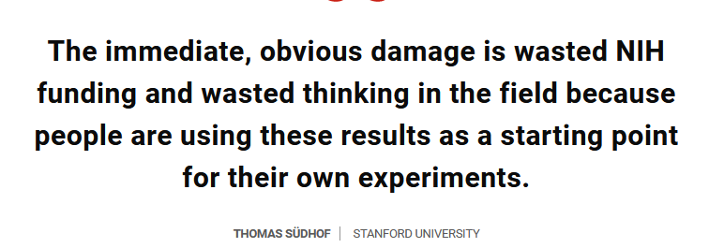
What are the signs of quality science?
Alzheimer disease research
Simufilam
8/2021: NIH received a report about potential data manipulation in the clinical testing of new drug Simufilam, which lead to federal investigation of Cassava Sciences company which owns it.
10/2023: Co-developer of the drug, Hoau-Yan Wang, was found guilty of research misconduct, based on image data manipulation.
https://www.science.org/content/article/co-developer-cassava-s-potential-alzheimer-s-drug-cited-egregious-misconduct
Sylvain Lesné
7/2022: Signs of image data manipulation exposed also in one of the most-cited works in the AD field (Lesné et al., 2006).
It is estimated that tens of millions USD from NIH grants and 16 years of research have been wasted.
https://www.science.org/content/article/potential-fabrication-research-images-threatens-key-theory-alzheimers-disease

Slide 8
What are the signs of quality science?
“Viroj Wiwanitkit has published 543 items indexed in PubMed in the last 12 months, the vast majority of them letters to the editor. Most of Wiwanitkit’s letters with colleagues appear to be only a single paragraph. Many concern COVID-19 and vaccinations, but the catalog includes letters about monkeypox, knee replacement surgery, bipolar disorder, even ChatGPT.”
Viroj Wiwanitkit
Joseph Ayobabalola University in Nigeria
https://retractionwatch.com/2023/07/24/meet-the-author-who-has-published-more-than-500-letters-to-the-editor-in-a-year/

Slide 9
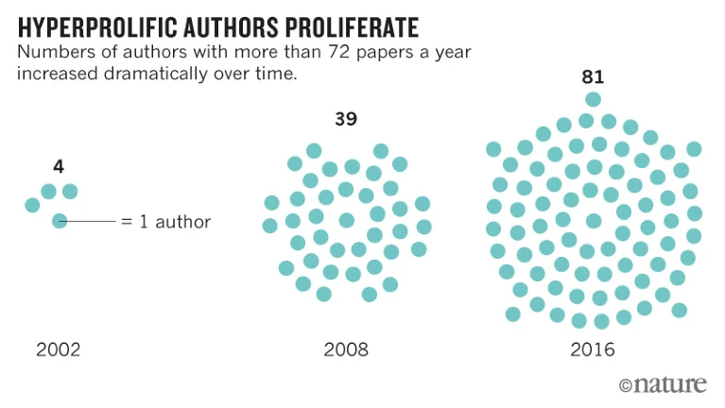
What are the signs of quality science?
“We searched Scopus for authors who had published more than 72 papers (the equivalent of one paper every 5 days) in any one calendar year between 2000 and 2016, a figure that many would consider implausibly prolific. We found more than 9,000 individuals, and made every effort to count only ‘full papers’ — articles, conference papers, substantive comments and reviews — not editorials, letters to the editor and the like.”
“The number of hyperprolific authors (after our exclusions) grew about 20-fold between 2001 and 2014, and then levelled off (…). Over the same period, the total number of authors increased by 2.5-fold.”
https://www.nature.com/articles/d41586-018-06185-8

Slide 10
Traditional publishing system is failing
Insufficient motivation of reviewers
Peer-reviewing is time-consuming and traditionally not honored by journals.
Financial conflict of interest of publishing houses
More papers in shorter time → more money.
Disproportionate open-access publishing fees
https://www.spectrumnews.org/news/imaging-journal-editors-resign-over-extreme-open-access-fees/
Insufficient motivation of publishers and institutions to investigate and retract problematic publications.
Investigation of research ethics is fully in hands of the affiliated institutions, which often leads to conflicts of interest (reputation loss, prominent position of involved researchers). Investigation rarely leads to punishment of involved researchers.
“Publish or perish” vs. replication crisis (replication studies and negative data are rarely published)
Reporting problematic data and ethical misconducts carries high personal and career risks but at the same time is not rewarded by publishers or institutions.

Slide 11
Problematic publications are not effectively eliminated from the scientific record.
Relative number of retracted publications does not reflect the yearly increase in number of all published articles.
“(…)we estimate — on the basis of evidence from surveys, studies and reports from sleuths — that one in 50 papers would meet at least one of the criteria for retraction from the Committee on Publication Ethics, a non-profit collective in Eastleigh, UK. These include “clear evidence that the findings are unreliable”, whether because of falsified data, plagiarism, faked peer review or just ‘major error’, which might involve contaminated cell lines or another non-fraudulent problem. Yet the rate of retraction is still under 0.1%.”
Ivan Oransky, founder of Retraction Watch, 2022.
https://www.nature.com/articles/d41586-022-02071-6

Slide 12
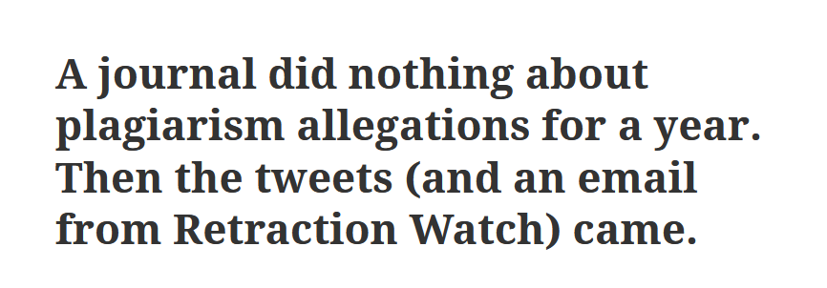
Problematic publications are not effectively eliminated from the scientific record.
Insufficient motivation of publishers/editors
Insufficient communication/unwillingness to verify critique by readers but also to publish corrections suggested by authors(!).
Too long periods of investigation (years).

Slide 13
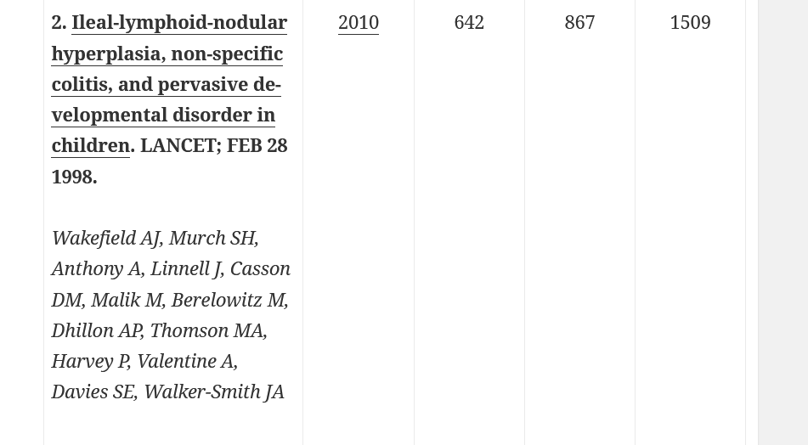
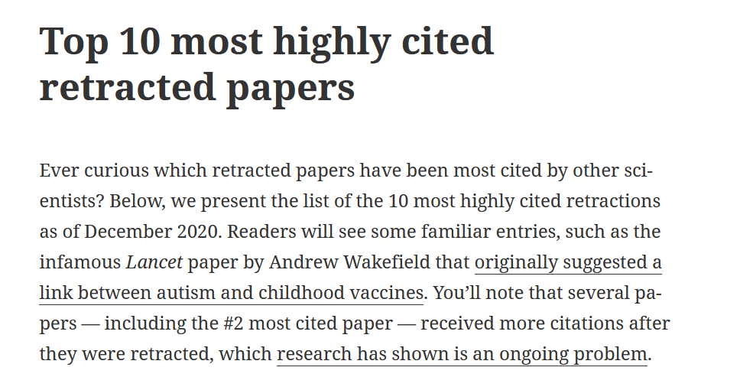
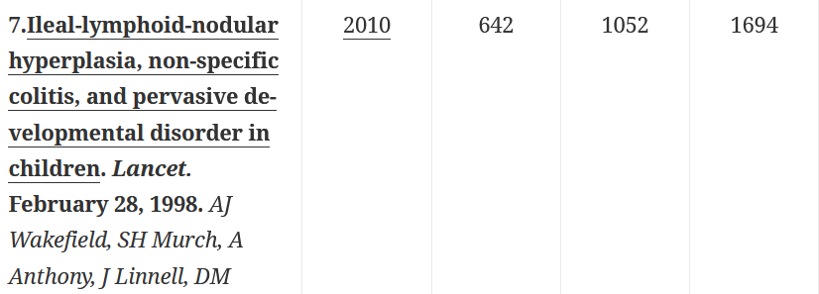
Problematic publications are not effectively eliminated from the scientific record.
Even when false publications are retracted, they can still be read and cited.
Before/after retraction
2023
2024
https://retractionwatch.com/the-retraction-watch-leaderboard/top-10-most-highly-cited-retracted-papers/

Slide 14
Problematic publications are not effectively eliminated from the scientific record.
Even when false publications are retracted, they can still be read and cited.
We identified 478 retracted articles, 220 (46%) of which were cited at least once. We contacted 1297 corresponding authors of the papers that cited these articles, 417 (30%) of whom responded to our survey and were included in the final analysis. The median number of authors in the analyzed articles was five, and the median elapsed time from retraction to citation was 3 yr. Most of the corresponding authors (89%) were unaware of the retracted status of the cited article, mainly because of inadequate notification of the retraction status in journals and/or databases and the use of stored copies.

Slide 15
When publication system fails, lives are at stake
Paolo Macchiarini
Karolinska Institutet (KI), Sweden
Experimental transplantation of artificial tracheas in combination with stem cells (2011-2012)
7 out of 8 operated patients died
“One patient died suddenly when the implant caused massive bleeding just 4 months after it was implanted; the two others survived for 2.5 and nearly 5 years, respectively, but suffered painful and debilitating complications before their deaths.”[1]
2016 – guilty of research misconduct (KI), and then few more times:
“The articles contain fabricated and distorted descriptions of the patients’ conditions before and after the operations. Justification is lacking for treatment of the patients on the grounds of so-called vital indication (when a given treatment is the last resort for survival), and one misses reference to relevant animal experiments which must precede human studies that involve unproven methods. Furthermore, ethical approvals are lacking, as are appropriate informed consents.”[2]
2023 – sentenced in Sweden to prison for 2,5 years for causing bodily harm to his patients
[1] https://www.science.org/content/article/transplant-surgeon-gets-prison-sentence-failed-stem-cell-treatments
[2] https://news.ki.se/seven-researchers-responsible-for-scientific-misconduct-in-macchiarini-case

Slide 16
Despite the long-standing evidence of data falsification and research misconduct ruling (2016), the articles in Lancet were only marked with an Expression of concern in February 2023 and retracted after public backlash in October 2023.
https://retractionwatch.com/2023/10/27/lancet-retracts-two-more-papers-by-convicted-surgeon-paolo-macchiarini/

Slide 17
Antivax movement as a symptom of publishing system dysfunction
Andrew J. Wakefield
Royal Free Hospital and UCL (London)
1998 – published an influential study in Lancet connecting vaccination against measles to new form of enterocolitis linked to autism. Attempts at replication by other researchers failed.
2004 – Sunday Times revealed undisclosed financial conflict of interest on Wakefield part. By selling test-kits for “autistic enterocolitis” he made up to 43 million GBP.
2006 - 2010 - General Medical Council (GMC) investigation.
Found evidence of research misconduct, falsification of data and ethical approvals.
2010 – article retracted, Wakefield struck off the UK medical register
More: https://www.bmj.com/content/342/bmj.c5347

Slide 18
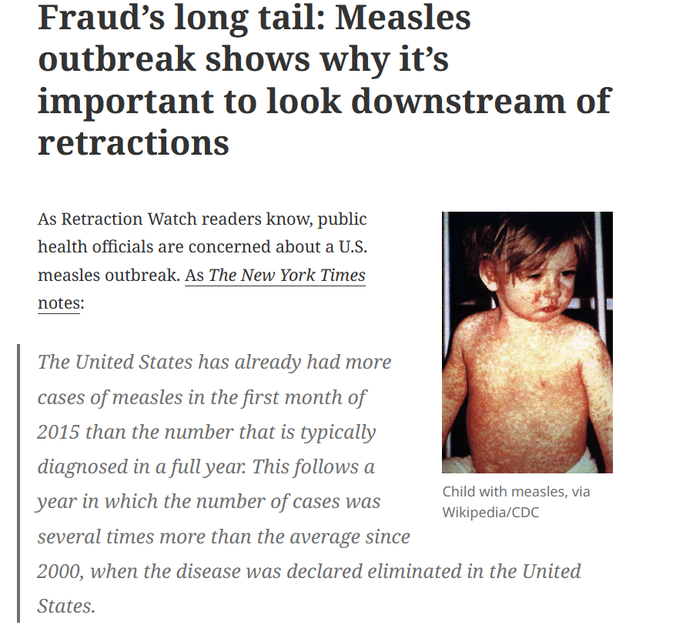
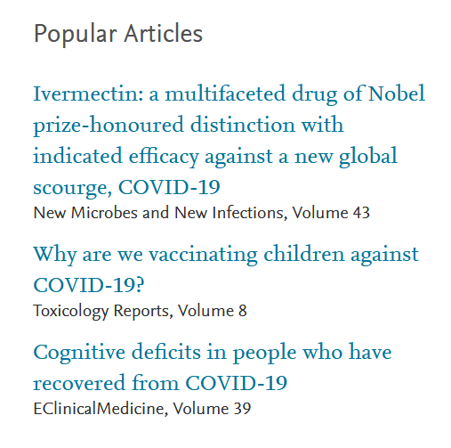
Antivax movement as a symptom of publishing system dysfunction
ScienceDirect homepage
November 2021
https://retractionwatch.com/2015/02/03/frauds-long-tail-measles-outbreak-shows-important-look-downstream-retractions/

Slide 19
Traditional publishing system is failing
Publishing industry works for profit and has no motivation to reform.
Journals are encouraged to publish increasing number of articles over shorter span of time.
Institutions and publishers are too passive to effectively investigate research misconduct.
Researchers are forced to publish as often as possible, but not honored for reviewing the literature, publishing replication and negative data.
Whistleblowers face high personal risks, but at the same time are not rewarded for their work.
The result is an environment which encourages production of poor-quality and falsified research publications.
Falsified publications are usually hard to uncover, but even when it happens, it can still undermine the trust of the public in scientific research in general.
Consequences of public distrust towards research are severe.

Slide 20
How to recognize problematic publication in biomedicine field?
Image data are currently one of the main sources for revealing problems in presented data.
At least 4 % of primary biomedicine publications (1 in 25) contains problematic image data.^{[1]}
This number likely represents only the tip of the iceberg:
Not all problematic publications contain image data
Not all problematic publications contain easily identifiable image problems.
Sometimes, the problem is hidden in the publication process itself (manipulation/absence of peer review, “hijacking” of special issues and whole journals).
The real number of problematic publications is much higher.
[1] https://journals.asm.org/doi/10.1128/mbio.00809-16

Slide 21
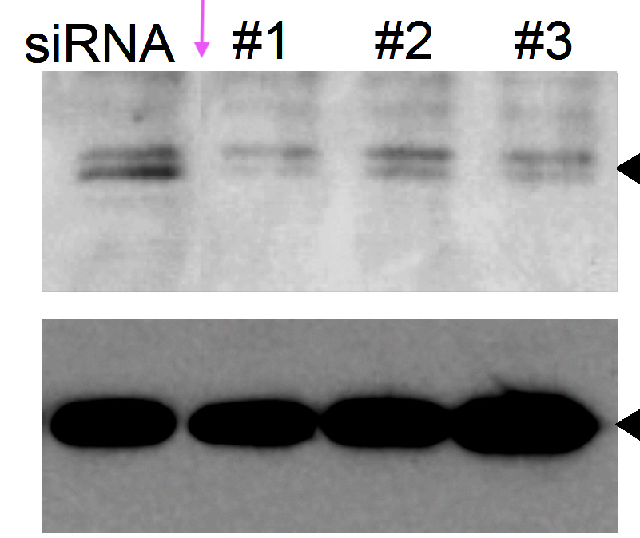
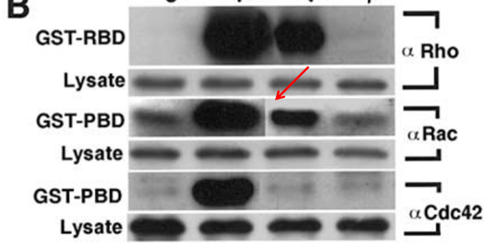
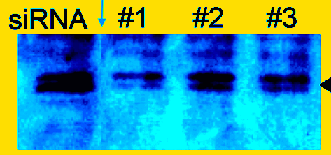
Case study
Splicing
Compiling bands from different membranes/gels next to each other.
Considered bad practice now but tolerated in older papers.

Slide 22
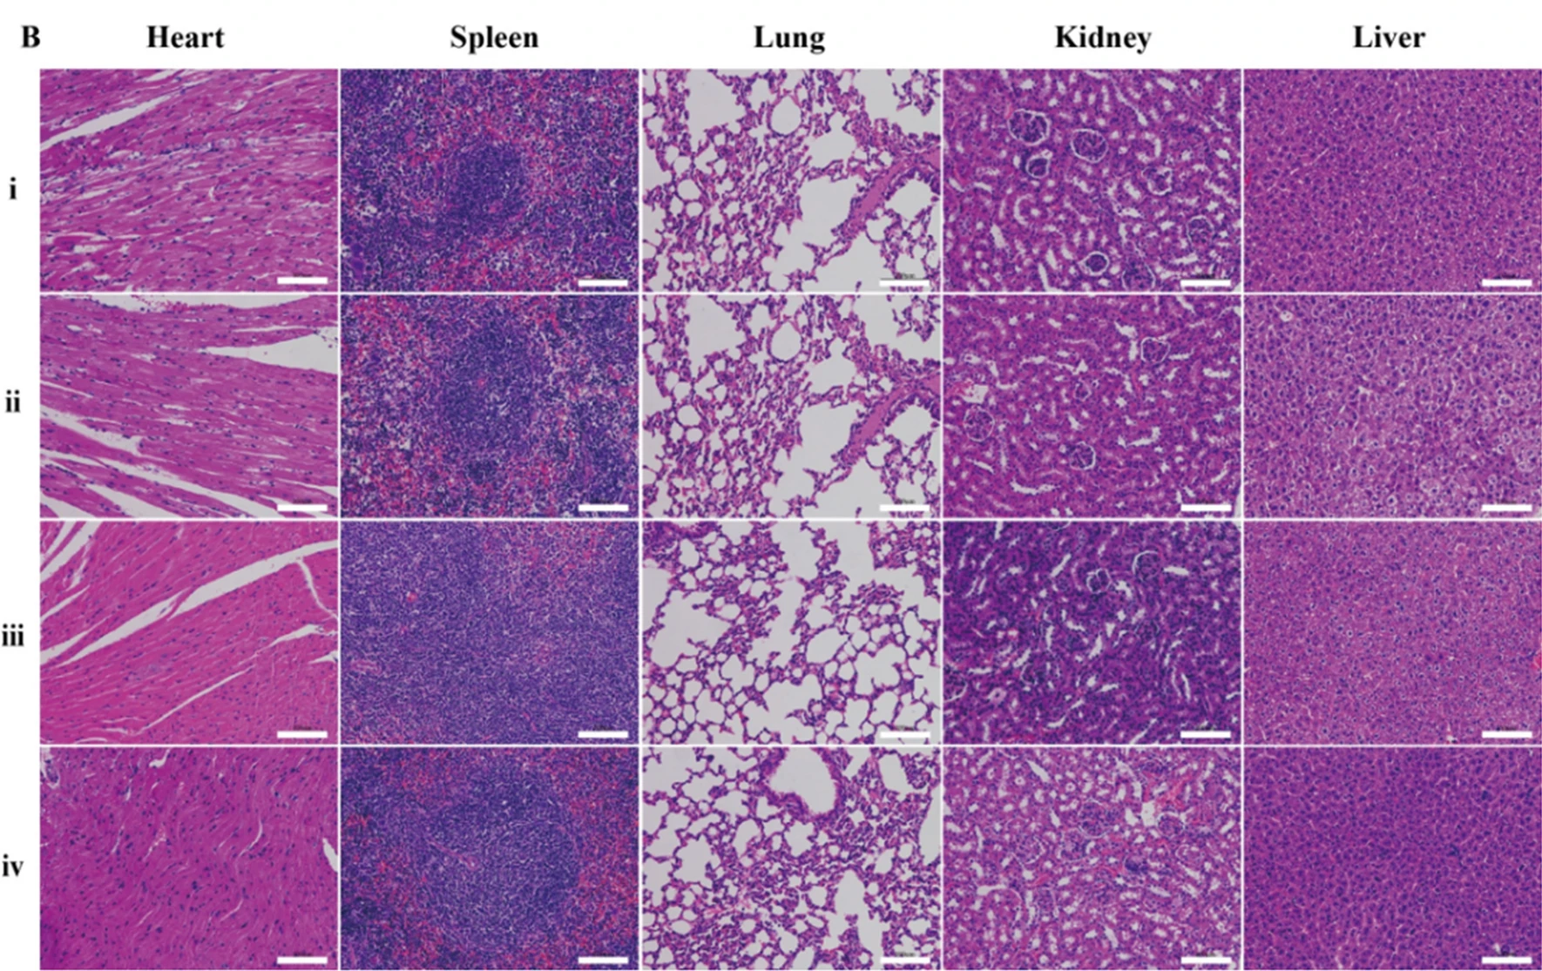
Case study
Image duplication type I (simple duplication of image panel).

Slide 23
Case study
Duplication type I (western blot)

Slide 24
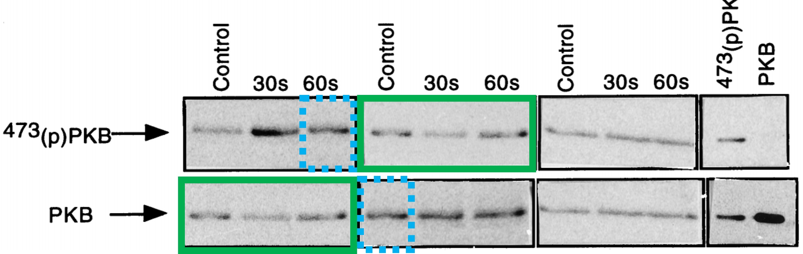
Case study
Duplication type II - overlapping panels

Slide 25
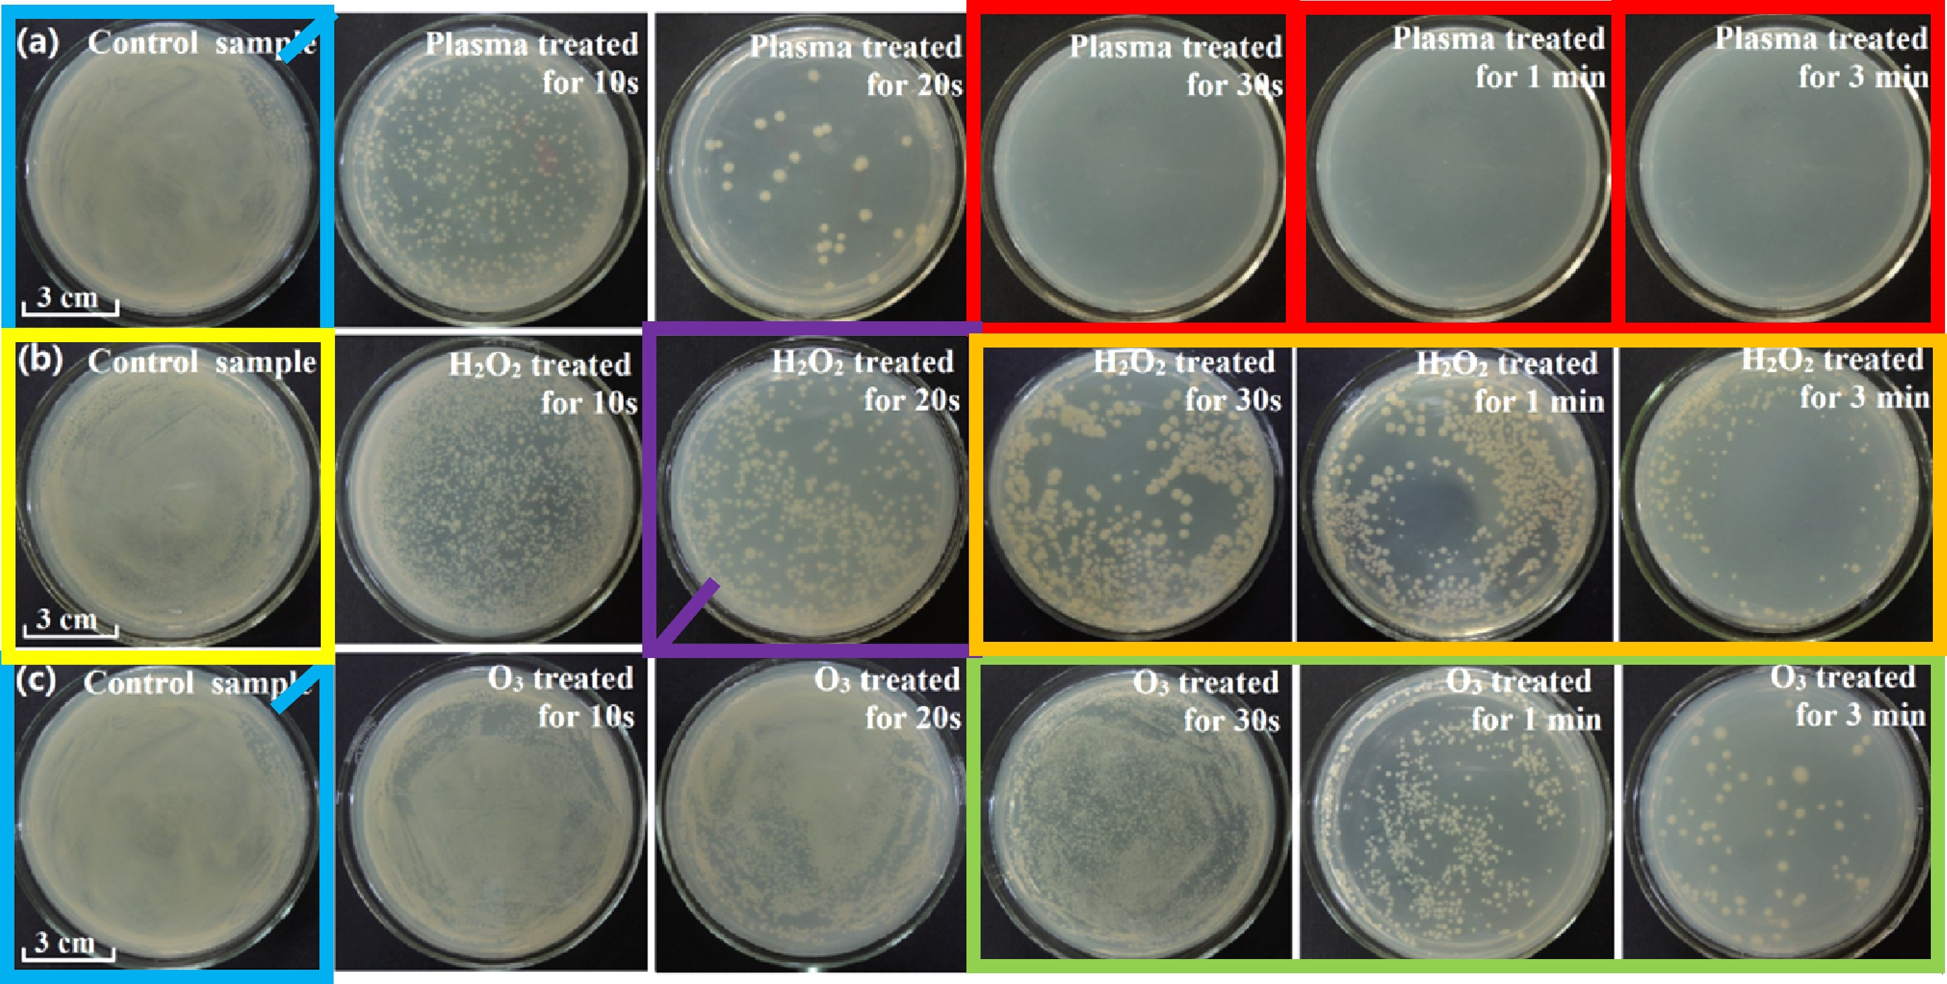
Case study
Duplication type I and II – rotation of panel

Slide 26
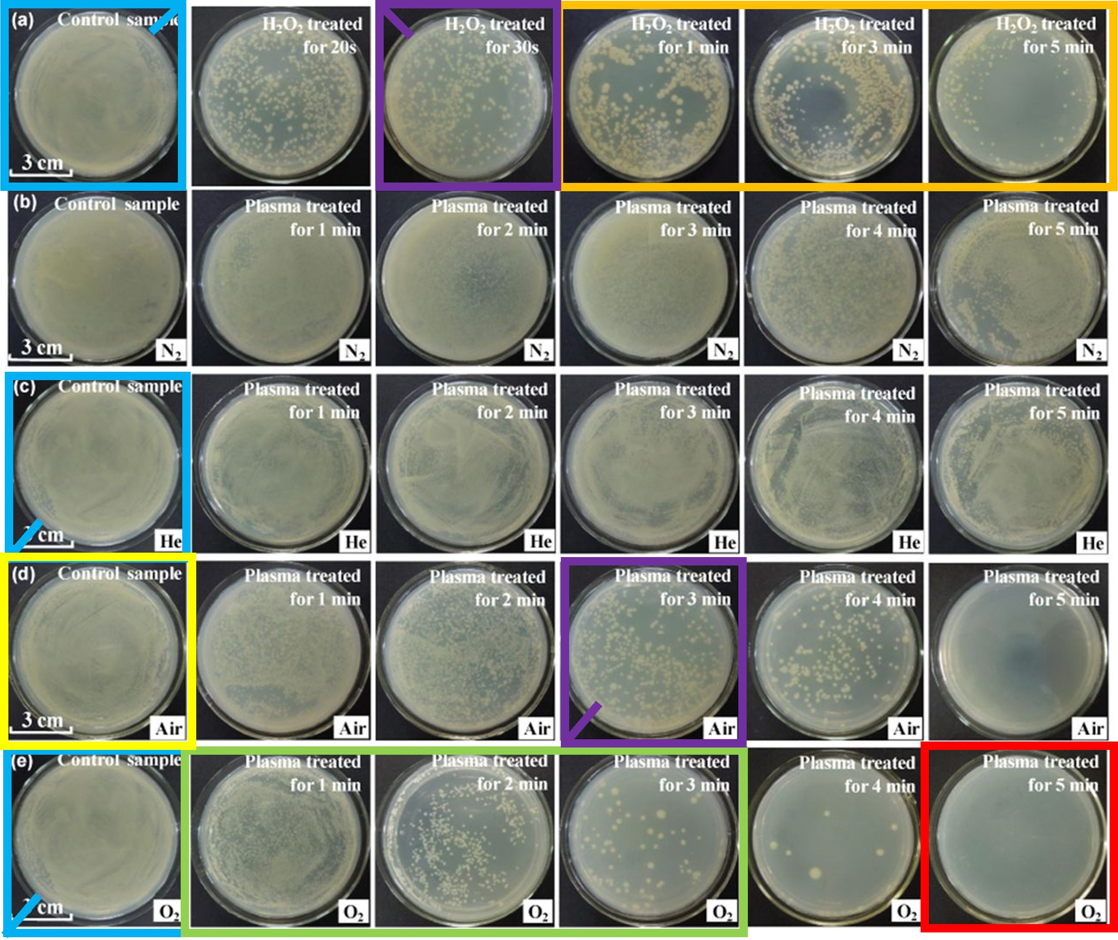
Case study
Duplication type I and II – rotation of panel
Image reuse for “illustration” of other experiments→ “self-plagiarism”

Slide 27
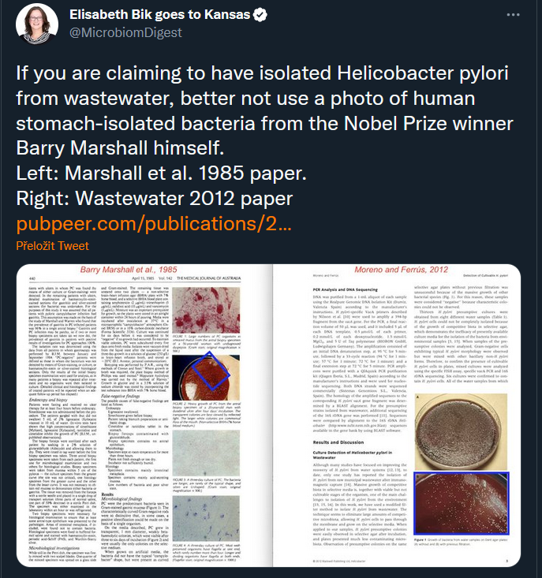
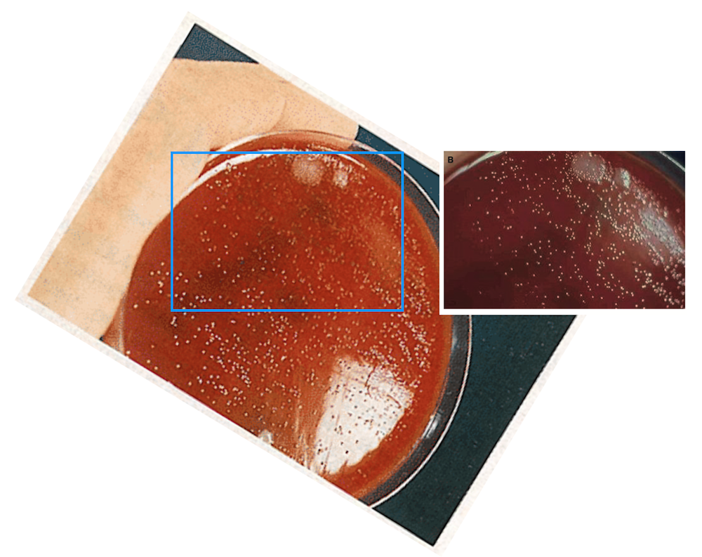
Case study
Unauthorized reuse of images from other sources (→ plagiarism)

Slide 28
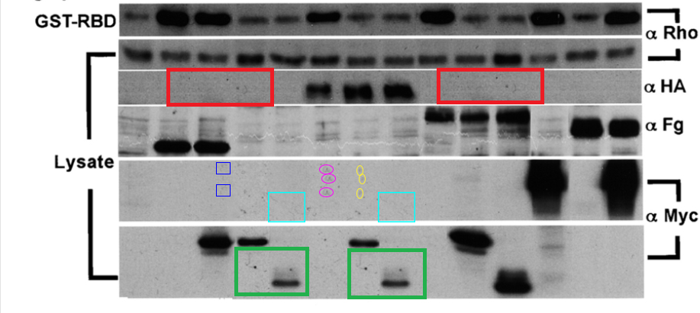
Case study
Duplication type III
Parts of the image repeat inside one panel or among panels.
What could have happened here?

Slide 29
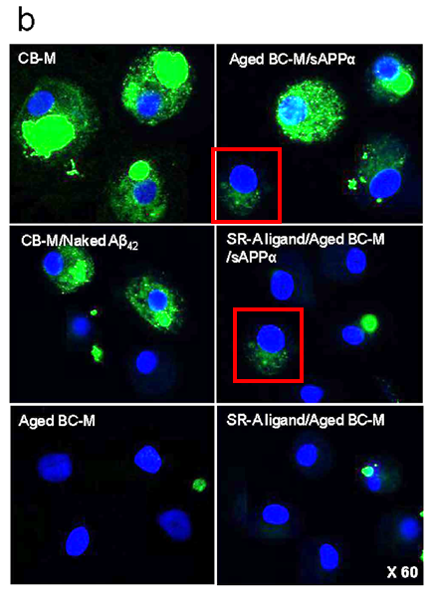
Case study
Duplication type III – parts of the image are identical between panels
What could have happened here?

Slide 30
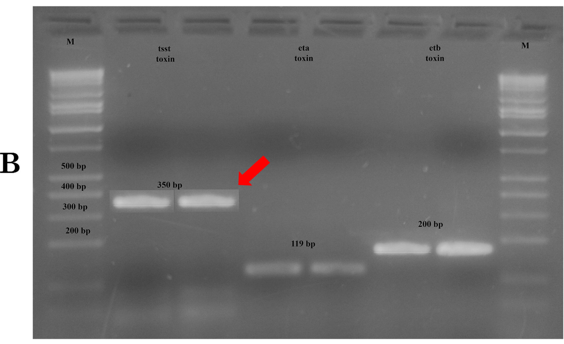
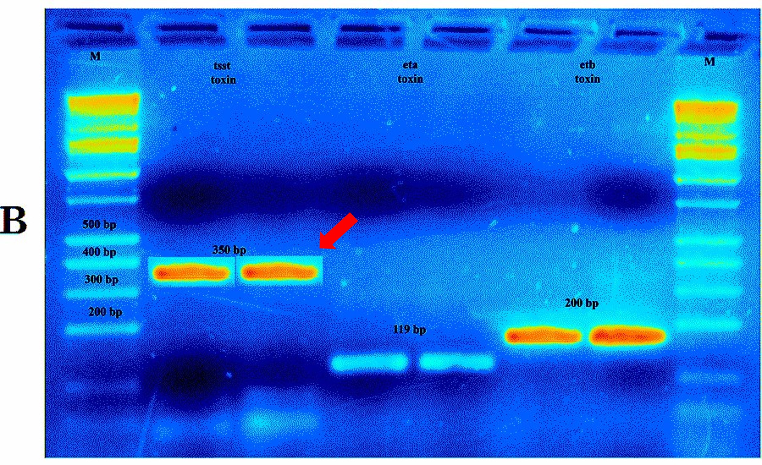
Case study
What could have happened here?

Slide 31
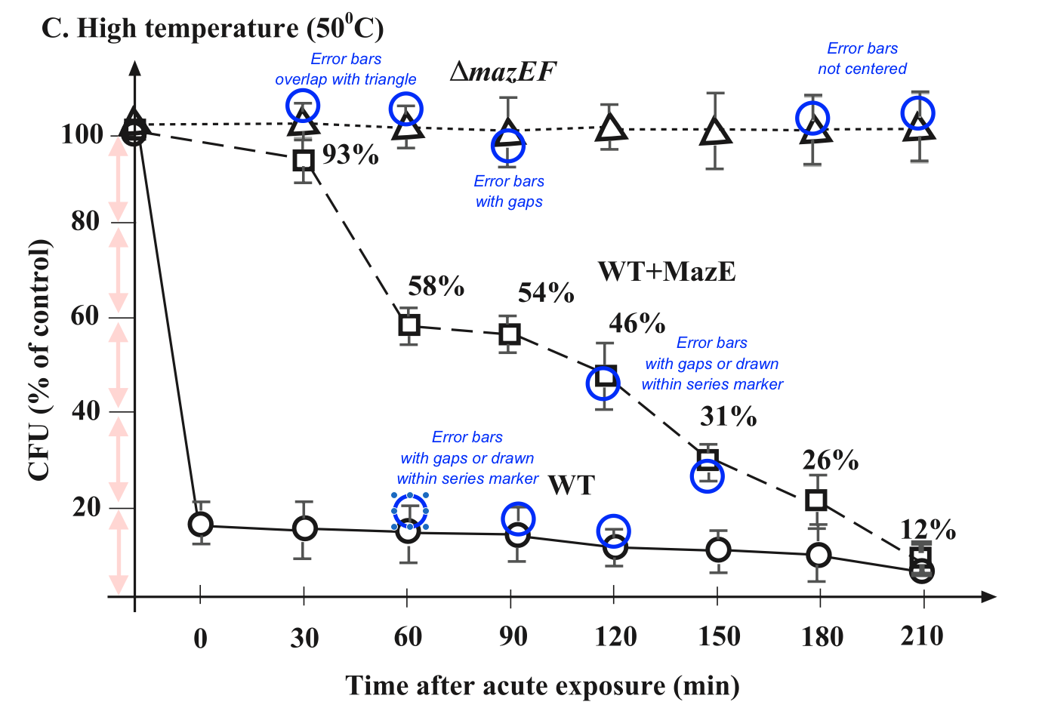
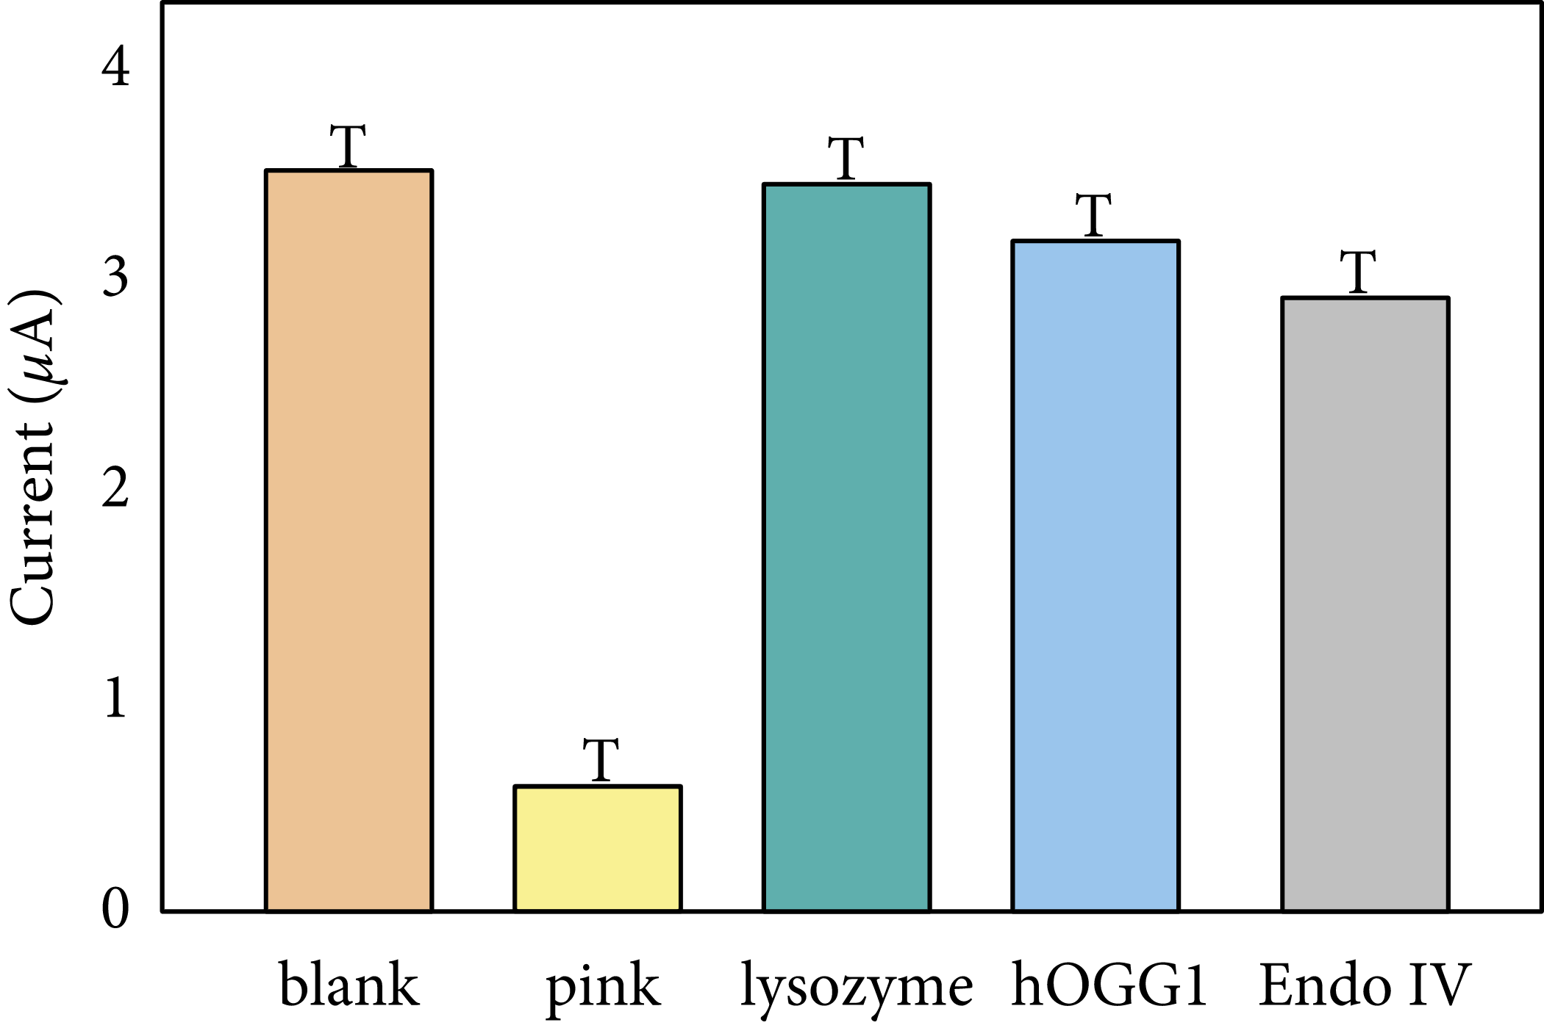
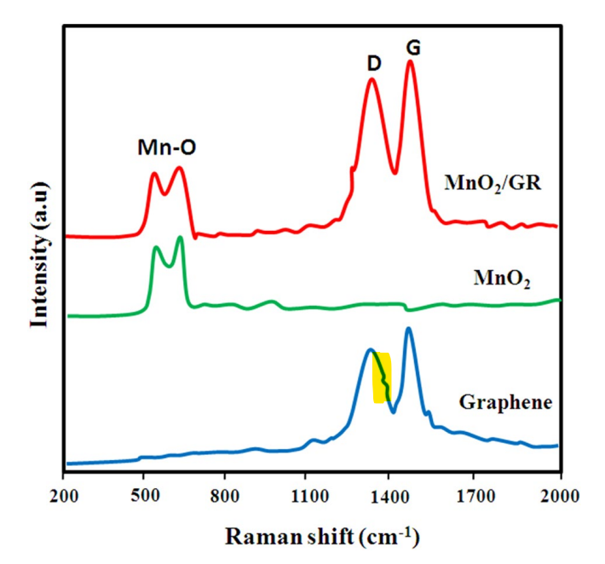
Sometimes the image data are not needed
https://retractionwatch.com/2022/12/05/a-paper-used-capital-ts-instead-of-error-bars-but-wait-theres-more/

Slide 32
Paper Mills
Organized groups (companies) producing and selling fabricated research articles prepared for publication (or including the publication).
They have templates and image libraries, which they use to generate content fitting the customer.
Typical scenario: The MDs in Chinese hospitals are required to publish in international journals for carrier advancement. This is not always realistic (lack of time, funding, research equipment, language barrier). The MD therefore pays the publication as a service in a specialized company. The company designs the publication based on the customer’s requests and target journal requirements.
Paper Mill products are very hard to expose for certain. You need to search through publications across topics, to find similar templates.

Slide 33
Paper Mills
The probability of encountering a paper-mill product depends on a journal and publisher.
In 2022 Committee on Publication Ethics (COPE) report estimates, that up to 2 % of all curently submitted manuscripts are Paper Mill products. (https://publicationethics.org/node/55256)
“Data on over 53,000 papers were analysed. This was shared by six publishers and spans a wide range of subject areas; overall the percentage of suspect papers being submitted to journals ranges from 2-46%. The analysis shows that most journals will see 2% suspected fake papers submitted and then for journals where paper mills have been successful in getting papers accepted, they see a sharp increase in suspect submissions.”
Another study trying to detect such publications concluded it could be up to 1% of articles in PubMed (https://www.nature.com/articles/d41586-022-02997-x)

Slide 34
Some signs of paper mill products
Template-like names
“Long non-coding RNA [enter name][enter effect] in [enter disease].”
Repeating and overlapping images in articles attributed to different authors from different institutions.
Very similar visual style of western blot and flow cytometry data.
No innovative approaches, unique methodology.
Binary character of conclusions (yes or no), or very shallow description.
Generic, non-institutional email addresses of authors (142838@168.com)
No responses from authors following inquiries.
If they do respond, they usually blame a different anonymous laboratory which made the experiments for them, but which is not acknowledged in the paper.

Slide 35
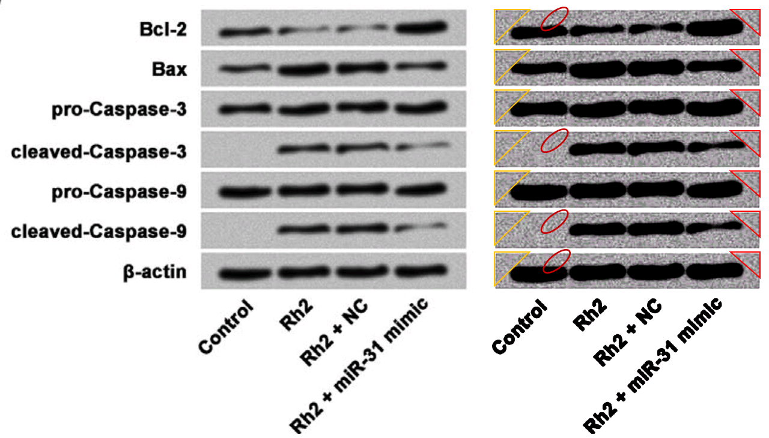
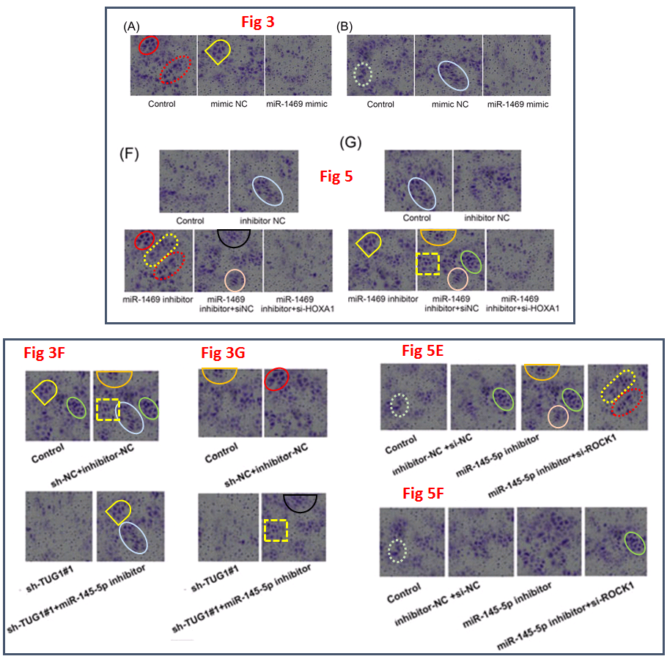
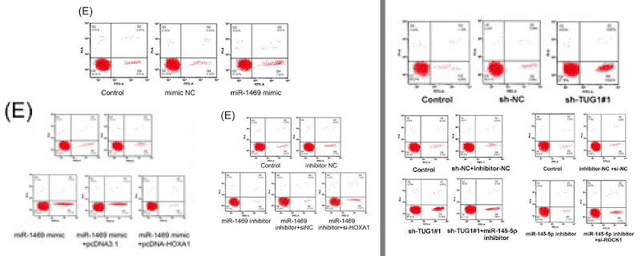
https://forbetterscience.com/2020/01/24/the-full-service-paper-mill-and-its-chinese-customers/
https://forbetterscience.com/2021/05/26/the-chinese-paper-mill-industry-interview-with-smut-clyde-and-tiger-bb8/

Slide 36
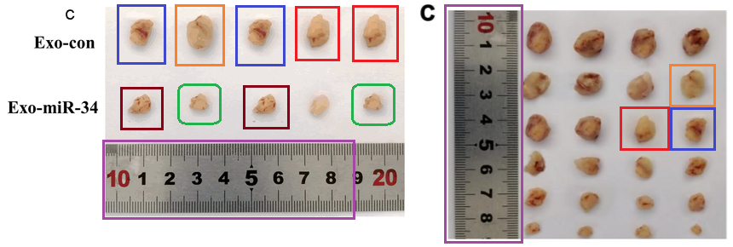
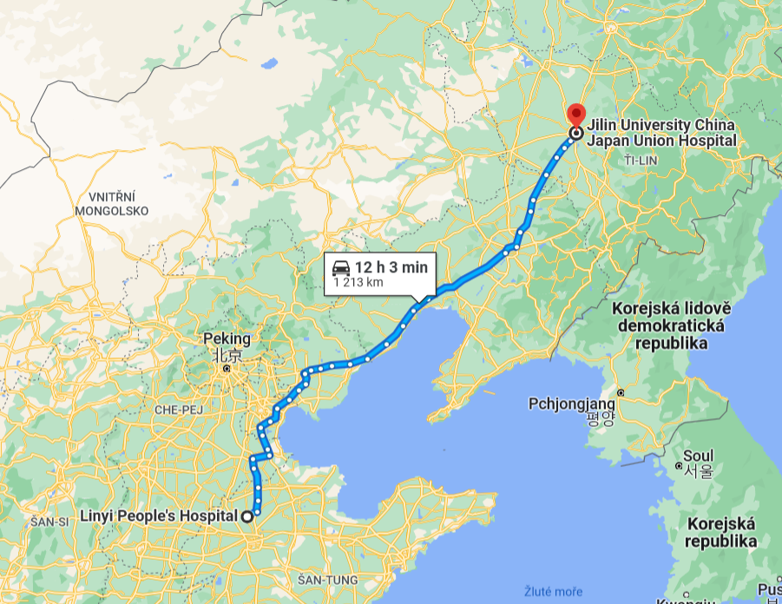
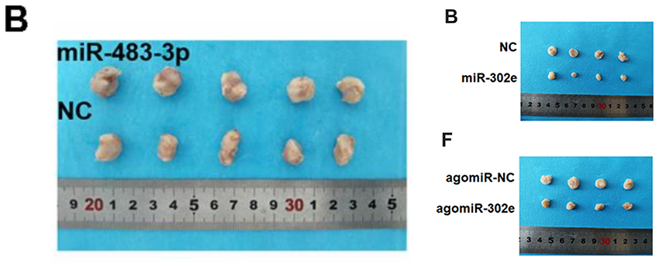
The Case of Travelling Ruler
Publication of authors from at least 4 different institutions contain images of the same ruler.
David Bimler
aka
“Smut Clyde”
https://forbetterscience.com/2021/05/17/the-ruler-of-the-aging-papermill/

Slide 37
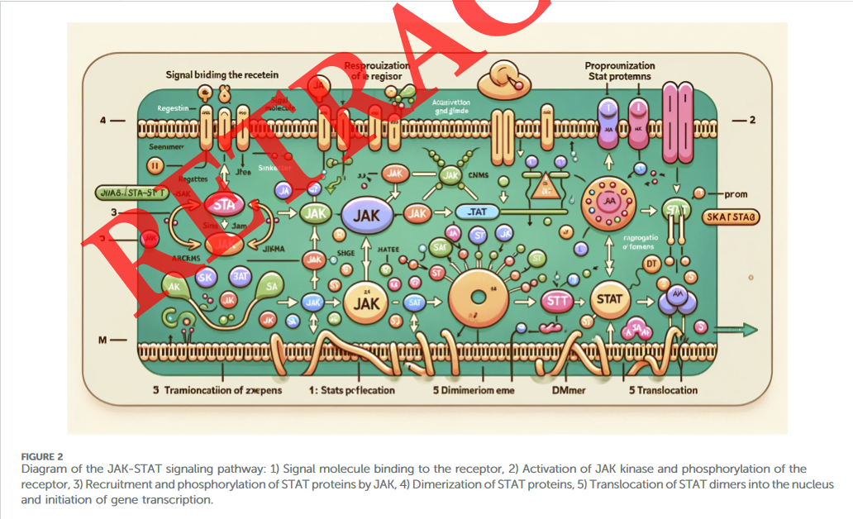
Fabrication using computer programs
Current revolution in AI connected to text and image generation represents acute danger for the future of scientific publishing because the falsified data will be harder and harder to distinguish.
https://doi.org/10.3389/fcell.2023.1339390

Slide 38
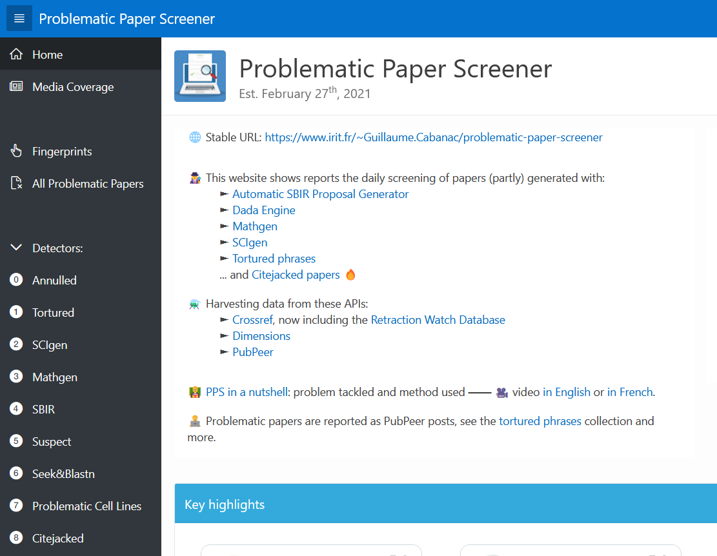
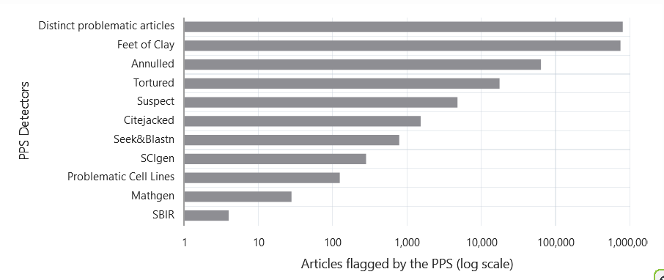
Problematic Paper Screener
https://www.irit.fr/~Guillaume.Cabanac/problematic-paper-screener
Guillaume Cabanac

Slide 39
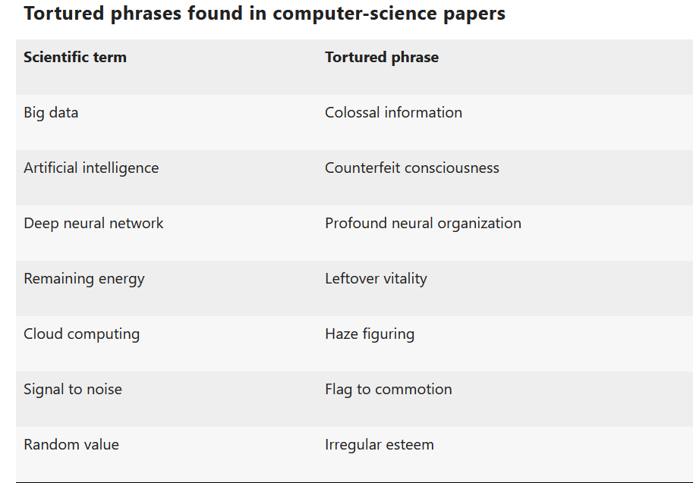
Tortured phrases
One way how to bypass the plagiarism detection is by using paraphrasing software, which uses thesaurus to replace phrases in text with synonyms.
It has a catch though:
Software is paraphrasing also the established scientific terms.
Result: Tortured phrases, which make the overall text unintelligible and can be automatically detected.

Slide 40
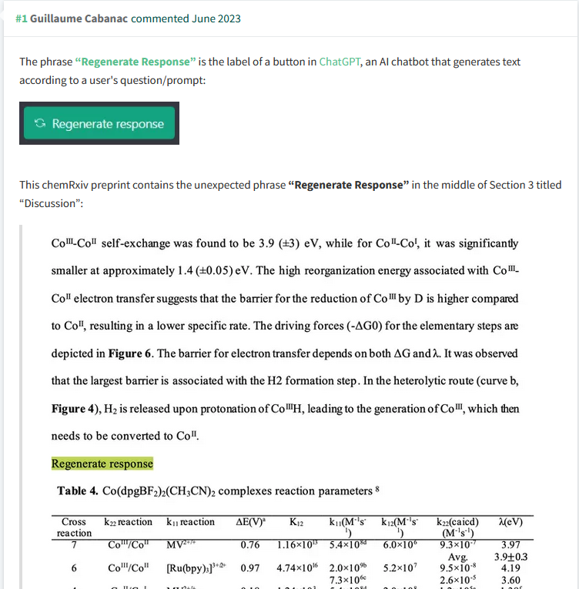
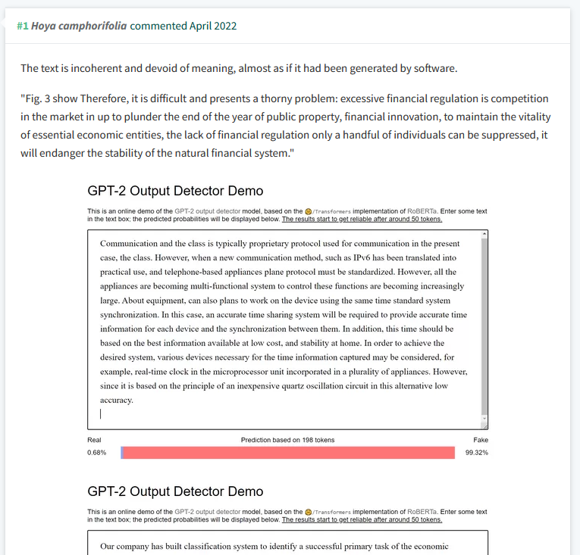
Abuse of ChatGPT for research fabrication

Slide 41
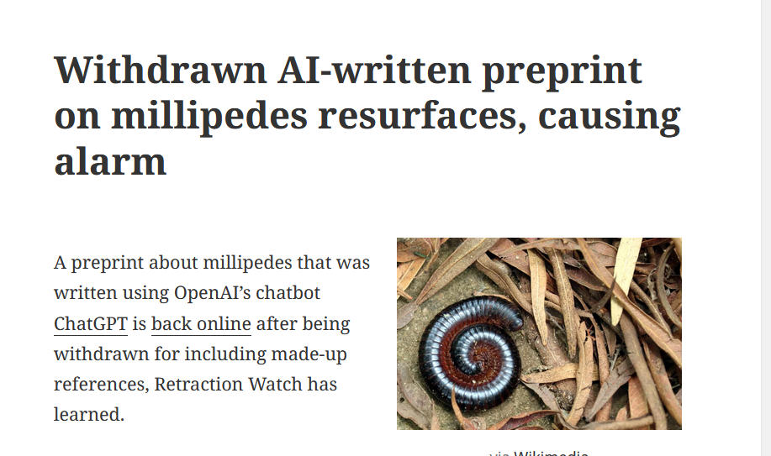
Abuse of ChatGPT for research fabrication

Slide 42
What can we do?
Be informed.
The best defense is offense. Report problematic data in scientific papers, when you encounter them.

Slide 43
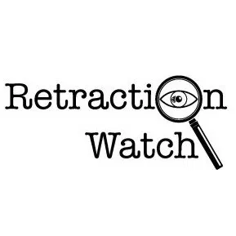
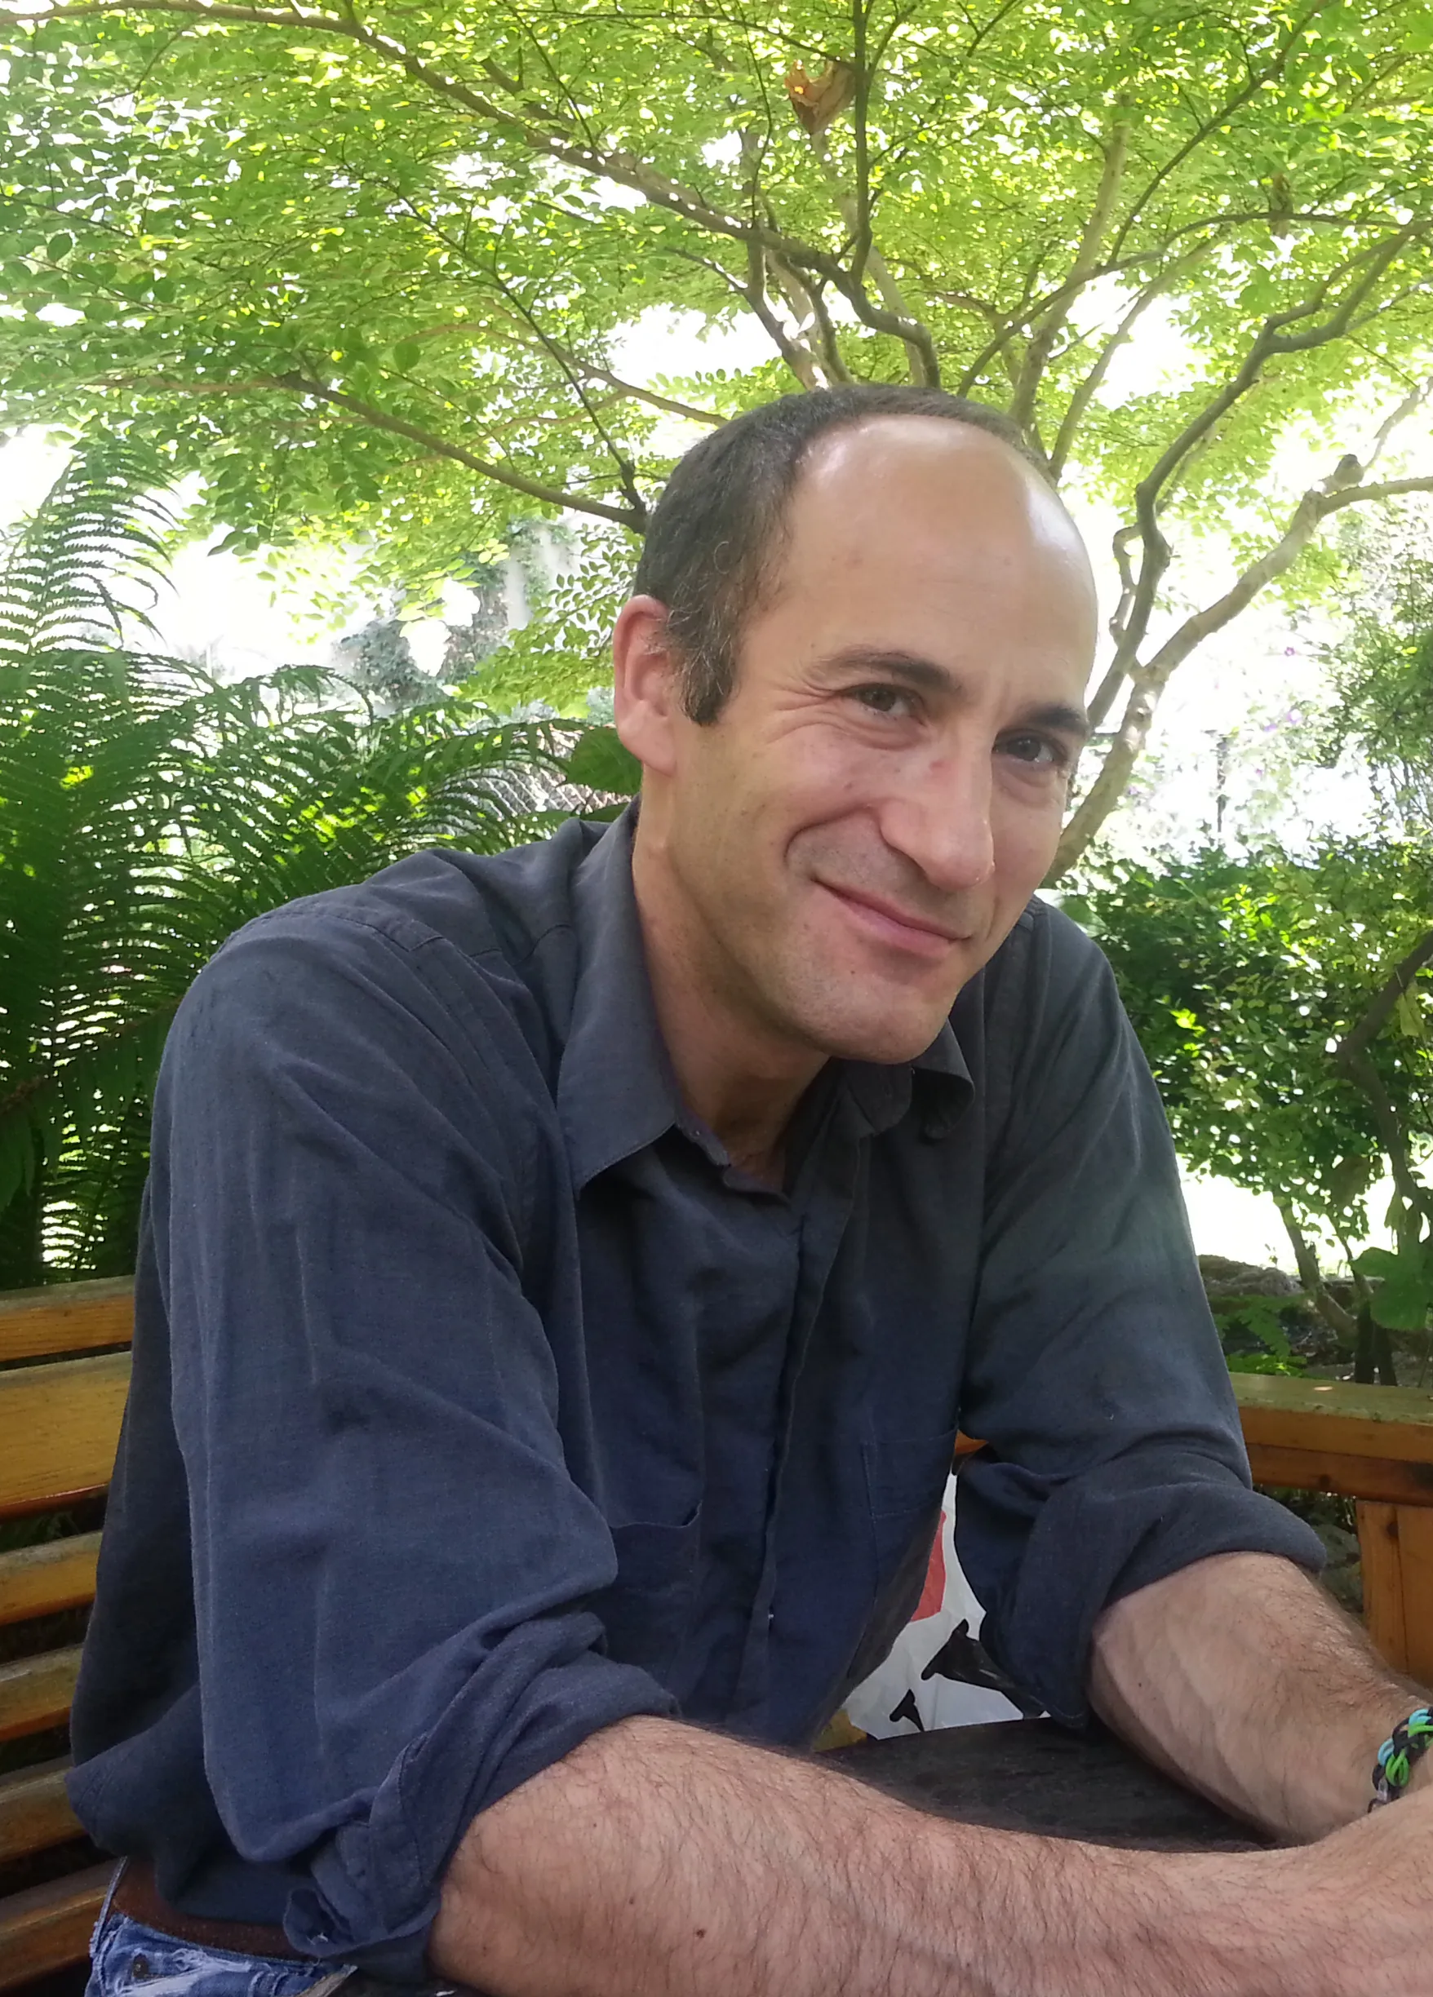
Information resources
Retraction Watch
https://retractionwatch.com/
Good source of information about ongoing investigations and retracted papers.
Also manages the database of all retractions:
http://retractiondatabase.org
Ivan Oransky
Adam Marcus

Slide 44
Information sources
For Better Science
https://forbetterscience.com/
Personal blog of Leonid Schneider.
Writes about ongoing investigations, but also about cases which have not been investigated yet.
Written in a humorous way.
Contains detailed description of Paper Mills and how they were exposed:
https://forbetterscience.com/2021/05/26/the-chinese-paper-mill-industry-interview-with-smut-clyde-and-tiger-bb8/
Leonid Schneider

Slide 45
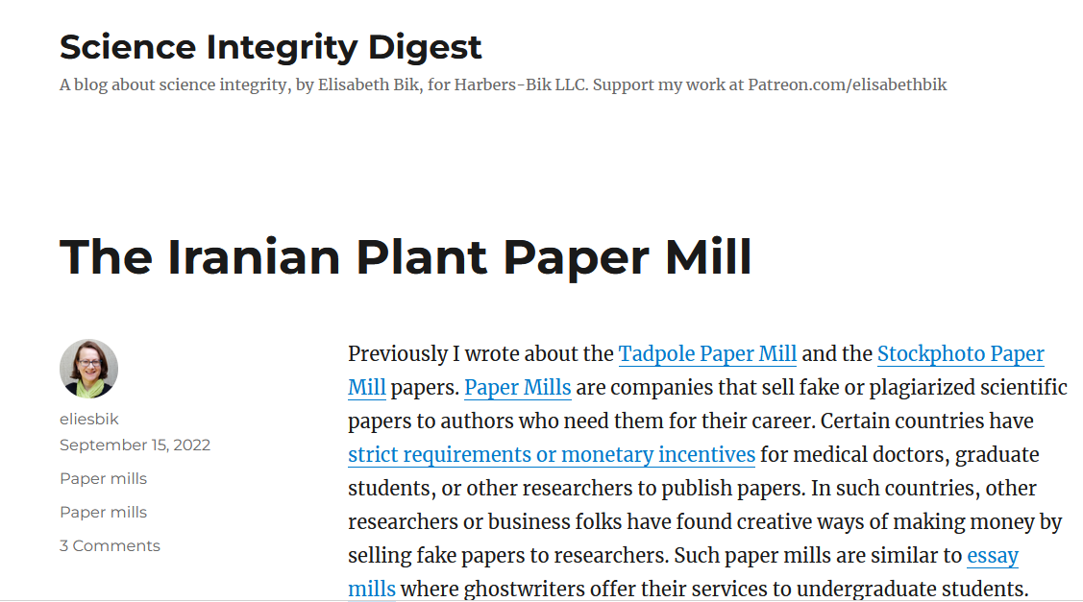
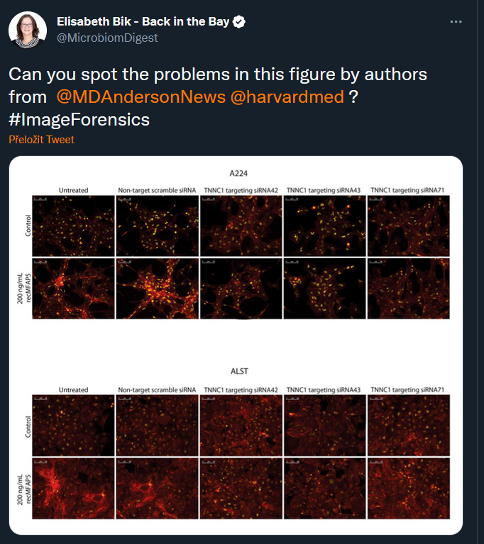
Information sources
Science Integrity Digest
https://scienceintegritydigest.com/
Blog of Elisabeth Bik, one of the leading sleuths in biomedical research.
Also very active on Twitter/X:
Elisabeth Bik

Slide 46
Information sources
PubPeer
https://pubpeer.com/
Discussion forum for individual articles (must have DOI or PMID identifier).
Can be used also for publishing of long (post-publication) peer-reviews of articles.
Offers extension to browsers and Zotero, which warns about the presence of papers with PubPeer comments.

Slide 47
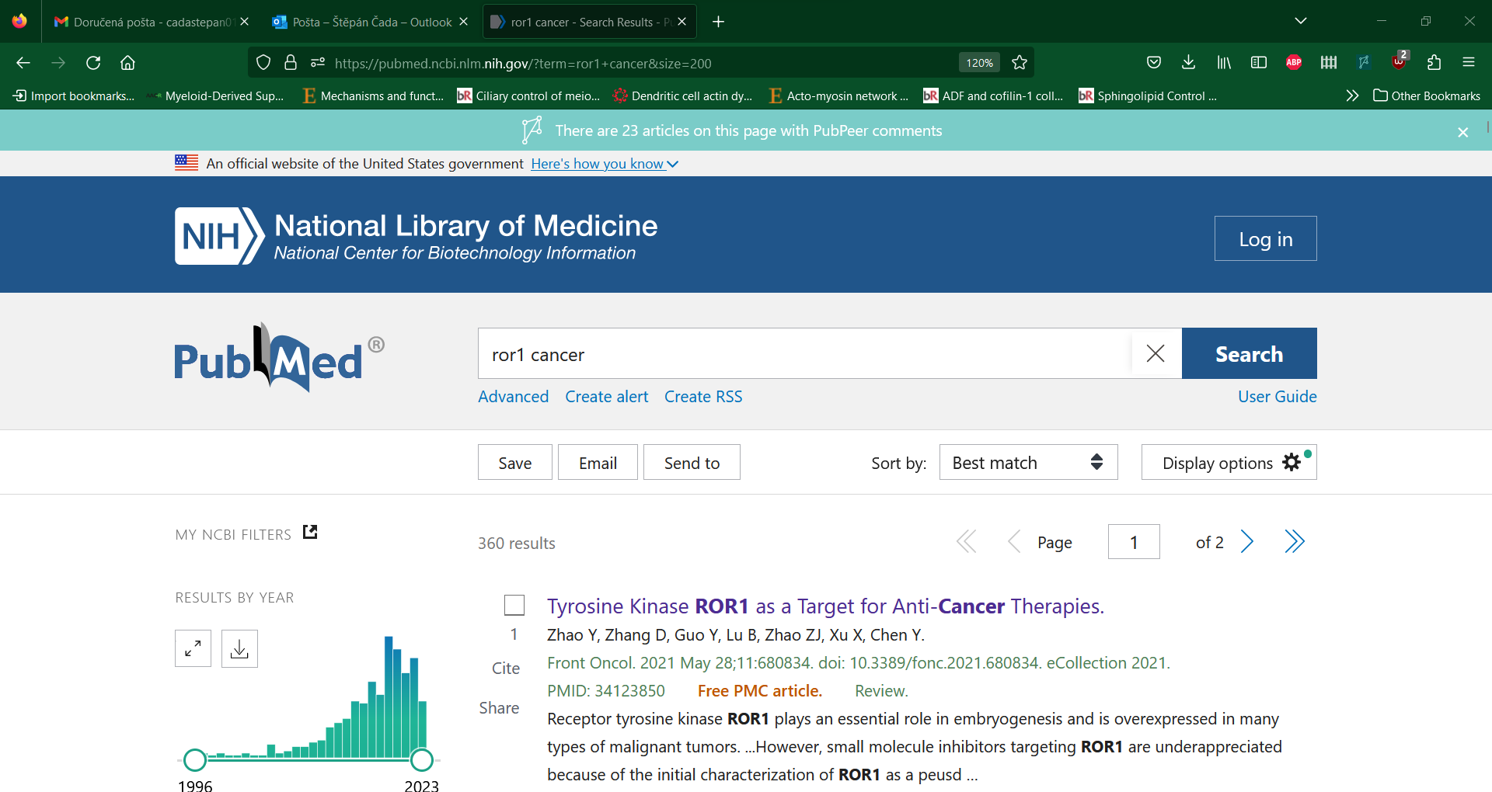
Informační zdroje
PubPeer
https://pubpeer.com/
Diskuzní forum k individuálním článkům majícím DOI nebo PMID číslo
Nabízí extension k prohlížeči a Zotero, které upozorňují na přítomnost článků s PubPeer komentáři
23 potentially problematic articles out of 200 displayed!

Slide 49
Using PubPeer to notify others about problematic data
Allows to post about the concerns connected to individual articles.
Discussion is moderated, which prevents baseless personal attacks.
Posts can be anonymous or under your own name.
By posting your question or concern, you can notify authors about the discovered problems (PubPeer sends email notifications to the corresponding author).
Even if the authors decide to not react, your post can warn other researchers about potential problems with the article.
PubPeer posts have been recently used as a base for institutional investigation.

Slide 50
Summary
Scientific publishing system is by large based on trust in the honest conduct of authors.
Currently, this system fails due to multiple factors which endangers public trust in research.
In all phases of working with literature, it is important to be aware of the existence of problematic publications and to avoid spreading their influence.
Part of the problematic publications can be identified based on image data.
Other types of problematic publications are hard to identify, it is therefore important to be informed about the latest developments in publishing ethics.
Protecting human knowledge from misinformation is the main duty of a researcher. It is therefore necessary to actively address and critique problematic publications and demand their correction or retraction.

Slide 51
Thank you for your attention!

Slide 52
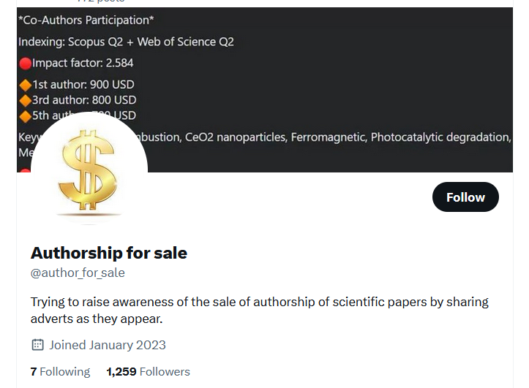
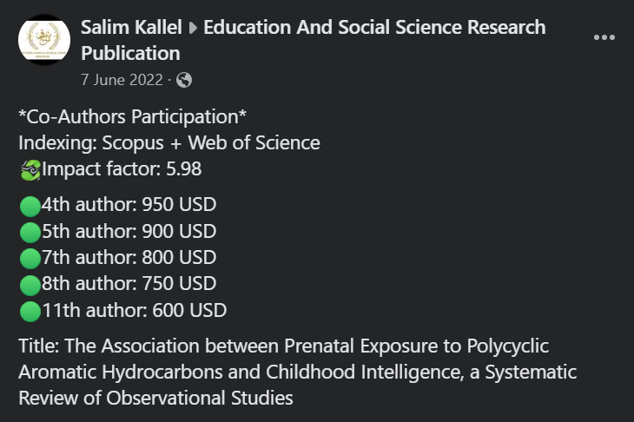
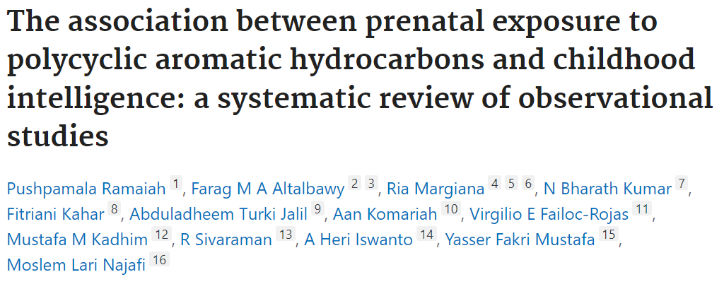
Bonus: Are we doing it wrong?
Publication fees to expensive? Sell the spots on your paper!

Slide 53
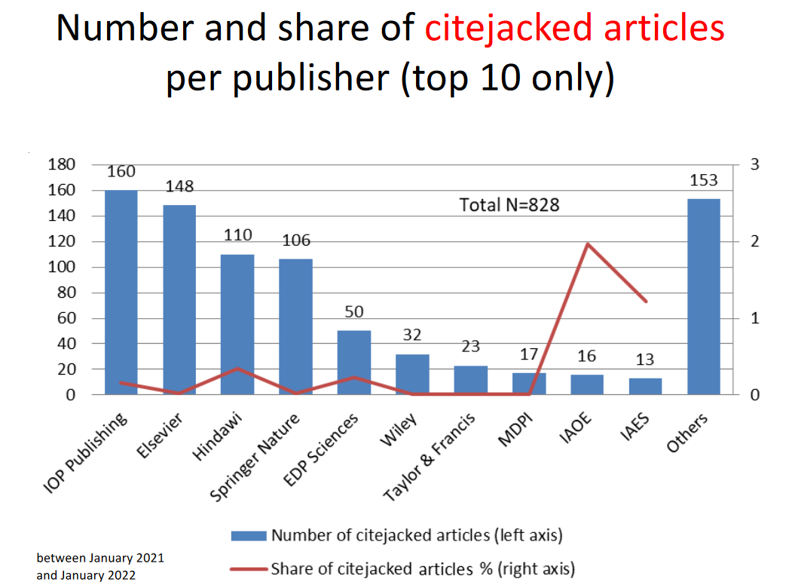
Bonus: Are we doing it wrong?
Hijacked journals
Use cloned websites and ISSN identifiers of established journals.
Articles do not undergo peer review and publication fee goes to hijackers.
Using fake identifiers, the articles can be indexed in Scopus anyway and cited.
Articles citing papers from hijacked articles are called “citejacked”.
Retraction Watch Hijacked Journal Checker:
https://retractionwatch.com/the-retraction-watch-hijacked-journal-checker/
https://www.irit.fr/~Guillaume.Cabanac/problematic-paper-screener/ACLM_Citejacked.pdf

Slide 54
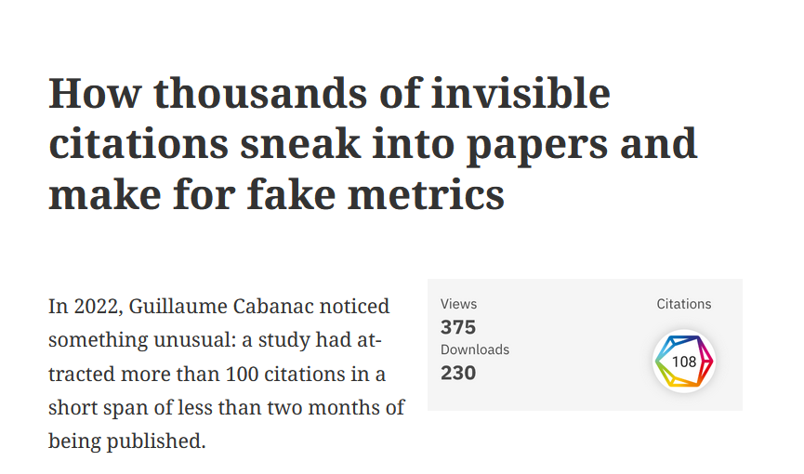
Bonus: Are we doing it wrong?
Sneaked references
Citation manipulation is one of the most common “publication crimes”.
Self-citations.
Citing of irrelevant articles.
Omitting important sources.
It is however not so hard to detect.
Sneaked citations are citations only present in article metadata.
Not visible to readers in the article itself.
Not visible even to authors/editors.
https://retractionwatch.com/2023/10/09/how-thousands-of-invisible-citations-sneak-into-papers-and-make-for-fake-metrics/

