Slide 1
Structure validation
Introduction

Slide 2

Low quality structures: We can not use them!
Garbage in garbage out

Slide 3

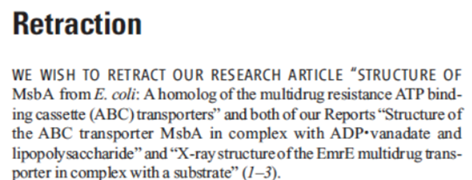
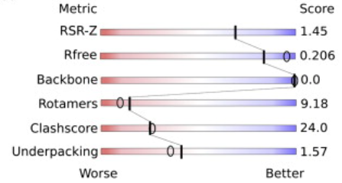
Validation – beginning
Nightmare before Christmas
Great structural biology results, excellent papers
2006: First problems - retraction of papers because wrong 3D structure data:
  Matthews B.W. (2007) Five retracted structure reports: inverted or incorrect? Protein science, 16, 1013–6.
  Johnston C.A., Kimple A.J., Giguere P.M., Siderovski D.P. (2008) RETRACTED: Structure of the Parathyroid Hormone Receptor C Terminus Bound to the G-Protein Dimer Gb1g2. Structure, 16, 1086–1094.
2008: X-ray Validation Task Force
  Read R.J. et. al (2011). A new generation of crystallographic validation tools for the protein data bank. Structure, 19(10), 1395-1412.
2009: NMR Validation Task Force
  Montelione G.T., et al. (2013). Recommendations of the wwPDB NMR validation task force. Structure, 21(9), 1563-1570.
2010: Electron Microscopy Validation Task Force
  Henderson R., (2012). Outcome of the first electron microscopy validation task force meeting. Structure, 20(2), 205-214.

Slide 4
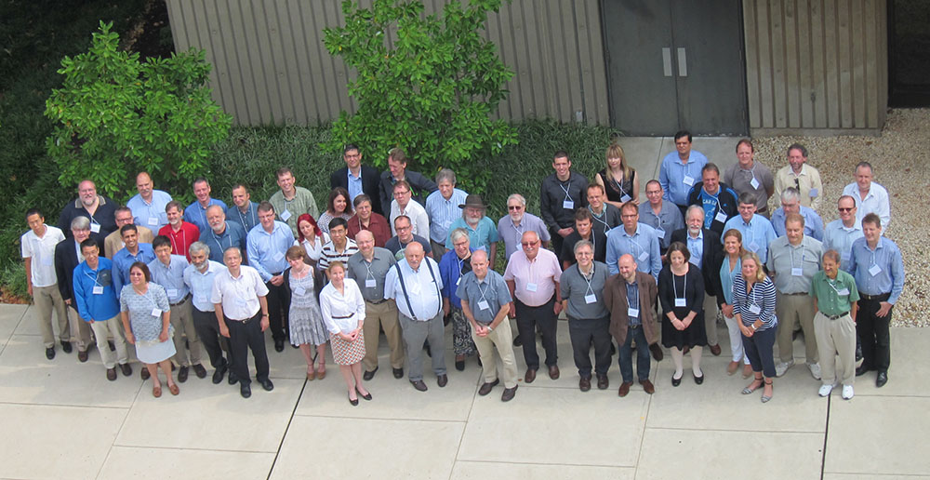
Validation – ligands
2015 ValidatorDB
  Sehnal D., Svobodová R., et al (2015). ValidatorDB: database of up-to-date validation results for ligands and non-standard residues from the Protein Data Bank. Nucleic acids research, 43(D1), D369-D375.
2016 wwPDB/CCDC/D3R Ligand Validation Workshop
  Adams P.D. …, Svobodová R., … (2016). Outcome of the first wwPDB/CCDC/D3R ligand validation workshop. Structure, 24(4), 502-508.

Slide 5
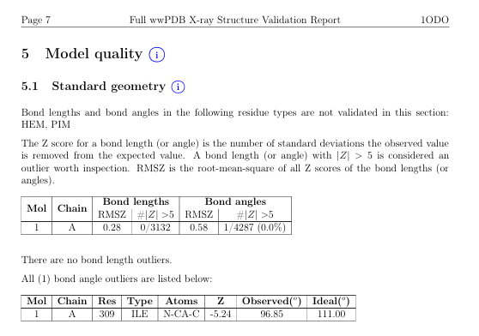




Validation – reports and metrics
2017 Validation reports
  Gore S., García E.S., Hendrickx P.M., Gutmanas A., Westbrook J.D., Yang H., ..., Kleywegt G.J. (2017). Validation of structures in the Protein Data Bank. Structure, 25(12), 1916-1927.
2018 Combined validation metrics
  Smart O.S., Horský V., Gore S., Svobodová R., Bendová V., Kleywegt G.J., Velankar S. (2018). Worldwide Protein Data Bank validation information: usage and trends. Acta Crystallographica Section D: Structural Biology, 74(3), 237-244.
Vladimír Horský

Slide 6
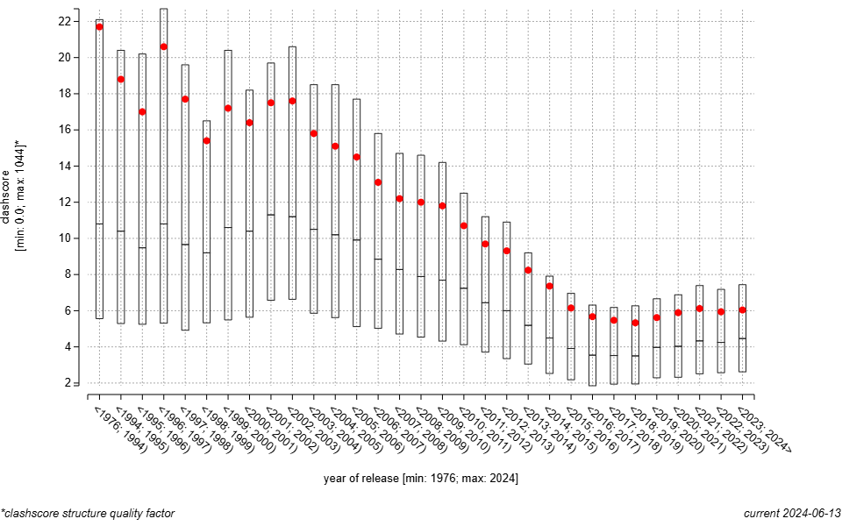
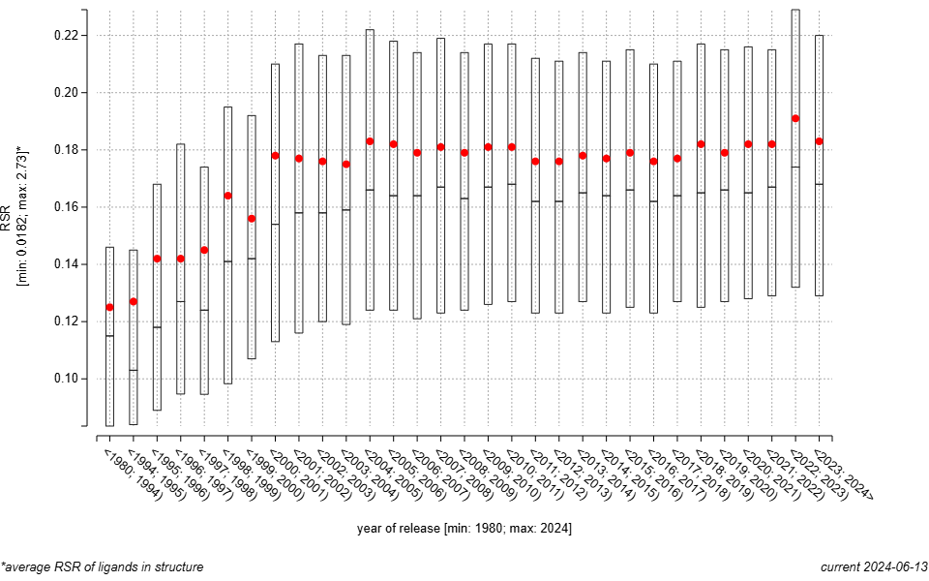
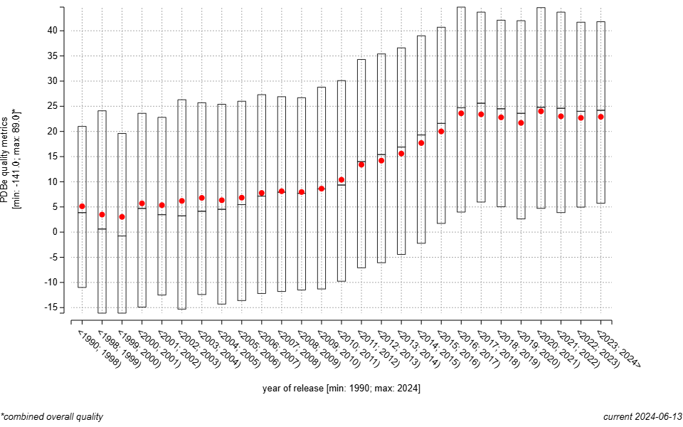
Validation: Does it help?
Horský V., Bendová V., Toušek D., Koča J., Svobodová R. (2019). ValTrendsDB: bringing Protein Data Bank validation information closer to the user. Bioinformatics, 35(24), 5389-5390.

Slide 7
Validation – lectures today
Protein validation
Ligand validation
Validation trends

