Slide 1
Sylabus – Přednášky a semináře C5855 a C5856, podzim 2024
Datum | Přednáška | Seminář
24.9. | Úvod do studia, Koncepce přípravy rekombinantních proteinů, Základní analytické pojmy | x
1.10. | Separační a Chromatografické metody, Ostatní separační metody: Fokusace, Ultracentrifugace, Dialýza | Úloha 1_TLC
8.10. | Spektroskopické techniky I : UV-Vis, Fluorescence, FRET | x
15.10. | Spektroskopické techniky II: CD, vibrační spektroskopie: IC, Raman, X-Ray, QD | Úloha 2_CD
22.10. | NMR a EPR | x
29.10. | Optická a elektronová mikroskopie (SEM,TEM), AFM, Fluorescenční mikroskopie, Konfokální mikroskopie, Klasická mikroskopie | x
5.11. | MS, LC-MS, Aplikace MS | Úloha 3_MALDI-TOF MS
12.11. | Úvod do elektrochemie (pH, pKa, Nernstova rovnice, Voltametrie, Potenciometrie, Amperometrie, Impedanční a Pulzní Voltametrie + jejich aplikace) | x
19.11. | Elektroforéza - Gelová ELFO, Kapilární ELFO, Aplikace | Úloha 4_SDS-PAGE
26.11. | Bio-elektrochemie - Rozptyl, X-Ray, Biosenzory, Aplikace, SPR. | x
3.12. | Strukturní biochemie - Techniky pro určování 3D struktur proteinu (X-ray, NMR, cryoEM, simulované žíhání) | Exkurze 1, pavilon C4 (Laboratoř přípravy proteinu a NMR park)
10.12. | Biointerakce - Metody pro určování interakcí a oligomerních stavů - BioKalorimetrie (Termostabilita, ITC a DSC + alternativní interakce/hydrodynamické techniky (osmometrie, centrifugace, Svedberg). | Exkurze 2, pavilon C4 (ITC, DLS, nanoDSF...)
17.12. | Metody lékařské diagnostiky | Exkurze 3, pavilon C14 (MS, MALDI-TOF MS, ESI-Orbitrap, DROBECEK (MS))

Slide 2
Exprese a purifikace proteinů
Jozef Hritz
(jozef.hritz@ceitec.muni.cz)

Slide 3
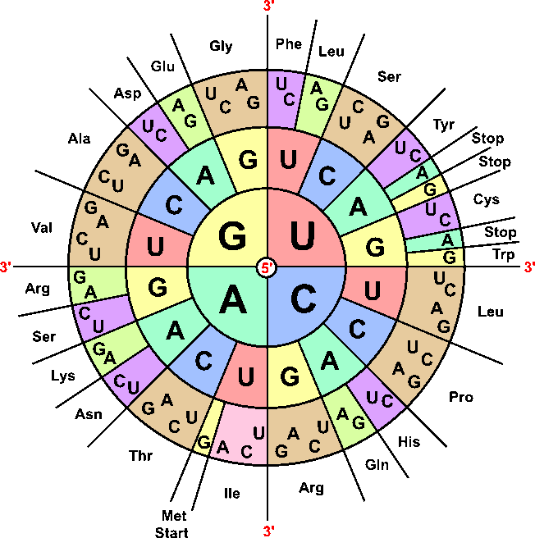
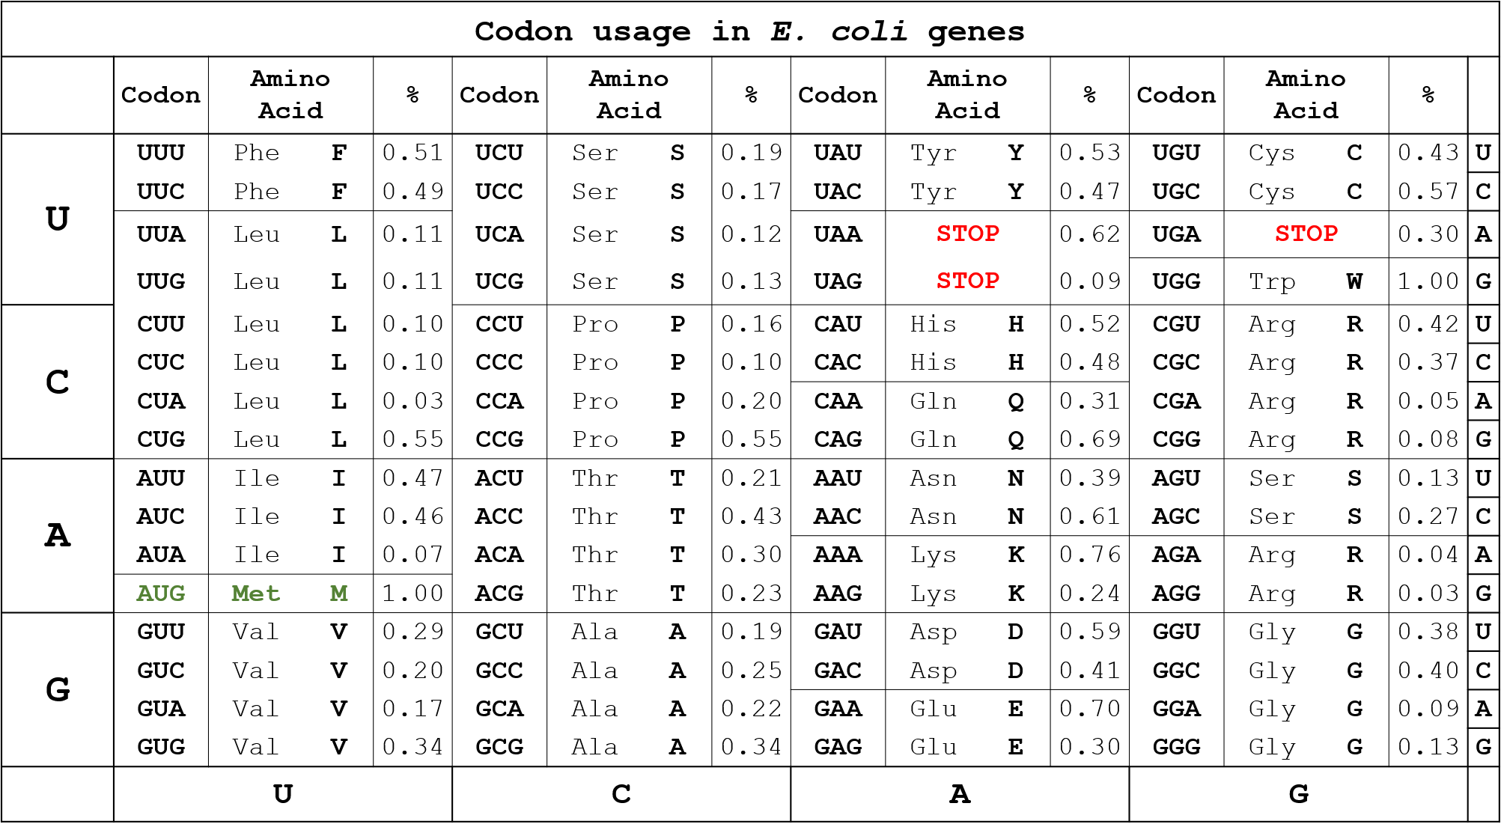
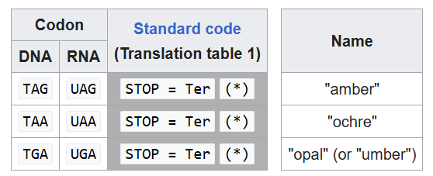
Central Dogma of Molecular Biology

Slide 4
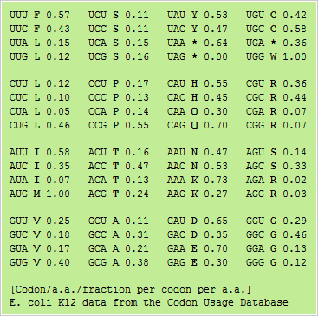
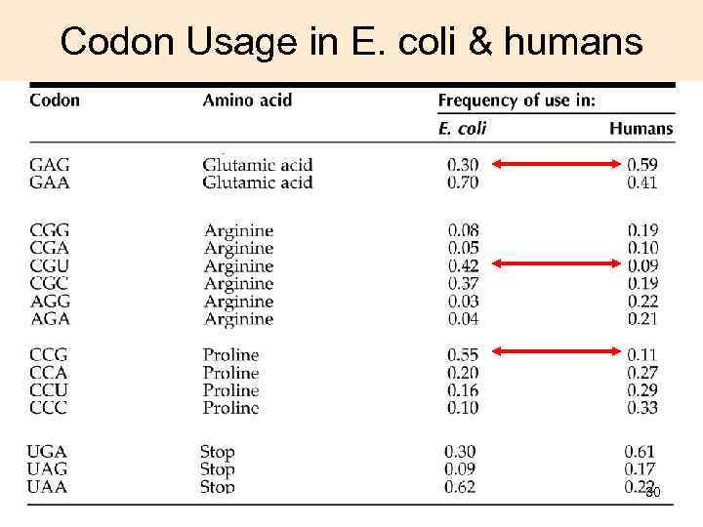
Different codon usage
e.g. BL21-Codon plus-RIL
Codon optimized sequence can be often achieved by synthetic gene synthesis - > particularly useful for the projects where the large expressions are needed, e.g. structural biology. Or isotopic labeling…

Slide 5
Often cleavage sites are considered
Thrombin (optimal pH ~8.0)
Pro-Arg/Gly
Pro-Lys/Leu
Ala-Arg/Gly
Gly-Lys/Ala
Ile-Arg/Ser
Leu-Arg/Ala
Ile-Arg/Ile
TEV protease
Glu-Asn-Leu-Tyr-Phe-Gln/Ser
pH 5.5 –8.5

Slide 6
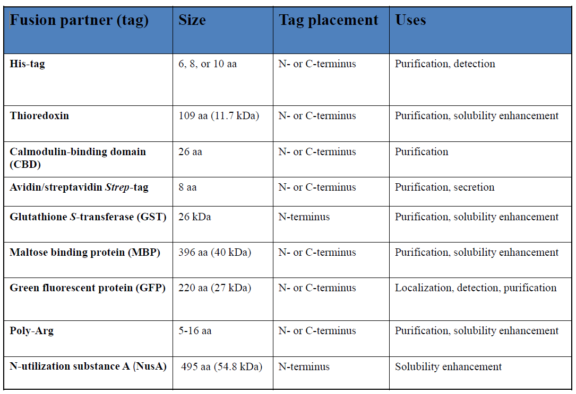
Phusion Tags
a) short peptides [ex. (His)n, (Asp)n, (Arg)n ... ].
b) protein domains, entire proteins
[ex. MBP, GST, thioredoxin …].
Purpose
Increasing the yield of recombinant proteins – Fusion of the N-terminus of the target protein to the C-terminus of a highly expressed fusion partner results in high level expression of the target protein.
Enhancing the solubility of recombinant proteins – Fusion of the N-terminus of the target protein to the C-terminus of a soluble fusion partner often improves the solubility of the target protein.
Facilitating the purification of recombinant proteins – Simple purification schemes have been developed for proteins used at either terminus which bind specifically to affinity resins.

Slide 7
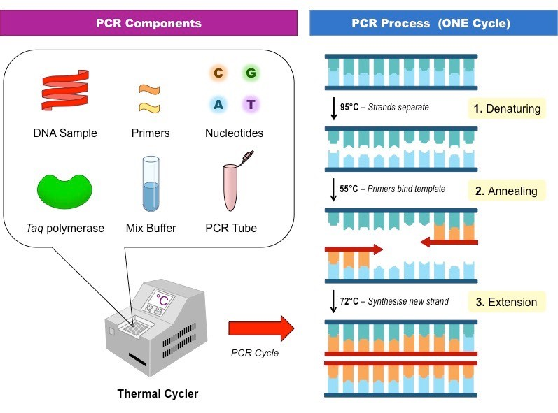
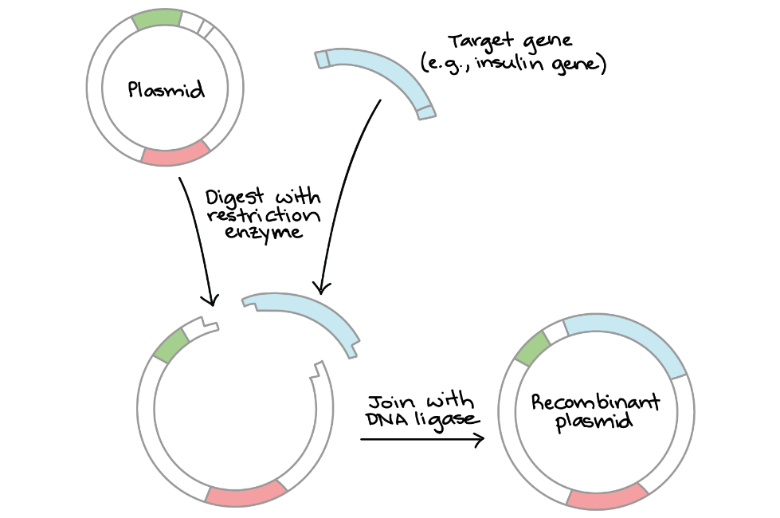
Once there is clear idea of DNA sequence
Gene amplification by PCR
insertion into the vector by e.g. restriction
endonucleases

Slide 8
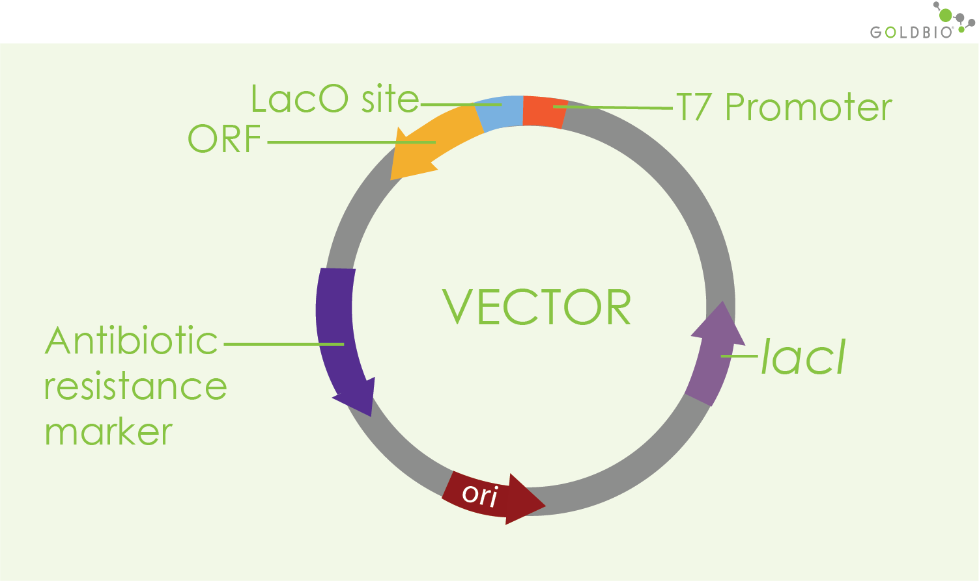
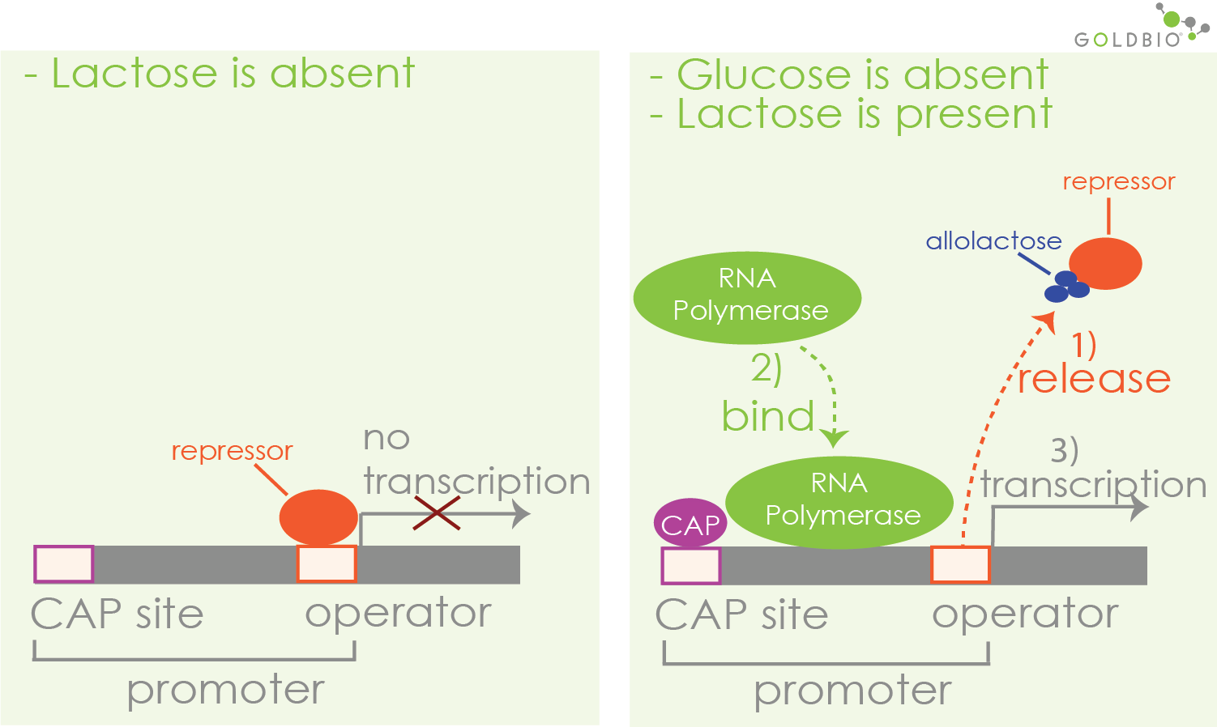
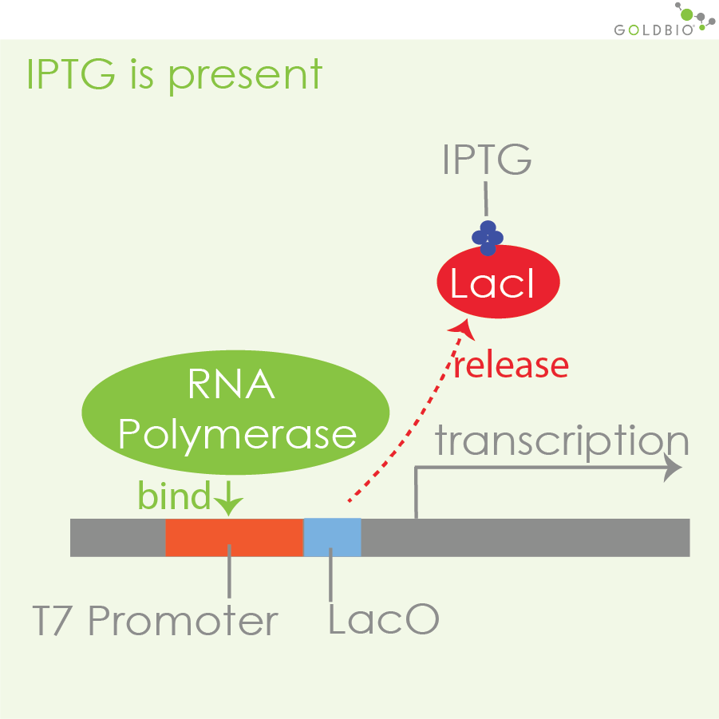
circular E.coli plasmids (in addition to E.coli genome) – why antibiotic resistance is needed?
Lac operator
target gene
pET plasmids

Slide 9
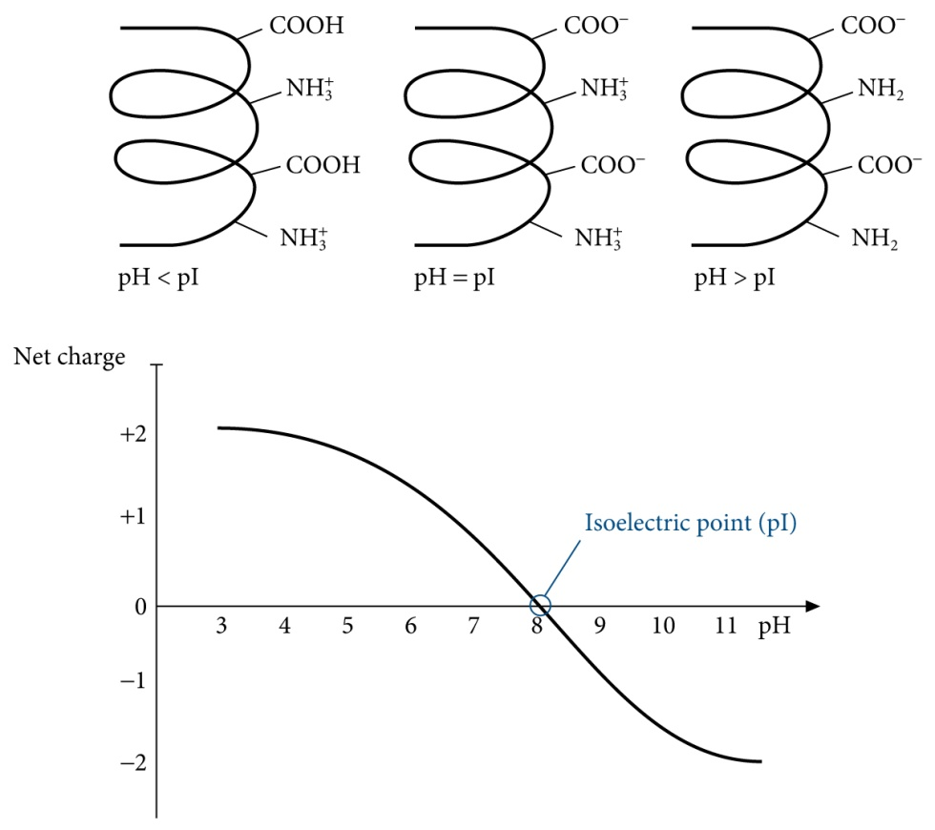
1.3. The primary structure of proteins
1.3.2. Information available from the amino acid sequence of a protein
1.3.2.1. Exact molecular mass
1.3.2.2. Isoelectric point
1.3.2.3. Absorption coefficient
1.3.2.4. Hydrofobicity
http://www.expasy.ch/tools/pi_tool.html

Slide 10
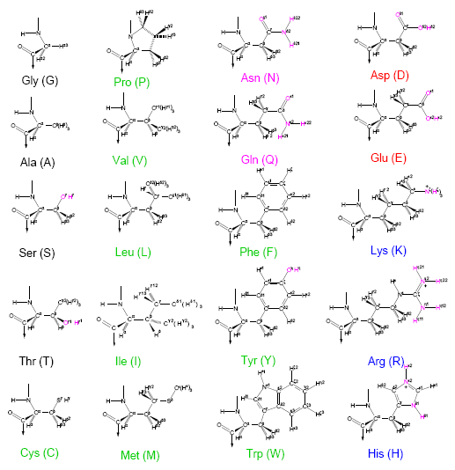
1.2. The amino acids
1.2.1. The variety of amino acids
1.2.2. Clasification of the amino acids in terms of polarity
Non-polar side chain
Ala, Gly, Ile, Leu, Met, Phe, Pro, Trp, Val
Polar, uncharged side chain
Asn, Cys, Gln, Ser, Thr, Tyr
Polar charged side chain
Arg, Asp, Glu, His, Lys

Slide 11
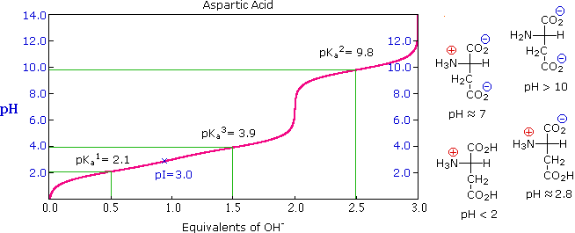
1.2. The amino acids
1.2.3. General properties of the amino acids
1.2.3.2. Ionization
http://www2.chemistry.msu.edu/faculty/reusch/VirtTxtJml/proteins.htm

Slide 12
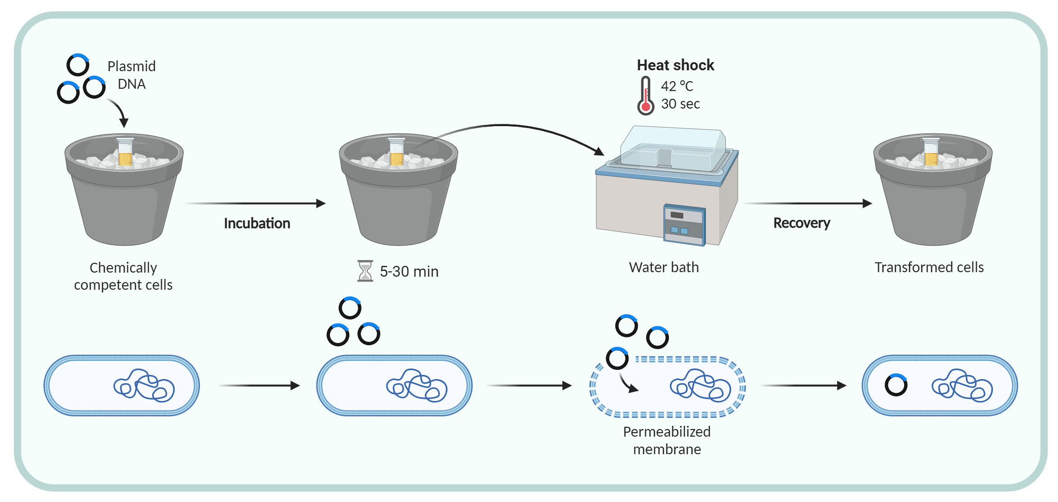
Transformace

Slide 13
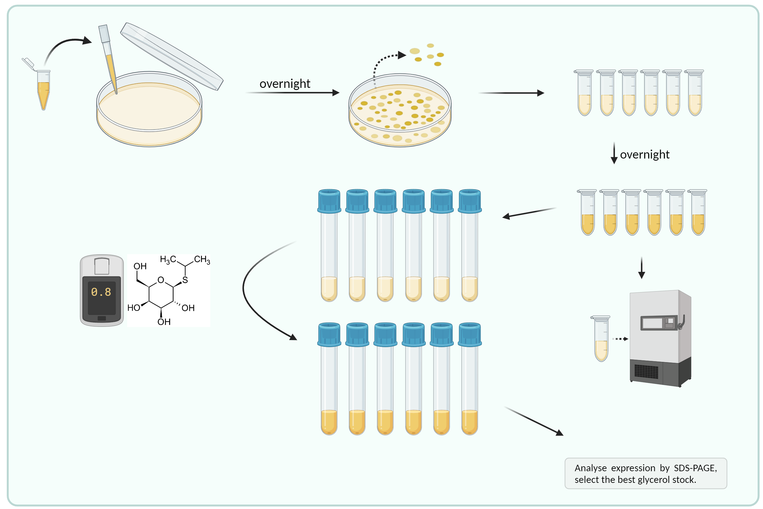
Colony selection
IPTG

Slide 14
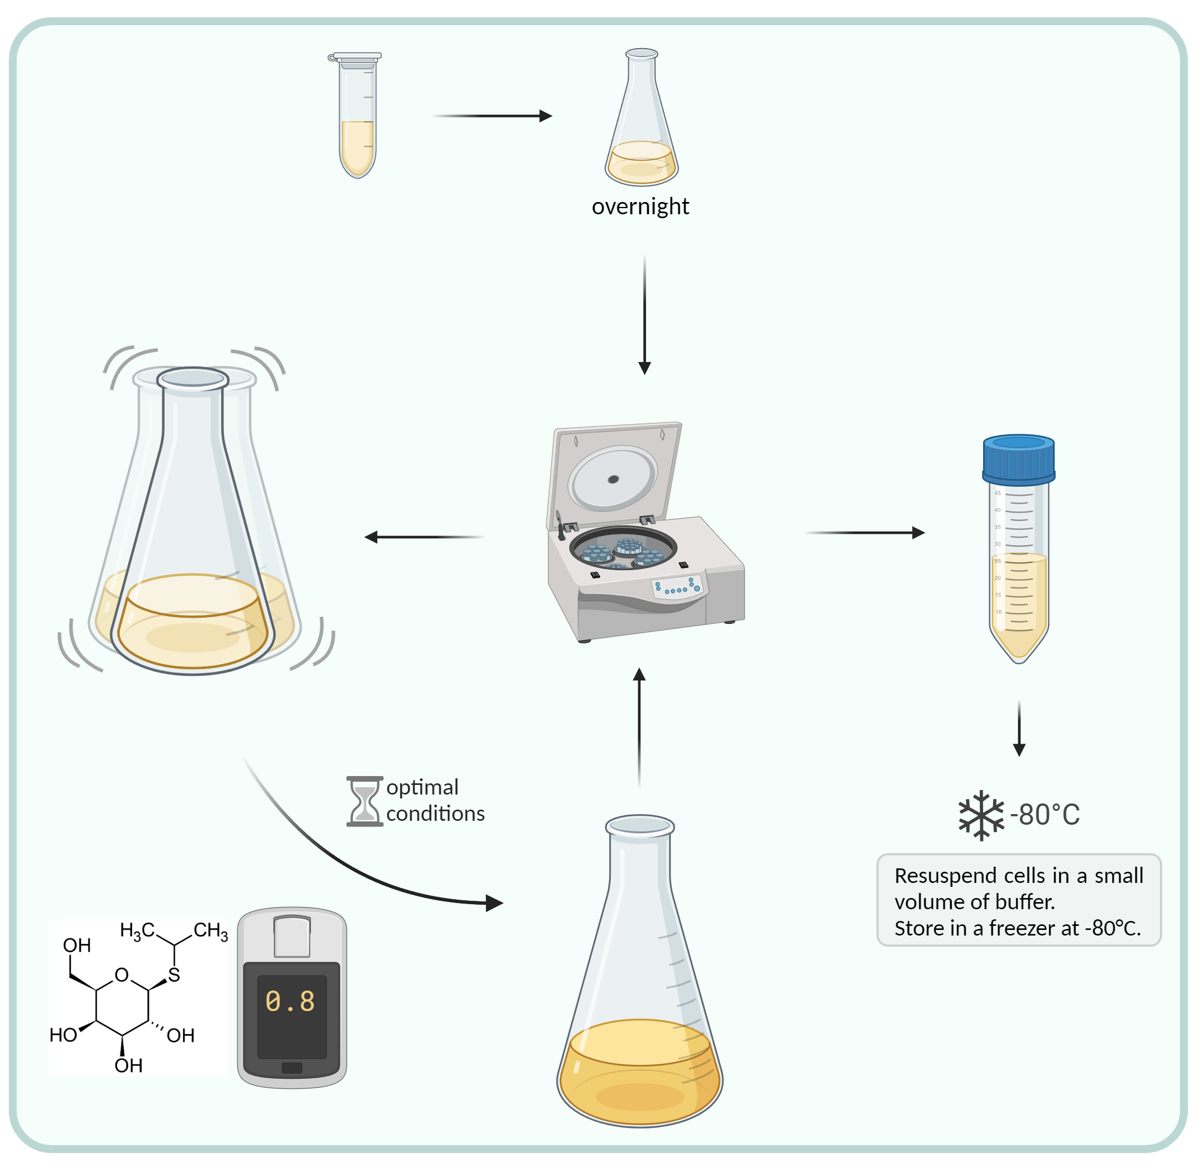
Exprese
What kind of growing media?
IPTG

Slide 15
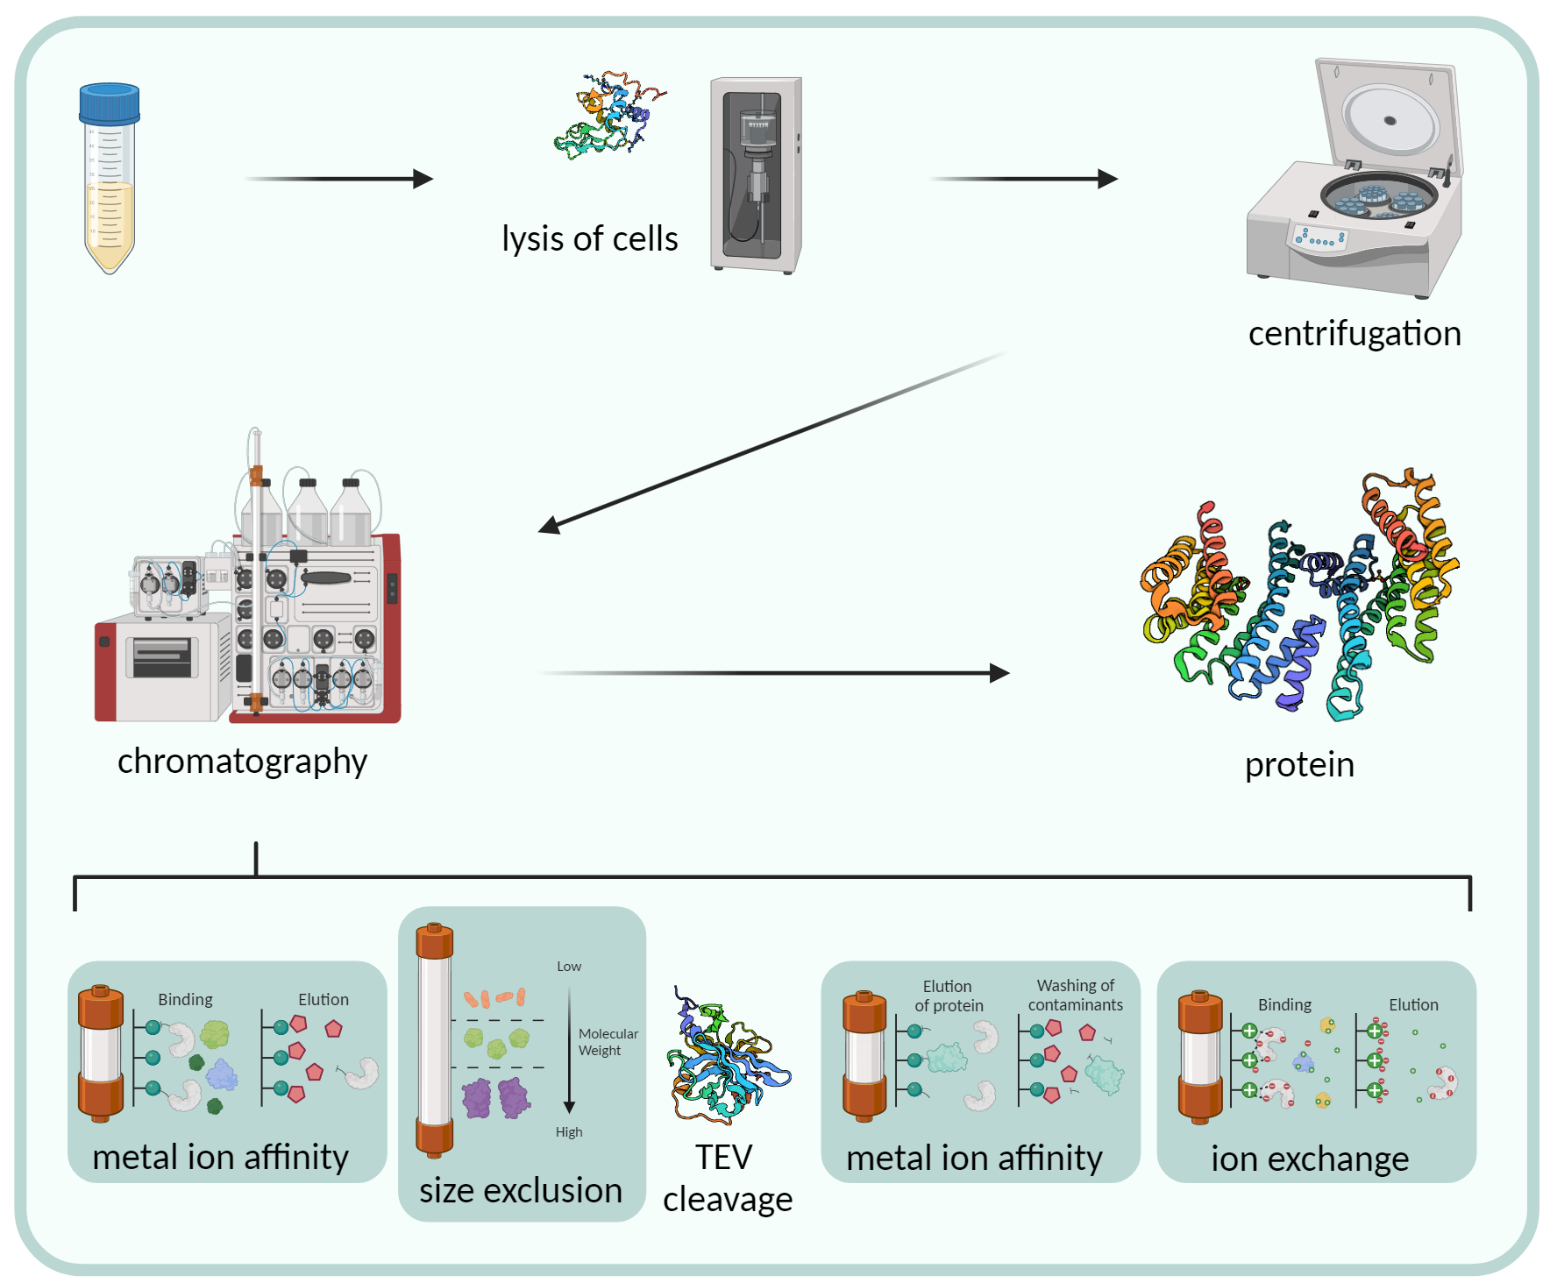
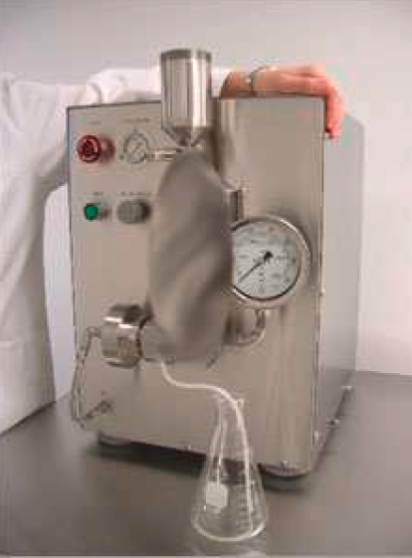
Purifikace

Slide 16
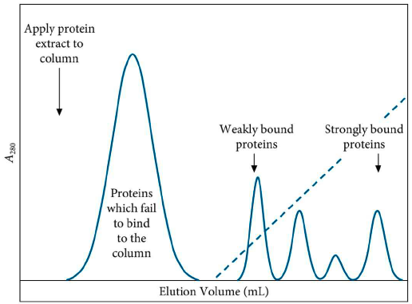
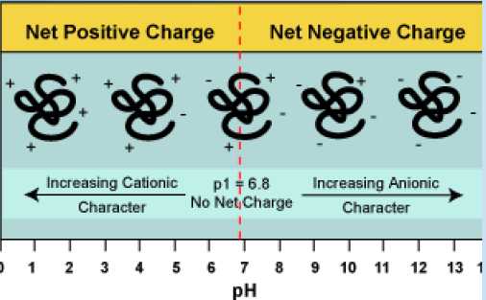
Affinity chromatography - Immobilized metal ion
affinity chromatography (IMAC)
Ion-exchange chromatography
Optimal binding of recombinant protein with metal ion is achieved at pH 7–8.
Buffers with a high salt concentration (0.5–1 M NaCl) reduce nonspecific electrostatic interaction.
Elution of contaminating proteins can be achieved by lowering the pH or using low concentrations of imidazole.
Elution of tagged protein is achieved at high imidazole concentrations (0–0.5 M), by strongly decreasing the pH, or by using EDTA.

Slide 17
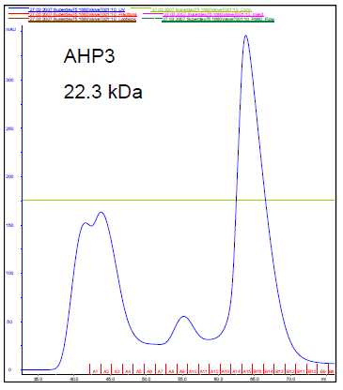
Size-exclusion chromatography (Gel filtration)
porous beads
Size-exclusion chromatography separates proteins
on the basis of size

Slide 18
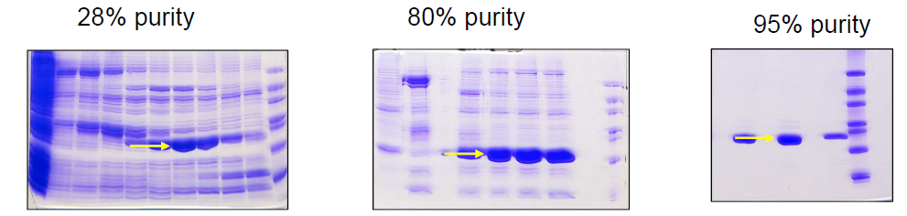
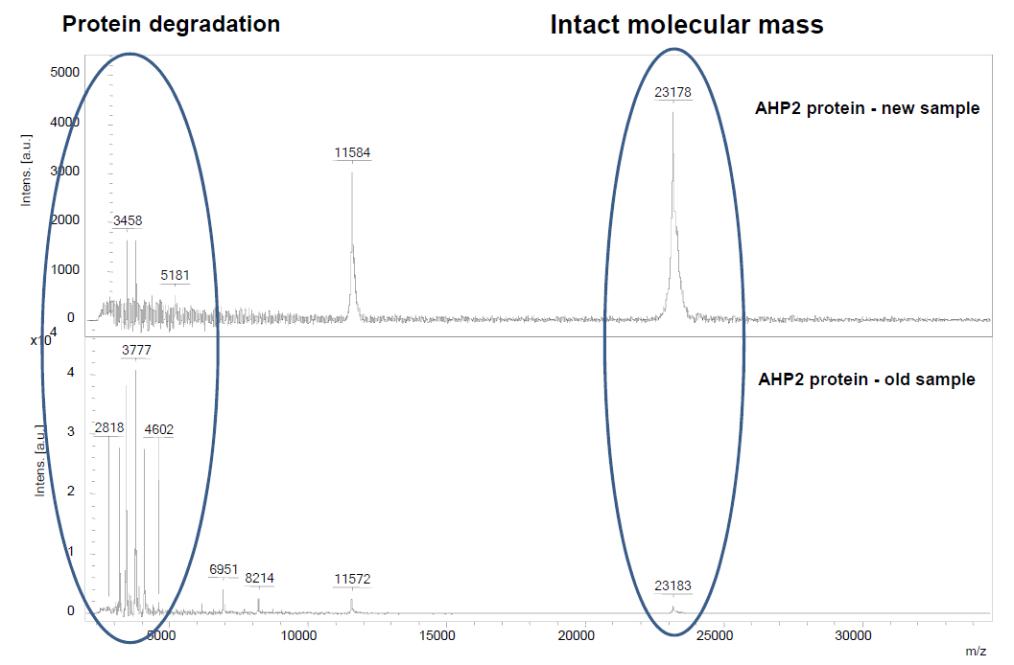
Protein Purity
What is molecular weight of 14-3-3zeta homodimer?
SDS-PAGE
Mass spectrometry (MS)-intact analysis, e.g. by MALDI-TOF MS
Another properties to check:
secondary structure (e.g. CD)
thermostability (typically in terms of Tm)
oligomeric state (e.g. DLS, AUC)

Slide 19
Viac detailne a hlavne prakticke informacie na danu temu - v ramci predmetu: C8980 Příprava a charakterizace proteinů I - Exprese a purifikace

