Slide 1
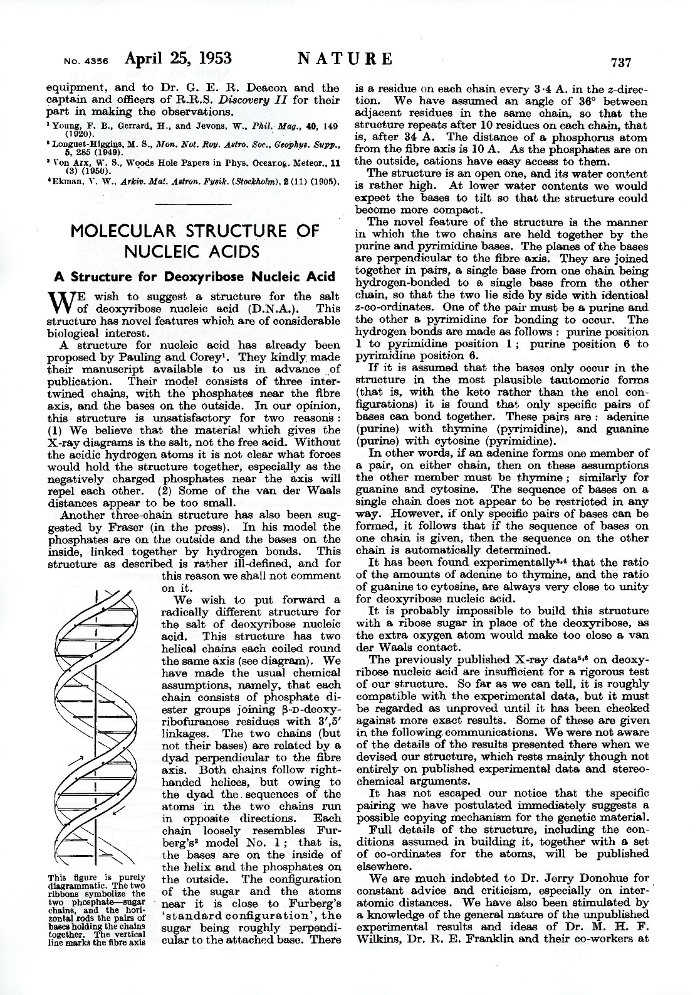
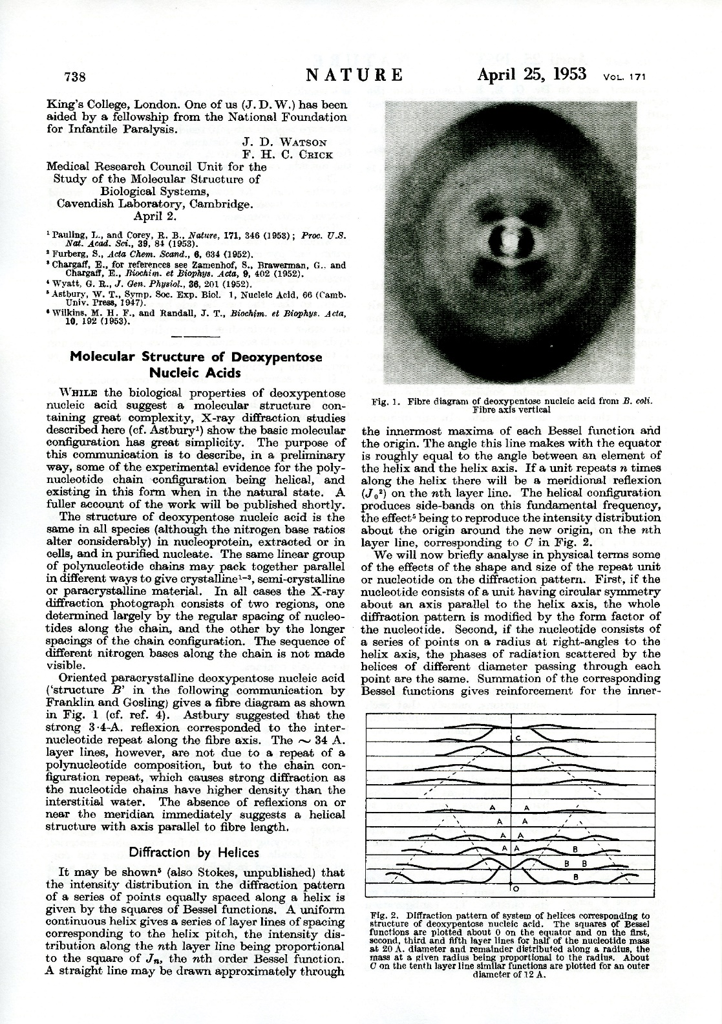

Slide 2
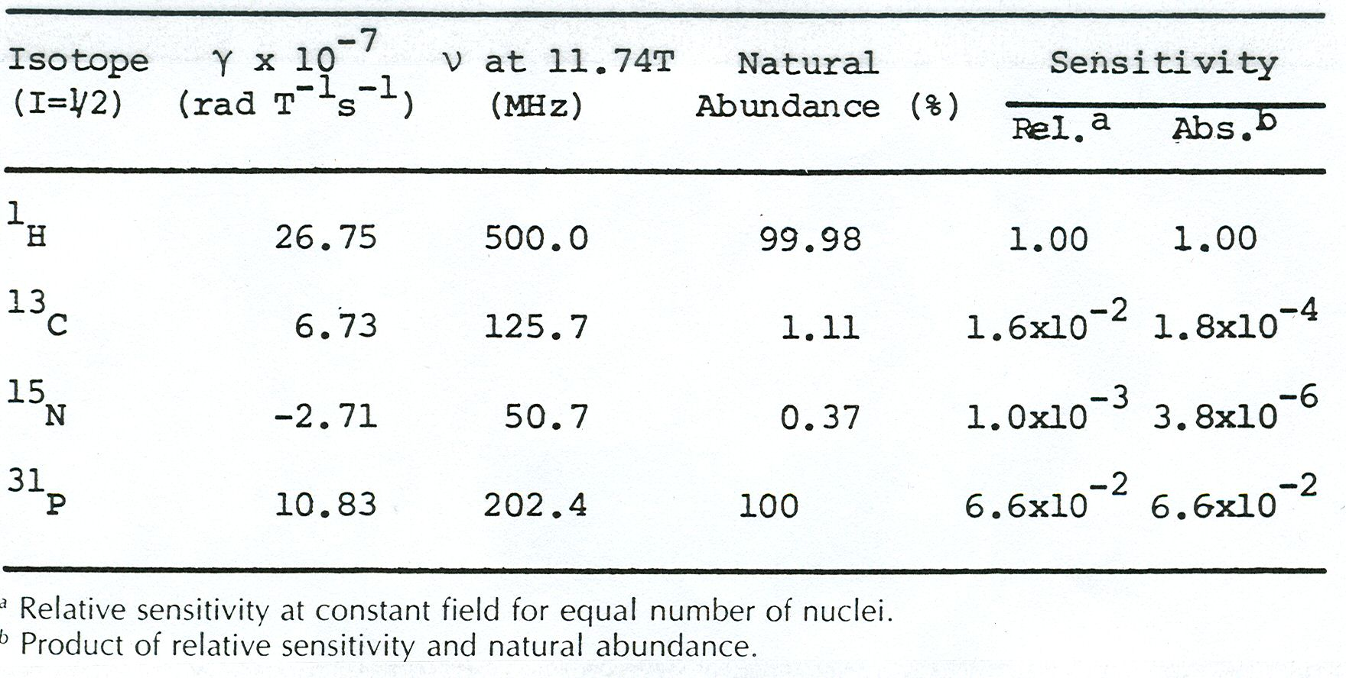
Nuclear properties of selected isotopes

Slide 3
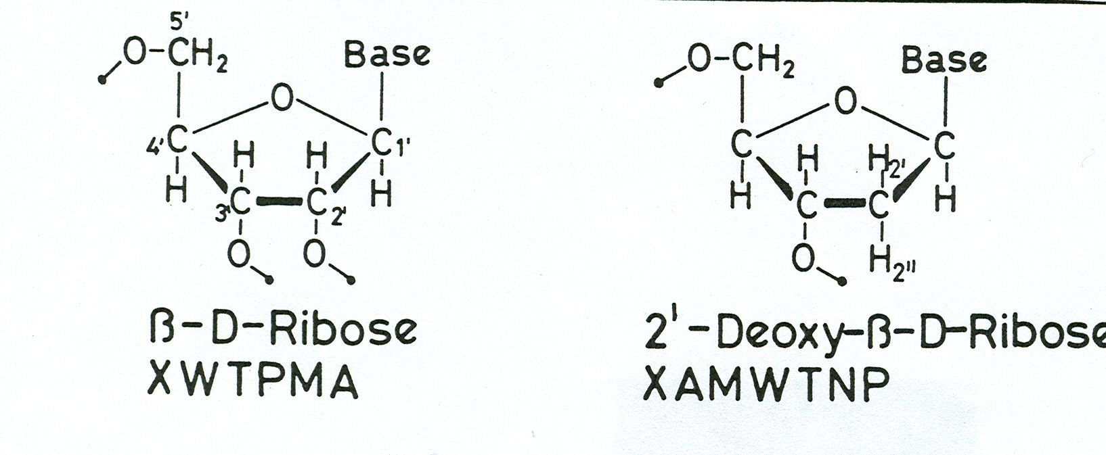
Spin systems in ribose and deoxyribose

Slide 4
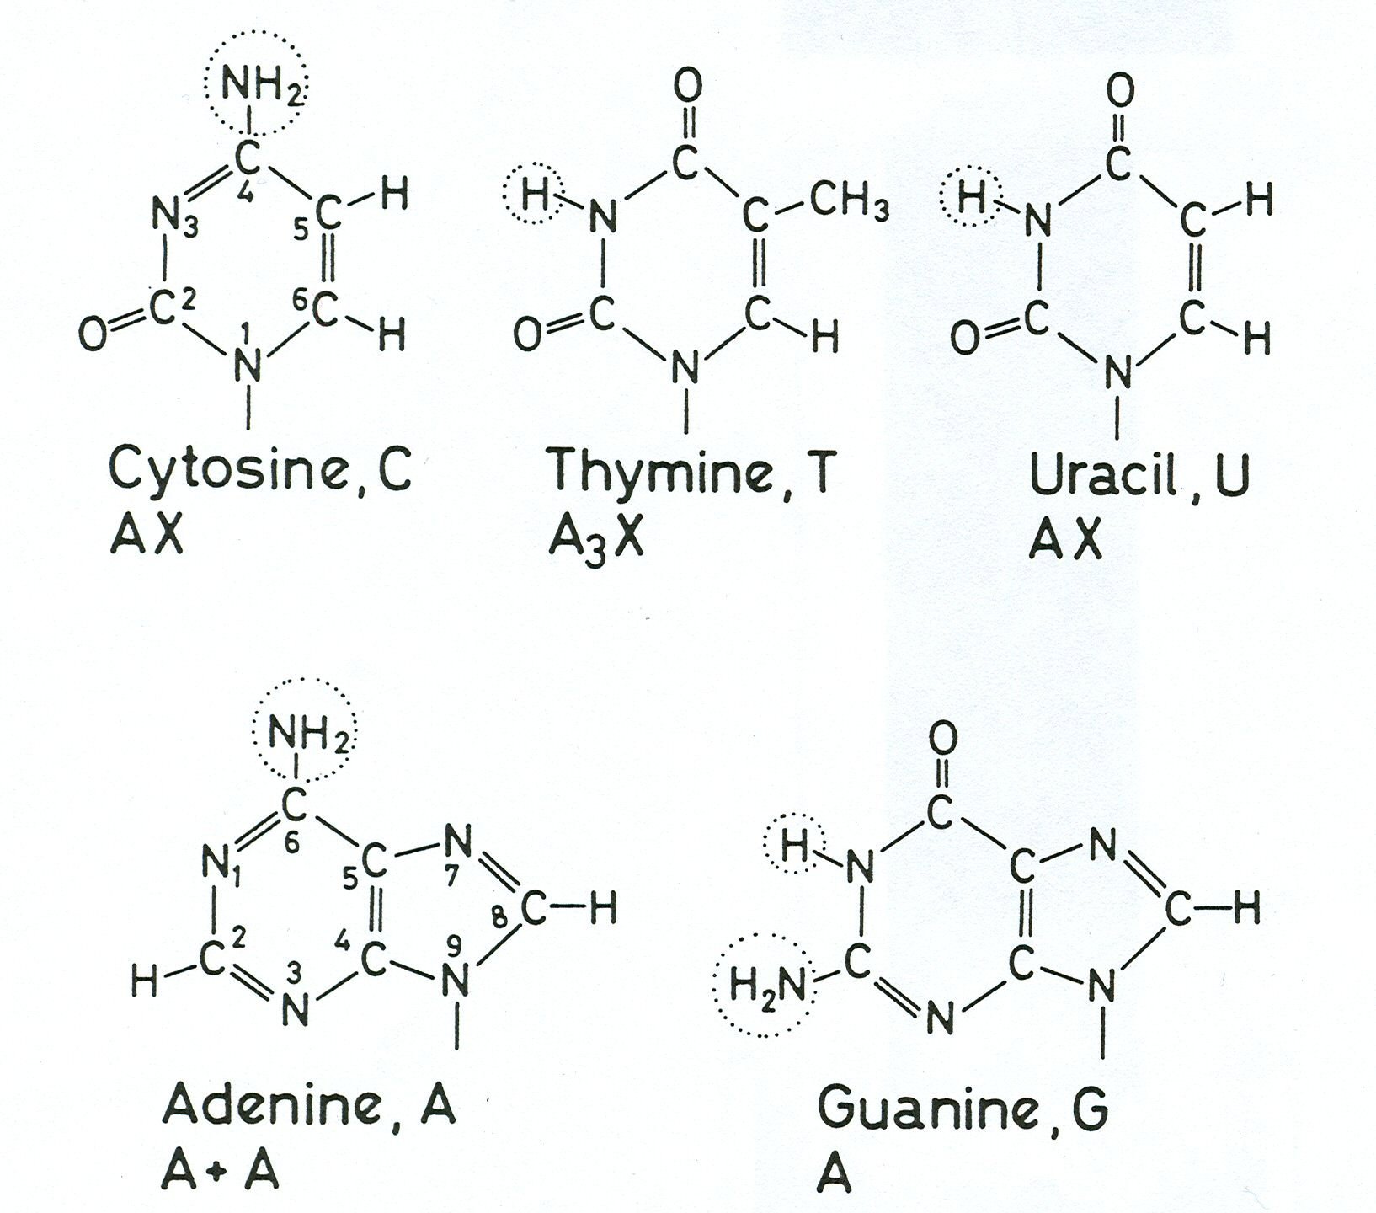
Spin systems in nucleic acid bases

Slide 5
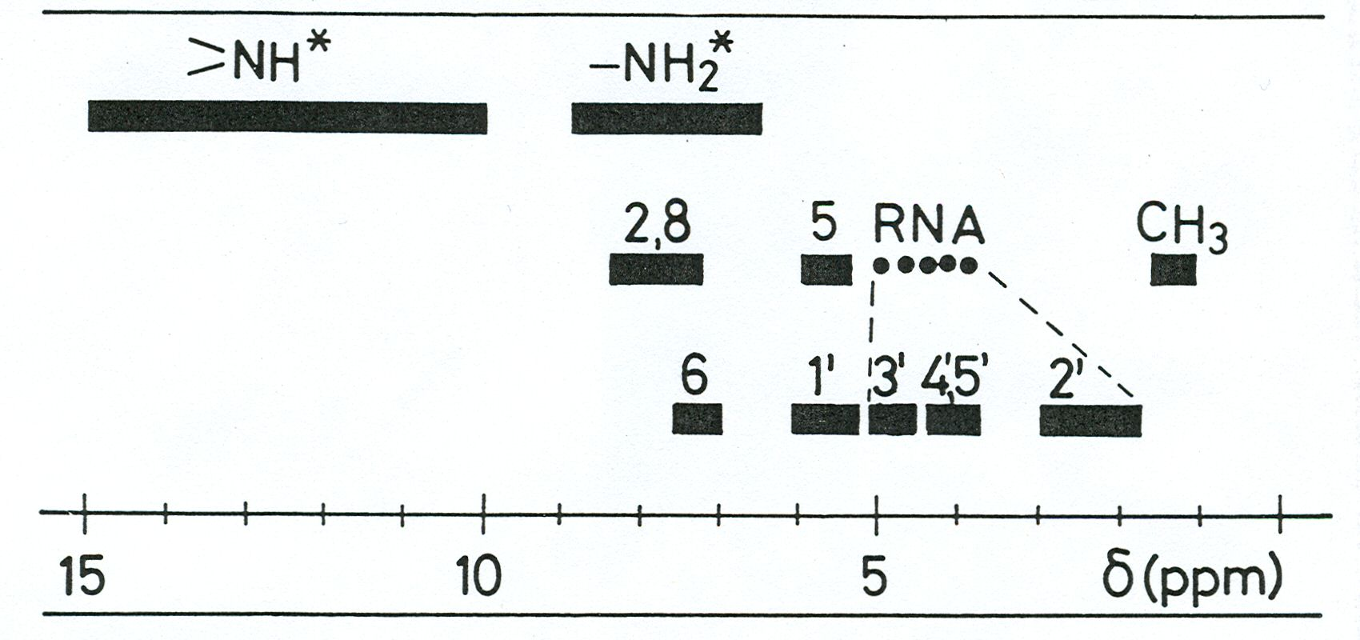
¹H chemical shift ranges in DNA and RNA

Slide 6
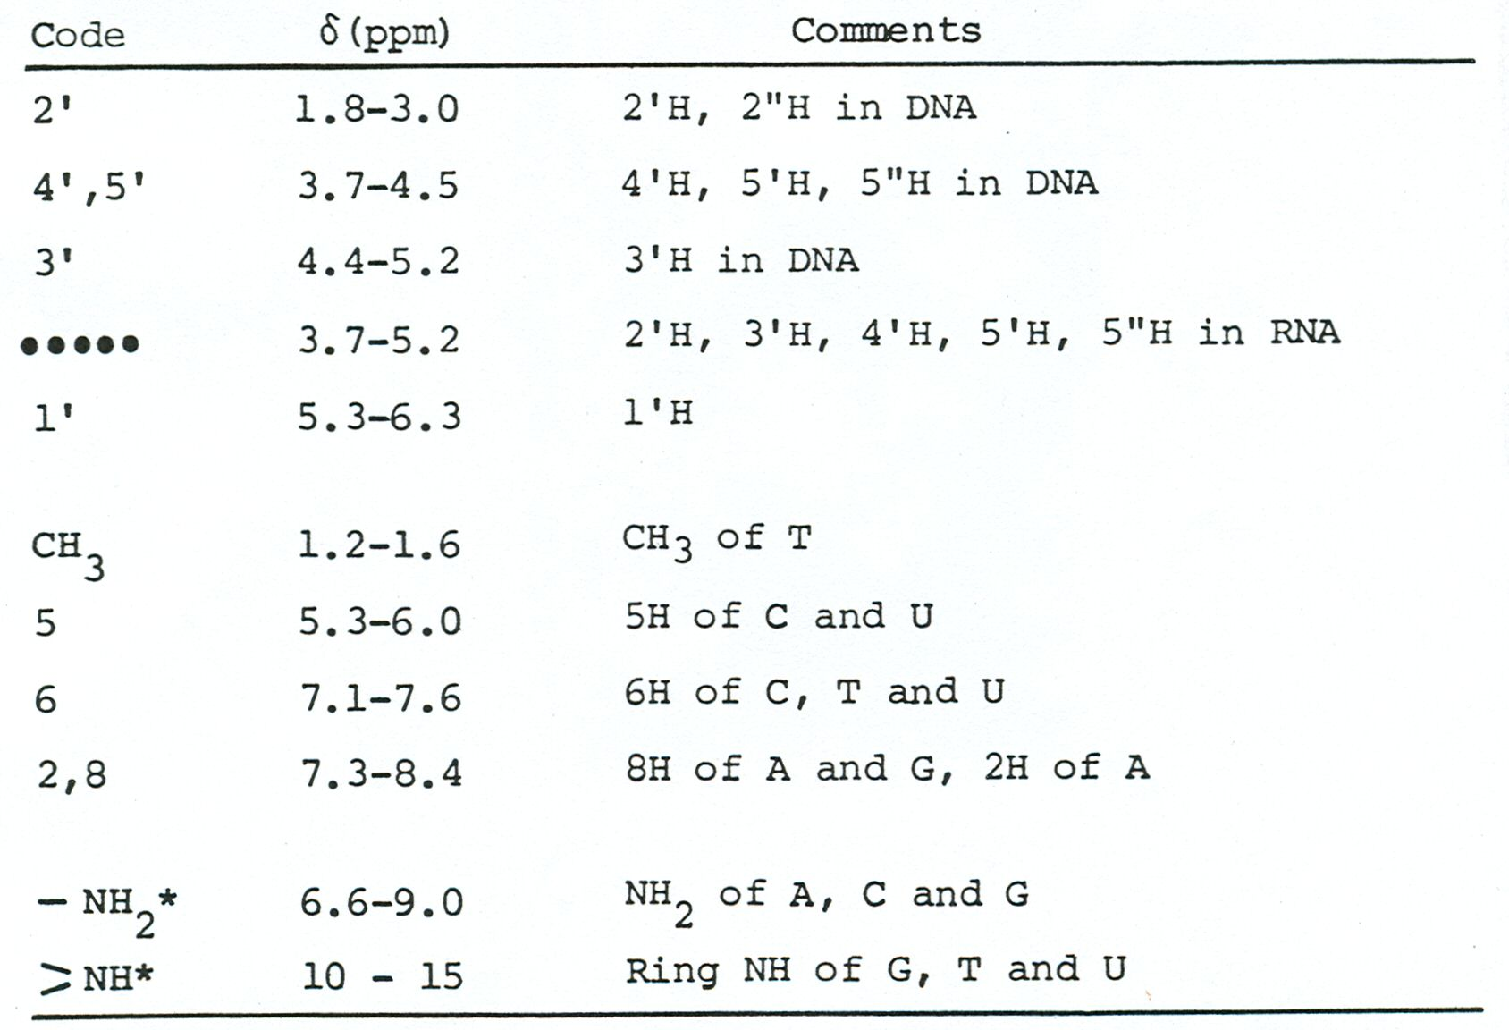
¹H chemical shift ranges in DNA and RNA

Slide 7
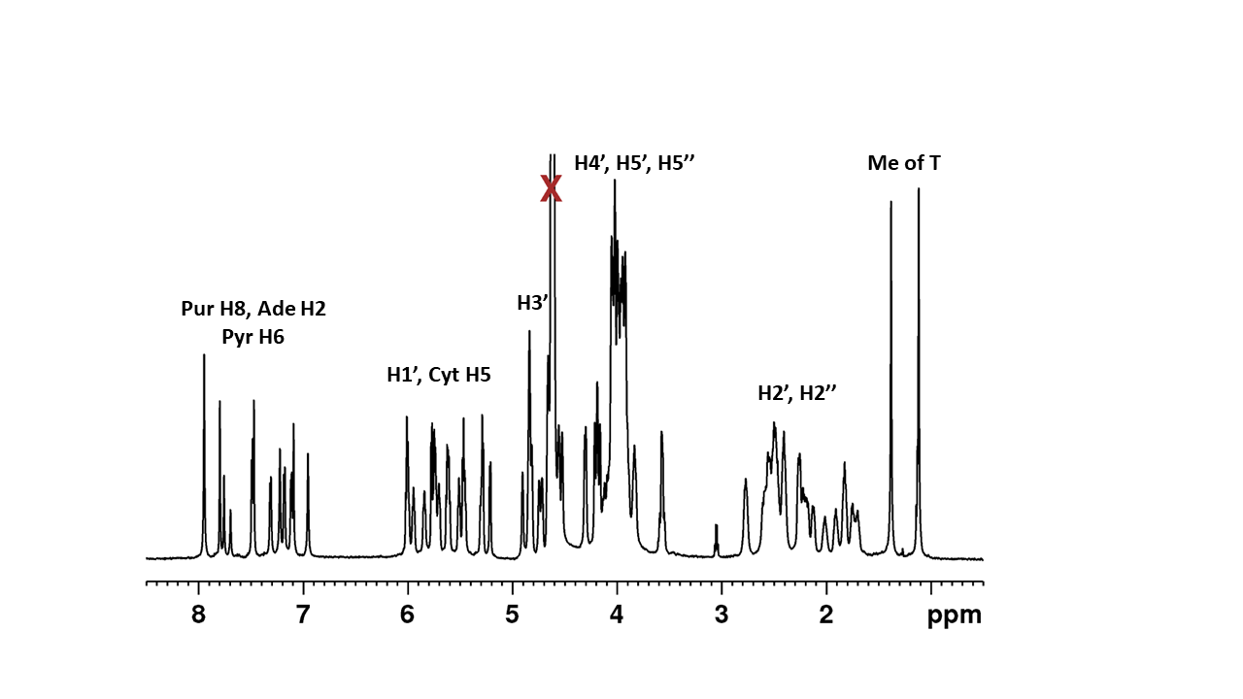
¹H NMR spectrum of d(CGCGAATTCGCG)

Slide 8
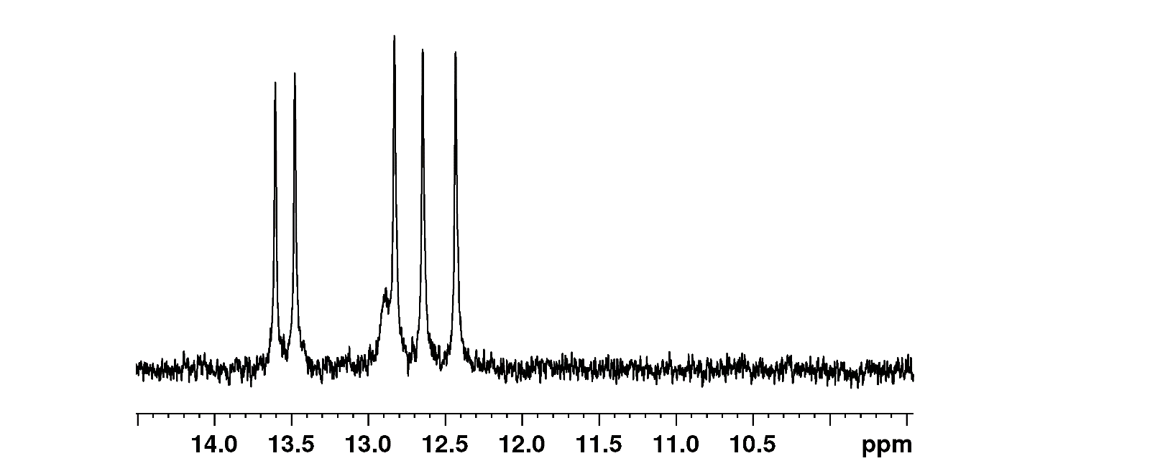
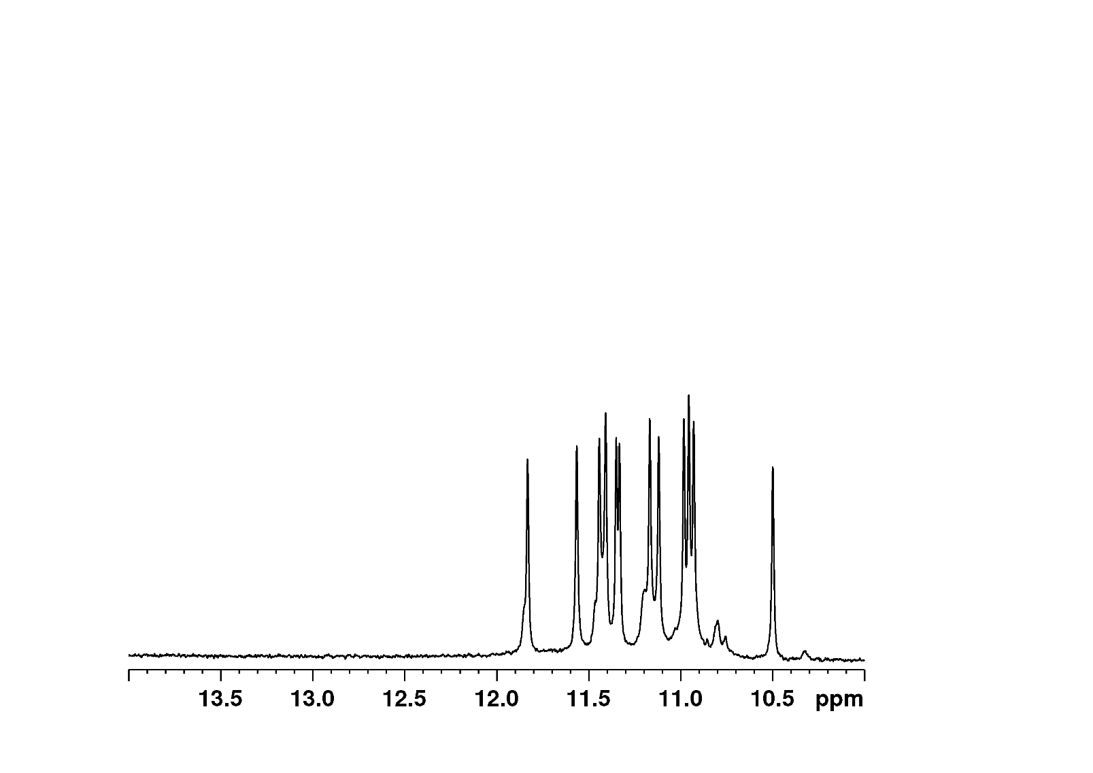
¹H NMR spectra in H₂O
Watson-Crick
d(CGCGAATTCGCG)₂
B-helix
Hoogsteen
d(AAT GGG T GGG TTT GGG T GGG TAA)
G-quadruplex

Slide 9
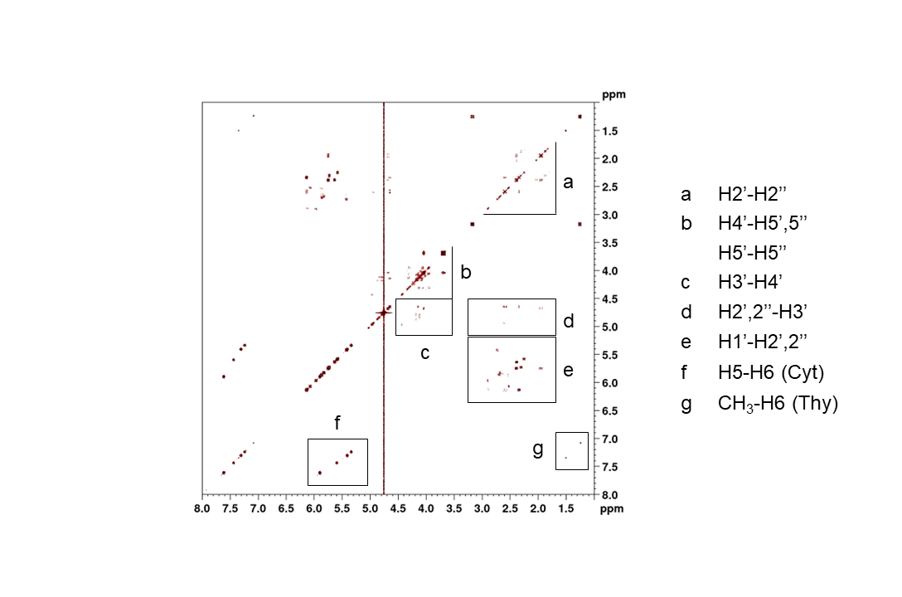
¹H COSY spectrum of DNA
d(CGCGAATTCGCG)₂

Slide 10
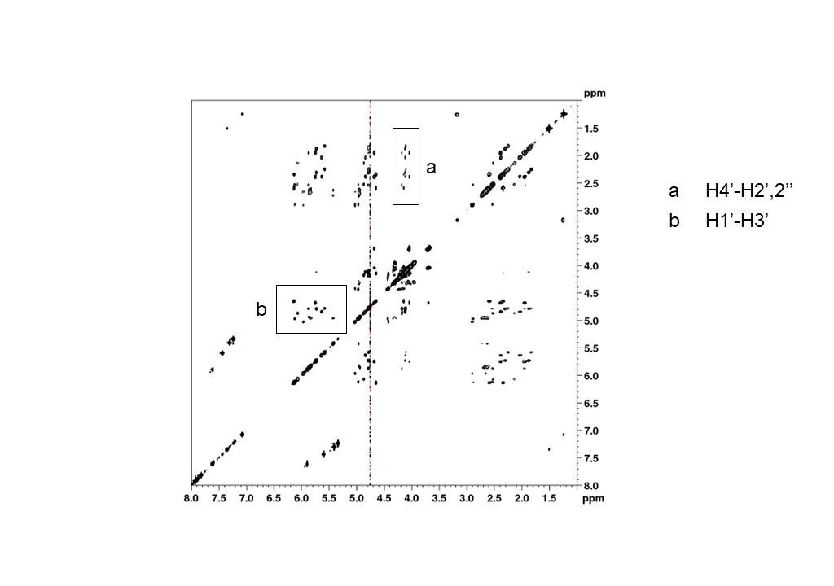
¹H TOCSY spectrum of DNA
d(CGCGAATTCGCG)₂

Slide 11
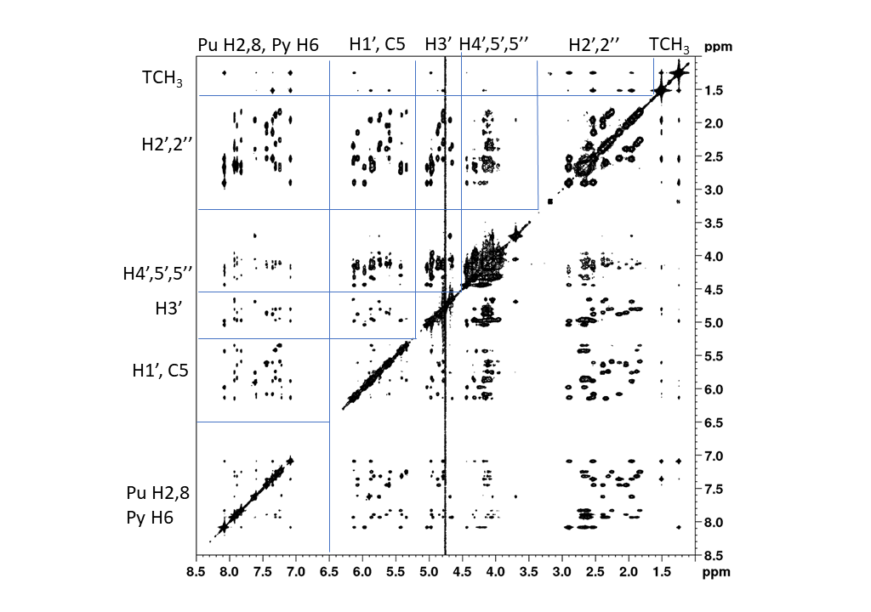
¹H NOESY spectrum of DNA in D₂O
d(CGCGAATTCGCG)₂

Slide 12
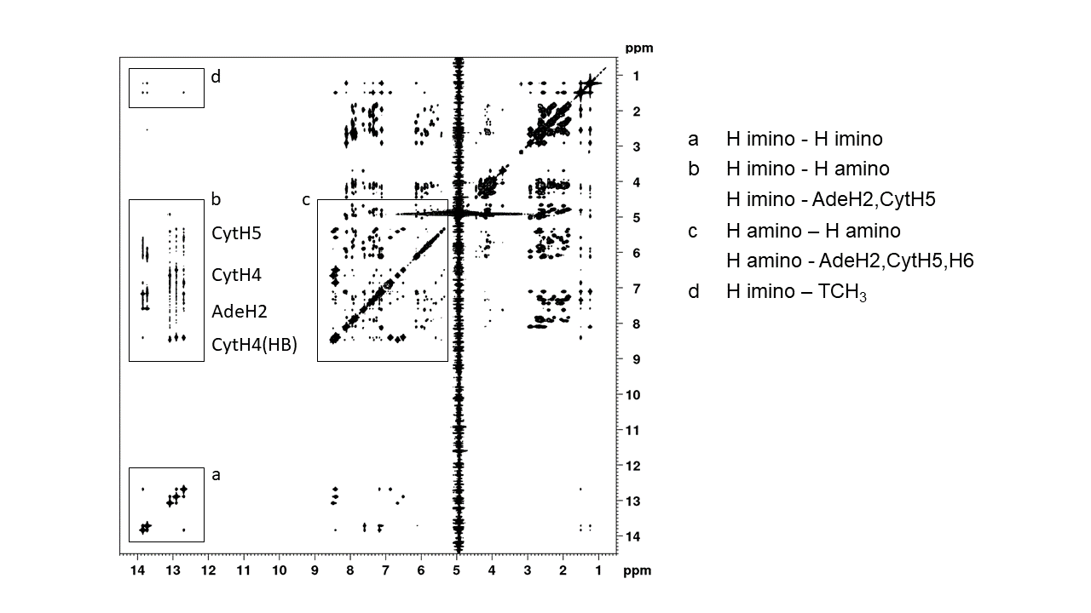
¹H NOESY spectrum of DNA in H₂O
d(CGCGAATTCGCG)₂

Slide 13
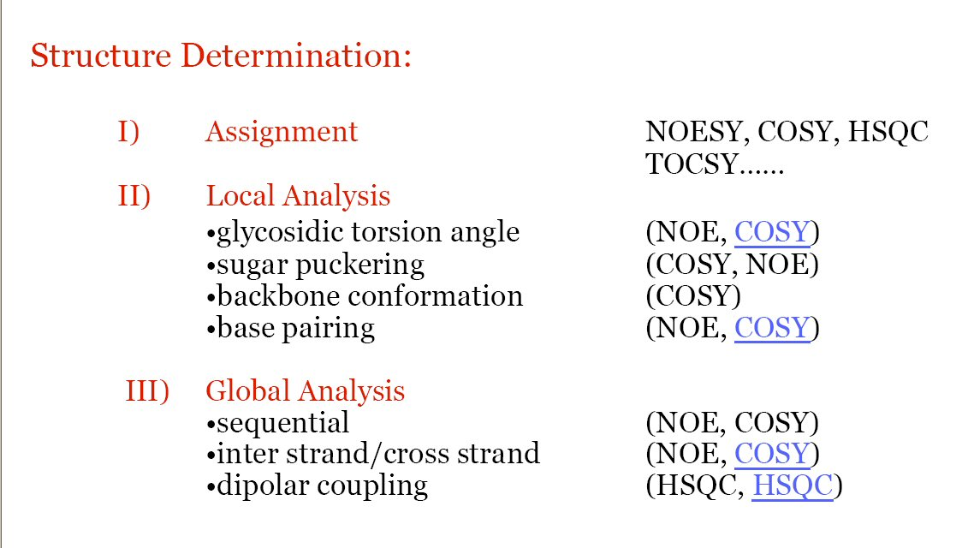
Structure Determination Procedure

Slide 14
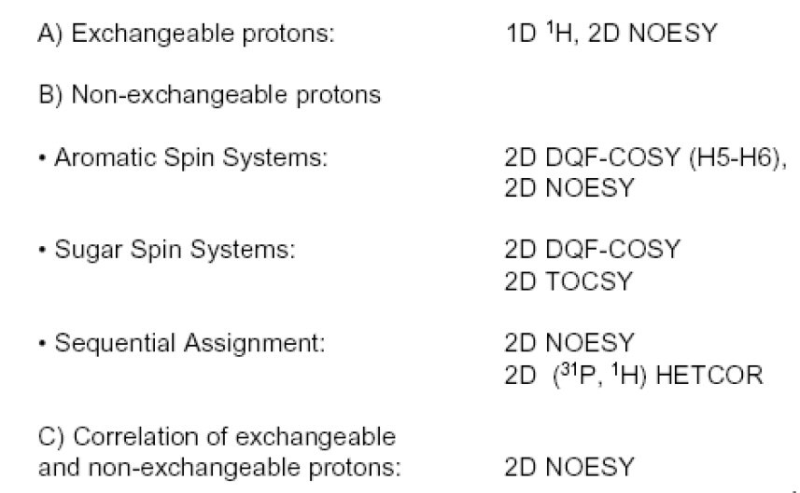
Resonance Assignment

Slide 15
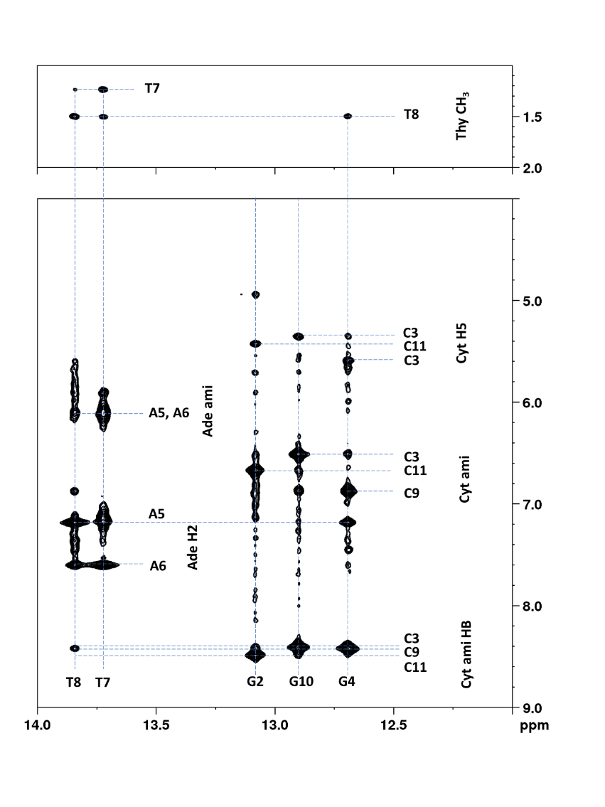
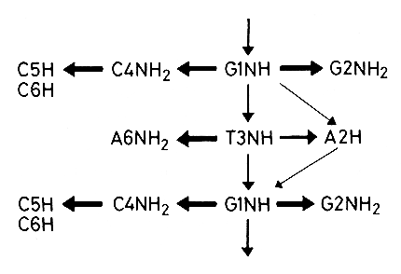
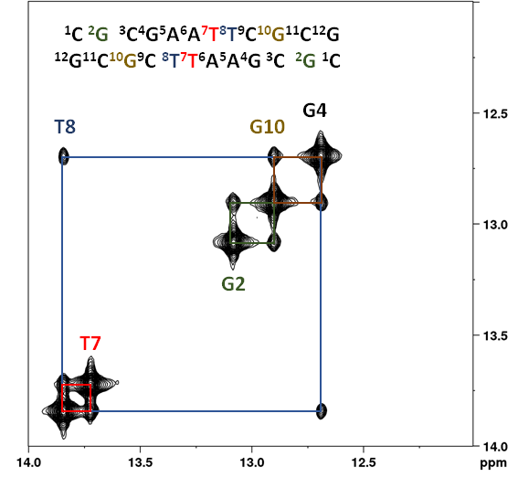
Sequential connectivities
with exchangeable protons
Dickerson’s dodecamer
d(CGCGAATTCGCG)₂‏
imino-imino
imino-amino

Slide 16
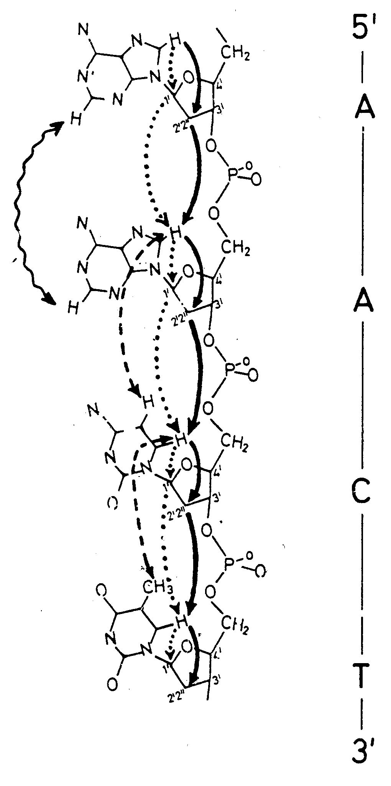
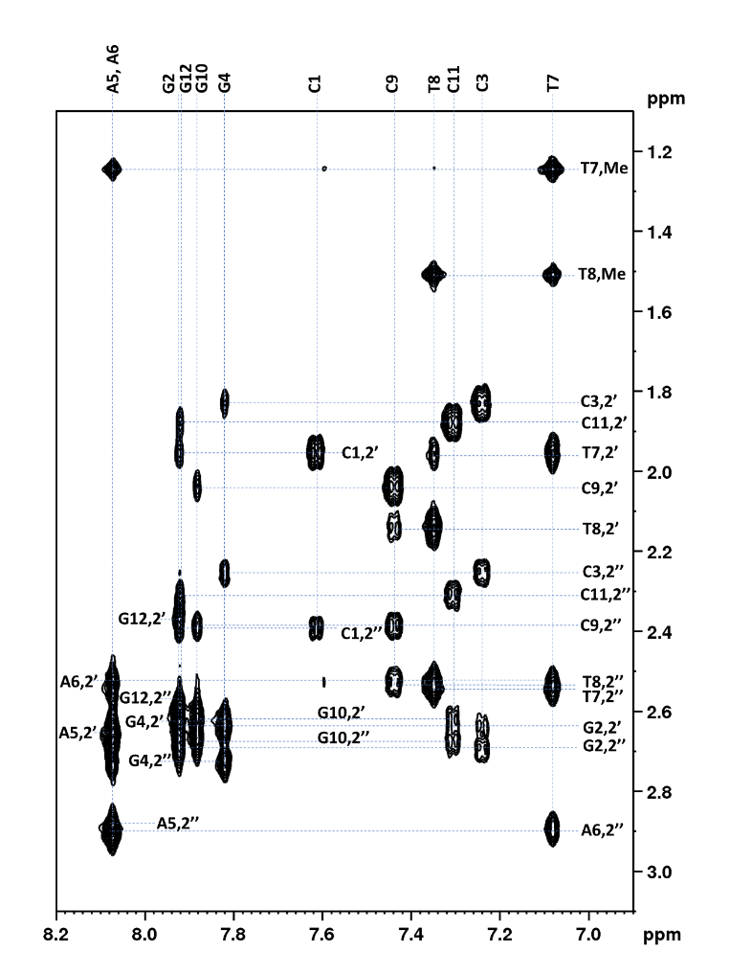
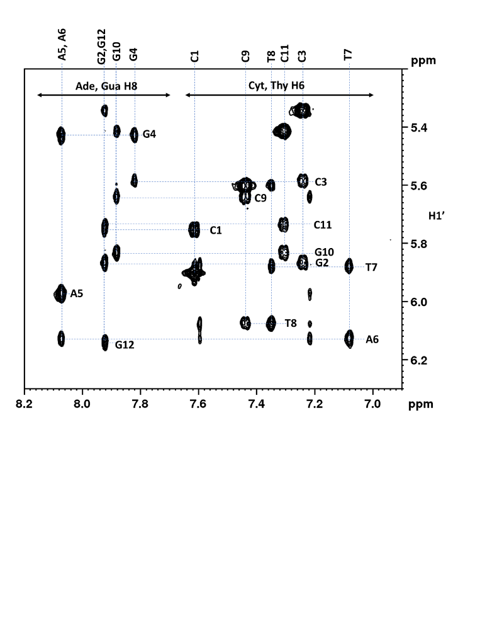
Sequential resonance assignments
H6/8-H2’,2’’/Me
H6/8-H1’
d(CGCGAATTCGCG)₂

Slide 17
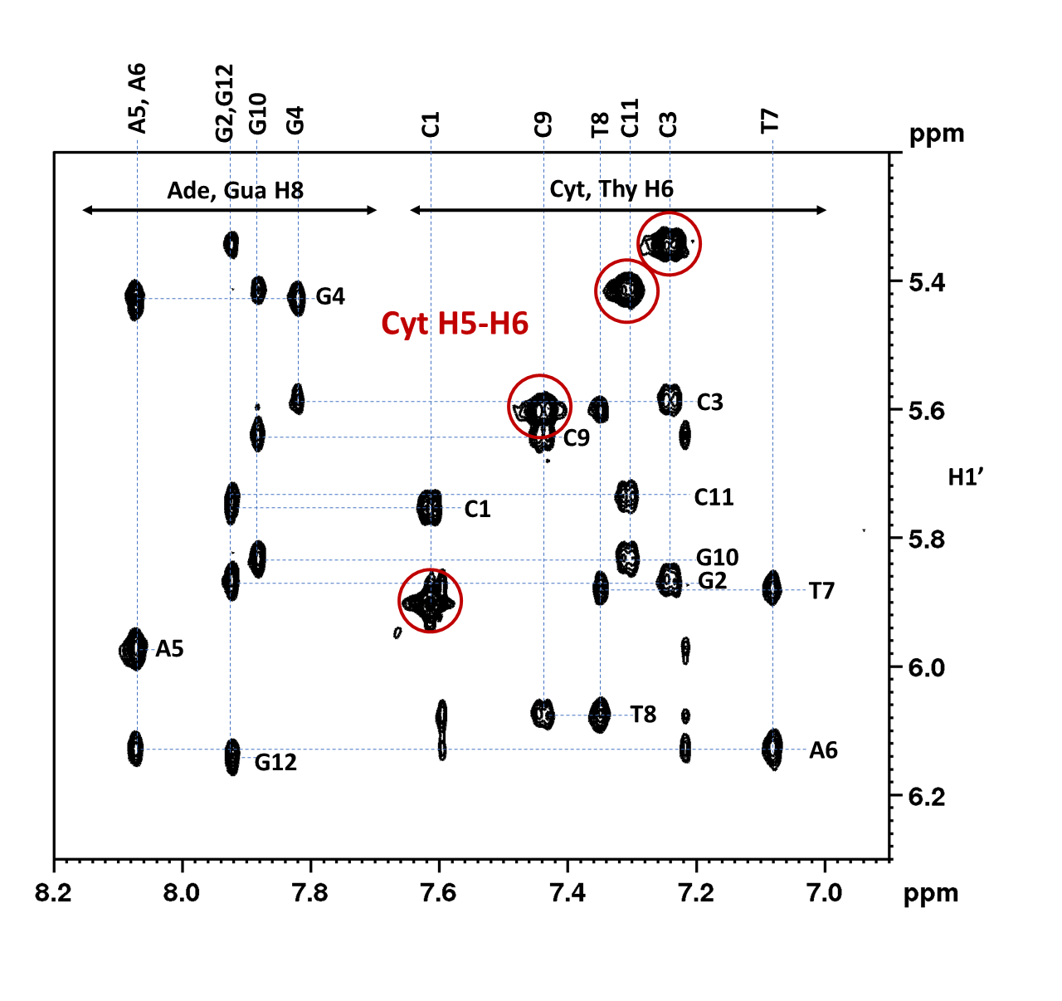
Assignment based on H6/8-H1’ connectivities
d(CGCGAATTCGCG)₂

Slide 18
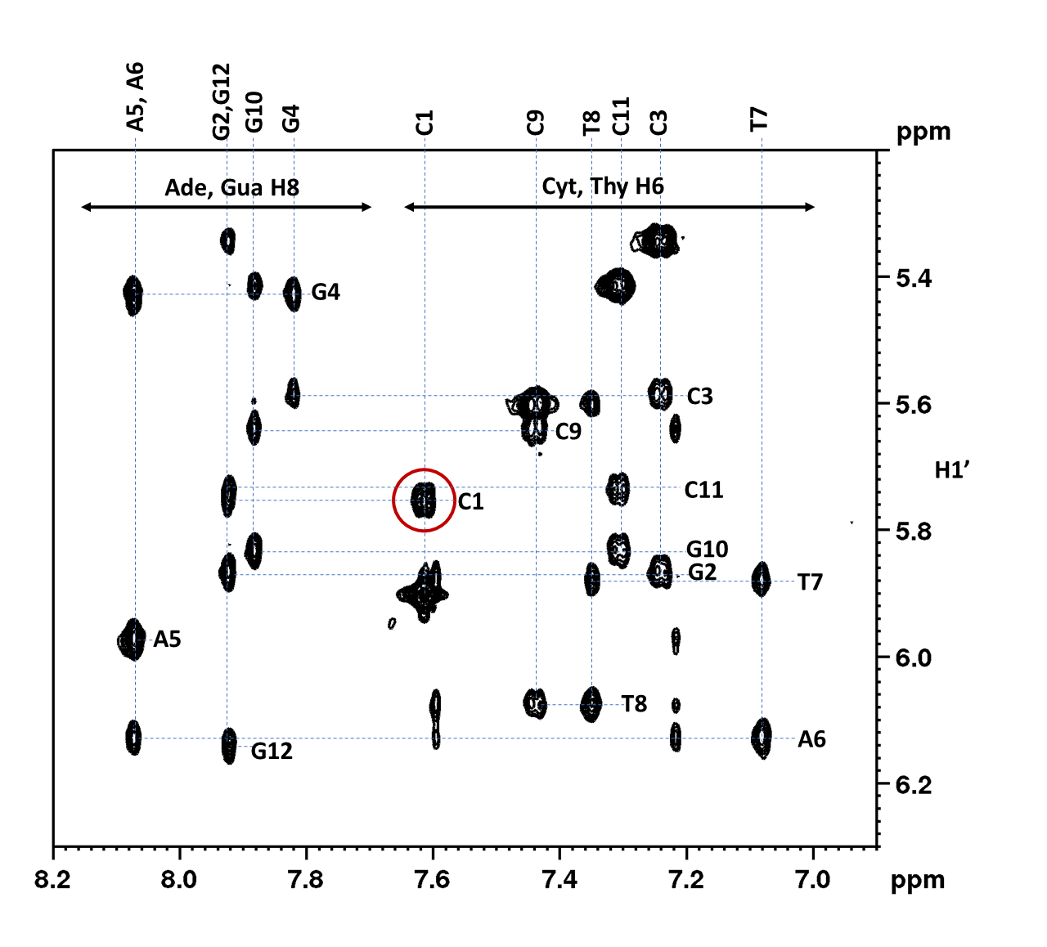
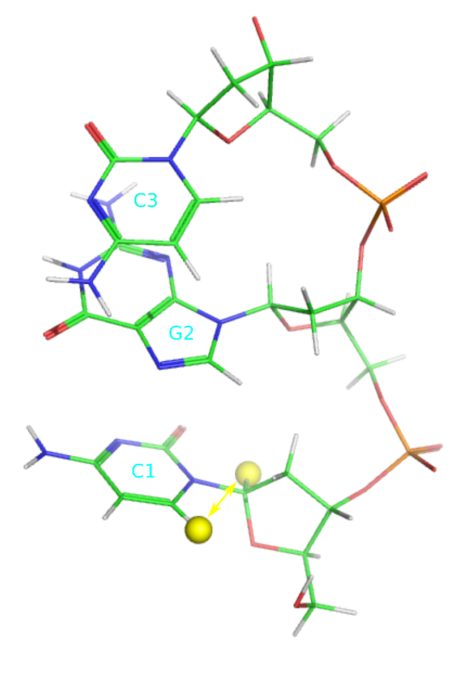
Assignment based on H6/8-H1’ connectivities
d(CGCGAATTCGCG)₂

Slide 19
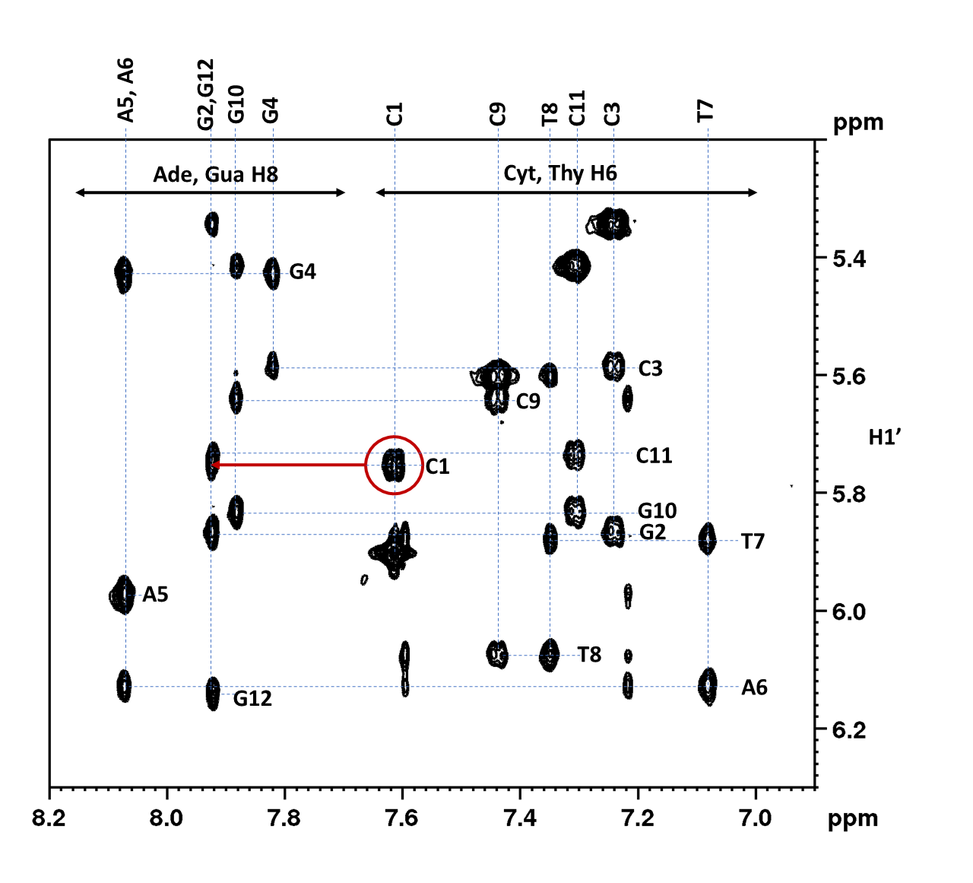
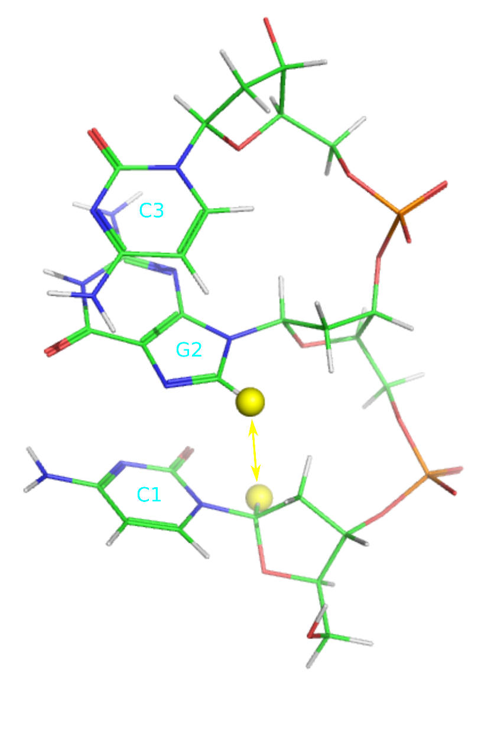
Assignment based on H6/8-H1’ connectivities
d(CGCGAATTCGCG)₂

Slide 20
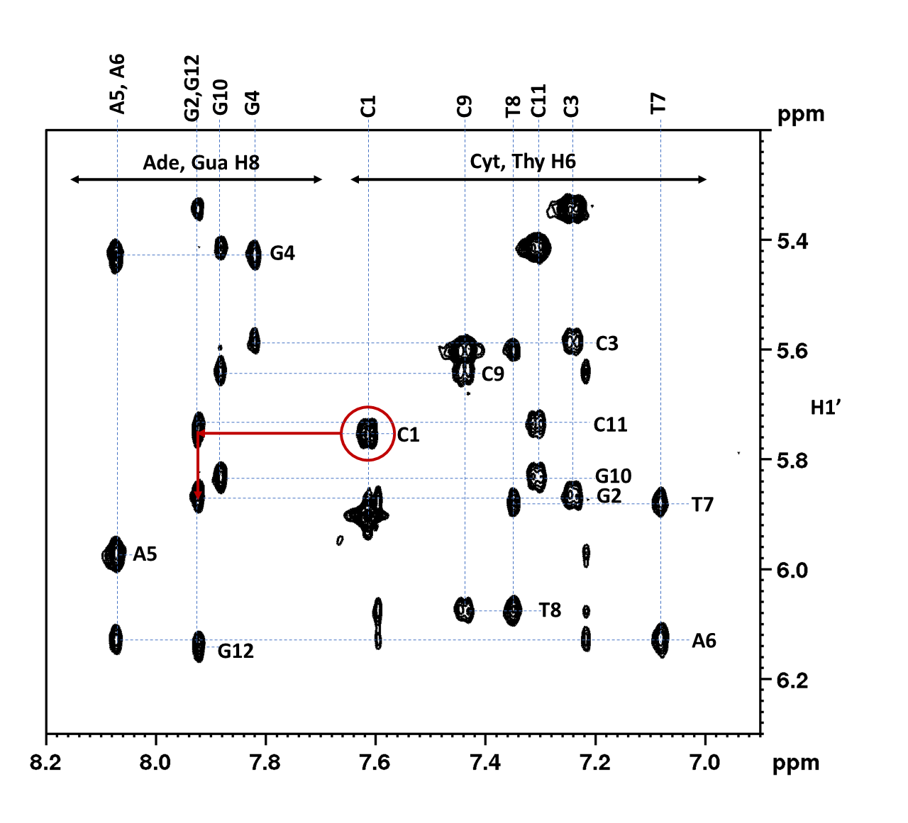
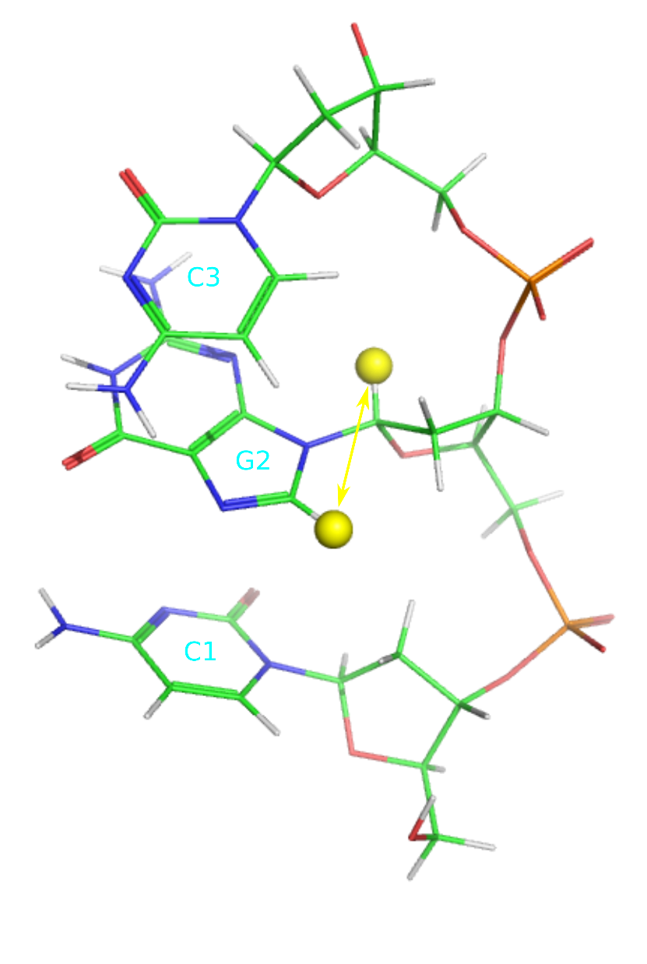
Assignment based on H6/8-H1’ connectivities
d(CGCGAATTCGCG)₂

Slide 21
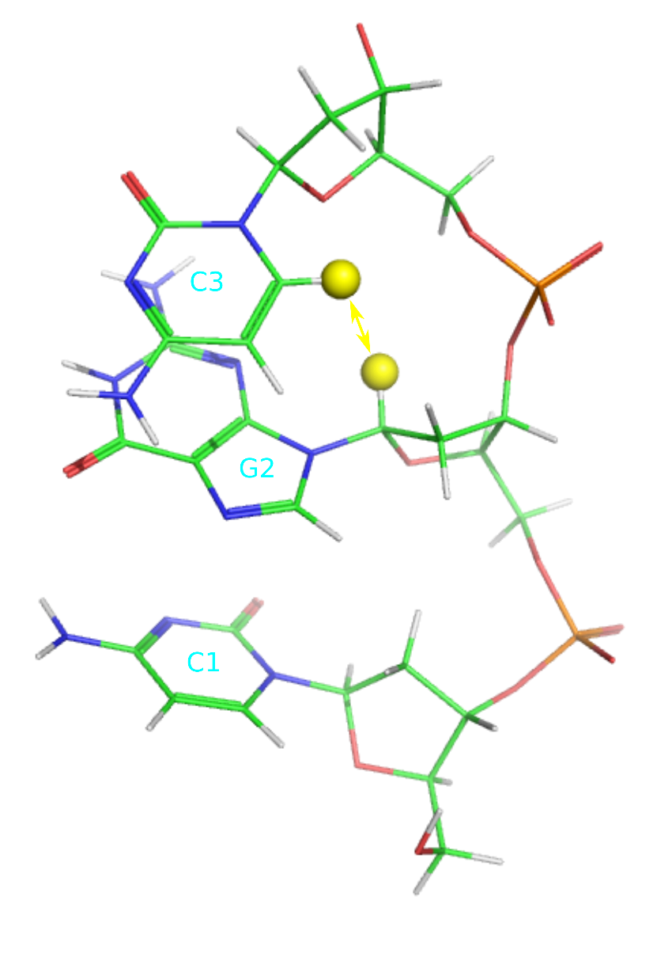
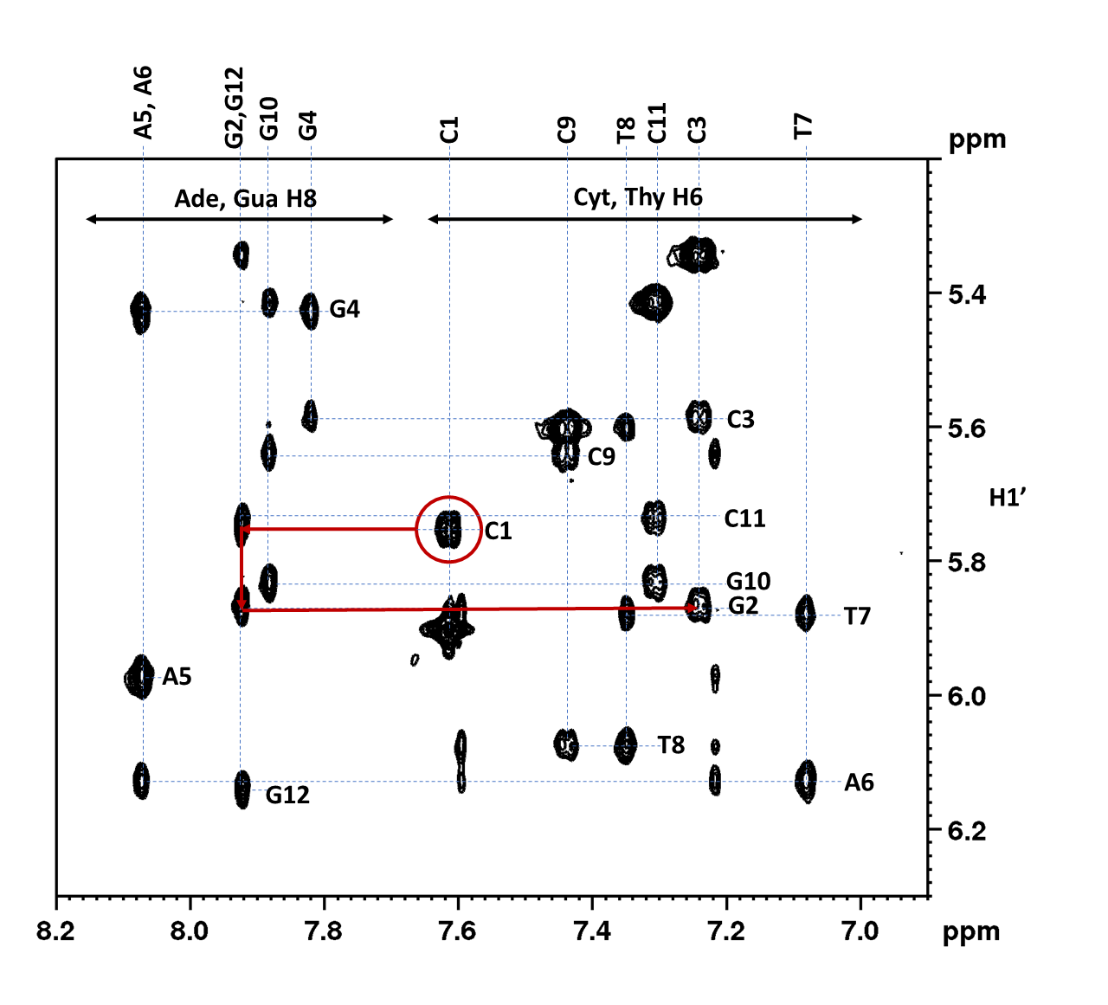
Assignment based on H6/8-H1’ connectivities
d(CGCGAATTCGCG)₂

Slide 22
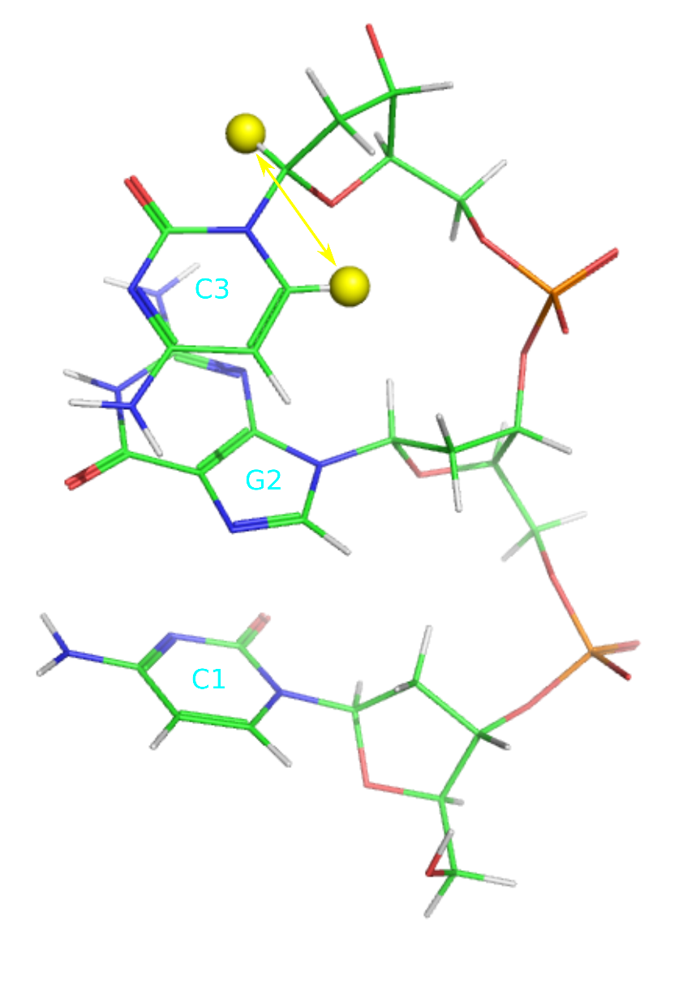
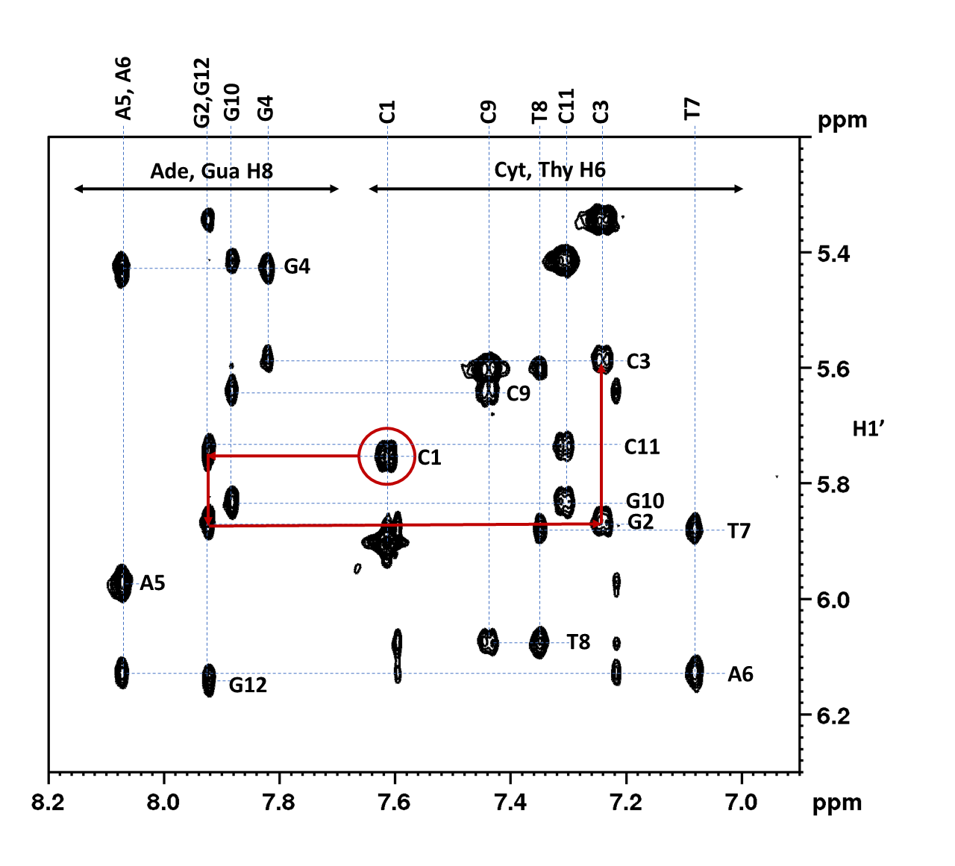
Assignment based on H6/8-H1’ connectivities
d(CGCGAATTCGCG)₂

Slide 23
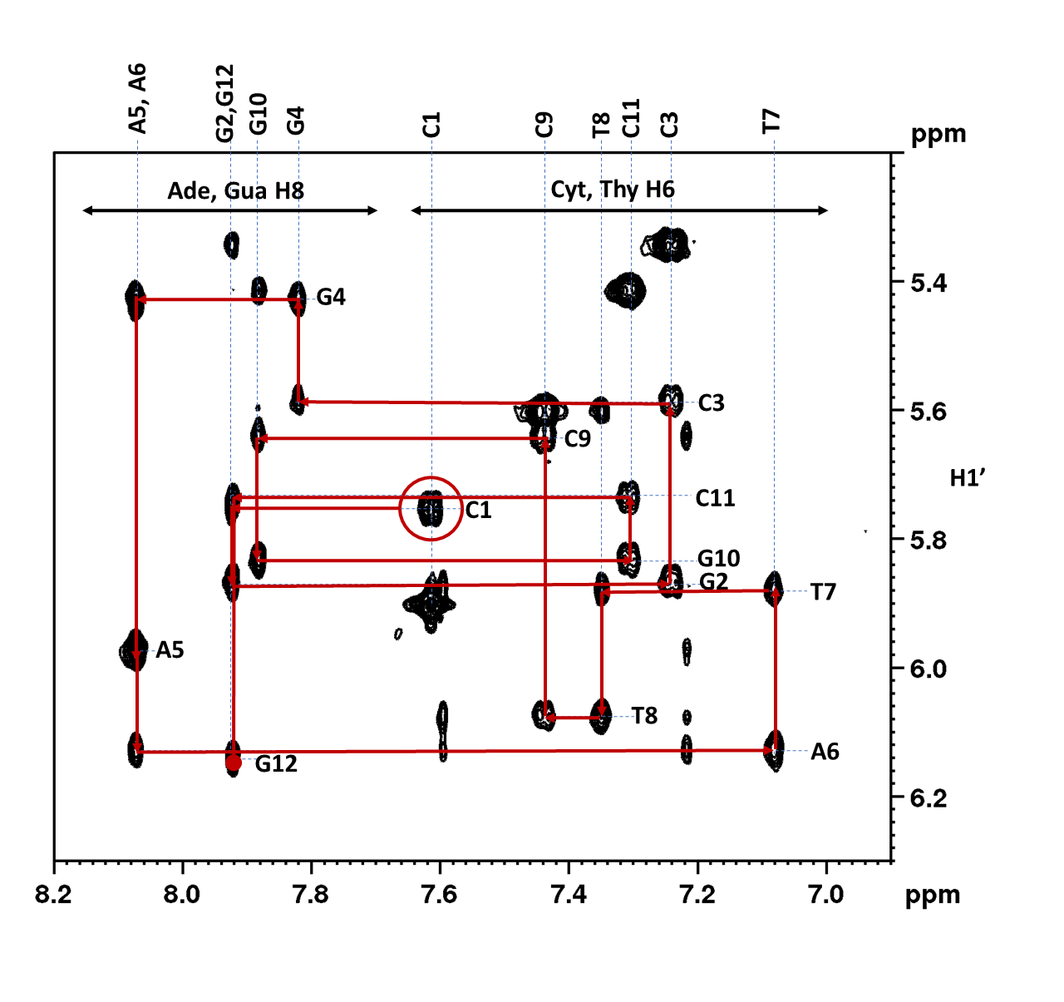
Assignment based on H6/8-H1’ connectivities
d(CGCGAATTCGCG)₂

Slide 24
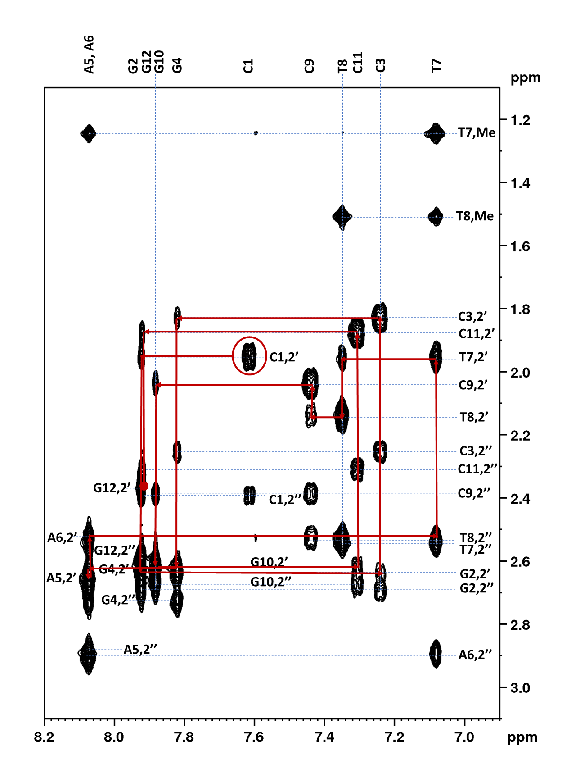
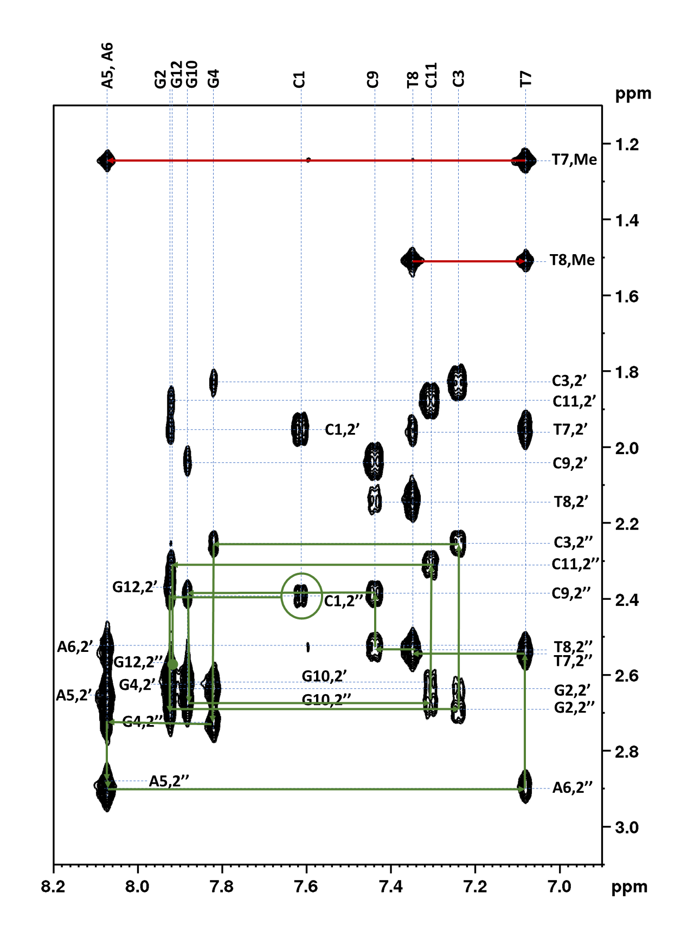
Assignment based on H6/8-H2’2’’ connectivities
d(CGCGAATTCGCG)₂

Slide 25
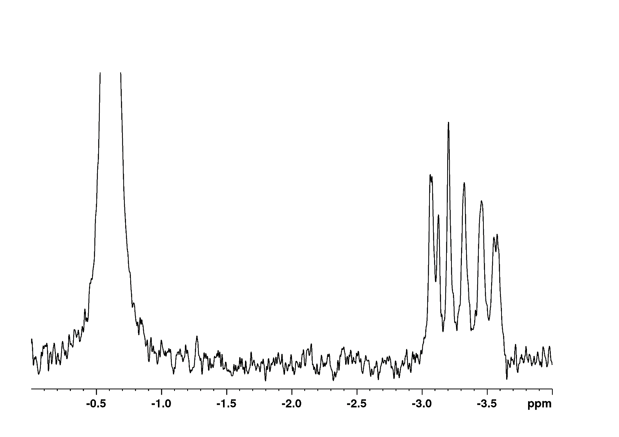
³¹P spectrum of DNA
d(CGCGAATTCGCG)₂
Phosphate buffer

Slide 26
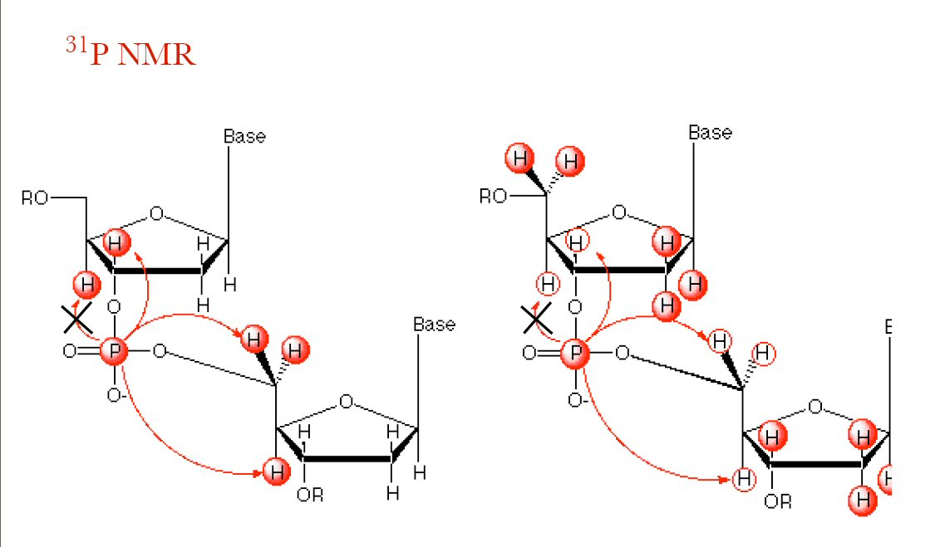
Assignment of Sugar-Phosphate Backbone
HP-COSY
HP-TOCSY

Slide 27
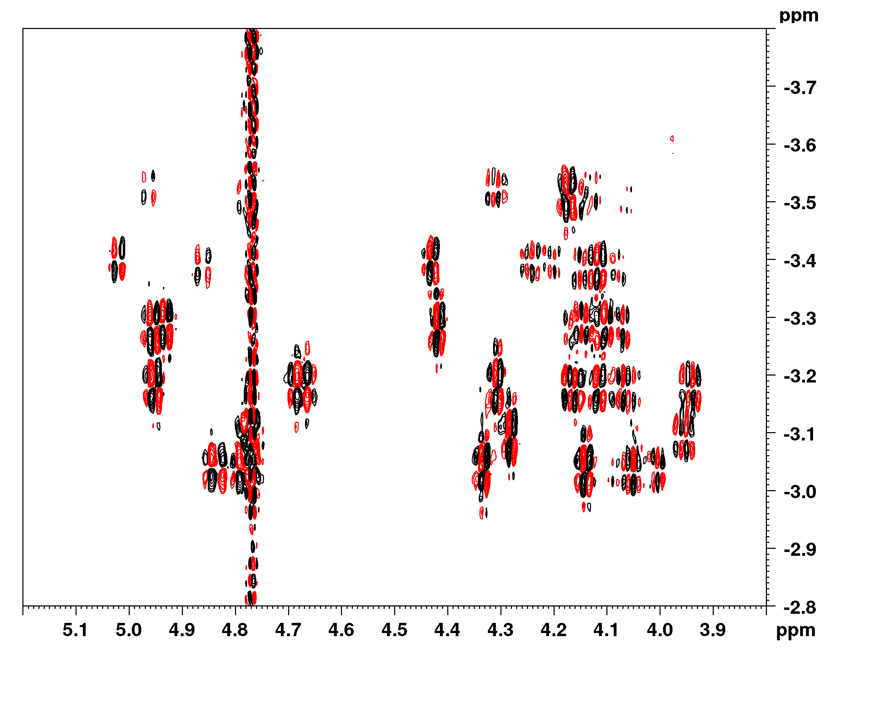
¹H - ³¹P correlation spectrum
3’
4’, 5’, 5’’
³¹P
d(CGCGAATTCGCG)₂
¹H

Slide 28
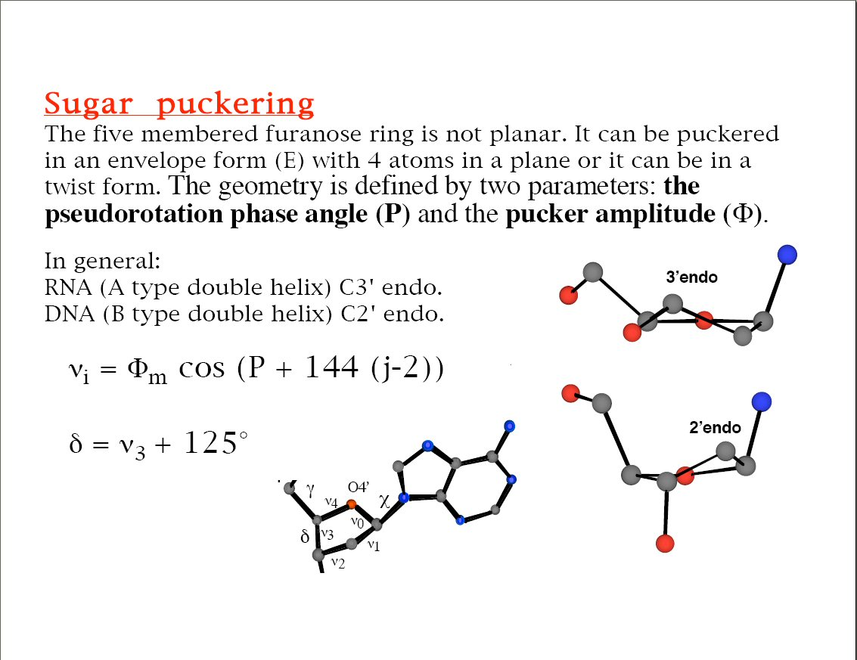

Slide 29
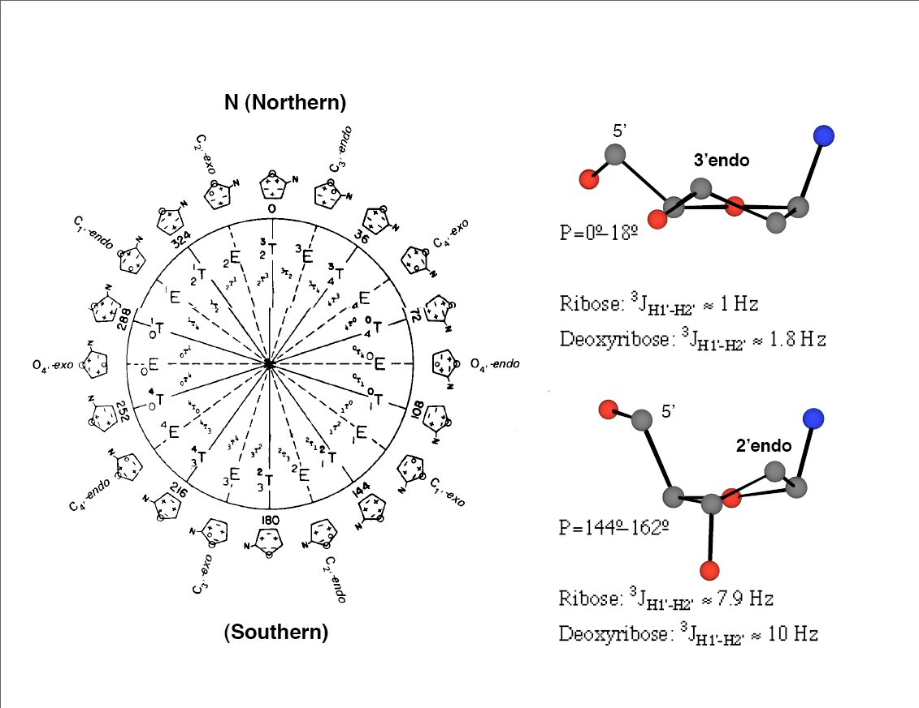

Slide 30
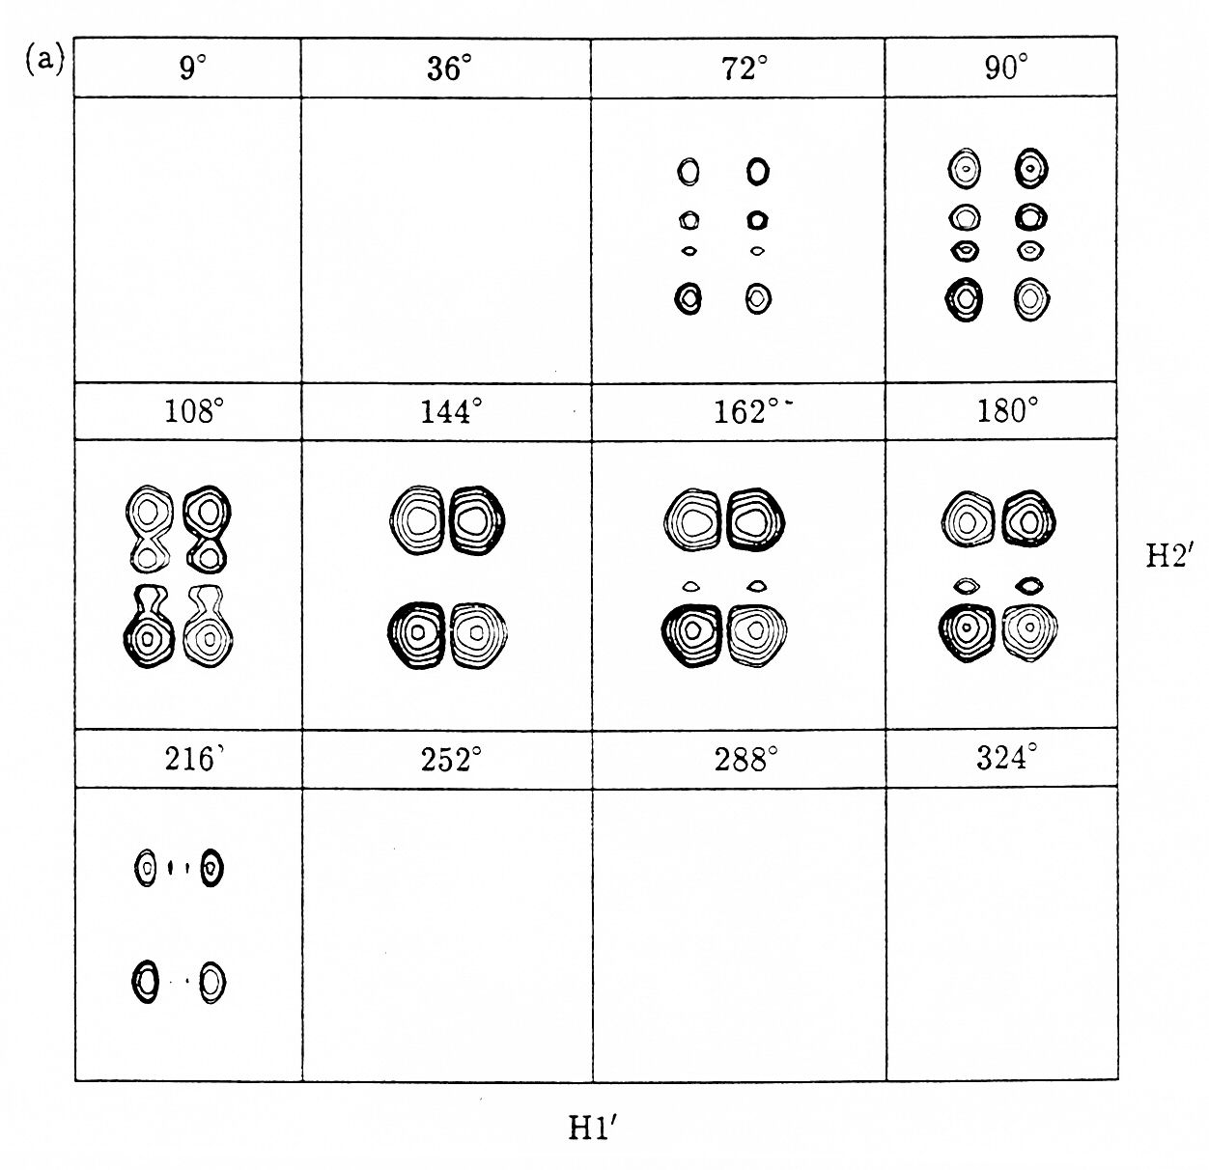
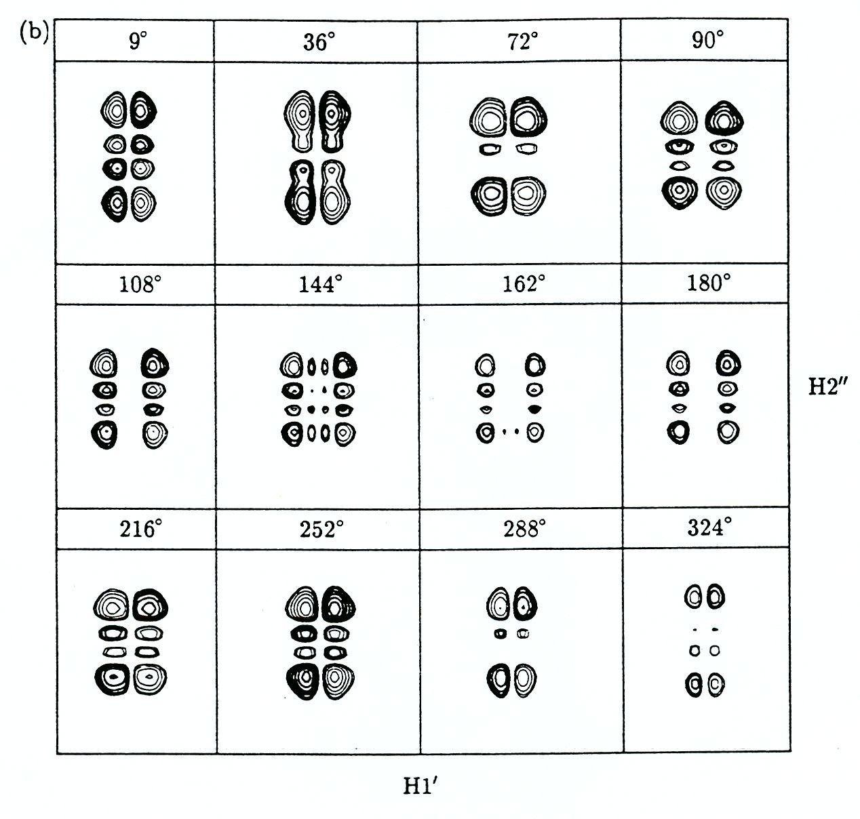
J-couplings from COSY spectra

Slide 31
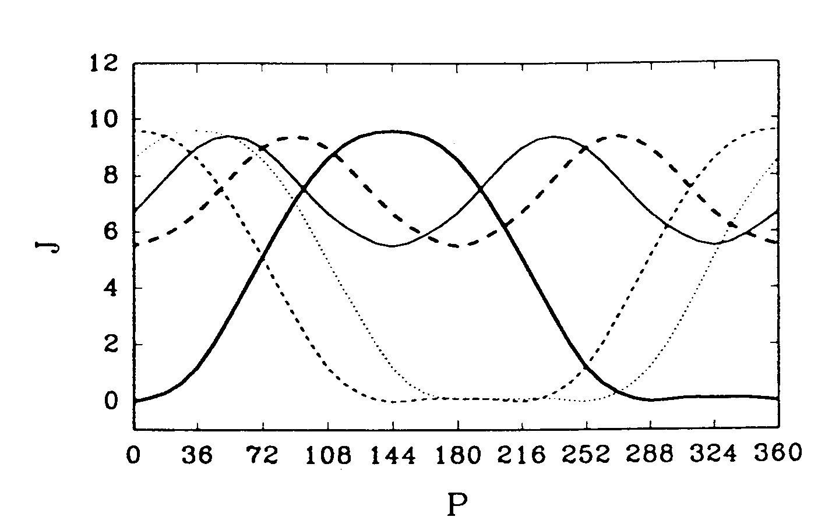
P determination from J-couplings
2’’3’
3’4’
1’2’’
2’3’
1’2’

Slide 32
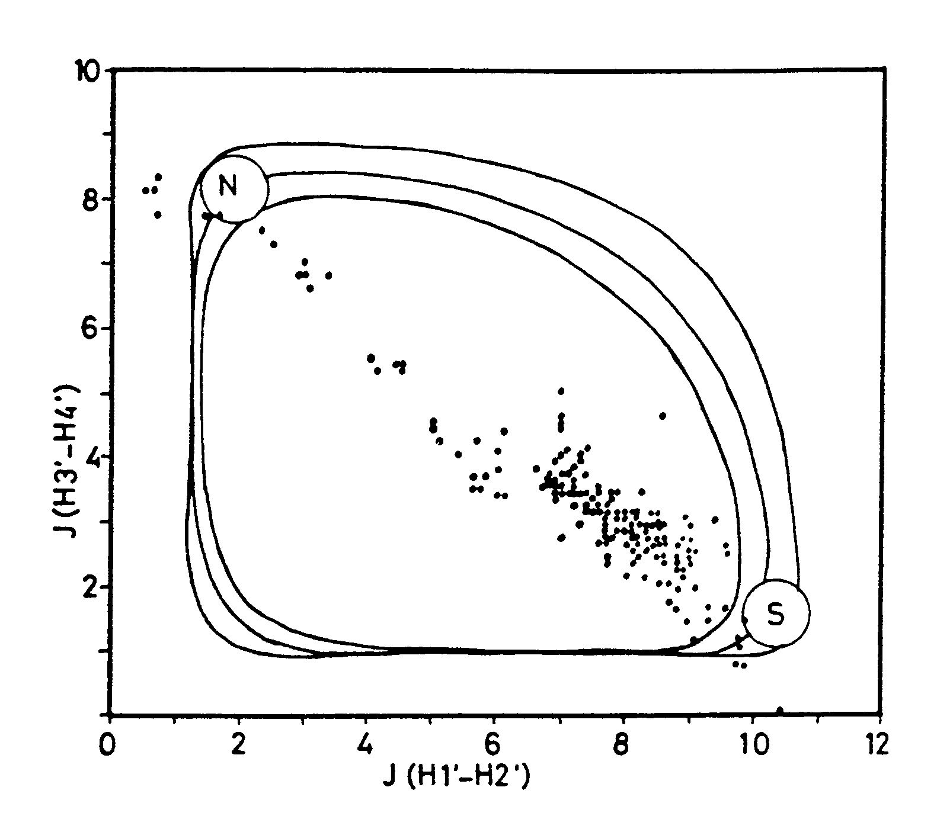
Equilibrium of N and S conformations
3’-endo
2’-endo

Slide 33
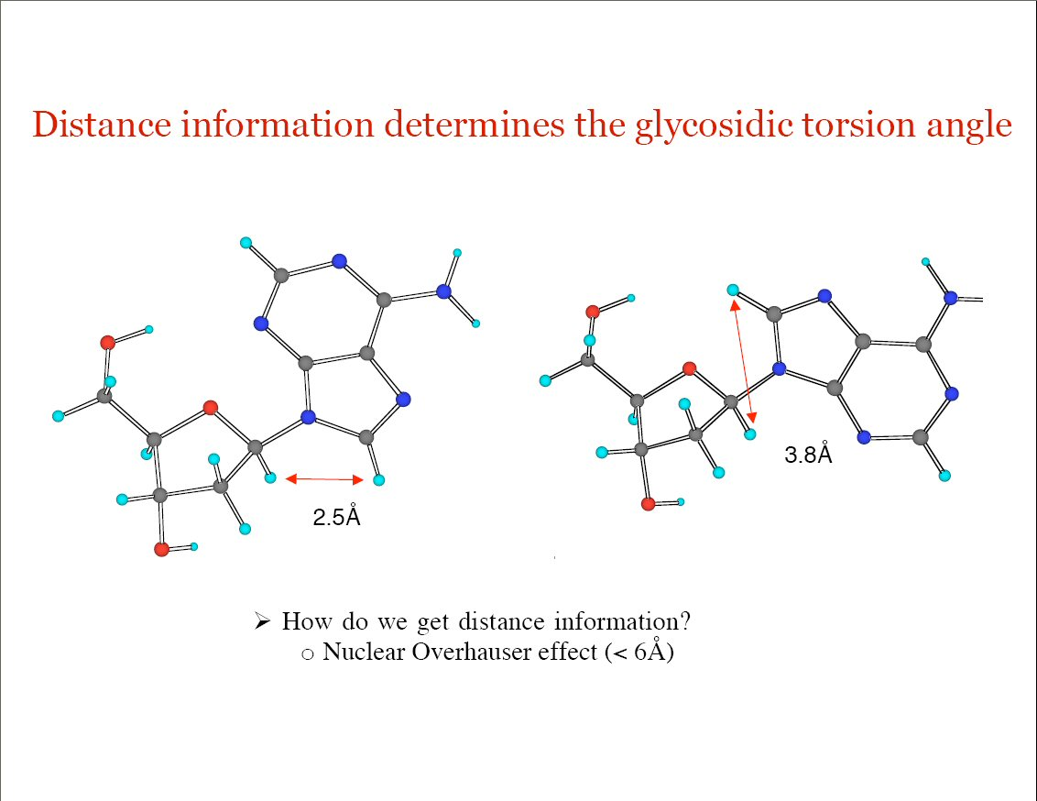

Slide 34
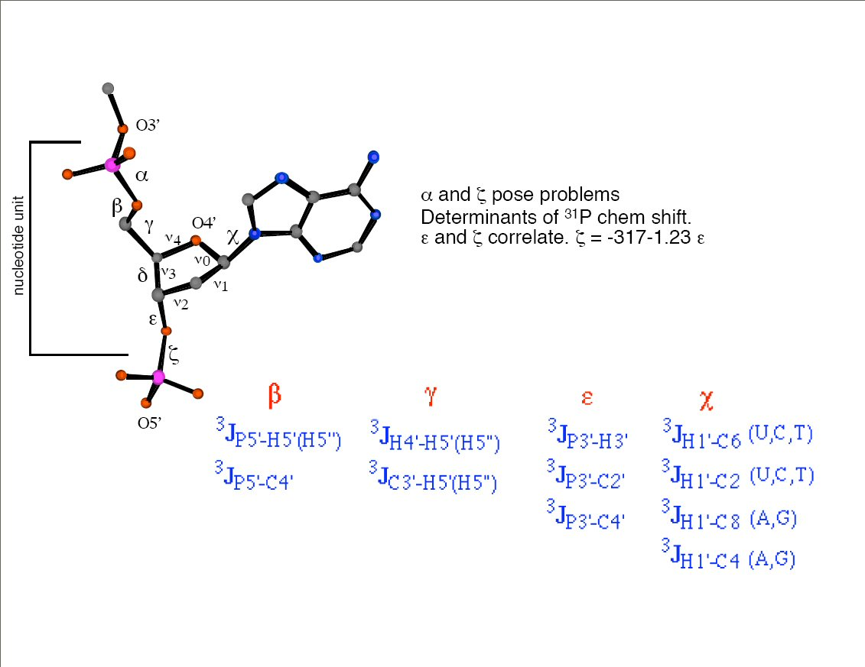

Slide 35
Heteronuclear NMR of Nucleic Acids
In most cases, requires samples isotopicaly enriched
by ¹³C and ¹⁵N (except for HSQC, HMQC)
Assignment uses NOE or through-bond experiments
Traditional constraints (NOEs, J-couplings)
Novel constraints (RDCs, residual CSA)
Studies of intramolecular dynamics

Slide 36
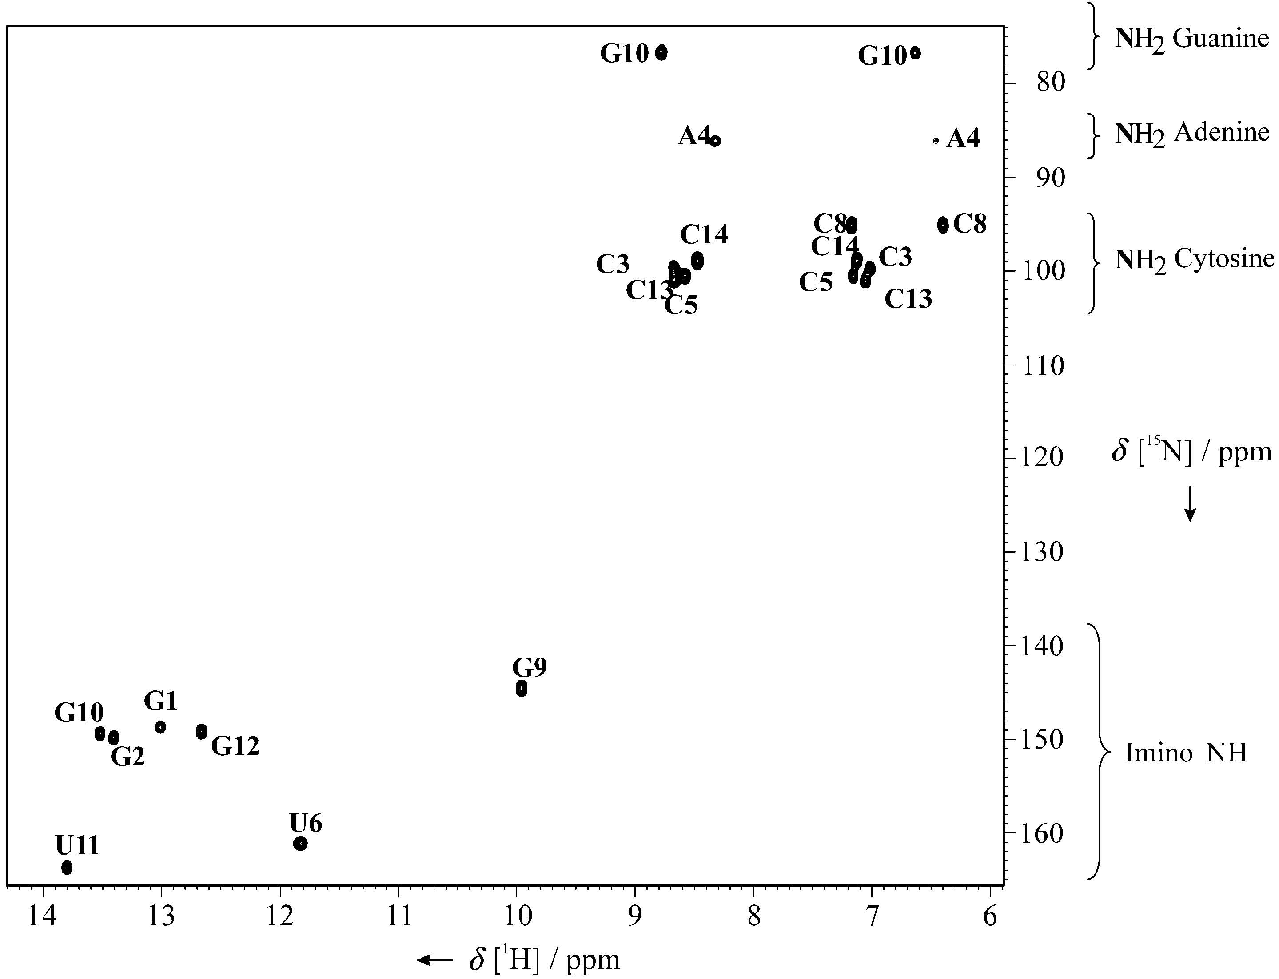
Correlation of exchangeable protons with ¹⁵N
U
C
U
G
C
G
5
10
A
U
C
G
G
C
1
G
C
Gradient sensitivity-enhanced HSQC
Kay, Keifer, Saarinen, JACS 1992.

Slide 37
Identification of hydrogen and carbon atoms in bases and sugars
sugar
base
(Constant-time) ¹H-¹³C HSQC experiment

Slide 38
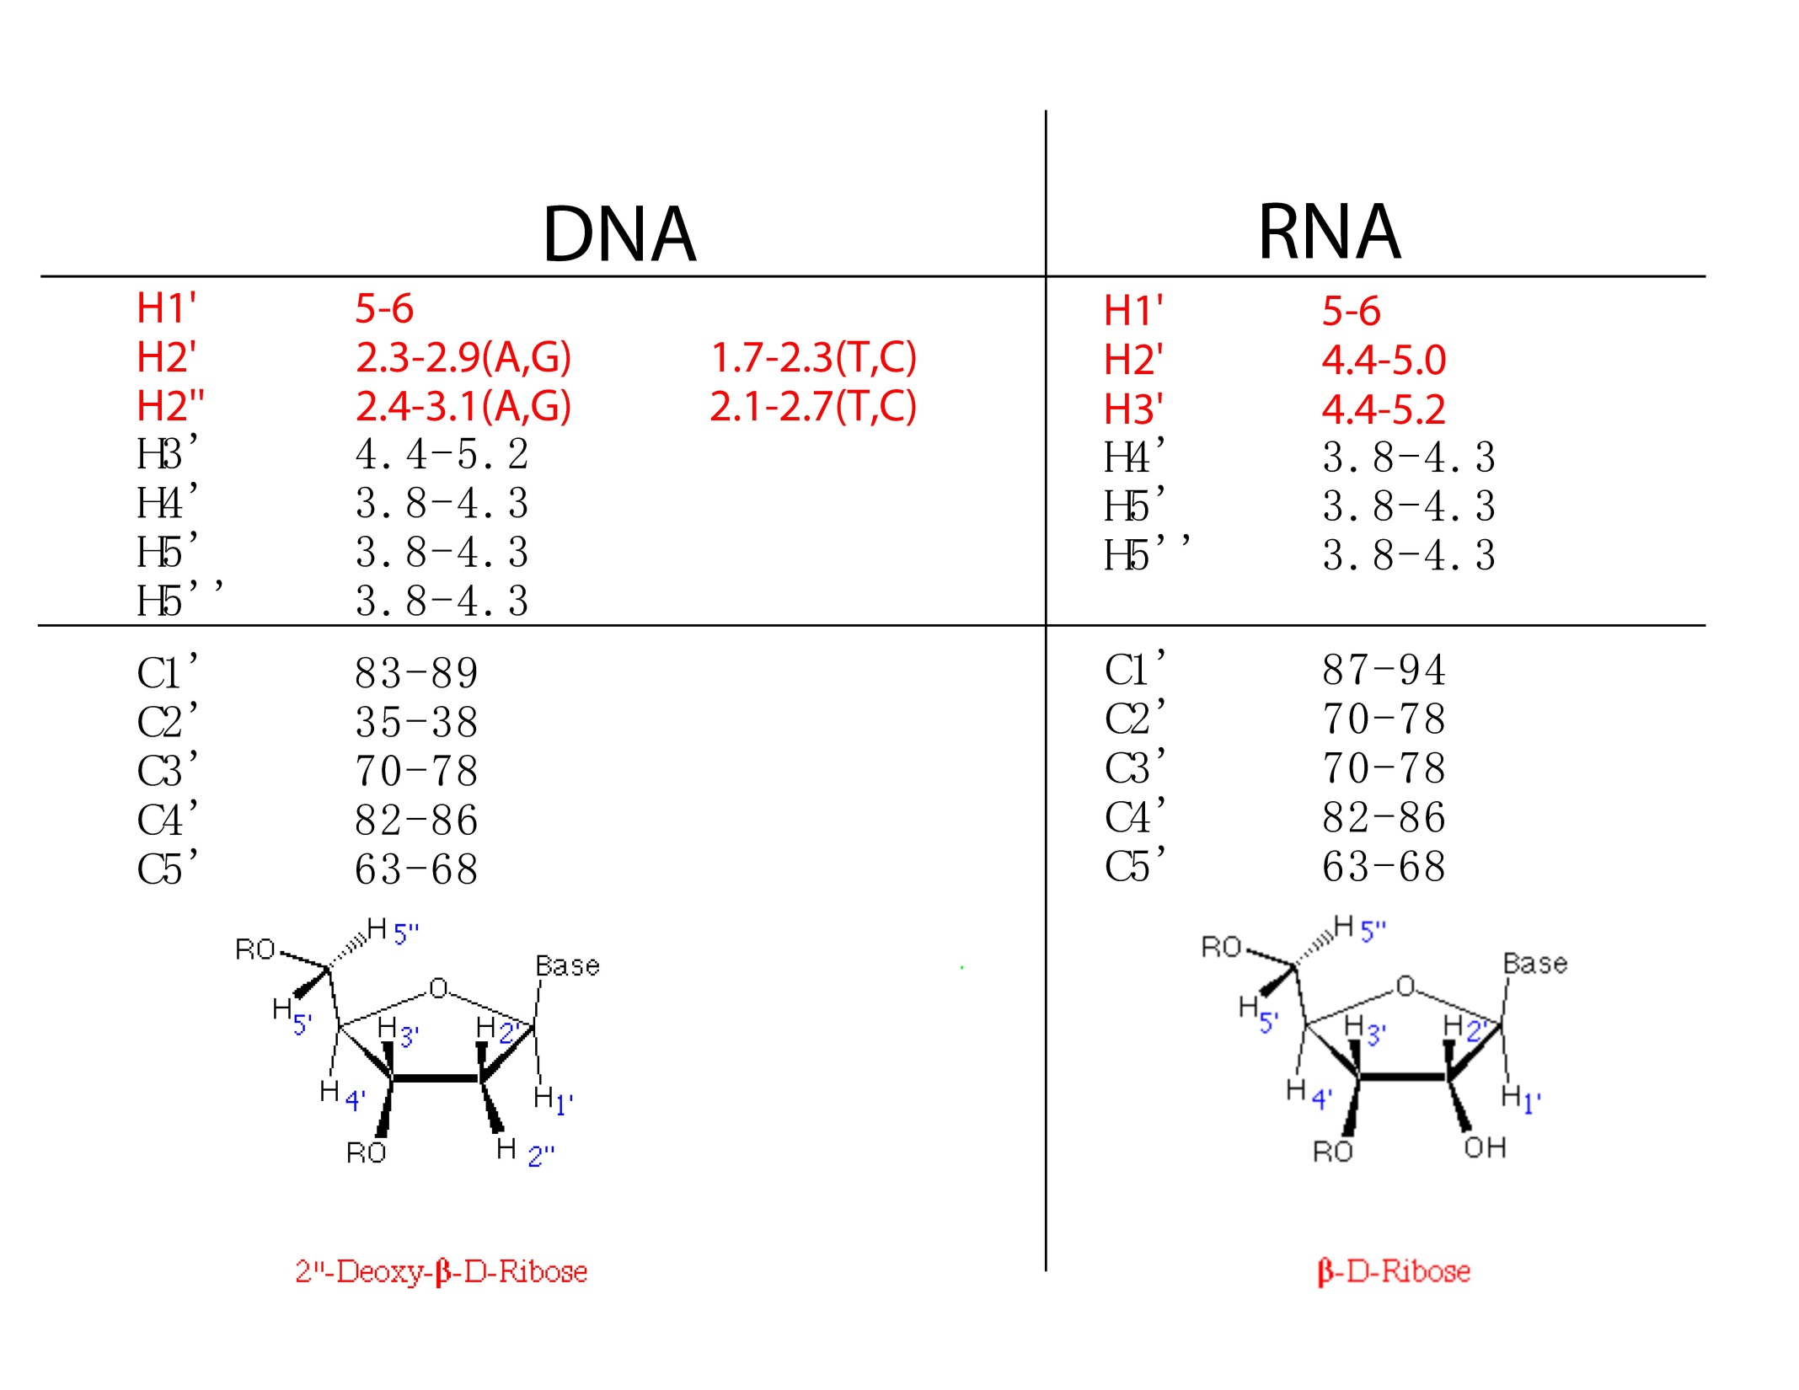

Slide 39
