Slide 1
BIOMARKERS AND TOXICITY MECHANISMS
09 – Mechanisms
Nuclear Receptors
Luděk Bláha, PřF MU, RECETOX
www.recetox.cz

Slide 2
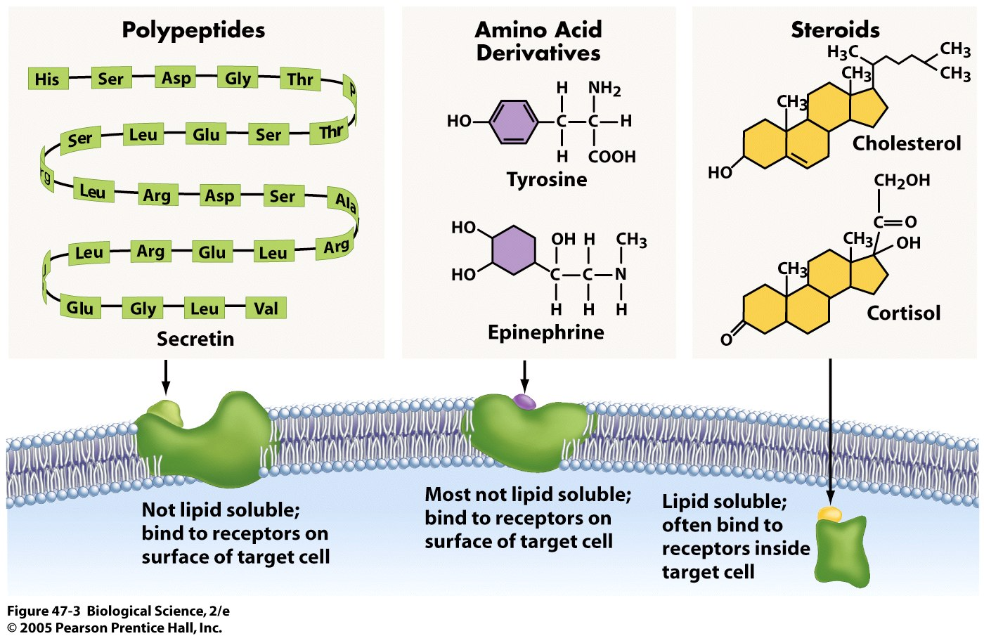
Various signalling types … now focus on nuclear receptors

Slide 3
NUCLEAR (Intracellular) RECEPTORS in summary
Important physiological functions, and
Important roles in pathologies and chemical toxicity
  Endocrine disruption
  Dioxin-like toxicity,etc.
All NRs share similar structure and mechanisms of action
  Act as direct transcription factors on DNA
Natural ligands are small lipophilic hormones (steroids, thyroids, retinoids)
  Role in toxicity – NR are modulated (activated/inhibited) by structurally close xenobiotics

Slide 4
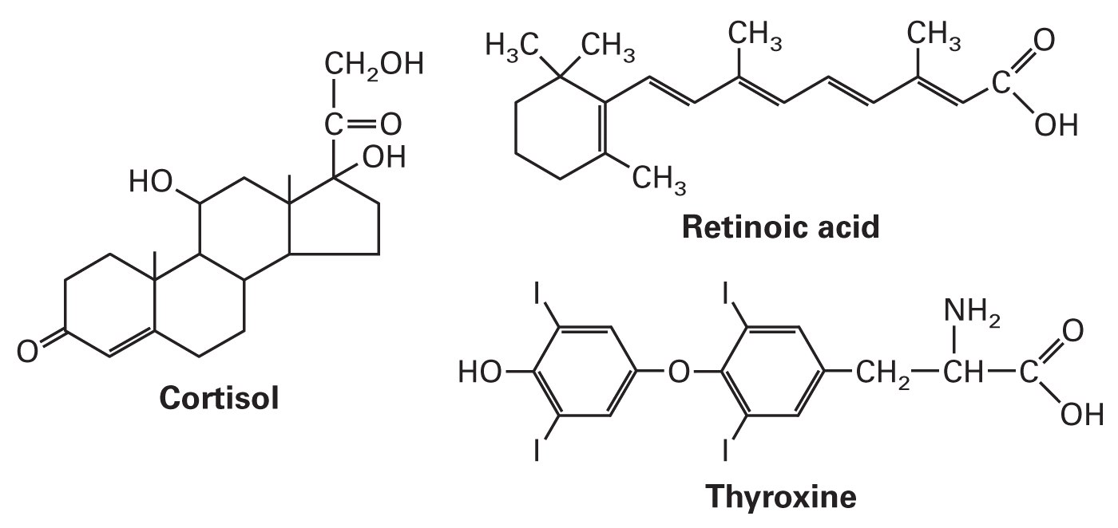
Natural ligands of NR
Small, lipid-soluble molecules
  Diffuse through plasma and nuclear membranes and interact directly with the transcription factors they control.
  STEROID HORMONES:
    sex steroids (estrogen, progesterone, testosterone)
    corticosteroids (glucocorticoids and mineralcorticoids)
  OTHER HORMONES and ligands
  Thyroid hormone, vitamin D3, retinoic acid, ligands of AhR
  Small molecules - gases
  e.g. NO (signaling for immune reactions)

Slide 5
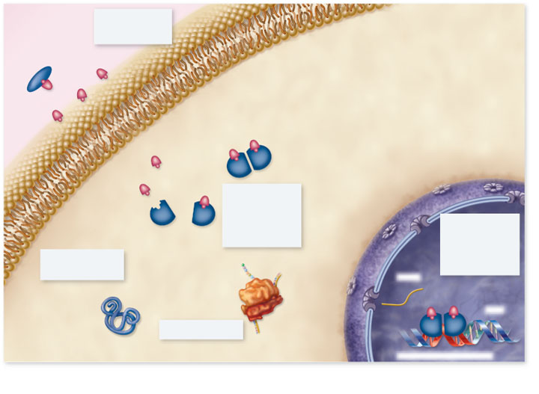
Copyright © The McGraw-Hill Companies, Inc. Permission required for reproduction or display.
Blood
plasma
1. Hormone passes
through plasma
membrane
Lipophilic hormones
Plasma membrane
Cytoplasm
Nucleus
2. Inside target
cell the hormone
binds to a
receptor protein
in the cytoplasm
or nucleus
Receptor
3. Hormone-receptor
complex binds to
hormone response
element on DNA,
regulating gene
transcription
5. Change in protein
synthesis is
cellular response
mRNA
Protein
DNA
4. Protein synthesis
Hormone response element
5
Notes:
5

Slide 6
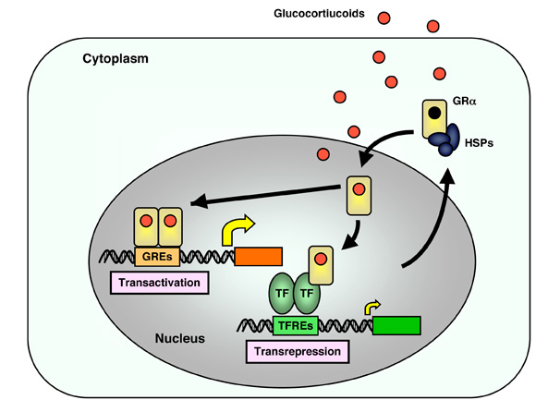
NR signalling is complex … examples of complexity (1)
Receptor activation is dependent not only on „ligand“ (glucocorticoid) but also on „inhibitor“ protein (Heat Shock Proteints - HSPs)
2. Dimerization (after the activation) is often needed for proper action – homodimers (e.g. ER-ER, etc.) AND/OR heterodimers (e.g. AhR-ER, etc.)
3. Receptor with ligand can activate its own targets (GREs) as well as „repress“ other binding sites (TFREs)

Slide 7
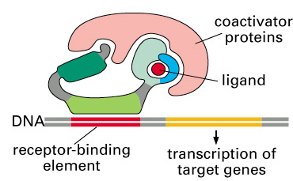
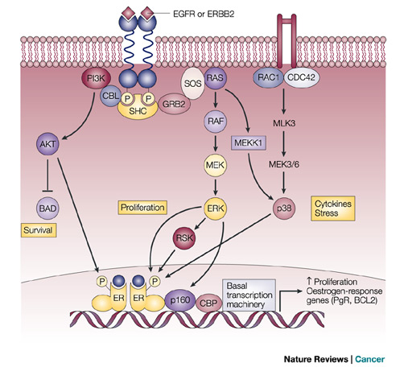
NR signalling is complex … examples of complexity 2
4. „Co-activator“ proteins are needed for proper action on DNA
5. Nuclear receptor action are (also) controlled - stimulated / suppressed - by other signalling pathways (e.g. phosphorylation by protein kinases)

Slide 8
NR signalling is complex … examples of complexity 3
6. Interaction (crosstalk) among various NRs
  “antiestrogenicity” of AhR ligands
  fast clearance of retinoids after AhR activation
  Immunosuprresions after ER activations
RAR
?
ER
AhR
P
P
P
hsp90
hsp90
ER
RAR
P
AhR
hsp90
hsp90
ER
AhR
AhR
RAR
ER
RAR

Slide 9
Why are NR important?
→ common mediators of adverse effects due to endocrine disruption

Slide 10
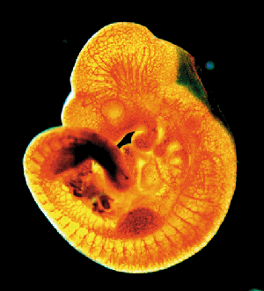
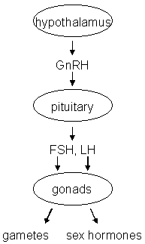
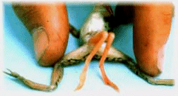
Endocrine disruption
Interference of xenobiotics with normal functioning of hormonal system
Known consequences
→ Disruption of homeostasis, reproduction, development, and/or behavior, and all other hormone-controlled processes:
  Shift in sex ratio, defective sexual development
  Low fecundity/fertility
  Hypo-immunity, carcinogenesis
  Malformations
  etc.

Slide 11
ED: toxicants interact with hormone system at all levels
Synthesis
Transport
Interaction with receptors
Metabolization
Suppression
Stimulation
Consequences of endocrine disruption mechanisms (both are negative!)

Slide 12
Mechanisms
of toxicant effects
in detail
→ various MoAs
of endocrine disruption
biosynthesis and release of hormones
e.g. steroidogenesis
e.g. modulation of CYP11A and/or CYP19 activities
binding to plasmatic transport proteins
e.g. down-regulation of receptor levels
binding to nuclear hormonal receptor (HR)
Direct interference (activation / inhibition)
activation of HR
(dissociation of associated heat shock proteins, formation of homodimers)
e.g. modulation of other nuclear receptors
(PPAR/RXR, RXR/TR)
binding of the activated receptor complex to specific DNA motifs
(HREs – Hormone Responsive Elements)
chromatin rearrangement and transcription of hormone-inducible genes
effects at cellular, tissue, organ, organism, and/or population level

Slide 13
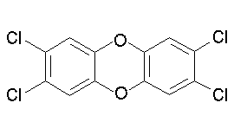
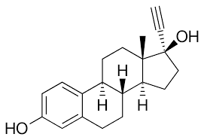
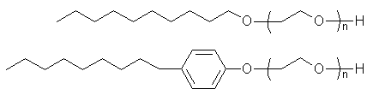
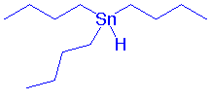
Endocrine Disrupting Componds (EDCs) in the environment?
2,3,7,8-TCDD
  Persistent Organic Compounds
  (POPs and their metabolites)
  steroid hormones and their
  derivatives from contraception pills
  alkylphenols
  organometallics (butyltins)
  pharmaceuticals
  Pesticides
  + many others
ethinylestradiol
alkylphenols
Tributyl-tin

Slide 14
STEROIDs - most studied ligands of nuclear receptors

Slide 15
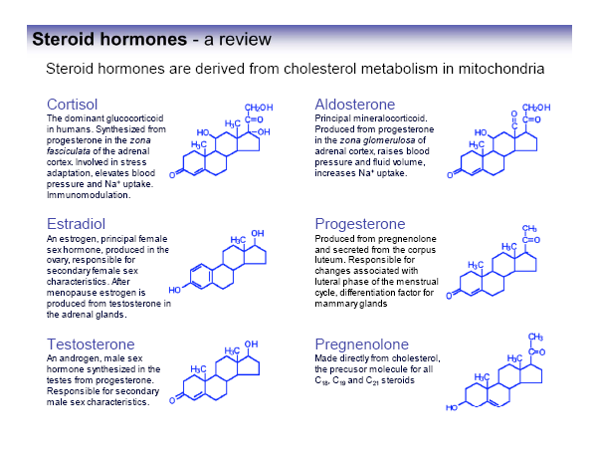

Slide 16
STEROID HORMONE biosynthesis
Aromatase

Slide 17
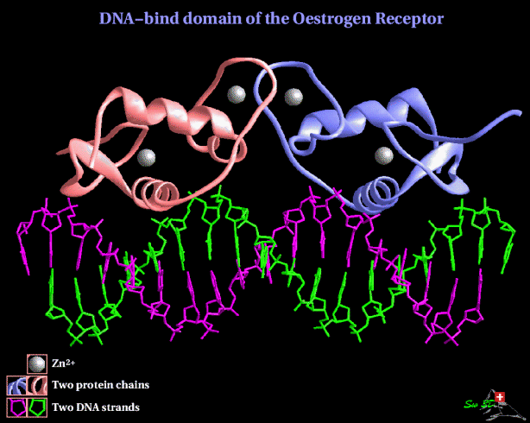
ESTROGEN RECEPTOR – ER the most studied target of EDCs

Slide 18
Estrogens
Synthesis in ovaries
Functions
  key roles in female hormone regulation and signalling
  responsible for metabolic, behavioural and morphologic changes occurring during stages of reproduction
  involved in the growth, development and homeostasis in a number of tissues
  control the bone formation, regulation of homeostasis, cardiovascular system and behaviour
  regulate production, transport and concentration of testicular liquid and anabolic activity of androgens in males
DISRUPTION OF ESTROGEN SIGNALLING
→ many documented effects in aquatic biota & laboratory organisms

Slide 19
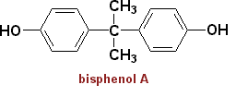

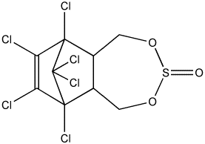
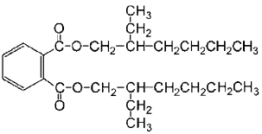
Environmental estrogens (xenoestrogens, exoestrogens)
>> Highly diverse group of substances
>> Do not necessarily share structural similarity to the prototypical estrogen 17β-estradiol
>> may act as AGONISTS and/or ANTAGONISTS (depending on situation and concentration!)
Natural products
genistein
naringenin
coumestrol
zearalenone
Industrial chemicals
Bisphenol A
Nonionic surfactants
Pthalate esters (eg. DEHP)
Endosulfan (pesticide)
Various POPs
DDT
kepone
PCBs/OH-PCBs
PAHs and dioxins
DEHP
Pharmaceuticals
Ethinyl estradiol
Diethylstilbestrol
gestodene
norgestrel

Slide 20
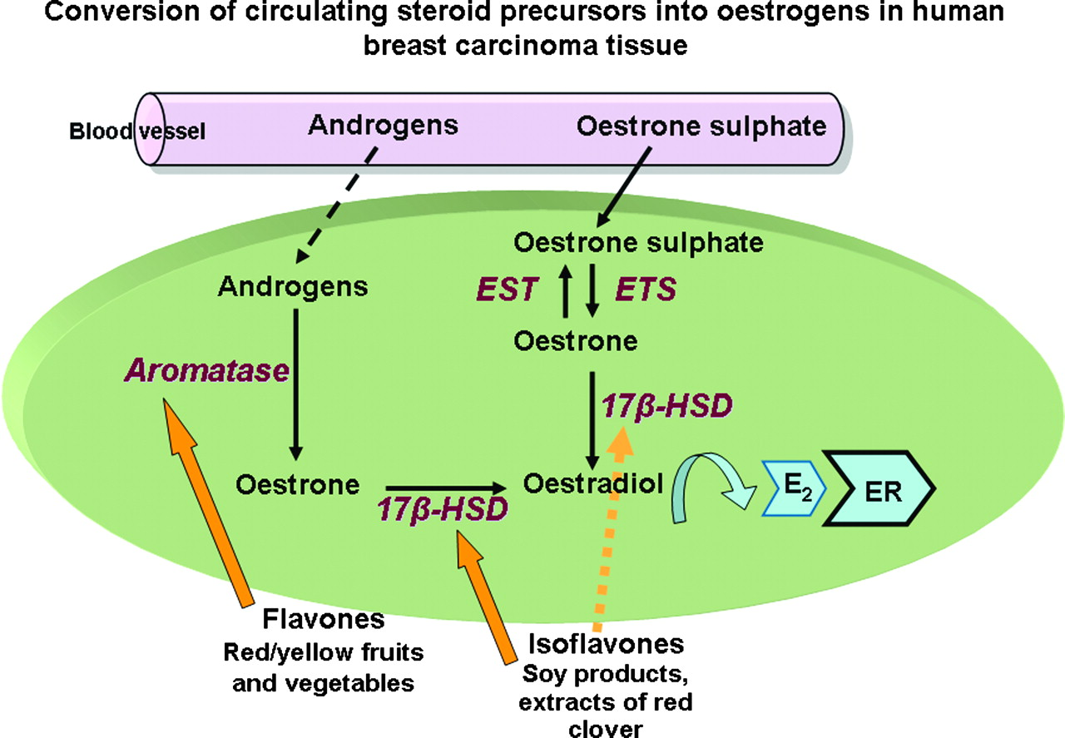
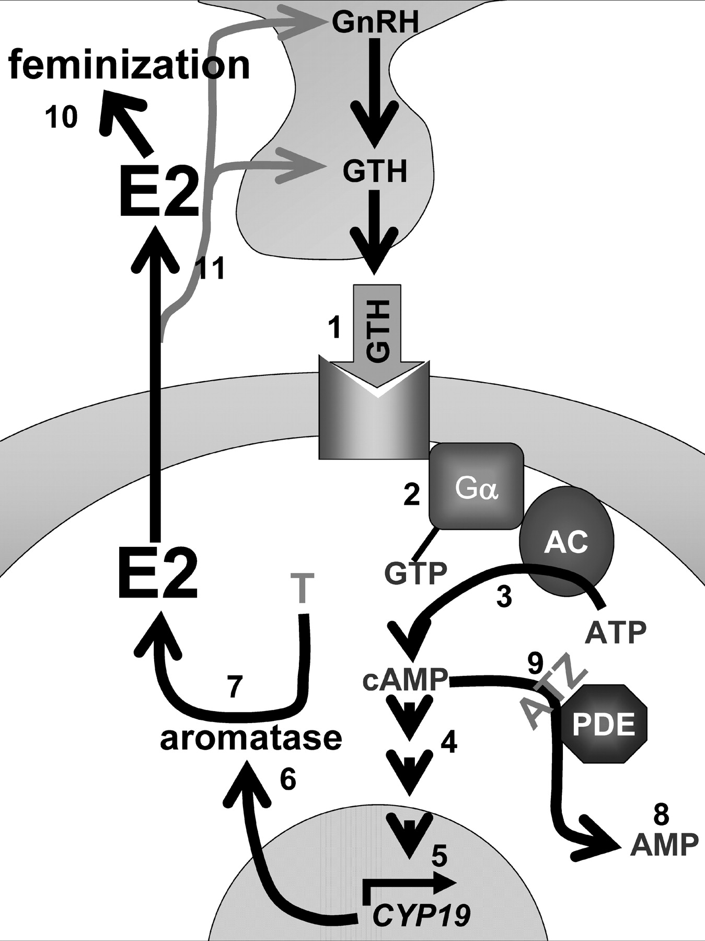
Examples – modulations of synthetic enzyme activities
Phytoestrogens induce genes involved
in estradiol (E2) synthesis (e.g. CYP19 Aromatase; 17b-HSD) inducing thus elevante E2 concentrations (→ feminization)
Modulation of E2 synthesis via a crosstalk with other signalling pathways (such as cAMP), which can be target to toxicants (see slides on signalling)

Slide 21
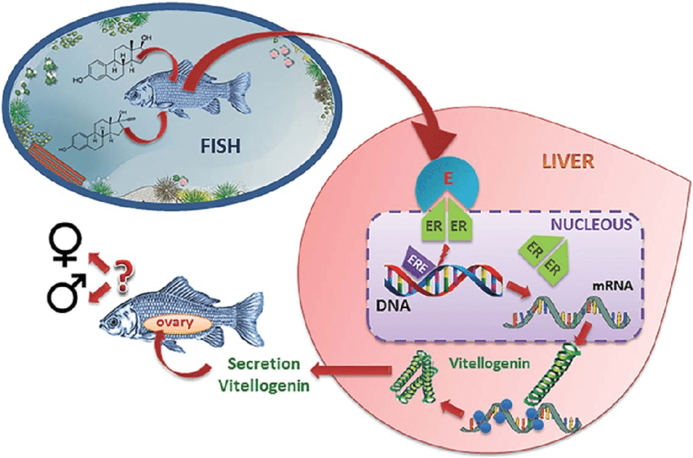
Activation of ER by xenoestrogens (e.g. synthetic hormones) in fish leading to disruption of reproduction

Slide 22
ANDROGEN RECEPTOR (AR)

Slide 23
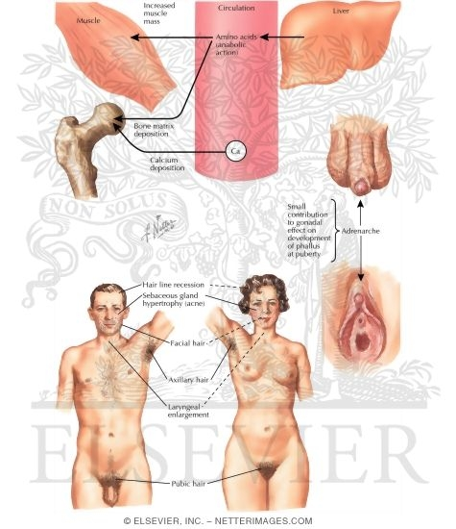
Androgens
Role of androgens in males is similar to that of estrogens in females
  development of male sexual characteristics
  stimulating protein synthesis, growth of bones
  cell differenciation, spermatogenesis
  male type of behaviour

Slide 24
Androgens – endogenous ligands
Endogenous ligands – androgen hormones
  Two key androgens
    testosterone (T)
    dihydrotestosterone (DHT)
  Other androgens – androstanediol,
  dehydroepiandrosterone, androstenedione
T: synthesis in testis (Leydig cells)
  in lesser extent in adrenals
DHT: Formed extratesticulary from T
  In several tissues (seminal vesicles, prostate, skin)
  higher affinity to androgen receptor than T
  Daily production 5-10% of testosterone
Testosterone

Slide 25
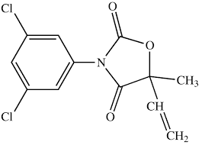
Several mechanisms how „xenoandrogens“ disrupt natural androgen signalling and action
1) Binding to AR
  Mostly competitive inhibition (xenobiotics mostly do not activate AR-dependent transcription) → outcome is the feminization
Few compounds activate AR in the absence of androgen hormones
… but they are still anti-androgenic in the presence of natural androgens like T or DHT
- metabolites of fungicide vinclozoline
- some PAHs
vinclozoline

Slide 26
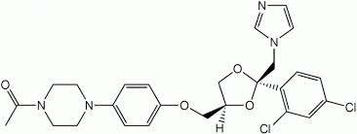
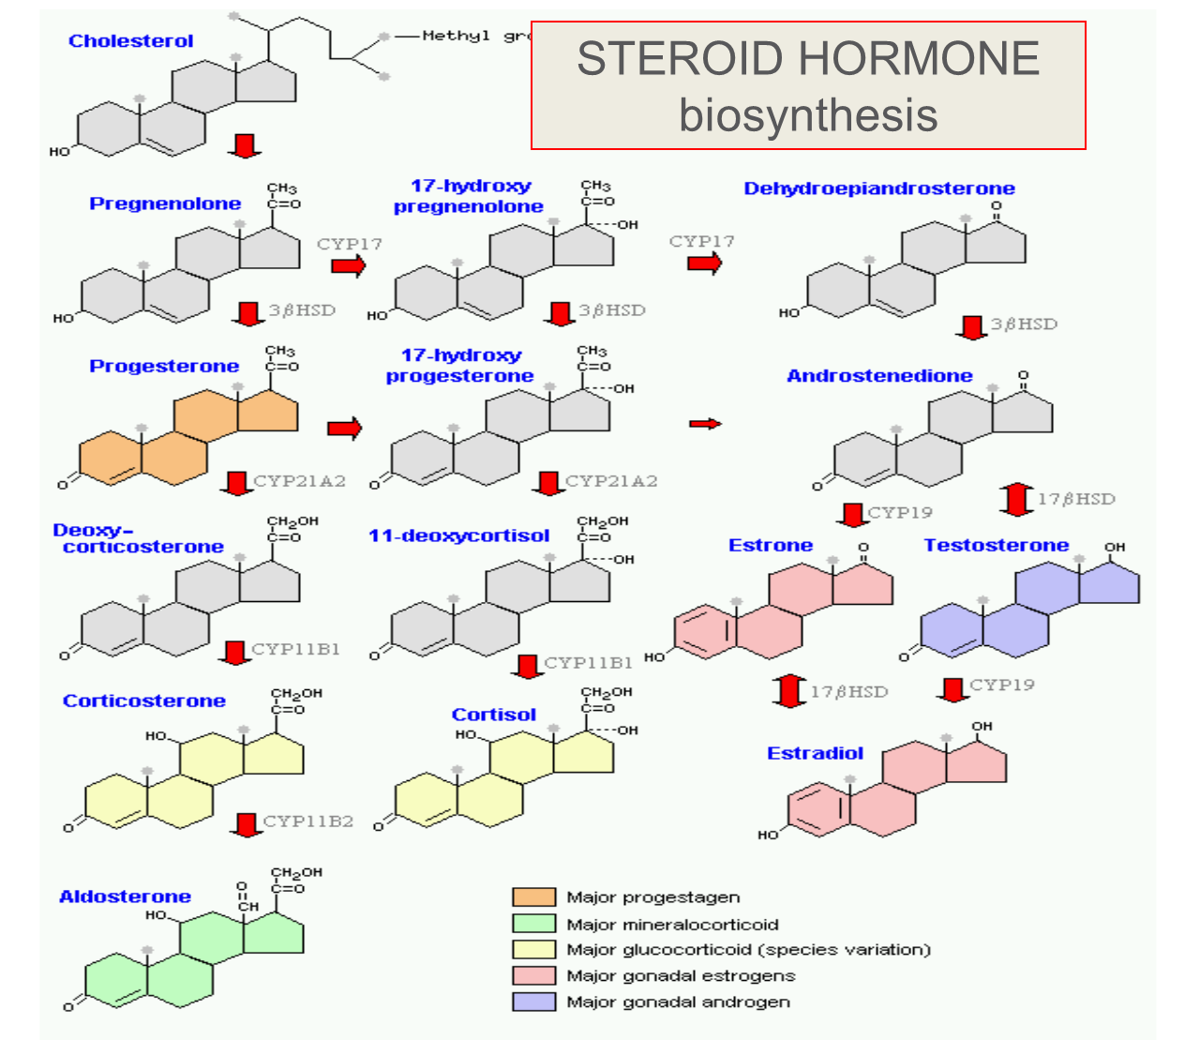
Mechanisms of androgen signalling disruption
2) Alterations of de novo testosterone synthesis
  Inhibition of P450scc needed for side chain cleavage of cholesterol or inhibitions of 17-beta-hydroxylase and other CYPs
    fungicide ketoconazol
The toxic outcome = feminization

Slide 27
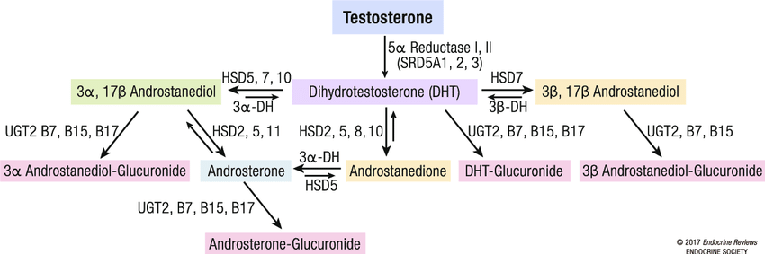
Mechanisms of androgen signalling disruption
3) Testosterone metabolic clearance
  Chemicals inducing detoxification enzymes – for Testosteron – most relevanat are UDP-glucuronosyltransferases (UGTs)
    Documented e.g. for pesticides endosulfan, mirex, o-p´-DDT
    (degradation → lower T concentrations → anti-androgenicity: feminization)

Slide 28
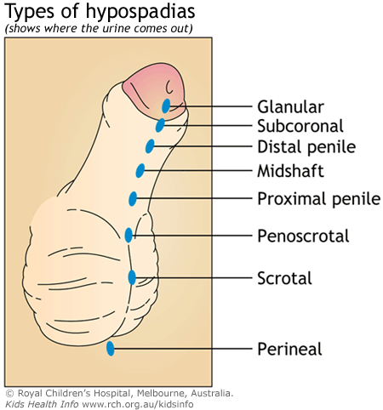
Effects of exposures to antiandrogens in males
Exposure during prenatal development:
  malformations of the reproductive tract
    reduced anogenital distance
    hypospadias (abnormal position of the urethral opening on the penis)
    vagina development
    undescendent ectopic testes
    atrophy of seminal vesicles and prostate gland
Exposure in prepubertal age:
  delayed puberty
  reduced seminal vesicles
  reduced prostate
Exposure in adult age:
  oligospermia
  azoospermia
  loss of sexual libido

Slide 29
Other selected nuclear receptors – examples of mechanisms beyond the toxic effects
Receptors for THYROID hormones
Receptors for RETINOID-like compounds

Slide 30
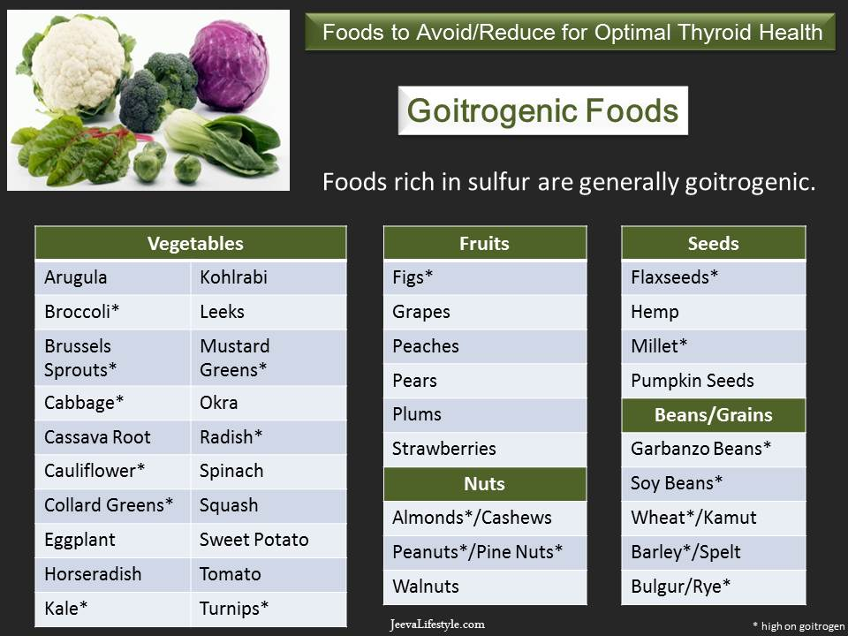

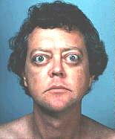
Thyroid hormones
Crucial roles in metabolism, development and maturation
  Regulation of metabolism
    increasing oxygen consumption
    modulating levels of other hormones (insulin, glucagon, somatotropin, adrenalin)
  Important in cell differenciation
  Crucial role in development of CNS, gonads and bones
EDC compounds interfering with thyroid signalling
  “GOITROGENS”
Many food (vegetables) contain goitrogens
HYPOTHYROIDISM
HYPERTHYROIDISM

Slide 31
Thyroid hormones
Thyroxine (T4)
Triiodothyronine (T3)
Contains 3 iodide ions
Most T3 is produced
by deiodination (deiodinases) in target tissues
Also known as tetraiodothyronine
Contains 4 iodide (I) ions
T4 – pro-hormone
5´-deiodination → active form: T3

Slide 32
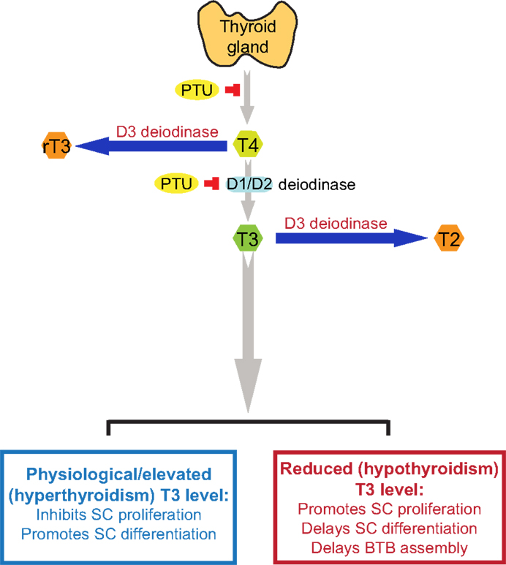
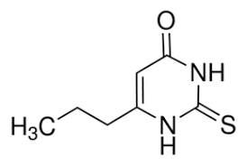
Disruption of enzymes involved in Thyroid metabolism
„outer“
Thyroid peroxidases
  iodination of tyrosyl residues
  coupling of iodinated tyrosyl residues
Thyroid deiodinases
  D1, D2 - activation of T4 into T3 via deiodination on „outer“ ring
  D3 - deactivation into rT3 via deiodination on „inner“ ring
Many goitrogens affect expression, activities and outcomes
of these key enzymes
  PTU – propylthiouracil
  →effect deiodinases
  Thiocyanate ([SCN]⁻) or perchlorate (NaClO₄)
  →effect on iodine uptake
„inner“

Slide 33
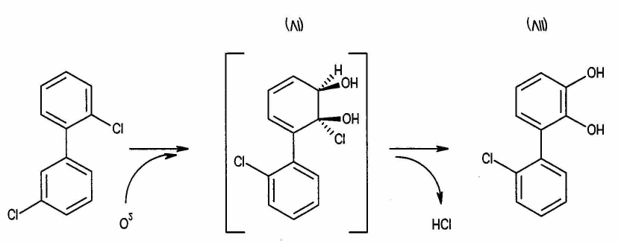
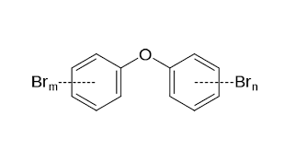
Disruption of transport of thyroid hormones in blood
SPECIFIC TRANSPORTERS in blood
  regulating free T4 and T3 levels
  3 types :
    Thyroid-binding prealbunin (transthyretin) (20-25%)
    Albumin (5-10%)
    Thyroid binding globulin (TBP, 75%)
NUMBER OF EDCs → act on transport proteins
  Brominated and chlorinated flame
  retardants, DDT, dieldrin
  OH-PCBs – equal affinity to TBP as T4 and T3 (!!!)
Increased levels of “free T4” in blood
  negative feedback to TSH release
  → increased depletion
  → increased weight, changes in thyroid gland
  Documented after exposures to POPs in vertebrates
Hydroxylated PCB formation
Polybrominated diphenyl ethers
(PBDEs) – flame retardants

Slide 34
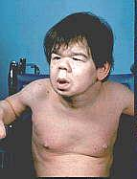
Effects of thyroid disruption
Exposures to goitrogens during prenatal stages
  severe damage of CNS (cretenism, delayed eye opening, cognition)
  Megalotestis
  Histological changes in thyroid gland (goitre)
Exposures during development
  nervous system fails to develop normally
  mental retardation
  skeletal development

Slide 35
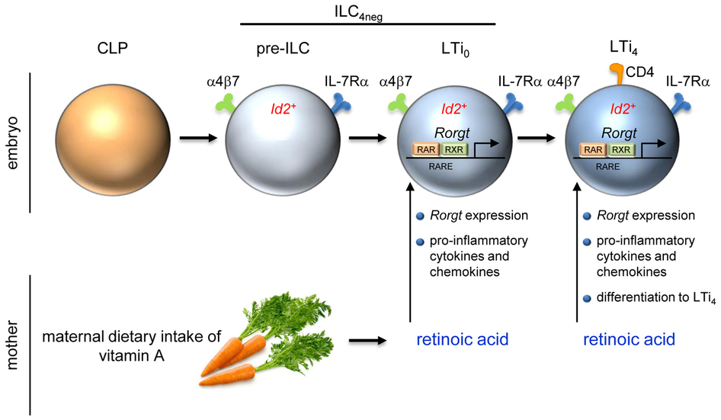
RAR/RXR receptors
- vitamin A and its derivatives: RETINOIDS -
& their role in toxicity

Slide 36
RETINOIDS
Sources: from diet - dietary hormones
Retinyl esters – animal sources
Plant carotenoids
β-karoten
Bond cleavage
Retinol (vitamin A)
atRA – all trans - Retinoic Acid

Slide 37
Retinoids and their functions
Regulation of development and homeostasis in tissues of vertebrates and invertebrates
Development of embryonic, epithelial cells (gastrointestinal tract, skin, bones)
Necessary for vision
Suppressive effects in cancer development
Important for cell growth, apoptosis and differenciation
Antioxidative agent
Affect nervous and immune function
Effects caused by retinoid (RAR/RXR) disruptors – see next slide
  Decreased retinoid levels in organisms
    Downregulation of growth factors
    Xerophtalmia, night blindness
    Embryotoxicity, developmental abnormalities
  Increased ATRA concentration
    teratogenic effects

Slide 38
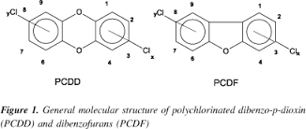
Disruption of retinoid signalling by xenobiotics
Modes of action – disruption of retinoid signalling:
  Metabolization of retinoids by detoxication enzymes (PCDD/Fs, PAHs, PCBs, pesticides
  Disruption of binding retinoids to transport proteins (PCBs and their metabolites)
  Retinoids as antioxidants may be consumed by oxidative stress induced by xenobiotics (general oxidative stress)
  Interference during binding to RAR/RXR
    pesticides (chlordane, dieldrin, methoprene, tributyltin…)
    Effect on ATRA mediated response – TCDD, PAHs

