Slide 1
BIOMARKERS AND TOXICITY MECHANISMS
11 – BIOMARKERS
of EXPOSURE and SUSCEPTIBILITY
Luděk Bláha, PřF MU, RECETOX
www.recetox.cz

Slide 2
Biomarkers of Exposure
Biomarkers of internal and effective dose
depends on toxicokinetics
Biomarkers of internal dose (short / long term)
– examples: Cd in urine, DDE in fat tissues
  - should be easy to sample (urine, breath)
  - instrumental analytical methods (analyses of toxicant)
Biomarkers of effective dose
- the chemical interacted with the biological target
→ analyses of ADDUCTS
Two types of adducts: selective and non-selective

Slide 3
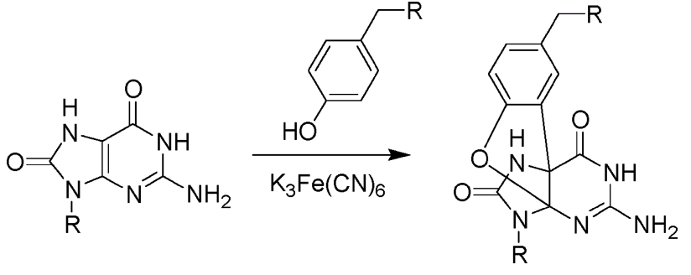
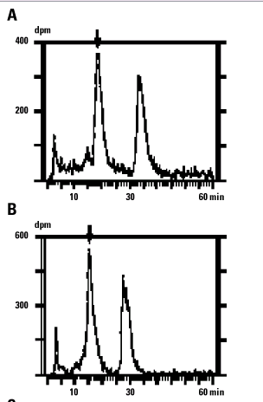
SELECTIVE ADDUCTS OF TOXICANTS with BIOMOLECULES
SELECTIVE = CHEMICAL-SPECIFIC
Adducts with DNA
styrene-oxide-O6-guanine
N7-guanyl-aflatoxin B1
Hemoglobin-pesticides adducts
Methods of analyses:
- analytical chemistry
- extraction from biological sample
- chemical determination by HPLC or GC (or ELISA)

Slide 4
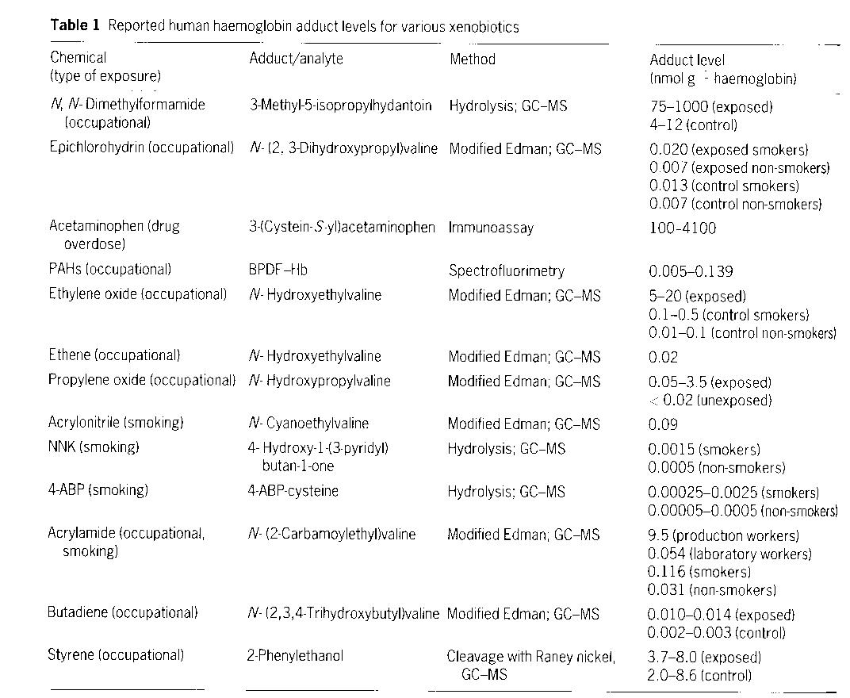

Slide 5
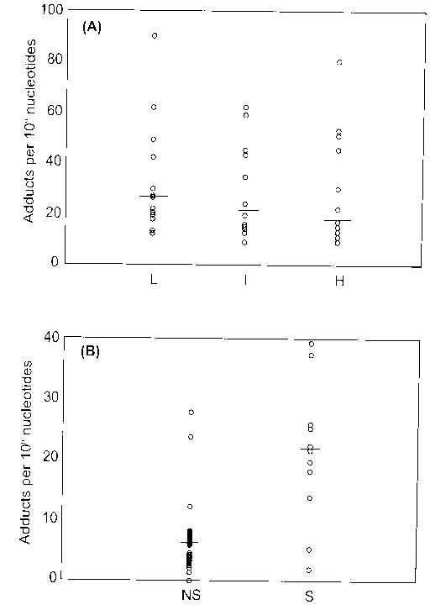
PAH-DNA adducts
PAH (polycyclic aromatic hydrocarbons)
* often high variability
* may have difficult interpretation
Occup. exposure
(Low / Intermed. / High)
Occupational
Non-exposed (NS)
vs.
Exposed (S)

Slide 6
Non-selective adducts
– binding of toxicant to macromolecule (DNA, proteins) with no further information on the structure of actual adduct
(i.e. causative agent is not clear but the „exposure“ clearly happened)
Typical nonselective biomarker of exposure methods - for DNA damage:
- ³²P-postlabelling assay
- oxidized DNA: 8-hydroxy-2´-deoxyguanosine

Slide 7
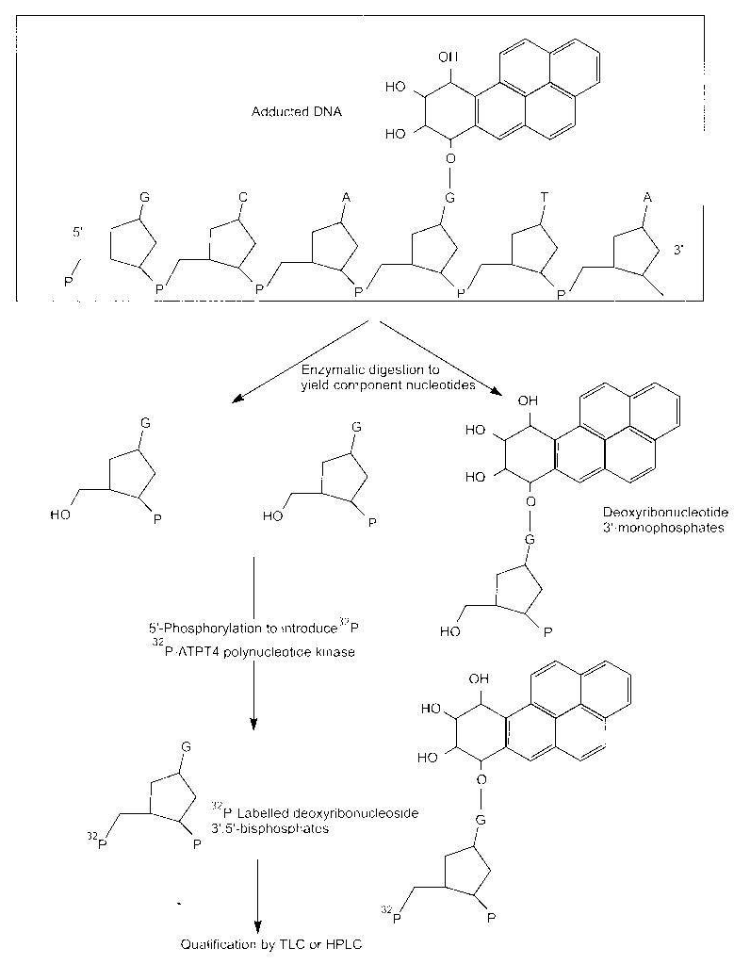
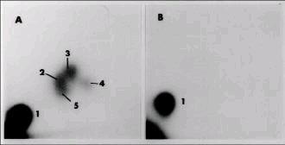
³²P-postlabelling assay
principle
Digestion of NA
Enzymatic labelling with 32P (kinase)
TLC (or HPLC) analyses of the product
(Not an absolute method
= comparison with controls always needed)
TLC result
(thin layer chromatography)
A - 2-5 = various adducts
B - controls

Slide 8
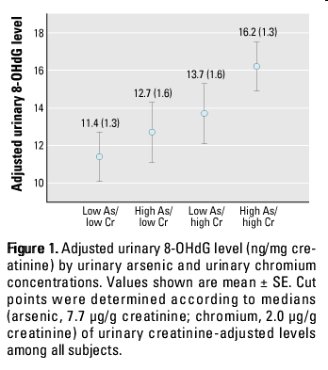
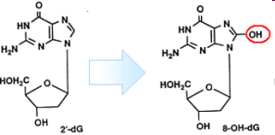
8-hydroxy-2´-deoxyguanosine - Analysis
Oxidative damage to DNA
- many causes → 8-OH-dG is the most common marker of DNA oxidation
Analysis: analytical chemistry methods
- HPLC
- immunochemistry-based methods ELISA

Slide 9
Biomarkers of susceptibility

Slide 10
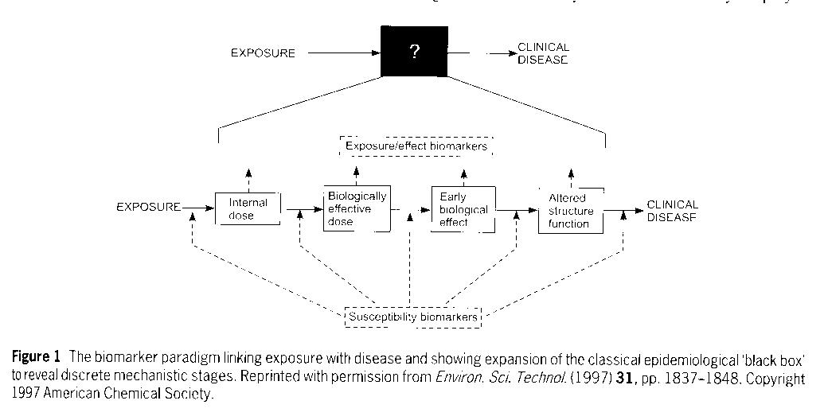
Importance of susceptibility biomarkers

Slide 11
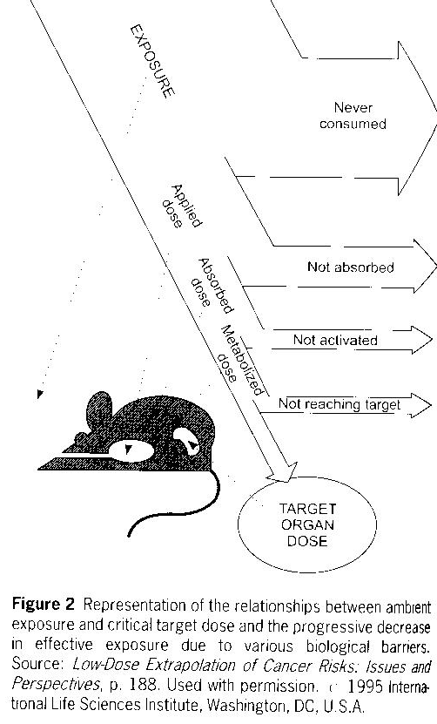
Toxicokinetics determines susceptibility of an individual at various levels
→ Biomarkers of susceptibility
Will the individual be sensitive?
Will patient respond to a drug?
Esp. METABOLISM is important and used as a BM of susceptibility
(mostly known for prototypical enzymes, like CYPs, for prototypical chemicals such as DRUGS…)

Slide 12
Biomarkers of susceptibility
Susceptibility depends on genotype >> metabolism
- genetic polymorphism in detoxification enzymes
- variability in specific isoenzymes
Example: susceptibility to „activate“ toxicants:
example: N-acetylation of arylamines (NAT2 gene)
  susceptibility to genotoxins
  family cancers
  susceptibility to drugs (including anticancer drugs)

Slide 13
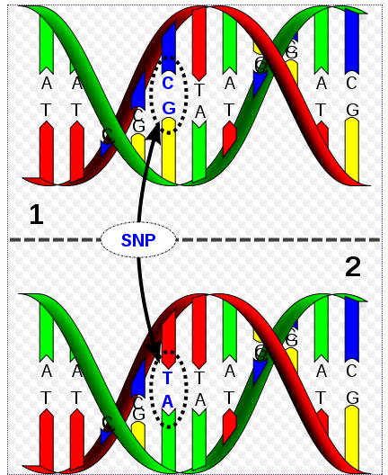
Example: genetic polymorphism
SNPs - single nucleotide polymorphism
SNPs
→ affects protein functions
→ in specific cases (see example) some SNPs identified
To identify SNP as a biomarker
Many genotypes (from many individuals) must be sequenced and compared with phenotype (e.g. responsiveness to certain drug)
→ application:
PERSONALIZED MEDICINE

Slide 14
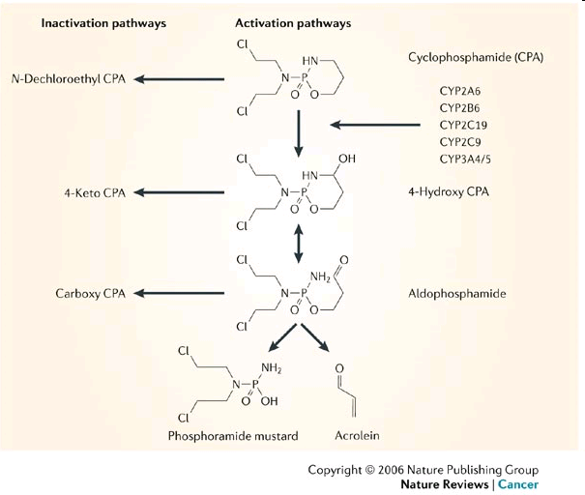
Cyclophosphamide (anticancer drug) and its toxicity
Genetic
polymorphism

Slide 15
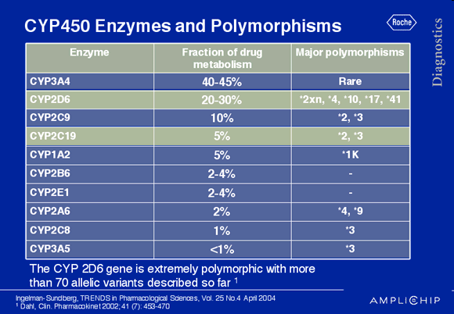
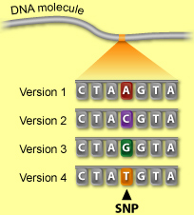
Example: genetic polymorphism
Alleles known
to be involved
in polymorphism

Slide 16
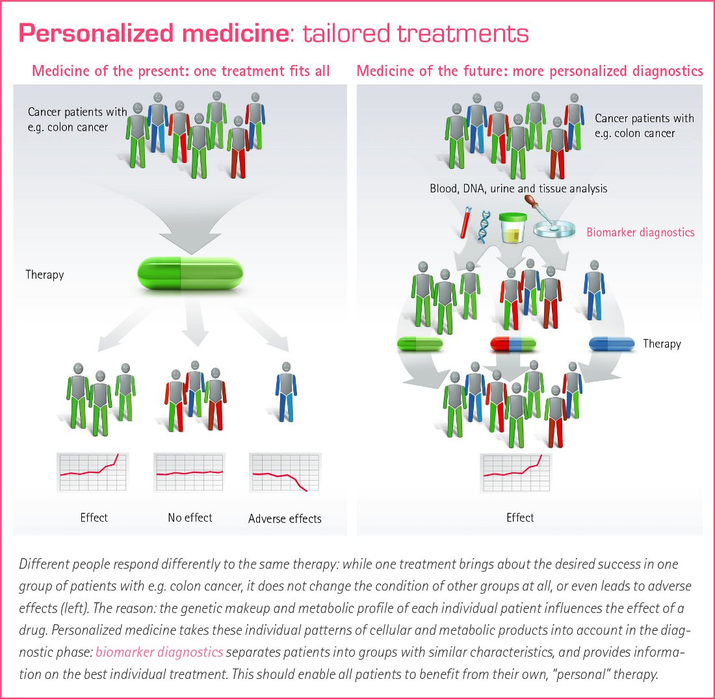
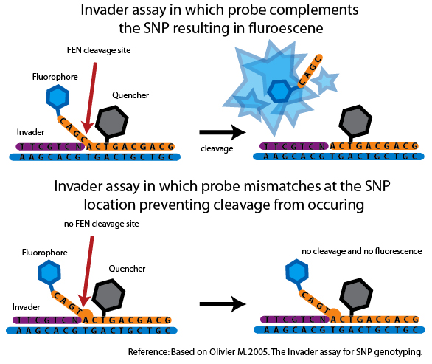
Personalized medicine
SNP diagnostics
1) DNA isolation
2) Multiplication of specific gene (eg. CYP)
3) SNP identification
... Molecular biology methods such as
* NA sequencing
* Probe pairing ... number of variants

