Slide 1
BIOMARKERS AND TOXICITY MECHANISMS
13 – BIOMARKERS
Summary and final notes
Luděk Bláha, PřF MU, RECETOX
www.recetox.cz

Slide 2
Topics covered in the final presentation
Biomarkers at different levels
  Omics
  ... and beyond
Biomarkers in human medicine and drug development
  Strategy and steps in development
  Application examples

Slide 3
Biomarkers have MANY APPLICATIONS ... such as:
Biomarkers in research
  Search of “potential” therapies/drugs
    Changes in biochemical responses provide information on efficiency and mechanism of action
  Identification of “early markers” of chronic diseases
    Early diagnosis (e.g. identification of developing cancer, coronary disease...)
Biomarkers in medicine
  Identification of status of an individual
    Healthy vs Disease
  Assessment of therapy/treatment
    Efficiency – Did treatment improved situation? (improvements in biomarker responses)
    Adverse or side effects of therapy
Biomarkers in toxicology
  Identification of status
    Intoxicated (exposed) vs Controls
    Forensic toxicology (e.g. consumption of drugs of abuse, alcohol etc)
  Early warnings of future health consequences
    Biochemical changes are detectable before the actual health problems

Slide 4
Biomarkers at various levels
“omics”

Slide 5
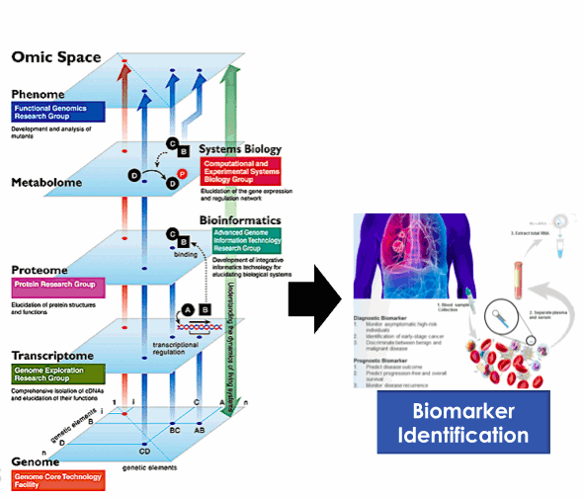
Biomarkers at different biological levels – „omics“ approach

Slide 6
Biomarkers at different biological levels
“Omics” techniques
  Systems biology research
  Screenings of responses (differences) at all levels of biological organization
GENOMICS
  Relatively stable
    not responding to environmental changes (e.g. Toxicants)
  Can be used as “biomarkers of susceptibility” (SNPs and personalized medicine)
OTHER “OMICS” layers
  Epigenomics + Transcriptomics, Proteo-, Metabolo-...
  Highly variable - responsive to environmental stress (including toxicants, therapy etc.)

Slide 7
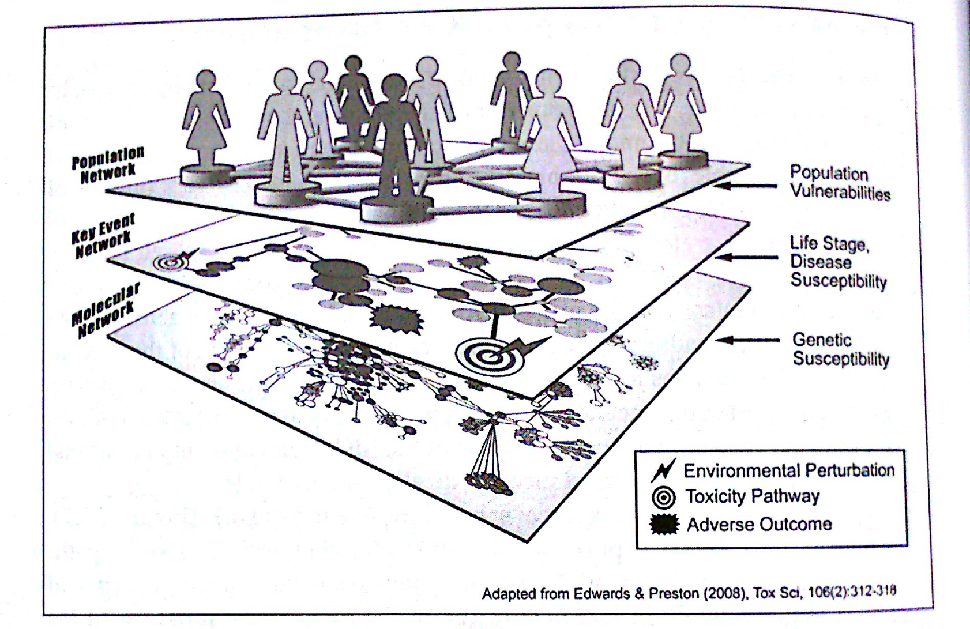
Biomarkers at different biological levels
TOXICANTS
(incl. EPIgenomics
DNA-methylation)

Slide 8
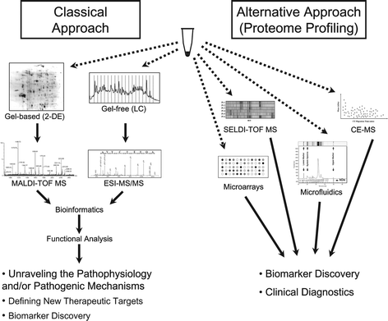
Hypothesis driven research Data driven research
(focus on pathways) (omics & profiling)

Slide 9
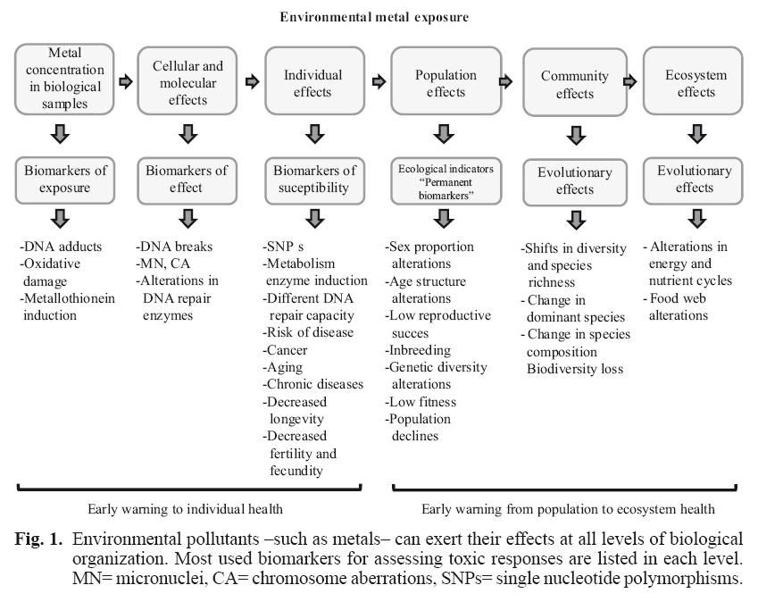
Biomarkers at even higher levels – example: toxic metals

Slide 10
Developments and applications of clinical biomarkers

Slide 11
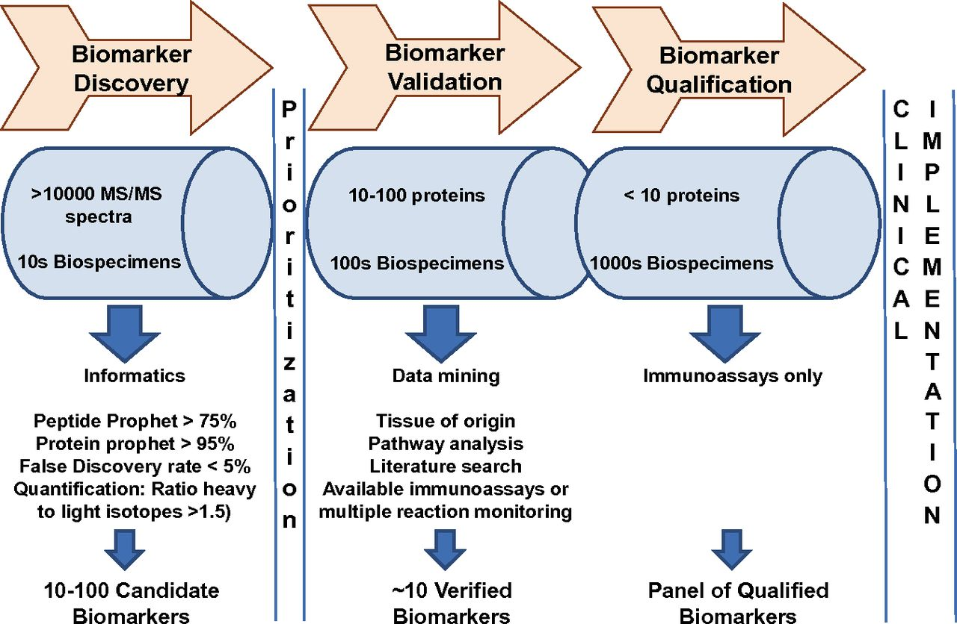
3 key steps towards the biomarker establishment
An example of protein-based biomarkers

Slide 12
3 key steps towards the biomarker establishment
Biomarker development
  High numbers of endpoints (e.g. proteins)
  Low numbers of samples compared (e.g. 10 controls vs 10 “treatments”)
Biomarker validation
  Decreasing number of markers
  Increasing numbers of specimens (biological samples)
Biomarker qualification and approval
  Individual markers
  Analytical methods validated and well established

Slide 13
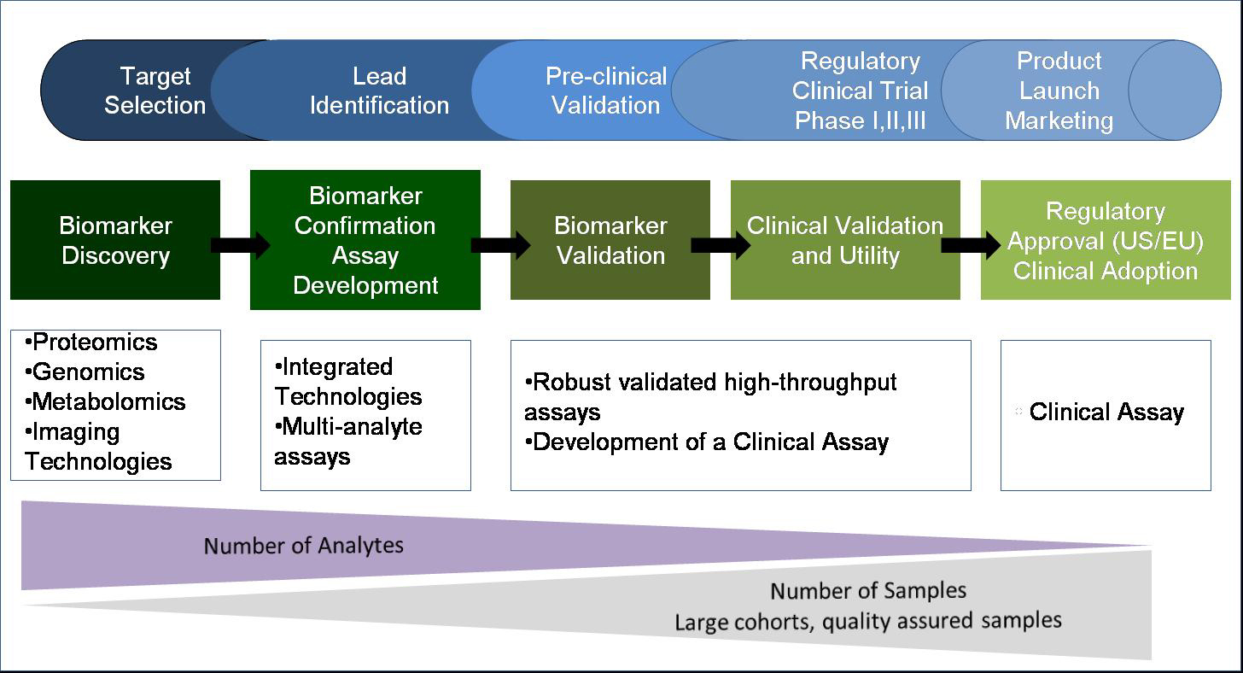
More detailed view: 5 steps leading to biomarker use in (clinical) practice
DISCOVERY → VALIDATION STEPS → APPROVAL

Slide 14
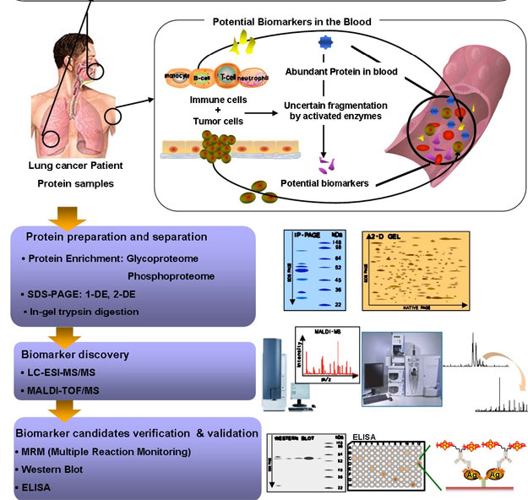
EXAMPLE process of biomarker establishment – lung cancer diagnosis
Which of the
many changes
are “significant” ?
→ Use quantitative
metrics
(see Following slide)

Slide 15
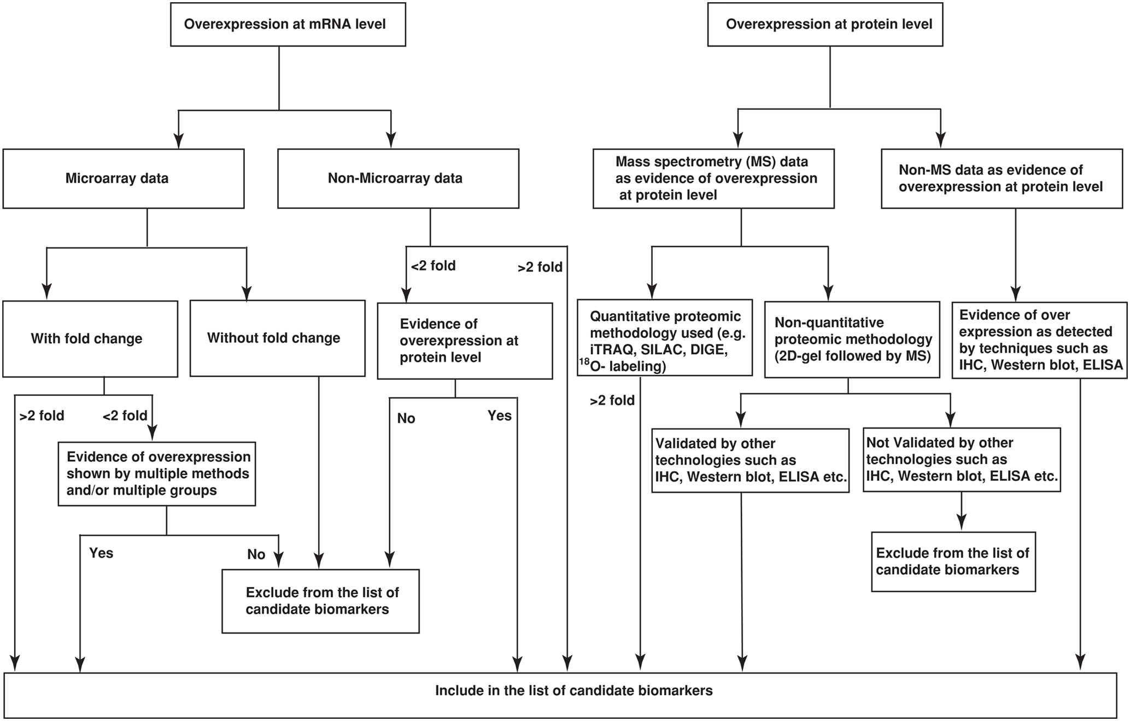
What is (what is not) a candidate biomarker: example flowchart
Use of quantitative metrics during development

Slide 16
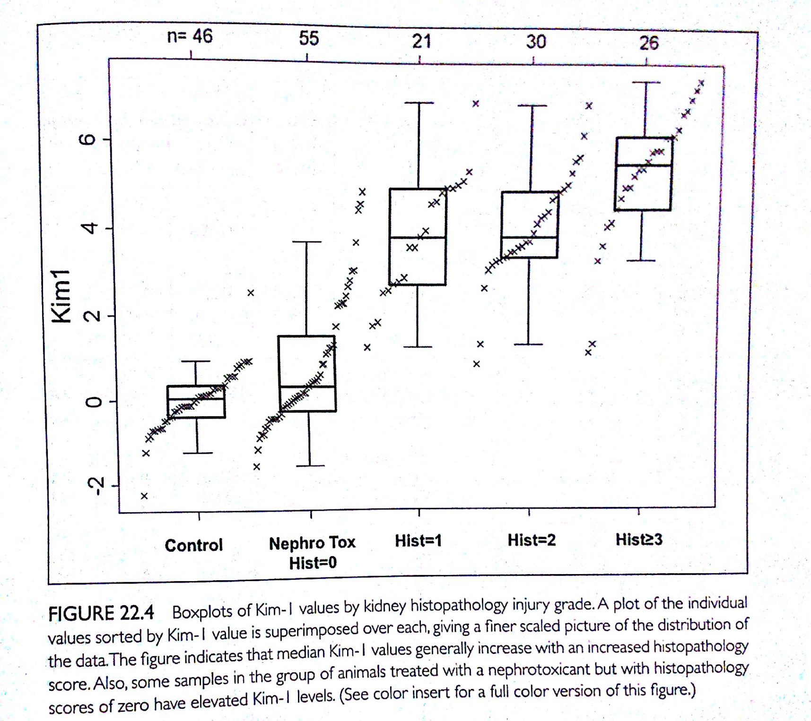
Biomarker validation EXAMPLE
Kim-1 protein levels and kidney clinical signs (histopathology grades 0-3)

Slide 17
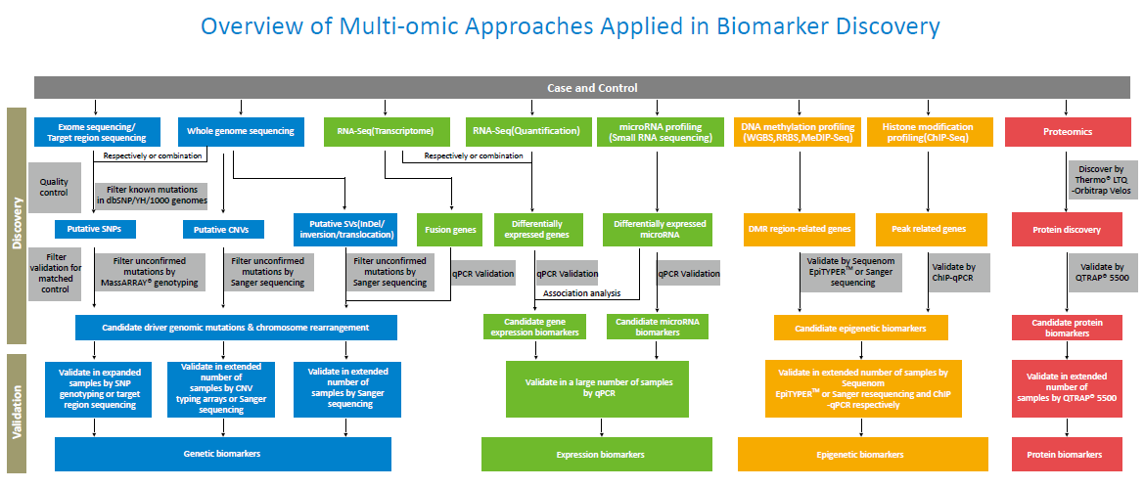
OMICS biomarkers in discovery and validation (1/2)

Slide 18
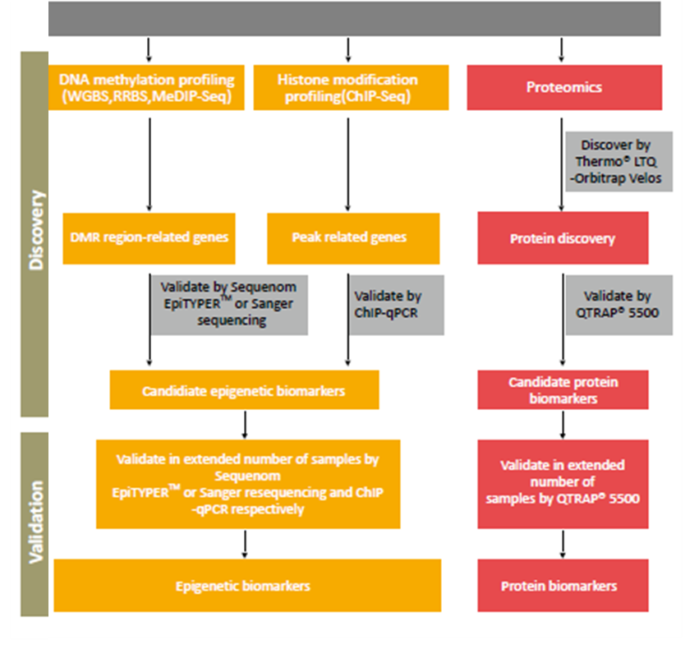
OMICS biomarkers in discovery and validation (2/2)

Slide 19
Summary and overview
Toxicity mechanisms (MoA) and biomarkers

Slide 20
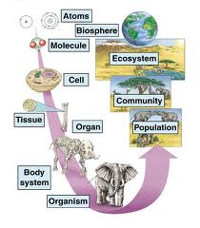
Class summary and take home message
* Molecular effects of toxicants = MoAs (1)
* Propagate to higher levels (2),
* … where they induce measurable “responses” - biomarkers (3)
1
3
Biomarkers
- types
- examples
- methods
MoAs
* Molecular interactions
* Key targets ...:
- DNA, RNAs
- proteins (and their functions)
- membranes
* Complex mechanisms
- Oxidative stress
- Signalling and hormones
- Detoxification
1
2
Biological
organization

Slide 21
Summary on toxicity mechanisms (MoA) and biomarkers
For excellent performance and successful exam student should:
have an overview of different types of MoAs (see also point 2 below) and be able to link MoAs to higher level effects (toxicity)
  Example: What is the in vivo manifestation (effect) after inhibition of AcCholE enzymes (mechanism)? [AcCholE inhibition propagates as neurotoxicity (effect)]
  Be ready to discuss also in a opposite way
  Example: What MoA can be beyond immunotoxicity? [Immunotoxicity can e.g. be caused by disruption of signaling pathways – LPS as an example]
know some details for selected example MoAs for different toxicant targets
= based on your own preference select one example from the following 7 categories, learn details, and be ready to discuss (i.e. learn details for 1 out of 7 example modes of toxic action)
  nucleic acids
  proteins
  membranes (lipids)
  cellular
  Complex 1 – detoxification/metabolization
  Complex 2 – intra- and inter-cellular signalling, hormones
  Complex 3 – oxidative stress
have understanding of biomarker issues
  What is a biomarker and what properties it should have (or not to have)?
  Why we search for them = how can they be used?
  What different types and groups of biomarkers can be recognized?
  What are suitable matrices for sampling and further analyses?
  What methods do we use for analyses of biomarkers? (LCMS, ELISA, PCR, Proteins-WBs, Enzyme actvities)
  What approaches are applied in biomarker discovery („hypothesis“ vs omics)?
and know example biomarkers
Related to the point 2 above
= based on your own interest (in point 2) learn about the effect biomarkers relevant for your selected toxicity mechanism
The final exam:
= 4 open questions + follow-up „colloquium-like“ discussion
Q1 + Q3 – general overview
Q2 + Q4 – select one topic from those listed (1-7) and know details about mechanisms & biomarkers

