Slide 1
6. Přenos chorob (epidemiologie, kontrola chorob, faktory patogenicity, antibiotická terapie, virové, bakteriální, plísňové a parazitární choroby)

Slide 2

Causes of Disease
Identifying causes of disease and the mechanisms by which they spread remains a primary focus of epidemiology
Etiology: Science and study of the causes of disease and their mode of operation

Slide 3
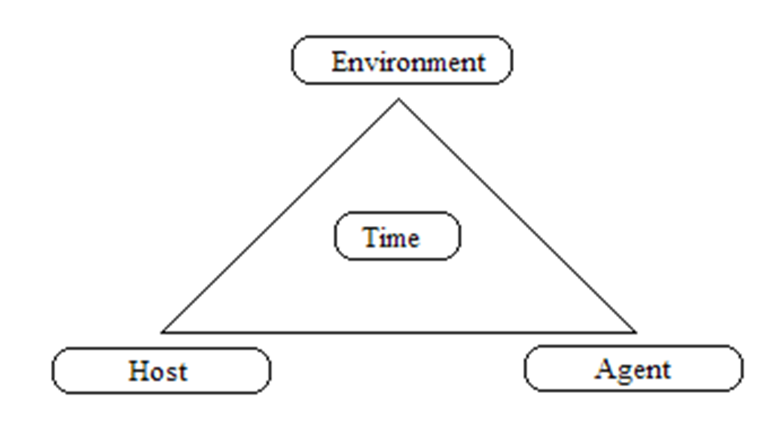
Etiology of Disease
The sum of all factors contributing to the occurrence of the disease
Agent factors + Host factors + Environmental factors = Etiology of Disease
Notes:
agent: A factor, such as a microorganism, chemical substance, or form of radiation, whose presence, excessive presence, or (in deficiency diseases) relative absence is essential for the occurrence of a disease. host factor: An intrinsic factor (age, race, sex, behaviors, etc.) which influences an individual's exposure, susceptibility, or response to a causative agent. environmental factor: An extrinsic factor (geology, climate, insects, sanitation, health services, etc.) which affects the agent and the opportunity for exposure.

Slide 4
Triangle is based on the communicable disease model
  Agent: the cause of the disease
  Host: an organism, usually a human or an animal, that harbors a disease
  Environment: those surroundings and conditions external to the human or animal that cause or allow disease transmission
  Time: accounts for incubation periods, life expectancy of host or pathogen, and duration of the course of the illness or condition.

Slide 5
How can epidemics be stopped?
At least one of elements of triangle must be:
(1) interfered with
(2) altered
(3) changed, or
(4) removed from existence, so that disease no longer continues in mode of transmission and routes of infection
How? Clean up environment, change behavior, vaccinate, medicine, etc.

Slide 6
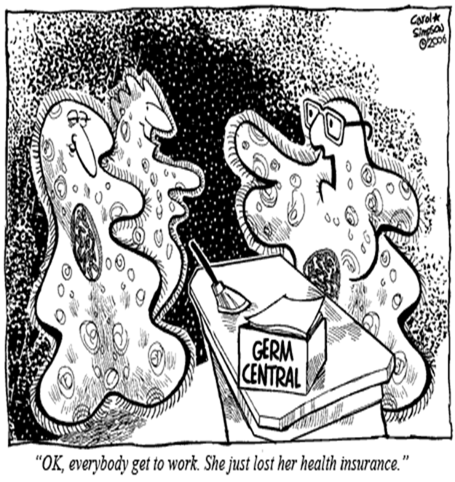
Other important Epi terms
Invasiveness: ability to get into a susceptible host and cause disease
Virulence: disease-evoking power of a pathogen
Communicability- ability of a disease to be transmitted from one individual to another or to spread in a population

Slide 7

Diseases are classified according to infectivity and communicability
Transmission of infectious communicable disease occurs through:
  Vertical Transmission
  Horizontal Transmission

Slide 8

Vertical transmission of infectious communicable diseases
Transmission from an individual to its offspring through sperm, breastmilk, placenta, or vaginal fluids
Examples:
  yeast infection, hepatitis B, C, rabies

Slide 9
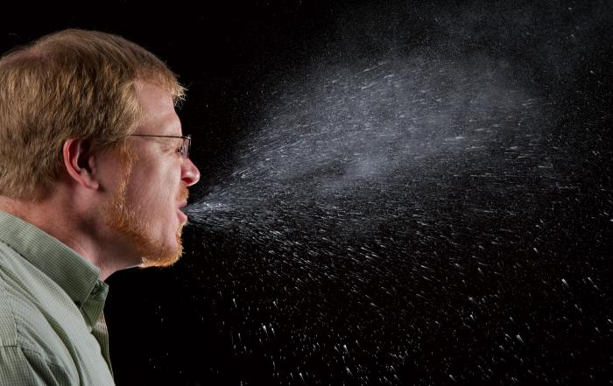
Horizontal transmission of infectious communicable diseases
Transmission of infectious agents from an infected individual to a susceptible contemporary (another person)
  Example:
    1. Common vehicles (blood-, water- or food-borne illnesses)
    2. Airborne pathogen (TB, flu)
    3. Vector borne pathogen (malaria, dengue, West Nile)
Picture retrieved from: http://phil.cdc.gov/phil/details.asp?pid=11161

Slide 10
Direct and indirect transmission

Slide 11
1. Direct transmission:
Disease transmitted by direct physical contact
Examples:
Touching with contaminated hands
Skin-to-skin contact
Kissing

Slide 12
2. Indirect transmission:
Disease transmitted when pathogens or agents are transferred or carried by some intermediate item, organism, means, or process to a susceptible host, resulting in disease
Examples:
fomites
vectors
air currents
dust particles
water droplets
water or food
oral-fecal contact

Slide 13
Diseases are classified by Severity and Duration:
Acute – disorder with sudden onset, relatively severe, and short duration of symptoms (e.g. common cold)
Chronic – develops slowly, lasting over long periods if not a lifetime (e.g. tuberculosis)
Subacute disease- intermediate between acute and chronic (e.g. endocarditis)
Latent disease- agent remains inactive for a period of time, but then activates to cause disease (e.g. shingles)

Slide 14
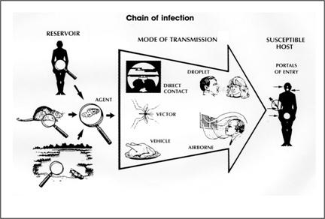
Patterns of Disease
Fig. from cdc.gov

Slide 15
Natural History of Disease
Pre-pathogenesis: Before agent reacts with host
Pathogenesis: After agent reacts with host
  Later stages include development of active signs and symptoms.
    Clinical end points are: recovery, disability, or death
  Each disease has natural history of progression if no medical intervention is undertaken and is allowed to run full course

Slide 16
4 Common Disease Stages
1. Stage of susceptibility (precedes disease; risk for acquiring disease)
2. Stage of pre-symptomatic disease (begins with exposure & subsequent pathologic changes before symptom onset)
  Incubation period: begins with exposure & subsequent pathologic changes before symptom onset (infectious diseases)
  Latency period: time from exposure to clinical symptoms (non-communicable chronic diseases)
Notes:
Stage of susceptibility- disease has not developed yet (risk factors promote development (poor diet, stress, etc.)
Pathologic changes- examples- high cholesterol-plaque formation
time between initial infection and appearance of signs or symptoms
Time depends on the type of microbe,virulence, inoculum amount, and host
resistance

Slide 17
Learning Check
Has disease occurred during the stage of susceptibility?
  What could be some risk factors that promote development?
    Unvaccinated child is susceptible to measles
    Alcohol consumption for Cirrhosis of liver
    High Cholesterol, obesity, Type of personality: Heart Diseases
What could be an example for the pre-symptomatic stage of disease?
  Ova of intestinal parasite in the stool of apparently healthy
  children.
Notes:
1.

Slide 18
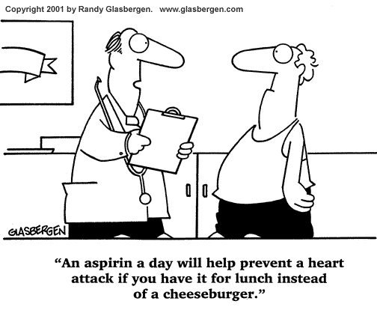
4 Common Disease Stages
3. Stage of clinical disease: when disease signs and symptoms appear
4. Stage of recovery, disability, or death (influenced by multiple factors including time of detection and treatment)
Notes:
3. Organ changes have occurred, now you see the symptoms
4. Temporary or long term reduction of a person’s activities

Slide 19
Learning Check
What would be an example of the stage of clinical disease?
  Common cold has a short and mild clinical stage and
  almost everyone recovers quickly
    If a common cold lasts for a short period of time and a person recovers fairly quickly, how would you classify its severity and duration?

Slide 20
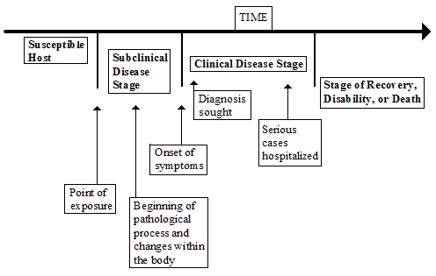
A generalized presentation of the natural history of disease

Slide 21
Identification of Cases
A case is a person who has been diagnosed as having a disease, disorder, injury, or condition

Slide 22
Primary case, index case
The first disease case in the population is the primary case.
The first disease case brought to the attention of the epidemiologist is the index case.
Note: index case is not always the primary case.

Slide 23
Secondary cases
Persons who become infected and ill once a disease has been introduced into a population
Those who become infected from contact with the primary case
Ex: MDR TB case (primary) from Chiapas who spread disease to family members (secondary) after visiting them in Los Angeles.

Slide 24

Different levels of diagnosis for Cases
Suspect: individual or group who have all of the signs and symptoms of a disease/ condition but haven’t been id’ed as having disease, nor have cause of the symptoms been yet connected to a suspected pathogen
Suspect
⬇
Probable
⬇
Confirmed

Slide 25
Different levels of diagnosis
As more info (such as lab results) becomes available to the physician, he/she generally upgrades his/her diagnosis
When all criteria are met and they meet the case definition, the case is classified as a confirmed case.

Slide 26
Categories of Disease Carriers

Slide 27
5 major types of carriers
1. Active carrier: persons who have been exposed to and who harbor a pathogen (disease-causing organism)
  Has done so for some time even though may have recovered from the disease
2. Convalescent carrier: persons who harbor a pathogen and who are in the recovery phase of the course of a disease but are still infectious

Slide 28
Types of carriers
3. Healthy (or passive) carrier: persons who have been exposed to and harbor a pathogen but still haven’t become ill nor shown any of the symptoms of the disease. [Often referred to as a subclinical case]
4. Incubatory carrier: persons who have been exposed to and who harbor a pathogen, are showing symptoms, and have ability to transmit the disease

Slide 29
Types of carriers
5. Intermittent carrier: persons who have been exposed to and harbor a pathogen and who can spread the disease at different places or intervals

Slide 30
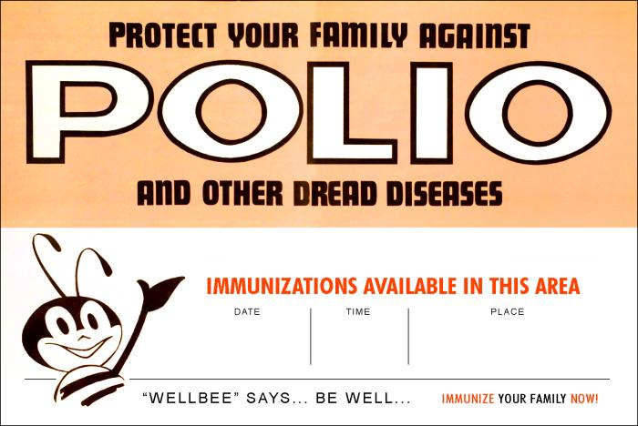
Levels of Disease Prevention
Three major levels of disease prevention
  Primary Prevention
    Targeted at healthy people
    Objectives are:
      Promotion of health
      Prevention of exposure
      Prevention of disease
    Examples:
      Immunization, sanitation, education, media campaigns

Slide 31
Level of Disease Prevention
Secondary Prevention
  Targeted at sick individuals
    Objective is to:
      Stop or slow the progression of disease and to prevent limit permanent damage through early detection and treatment

Slide 32
Level of Disease Prevention
Tertiary Prevention
  Targeted at people with chronic diseases and disabilities that can’t be cured
    Objective is to:
      Prevent further disability or death and limit impacts of disability through rehabilitation

Slide 33
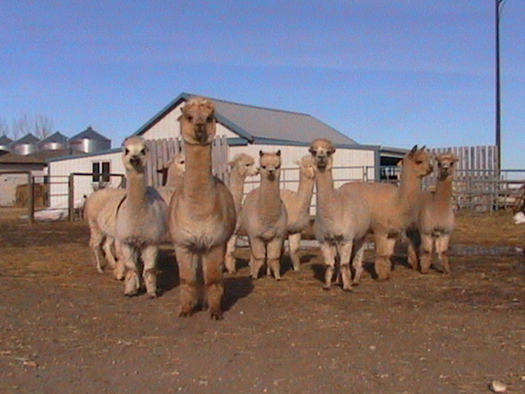
KEY Epi CONCEPT:
Herd immunity
Viewed as resistance a population has to invasion/spread of an ID
Based on notion that if a population or group is mostly protected from a disease by immunizations (> 85%), then chance of a major epidemic occurring is limited

Slide 34
Herd Immunity
Herd immunity provides barrier to direct transmission of infections through population
Lack of susceptible persons stops spread of a disease through throughout group

Slide 35
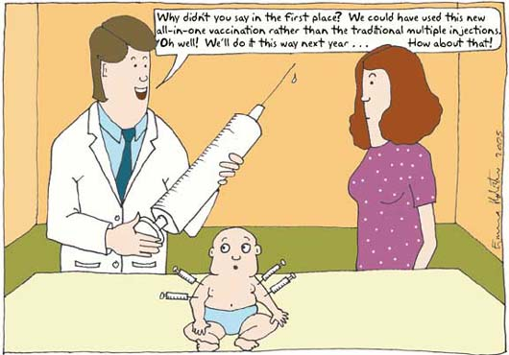
Herd Immunity
Public health immunization program goal: attain as close to 100% coverage as is possible to prevent even one case from occurring

Slide 36
Diseases for which vaccines are used
Anthrax Cholera Chickenpox Diphtheria German measles (rubella) Hepatitis A Hepatitis B Influenza Measles Meningitis Mumps Pertussis | Plague Pneumonia Polio Rabies Smallpox Spotted fever Tetanus Tuberculosis Typhoid fever Typhus Whooping cough Yellow fever

Slide 37
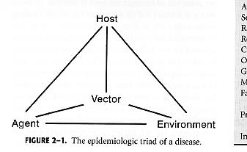

Slide 38
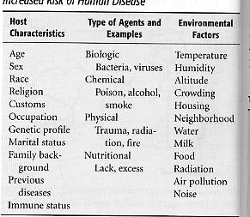

Slide 39
Terms Associated with Disease Causation & Transmission
Host
Agent
Environment
Fomites
Vector
Carrier – active
Incubatory
Convalescent
Healthy
Intermittent
You will cover
these in today’s
discussion.

Slide 40
Modes of Transmission
Direct
Indirect

Slide 41
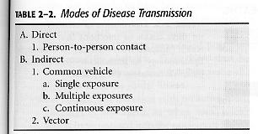

Slide 42
Chain of Infection
Etiological agent
Source/Reservoir
Portal of exit
Mode of transmission
Portal of entry
Susceptible host

Slide 43
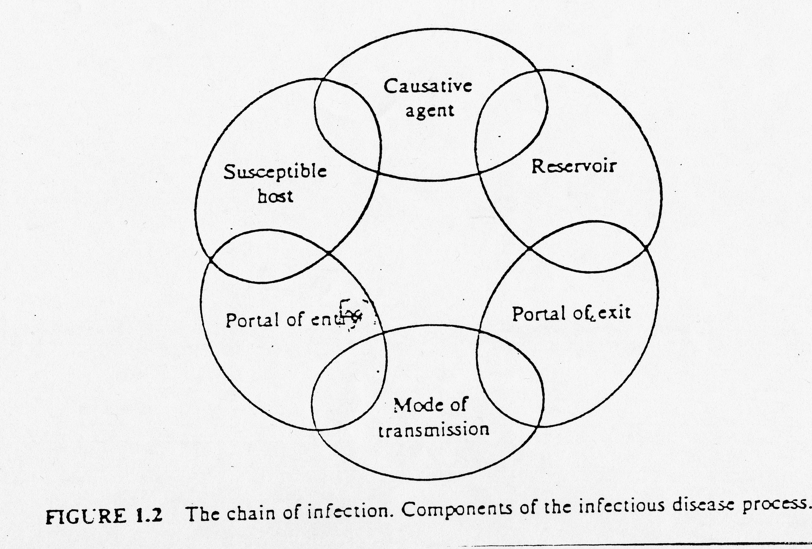

Slide 44
Forms of Disease
Clinical
  acute
  sub-acute
Non-clinical (Inapparent)
  pre-clinical
  sub-clinical
  chronic (persistent)
  latent
Your Assignment:
familiarize yourself
with the definitions
of these terms

Slide 45
Disease Investigation
Establish diagnosis
Identify specific agent
Describe according to person, place and time
Identify source of agent
Identify mode of transmission
Identify susceptible populations

Slide 46
Steps in the Investigation of an Epidemic
Define the epidemic
Examination the distribution of cases
Look for combinations of variables
Develop hypothesis (es)
Test hypothesis
Recommend control measures

Slide 47
Determinants of Disease Outbreak
Based on balance of disease in a population
  herd immunity
    disease restricted to single host
    transmission must be relatively direct

Slide 48
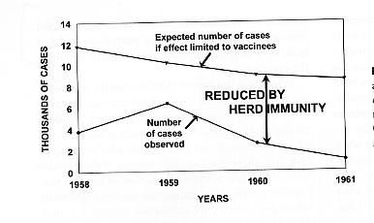
Effect of Herd Immunity

Slide 49
Incubation Period
The period of time after an infection is established but before the first signs or symptoms appear
Different diseases generally have different incubation times and symptoms
Therefore, can derive epidemic curves

Slide 50
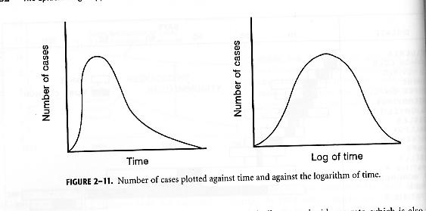
Epidemic Curve for Single Exposure Common-Vehicle Outbreak

Slide 52
Incubation Period
???????Dependent upon: D = (N)(V) / I
Your Assignment:
define the variables
in this formula

