Slide 1
Respiratory system IV
Lung diseases
VLA 1. 12. 2020

Slide 2
Pod pojmem dýchání rozumíme výměnu dýchacích plynů mezi vnitřním a zevním prostředím.
Někdy se používá pojem buněčné dýchání pro procesy spojené s tvorbou energie za spotřeby kyslíku v mitochondriích buněk.
Opakování
Anatomie dýchacího systému
Horní cesty dýchací
Dolní cesty dýchací
Plíce
Hlavní funkce dýchacího systému
Ventilace
Difúze
Perfúze
Činnost respiračního systému úzce souvisí s činností oběhového systému, proto se někdy mohou poruchy oběhového systému manifestovat jako poruchy respirace.

Slide 3
Funkce horních cest dýchacích
Funkce dolních cest dýchacích
Křižovatka mezi dýchacími cestami a trávícím traktem.
Ochrana dýchacích cest před průnikem potravy – epiglotis, hlasivky – laryngeální spasmus
Zvlhčit a ohřát vzduch
Odstranit větší nečistoty
Relativní vlhkost vzduchu
Ztráty vody dýchacím systémem cca 0,5l/den
Funkce plic
Vlastní výměník, ve kterém dochází k výměně plynů mezi alveolárním vzduchem a krví.
Ventilace
Alveolární ventilace V_{A} je rozdíl mezi celkovou plicní ventilací a ventilací mrtvého prostoru. V_{A}=V_{T}-V_{D}
Ventilace je součin dechové frekvence a dechového objemu V_{A}= f*(TV-DV)
Při růstu dechové frekvence a poklesu dechového objemu zůstává sice V_{T} zachována ale V_{A} klesá, protože relativně roste ventilace mrtvého prostoru.

Slide 4
Perfúze
Výměna plynů mezi krví a alveolárním vzduchem probíhá jen tehdy pokud dochází ke kontaktu krve a vzduchu na dostatečně velké ploše alveolokapilární membrány po dostatečně dlouhou dobu.
Regulace vlivem hypoxie.
Respiračně perfúzní poměr
Filtrace krve – trombembolie, metastázy; rezervoár krve.
Tlakový gradient
Nádech
Výdech
Aktivní a pasivní děje
Negativní tlak v pleurální dutině
Elasticita plic
Odpor dýchacích cest
Difúze
Na rychlosti difúze, respektive difúzním toku se podílí vlastnosti membrány, koncentrační gradient a velikost plochy.
Vůči různým plynům se difúzní membrána chová různě.
Oxid uhličitý difunduje snáze než kyslík 20x – při chorobných stavech bývá postižen přestup kyslíku více než přestup CO₂.
Hlavní typy poruch funkce dýchacího systému
Poruchy pleurální dutiny
Obstrukce dýchacích cest
Restrikční plicní choroby
Cirkulační plicní poruchy
Intersticiální plicní nemoci
Respirační selhání

Slide 5
Odlišení dvou hlavních klinických kategorií
Pleurální dutina
Obstrukční plicní choroby
Restrikční plicní choroby
Pleuritida
Exudát, transudát
Pneumothorax (zevní x vnitřní, otevřený, uzavřený, ventilový)
Atelektáza x kolaps plicní tkáně
Obstrukce dýchacích cest
Obstrukce dolních dýchacích cest. Ovlivněn hlavně výdech, primárně snížení ventilace
Asthma bronchiale
Extrinsic asthma
Intrinsic asthma
Otok, sekrece, spasmus
Chronický zánět

Slide 6
Emfyzém
Destrukce interalveolárních sept vedoucí ke hyperinflaci plicní tkáně a kolapsu malých dýchacích cest.
Kouření cigaret, defekt alfa1-antitripsinu (1% případů).
Chronic obstructive pulmonary disease
  Chronická obstruktivní bronchitida
  Emfyzém
Chronická bronchitida
Kouření a chronické infekce.
Hypersekrece hlenu a hypertrofie hlenovýchžláz s fibrózou stěny bronchu.
Klinický obraz COPD - zjednodušeno
Pink puffer - emfyzematik s hyperventilací
Blue bloater - bronchitik s hypoxií

Slide 7
Intersticiální plicní choroby
Poruchy krevního oběhu
Plicní embolie
  Tromembolie
  Jiné typy embolií
Plicní hypertenze
  Prekapilární (pravolevý zkrat, embolie)
  Kapilární (hypoxie)
  Postkapilární (levostranné srdeční selhání)
Cor pulmonále
Pneumokoniózy
Sarkoidosa
Některé léky, ionizující záření
Autoimunitní choroby
ARDS
Acute respiratory distress syndrome
Popsán teprve v roce 1967
Vyústění spousty etiopatogeneticky rozličných, velmi těžkých stavů
Poškození alveolokapilární membrány, deaktivace surfaktantu.
Respirační selhání
Hypoxemie
Hypoxemie s hyperkapnií
Hypoventilace
Ventilačně perfúzní nepoměr
Poruchy difúze

Slide 8
Pathophysiology of pulmonary hypertension

Slide 9
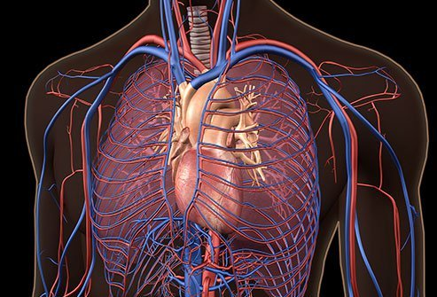
Background normal anatomy and physiology

Slide 10
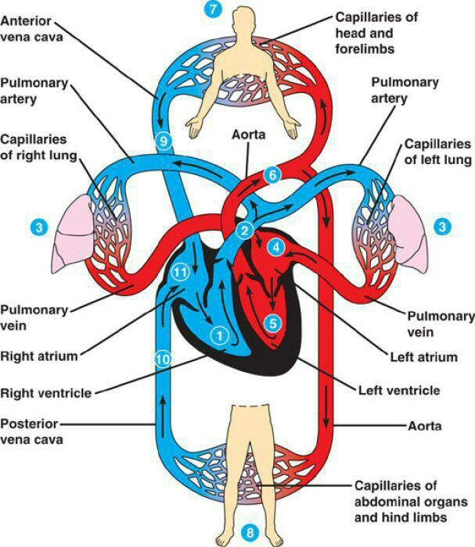
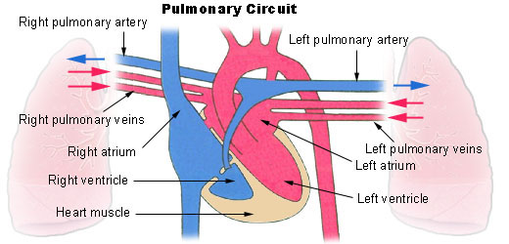
Anatomy review - schematic

Slide 11
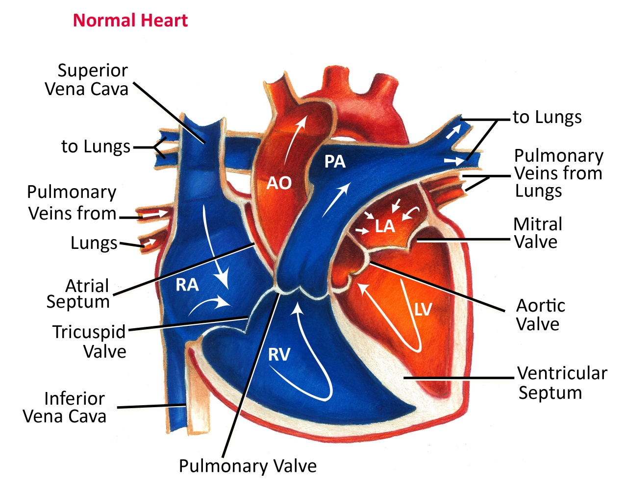
Anatomy review - Realistic

Slide 12
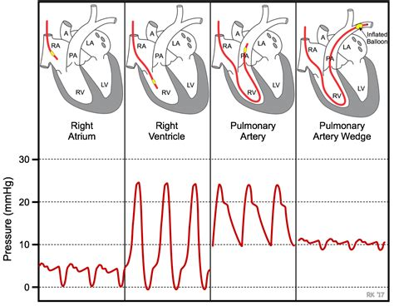
Swan Ganz catheter placement

Slide 13
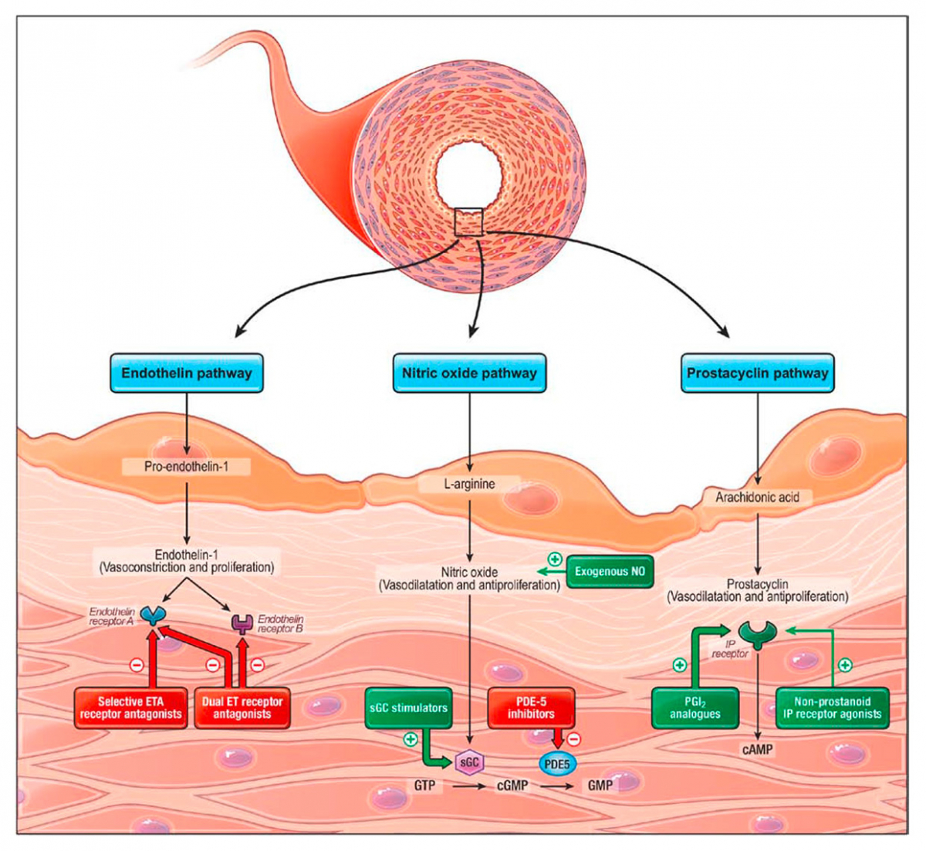
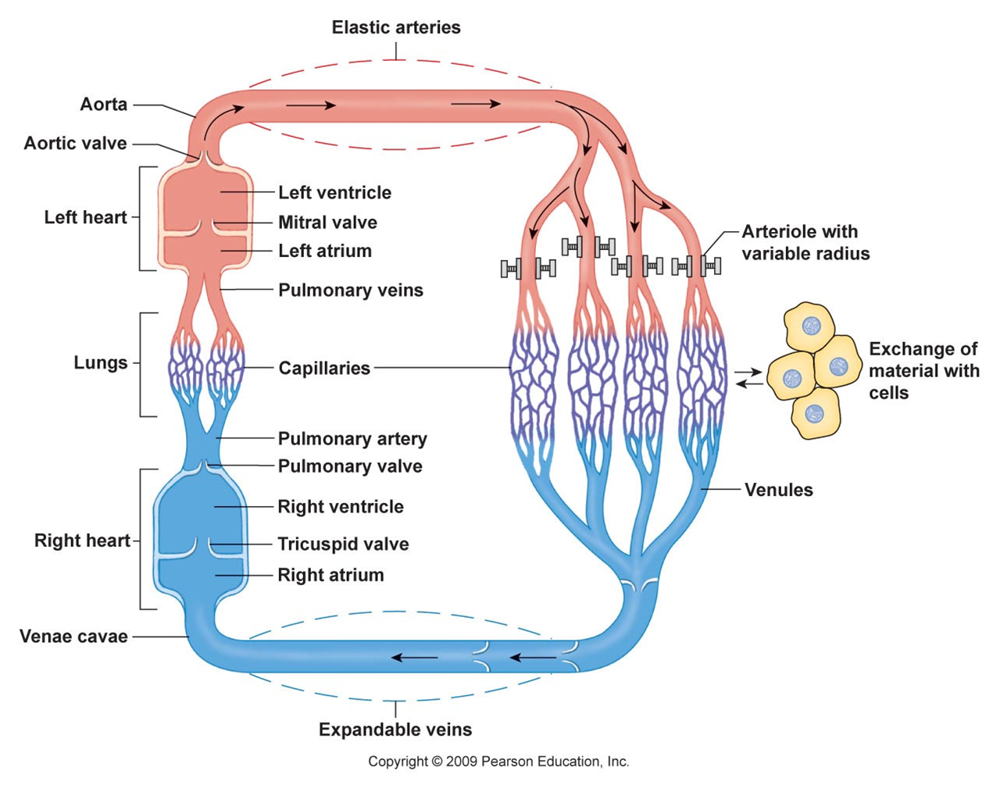
Why is pulmonary artery pressure normally low?

Slide 14
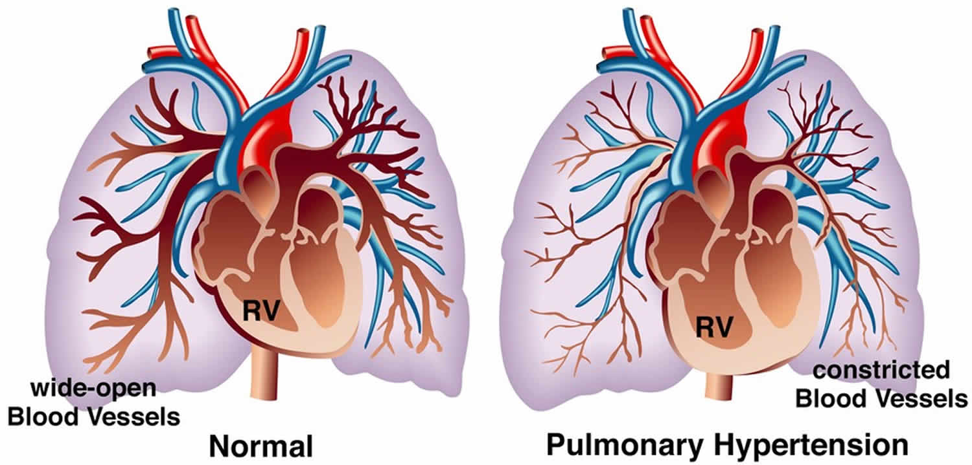
Abnormal anatomy and physiology

Slide 15
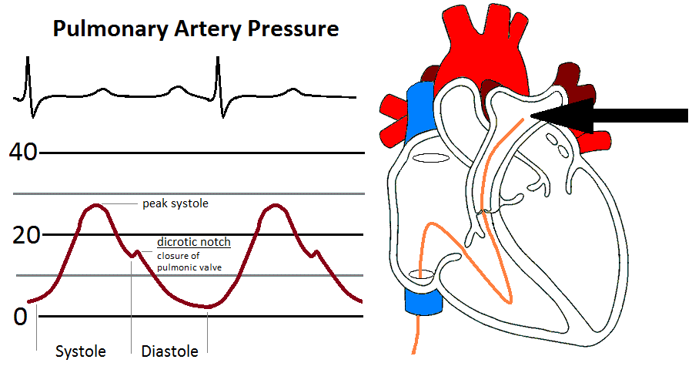
Abnormal PA pressures in real patients range from 30 to 100 mmHg

Slide 16
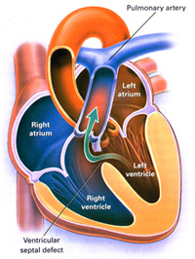
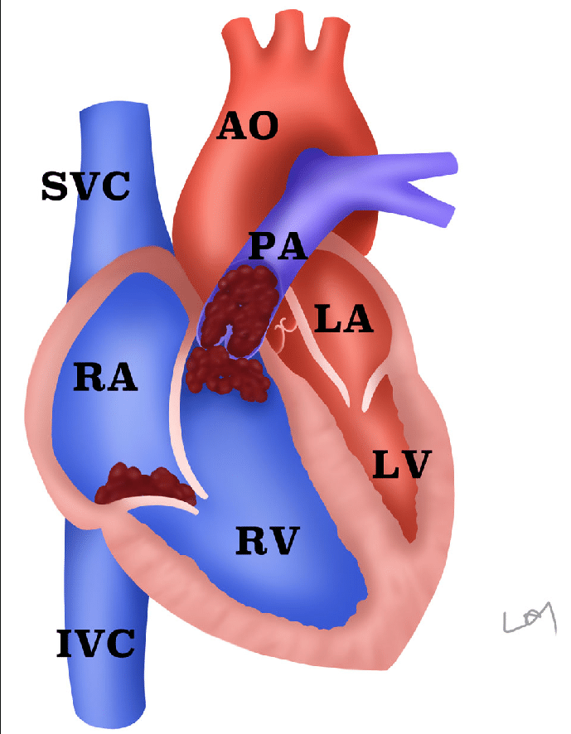
Ventricular septal defect and pulmonary embolism

Slide 17
Blood flow vs. Velocity of blood flow
  Ohm´s law:
BF=BP/R, BP=blood pressure, BF=blood flow, R= resistance of blood vessels
BF=BP/R
Velocity of blood flow (v):
Π x r² . v = (constant !!!!!)
Blood vessels „like“ their natural (physiological) diameter and they have tendency to do it by
remodelling of blood flow

Slide 18
Blood flow energy
Because flowing blood has mass and velocity it has kinetic energy (KE). This KE is proportionate to the mean velocity squared (V²; from KE = ½ mV²). Furthermore, as the blood flows inside a vessel, pressure is exerted laterally against the walls of the vessel; this pressure represents the potential or pressure energy (PE). The total energy (E) of the blood flowing within the vessel, therefore, is the sum of the kinetic and potential energies (assuming no gravitational effects) as shown below.
E = KE + PE (where KE ∝ V²) Therefore, E ∝ V² + PE

Slide 19
Blood as hemodynamic priority
Blood flow is driven by the difference in total energy between two points. Although pressure is normally considered as the driving force for blood flow, in reality it is the total energy that drives flow between two points (e.g., longitudinally along a blood vessel or across a heart valve). Throughout most of the cardiovascular system, KE is relatively low, so for practical purposes, it is stated that the pressure energy (PE) difference drives flow. When KE is high, however, adding KE to the PE significantly increases the total energy, E. To illustrate this, consider the flow across the aortic valve during cardiac ejection. Late during ejection, the intraventricular pressure (PE) falls slightly below the aortic pressure (PE), nevertheless, flow continues to be ejected into the aorta. The reason for this is that the KE of the blood as it moves across the valve at a very high velocity ensures that the total energy (E) in the blood crossing the valve is higher than the total energy of the blood more distal in the aorta.

Slide 20
Energy of blood flow and Bernoulli's Principle
Kinetic energy and pressure energy can be interconverted so that total energy remains unchanged. This is the basis of Bernoulli's Principle. This principle can be illustrated by a blood vessel that is suddenly narrowed then returned to its normal diameter. In the narrowed region (stenosis), the velocity increases as the diameter decreases. Quantitatively, v ∝ 1/D² because flow (BF) is the product of mean velocity (v) and vessel cross-sectional area (S) (BF = v ∙ D), and S is directly related to diameter (D) (or radius, r) squared (from S = π ∙ r²). If the diameter is reduced by one-half in the region of the stenosis, the velocity increases 4-fold. Because KE ∝ v², the KE increases 16-fold. Assuming that the total energy is conserved within the stenosis (E actually decreases because of resistance), then the 16-fold increase in KE must result in a proportionate decrease in PE. Once past the narrowed segment, KE will revert back to its pre-stenosis value because the post-stenosis diameter is the same as the pre-stenosis diameter and flow is conserved. Because of the resistance of the stenosis, and the likelihood of turbulence, the post-stenosis PE and E will both fall.
To summarize this concept, blood flowing at higher velocities has a higher ratio of kinetic energy to potential (pressure) energy.

Slide 21
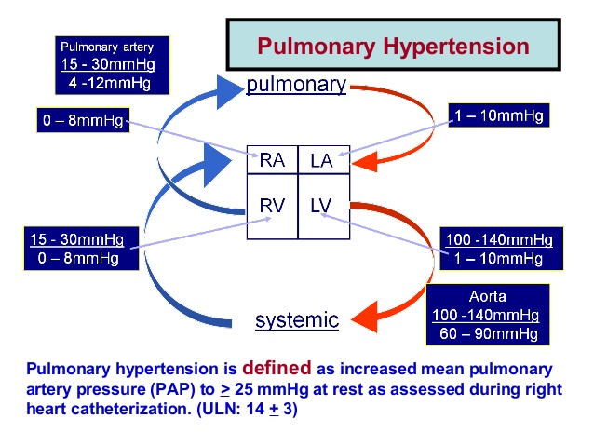
Many causes of PAH*, Part 1

Slide 22
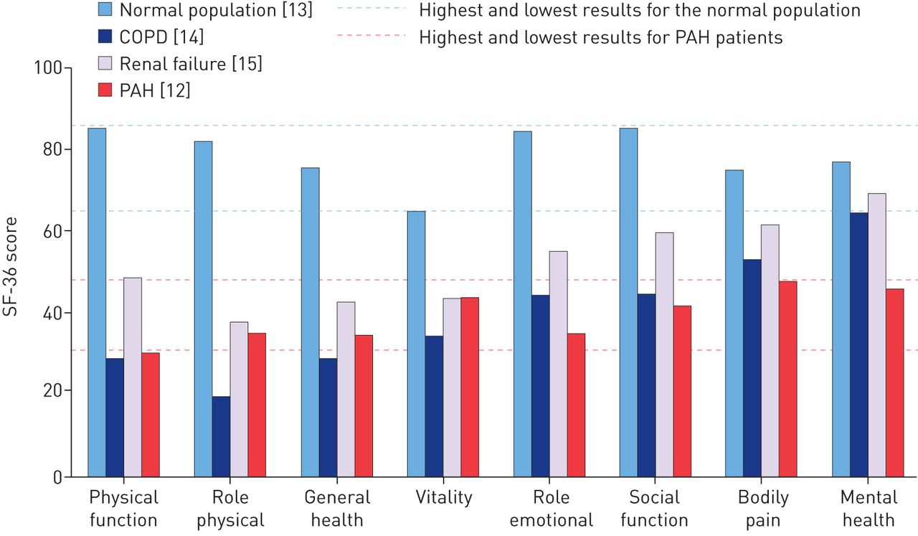
Effect of pulmonary arterial hypertension (PAH) on SF-36-measured health-related quality of life (HRQoL) measures versus the normal population and other disease conditions [12–15].
Marion Delcroix, and Luke Howard Eur Respir Rev 2015;24:621-629
©2015 by European Respiratory Society
Notes:
Effect of pulmonary arterial hypertension (PAH) on SF-36-measured health-related quality of life (HRQoL) measures versus the normal population and other disease conditions [12–15]. COPD: chronic obstructive pulmonary disease; SF-36: Medical Outcomes Study 36-item short form.

Slide 23
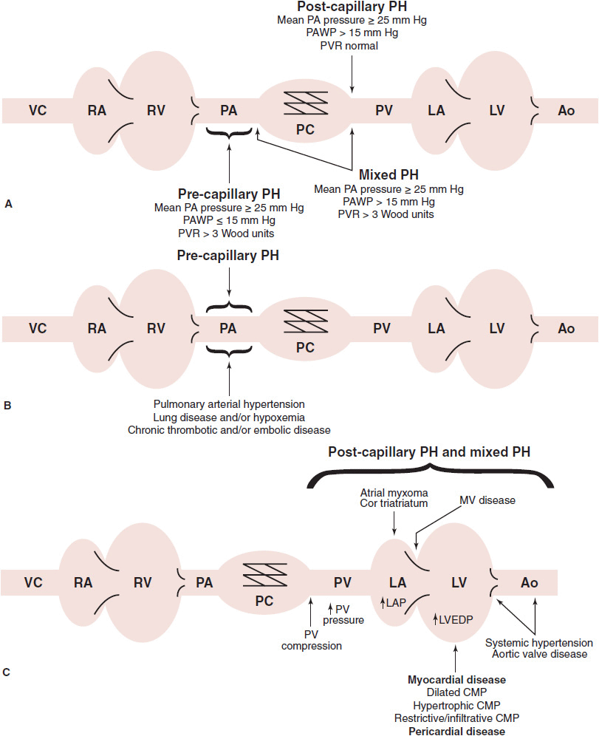
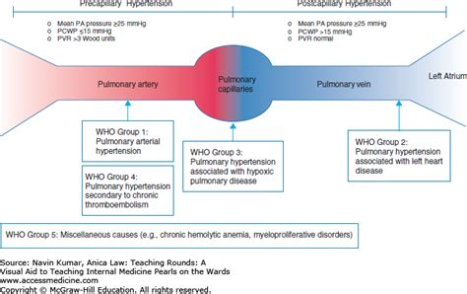
Precapillary vs. postcapillary PAH

Slide 24
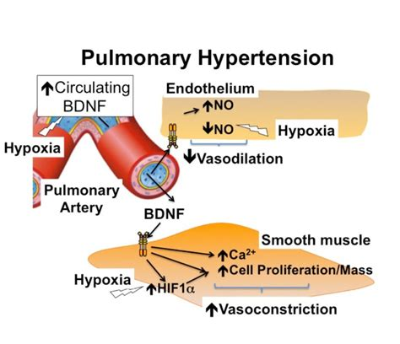
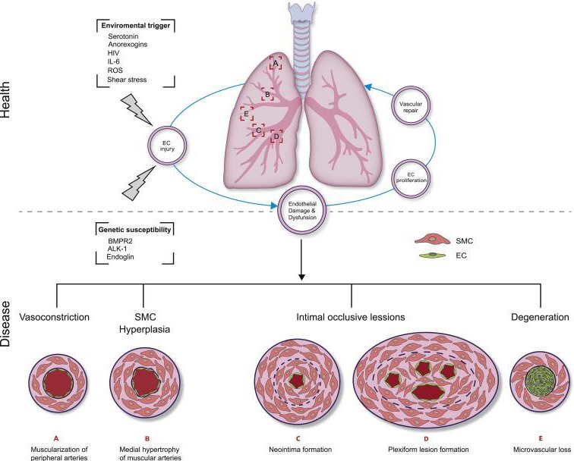
Pathophysiology of pulmonary hypertension
Continuing Cardiology Education, Volume: 4, Issue: 1, Pages: 2-12, First published: 27 July 2018, DOI: (10.1002/cce2.71)
Notes:
Pathophysiological mechanisms of PAH. Environmental insults can contribute to PAEC damage and injury. In the healthy state, physiological repair processes restore normal lung function via proliferation of nearby ECs and/or the recruitment of circulating endothelial progenitor cells (EPCs). In PAH, pulmonary vascular cell damage contributes to the degeneration of microvasculature and/or arteriolar remodeling. In patients with hereditary PAH underlying genetic mutations are associated with increased susceptibility to PAEC damage and injury. [Adapted from: Foster et al.] with permission from the Canadian Cardiovascular Society.
IF THIS IMAGE HAS BEEN PROVIDED BY OR IS OWNED BY A THIRD PARTY, AS INDICATED IN THE CAPTION LINE, THEN FURTHER PERMISSION MAY BE NEEDED BEFORE ANY FURTHER USE. PLEASE CONTACT WILEY'S PERMISSIONS DEPARTMENT ON PERMISSIONS@WILEY.COM OR USE THE RIGHTSLINK SERVICE BY CLICKING ON THE 'REQUEST PERMISSIONS' LINK ACCOMPANYING THIS ARTICLE. WILEY OR AUTHOR OWNED IMAGES MAY BE USED FOR NON-COMMERCIAL PURPOSES, SUBJECT TO PROPER CITATION OF THE ARTICLE, AUTHOR, AND PUBLISHER.

Slide 25
Pulmonary vascular disease
is an important risk factor for disease progression and exacerbation risk. Relative pulmonary artery enlargement on computed tomography scan, defined by a pulmonary artery to aortic (PA:A) ratio >1, has been evaluated as a marker of pulmonary vascular disease.
In healthy patients a PA:A ratio >0.9 is considered to be abnormal.
The PA:A ratio has been compared with invasive hemodynamic parameters, primarily mean pulmonary artery pressure in various disease conditions and is more strongly correlated with mean pulmonary artery pressure in obstructive as compared with interstitial lung disease.
In patients without known cardiac or pulmonary disease, the PA:A ratio is predictive of mortality, while in COPD, an elevated PA:A ratio is correlated with increased exacerbation risk, outperforming other well established predictors of these events.

Slide 26
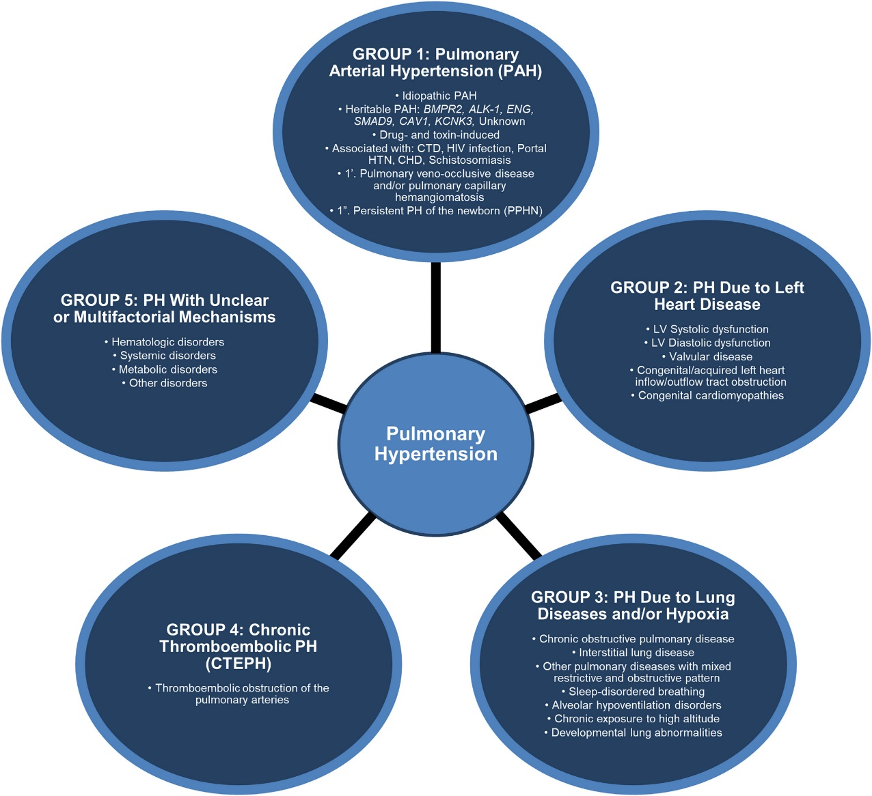
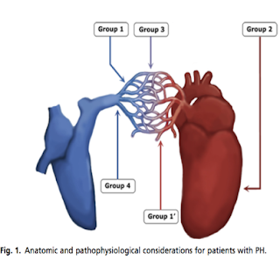
Classification of pulmonary hypertension
Continuing Cardiology Education, Volume: 4, Issue: 1, Pages: 2-12, First published: 27 July 2018, DOI: (10.1002/cce2.71)
Notes:
Pulmonary hypertension is classified into five distinct groups based on the findings and recommendations from world experts at the most recent World Symposium on Pulmonary Hypertension (Nice, France, 2013).
IF THIS IMAGE HAS BEEN PROVIDED BY OR IS OWNED BY A THIRD PARTY, AS INDICATED IN THE CAPTION LINE, THEN FURTHER PERMISSION MAY BE NEEDED BEFORE ANY FURTHER USE. PLEASE CONTACT WILEY'S PERMISSIONS DEPARTMENT ON PERMISSIONS@WILEY.COM OR USE THE RIGHTSLINK SERVICE BY CLICKING ON THE 'REQUEST PERMISSIONS' LINK ACCOMPANYING THIS ARTICLE. WILEY OR AUTHOR OWNED IMAGES MAY BE USED FOR NON-COMMERCIAL PURPOSES, SUBJECT TO PROPER CITATION OF THE ARTICLE, AUTHOR, AND PUBLISHER.

Slide 27
Group 1 PAH
1.1 Idiopathic PAH
1.2 Heritable PAH
1.2.1 BMPR2
1.2.2 ALK-1, ENG, SMAD9, CAV1, KCNK3
1.2.3 Unknown
1.3 Drug and toxin induced
1.4 Associated with:
1.4.1 Connective tissue disease
1.4.2 HIV infection
1.4.3 Portal hypertension
1.4.4 Congenital heart diseases
1.4.5 Schistosomiasis
1
0
Pulmonary veno-occlusive disease and/or pulmonary capillary
hemangiomatosis
1
00
Persistent pulmonary hypertension of the newborn (PPHN)
IPAH
Familial – BMPR2, ALK 1,Unknown Associated with PAH
Connective Tissue Disease (Scleroderma, SLE, MCTD, RA)
Congenital Heart Disease
Portal hypertension (5-7% of patients)
HIV (0.5% of patients)
Drugs/toxins (aminorex-, dexfenfluramine-, or fenfluramine- containing products, cocaine, methamphetamine)
Other:
hereditary hemorrhagic telangiectasia, hemoglobinopathies, myeloproliferative disorders, splenectomy
Associated with venous/capillary involvement
Pulmonary veno-occlusive disease (evidence of pulmonary vascular congestion)
Pulmonary capillary hemangiomatosis Persistent PH of newborn.

Slide 28
Group 2-3
Group 2: Pulmonary hypertension due to left heart disease
  2.1 Left ventricular systoli c dysfunction
  2.2 Left ventricular diasto lic dysfunction
  2.3 Valvular disease
  2.4 Congenital/acquired left heart inﬂow/outﬂow tract obstruction and congenital cardiomyopathies
Group 3: Pulmonary hypertension associated with lung disease and/or hypoxemia
  3.1 Chronic obstructive pulmonary disease
  3.2 Interstitial lung disease
  3.3 Other pulmonary diseases with mixed restrictive and obstruc-
  tive pattern
  3.4 Sleep-disordered breathing
  3.5 Alveolar hypoventilation disorders
  3.6 Chronic exposure to high altitude
  3.7 Developmental lung diseases

Slide 29
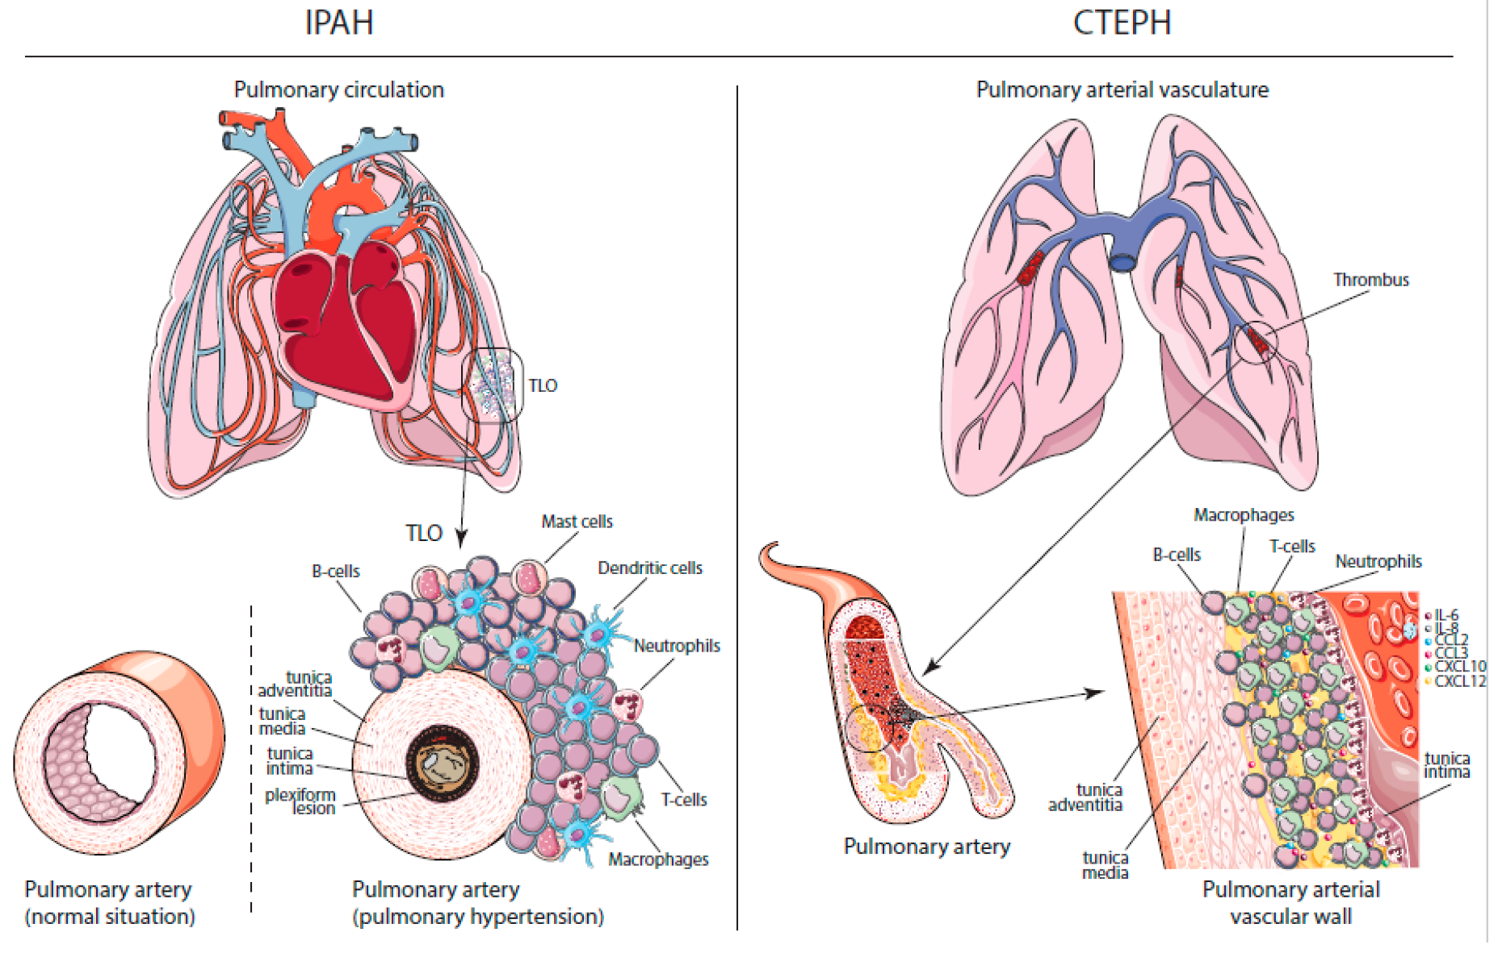
Differences
Continuing Cardiology Education, Volume: 4, Issue: 1, Pages: 2-12, First published: 27 July 2018, DOI: (10.1002/cce2.71)
Notes:
Schematic representations of pulmonary hypertension. Representation of site of initiation of elevated pulmonary arterial pressure of precapillary pulmonary hypertension, postcapillary pulmonary hypertension, and CTEPH. L.V., left ventricle; PH, pulmonary hypertension; R.A., right atrium; R.V., right ventricle. [Adapted from: Gordeuk et al.]
IF THIS IMAGE HAS BEEN PROVIDED BY OR IS OWNED BY A THIRD PARTY, AS INDICATED IN THE CAPTION LINE, THEN FURTHER PERMISSION MAY BE NEEDED BEFORE ANY FURTHER USE. PLEASE CONTACT WILEY'S PERMISSIONS DEPARTMENT ON PERMISSIONS@WILEY.COM OR USE THE RIGHTSLINK SERVICE BY CLICKING ON THE 'REQUEST PERMISSIONS' LINK ACCOMPANYING THIS ARTICLE. WILEY OR AUTHOR OWNED IMAGES MAY BE USED FOR NON-COMMERCIAL PURPOSES, SUBJECT TO PROPER CITATION OF THE ARTICLE, AUTHOR, AND PUBLISHER.

Slide 30
Group 4-5
Group 4: Pulmonary hypertension due to chronic thrombotic and/or embolic disease
Thromboembolic obstruction of proximal pulmonary arteries
Thromboembolic obstruction of distal pulmonary arteries
Group 5: Miscellaneous
5.1 Hematologic disorders: chronic hemolytic anemia, myeloproliferative disorders, splenectomy
5.2 Systemic disorders: sarcoidosis, pulmonary histiocytosis,lymphangioleiomyomatosis
5.3 Metabolic disorders: glycogen storage disease, Gaucher disease, thyroid disorders
5.4 Others: tumoral obstruction, ﬁbrosing mediastinitis, chronic renal failure, segmental PH

Slide 31
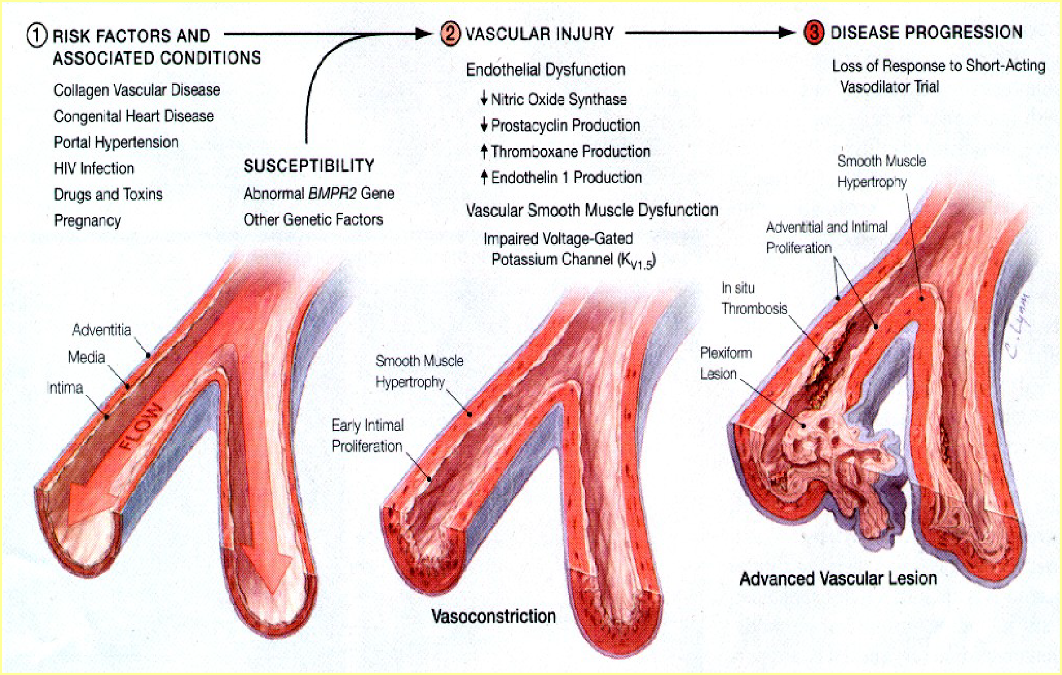

Slide 32
Group 1 - Pathophysiology
Exact mechanism – unknown.
Multifactorial.
Excessive vasoconstriction -abnormal function or expression of potassium channels in the smooth muscle cells .
Endothelial dysfunction leads to chronically impaired production of vasodilator and Vasoconstrictors
(NO, prostacyclin, thromboxane A2 and endothelin-1)

Slide 33
Reduced plasma levels of other vasodilator and antiproliferative substances such as vasoactive intestinal peptide
In the adventitia there is increased production of extracellular matrix including collagen, elastin, fibronectin. Inflammatory cells and platelets (through the serotonin pathway)
Prothrombotic abnormalities have been demonstrated in PAH patients, and thrombi are present in both the small distal pulmonary arteries and the proximal elastic pulmonary arteries

Slide 34
Tunica media hypertrophy
Tunica intima proliferation
Fibrotic changes of tunica intima
concentric eccentric
Tunica adventitial thickening with moderate perivascular infiltrates
Complex lesions Plexiform Dilated
Thrombotic lesions.

Slide 35
Group 2 - Pathophysiology
Due to lt. heart diseases:
Pulmonary venous hypertension-most common cause
Usually due to left-sided heart disease (valvular, coronary or myocardial), ◊obstruction to blood flow downstream from the pulmonary veins.
Reversibility is variable, dependent on lesion.

Slide 36
Group 3 - Pathophysiology
PH due to lung diseases and/or hypoxia:
Multiple
hypoxic vasoconstriction,
mechanical stress of hyperinflated lungs,
loss of capillaries – emphysema, fibrosis
inflammation, and toxic effects of cigarette smoke. 5)endothelium-derived vasoconstrictor–vasodilator imbalance.
Hypoxia induced pulmonary vasoconstriction and anatomical destruction of the vascular bed due to high pulmonary resistance and ultimately RV failure.

Slide 37
Group 4-5 - Pathophysiology
CTEPH: non-resolution of acute embolic masses which later undergo fibrosis leading to mechanical obstruction of pulmonary arteries is the most important process.
PH with unclear and/or multifactorial mechanisms.

Slide 38
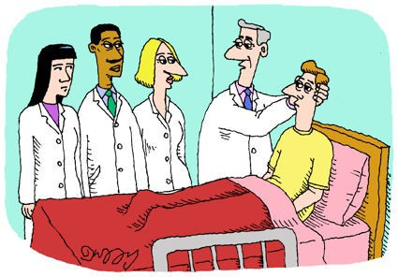
Reasons to suspect PH
Unexplained dyspnea despite multiple diagnostic tests
Typical symptoms (look for Raynaud’s)
Comorbid conditons:
  CREST, liver disease, HIV, sickle cell, OSA
  Family history of PAH
  History of stimulant/anorexigen use

Slide 39
Symptoms of PH
Dyspnea
Fatigue
Near syncope/syncope Chest pain Palpitations
LE edema Hoarseness of voice (Ortners syndrome)
60%
19%
13%
7%
5%
3%
2%

Slide 40
Pathophysiology of ARDS

Slide 41
2016 ARDS epidemiology
ARDS stats
170,000 cases/year
10 percent of ICU patients diagnosed with ARDS
78 percent within 48 hours of admission
23 percent of ventilated patients develop ARDS
  Most develop ARDS within 24 hours of ventilation
Ventilator stats
  - 8 day LOS
  35 percent received >8 ml/kg PBW tidal volumes
  82 percent received <12 PEEP
Cost: $115,000 per hospital stay
Severe ARDS survivors
Ventilator LOS 11 days
ICU LOS 14 days
Hospital LOS 26 days
Bellaini, et al (2017). Epidemiology, patterns of care, and mortality for patients with acute respiratory distress syndrome in intensive care units of 50 countries. Journal of American Medical Association, 315 (8),: 788-800.
Notes:
The above describes a 2017 analysis of ARDS worldwide, 459 ICUs, 50 countries over 4 weeks in Winter 2014- 3022 patients studied
Bellaini, et al (2017) Epidemiology, patterns of care, and mortality for patients with acute respiratory distress syndrome in intensive care units of 50 countries. Journal of American Medical Association, 315 (8), 788-800.
Acute hypoxemic respiratory failure defined: p/f <300, new pulmonary parenchymal xray/CT abnormalities, and ventilator support with continuous CPAP

Slide 42
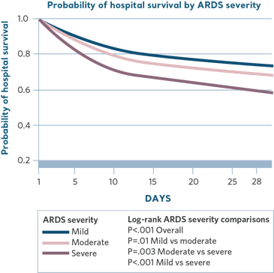
2016 ARDS epidemiology continued
Identification and diagnosis of ARDS is lacking
40 percent of all cases never diagnosed with ARDS
Only 34 percent of ARDS cases being identified when criteria is met
Opportunity to improve outcomes with early identification and intervention
IDENTIFICATION AND DIAGNOSIS OF ARDS IS LACKING
40% of all cases never diagnosed with ARDS
Only 34% of ARDS cases being identified when criteria is met
Opportunity to improve outcomes with early identification and intervention
Bellaini, et al (2017). Epidemiology, patterns of care, and mortality for patients with acute respiratory distress syndrome in intensive care units of 50 countries. Journal of American Medical Association, 315 (8),: 788-800.
Notes:
This table demonstrates the reduction in survivability every additional day a patient has ARDS. 100% survivability at day one, significantly dropping with severe ARDS. Visual representation of early intervention = improved mortality
Bellaini, et al (2017) Epidemiology, patterns of care, and mortality for patients with acute respiratory distress syndrome in intensive care units of 50 countries. Journal of American Medical Association, 315 (8), 788-800.

Slide 43
Causes of ARDS
Direct injury
Pulmonary contusion
Pneumonia
Aspiration of gastric contents
Inhalation of toxins
Pulmonary infection (flu/H1N1)
Oxygen toxicity
Indirect injury
Sepsis syndrome
Multiple transfusions
Trauma
Pancreatitis
Cardiopulmonary bypass
DIC
Bellaini, et al (2017). Epidemiology, patterns of care, and mortality for patients with acute respiratory distress syndrome in intensive care units of 50 countries. Journal of American Medical Association, 315 (8),: 788-800.
2000 ARDSnet study- patient population diagnoses.The New England Journal of Medicine, (342) 18.
Notes:
Pie chart is statistics from the Bellani epidemiology report
Bellaini, et al (2016) Epidemiology, patterns of care, and mortality for patients with acute respiratory distress syndrome in intensive care units of 50 countries. Journal of American Medical Association, 315 (8), 788-800.
http://www.aafp.org/afp/2002/0501/p1823.html
http://www.aafp.org/afp/2003/0115/p315.html
Common causes: 2000 ARDSnet study- patient population diagnoses
http://www.nejm.org/doi/pdf/10.1056/NEJM200005043421801

Slide 44
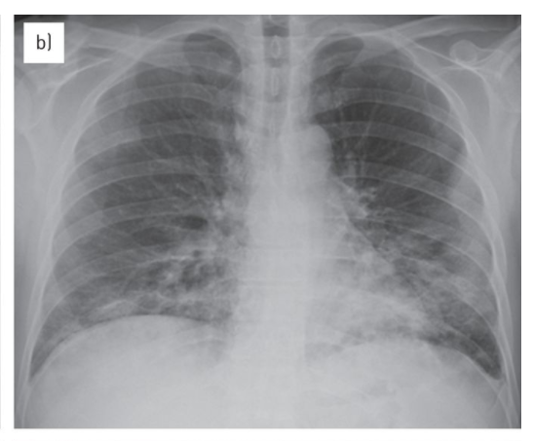
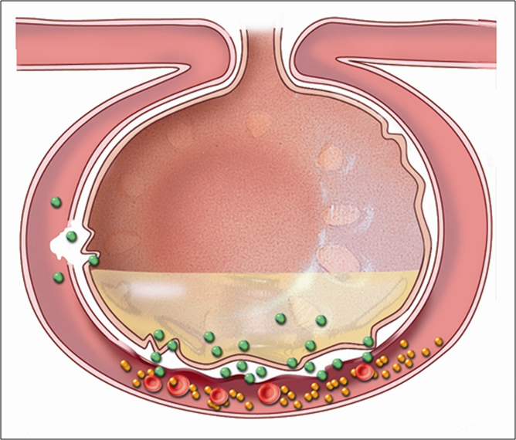
Phases of ARDS
Phase no. 1 – Injury or Exudative
1-7 days post-injury, 50 percent of cases within 24 hours of event
Pathophysiology
Reduced blood flow to lungs
Inflammatory mediator release
Increased capillary permeability
Intrapulmonary shunting begins
Symptoms
Refractory hypoxemia
Increased respiratory rate
Decreased tidal volume
Respiratory alkalosis
CXR infiltrates
Levy, B., Shapiro, S., and Choi., A. Acute Respiratory Distress Syndrome. Critical Care Medicine Chapter 268, retrieved from http://media.axon.es/pdf/83592.pdf
Zompatori, M., Ciccarese, F., and Fasano, L. Overview of current lung imaging in acute respiratory distress syndrome. European Respiratory Review, 2014; 23: 519-530.
Notes:
*****About 50% of patients who develop ARDS do so within 24 hours of the inciting event. 72 hours post event 85% of patients exhibit symptoms***
http://www.aafp.org/afp/2003/0115/p315.html
All patients progress differently through these phases. Please note that some patients may be in stage two much earlier than 7 days.

Slide 45
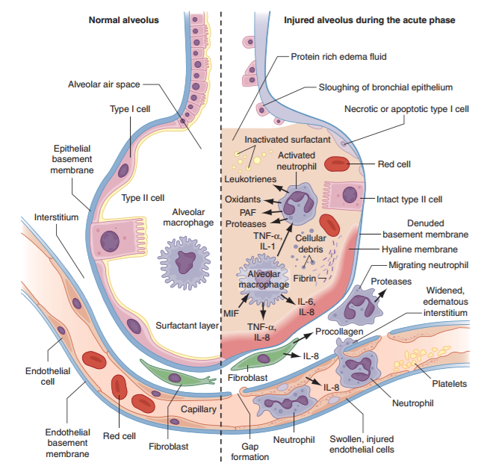
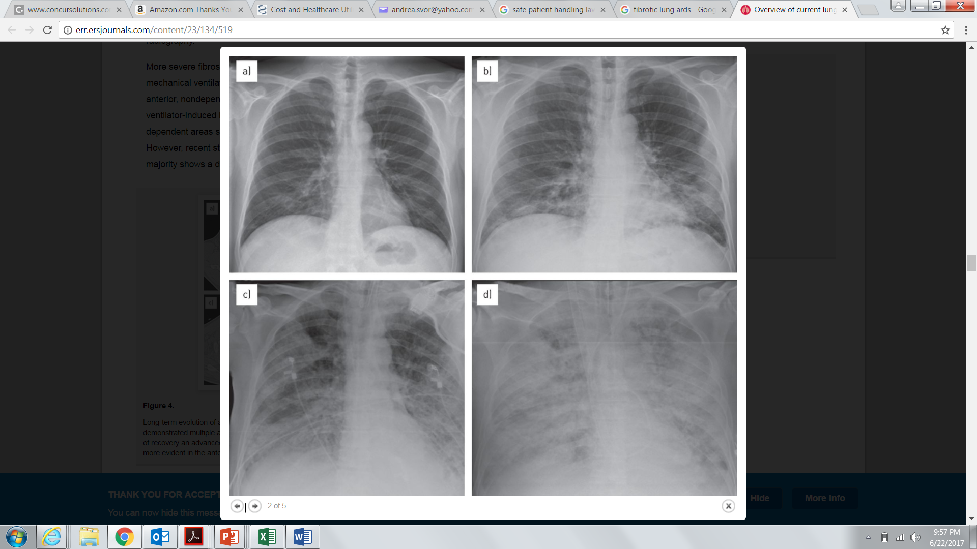
Phases of ARDS
Phase no. 2 – Reparative or Proliferative 1-2 weeks after initial injury
Pathophysiology
Increased capillary permeability
Protein and fluid leakage
Pulmonary edema
Alveolar collapse
Symptoms
Decreased lung compliance
Worsened hypoxia
CXR “white out”
Levy, B., Shapiro, S., and Choi., A. Acute Respiratory Distress Syndrome. Critical Care Medicine Chapter 268, retrieved from http://media.axon.es/pdf/83592.pdf
Zompatori, M., Ciccarese, F., and Fasano, L. Overview of current lung imaging in acute respiratory distress syndrome. European Respiratory Review 2014; 23: 519-530.
Notes:
Ventilator-induced lung injury is initiated by the application of excessive stress and strain to the lung. High levels of mechanical stress and strain that occur when high airway pressures and volumes are delivered can disrupt the pulmonary fibroelastic skeleton (baro or volutrauma). This trauma triggers a secondary response referred to as biotrauma. Moderate degrees of stress and strain related to the cyclic opening and closing of the parts of the lungs causes atelectrauma, which may directly induce the release of inflammatory mediators and noxious proteinases. If reparative phase persists, fibrous tissue results; if this phase is arrested, lesions are able to resolve.
Marini JJ, Gattinoni L. Ventilatory management of acute respiratory distress syndrome: a consensus of two. Crit Care Med 2004;32:250-5

Slide 46
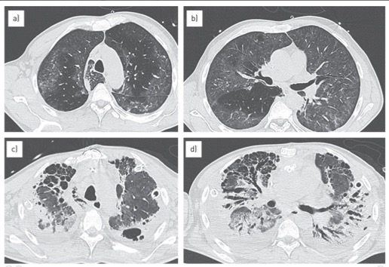
Phases of ARDS
Normal Human Lung Capillaries
Phase no. 3 – Fibrotic or Chronic
2-3 weeks after injury
Pathophysiology
Fibrous tissue throughout lung
Diffuse scarring
Symptoms
Severe acidosis on ABG
Overwhelming hypoxemia
Multi-organ dysfunction (MODS)
Hypotension
Low urine output
Early ARDS
Lung Capillaries – 14 day ARDS
Fibrotic ARDS
Zompatori, M., Ciccarese, F., and Fasano, L. Overview of current lung imaging in acute respiratory distress syndrome. European Respiratory Review, 2014; 23: 519-530.

Slide 47
Calculating PaO₂ / FiO₂ ratio
It is important to consider how much oxygen a patient requires to achieve their PaO₂ on an ABG. The P/F ratio is a very useful tool to monitor your patient’s oxygenation status.
PaO₂ / FiO₂= P/F Ratio
Healthy adult PaO₂ = 80-100 mmHg
Room air = 21 percent oxygen
100/.21 = P/F ratio 476 for a healthy adult
PaO₂
FiO₂
= P/F ratio
European Society of Intensive Care. Medicine, Journal of American Medical Association June 2012: 307 (23).
Notes:
Calculating PF ratio is a great tool for your everyday nursing assessments. While we were taught that a ‘normal’ PaO2 is 80-100, we must think beyond that and consider how much oxygen a patient is taking in to get to that “normal” PaO2. So think about it like this- if your patient is on 40% FiO2 and has a PaO2 of 80, they are requiring TWICE as much oxygen as a healthy person does to get to the same ‘normal’ number.
To calculate a P/F ratio, divide the PaO₂ by the FiO₂. For example:
If normal PaO₂ is 80 – 100 and the FiO₂ at room air is 21%,
100/0.21 = 476
The P/F ratio is 476.
Let’s use 476 as a benchmark for normal. A P/F ratio of around 476 would be an indicator of an efficient exchange of gases.
Let’s do another:
If the PaO2 is 80 and the FiO2 delivered is 40%,
80/0.40
The P/F ratio is 200
A P/F ratio of 200 is indicative of a possible intrapulmonary shunt and possible ARDS if the patient meets other diagnostic criteria.
Consider the amount of oxygen the patient is taking in at 40%. Would you be concerned about this patient? When you consider the fact that the patient is taking in 2 times the amount of oxygen in room air to get to the same number of 80… Calculating P/F can really make a difference in how you view your patients!

Slide 48
2012 Berlin ARDS definition
2012 BERLIN ARDS DEFINITION
 | Mild | Moderate | Severe
Timing | Acute onset within 1 week of known clinical consult or new/worsening symptoms
Hypoxemia | PaO₂ / FiO₂ <300->200 with PEEP ≥ 5 | PaO₂ / FiO₂ <200->100 with PEEP ≥ 5 | PaO₂ / FiO₂ ≤100 with PEEP ≥ 5
Origin of Edema | Respiratory failure not fully explained by cardiac failure or fluid overload objective assessment if no risk factors present
Radiologic Abnormalities | Bilateral chest opacities | Bilateral chest opacities | Opacities involving at least 3 quadrants
Munro, C.L. and Savel, R. H. A, Journal of Critical Care, Sept. 2012. http://ajccjournals.org/content/21/5/305.
European Society of Intensive Care. Medicine, Journal of American Medical Association, June 2012: 307 (23).
Notes:
New definition removed the confusion of ALI vs ARDS and simply calls each type mild, moderate, severe
The limits found included no measurement of PEEP, the lack of standard use of wedge pressure measurement, and the limited description of lung quadrants affected.
The classifications of ALI/ARDS created confusion
A publication was released in the Intensive Care Medicine journal titled, “An attempt to validate the modification of the American-European consensus definition of acute lung injury/acute respiratory distress syndrome by the Berlin definition in a university hospital.” This research with many of the same researchers who were part of the consensus panel and the Professor Guerin research were co-authors.
They assessed 278 patients, of which 18 (6.5%) did not comply with the Berlin criterion of PEEP and Pa02/FiO2 ratios. This study at a single site did not validate the Berlin definition of ARDS. Neither the Pa02/Fi02 or the stratification by severity at study entry was independently associated with mortality. A weakness of the study was “covariates were measured at the time of inclusion and management afterwards was not recorded. Therefore, the multivariate analysis of mortality did not include variables that may impact on patient outcomes, like prone positioning or fluid balance control.
Reference:
Intensive Care Med (2013) 39:2161 – 2170 DOA 10.1007/s00134-013-3122-6

Slide 49
ARDS mortality rates 2012 to 2016
Bellaini, et al (2017). Epidemiology, patterns of care, and mortality for patients with acute respiratory distress syndrome in intensive care units of 50 countries. Journal of American Medical Association,
315 (8): 788-800.
Notes:
REFERENCE:
Amaral, Rubenfeld. The Future of Critical Care. Current Opinion in Critical Care. 2009;15:308-313
Phua, Badia, et al. Has Mortality from Acute Respiratory Distress Syndrome Decreased Over Time. Am Respir Crit Care Med. 2009; 179: 220-227
Johnson, E.R. & Matthay, M.A., Acute Lung Injury: Epidemiology, Pathogenesis, and Treatment. J Aerosol Med Pulm Drug Deliv. 2010 23(4): 243-252.
Epidemiology, Patterns of Care, and Mortality for Patients With Acute Respiratory Distress Syndrome in Intensive Care Units in 50 Countries. JAMA. 2016 Feb 23;315(8):788-800. doi: 10.1001/jama.2016.0291.
www.ncbi.nim.hin.gov/pmc/articles/PMC3133560
http://www.uptodate.com/contents/acute-respiratory-distress-syndrome-prognosis-and-outcomes-in-adults#H3

Slide 50
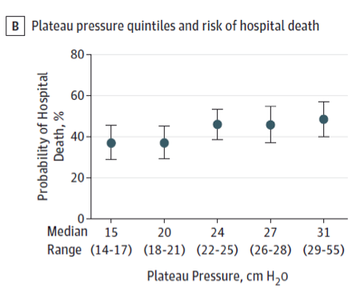
ARDS predictors of mortality
  Severity of hypoxemia
  Infection/sepsis
  Multi-organ dysfunction
  Positive fluid balance
  Age
  Patients with higher plateau pressures have higher risks of death (>20 cm H₂0)
Bellaini, et al (2017). Epidemiology, patterns of care, and mortality for patients with acute respiratory distress syndrome in intensive care units of 50 countries. Journal of American Medical Association, 315 (8): 788-800.
Notes:
The graph represents the relationship between probability of death and plateau pressure. High plateau pressures lead to increased risk for death based on the recent Bellaini ARDS epidemiology study.
REFERENCE:
Amaral, Rubenfeld. The Future of Critical Care. Current Opinion in Critical Care. 2009;15:308-313
Phua, Badia, et al. Has Mortality from Acute Respiratory Distress Syndrome Decreased Over Time. Am Respir Crit Care Med. 2009; 179: 220-227
Johnson, E.R. & Matthay, M.A., Acute Lung Injury: Epidemiology, Pathogenesis, and Treatment. J Aerosol Med Pulm Drug Deliv. 2010 23(4): 243-252.
Epidemiology, Patterns of Care, and Mortality for Patients With Acute Respiratory Distress Syndrome in Intensive Care Units in 50 Countries. JAMA. 2016 Feb 23;315(8):788-800. doi: 10.1001/jama.2016.0291.
www.ncbi.nim.hin.gov/pmc/articles/PMC3133560
Bellaini, et al (2017) Epidemiology, patterns of care, and mortality for patients with acute respiratory distress syndrome in intensive care units of 50 countries. Journal of American Medical Association, 315 (8), 788-800.

Slide 51
P/F ratio calculation
PaO₂
FiO₂
80
.6
Let’s do a quick analysis of an ICU patient diagnosed with pneumonia and recently intubated:
ABG
pH 7.12 PaO₂ 80 HCO₃ 19 CO₂ 60 FiO₂ 80%
What is their P/F ratio and their stage in ARDS?
P/F ratio
133
Moderate
ARDS
Notes:
What is a normal paO2 for ARDS?
What are the considerations

Slide 52
Treatment modalities for ARDS
Low Tidal Volume Ventilation
(4-8ml/kg IBW)
Prone Positioning
IV Steroid
Inhaled Pulmonary Vasodilator
(Nitric/Flolan)
Advanced Ventilatory Management
(APRV/Bilevel/PRVC/HFOV)
Neuromuscular Blockade
Increase PEEP
ECMO
Evidence-based / standard of care
Salvage therapy in ARDS
Physician/facility specific
Notes:
Ask the nurses: do they remember tidal volumes of 800-1000? Most reply yes, but they do not see that anymore, now they see tidal volumes around 400-500. Would be a great time to point out recent evidence showing that even after a large study (ARDSnet) showing low tidal volume as standard of care, that still 35% of patients aren’t receiving the low tidal volume ventilation. May explain why it’s so difficult to change practice even after the great evidence we have seen with pp.
Interesting to note: while low tidal volume is standard of care and has been for years, a recent study (2016 Bellaini) found that 35% of patients with ARDS were ventilated with >8ml/kg tidal volumes, and 83% received PEEP <12!

Slide 53
Why does prone positioning work?
Oxygenation benefits
Ventilation benefits
Cardiovascular benefits
Figure 1. Pelosi, et al. Prone position in acute respiratory distress syndrome. European Respiratory Journal, 2002; 20(4): 1017-1028
Notes:
There are several reasons why prone positioning is a desirable treatment for ARDS. In the next several slides, each of these reasons will be discussed in depth.

Slide 54

What do you do when you are out of breath?
Notes:
Ask the clinicians, what do they do when they’re out of breath? Do they lay flat on their back and breathe out of a straw?
There are many reasons why we use the tripod position to catch our breath- let’s review.

Slide 55
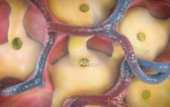

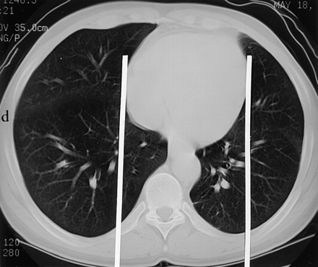
Oxygenation benefits
Shape of the lungs
Dependent fluid accumulation
Alveolar recruitment
Mobilization of secretions
Downward shape of esophagus
Secretions!
~ 75 percent of patients will have an increase in oxygenation in the prone position.
Mackenzie, CF. Anatomy, Physiology, and pathology of the prone position and postural drainage. Critical Care Medicine, 2001;29(5): 1084-1085.
Notes:
Guerin, 2014
The picture of the lung depicts its’ shape supine, imagine the secretions accumulating in that large surface area. Imagine the secretions in the alveoli mobilizing with the position change. The last blue picture depicts the pressure on the alveoli in the supine position, causing compression of the dependent regions of the lung supine.

Slide 56
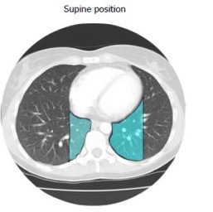
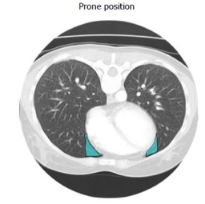
Cardiovascular benefits
Relief of pressure of heart on lungs
    Improved tidal volume
    Reduced pressure on right ventricle
      Supine compression of the lungs from the heart is ~20 percent
      Prone compression of the lungs is ~3.5 percent
Perfusion preferentially directed to dorsal lung regions
Removal of abdominal pressure reduces pressure on vena cava to improve venous return
Murray, T. A. and Patterson, L.A. Prone positioning of trauma patients with acute respiratory distress syndrome and open abdominal incisions. Critical Care Nurse, June 2002; 22 (3): 52-56.
From Cardiopulmonary Anatomy & Physiology 4th edition by DESJARDINS. ©2002. Reprinted with permission of Delmar Learning, a division of Thomson Learning: www.thomsonrights.com. Fax 800 730-2215
Anzueto, A., and Gattinoni, L. Prone position and acute respiratory distress syndrome. Acute Respiratory Distress Syndrome. 2003. New York: Marcel Dekker, Inc.

Slide 57
Physiologic effects prone vs. supine
Supine | Prone
Decreased lung volumes | Increased lung volumes
Accumulation of atelectasis in dependent regions | Facilitation of secretion drainage
Refractory hypoxemia exacerbated by accumulation of secretions in dependent regions of lungs | Increased oxygenation due to mobilization of secretions and alveolar recruitment
Regional and gravitational differences in lungs increase V/Q mismatch and increased stress and strain on the lung | Optimized ventilation due to smaller vertical pleural pressure gradient, increased FRC and more even gas volume distribution
Notes:
Let’s review– is there really any benefit to the supine position in ARDS?
FRC- functional residual capacity- volume of air present in lungs @ end of expiration
Prone- increased FRC related to the relief of pressure on the lungs from the abdomen, relief of pressure on the lung by the heart
All of these effects demonstrate why the prone position is much more beneficial to patients in the supine position. It also demonstrates why patients usually do not tolerate the supine position when they are later in the disease process of ARDS.

Slide 58
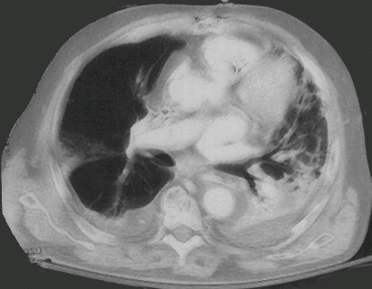
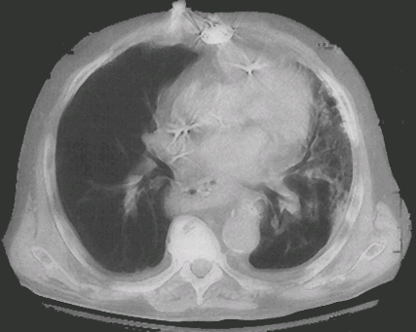
ARDS lung and effect of proning
At enrollment
After 2 days of proning
Images courtesy of Frank Sebat, M.D.
Notes:
Both of these CT scans from Dr. Sebat’s study are the same patient in the supine position -- one at initial enrollment and the second CT scan demonstrating improvement in patient after just 2 days of prone positioning.
Note the size of an ARDS patient’s heart compared to the previous picture of a healthy CT scan. Also note where the secretions develop.

Slide 59
Restrictive lung diseases
Alteration in lung parenchyma.
Diseases of the pleura, chest wall or neuromuscular apparatus.
Physiologically restrictive lung diseases are defined by reduced total lung capacity, vital capacity and functional residual capacity, but with preserved air flow.

Slide 60
Restrictive lung diseases may be divided into the following groups:
Intrinsic lung diseases (diseases of the lung parenchyma)
Extrinsic disorders (extra-parenchymal diseases)

Slide 61
Intrinsic lung diseases
These diseases cause either:
Inflammation and/or scarring of lung tissue (interstitial lung disease)
or
Fill the air spaces with exudate and debris (pneumonitis).
These diseases are classified further according to the etiological factor.

Slide 62
Extrinsic lung disorders
The chest wall, pleura and respiratory muscles are the components of respiratory pump.
Disorders of these structures will cause lung restriction and impair ventilatory function.
These are grouped as:
Non-muscular diseases of the chest wall.
Neuromuscular disorders.

Slide 63
Pathophysiology
Intrinsic lung diseases:
Diffuse parenchymal disorders cause reduction in all lung volumes.
This is produced by excessive elastic recoil of the lungs.
Expiratory flows are reduced in proportion to lung volumes.
Arterial hypoxemia is caused by ventilation/perfusion mismatch.
Impaired diffusion of oxygen will cause exercise- induced desaturation.
Hyperventilation at rest secondary to reflex stimulation.

Slide 64
Extrinsic Disorders
Diseases of the pleura, thoracic cage, decrease compliance of respiratory system.
There is reduction in lung volumes.
Secondarily, atelectasis occurs leading to V/Q mismatch ➜ hypoxemia.
The thoracic cage and neuromuscular structures are a part of respiratory system.
Any disease of these structures will cause restrictive disease and ventilatory dysfunction.

Slide 65
Diseases of the Lung Parenchyma

Slide 66
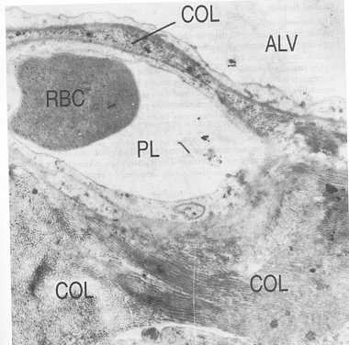
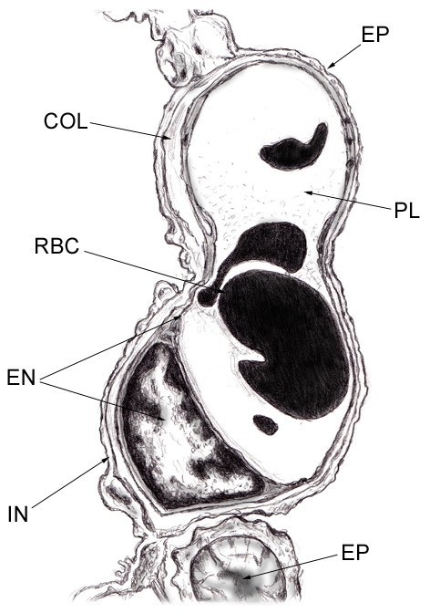
EM in Pulmonary Fibrosis
Structure of the
Alveolar Wall

Slide 67
Diffuse Interstitial Pulmonary Fibrosis
Synonyms: idiopathic pulmonary fibrosis, interstitial pneumonia, cryptogenic fibrosing alveolitis.
Pathology
Thickening of interstitium.
Initially, infiltration with lymphocytes and plasma cells.
Later fibroblasts lay down thick collagen bundles.
These changes occur irregularly within the lung.
Eventually alveolar architecture is destroyed – honeycomb lung

Slide 68
Pathogenesis
Unknown, may be immunological reaction.
Clinical Features
Uncommon disease, affects adults in late middle age.
Progressive exertional dyspnea, later at rest.
Non-productive cough.
Physical examination shows finger clubbing, fine inspiratory crackles throughout both lungs.
Patient may develop respiratory failure terminally.
The disease progresses insidiously, median survival 4-6 years.

Slide 69
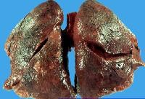
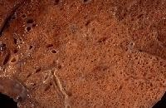

Slide 70
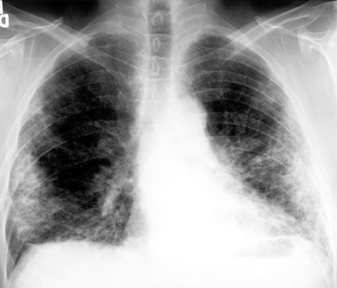

Slide 71
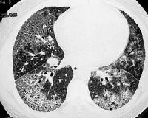
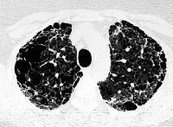

Slide 72
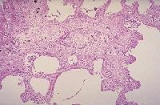
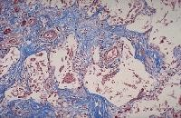

Slide 73
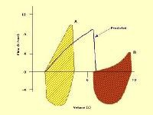
Pulmonary Function
Spirometry reveals a restrictive pattern. FVC is reduced, but FEV₁/FVC
supernormal.
All lung volumes – TLC, FRC, RV – are reduced.
Pressure volume curve of the lung is displaced downward and flattened.

Slide 74
Gas Exchange
Arterial PaO₂ and PaCO₂ are reduced, pH normal.
On exercise PaO₂ decreases dramatically.
Physiologic dead space and physiologic shunt and VQ mismatch are increased.
Diffuse impairment contributes to hypoxemia on exercise.
There is marked reduction in diffusing capacity due to thickening of blood gas barrier and VQ mismatch.

Slide 75
Diagnosis
Diagnosis is often suggested by history, chest radiograph and high resolution CT scan of the lungs.
If old chest x-rays show classical disease, absence of other disease processes on history and no occupational or environmental exposure – clinical diagnosis can be made.
In other cases a surgical lung biopsy is obtained.

Slide 76
Thank you for attention

