Slide 1
E5080 / E0323
Ecotoxicology
Ecotoxicology in Legislative Praxis
Jakub Hofman

Slide 2
Use in praxis

Slide 3
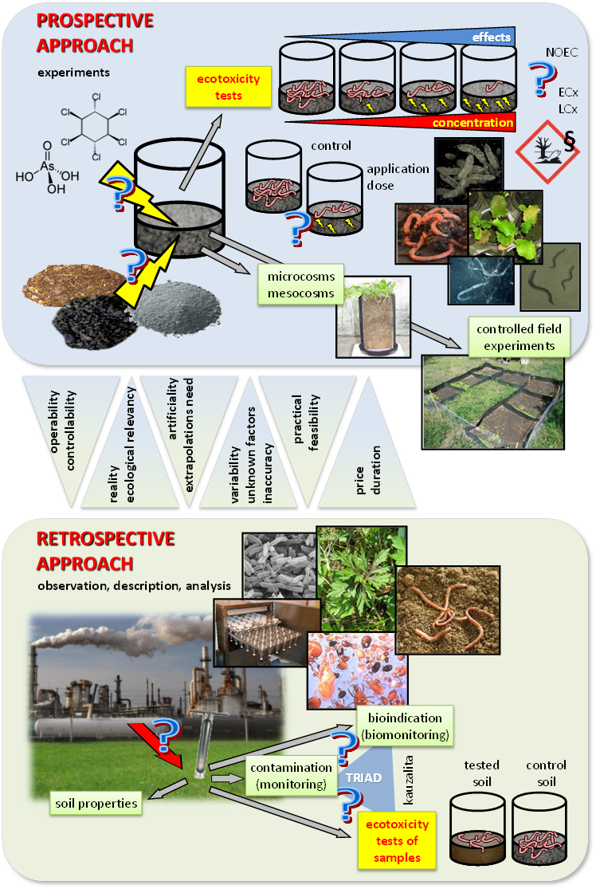
Use of bioassays in praxis
„praxis“ = environmental protection, regulation, legislation ...
use of bioassays depends on: are they officially required by legislation/regulation??
this is changing in time! – legislation development
bioassays are used in both prospective (MORE) and retrospective (LESS) approaches
in prospective approach, very often in concept of RISK ASSESSMENT

Slide 4
Use of bioassays in praxis
mainly for hazard identification / characterization of chemical substances including important specific groups of
pesticides, biocides, pharmaceuticals, cosmetics ...
properties of same chemical (unique CAS No.), including ecotox, are constant
including the setting of limits for pollution
use of bioassays in legislation
less (but increasing) for complex samples (materials) in prospective approach (e.g. before their use) – wastes, sewage sludge, fertilizers etc.
each sample is different (e.g. sewage sludge sampled different days) – new testing needed
legislative use is rare (only national)
less (but increasing) for complex environmental samples (water, soil, sediment ...) in retrospective approach (diagnostics)
legislative use is rare (only national)

Slide 5
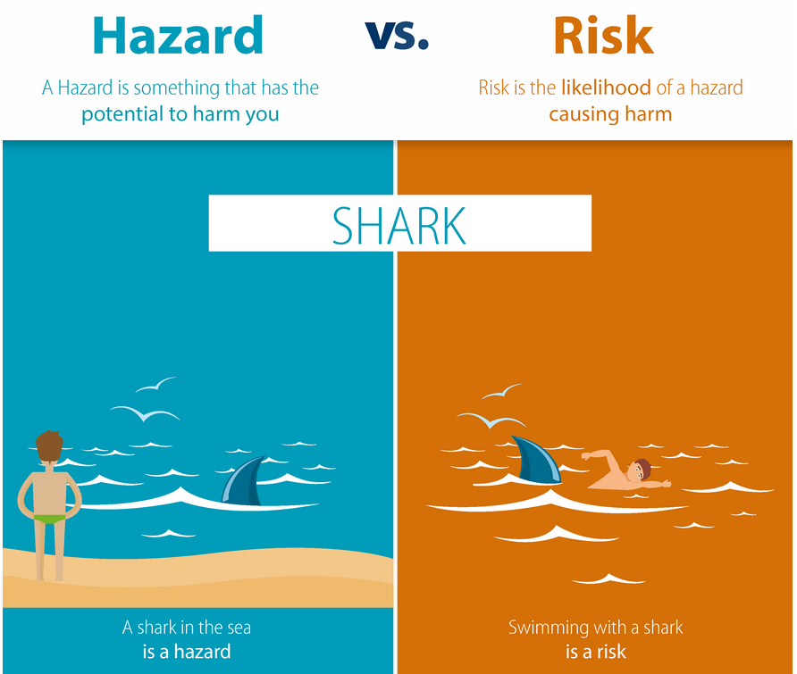
Risk assessment concept
ecotoxicological bioassays are used to quantify HAZARD (i.e. kind of property of chemicals / materials ...)
RISK is then result of combination of hazard and exposure – probability that hazard will occur

Slide 6
Risk assessment concept
HAZARDS
are also physico-chemical and toxicological and other harmful properties
ecotoxicological hazards are derived from the results of bioassays:
direct use of LCx/ECx, NOEC, LOEC ...
tuning these values towards PNEC (Predicted No Effect Concentration), often by the most sensitive result + using so called uncertainty factors

Slide 7
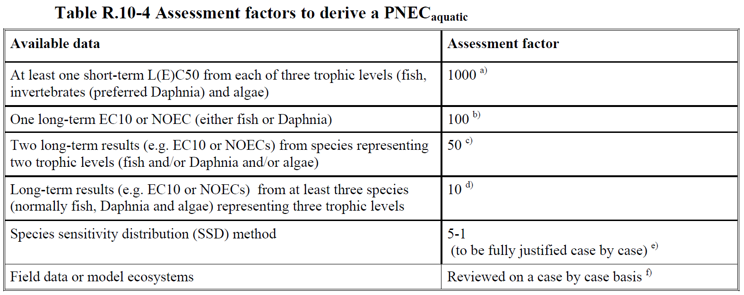
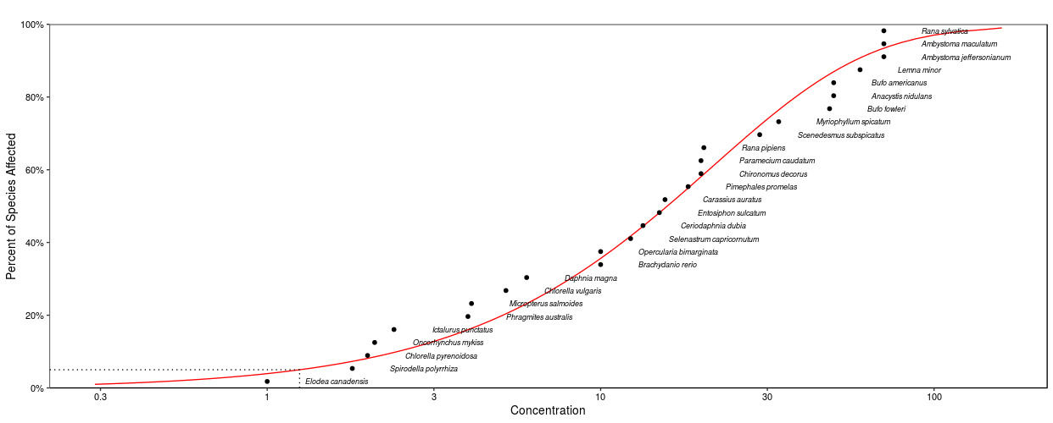
Risk assessment concept
PNEC derivation from ecotoxicity data
objective is to protect real ecosystems, safe concentration
➔ need to extrapolate bioassay results to be valid for ecosystems
how much information we have? → uncertainty factors, 1, 10, 100, 1000
Extrapolation
Species sensitivity distribution (SSD)
ECHA (2008): Guidance on information requirements and chemical safety assessment. Chapter R.10: Characterisation of dose [concentration]-response for environment. https://echa.europa.eu/guidance-documents/guidance-on-information-requirements-and-chemical-safety-assessment
HC5 = 95% protection level
PNEC (limits, EQS)

Slide 8
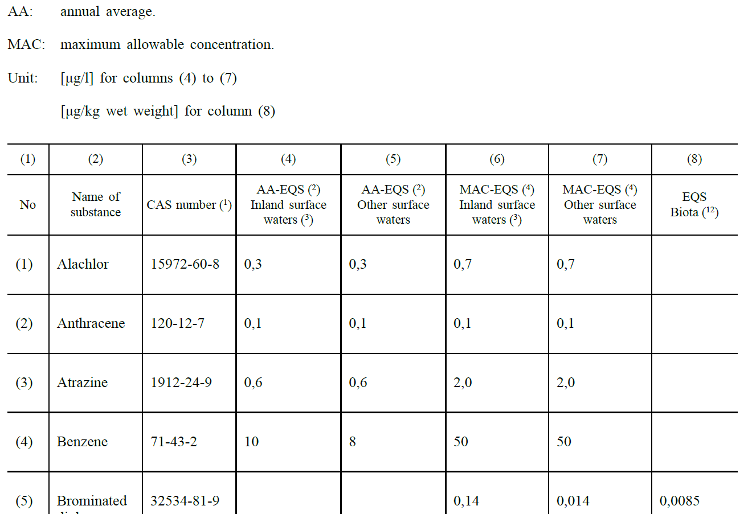

Risk assessment concept
$$HQ=\frac{PEC}{PNEC}$$
Use of PNECs
to assess RISKs in combination with exposure data
see next slides
to derive safe limits for environmental concentrations of pollutants – Environmental Quality Standards (EQS)
e.g. EQS in EU Water Framework Directive
https://eur-lex.europa.eu/legal-content/EN/TXT/?uri=CELEX%3A02008L0105-20130913

Slide 9
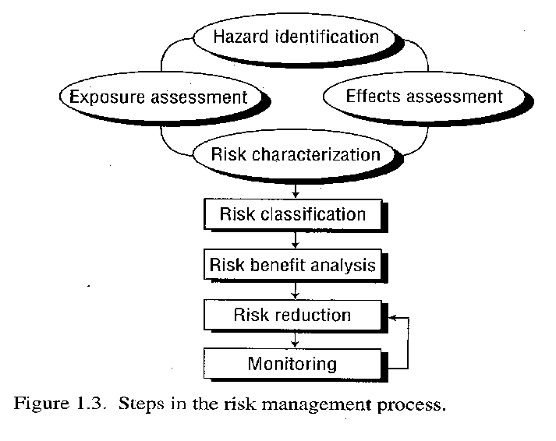
Risk assessment concept
RISK
combines by some way
EFFECT data (LCx/ECx, NOEC, NOAEL, PNEC etc.)
with EXPOSURE (Predicted Environmental Concentration – PEC, Measured Environmental Concentration – MEC, etc.)
depends on situation (factors)
can be mitigated and managed

Slide 10
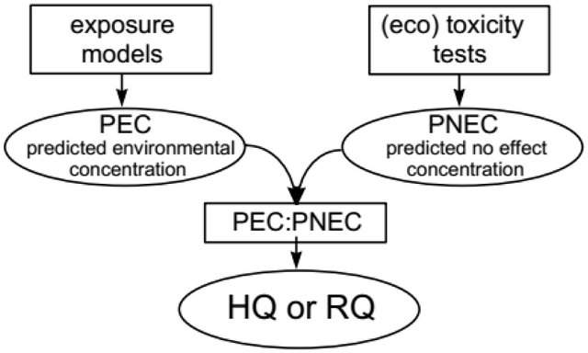
Risk assessment concept
RISK
different expressions:
  hazard or risk quotient (HQ or RQ)
  TER – toxicity / exposure ratio

Slide 11
Risk assessment concept
human health risk assessment (HHRA) – human health as endpoint
ecological risk assessment (EcoRA, ERA) – ecosystems, non-human organisms and populations as endpoints
environmental risk assessment (ERA) – unclear term, involves both

Slide 12
Battery of bioassays

Slide 13
Battery of bioassays
different organisms give different response to toxicants (sensitivity, bioavailability, exposure, metabolization ...) and also different conditions and factors in different bioassays
none single bioassay can give complete response !!
usually it is very good to combine more bioassays together = battery
more and „better“ (e.g. chronic preferably to acute) bioassays used ➔ lower uncertainty of the finally derived hazard and risk of the tested chemical substance (lower „uncertainty factors“ in risk assessment used)
selection should follow defined final goal of the ecotoxicity testing

Slide 14
Battery of bioassays
different approaches (different purposes/legislation needs) how to do it:
combine bioassays based on some principle
e.g. golden rule = combine trophic levels: a) producer (plants), b) consumer (invertebrates, vertebrates), c) destruent (microbes)
+ also combine different routes of exposure, test duration etc.
mix scientific principle (1) with practical demands (low number of tests, quick, cheap, standardized tests ... etc.) - most common batteries in praxis:
  algae / D. magna / fish for aquatic environment
  earthworm (enchytraeid/springtail) / plant for soil environment
tiered approach = based on the results of previous tier its decided if next (and what next) testing will be done:
fast screening bioassays → standardized acute bioassays → chronic/prolonged studies → field tests (so called higher tiers)

Slide 15
Battery of bioassays
Example: ISO guidelines showing how to combine bioassays for testing soils and soil-like materials
ISO 15799: Guidance on the ecotoxicological characterization of soils and soil materials
ISO 17616: Guidance on the choice and evaluation of bioassays for ecotoxicological characterization of soils and soil materials

Slide 16
Battery of bioassays
Example: Battery prepared for testing ecotoxicity of wastes
current situation:
  https://ec.europa.eu/environment/waste/index.htm
  Directive 2008/98/EC on waste (Waste Framework Directive)
  https://eur-lex.europa.eu/legal-content/EN/TXT/?uri=CELEX%3A02008L0098-20180705
  H14 Ecotoxicity is one of the hazardous properties of wastes
  it is assessed based on the analysis of wastes and database data
  no real testing with bioassays

Slide 17

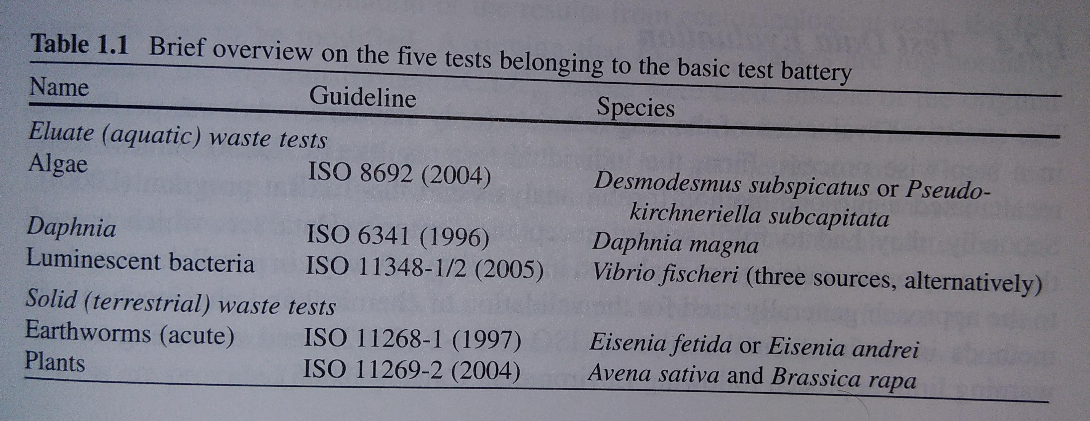
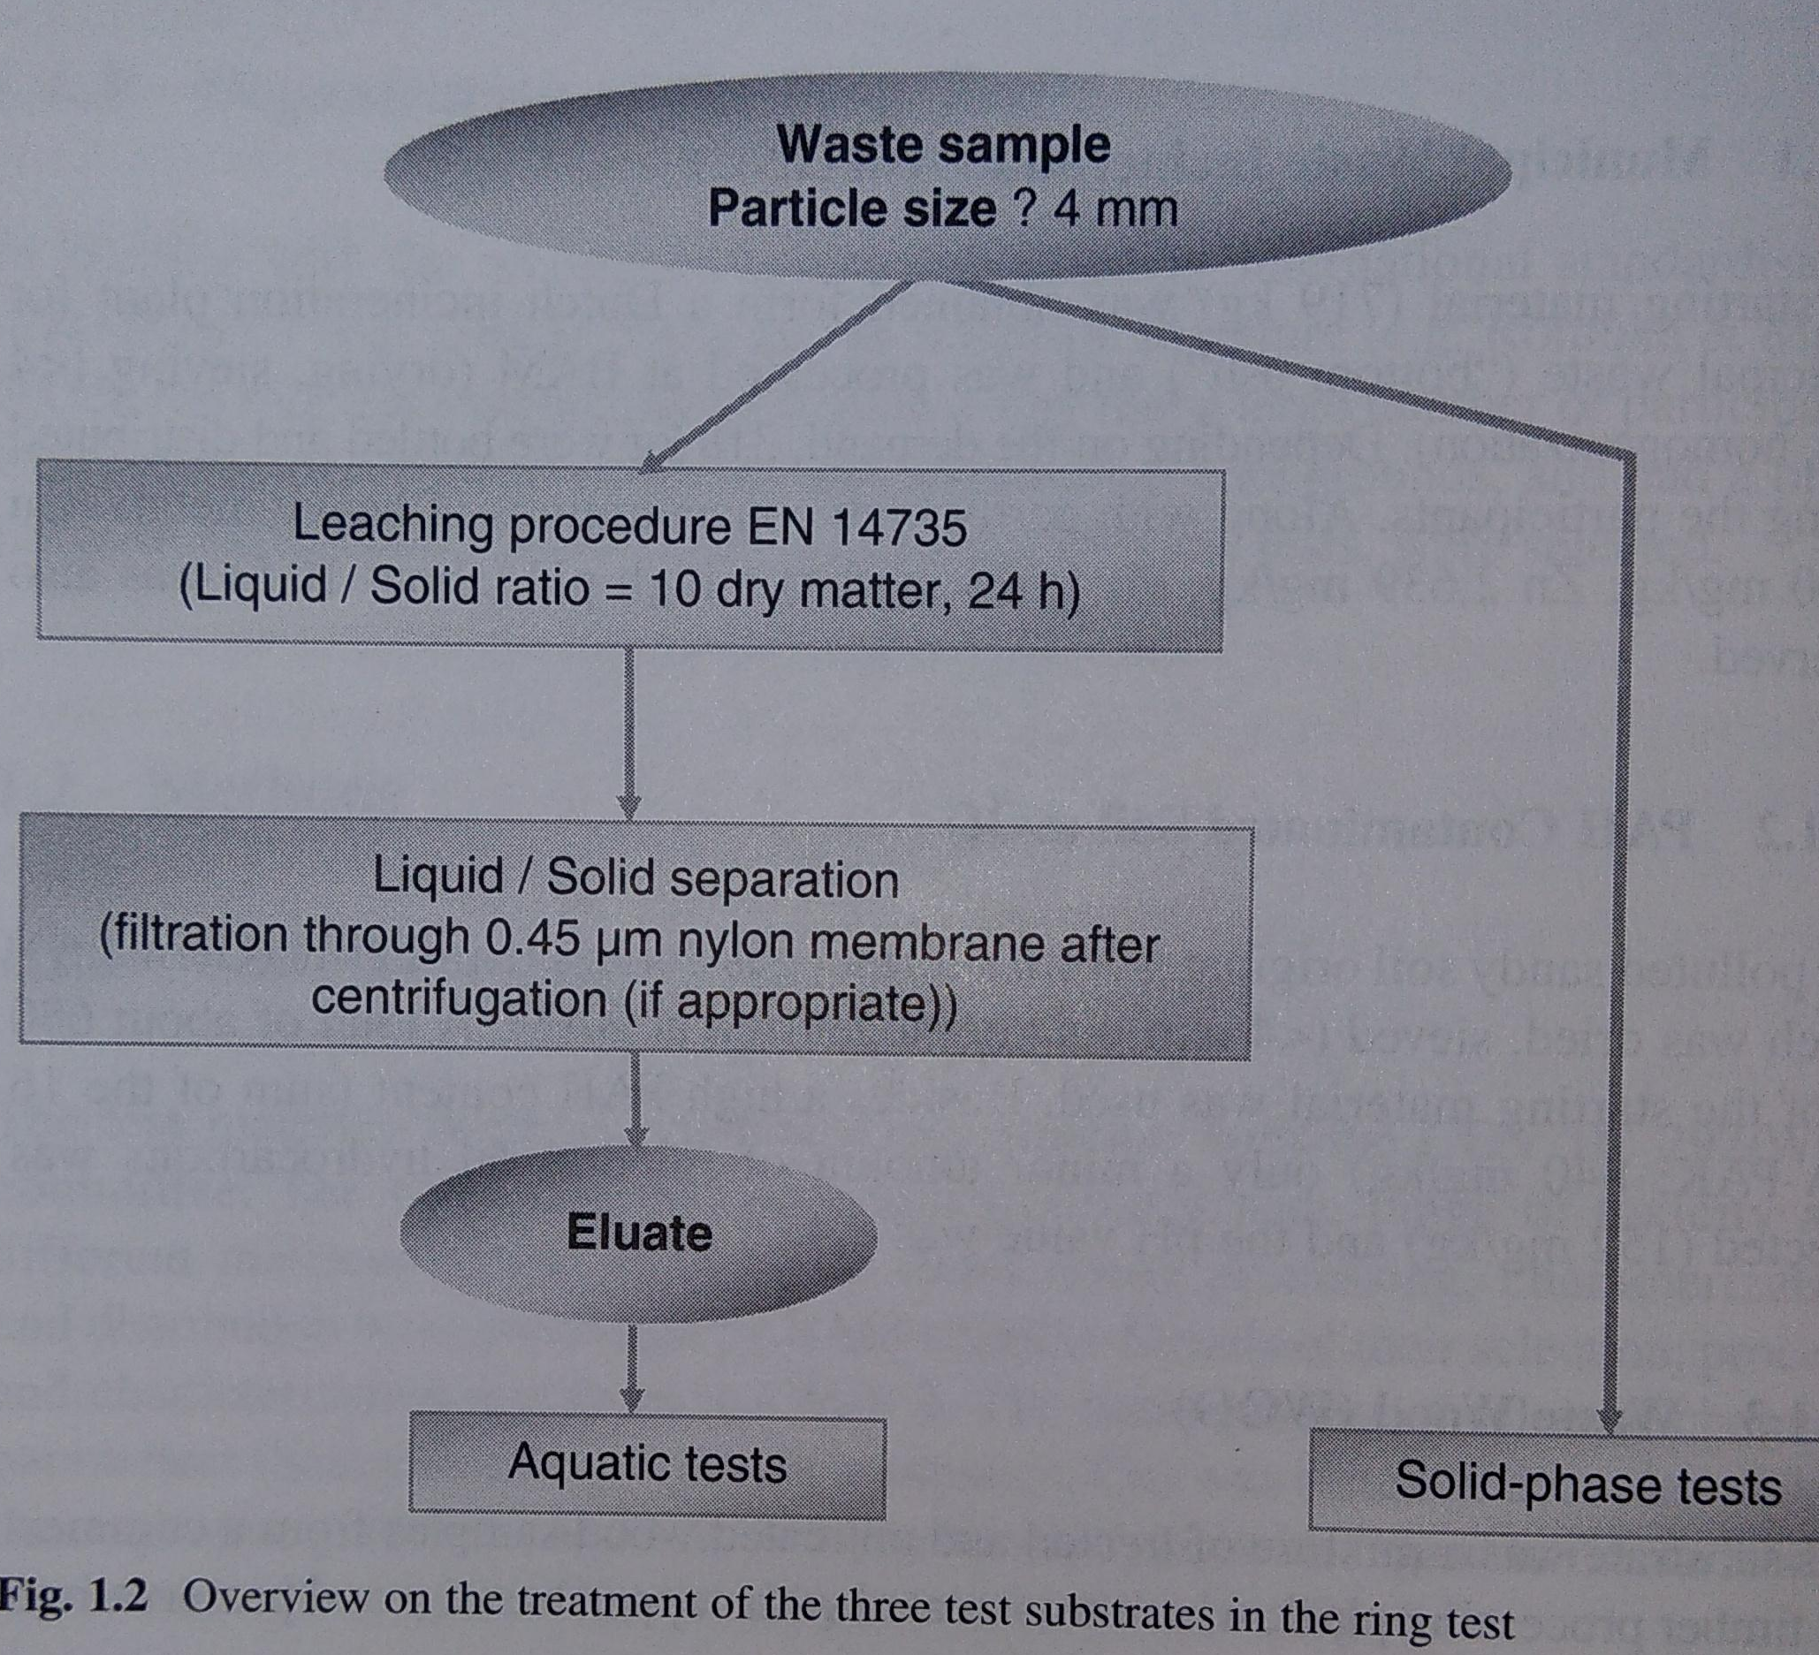
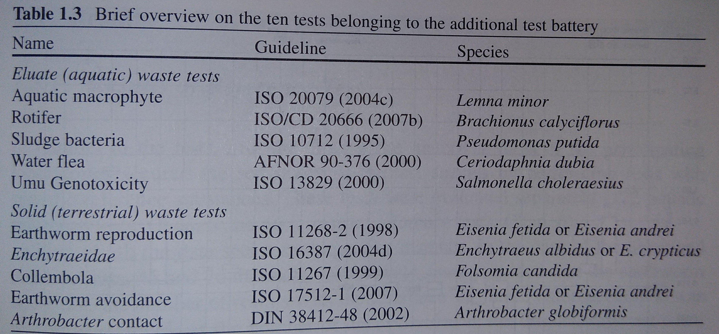
Battery of bioassays
Example: Battery prepared for testing ecotoxicity of wastes
there was huge ringtest focused on selection of appropriate bioassays
for testing wastes (13 countries, 59 labs, 500 kg of waste tested ...)

Slide 18
Battery of bioassays
Example: Czech legislation for waste
H14 Ecotoxicity hazardous property determination (decree 376/2001):
  waste eluate 10 L/kg (EN 12457-4)
  if any of these tests has LC(EC,IC)₅₀ ≤ 10 ml/L, the waste sample is H14
    ISO 6341 Daphnia magna acute
    ISO 8692 Algae growth
    ISO 7346-2 Fish acute test
    mustard Sinapsis alba germination and root growth

Slide 19
Battery of bioassays
Example: Czech legislation for waste
ecotoxicity testing for waste use on land surface or landfilling (decree 294/2005):
  waste eluate 10 L/kg (EN 12457-4)
  use of waste for for closing landfills, forming protective layer, sealing layer or reclamation layer of landfill is allowed if:
    Fish acute test: no mortality or behavior change
    Daphnia magna acute test: < 30% imobilization compatred to control
    Algae growth test: < 30% inhibition compared to control
    Sinapis alba germination and root elongation: < 30% inhibition compared to control

Slide 20
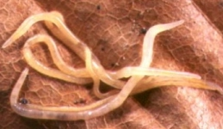
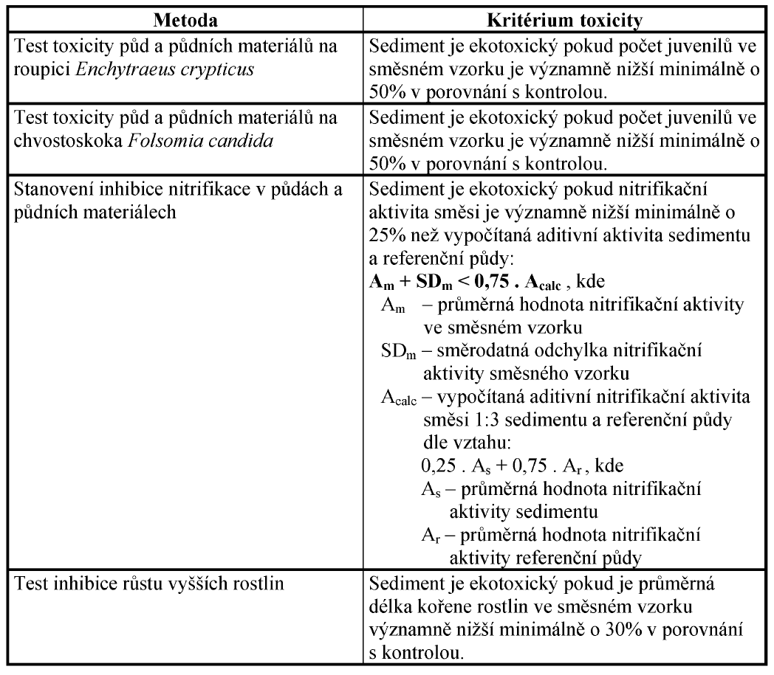
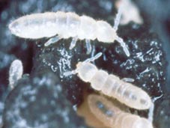
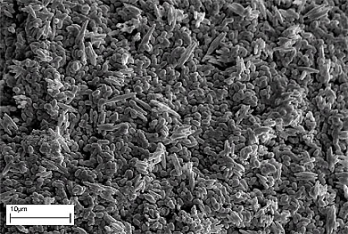
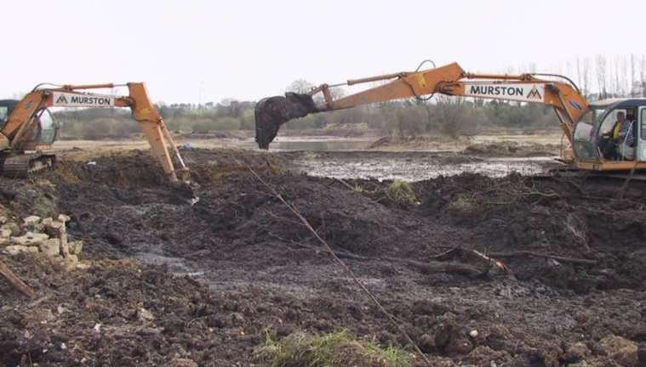
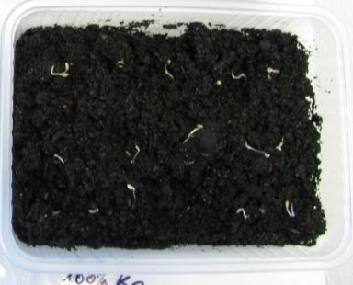
Battery of bioassays
Example: Czech legislation for dredged sediments
before application on agricultural land
limits are given for concentration of pollutants
ecotoxicity bioassays and criteria are given
ISO 16387
ISO 11267
ISO 15685
11269-1

Slide 21
Examples of ecotoxicity bioassays use in legislation

Slide 22
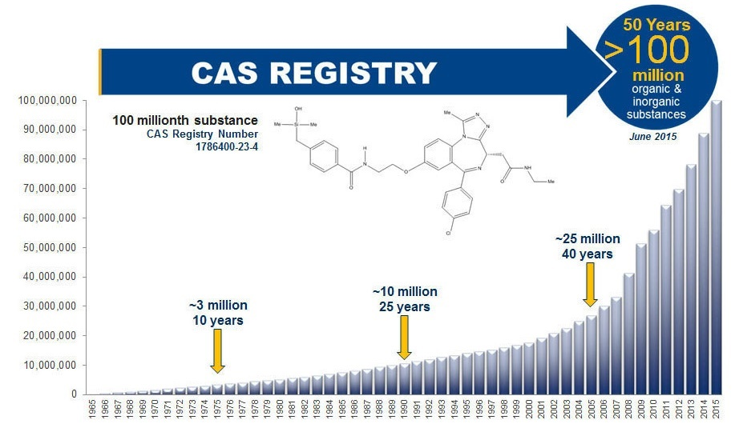
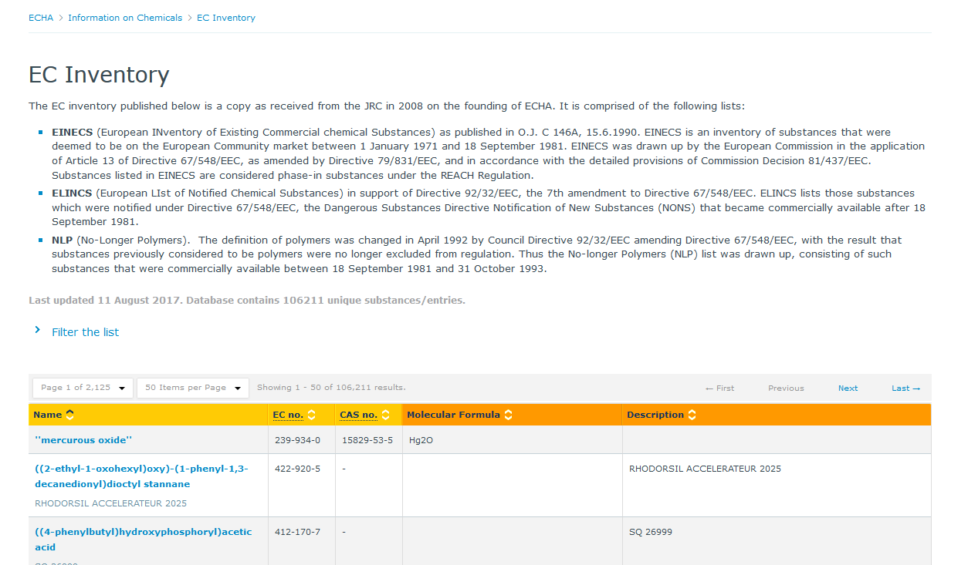
Testing of chemical substances
mainly „chemicals“ – they have CAS No.
> 100 millions of chemicals known
> 100 000 we produce and use
HPVC = high production volume chemicals > 1000 t/y production
„priority pollutants“ – e.g. Water Framework Directive, Stockholm Convention ...
https://echa.europa.eu/cs/information-on-chemicals/ec-inventory

Slide 23
Testing of chemical substances
developed legislation (EU, US ...) requires determination of ecotoxicity (+ lot of other properties – phys-chem, toxicity ...) before marketing and use of chemicals
what does it mean:
  precise testing using standardized (OECD ...) bioassays in accredited labs with all validity requirements and quality assurance / quality control (QA/QC) measures
  results of ecotoxicity clearly expressed avoiding any confusion or missinterpretation:
    what parameter – ECx/LCx, NOEC ...
    which units – mg/L, mol/L, mg/kg, % ...
    specify clearly possible variants in procedure: i.e. D. magna, 24h, LC50 = XY mg/L
    ...
  results used for risk assessment of chemicals, labelling, decision making, authorizations, restrictions, management etc.

Slide 24

Example 1
Labelling chemicals - GHS

Slide 25
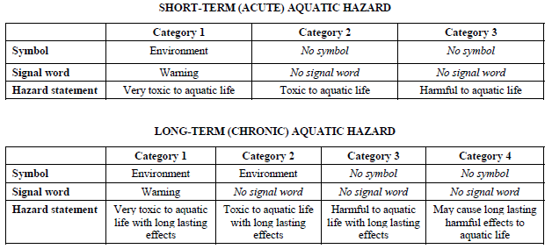
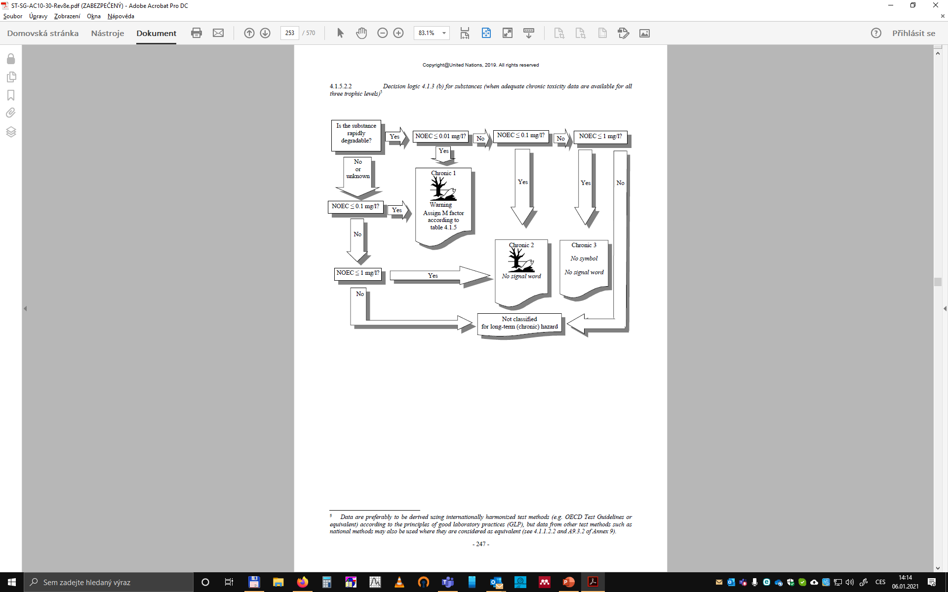
GHS
Globally Harmonised System of Classification and Labelling of Chemicals (https://unece.org/about-ghs)
„hazardous to aquatic environment“
OECD tests preferred and GLP (good laboratory praxis) should be followed
  acute aquatic toxicity
  chronic aquatic toxicity
  potential for or actual bioaccumulation
  degradation (biotic or abiotic) for organic chemicals

Slide 26
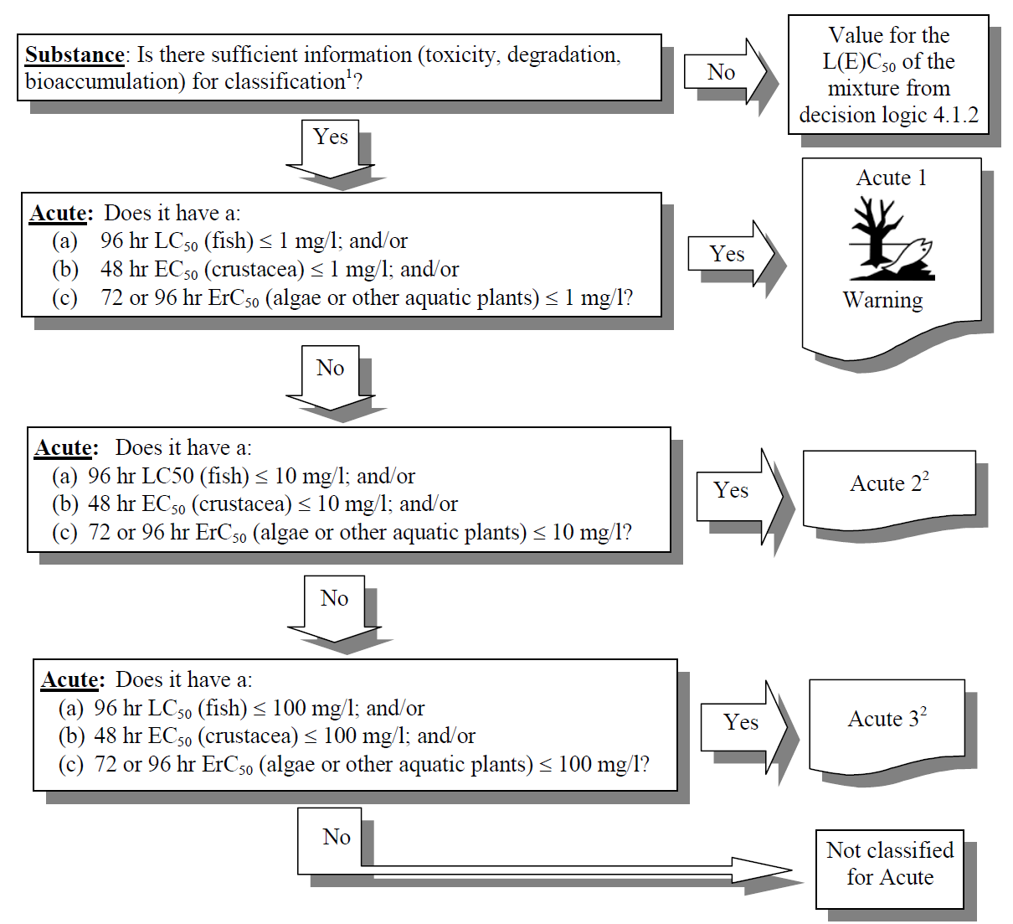
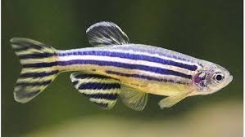
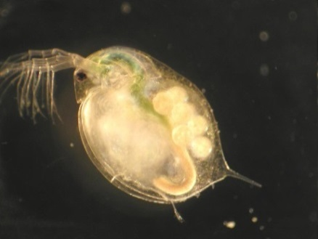
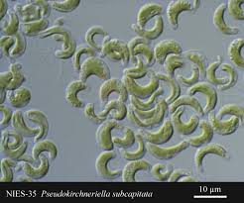
GHS
Acute classification categories 1 to 3
defined on the basis of the acute toxicity data only (EC50 or LC50)
  fish 96h (OECD 203)
  Daphnia 48h (OECD 202)
  algae growth inhibition test (OECD 201)
United Nations (2019): Globally Harmonized System of Classification and Labelling of Chemicals (GHS). Eighth revised edition. https://unece.org/ghs-rev8-2019

Slide 27
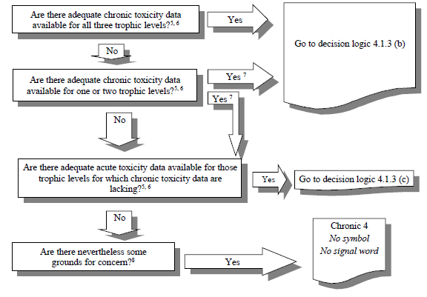
GHS
Chronic classification categories 1 to 3
based on tiered approach ➔
  available information on chronic toxicity
    fish early life stage (OECD 210)
    daphnia reproduction (OECD 211)
    algae growth inhibition test (OECD 201)
    NOEC or ECx (e.g. EC₁₀)
  or acute toxicity data combined with
  environmental fate data
next page
next page
United Nations (2019): Globally Harmonized System of Classification and Labelling of Chemicals (GHS). Eighth revised edition. https://unece.org/ghs-rev8-2019

Slide 28
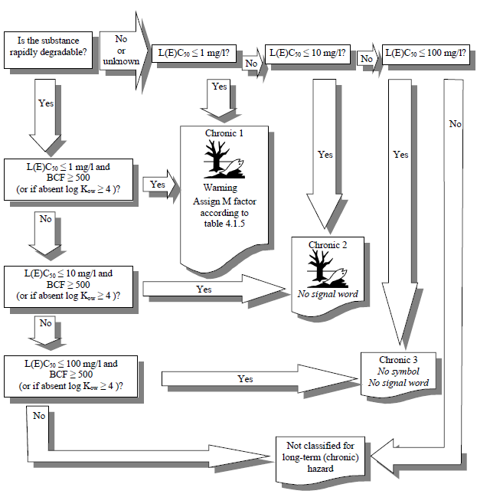
GHS
chronic classification
data available data unavailable
United Nations (2019): Globally Harmonized System of Classification and Labelling of Chemicals (GHS). Eighth revised edition. https://unece.org/ghs-rev8-2019

Slide 29
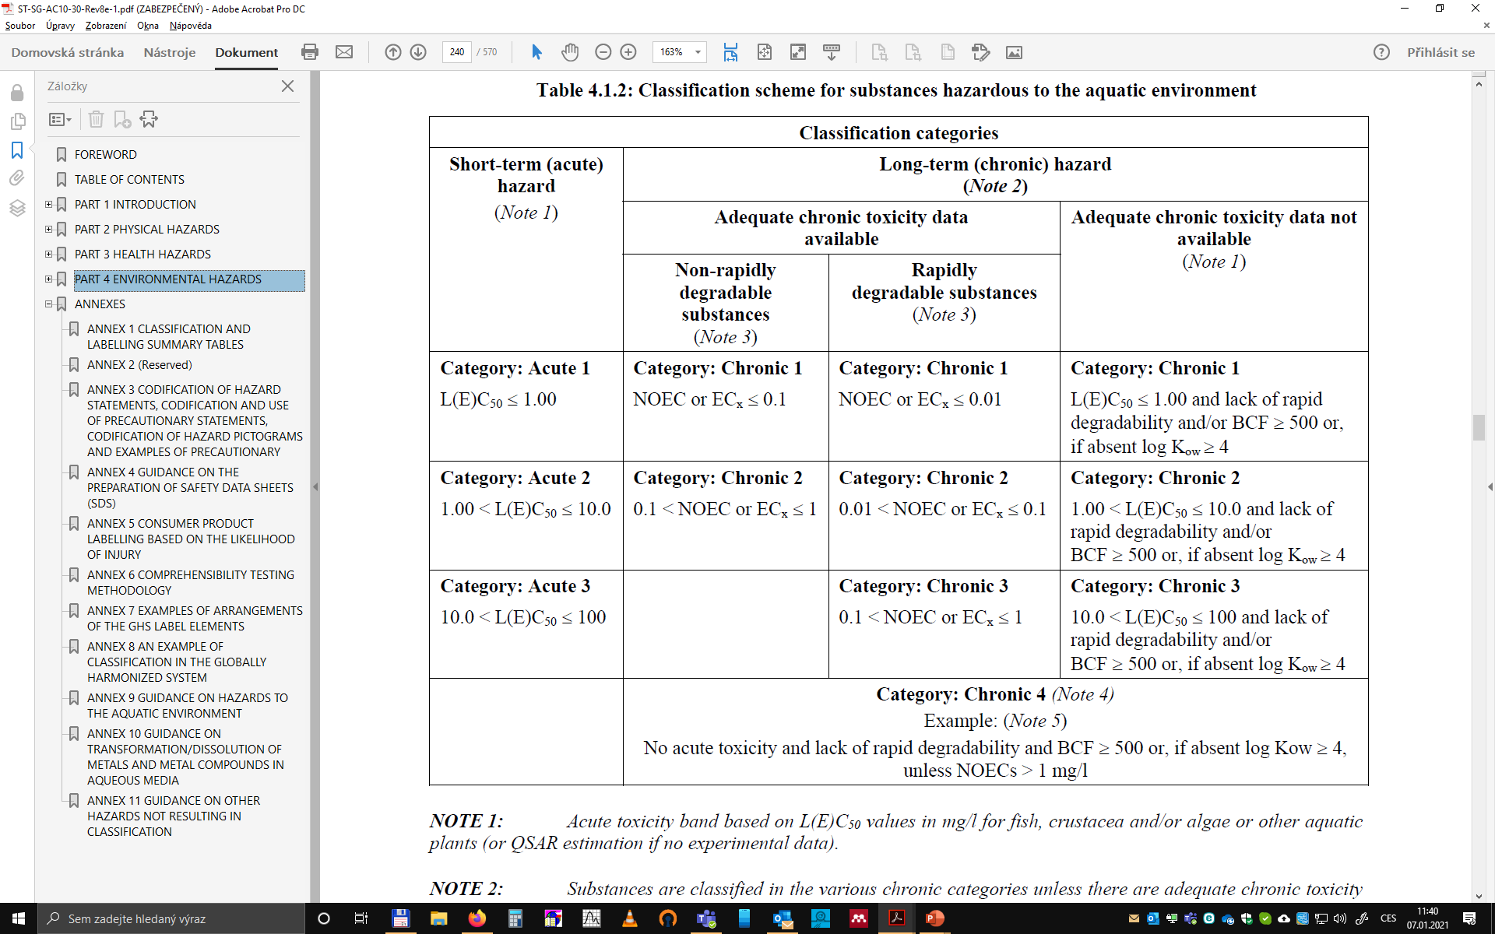
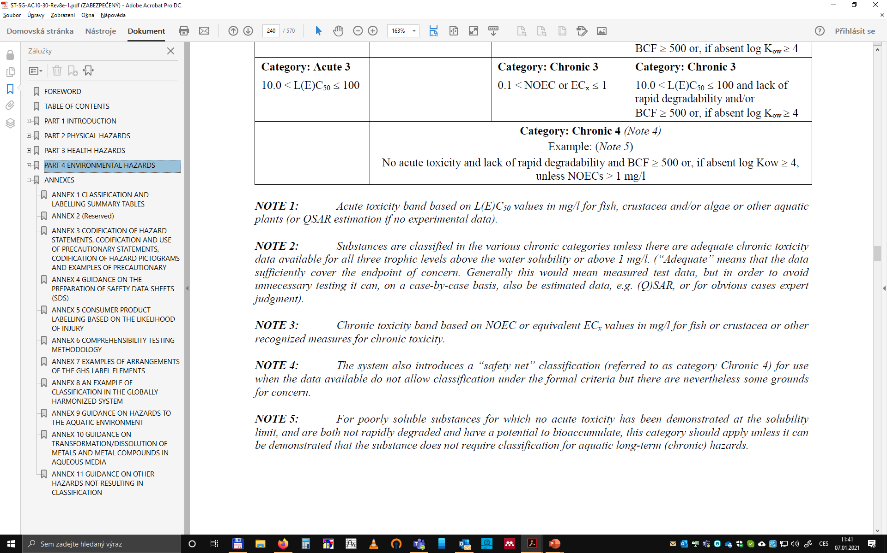
GHS
aquatic hazards summary
United Nations (2019): Globally Harmonized System of Classification and Labelling of Chemicals (GHS). Eighth revised edition. https://unece.org/ghs-rev8-2019

Slide 30

Example 2
Chemicals – in EU

Slide 31

REACH
https://ec.europa.eu/environment/chemicals/index_en.htm
Regulation 1907/2006, concerning the Registration, Evaluation, Authorisation and Restriction of Chemicals (REACH)
https://eur-lex.europa.eu/legal-content/EN/TXT/?uri=CELEX%3A02006R1907-20200824
responsible is European Chemicals Agency (ECHA) https://echa.europa.eu/home

Slide 32
REACH
REACH allows to produce and use in EU only such chemical substances that are registered, evaluated and authorized in EU (does not apply to substances with production or import below 1 t/y)
the risk they may pose to human health and the environment must be characterized and they must be classified accordingly
registration is based on technical dossier, which includes data on the properties of the registered substance determined by defined testing procedures
Regulation No 440/2008, laying down test methods pursuant to Regulation No 1907/2006 (REACH)
https://eur-lex.europa.eu/legal-content/EN/TXT/?uri=CELEX%3A02008R0440-20191016
for substances with production or import > 10 t/y also Chemical Safety Report (CSR) must be prepared involving evaluation of hazards and risks related to production and use
concept: with increasing volume of production (1, 10, 100 and 1000 t/y) number of needed data (methods, tests, including ecotoxicity bioassays) is increasing

Slide 33
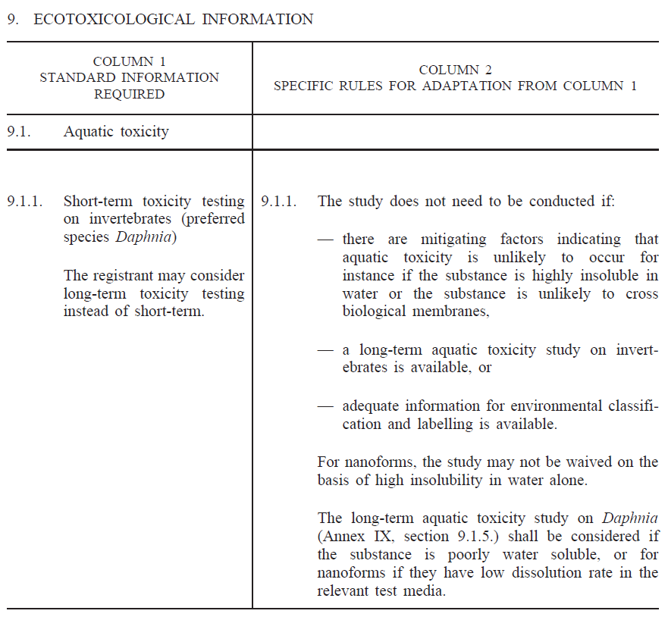
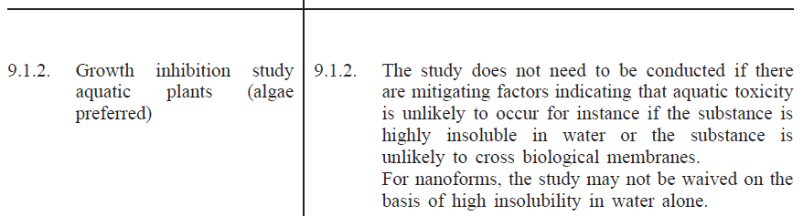
REACH
all substances > 1 t/y

Slide 34
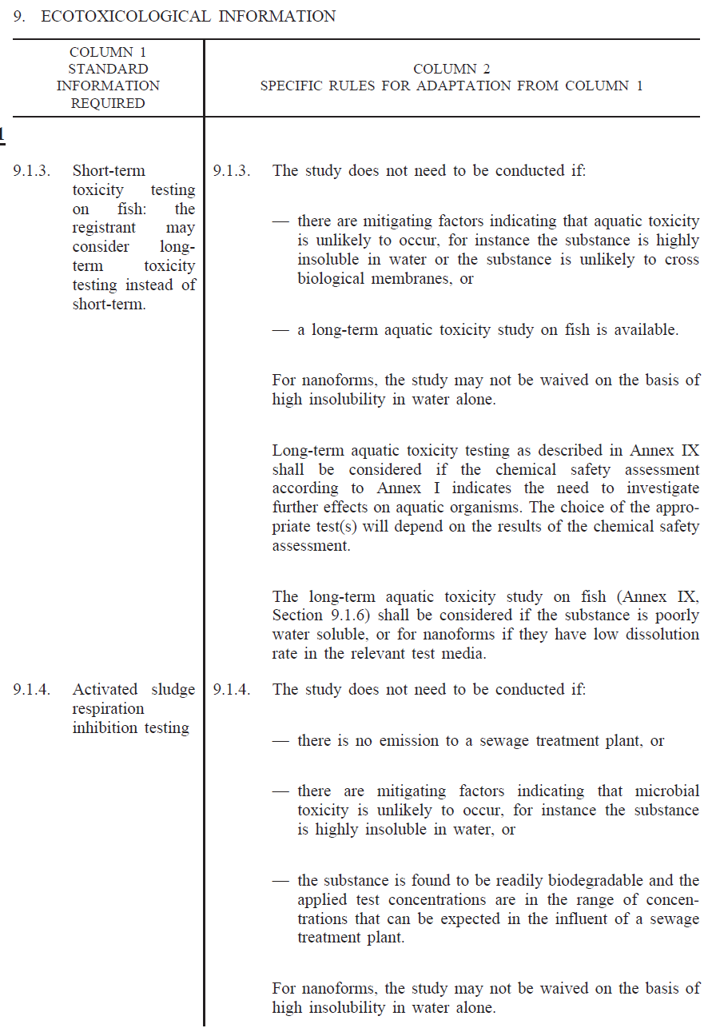
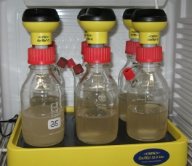
REACH
all substances > 10 t/y

Slide 35
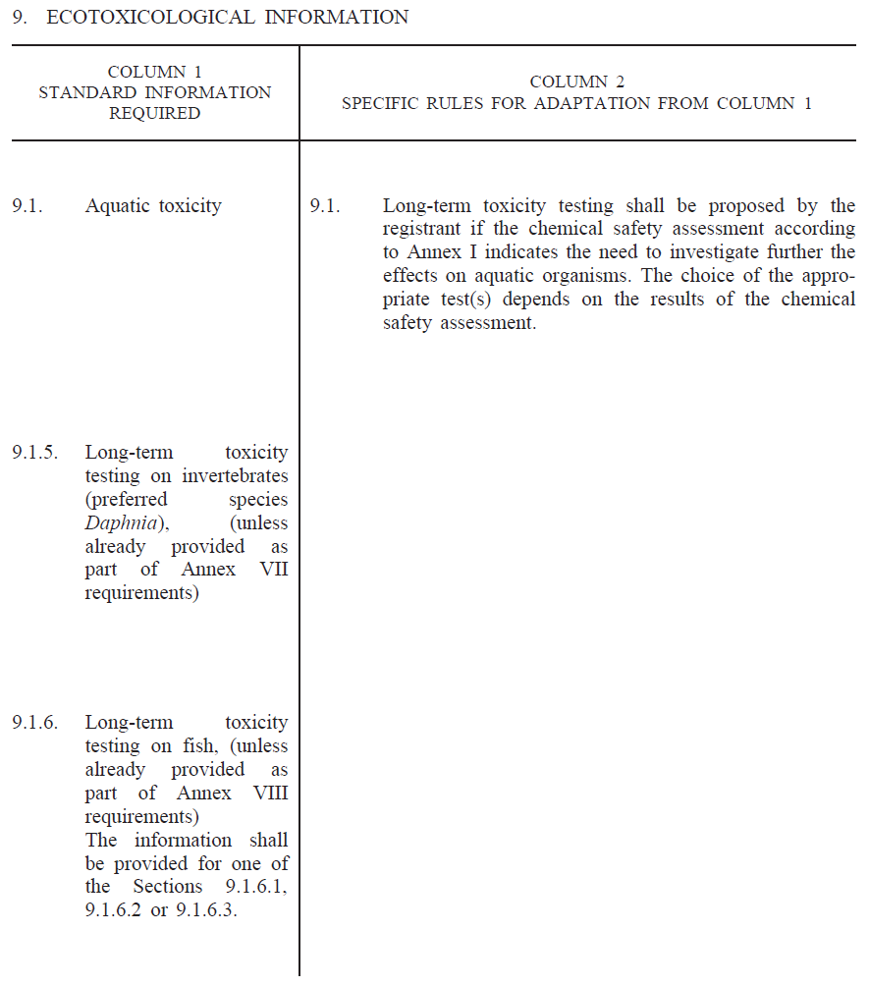
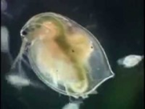
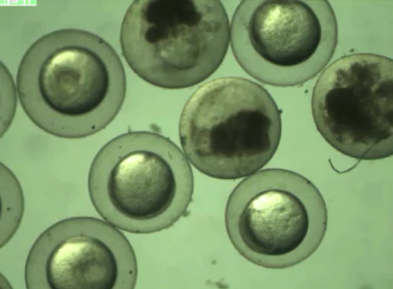
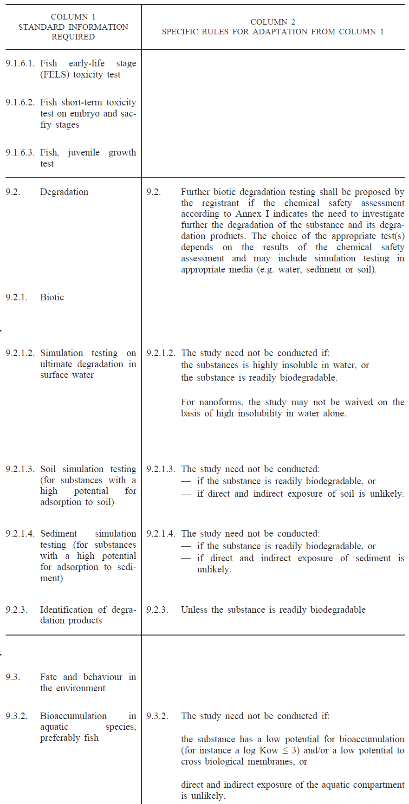
REACH
all substances > 100 t/y

Slide 36
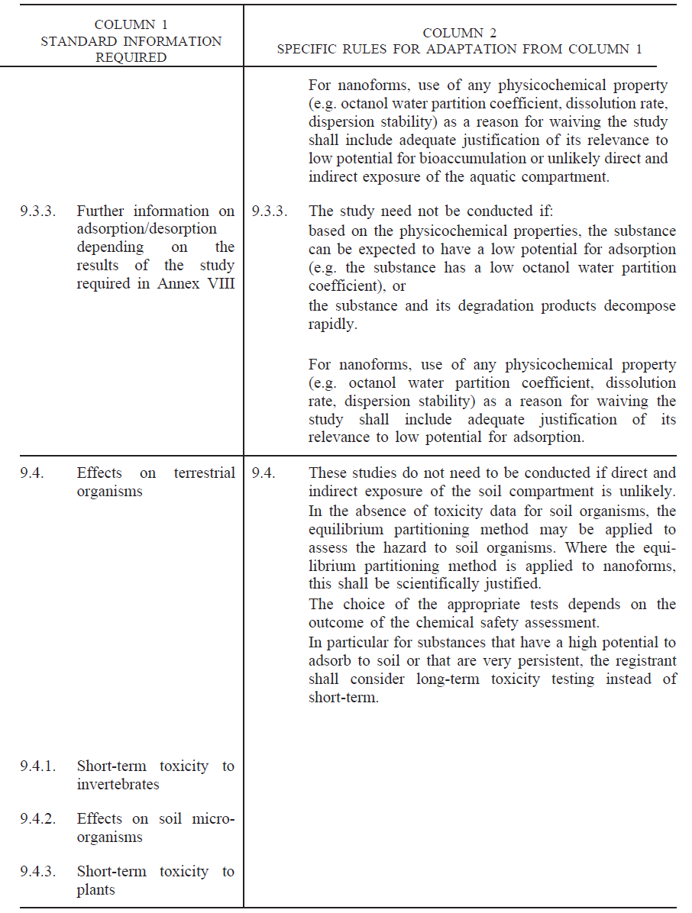
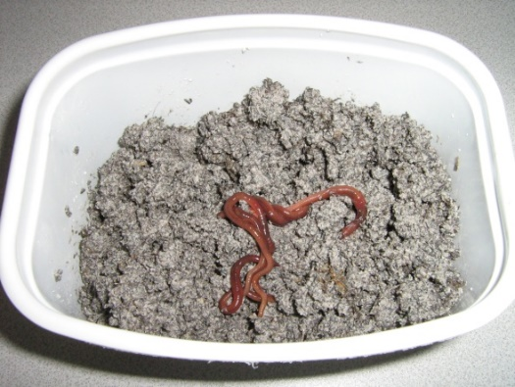
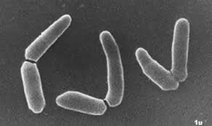
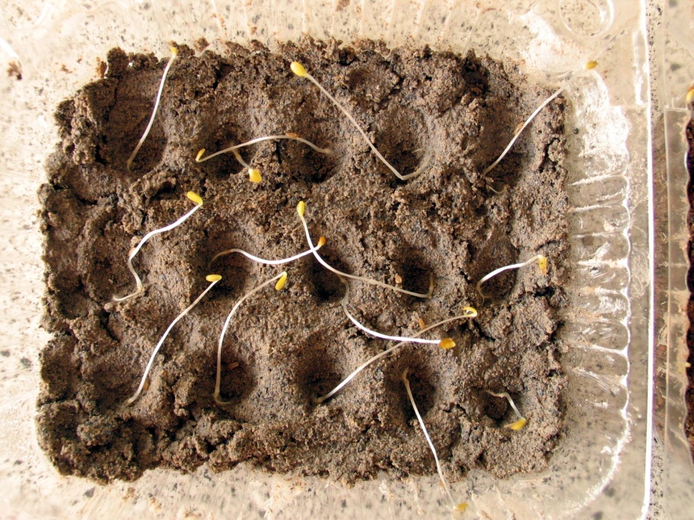
REACH
all substances > 100 t/y

Slide 37
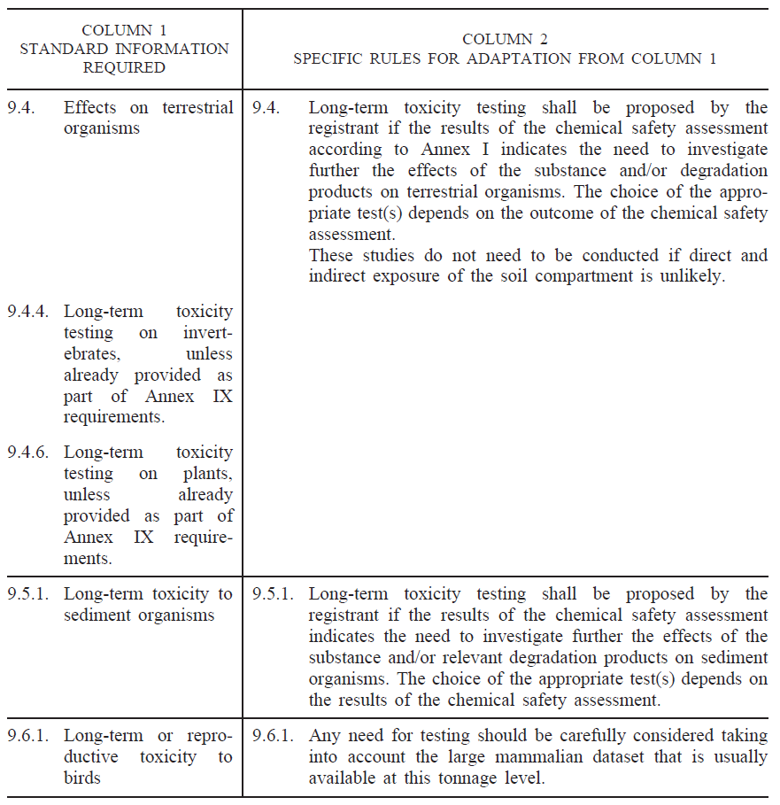
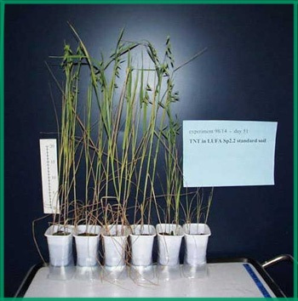
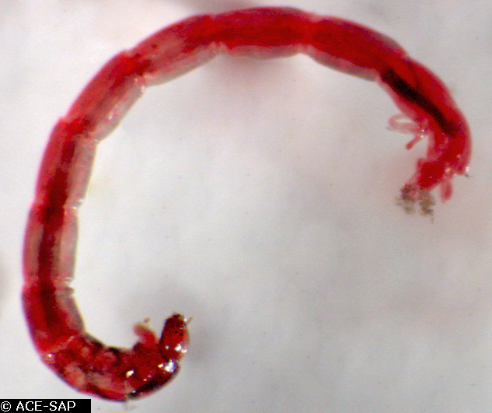
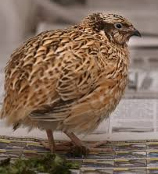
REACH
all substances > 1000 t/y

Slide 38
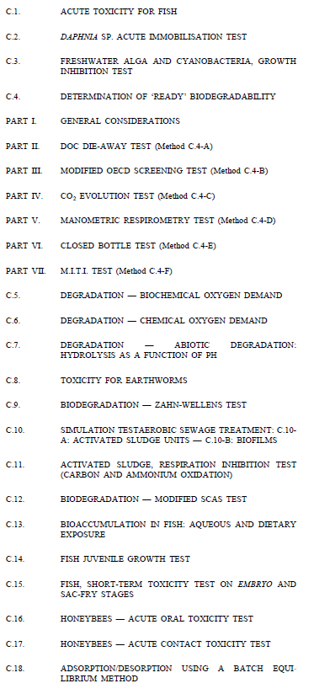
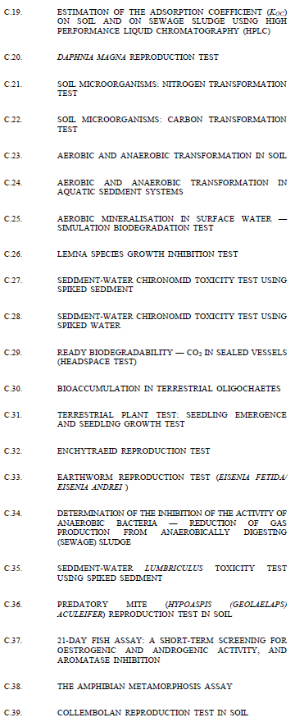
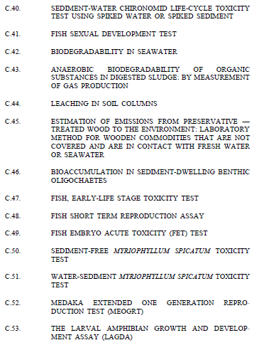
REACH
Regulation No 440/2008, laying down test methods pursuant to Regulation No 1907/2006 (REACH)
https://eur-lex.europa.eu/legal-content/EN/TXT/?uri=CELEX%3A02008R0440-20191016
lists the methods including procedures
often follows OECD guidelines

Slide 39
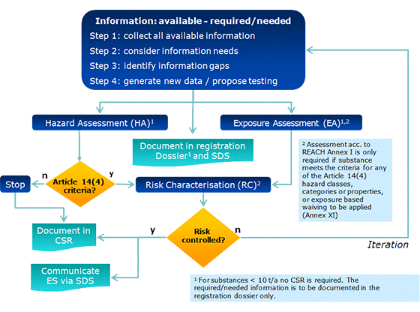
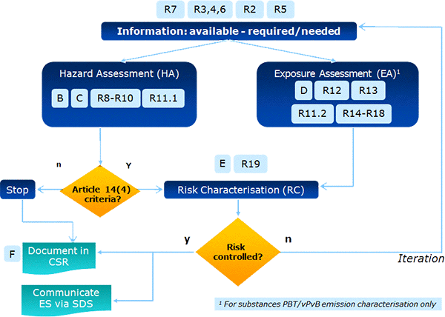
REACH
chemical safety assessment ~ risk assessment principle = combination of HAZARD and EXPOSURE
detailed guidelines for each phase
https://echa.europa.eu/guidance-documents/guidance-on-information-requirements-and-chemical-safety-assessment

Slide 40
REACH
Environmental hazard assessment
PNEC (predicted no effect concentration) for each environmental compartment
concentration below which adverse effects on ecosystems will not occur
derived on basis of available information on toxicity to species from relevant environments, i.e. toxicity test endpoints (LC50s or NOECs/EC10s), using appropriate assessment factors (AF) to extrapolate from single-species laboratory data to a multi-species ecosystem, to address:
  intra- and inter-laboratory variation of toxicity data
  intra- and inter-species variations (biological variance)
  short-term to long-term toxicity extrapolation
  laboratory data to field impact extrapolation
  ...

Slide 41

REACH
Environmental hazard assessment
PNEC determination
ECHA (2008): Guidance on information requirements and chemical safety assessment. Chapter R.10: Characterisation of dose [concentration]-response for environment. https://echa.europa.eu/guidance-documents/guidance-on-information-requirements-and-chemical-safety-assessment
ECHA (2011): Guidance on information requirements and chemical safety assessment
Part B: Hazard assessment. https://echa.europa.eu/guidance-documents/guidance-on-information-requirements-and-chemical-safety-assessment

Slide 42

REACH
Environmental hazard assessment
PNEC determination
What will be PNECwater ???
ECHA (2011): Guidance on information requirements and chemical safety assessment
Part B: Hazard assessment. https://echa.europa.eu/guidance-documents/guidance-on-information-requirements-and-chemical-safety-assessment

Slide 43
REACH
Environmental hazard assessment
PNEC determination
ECHA (2011): Guidance on information requirements and chemical safety assessment
Part B: Hazard assessment. https://echa.europa.eu/guidance-documents/guidance-on-information-requirements-and-chemical-safety-assessment

Slide 44

REACH
Exposure assessment
PEC (predicted environmental concentration) for each environmental compartment
models based on production of chemicals,

Slide 45



REACH
Environmental risk characterization
$$HQ=\frac{PEC}{PNEC}$$
PEC > PNEC
(HQ>1)
PEC < PNEC
(HQ<1)

Slide 46


REACH
Example CSR report
https://echa.europa.eu/support/practical-examples-of-chemical-safety-reports
from page 53

Slide 47

REACH
some data available in EC inventory and IUCLID 6
but not full Chemical Safety Reports
example: https://echa.europa.eu/substance-information/-/substanceinfo/100.100.840
https://iuclid6.echa.europa.eu/project-iuclid-6
https://echa.europa.eu/cs/information-on-chemicals/ec-inventory

Slide 48


REACH
for chemicals, producers and importers must provide information about risks related to substance use, based on Regulation No 1272/2008, on the classification, labelling and packaging of substances and mixtures (CLP Regulation)
https://eur-lex.europa.eu/legal-content/EN/TXT/?uri=CELEX%3A02008R1272-20201114
information on risks is provided in agreement with Globally Harmonised System of Classification and Labelling of Chemicals (https://unece.org/about-ghs)
among plenty of other data and properties, ecotoxicity is evaluated
GHS

Slide 49
Example 3
Pesticides - Plant protection products (PPP) – in EU

Slide 50








Plant protection products (PPP)
pesticides are very hazardous chemicals!
Hofman analysis 11/2018: 204 / 441 approved AS have some classification according to EC 1272/2008 (CLP) - majority AS have 3 or more (max 9 – e.g. Spiroxamin), in total there are 723 hazard statements found for all approved AS
  12 acute toxicity 1
  28 carcinogenicity 2
  153 acute aq. tox. 1
  11 reprod. tox. 1B

Slide 51


Plant protection products (PPP)
ecotoxicity assessment is related to the expected behavior and impacts after PPP application
lot of non-target biota under risk of undesired negative impact

Slide 52


Plant protection products (PPP)
lot of non-target biota under risk of undesired negative impact, including indirect effects

Slide 53

Plant protection products (PPP)
https://ec.europa.eu/food/plant/pesticides_en
www.efsa.europa.eu/en/topics/topic/pesticides
in EU, EFSA is responsible for the authorization of PPP
Regulation 1107/2009, concerning the placing of plant protection products on the market
https://eur-lex.europa.eu/legal-content/EN/TXT/?uri=CELEX%3A02009R1107-20191214
Regulation 546/2011, uniform principles for evaluation and authorisation of PPP
https://eur-lex.europa.eu/legal-content/EN/TXT/?uri=CELEX%3A02011R0546-20180524
overview of whole process:
https://www.efsa.europa.eu/en/interactive-pages/pesticides-authorisation/PesticidesAuthorisation
https://ec.europa.eu/assets/sante/food/plants/pesticides/lop/index.html

Slide 54


Plant protection products (PPP)
the whole system is divided to:
active substances approval - done for whole EU
a.s. – substance having action against harmful organisms
authorization of PPP – done in member states (zones)
mix of a.s. and other components: safeners (eliminate or reduce phytotoxic effects of PPP), synergists (enhance a.s. effect), co-formulants (other components), adjuvants (added to PPP by end-user)

Slide 55


Approval of a.s.
dossier
DAR/RAR
Regulation 283/2013, setting out the data requirements for active substances
https://eur-lex.europa.eu/legal-content/EN/TXT/?uri=CELEX%3A02013R0283-20141117
Regulation 540/2011, list of approved active substances
https://eur-lex.europa.eu/legal-content/EN/TXT/?uri=CELEX%3A02011R0540-20201126
EU pesticide database
https://ec.europa.eu/food/plant/pesticides/eu-pesticides-db_en
peer review
its decided if a.s. is approved or not, what conditions and labelling (CLP) and also limits for residues are set (MRL)
its valid for 10 year and then re-assessment
conclusion
decision

Slide 56
Approval of a.s.
8.1. | Effects on birds and other terrestrial vertebrates | 8.3. | Effect on arthropods
8.1.1. | Effects on birds | 8.3.1. | Effects on bees
8.1.1.1. | Acute oral toxicity to birds | 8.3.1.1. | Acute toxicity to bees
8.1.1.2. | Short-term dietary toxicity to birds | 8.3.1.1.1. | Acute oral toxicity
8.1.1.3. | Sub-chronic and reproductive toxicity to birds | 8.3.1.1.2. | Acute contact toxicity
8.1.2. | Effects on terrestrial vertebrates other than birds | 8.3.1.2. | Chronic toxicity to bees
8.1.2.1. | Acute oral toxicity to mammals | 8.3.1.3. | Effects on honeybee development and other honeybee life stages
8.1.2.2. | Long-term and reproductive toxicity to mammals | 8.3.1.4. | Sub-lethal effects
8.1.3. | Active substance bioconcentration in prey of birds and mammals | 8.3.2. | Effects on non-target arthropods other than bees
8.1.4. | Effects on terrestrial vertebrate wildlife (birds, mammals, reptiles and amphibians) | 8.3.2.1. | Effects on Aphidius rhopalosiphi
8.1.5. | Endocrine disrupting properties | 8.3.2.2. | Effects on Typhlodromus pyri
8.2. | Effects on aquatic organisms | 8.4. | Effects on non-target soil meso- and macrofauna
8.2.1. | Acute toxicity to fish | 8.4.1. | Earthworm — sub-lethal effects
8.2.2. | Long-term and chronic toxicity to fish | 8.4.2. | Effects on non-target soil meso- and macrofauna (other than earthworms)
8.2.2.1. | Fish early life stage toxicity test | 8.4.2.1. | Species level testing
8.2.2.2. | Fish full life cycle test | 8.5. | Effects on soil nitrogen transformation
8.2.2.3. | Bioconcentration in fish | 8.6. | Effects on terrestrial non-target higher plants
8.2.3. | Endocrine disrupting properties | 8.6.1. | Summary of screening data
8.2.4. | Acute toxicity to aquatic invertebrates | 8.6.2. | Testing on non-target plants
8.2.4.1. | Acute toxicity to Daphnia magna | 8.7. | Effects on other terrestrial organisms (flora and fauna)
8.2.4.2. | Acute toxicity to an additional aquatic invertebrate species | 8.8. | Effects on biological methods for sewage treatment
8.2.5. | Long-term and chronic toxicity to aquatic invertebrates | 8.9. | Monitoring data
8.2.5.1. | Reproductive and development toxicity to Daphnia magna
8.2.5.2. | Reproductive and development toxicity to an additional aquatic invertebrate species
8.2.5.3. | Development and emergence in Chironomus riparius
8.2.5.4. | Sediment dwelling organisms
8.2.6. | Effects on algal growth
8.2.6.1. | Effects on growth of green algae
8.2.6.2. | Effects on growth of an additional algal species
8.2.7. | Effects on aquatic macrophytes
8.2.8. | Further testing on aquatic organisms
Regulation 283/2013 defines what data, including ecotoxicological, are required for approval of active substance
ANNEX section 8
some details provided on the bioassays performance, but more in specific guideline documents

Slide 57



Authorization of PPP
Regulation 284/2013, setting out the data requirements for PPP
https://eur-lex.europa.eu/legal-content/EN/TXT/?uri=CELEX%3A02013R0284-20150917
example of PPP database from CR
http://eagri.cz/public/app/eagriapp/POR/Vyhledavani.aspx?type=0&vyhledat=A&stamp=1609840149173

Slide 58
Authorization of PPP
Regulation 284/2013 defines what data, including ecotoxicological, are required for PPP authorization
ANNEX section 10
some details provided on the bioassays performance, but more in specific guideline documents
testing necessary where PPP toxicity cannot be predicted on the basis of data on AS
aim = to demonstrate PPP is more toxic than AS (bridging studies or limit test may be sufficient); if yes, definitive testing is required
10.1. | Effects on birds and other terrestrial vertebrates | 10.4. | Effects on non-target soil meso- and macrofauna
10.1.1. | Effects on birds | 10.4.1. | Earthworms
10.1.1.1. | Acute oral toxicity to birds | 10.4.1.1. | Earthworms — sub-lethal effects
10.1.1.2. | Higher tier data on birds | 10.4.1.2. | Earthworms — field studies
10.1.2. | Effects on terrestrial vertebrates other than birds | 10.4.2. | Effects on non-target soil meso- and macrofauna (other than earthworms)
10.1.2.1. | Acute oral toxicity to mammals | 10.4.2.1. | Species level testing
10.1.2.2. | Higher tier data on mammals | 10.4.2.2. | Higher tier testing
10.1.3. | Effects on other terrestrial vertebrate wildlife (reptiles and amphibians) | 10.5. | Effects on soil nitrogen transformation
10.2. | Effects on aquatic organisms | 10.6. | Effects on terrestrial non-target higher plants
10.2.1. | Acute toxicity to fish, aquatic invertebrates, or effects on aquatic algae and macrophytes | 10.6.1. | Summary of screening data
10.2.2. | Additional long-term and chronic toxicity studies on fish, aquatic invertebrates and sediment dwelling organisms | 10.6.2. | Testing on non-target plants
10.2.3. | Further testing on aquatic organisms | 10.6.3. | Extended laboratory studies on non-target plants
10.3. | Effects on arthropods | 10.6.4. | Semi-field and field tests on non-target plants
10.3.1. | Effects on bees | 10.7. | Effects on other terrestrial organisms (flora and fauna)
10.3.1.1. | Acute toxicity to bees | 10.8. | Monitoring data
10.3.1.1.1. | Acute oral toxicity
10.3.1.1.2. | Acute contact toxicity
10.3.1.2. | Chronic toxicity to bees
10.3.1.3. | Effects on honey bee development and other honey bee life stages
10.3.1.4. | Sub-lethal effects
10.3.1.5. | Cage and tunnel tests
10.3.1.6. | Field tests with honeybees
10.3.2. | Effects on non-target arthropods other than bees
10.3.2.1. | Standard laboratory testing for non-target arthropods
10.3.2.2. | Extended laboratory testing, aged residue studies with non-target arthropods
10.3.2.3. | Semi-field studies with non-target arthropods
10.3.2.4. | Field studies with non-target arthropods
10.3.2.5. | Other routes of exposure for non-target arthropods

Slide 59


PPP exposure assessment
exposure is expressed by different ways:
directly as application rate (e.g. g a.s. / ha)
  initial, maximum or modifications
as concentrations in various compartments
  Predicted Exposure Concentration – PEC (PECs, PECsw ...)
  predicted by different environmental fate models
  e.g. https://esdac.jrc.ec.europa.eu/projects/focus-dg-sante
  e.g. https://www.pesticidemodels.eu/swash/home
  = models of transport and behavior of PPP in the environment
  (drift, sorption, degradation, mobility, accumulation ...) in time
dietary daily intake (DDD) – for birds and mammals

Slide 60
Example of PECsoil calculation
The application rate of Roundup Superhero plant protection product to the oilseed-rape field is 4 L per ha. The concentration of glyphosate in the product is 400 g/L. Half of the glyphosate amount applied is retained by the oilseed-rape plants and never come to the soil. You also know the following: the layer of soil considered for the calculations is 5 cm (in this layer glyphosate is homogenously distributed and does not go deeper); density of wet soil is 2 kg/L; the soil has 20% water by weight basis; DT50 (half-life) of glyphosate in the soil is 15 days.
What will be the soil concentration (in mg/kg dry weight) after 30 days from the application (PECsoil,30d)? Explain the reasons for your answer in detail; if any calculations, show them clearly.

Slide 61
Example of PECsoil calculation
Application rate is 4 L per ha. Concentration of glyphosate in the product is 400g/L. That means in 4 L are 1600 g Glyphosate.
Half of the glyphosate is retained in the oil seed rape plants half goes to the soil. That means 800 g Glyphosate go into the soil 800g to the plant. 1600g:2 = 800g
The layer of soil considered is 5 cm = 0,05 m
The plant protection is sprayed on 1 ha = 10 000 m2
The volume of land where the pesticide is distributed 10 000m2 x 0,05 m (hight) → V = 500 m3
500 m3 = 500 000 dm3 = 500 000 L
Density of wet soil is 2 kg/L → 2 kg/L x 500 000 L = 1 000 000 kg soil
20% is water → 800 000 kg dry soil
800 g glyphosate goes into 800 000 kg dry soil
800 000 mg / 800 000 kg dry soil = 1 mg/kg dry soil
After 15 days the concentration will be 0,5 mg glyphosate per kg dry soil
After 30 days the concentration will be 0,25 mg glyphosate per kg dry soil

Slide 62
PPP ecotoxicity and risk assessment
assessment of (eco)toxicity and acute / short-term / long-term risks for:
  birds and other terrestrial vertebrates
  aquatic organisms (fish, inventebrates, algae, plants, sediment organisms)
  bees
  non-target arthropods
  earthworms
  soil macro- and mesofauna (other than earthworms)
  soil microorganisms (C mineralization, N mineralization)
  non target plants
  biological methods of sewage treatment

Slide 63
PPP ecotoxicity and risk assessment
fundamental principle: risk assessment = combining effects and exposures
  most often as TER = toxicity/exposure ratio = ratio of effect endpoint and estimated exposure
  but for bees or non-target arthtropods, hazard quotient (HQ) - ratio between exposure and toxicity (usually in units of g a.s. / ha)
used endpoints (LD50, NOEL, LC50, EC50, NOEC ... acute, short-, or long-term) and units (e.g. in body or in environment, initial, long- or short-term ...) depend on the specific bioassay and results
the most sensitive organism used in the tests has key influence on the final decisions

Slide 64


PPP ecotoxicity and risk assessment
TER is compared to trigger (= Assessment Factor = Safety Factor)
these are laid down in Regulation 546/2011 and Guidance Documents
example for birds and mammals (tier 1):
example for aquatic organisms (tier 1):

Slide 65
PPP ecotoxicity and risk assessment
Regulation 546/2011: no authorisation shall be granted if:
birds and other non-target terrestrial vertebrates
  acute and short-term TER < 10 (using LD50) or long-term TER < 5
  secondary poisoning from food (fish, earthworms)
aquatic organisms
  fish and Daphnia TER < 100 for acute exposure and < 10 for long-term exposure
  algal growth inhibition TER < 10
  BCF > 1000 for readily biodegradable or > 100 for not readily biodegradable AS
bees
  hazard quotient for oral or contact exposure > 50
beneficial arthropods other than honeybees
  > 30 % of test organisms affected in lethal or sublethal laboratory tests of max application rate
earthworms
  long-term TER < 5
soil microorganisms
  nitrogen or carbon mineralisation affected > 25 % after 100 days
However, in general more detailed decision is performed based on specific guidelines!
Regulation 546/2011, uniform principles for evaluation and authorisation of PPP
https://eur-lex.europa.eu/legal-content/EN/TXT/?uri=CELEX%3A02011R0546-20180524
higher tier „unless“: „unless clearly established through an appropriate risk assessment that under field conditions no unacceptable impact occurs after PPP use in accordance with the proposed conditions of use“

Slide 66





PPP ecotoxicity and risk assessment
details for the testing and evaluation (risk assessment) in guideline documents
for ecotox mainly these 4 are of key importance:
EFSA (2009): Risk assessment for birds and mammals: EFSA guidance document. EFSA Journal 7(12): 1438. http://www.efsa.europa.eu/en/efsajournal/pub/1438
EFSA (2013): Guidance on tiered risk assessment for plant protection products for aquatic organisms in edge-of-field surface waters. EFSA Journal 11(7): 3290. https://www.efsa.europa.eu/en/efsajournal/pub/3290
European Commission (2002): Guidance document on terrestrial ecotoxicology. Draft Working Document SANCO/10329/2009, rev.2, final. https://ec.europa.eu/food/sites/food/files/plant/docs/pesticides_ppp_app-proc_guide_ecotox_terrestrial.pdf
Candolfi (2000): ESCORT2 - Guidance document on regulatory testing and risk assessment procedures for plant protection products with non-target arthropods.
EFSA (2013): Guidance on the risk assessment of plant protection products on bees (Apis mellifera, Bombus spp. and solitary bees). EFSA Journal 11(7): 3295. https://www.efsa.europa.eu/en/efsajournal/pub/3295

Slide 67

Tiered approach - general
this approach saves time, money, laboratory organisms etc.
it tries to go narrow pathway „linking questions about risks asked by stakeholder to answers that can be provided by researchers“
its always trade-off between price and accuracy of assessment and these are different for each tier
Posthuma et al. 2008, Science of the Total Environment, 406:503-517

Slide 68
Tiered approach - general
this approach saves time, money, laboratory organisms etc.
Tier 1 = starts with default (worst-case) parameters for exposure
  = standard ecotox bioassays as we know them
  rough assessment, conservative
  if risk is not acceptable then →
Tier 2 = refinement, assessment closer to reality (e.g. representative organisms, real conditions, considering protective distances ...), if risks not acceptable then →
Tier 3, Tier 4 ... e.g. mesocosm or field studies
based on the results of previous tier, its decided what to do next

Slide 69


Tiered approach - examples
Aquatic organisms
Tier 1 - based on standard laboratory studies
Tier 2 - based on additional laboratory studies:
  Tier 2A – based on geomean/AF approach
  Tier 2B – based on SSD approach (Species Sensitivity Distribution)
  Tier 2C – based on refined exposure laboratory tests/AF approach
Tier 3 - based on mesocosm/microcosm studies
at each tier, regulatory acceptable concentrations (RACs) derived
and compared to PEC
EFSA (2013): Guidance on tiered risk assessment for plant protection products for aquatic organisms in edge-of-field surface waters. EFSA Journal 11(7): 3290. https://www.efsa.europa.eu/en/efsajournal/pub/3290

Slide 70

Tiered approach - examples
Aquatic organisms
From: Better Training for Safer Food Initiative workshop, 2019

Slide 71

Tiered approach - examples
Aquatic organisms
From: Better Training for Safer Food Initiative workshop, 2019

Slide 72

Tiered approach - examples
Birds and mammals
screening – general model, indicator species
tier 1 – specific model, generic focal species with different feeding preferences and growth stages
higher tier – focal species, corrections using measured data (monitoring studies)
  Indicator species – used in the screening step, it is not a real species but, by virtue of its size and feeding habits is considered to have higher exposure than (i.e. to be protective of) other species that occur in a particular crop at a particular time.
  Generic focal species – used in Tier 1assessment, it is not a real species, however it is considered to be representative of all those species potentially at risk. Instead of the one single food item approach of the screening step in this assessment a mixed diet is applied when appropriate for the generic focal species. In addition, interception of the spray by the crop is taken into account by calculating the residue level on the several food types for the birds and the mammals.
  Focal species – used in higher tier assessment, it is a real species that actually occurs in the crop when the pesticide is being used (see section 6.1.3 for identification of focal species.).

Slide 73



Tiered approach - examples
Birds and mammals
shortcut values for screening and Tier 1 calculations - describe feeding habits and other ecological needs for indicator and generic focal species
Theoretical dietary exposure routes for birds feeding in crop (e.g., cereals) sprayed with a plant protection product. Most of the plant protection product will be deposited in the treated crop area, but some may enter neighboring water bodies. Exposure to birds in the treated area can therefore occur by feeding on the crop itself (a), ground‐dwelling (b) or foliar‐dwelling (c) invertebrates, weeds (d), or weed seeds (e). Birds may also feed on earthworms living in the treated soil (f) or fish living in neighboring contaminated surface waters (g). Exposure may also occur by drinking from contaminated puddles within the treated crop area (h)

Slide 74


Tiered approach - examples
Birds and mammals
higher tiers, e.g. field studies

Slide 75


Tiered approach - examples
Soil organisms Non-target arthropods (NTA)
European Commission (2002): Guidance document on terrestrial ecotoxicology. Draft Working Document SANCO/10329/2009, rev.2, final. https://ec.europa.eu/food/sites/food/files/plant/docs/pesticides_ppp_app-proc_guide_ecotox_terrestrial.pdf
Candolfi (2000): ESCORT2 - Guidance document on regulatory testing and risk assessment procedures for plant protection products with non-target arthropods.

Slide 76
Simplified example of evaluation
Soil organisms
Exposure estimation - PEC_{soil}
percentage of applied spray volume reaching soil depending on interception (e.g. 50%)
even distribution in the top 5 cm of soil
soil density of 1.5 g/cm³
calculate PEC_{soil} in mg a.s. / kg soil
example results for PPP „Pest-Killer“
application dose is 150 g a.s. / ha
1 ha of 5 cm soil corresponds to 500,000,000 cm³ which is 750,000 kg soil
PEC_{soil} is 0.2 mg a.s. / ha
European Commission (2002): Guidance document on terrestrial ecotoxicology. Draft Working Document SANCO/10329/2009, rev.2, final. https://ec.europa.eu/food/sites/food/files/plant/docs/pesticides_ppp_app-proc_guide_ecotox_terrestrial.pdf
Candolfi (2000): ESCORT2 - Guidance document on regulatory testing and risk assessment procedures for plant protection products with non-target arthropods.

Slide 77

Simplified example of evaluation
Soil organisms
TIER 1
reproduction effects on earthworms - NOEC are derived
TER > 5 OK, TER < 5 further studies needed
example results for PPP „Pest-Killer“
  tested at 0.02, 0.04, 0.08, 0.16, 0.32, 0.64 mg a.s. / kg
  NOEC was 0.32 mg a.s. / kg
TER = NOEC/PEC_{soil} = 0.32 / 0.2 = 1.6 (< 5, not OK and further studies are needed)
European Commission (2002): Guidance document on terrestrial ecotoxicology. Draft Working Document SANCO/10329/2009, rev.2, final. https://ec.europa.eu/food/sites/food/files/plant/docs/pesticides_ppp_app-proc_guide_ecotox_terrestrial.pdf
Candolfi (2000): ESCORT2 - Guidance document on regulatory testing and risk assessment procedures for plant protection products with non-target arthropods.

Slide 78


Simplified example of evaluation
Non-target arthropods (NTA)
in-field and off-field assessment
TIER 1
risk assessment based on two indicator species:
  Typhlodromus pyri
  Aphidius rhopalosiphi
standard toxicity tests to determine LR50 in g a.s. / ha based on mortality
example results for PPP „Pest-Killer“
  tested at 1.25, 2.5, 5, 10, 20, 40, 80 g a.s./ha
  LR50 for both species = 2.5 g a.s./ha
  all in acreditted labs with GLP
European Commission (2002): Guidance document on terrestrial ecotoxicology. Draft Working Document SANCO/10329/2009, rev.2, final. https://ec.europa.eu/food/sites/food/files/plant/docs/pesticides_ppp_app-proc_guide_ecotox_terrestrial.pdf
Candolfi (2000): ESCORT2 - Guidance document on regulatory testing and risk assessment procedures for plant protection products with non-target arthropods.

Slide 79

Simplified example of evaluation
Non-target arthropods (NTA)
TIER 1 (cont.)
now to determine hazards, compare exposure to effect in hazard quotient (HQ) – exposure (application rate) and LR50 must not differ in units
if resulting HQ ≥ 2, there is potential hazard to non-target arthropods
$$HQ=\frac{application rate in g a.s./ha}{LR50 in g a.s./ha}$$
Ratio between rate after max. recommended no. of applications and the initial rate after a single application
European Commission (2002): Guidance document on terrestrial ecotoxicology. Draft Working Document SANCO/10329/2009, rev.2, final. https://ec.europa.eu/food/sites/food/files/plant/docs/pesticides_ppp_app-proc_guide_ecotox_terrestrial.pdf
Candolfi (2000): ESCORT2 - Guidance document on regulatory testing and risk assessment procedures for plant protection products with non-target arthropods.
Single application in g a.s. / ha
Application rate x MAF
In-field HQ =
LR50
= % drift/100
(90th percentile)
For 2-D exposure (= glass plate) this = 10
To account for uncertainty between species this = 10
LR50 expressed in g a.s. / ha
Application rate x MAF x (drift / veg distribution factor) x correction factor
Off-field HQ =
LR50

Slide 80

Simplified example of evaluation
Non-target arthropods (NTA)
TIER 1 (cont.)
application details:
  application rate = 56 g a.s./ha
  No. of treatments = 3 per crop
  LR50 = 2.5 g a.s. / ha
assumptions:
  Drift value – 2.01
  MAF – 2.3
  Application to field crops at tier 1 use the shortest distance – 1 m (3m for orchards, vines etc)
in-field risk is not acceptable (HQ ≥ 2), off-field is also not acceptable (HQ ≥ 2)
European Commission (2002): Guidance document on terrestrial ecotoxicology. Draft Working Document SANCO/10329/2009, rev.2, final. https://ec.europa.eu/food/sites/food/files/plant/docs/pesticides_ppp_app-proc_guide_ecotox_terrestrial.pdf
Candolfi (2000): ESCORT2 - Guidance document on regulatory testing and risk assessment procedures for plant protection products with non-target arthropods.
56 g a.s./ha x 2.3
56 g a.s./ha x 2.3 x (2.01/100) x 10
In-field effects:
HQ = 51.52
Off-field effects:
HQ = 10.03
2.5 g a.s./ha
2.5 g a.s./ha

Slide 81

Simplified example of evaluation
Non-target arthropods (NTA)
TIER 1 (cont.)
European Commission (2002): Guidance document on terrestrial ecotoxicology. Draft Working Document SANCO/10329/2009, rev.2, final. https://ec.europa.eu/food/sites/food/files/plant/docs/pesticides_ppp_app-proc_guide_ecotox_terrestrial.pdf
Candolfi (2000): ESCORT2 - Guidance document on regulatory testing and risk assessment procedures for plant protection products with non-target arthropods.

Slide 82






Simplified example of evaluation
Simplified example of evaluation: non-target arthropods (NTA)
TIER 2
if HQ ≥ 2 for in-field risk assessment, test affected indicator species + 1 additional species
if HQ ≥ 2 for off-field risk assessment, test affected species + 2 additional species
preferred species: Orius laevigatus, Chrysoperla carnea, Coccinella septempunctata, Aleochara bilineata, Poecilus cupreus
extended laboratory studies; aged residue studies; semi-field studies; field studies
European Commission (2002): Guidance document on terrestrial ecotoxicology. Draft Working Document SANCO/10329/2009, rev.2, final. https://ec.europa.eu/food/sites/food/files/plant/docs/pesticides_ppp_app-proc_guide_ecotox_terrestrial.pdf
Candolfi (2000): ESCORT2 - Guidance document on regulatory testing and risk assessment procedures for plant protection products with non-target arthropods.

Slide 83
Simplified example of evaluation
Non-target arthropods (NTA)
TIER 2
HQ approach with criteria of ≥ 2 is not applied !
predicted exposure rates are calculated based on similar equations as in Tier 1
compared directly to toxicity endpoints LR50 or ER50 (the lower one should be used)
i.e. trigger is less than 50% negative effects
European Commission (2002): Guidance document on terrestrial ecotoxicology. Draft Working Document SANCO/10329/2009, rev.2, final. https://ec.europa.eu/food/sites/food/files/plant/docs/pesticides_ppp_app-proc_guide_ecotox_terrestrial.pdf
Candolfi (2000): ESCORT2 - Guidance document on regulatory testing and risk assessment procedures for plant protection products with non-target arthropods.

Slide 84

PPP assessment – results available
ecotoxicological data and risk assessment (i.e. data on tox/ecotox are combined with data on exposure and env. fate) are available:
in Draft Assessment Reports or Renewal Assessment Reports (DAR / RAR)
http://registerofquestions.efsa.europa.eu/roqFrontend/wicket/page?5
(generally: https://www.efsa.europa.eu/en/calls/consultations)
Part A: Summary of each section; List of Endpoints
Part B: Detailed evaluation for each area; Ecotox in section B.9
Part C: Confidential information
in EFSA Conclusions, Peer Reviews and Peer Review Reports; example of Epoxiconazole:
https://www.efsa.europa.eu/en/efsajournal/pub/rn-138
https://www.efsa.europa.eu/en/efsajournal/pub/4123
http://registerofquestions.efsa.europa.eu/roqFrontend/wicket/page?16

Slide 85
Example 4
Veterinary pharmaceuticals – in EU

Slide 86


Veterinary pharmaceuticals
growing problem – increasing release
of bioactive substances to environment
veterinary medicines - more attention is logical
  huge consumption
  their entry into the environment (water and soil) is more possible
  (use of agricultural waste on soil)
  killing beneficial soil organisms or development of antibiotic resitance

Slide 87
Veterinary pharmaceuticals
Regulation 726/2004, authorisation and supervision of medicinal products for human and veterinary use
https://eur-lex.europa.eu/legal-content/EN/TXT/?uri=CELEX%3A02004R0726-20190330
Directive 2001/83/EC, medicinal products for human use
https://eur-lex.europa.eu/legal-content/EN/TXT/?uri=CELEX%3A02001L0083-20190726
Directive 2001/82/EC, veterinary medicinal products
https://eur-lex.europa.eu/legal-content/EN/TXT/?uri=CELEX%3A02001L0082-20090807
pharmacovigilance – careful assessment of all undesired impacts
European Medicines Agency (EMA) https://www.ema.europa.eu/en
part of the registration proces is also Environmental Risk Assessment
for veterinary - detailed evaluation procedure in EMA CVMP (Committee for Medicinal Products for Veterinary Use)
https://www.ema.europa.eu/en/committees/committee-medicinal-products-veterinary-use-cvmp
guidelines including assessment of environmental fate, ecotoxicity and risks
https://www.ema.europa.eu/en/veterinary-regulatory/marketing-authorisation/environmental-risk-assessment-veterinary-medicines

Slide 88
Veterinary pharmaceuticals
guidelines including assessment of environmental fate, ecotoxicity and risks
https://www.ema.europa.eu/en/veterinary-regulatory/marketing-authorisation/environmental-risk-assessment-veterinary-medicines
VICH GL6 Environmental impact assessment (EIAS) for veterinary medicinal products - Phase I
VICH GL38 Environmental impact assessments for veterinary medicinal products - Phase II

Slide 89

Veterinary pharmaceuticals
Koschorreck, J., Koch, C., Rönnefahrt, I., 2002. Environmental risk assessment of veterinary medicinal products in the EU—a regulatory perspective. Toxicology Letters 131, 117–124.. doi:10.1016/s0378-4274(02)00047-4

