Slide 1
How I See Optimal Presentation
Karel Kubíček

Slide 2
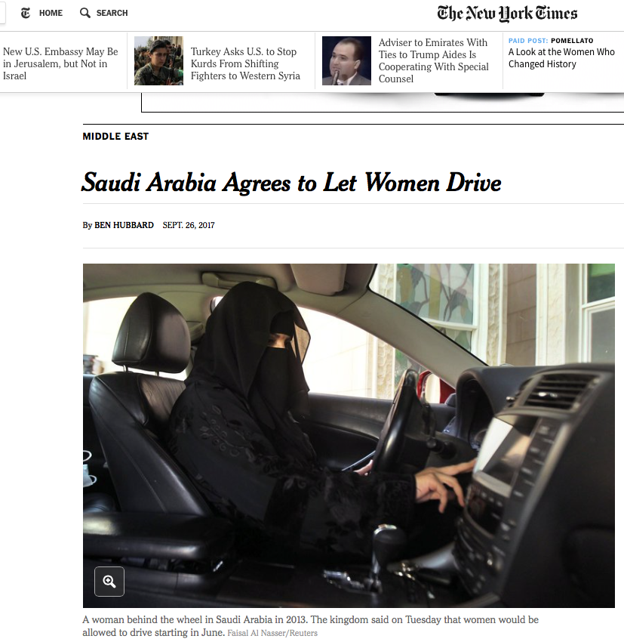

Searching for Gender Equality — International Women’s Day
https://youtu.be/lkfpqGWzHCE

Slide 3

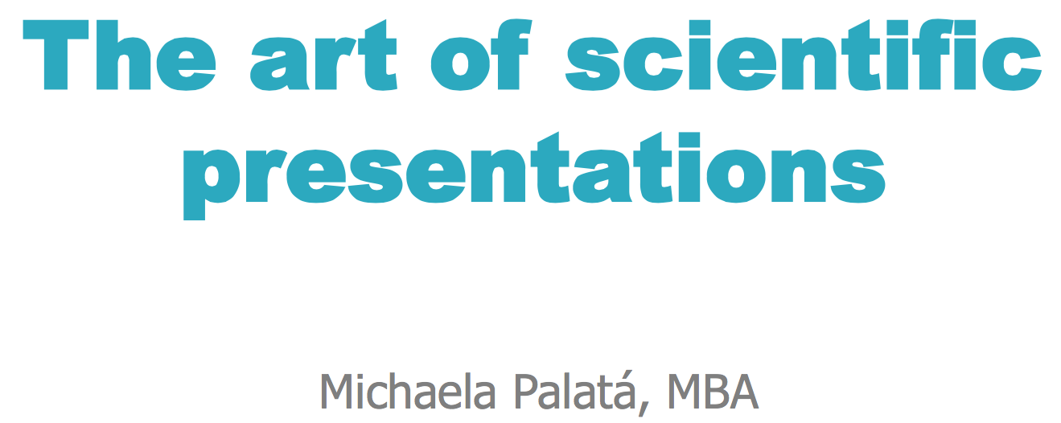

Slide 4
Outline of this talk
Introduction
Who are you going to talk to?
Where are you going to give the talk?
General rules – fonts, colors, sizes, sans serifs etc.
Timing / practicing
Description of gel, description of graph, of anything …
Structure of your talk - Intro, Goals, Methods, Results, Conclusion, Take Home Message, Acknowledgment

Slide 5
Make things as simple as possible, but not simpler
Albert Einstein

Slide 6
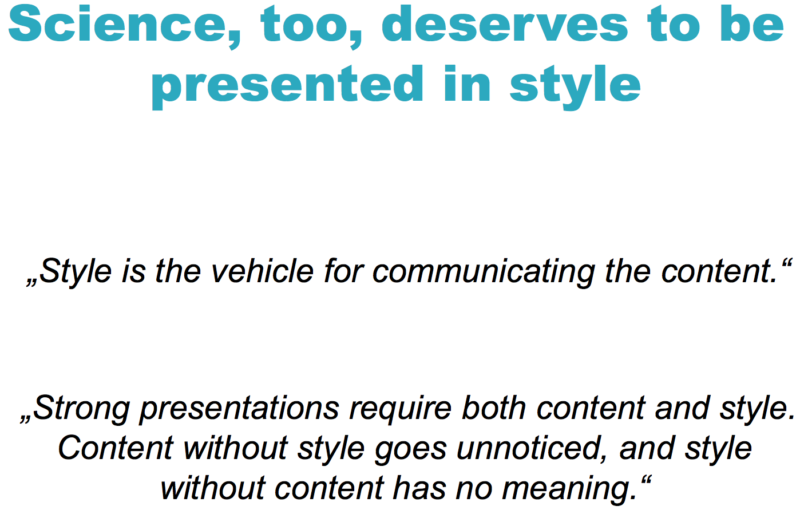

Slide 7
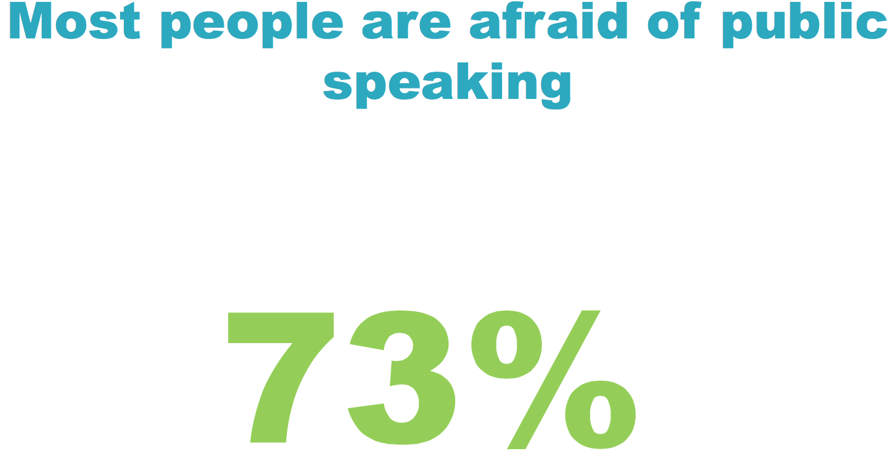

Slide 8
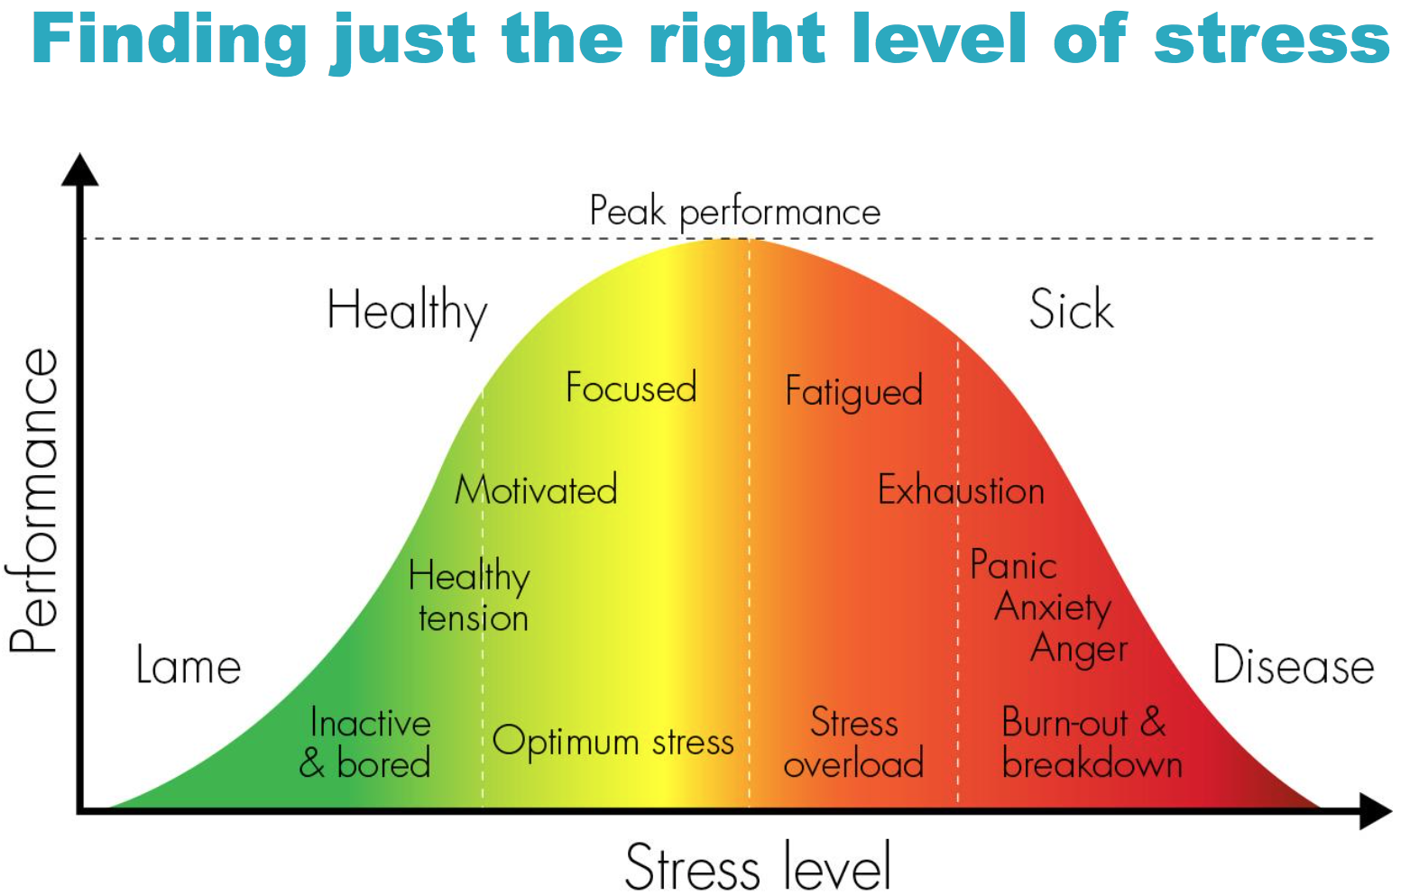

Slide 9


Slide 10
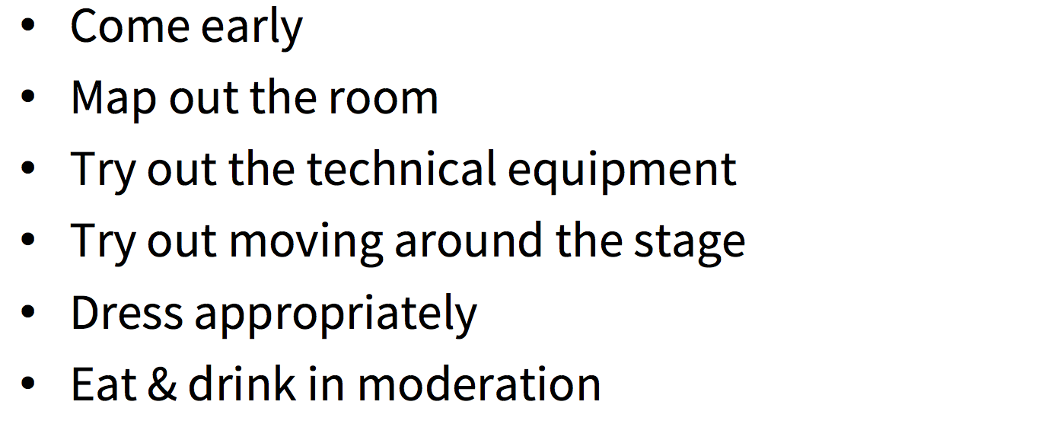
How to overcome anxiety

Slide 11
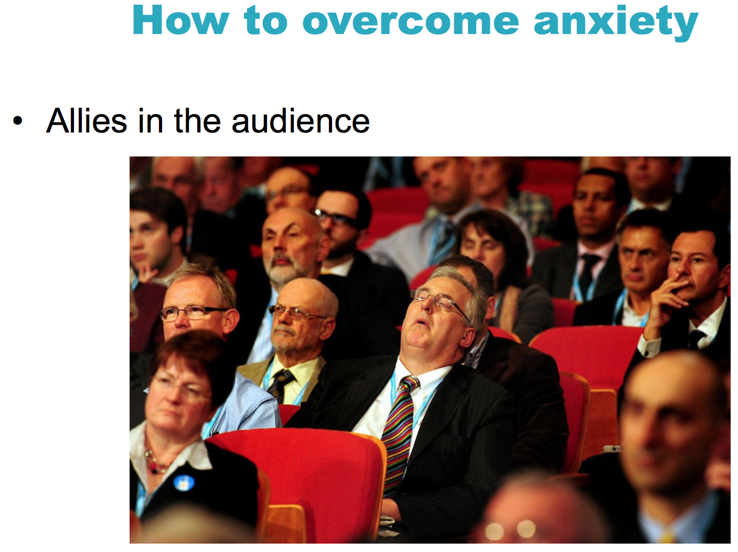

Slide 12
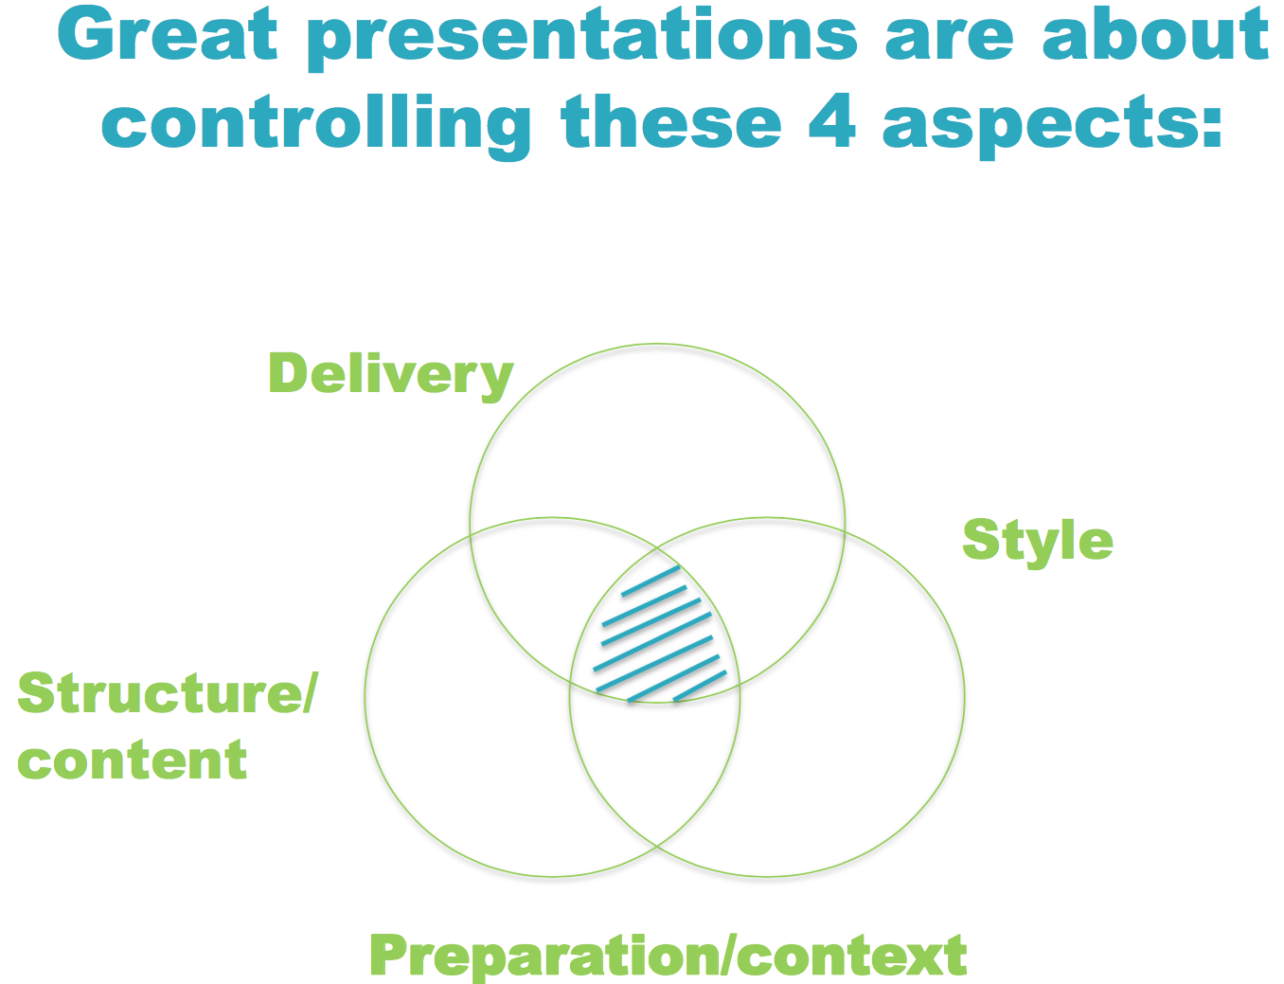

Slide 13
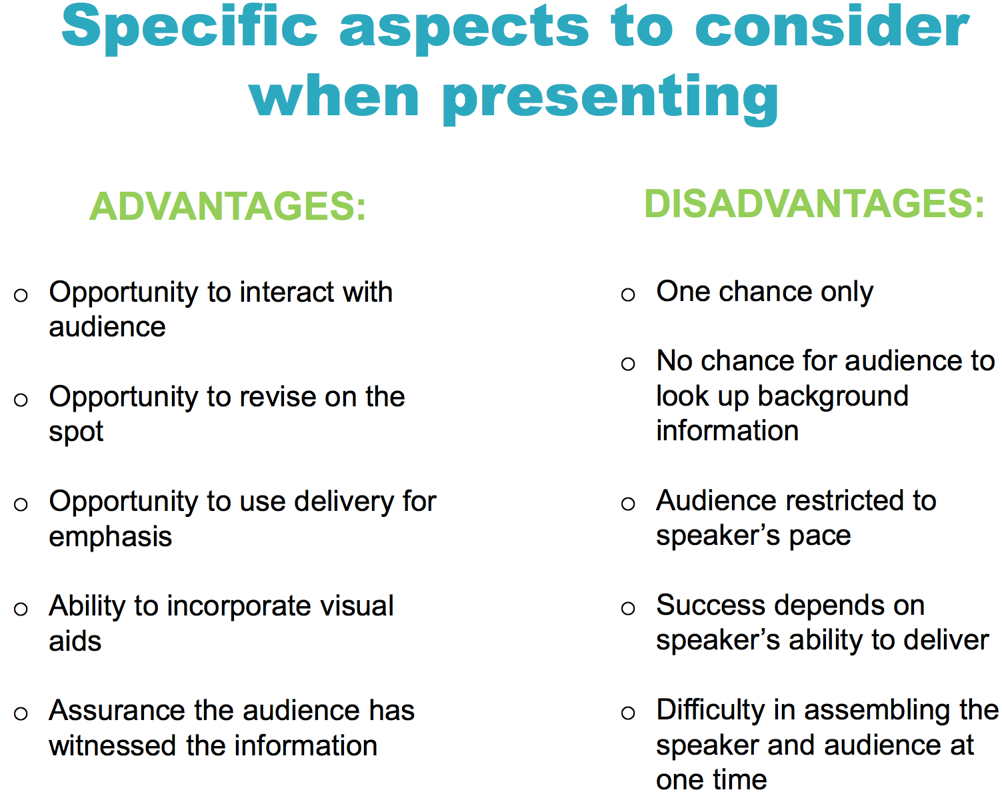

Slide 14
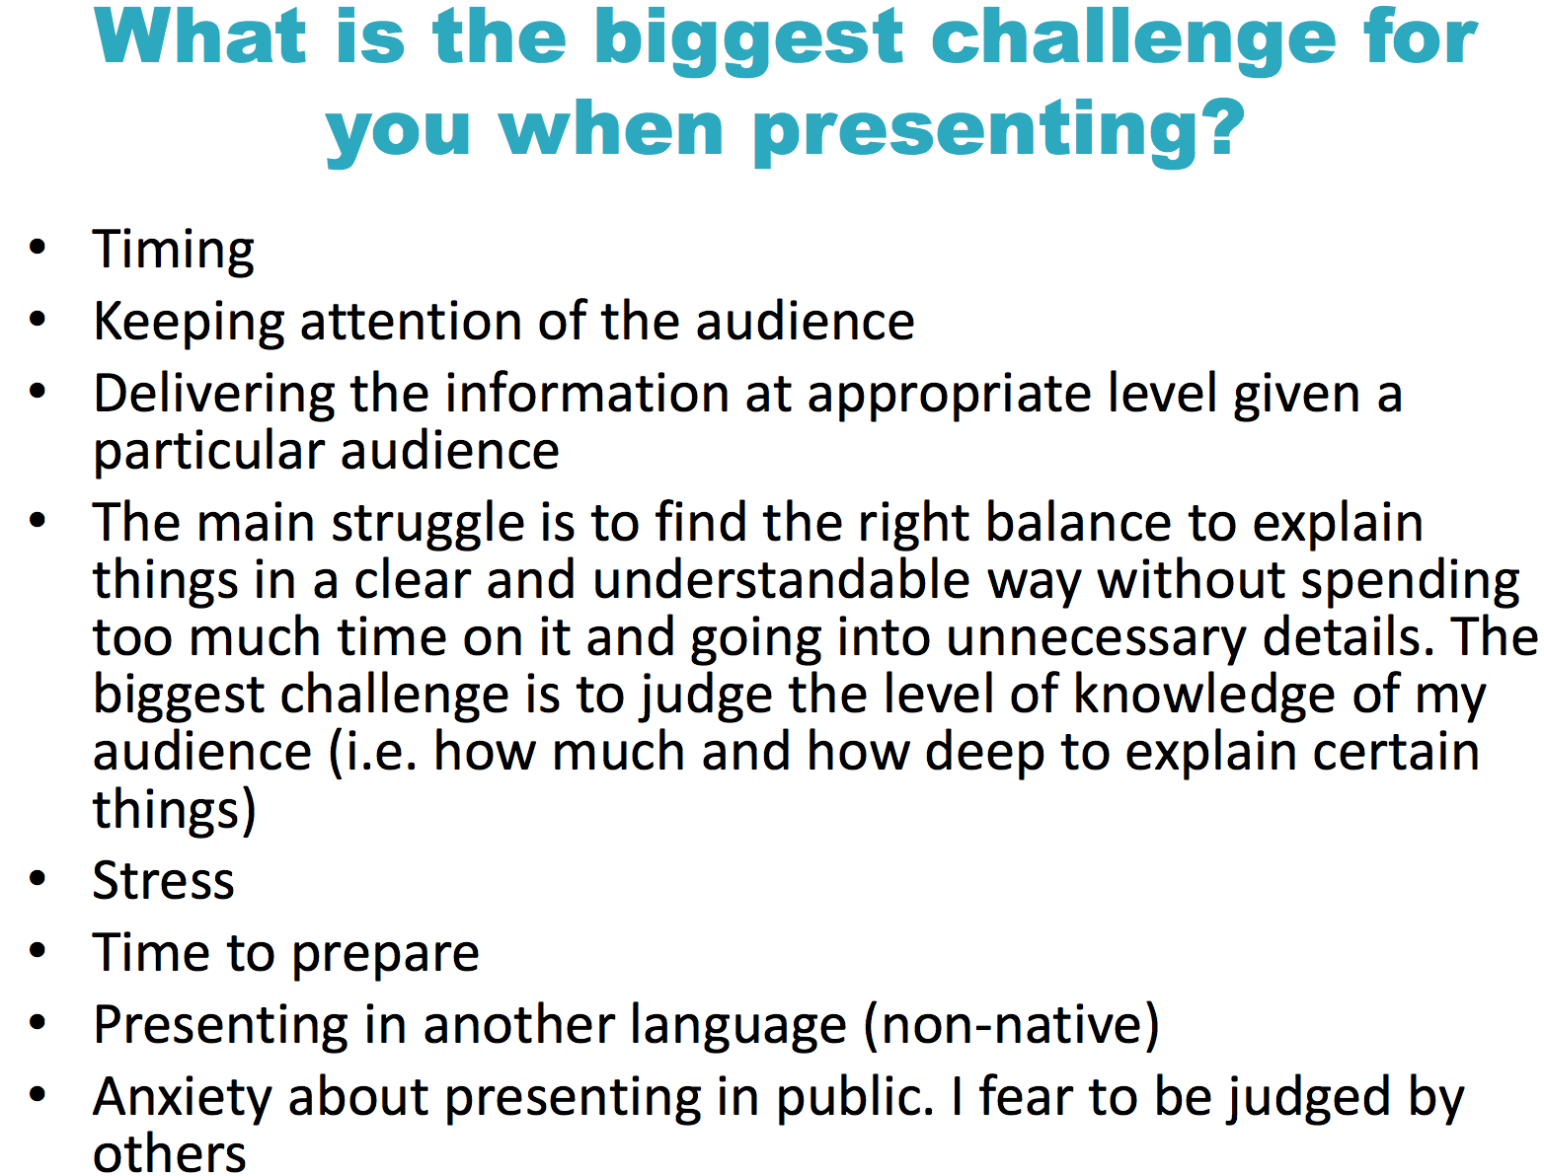

Slide 15
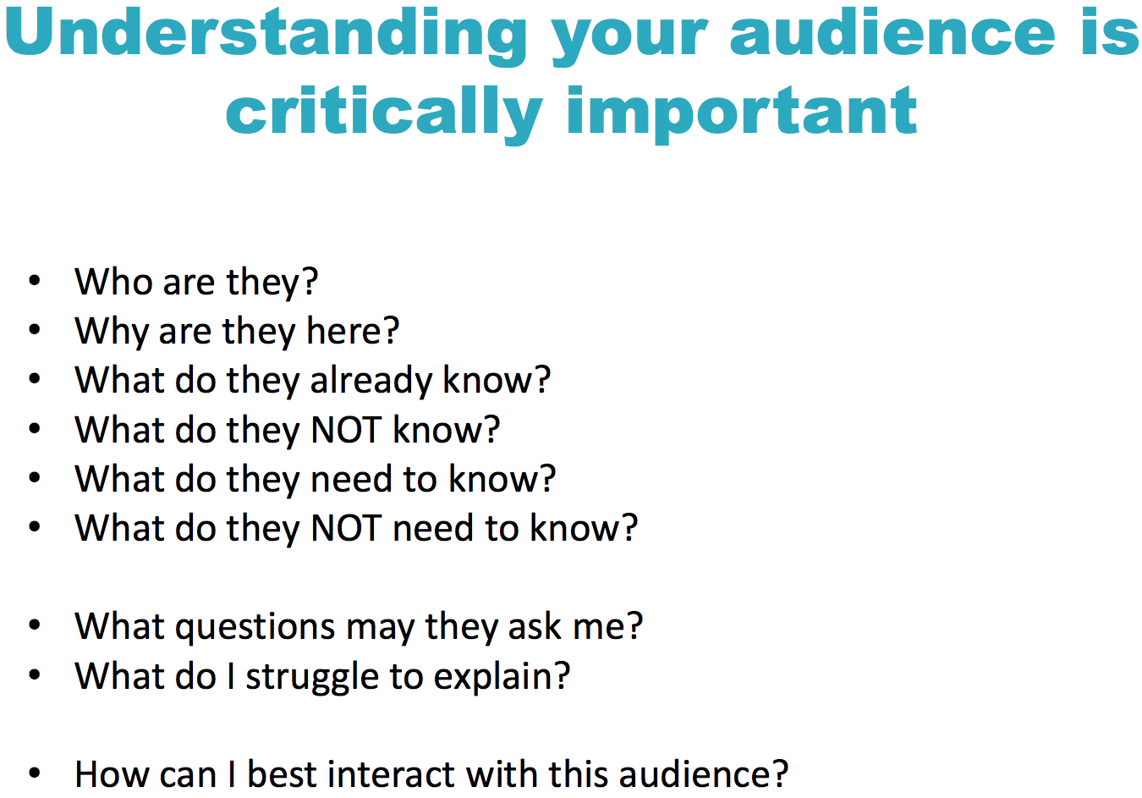

Slide 16
Depending on whether you are going to speak to experts in your field or to broad audience, your talk should reflect that
You do not need to explain the experts all technical details!
All others may need / want to know what do you mean when saying:
“from the pictures / graph / gel it is obvious …”

Slide 17
Find out if audience includes
• many non-experts: include basics, simple pictures
• mostly theorists: explain which quantity are you measuring,
skip experimental details
• people who have done work relevant to yours
Be sure to mention their work
• “friendly” competitors: be generous

Slide 18
We may not be experts at public speaking...

Slide 19
We may not be experts at public speaking...
… but we are all experts at listening to talks

Slide 20
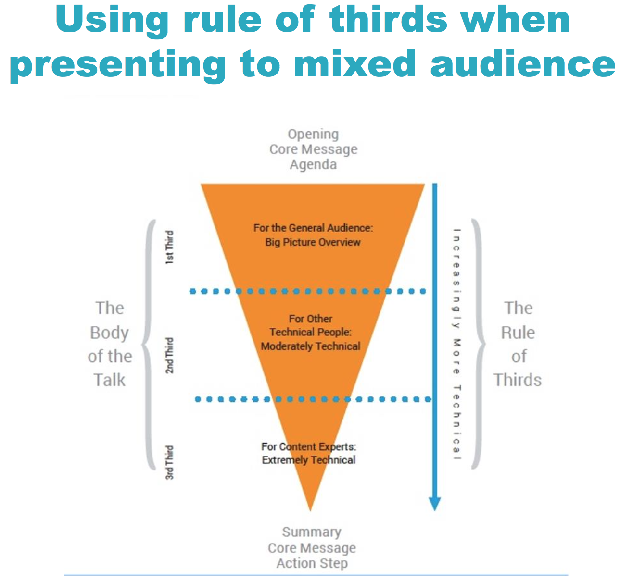

Slide 21
Check:
The room – size, acoustic, lights, screen size …
Beamer – resolution, colors, brightness / contrast
Technique available – not everywhere you are welcome to use your notebook (ERC – Acrobat XY, USB stick communicating with Windows XY …)

Slide 22
Use a Sans Serif font:
This font is Arial.
    This font is Comic Sans.
    This font is Trebuchet.
Serif fonts take longer to read...
    This font is Times New Roman.
    This font is Courier (monospace=fixed-width, e.g., good for alignments)
    This font is Didot.

Slide 23
AVOID USING ALL CAPITAL LETTERS
BECAUSE IT’S REALLY HARD TO READ!

Slide 24
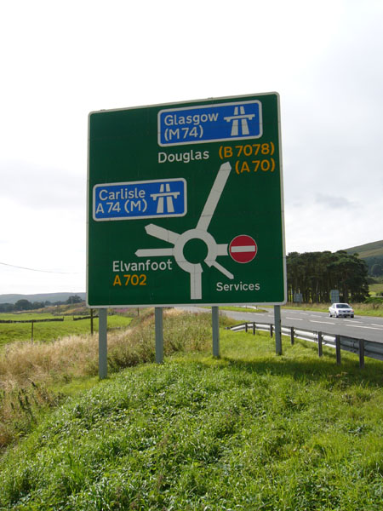
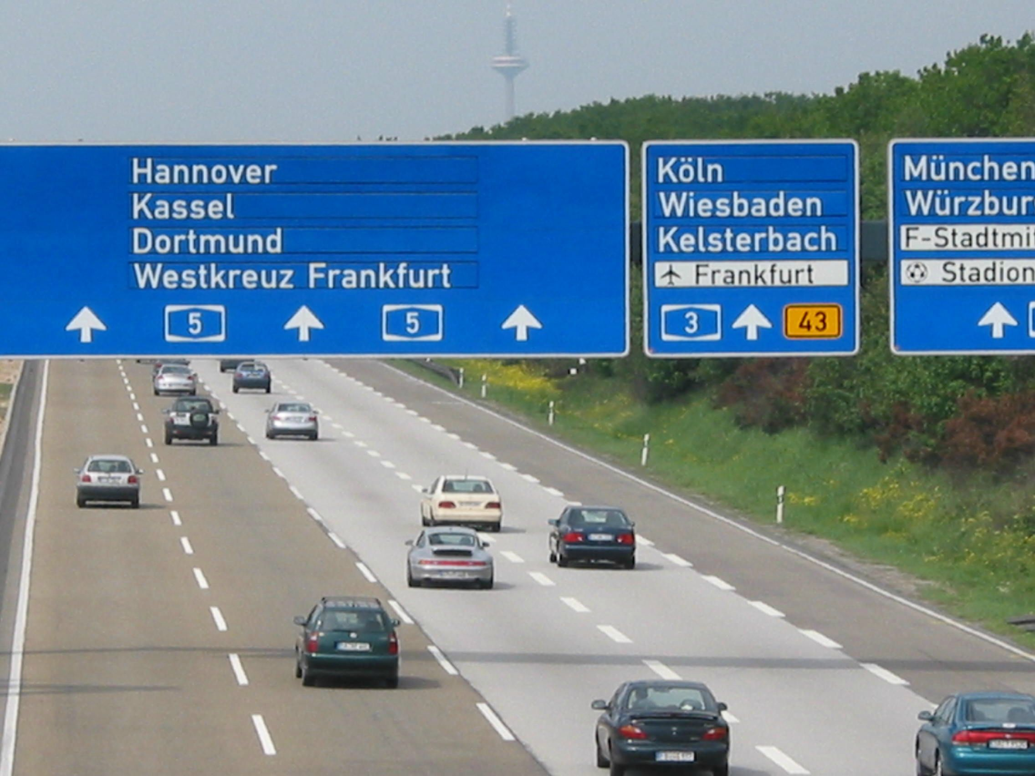

Slide 25


Slide 26
What a good presentation cannot do
There is no substitute for
• good data (let’s assume you got some)
• knowledge of the subject area
Most scientific audiences will figure out quickly if you don’t know what you are talking about In preparing your talk, think about
• precedents
• possible questions from the audience
You should be able to say something sensible in response to almost every question

Slide 27
Talks are the most important way to demonstrate that
• you have done excellent work
• you understand the scientific background and motivation of your work
• you can develop ideas and perspectives for future work
Talks are decisive factors in
• job appointments and promotions
• funding
• recognition for the work you do

Slide 28
Motivation
In a few words: Why should the audience be interested in what you have to say?
Coworkers
make sure list is complete
highlight key people
mention in beginning no chance to forget later
Outline
For long talks, diverse topics: repeat to keep audience oriented

Slide 29
Conclusion
• restrict to a few key points
• indicate if conclusion is tentative
Outlook
• further exciting experiments you are about to do
(or could do with more money / right position)

Slide 30
Structure of a good talk
Start broad -> get specific -> End broad

Slide 31
Go into depth, but then use your me slide to make transitions

Slide 32
Go into depth, but then use your me slide to make transitions
Nontechnical
General technical
Specialist

Slide 33
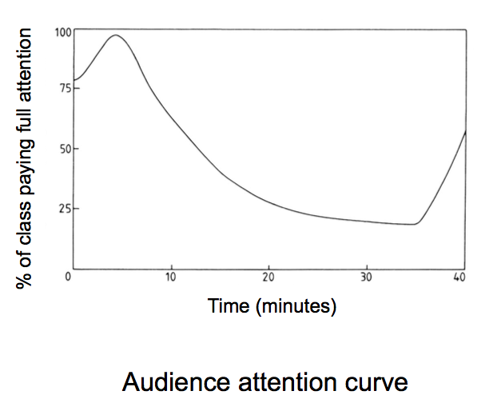
Audience attention increases as you signal the end of the talk

Slide 34
Time your talk!
Running over your allotted time is a mark of incompetence, and displaying your incompetence is a poor way to get someone to read your paper. Remember that talking to an audience takes longer than talking to a mirror.
Rule #X: practice, practice, practice
Watch time, skip nonessential transparencies if necessary

Slide 35
You are now thinking:
"All those dull speakers I've listened to should use these rules, but I don't need them because my talks are interesting."
All those dull speakers are now thinking exactly the same thing.
Read the rules again with the proper humility. They apply to everyone.
"The only wisdom we can hope to acquire
Is the wisdom of humility: humility is endless."

Slide 36

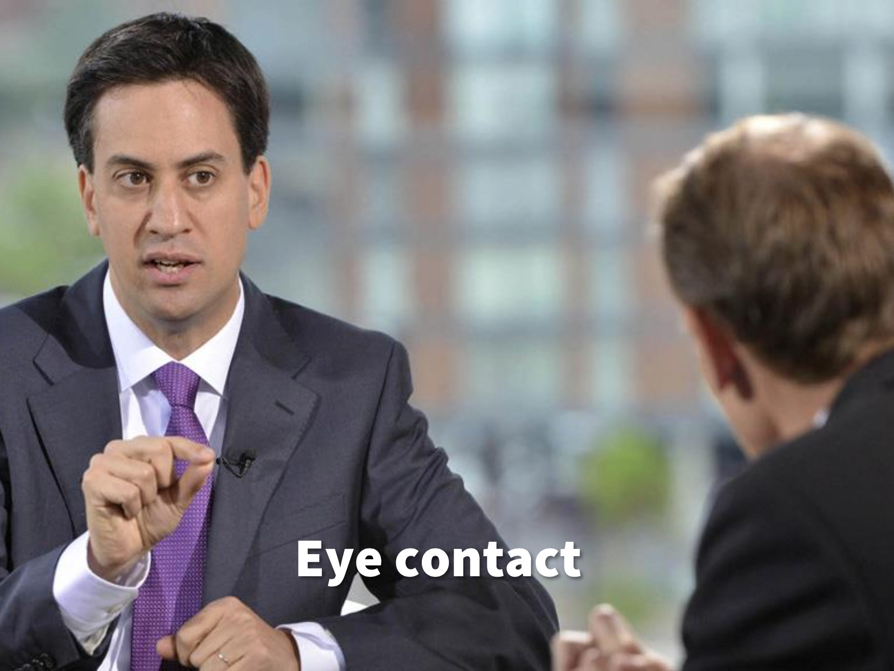
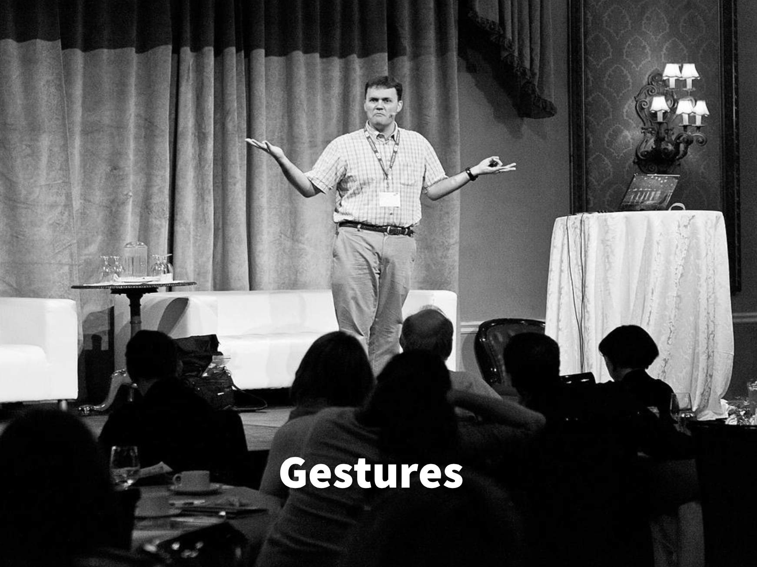

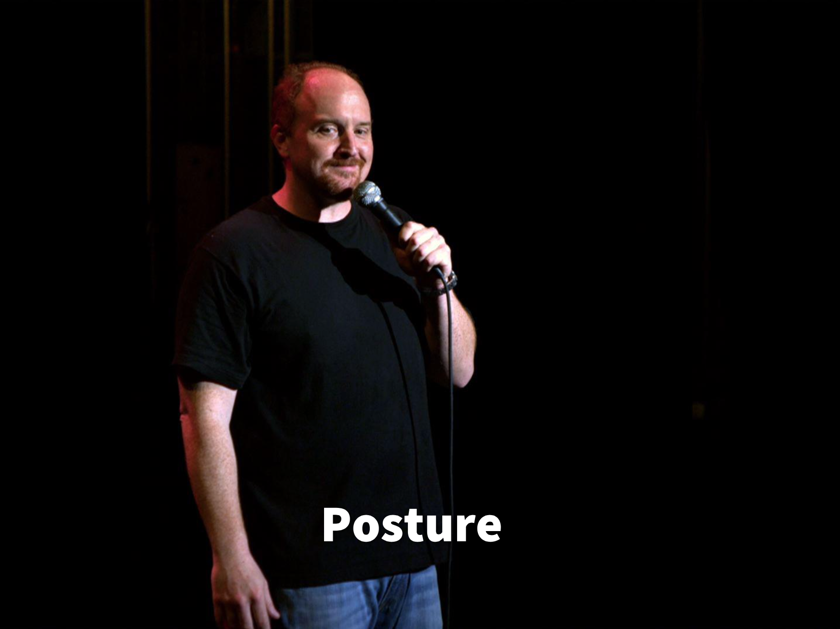
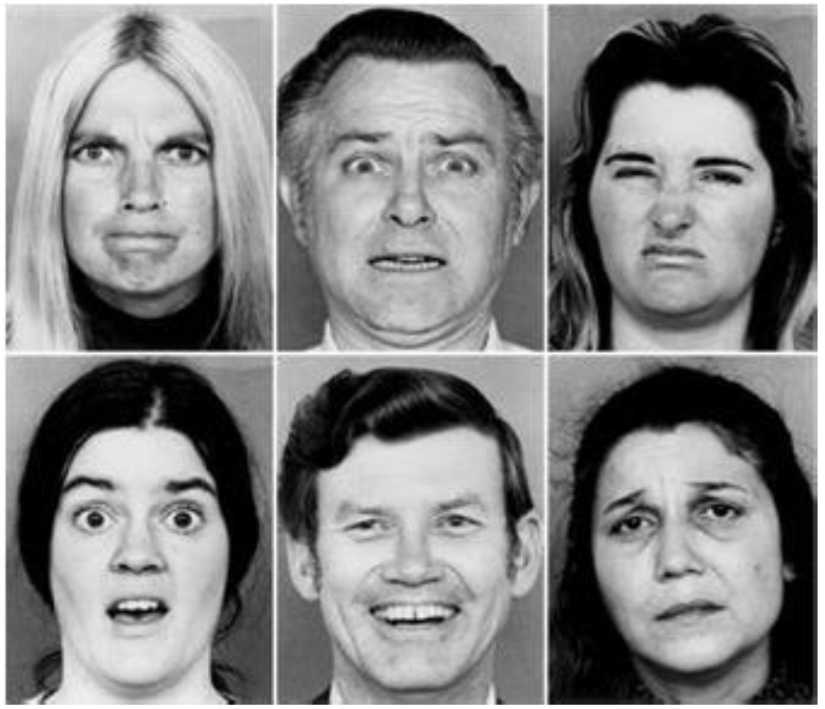
Facial Expressions

Slide 37


Slide 38
Here you can see a graph!

Slide 40
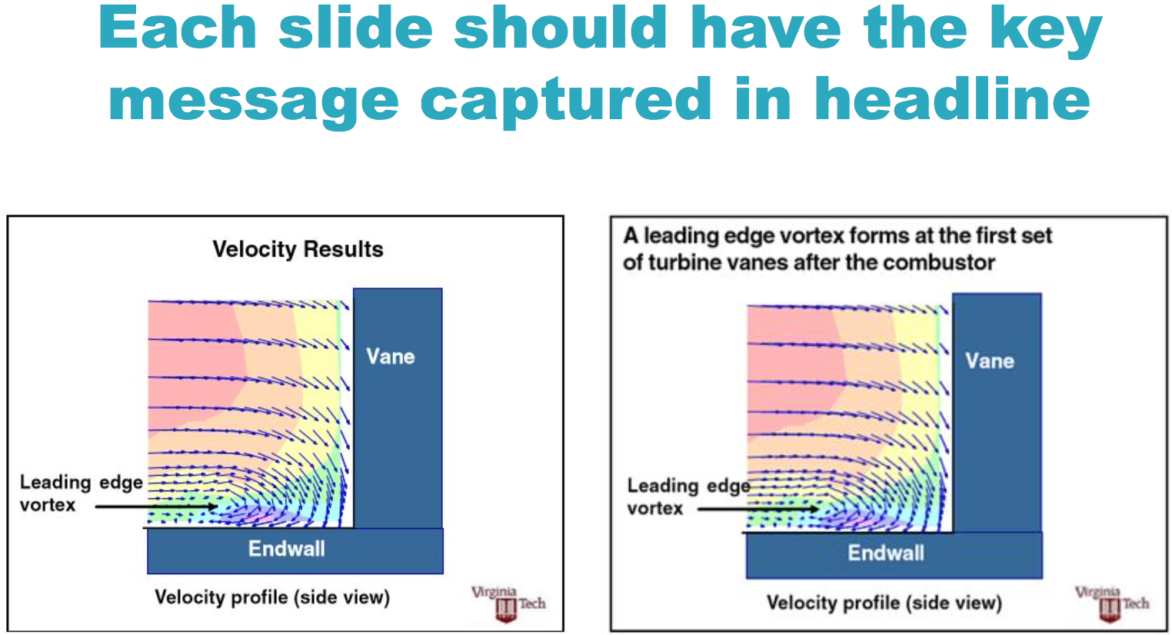

Slide 41
How to present a table
 | Age | Height | Weight | Gender | Budget
Pavel | 38 | 183 | 90 | M | 11.3
Petr | 42 | 175 | 85 | M | 12
Irena | 31 | 176 | 75 | F | 12.5
Jaroslav | 5 | 100 | 27 | M | 0.1
Jiří | 6 | 110 | 30 | M | 0.3
Mikuláš | 50 | 165 | 80 | M | 13.4
Karel | 39 | 185 | 81 | M | 15.89

Slide 42
How to present a table
 | Age | Height | Weight | Gender | Budget
Pavel | 38 | 183 | 90 | M | 11.3
Petr | 42 | 175 | 85 | M | 12
Irena | 31 | 176 | 75 | F | 12.5
Jaroslav | 5 | 100 | 27 | M | 0.1
Jiří | 6 | 110 | 30 | M | 0.3
Mikuláš | 50 | 165 | 80 | M | 13.4
Karel | 39 | 185 | 81 | M | 15.89

Slide 43
How to present a table
 | Age [years] |  | Height [cm] | Weight [kg] | Gender | Budget [MKč]
Pavel | 38 |  | 183 | 90 | M | 11.3
Petr | 42 |  | 175 | 85 | M | 12.0
Irena | 31 |  | 176 | 75 | F | 12.5
Jaroslav | 5 |  | 100 | 27 | M | 0.1
Jiří | 6 |  | 110 | 30 | M | 0.3
Mikuláš | 50 |  | 165 | 80 | M | 13.4
Karel | 39 |  | 185 | 81 | M | 15.9

Slide 44
How to present a table
 | Age [years] |  | Height [cm] | Weight [kg] | Gender | Budget [MKč]
Pavel | 38 |  | 183 | 90 | M | 11.3
Petr | 42 |  | 175 | 85 | M | 12.0
Irena | 31 |  | 176 | 75 | F | 12.5
Jaroslav | 5 |  | 100 | 27 | M | 0.1
Jiří | 6 |  | 110 | 30 | M | 0.3
Mikuláš | 50 |  | 165 | 80 | M | 13.4
Karel | 39 |  | 185 | 81 | M | 15.9

Slide 45
How to present a table
 | Age [years] |  | Height [cm] | Weight [kg] | Gender | Budget [MKč]
Pavel | 38 |  | 183 | 90 | M | 11.3
Petr | 42 |  | 175 | 85 | M | 12.0
Irena | 31 |  | 176 | 75 | F | 12.5
Jaroslav | 5 |  | 100 | 27 | M | 0.1
Jiří | 6 |  | 110 | 30 | M | 0.3
Mikuláš | 50 |  | 165 | 80 | M | 13.4
Karel | 39 |  | 185 | 81 | M | 15.9

Slide 46
How to present a table
 | Age [years] |  | Height [cm] | Weight [kg] | Gender | Budget [MKč]
Pavel | 38 |  | 183 | 90 | M | 11 | .3
Petr | 42 |  | 175 | 85 | M | 12
Irena | 31 |  | 176 | 75 | F | 12 | .5
Jaroslav | 5 |  | 100 | 27 | M |  | .1
Jiří | 6 |  | 110 | 30 | M |  | .3
Mikuláš | 50 |  | 165 | 80 | M | 13 | .4
Karel | 39 |  | 185 | 81 | M | 15 | .9

Slide 47
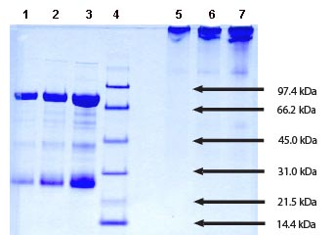
How to present a gel
M_{w} of my protein is ~80 kDa, here you can see the band of the protein and here presumably some degradation of it. As it is multi-domain protein, may be one of the domain is auto-cleaved, protein is tagged with SUMO (M_{w}=XY), GST (M_{w}=XY) etc. so it may be also some of these …

Slide 48
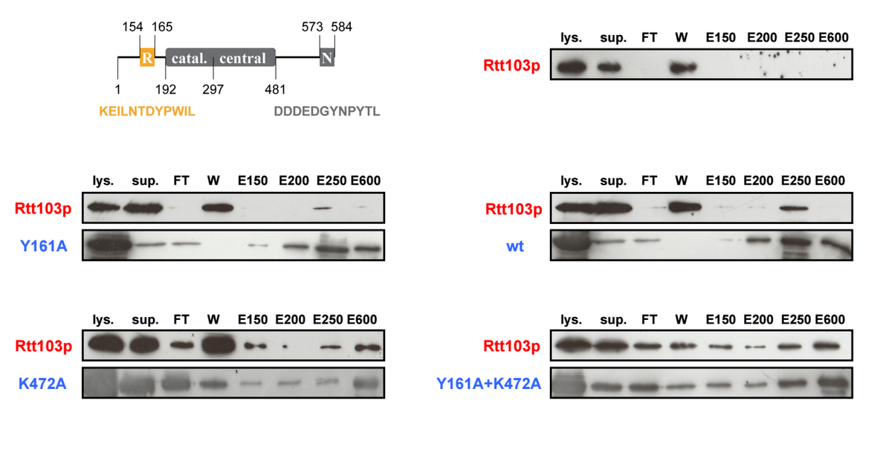
Does Trf4 interact with Rtt103?
Trf4p
Rtt103 – FLAG-tagged, Trf4 – His-tagged

Slide 49
Does Trf4 interact with Rtt103?
Trf4p
Anti-His – control
Rtt103 – FLAG-tagged, Trf4 – His-tagged

Slide 50
Does Trf4 interact with Rtt103?
Trf4p
Anti-His – control
Rtt103 – FLAG-tagged, Trf4 – His-tagged

Slide 51
Does Trf4 interact with Rtt103?
Trf4p
Anti-His – control
Rtt103 – FLAG-tagged, Trf4 – His-tagged

Slide 52
Does Trf4 interact with Rtt103?
Trf4p
Anti-His – control
Rtt103 – FLAG-tagged, Trf4 – His-tagged

Slide 53
Does Trf4 interact with Rtt103?
Trf4p
Anti-His – control
Yes, they do! (It’s obvious:-)
Rtt103 – FLAG-tagged, Trf4 – His-tagged

Slide 54
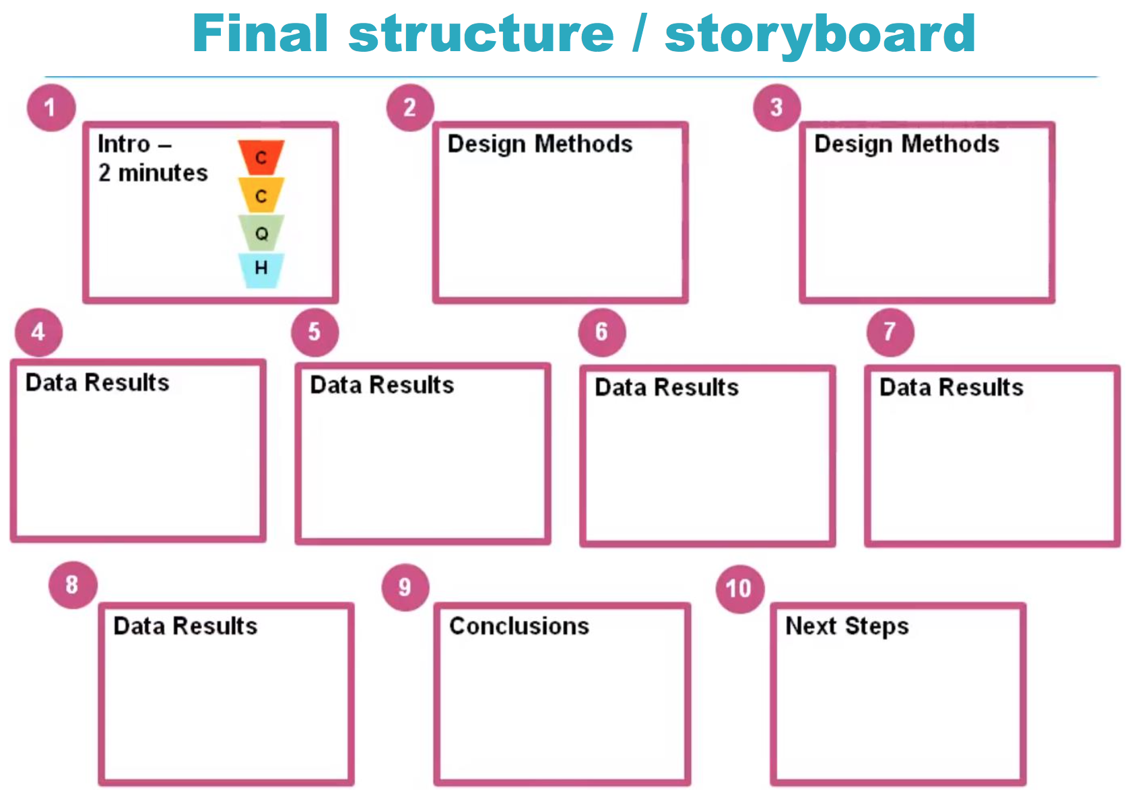

Slide 55
“Naše mládež miluje přepych, je špatně vychovaná, vysmívá se představeným a vůbec si neváží starých lidí. Děti jsou hotoví tyrani. Nepovstanou, když do místnosti vejde starší člověk. Odmlouvají rodičům. Řečeno jednoduše: jsou velmi špatní …”
Seneca, roku 50 p. K.
“Ztratil jsem všechny naděje, pokud jde o budoucnost naší země až dnešní mládež převezme do svých rukou otěže řízení. Je to mládež neukázněná, drzá a nesnesitelná.”
Hesiodos, 720 př. K.
“Náš svět je v kritickém stavu. Děti neposlouchají rodiče, neučí se, nemají snahu po vzdělání. Konec světa není příliš daleko.”
neznámý egyptský kněz, 2000 př.n.l.

Slide 56
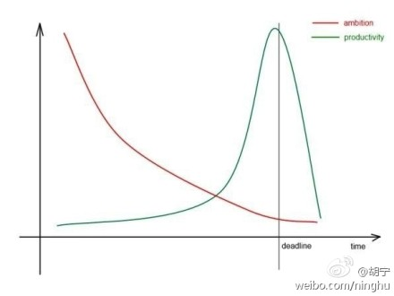
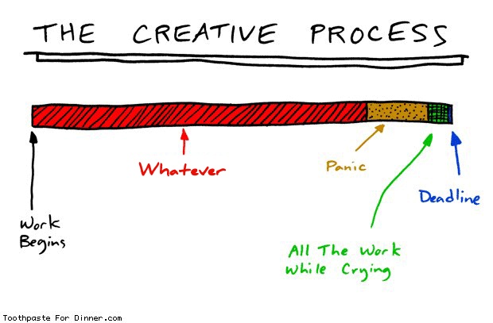

Slide 57
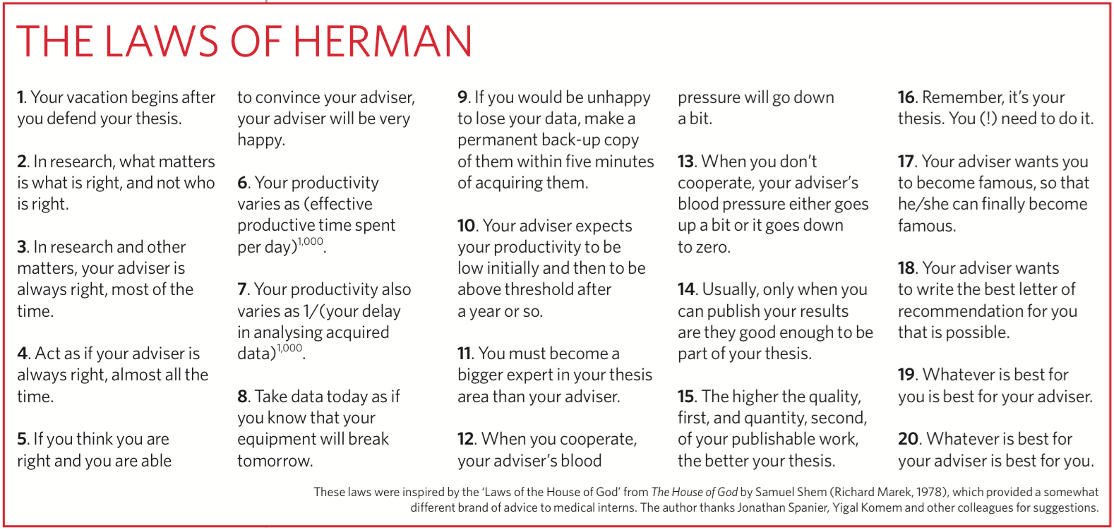

Slide 58
What makes a good (PhD) student
Choose a supervisor whose work you admire and who is well supported by grants and departmental infrastructure.
Take responsibility for your project.
Work hard — long days all week and part of most weekends. If research is your passion this should be easy, and if it isn't, you are probably in the wrong field. Note who goes home with a full briefcase to work on at the end of the day. This is a cause of success, not a consequence.
Take some weekends off, and decent holidays, so you don't burn out.
Read the literature in your immediate area, both current and past, and around it. You can't possibly make an original contribution to the literature unless you know what is already there.
Plan your days and weeks carefully to dovetail experiments so that you have a minimum amount of downtime.
Keep a good lab book and write it up every day.
Be creative. Think about what you are doing and why, and look for better ways to go. Don't see your PhD as just a road map laid out by your supervisor.
Develop good writing skills: they will make your scientific career immeasurably easier.
To be successful you must be at least four of the following: smart, motivated, creative, hard-working, skillful and lucky. You can't depend on luck, so you had better focus on the others!
Nature 441, 252 (10 May 2006) | 10.1038/nj7090-252b

Slide 59
Time management story to show/understand how planning of tasks is the key to time management.
Start with a bucket, some big rocks enough to fill it, some small stones, some sand, and water.
The bucket is your available time. The rocks, stones, sand and water are your tasks - a few big ones, some more medium-sized ones, and lots of small jobs and continuous demands and interruptions.
Put the big rocks in the bucket - is it full?
Put the small stones in around the big rocks - is it full?
Put the sand in and give it a shake - is it full?
Put the water in. Now it's full.
The point is: unless you put the big rocks in first, you won't get them in at all.
In other words: Plan time-slots for your big issues before anything else, or the inevitable sand and water issues will fill up your days and you won't fit the big issues in.
Note that a big 'task' isn't necessarily a work task - it could be your child's sports-day, or a holiday.

Slide 60
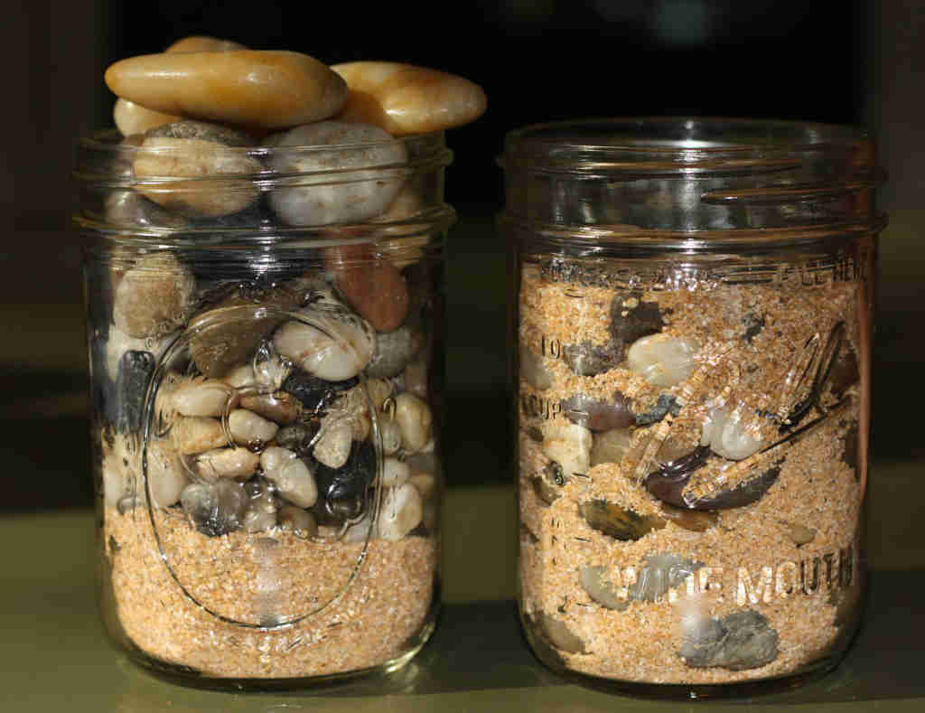
http://www.visjonaer.com/blog/put-the-big-rocks-in-first-in-the-jar-of-life

Slide 61
Neumíš?
Naučíme Tě!
Nemůžeš?
Pomůžeme Ti!
Nechceš?
Nepotřebujeme Tě!

Slide 62
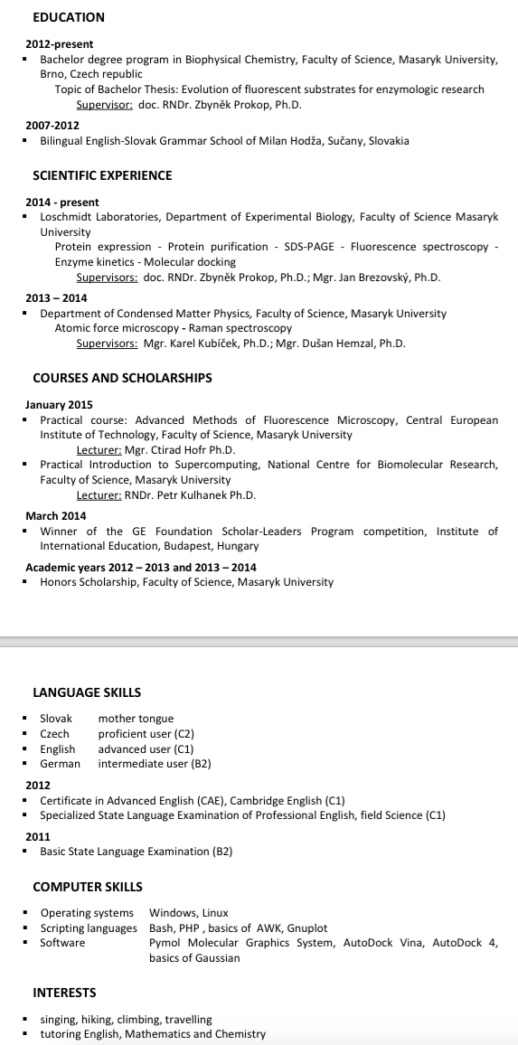
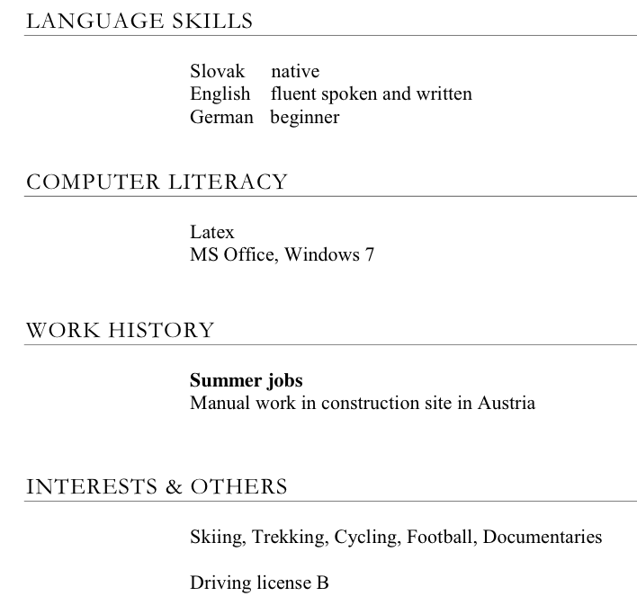

Slide 63
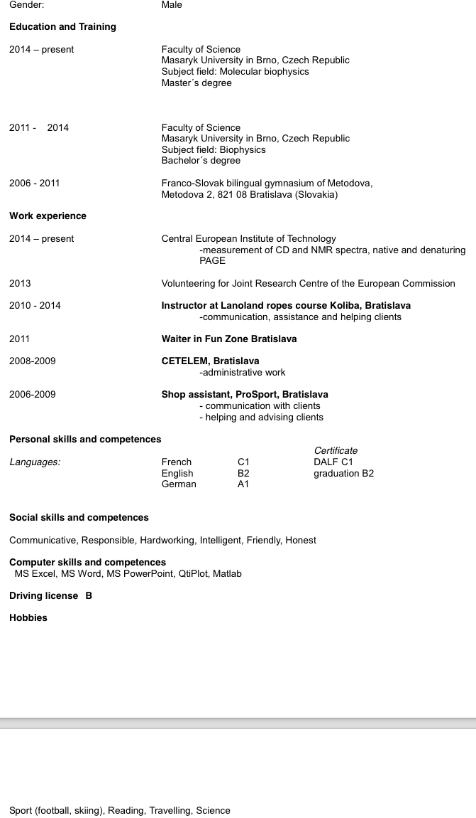
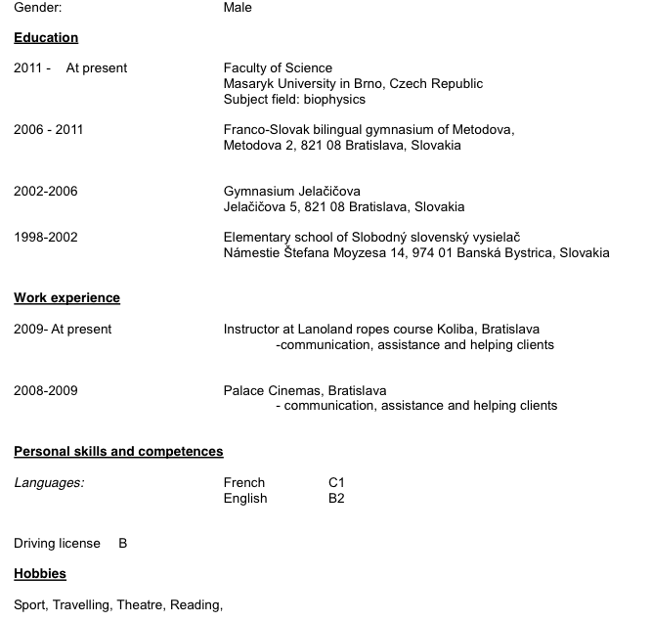

Slide 64
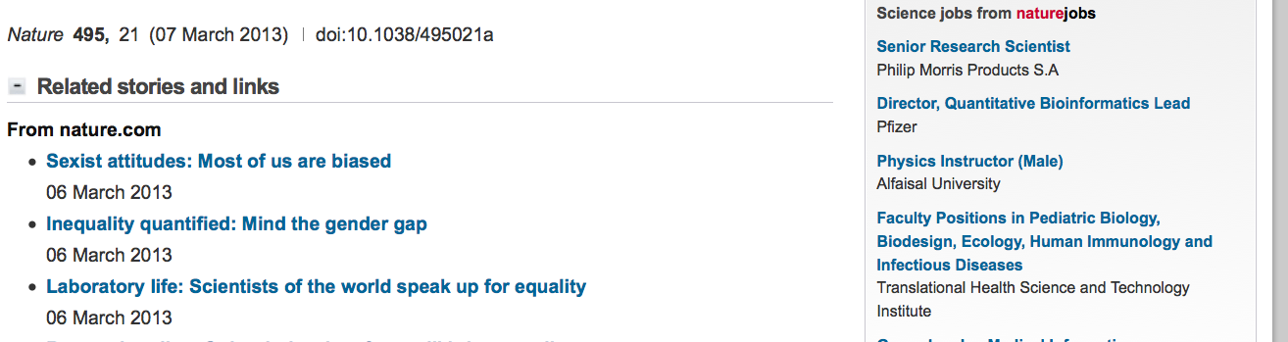

Slide 65
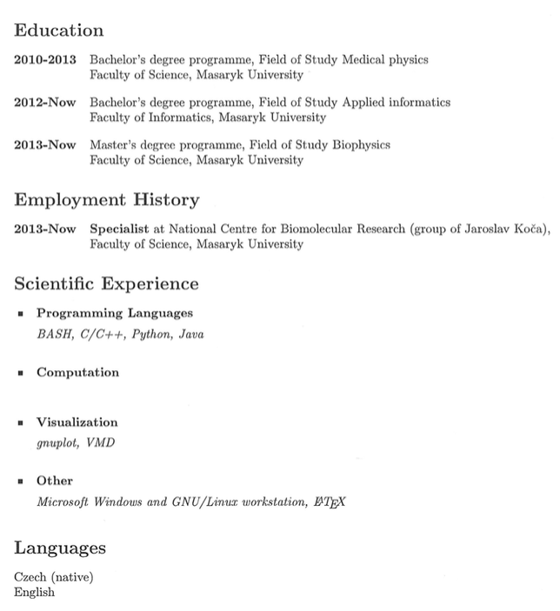

Slide 66
CV
Why to write one
  Apply for
    Job
    Funding
    Speculative application
    Collaboration
    People remember you
    Ask for supporting letter
What does the reader expect
What you have
    Done
    Achieved
=> Selected or Not?

Slide 67
Your CV is a marketing document, not just information record
“Students need to be reminded that the CV is a piece of personal marketing that has to engage the reader immediately”
How many CVs?
Each reader is looking for something different => shape your CV according to the position you’re applying for.

Slide 68
CV –structure
University of Cambridge recommends NOT to put Curriculum Vitae, rather your name
Name
Contacts - something that is secure, stable, and reliable (and verifiable), “intelligent” contacts – hchkrdtn@html, beruska@html, brouk@html, 42353478@hmtl …
Education - not before high-school degree
Employment / Work Experience
- your roles, achievements
Additional Skills - RELEVANT to the position you’re applying for
Activities and Interests - what do you want to show – responsibility and sense of personality or motivations
References / Referees - their position and contacts – make sure they know (and agreed) about being referees for you

Slide 69
Most Frequent Mistakes (???)
Photo
Formatting
Structure – priorities – time or thematically organized
Typos
Rarely Achievements / Awards / Recognitions
Qualification – tasks you’re able / experienced with

Slide 70
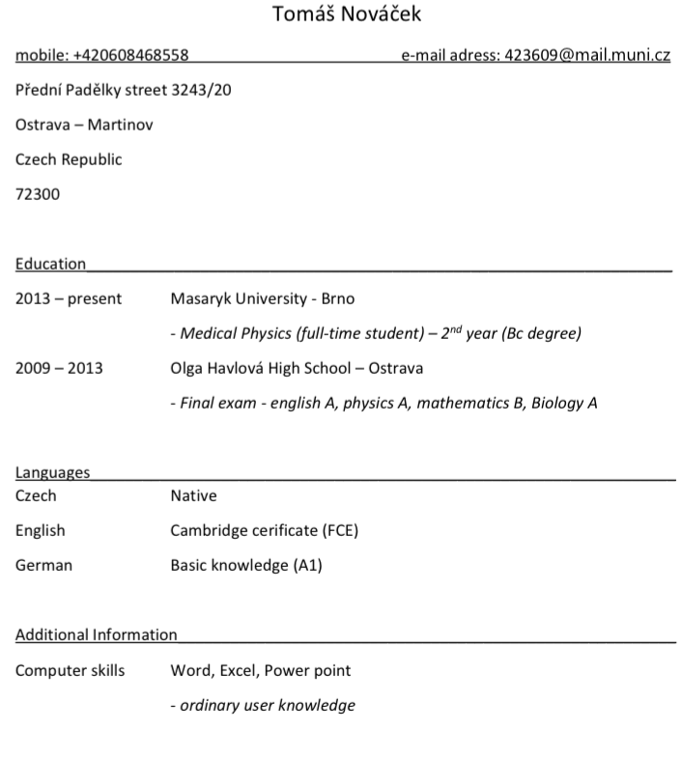
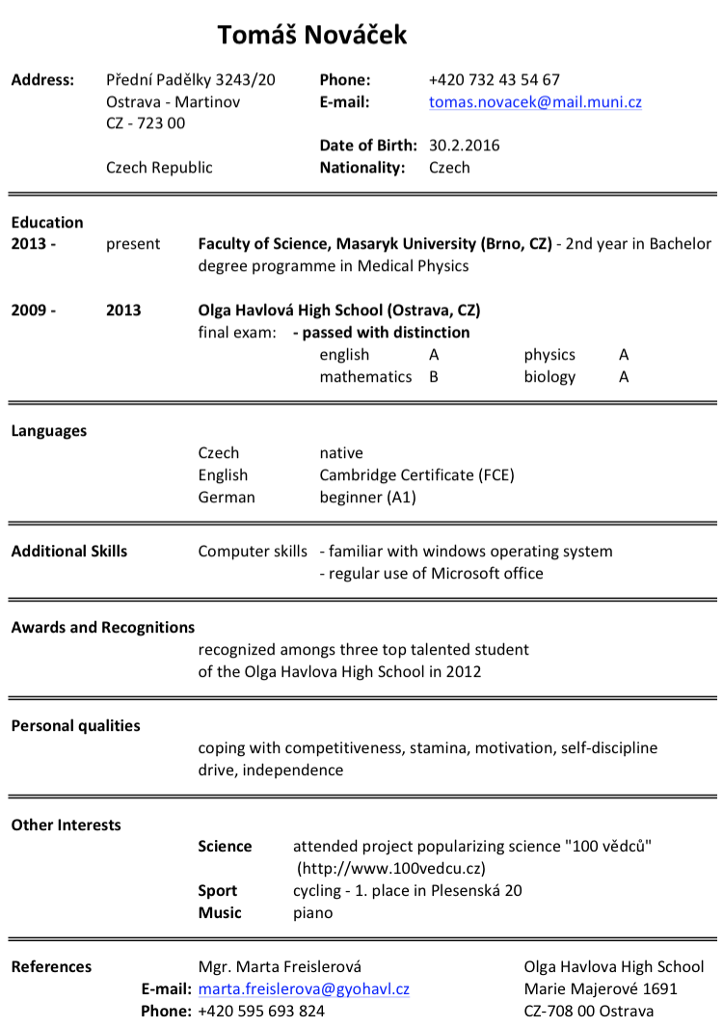

Slide 71
Practice makes the master!
Acknowledgement:
Tomasz Kabzinski
Magdaléna Krejčíková
Jiří Chaloupka
Materials used:
Susan K. McConnell (Stanford University)
Prof. Keimer (MPI Stuttgart)
Leslie Lamport, 4 August 1979

Slide 72
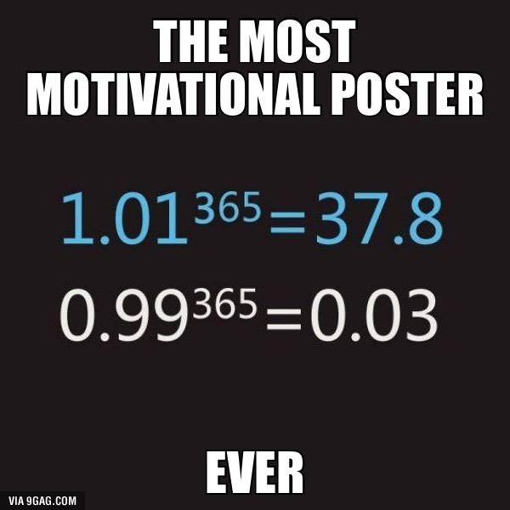

Slide 73
What Is a Motivation Letter?
short letter that explains why you’re the perfect fit for a job.
one page
It’s chance to highlight achievements and showcase interests.
for a job.
applying to a college or university
an educational program
an internship
or even a volunteer role

Slide 74
Motivation Letter vs. Cover Letter
might seem pretty similar at first glance
both are 1 page or less and go along with your resume and application
to impress the hiring manager and make them seriously consider your application.
One key difference
Cover letters dive into the nitty-gritty, with specific examples of how your education, skills, job experience, and achievements perfectly align with the job requirements. They concentrate on highlighting your work experience.
Motivation letters take a broader approach. Instead of focusing on specifics, they showcase your interests, personality traits, and the reasons behind your application. They’re great when you don’t have much relevant experience to share. We’ll dig into this more in the next section.

Slide 75
Motivation letter
motivation letter is actually “part two” of your application
CV is a summary of the facts (educational background and work experience)
motivation letter allows to show a bit more of personality and indicate why you are suitable for the particular position
make sure that your motivation letter supports your CV
emphasise relevant information about skills and experience
Before you start, analyse the vacancy and make sure you have enough information to write a good and compelling motivation letter.
e.g. LinkedIn can also help
Radboud Universiteit

Slide 76
General tips
Use short, active sentences - get to the point
Ensure your motivation letter is in line with your CV but avoid identical overlap. In your CV, you can mention aspects about which you provide further details in your motivation letter
Avoid negative/denying words
Carefully check the name and job position of the receiver
Write convincingly, but not obtrusively. Don’t draw conclusions in your text, but rather formulate your arguments in such a way that the receiver can reach the desired conclusion
Try to imagine the perspective of the reader. They want to know “What's in it for me?” So don’t focus on what the company and/or the job position means to you

Slide 77
General tips
Customise your motivation letter for every application, delete, clarify or move items
Avoid abbreviations and technical jargon
Make sure there are no spelling mistakes in your motivation letter
A motivation letter should be a maximum of 1 A4 sized page about 2/3 filled with text
Always send your CV and motivation letter in PDF format and put your name in the title of your CV, motivation letter and email
Have your motivation letter read by someone else before you send it.

Slide 78
Structure of the motivation letter
General info
Motivational paragraph
Paragraph(s) about yourself
Conclusion of your motivational letter

Slide 79
Structure of the motivation letter
General info
Address details
Company details and contact person
Place and date
Subject
Dear Mrs __ or Mr __, Make sure you have a name and do not send the letter to “Dear Mr/Mrs”

Slide 80
Structure of the motivation letter
Motivational paragraph
Choose a neutral opening or a real distinctive, compelling phrase if you have a talent for writing. (DeepL/Write, Grammarly, ChatGPT …)
Be sure to use wording that is right for you and is appropriate for the job position.
Example:
Hereby, I respond to the ___ vacancy which I found on the Faculty of Arts Career Services website. This vacancy caught my attention, because I see a great deal of similarity between the job requirements and my experiences.
If possible, refer to a previous contact moment that you may have had by phone or email.
Example:
I would like to respond to the ___ vacancy which I found on the website www.muni.cz. Our phone call on [date] stoked my interest in the vacancy and has made me very enthusiastic about fulfilling this exiting job position.

Slide 81
Structure of the motivation letter
Paragraph(s) about yourself
Convince the recipient that you are the right candidate. Explicitly argue and name
characteristics, work experience, and skills which you possess and which match the requirements of the vacancy.
Writing these paragraphs is easiest if you have first made a list of the most important
requirements of the job position and the desires of the company along with a list of your
characteristics, experiences and skills that match the profile. Based on this scheme, you can “build” your argument.

Slide 82
Structure of the motivation letter
Paragraph(s) about yourself
Possible arguments:
I have the right education.
I have relevant work experience.
I have the right characteristics/attitude/mentality.
I'm specifically interested in this job position / organisation because ...
Please note: you may not be required to include a motivation letter with your CV, instead you may be asked to provide a short motivation. In this case, include the information from the “paragraphs about yourself”.

Slide 83
Structure of the motivation letter
Conclusion of your motivational letter
Briefly indicate your goal for this application - getting an invitation for a job interview. Also here you can choose a neutral conclusion or a distinctive and compelling phrase. Just make sure the writing style is consistent with the paragraphs above.
Example:
I would like to further clarify my motivation in a personal conversation. I look forward to your swift response.
Kind regards, Jan Novák
Annex: Curriculum Vitae

Slide 84
Proofread your motivation letter
Proofread your motivation letter to make it more concise and professional.
Correct any spelling and grammatical errors and awkward phrasing.
Edit information already listed in your application form or resume to ensure your motivation letter contains only unique information.
You may need to proofread your motivation letter several times to identify all problem areas. If time permits, complete this step two days or more after writing your motivation letter as time away from your work allows you to view it more objectively. To help ensure your letter has professional grammar and spelling, ask a trusted friend or family member to proofread your motivation letter after you.

