Slide 1
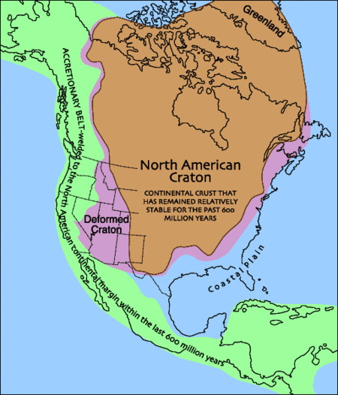
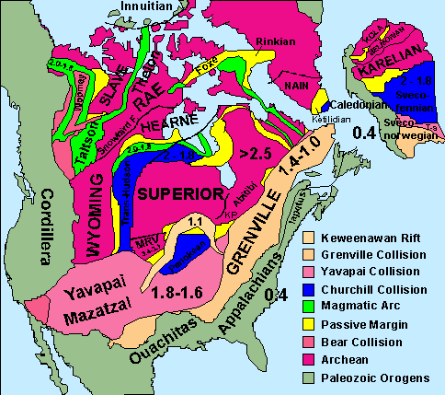
Severoamerický kraton (Laurentie)

Slide 2
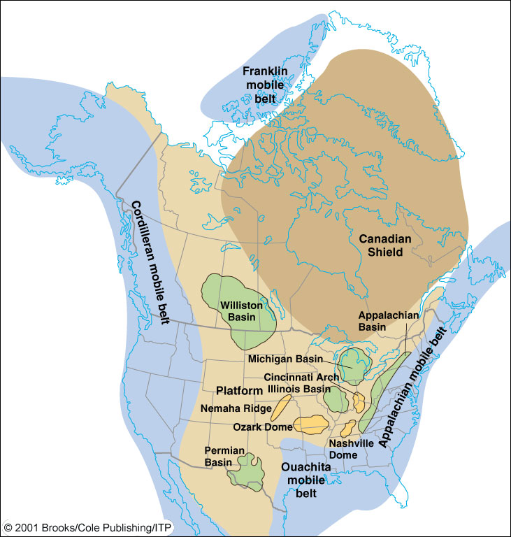

4
Canadian (Laurent) shield – not covered during Paleozoic, re-mainder of craton (light brown) was periodically cover-ed by epeiric (shallow, inland) seas. Green (basins) & yellow (domes) = local areas of gentle warpage of platform sedimentary rocks.
Appalachian Basin

Slide 3

První významnou orogenezí byla na konci archaika orogeneze algomská (kenoranská), která vytvořila kraton Superior. V paleoproterozoiku Taltson – Thelon orogeneze přičlenila ke kratonu Rae kraton Slave. Hlavní část laurentského kratonu byla vytvořena při transhudsonské orogenezi (1,8-1,9 Ga), menší části byly přičleněny při woopmayské, yavapaiské-mazatzalské a penocké orogenezi (1,5-1,8). Nejmladší proterozoickou orogenezi je grenvilská, která skončila před 1,0 Ga.

Slide 4
Trans-Hudson orogeny
The Trans-Hudson orogeny was the major mountain building event that formed the Precambrian Canadian Shield and the North American Craton (also called Laurentia), forging the initial North American continent. The Trans-Hudson orogen sutured together the Hearne-Rae, Slave, Wyoming and Superior cratons to form the cratonic core of North America in a network of Paleoproterozoic orogenic belts. The Trans-Hudson orogenic belt developed as a result of closure of the Manikewan Ocean. Manikewan Ocean opened at approximately 2.1 Ga via rifting of a possible Neoarchean supercontinent along the margins of the Hearne and Superior Cratons

Slide 5
Fig.2. Series of cartoons illustrating a map view of the geological evolution of the THO, with the main tectonic
elements shown: (a) main lithotectonic elements during the interval 1.98–1.92 Ga, prior to the onset of convergence;(b) the interval 1.92–1.89 Ga; (c) the interval 1.88–1.865 Ga; (d) the interval 1.865–1.85 Ga; (e) the interval 1.85–1.83 Ga; and (f) the interval 1.83–1.80 Ga. The blue coloured hashed lines represent possible extensions of the Superior Craton at Moho. Although not discussed in text, evolution of North Atlantic Craton (shown here to include Archaean basement rocks and their cover on Hall and Cumberland peninsulas on Baffin Island (e.g. Scott 1999;Jackson & Berman 2000) and tectonostratigraphic elements of the New Quebec and Torngat orogens are after Wardle et al. (2002). Abbreviations: Am, Amer group; B, Burwell arc; BeS, Bergeron suture; BS, Baffin suture; BiS, Big Island suture; Bf, Bravo formation; Ch, Chukotat; FFG, Flin Flon–Glennie Complex; FR, Fox River belt; GFtz, Great Falls tectonic zone; GLsz, Granville Lake structural zone; Hoare Bay group; KB, Kisseynew Basin; Ke, Ketyet group; LL, La Ronge–Lynn Lake belts; LTSz, Lac Tudor shear zone; M, Molson dykes; MHB, Medicine Hatblock; M.I., Meta Incognita micro-continent; Pe, Penrhyn group; Pi, Piling group; PS, Parent arc and Spartan forearc; PT, Pelican thrust; SL, Snow Lake belt; SS, Sugluk suture; STZ, Snowbird Tectonic Zone; TA, Tasiuyak
domain; TNB, Thompson Nickel Belt

Slide 6
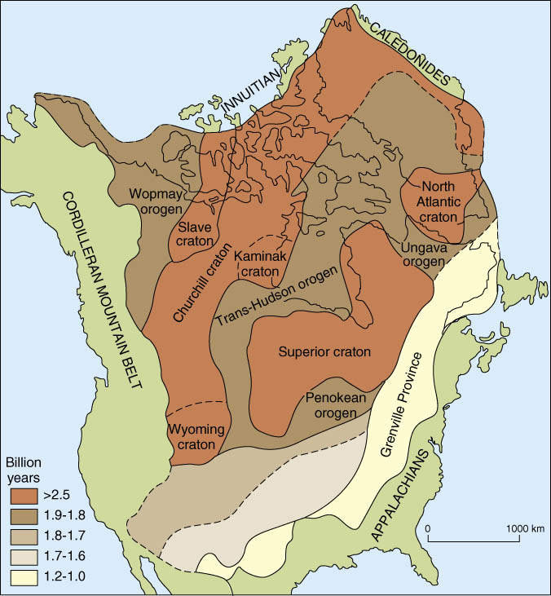

Slide 7
Grenville Orogeny
Late Mesoproterozoic Grenville Orogeny records convergence, arc accretion, and continent continent collision between ca. 1350 and 1000 Ma. Within the Grenville Province of south-eastern Canada, which is the most thoroughly studied portion of this composite orogen, this period of orogenesis included (1) an early accretionary stage at 1.3–1.2 Ga, (2) an interval of widespread magmatism at 1.18–1.08 Ga, (3) and a period of continent–continent collision at 1.08–0.98 Ga that was rapidly followed by uplift and exhumation of the orogenic core.
The Grenville orogeny was a long-lived Mesoproterozoic mountain-building event associated with the assembly of the supercontinent Rodinia. Its record is a prominent orogenic belt which spans a significant portion of the North American continent, from Labrador to Mexico, as well as to Scotland. It is assumed that separate continental blocks collided with Laurentia – Kalahari, Baltica and Amazonia

Slide 8
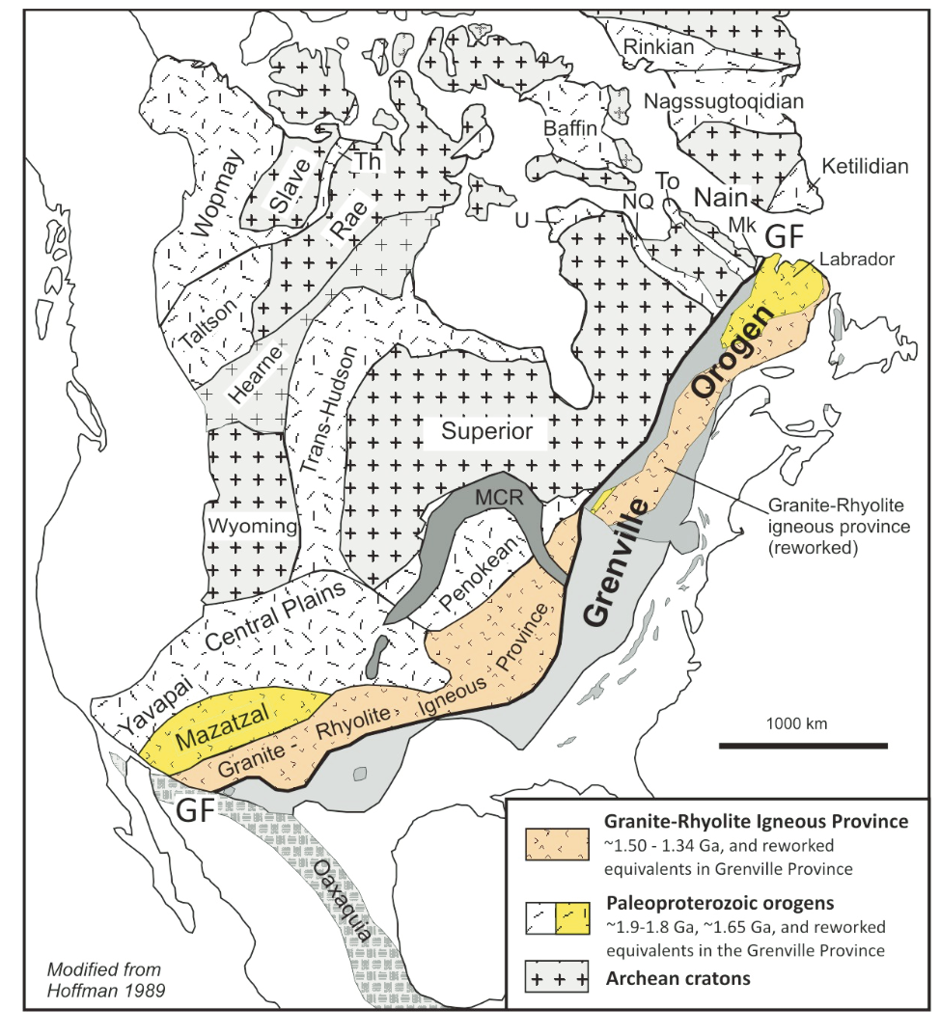
Grenville orogeny
The Grenville orogeny was a long-lived Mesoproterozoic mountain-building event associated with the assembly of the supercontinent Rodinia

Slide 9
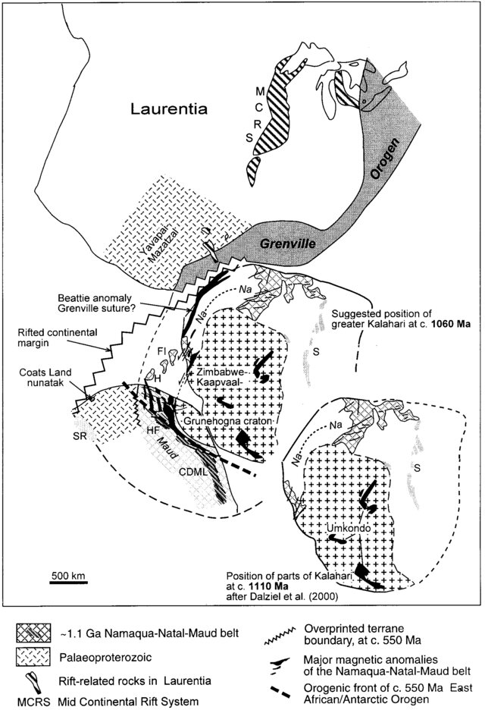
Fig. 7 Reconstruction of Laurentia and Kalahari at ca. 1,110 Ma (after Dalziel et al. 2000), and a possible closer fit at ca. 1,060 Ma at the end of the Grenville orogeny. Note possible correlation of Coats Land and the Yavapai-Mazatzal Province. During later rifting Kalahari inherited parts of the Laurentia foreland, i.e. Coats Land. CDML Central Dronning Maud Land; SR Shackleton Range; HF Heimefrontfjella; H Haag Nunatak; FI Falkland Islands; Na-Na Namaqua-Natal; S Sinclair Suite (ca. 1.1 Ga)

Slide 10
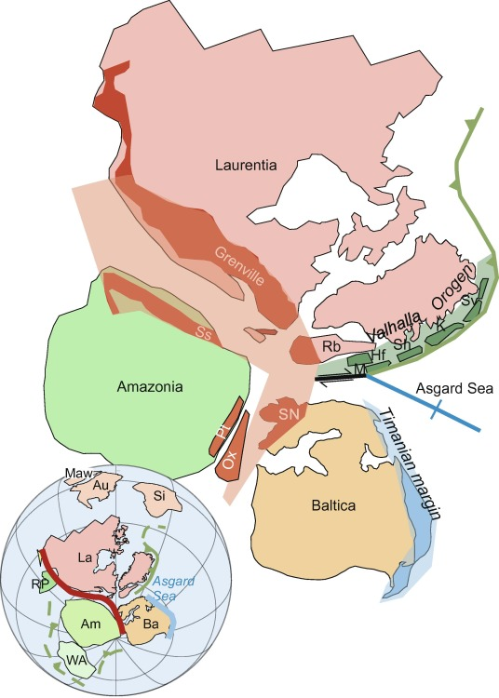
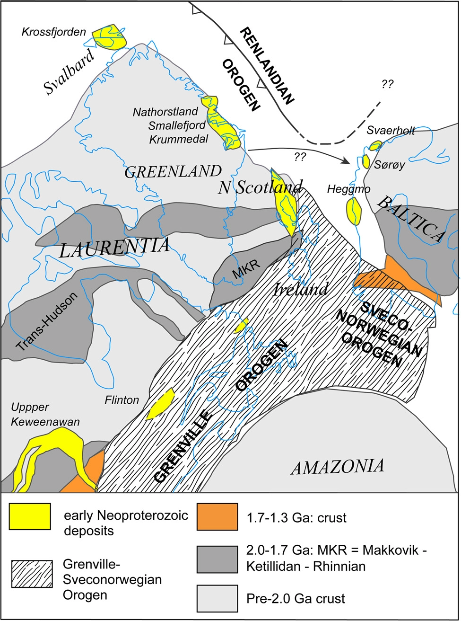

Slide 11
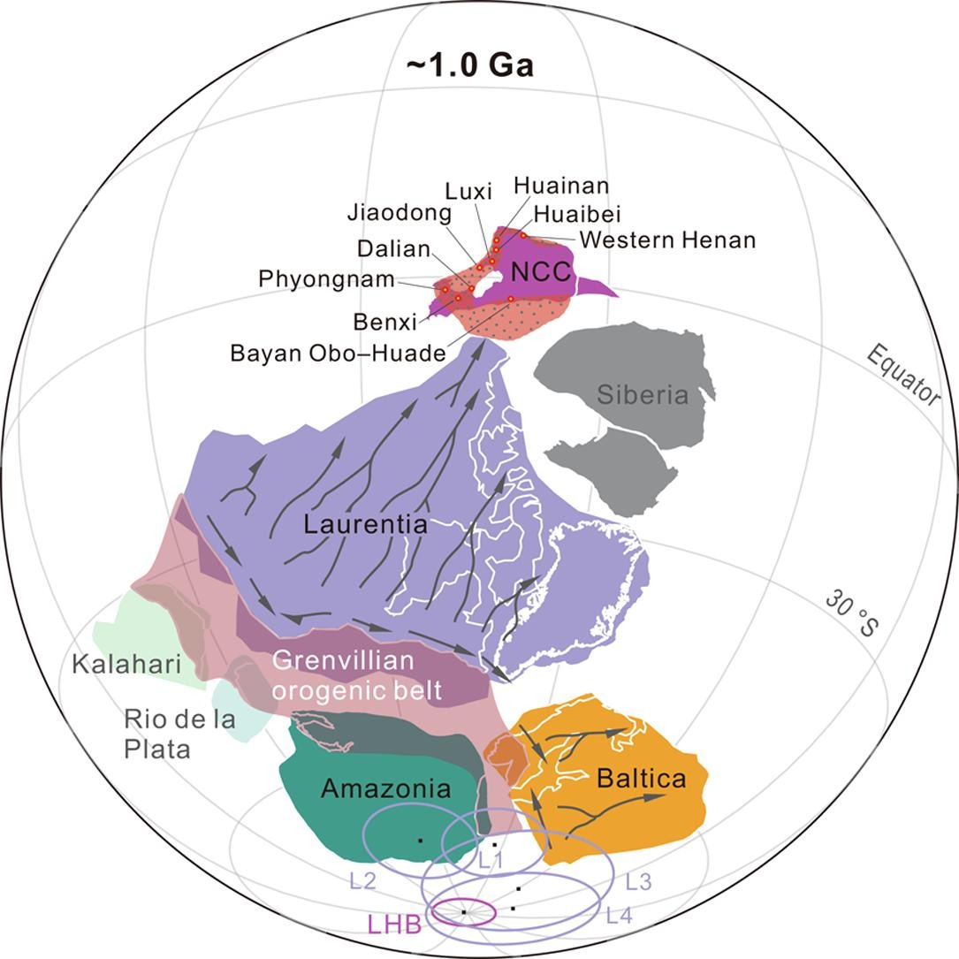
Fig. 15. Paleogeographic reconstruction of the North China craton (NCC), Laurentia, Baltica and other major cratons in supercontinent Rodinia at ∼1.0 Ga

Slide 12
Fanerozoické mobilní zóny
Apalačskou mobilní zónu a na ní navazující na severu britské kaledonidy a na jihu pásmo Quatchita-Marathon
Kordilerská mobilní zóna
Franklinsko-inuitská mobilní zóna

Slide 15
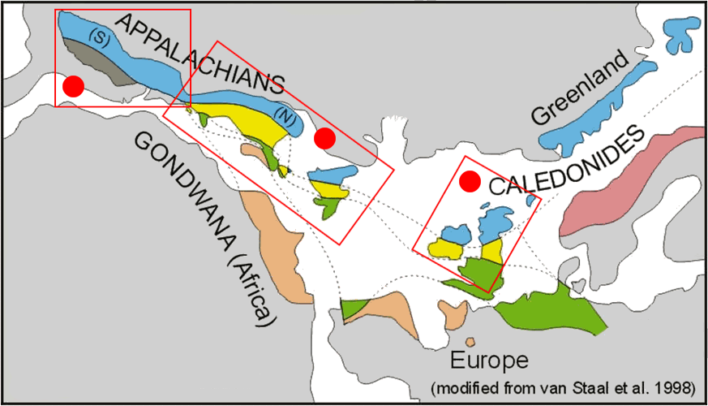

Slide 16
KALEDONSKO-VARISKÁ OROGENEZE
As the Rodinia supercontinent continued to break apart, the Iapetus Ocean opened, splitting apart Laurentia, Baltica and Gondwana.

Slide 17
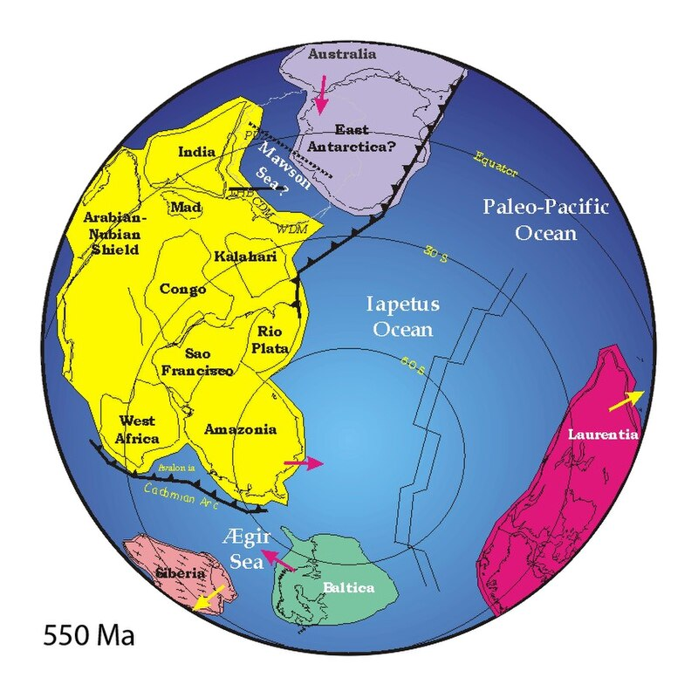

Slide 18
Grónské kaledonidy - kolize se skandinávskou části Evropy
Apalače – teránní stavba u kaledonské orogeneze (takonská, salinická, akadská fáza)
variské (alleghanská) orogeneze – kolize s Gondwanou
Britské kaledonidy-pokračování Apalačí
Pásmo Quatchita-Marathon – alleghanská fáze, kolize s
jihoamerickou části Gondwany

Slide 19
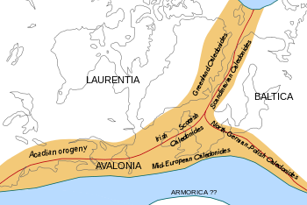

Slide 20
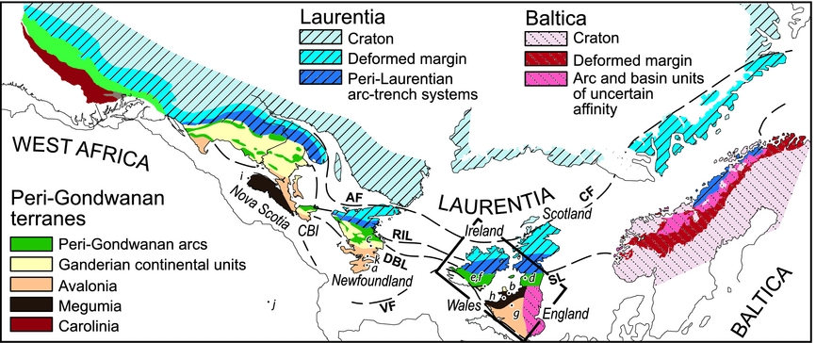
Figure 1. Map of the Appalachian–Caledonide Orogen superimposed on a ‘Pangea’ reconstruction prior to Atlantic opening, after Waldron et al. Reference Waldron, Schofield, Murphy and Thomas(2014b). Locations a–k correspond to samples plotted in Figures 3–5. AF – Appalachian Front; CBI – Cape Breton Island; CF – Caledonide Front; DBL – Dog Bay Line; RIL – Red Indian Line; SL – Solway Line; VF – Variscan Front.

Slide 21
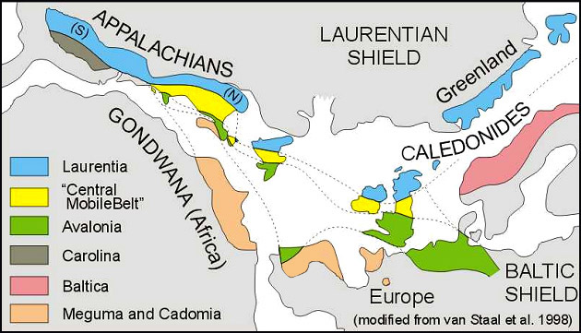

Slide 22
APALAČE
As the Rodinia supercontinent continued to break apart, the Iapetus Ocean opened, splitting apart Laurentia, Baltica and Gondwana. Appalachian orogeny started with the closure of the Iapetus and continued with the closure of the Rheic ocean - collision with African part of Gondwana
Accretionary orogen with final collision of African part of Gondwana in the southern part

Slide 23
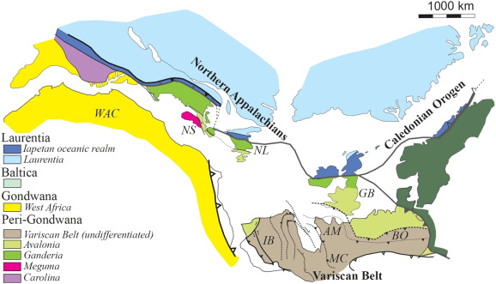
Fig. 1. Tectonic map of the Appalachian-Variscan-Caledonian orogen

Slide 24
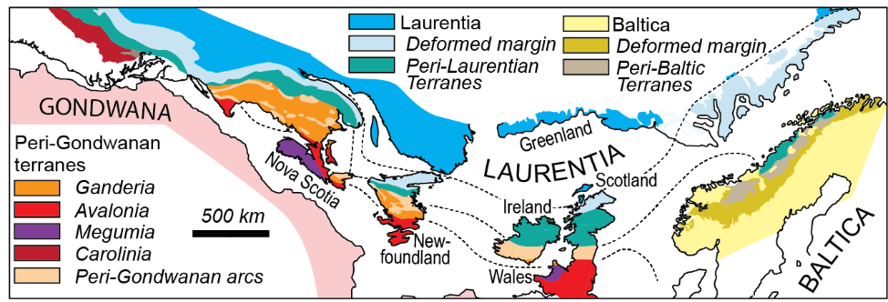
Apalače představují složený orogen, jehož tvorba probíhala jak během kaledonských fází tak během variských fází. Údaje seismiky ukazují, že celá jižní část Apalačí je pravděpodobně podstýlána velkou zónou odlepení a celý horský hřeben je alochtonní.
Apalače byly utvářeny při 4 hlavních orogenezích. Takonská orogeneze zahrnovala kolize perilaurentskými bloky Notre Dame a Inner Piedmont situovanými v oceanu Iapetus v části přiléhající k Laurentii. Salinická kolizi Ganderie s Laurentii. Akadská a neoakadská fáze kolizi Ganderie a Avalonie a Avalonie a Megumy na severu a superteránu Carolina na jihu s tehdejším okrajem Laurentie. Alleghanská orogeneze potom kolizi s africkou částí Gondwany. Ta je reprezentováná teránem Atlantic coastal plain

Slide 25
Coastal plain

Slide 26
Hlavní tektonické jednotky Apalačí
Okraje Laurentie – skupina I, Humber, more to the south Valley and Ridge, Blue-Ridge
teranes
Centrální zóna – terány II. a III. skupiny složitá akreční melanž teránů různé povahy situvaných v oceánu Iapetus a při jeho okrajích. Kontinentálních fragmenty, vulkanické oblouky, oceánické sedimenty. V podstatě se dají rozlišit terány, které vznikaly při okraji Laurentie a terány, které vznikaly při okraji perigondwany.
Perilaurentské terány skupiny II
V severní části Apalačí to je zejména zóna Notre Dame, vznikající na fragmentu Humberu. V jižní části zóna Inner Piedmont vznikající na fragmentu Blue Ridge okraje Laurentie. Fragmenty Laurentie a vulkanické oblouky Iapetu
Perigonwanské terány skupiny III – fragmenty Gondwany a přilehlé vulkanické oblouky Iapetu
Je to perigondwanská Ganderie tvořená fragmentem Gondwany (Gander) a vulkanickými oblouky oceanické a kontinentální povahy (Popelogan arc – fragment Ganderu) a horninami zaobloukové pánve. V jižní části Apalačí je to perigondwanský superterán Carolina
Perigondwanské terány – terány IV a V -Avalonia,, Meguma-původně součástí Gondwany
Gondwana - Atlantic coastal plain

Slide 27
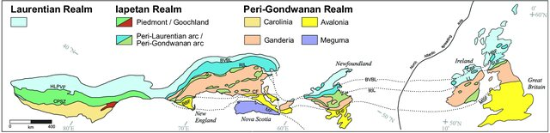
Peri-laurentské a peri-gondwanské vulkanické oblouky oceánu Iapetus nejde vždy dobře oddělit
Figure 1. Appalachian lithotectonic realms and their continuation into Britain and Ireland (modified after Pollock et al. 2012). BBF = Bloody Bluff fault; BVBL = Baie Verte Brompton Line; CF = Caledonia fault; CPSZ = Central Piedmont shear zone; CBF = Clew Bay fault; DHF = Dover-Hermitage Bay fault; HBF = Highland Boundary fault; HLPVF = Hollins Line-Pleasant Valley fault; LL = Leadhills Line; MF = Minas fault; MSF = Menai Strait fault; RIL = Red Indian Line; SUF = Southern Uplands fault.

Slide 28
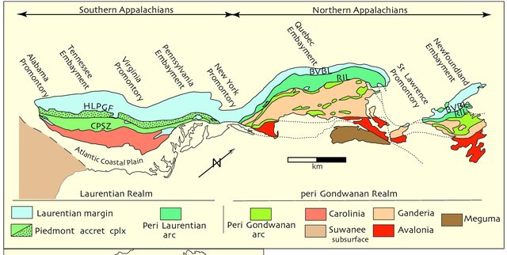
Figure 1. First-order architecture of the Appalachian orogen depicting distribution of the major, mainly preSilurian, lithotectonic divisions. BVBL = Baie VerteBrompton line; CPSZ = central Piedmont shear zone; HLPGF = Hollins line-Pleasant Grove fault system; RIL = Red Indian line.

Slide 29
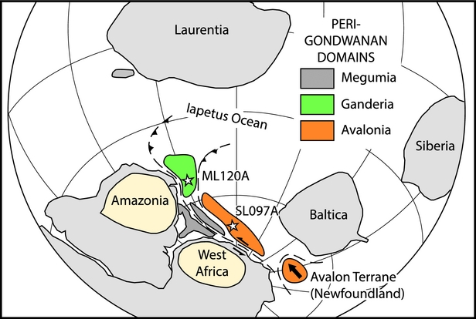
Figure 7. Highly schematic cartoon showing possible terrane relationships of selected peri-Gondwanan terranes in Cambrian time, based on Murphy et al. (Reference Murphy, Waldron, Schofield, Barry and Band2014), Waldron et al. Reference Waldron, Schofield, Murphy and Thomas(2014b) and Pothier et al. (Reference Pothier, Waldron, Schofield and DuFrane2015a,b).

Slide 30
Fig. 1. Tectonicmap of the Appalachian-Variscan-Caledonian orogen. Tectonicmap showing the distribution of the Appalachian, Variscan and Caledonian belts at the end of the Paleozoic.
Shown are themajor cratonic andmicrocontinental components within the orogenic belts including Iberia (IB), Amorican Massif (AM), Massif Centrale (MC), Bohemian Massif (BO) and
theWest African Craton (WAC). This represents the approximate configuration of Pangea following late Paleozoic convergence between Laurentia and Gondwana.
The figure is modified from Hibbard et al. (2007), Barreiro et al. (2007), Keppie et al. (2008) and Pollock et al. (2011).

Slide 31
Severní Apalače

Slide 32
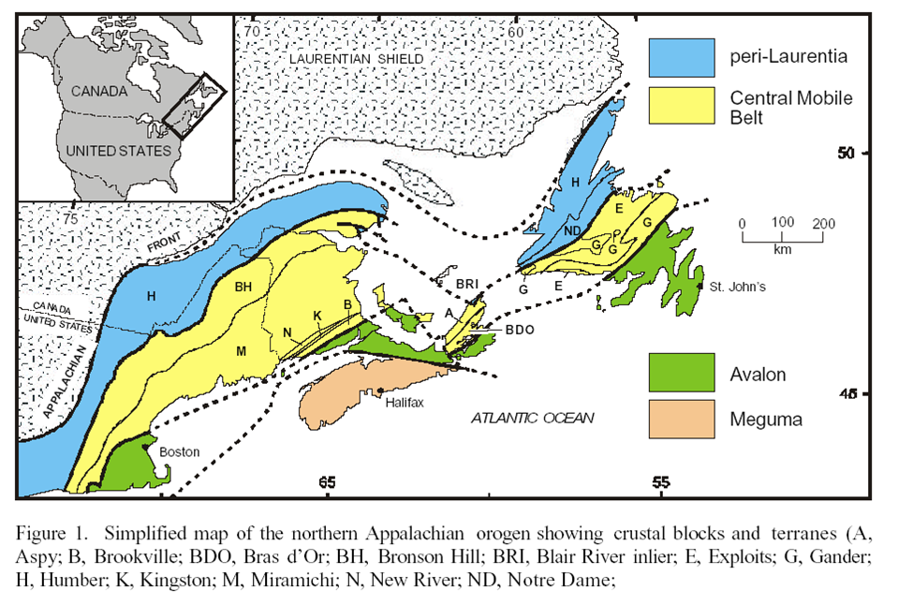
Terán Humber – terán skupiny I
Tektonicky modifikovaný okraj Laurentie. Tento terán zahrnuje miogeosynklinálu situovanou na laurentinském pasivním kontinentálním okraji. Táhne se od SZ Newfoundlandu do zóny Valley and Ridge a Blue Ridge na jihu. Basement se skládá z grenvilských rul (1,0Ma) na kterých spočívají klastické a karbonátové riftové sedimenty kambria až spodního ordoviku.

Slide 33
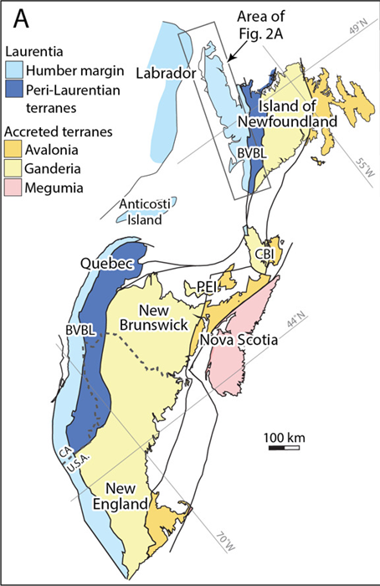
Figure 1. (A) Simplified map of the northern Appalachian orogen modified from Hibbard et al. (2006). Humber margin rocks include autochthonous and allochthonous continental margin units exposed in the westernmost Appalachians. CA - Canada; CBI - Cape Breton Island; PEI - Prince Edward Island; U.S.A. - United States of America. (B) Interpreted continental margin geometry of eastern Laurentia modified from Allen et al. (2010) that assumes formation by a simple-shear, low-angle detachment rift system. The ocean-continent transition is oversimplified and does not show zones of hyperextended crust and exhumed continental mantle in outboard regions. Selected igneous rock occurrences: BC - Birchy complex (556–564 Ma, van Staal et al. , 2013); BR - Blair River dikes (576 Ma and 581 Ma: Miller & Barr , 2004); BM - Baie des Moutons complex (583 M: McCausland et al. , 2011); DH - Disappointment Hill pluton (607 Ma: Hodgin et al. , 2021); LRD - Long Range dikes (615 Ma: Kamo et al., 1989, 1995); LM - Lac Matapédia volcanics (565 Ma: Hodych & Cox , 2007); LS - Lady Slipper pluton (555 Ma: Cawood et al. , 2001); MR - Mont Rigaud syenite (533 Ma: McCausland et al. , 2007); RP - Round Pond granite (602 Ma: Williams et al. , 1985); SC - Skinner Cove Formation volcanics (Cawood et al. , 2001); SI - Sept Îles complex (564 Ma, Higgins & van Breemen , 1998); SH - St. Honoré complex (571 Ma: McCausland et al. , 2009); TH - Tibbit Hill Formation volcanics (554 Ma: Kumarapeli et al. , 1989). Ar-Ar cooling ages of pseudotachylyte from O’Brien and van der Pluijm (2012). Zircon (U-Th)/He cooling ages from Powell et al. (2018).

Slide 34
Iapetan realm
Broadly, the Iapetan realm is subdivided into peri-Laurentian oceanic crust referred to as either the Taconic or Humber Seaway) and peri-Gondwanan domain thought to be separated by the Red Indian Line that bounds the eastern limit of the Notre Dame Subzone The former Dunnage zone (or terrane) can be divided into two portions characterized by peri-Laurentian and peri-Gondwanan arcs, corresponding respectively to the Notre Dame and Ganderia

Slide 35
Terány II a III zahrnují fragmenty kontinentů a vulkanické oblouky, ofiolity a přidruženou akreční melánž, Jedná se o peri-laurentskou (perihumberskou) zónu Notre Dame (skupina II) a perigondwanskou Ganderii (III). Seismické údaje ukazují, že terány Notre Dame, a Ganderie jsou alochtonní nad spodní kontinentální kůrou a že seveoamerický okraj pokračuje 70 km pod ně. Tyto zóny představují jenom velmi hrubé rozdělení, protože každá z nich se skládá ze značného počtu fragmentů (nebo dílčích teránů?) různého původu. Vedle fragmentů Laurentie nebo Gondwany obsahují mnoho ofiolitů a vulkanických oblouků odvozených z Iapetu a deformovaných během kolize kontinentálních okrajů Laurentie Ganderie a Avalonie.

Slide 36


Slide 37
Figure 1. (A) Simplified map of the northern Appalachian orogen modified from Hibbard et al. (2006). Humber margin rocks include autochthonous and allochthonous continental margin units exposed in the westernmost Appalachians. CA - Canada; CBI - Cape Breton Island; PEI - Prince Edward Island; U.S.A. - United States of America. (B) Interpreted continental margin geometry of eastern Laurentia modified from Allen et al. (2010) that assumes formation by a simple-shear, low-angle detachment rift system. The ocean-continent transition is oversimplified and does not show zones of hyperextended crust and exhumed continental mantle in outboard regions. Selected igneous rock occurrences: BC - Birchy complex (556–564 Ma, van Staal et al. , 2013); BR - Blair River dikes (576 Ma and 581 Ma: Miller & Barr , 2004); BM - Baie des Moutons complex (583 M: McCausland et al. , 2011); DH - Disappointment Hill pluton (607 Ma: Hodgin et al. , 2021); LRD - Long Range dikes (615 Ma: Kamo et al., 1989, 1995); LM - Lac Matapédia volcanics (565 Ma: Hodych & Cox , 2007); LS - Lady Slipper pluton (555 Ma: Cawood et al. , 2001); MR - Mont Rigaud syenite (533 Ma: McCausland et al. , 2007); RP - Round Pond granite (602 Ma: Williams et al. , 1985); SC - Skinner Cove Formation volcanics (Cawood et al. , 2001); SI - Sept Îles complex (564 Ma, Higgins & van Breemen , 1998); SH - St. Honoré complex (571 Ma: McCausland et al. , 2009); TH - Tibbit Hill Formation volcanics (554 Ma: Kumarapeli et al. , 1989). Ar-Ar cooling ages of pseudotachylyte from O’Brien and van der Pluijm (2012). Zircon (U-Th)/He cooling ages from Powell et al. (2018).

Slide 38
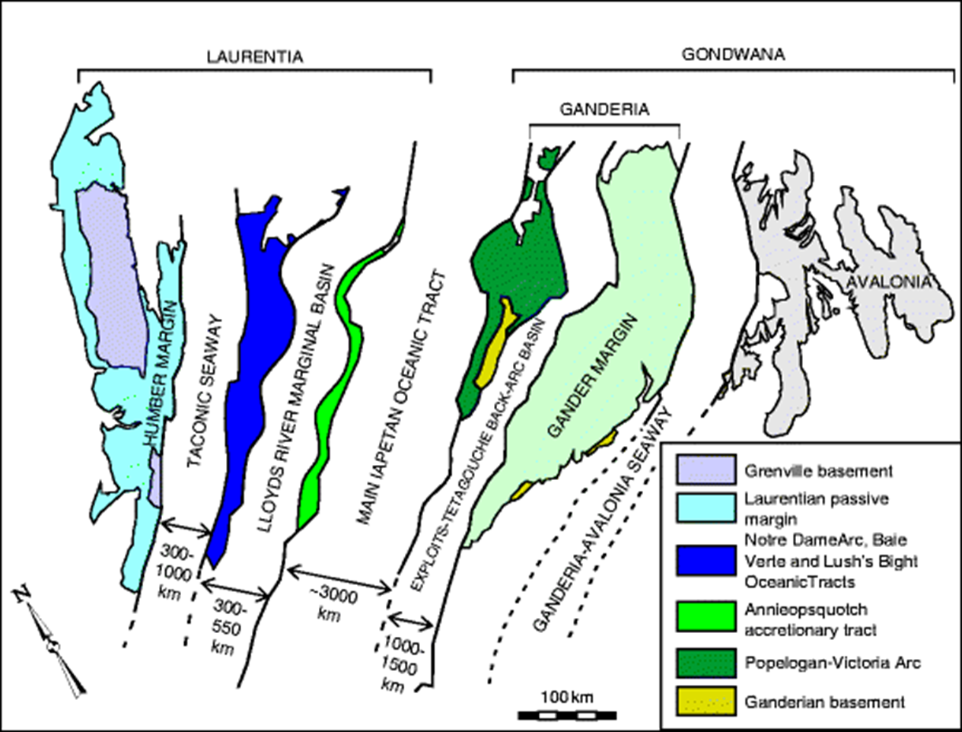
Notre Dame
Peri-lauretian group II
Perigondwanan group III
Humber
Annieopsquotch accretionary
tract

Slide 39
Peri-Laurentian domain

Slide 40
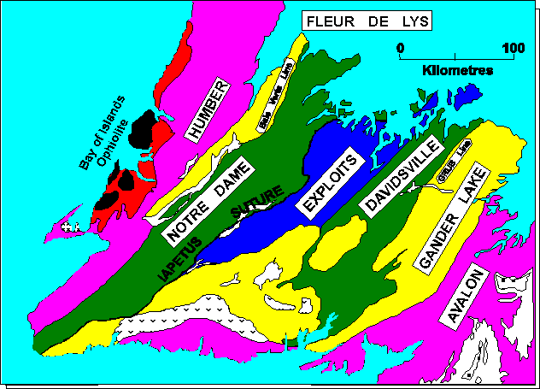
Notre Dame zone
V první fázi se od teránu Humber odděli terán Dashwood. Takonská orogeneze potom souvisela s uzavíraním okrajového oceánu a s kolizí teránu Dashwood s Humber – okrajem Laurentie.
Na kontinentální okraj jsou obdukovány dva typy teránů – Fleur de Lys Supergroup (metapelity a meetapsamity interpretované jako sedimenty kontinentálního svahu na jv od karbonátové sedimentace + ofiolity) a velké alochtony obsahující ofiolity jako jsou Bay of Island Complex nebo Baie Verte oceanic tract), který byly obdukovány v llanvirnu.
Vznik komplexu Bay of Island

Slide 41
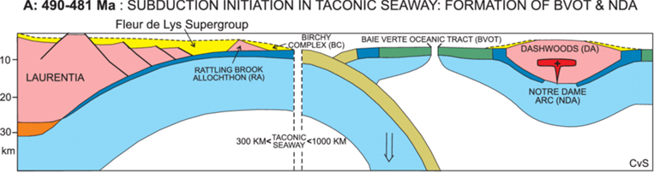
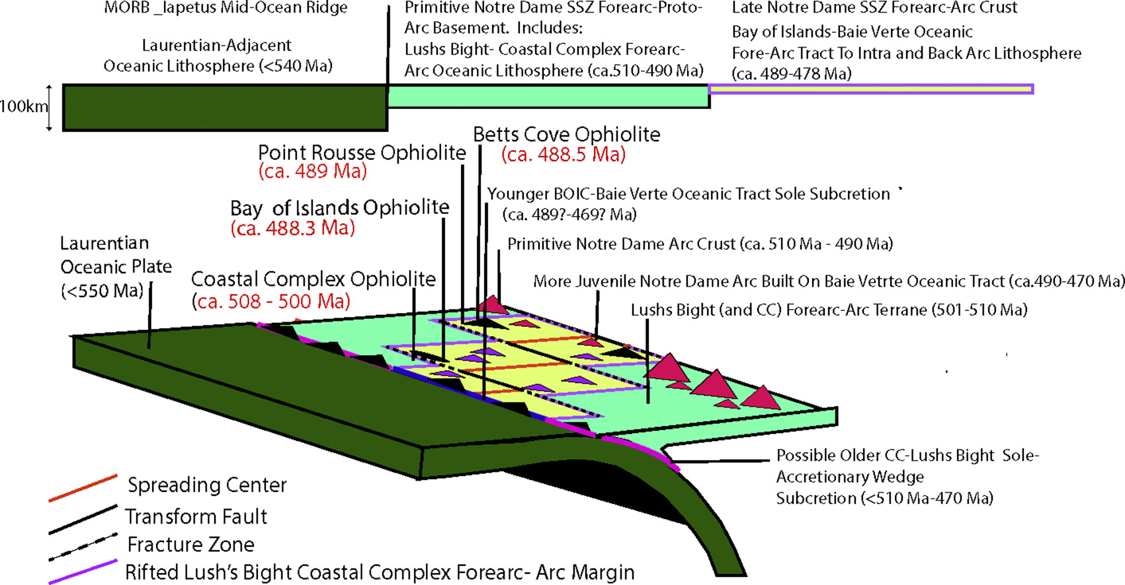
Ofiolity nasunuté na
Humber

Slide 42
Fig. 1. Generalized geologic map of the distribution of major rock units in Western Newfoundland including Humber Zone to the west and Notre Dame Subzone to the east, that are approximately separated by the Baie Verte Line (modified from Dewey and Casey, 2021). The eastern edge of the Notre Dame Subzone is bounded by the Red Indian Line interpreted to be the boundary between peri-Laurentia and peri-Gondwana terrane accreted to Laurentia (also see Fig. 2 inset). The allochthonous ‘‘forearc” Bay of Islands Complex (BOIC) and Coastal Complex (CC) ophiolitic klippen in the Humber Zone were originally contiguous with the Notre Dame Subzone before isolated by tectonism and erosion in the allochthons of the Humber Zone.

Slide 43
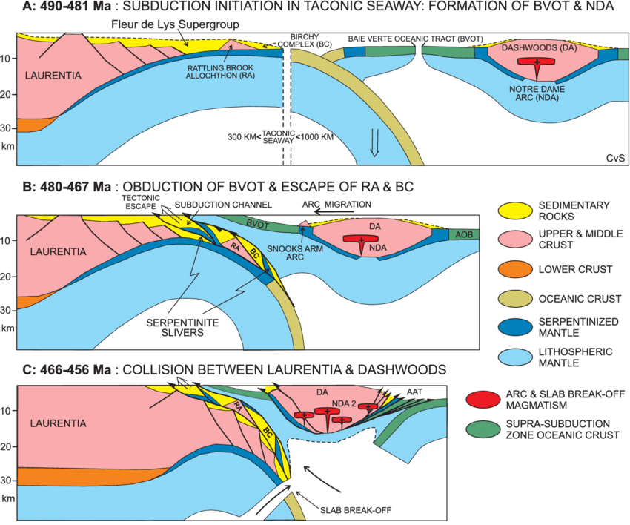
BVOT – Baie Verte oceanic tract

Slide 44
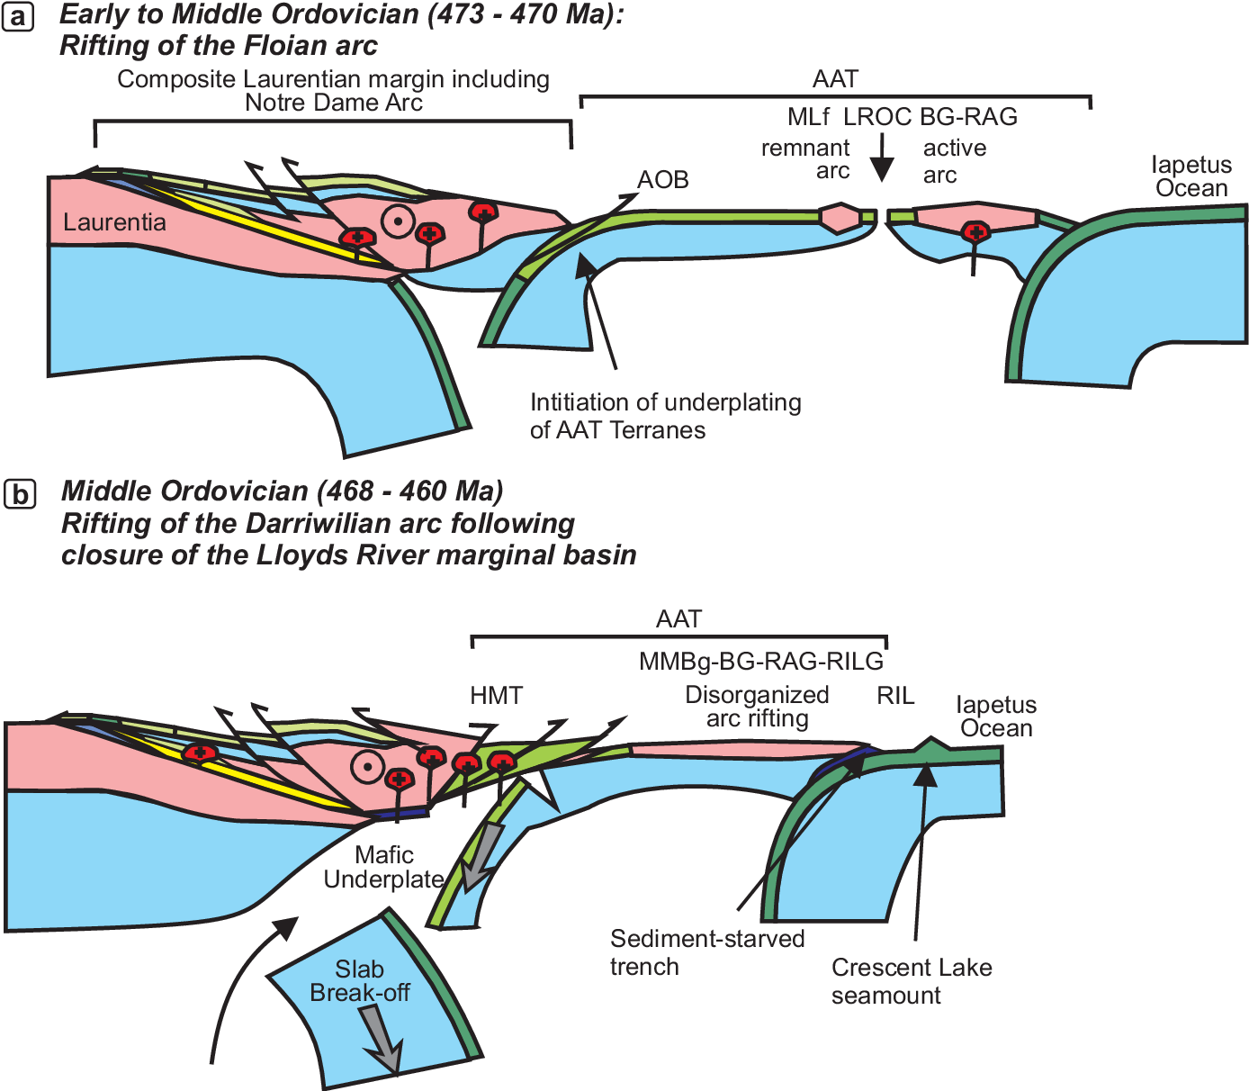
Annieopsquotch accretionary tract (AAT)

Slide 45
Figure 11. Schematic tectonic evolution of the closure of the Taconic sea-way and the Notre Dame arc-Laurentia collision between 490 and 456 Ma.. A: Initiation of eastdirected subduction in the Taconic sea-way at ca. 490 Ma, which led to suprasubduction zone spreading and formation of the boninitic ophiolites of the Baie Verte oceanic tract (BVOT) and first phase of the Notre Dame arc (489-476 Ma). The BVOT became basement to the forearc basin attached to the Notre Dame arc, as indicated by ample continental arc fragments in the basal part of the Flat Water Pond/Snooks Arm groups deposited above the BVOT (Skulski et al. 2010). These figures are a continuation of Figure 9 of van Staal et al. (2013), which illustrated the progressive hyperextension of the Humber margin with exhumation of lithospheric continental mantle onto the seafloor and the subsequent spreading that led to formation of the oceanic Taconic sea-way and isolation of Dashwoods.B: Start of the Taconic collision. Entrance and partial escape of former extensional allochthons (Rattling Brook allochthon) and transitional oceanic crust (Birchy Complex) of the hyperextended Humber margin of Laurentia into a progressively widening subduction channel. The hanging wall lid of the subduction channel is the partially obducted BVOT. Progressive steepening of the down-going Humber margin slab caused arc magmatism to locally migrate onto the BVOT, forming the 476-467 Ma extensional Snooks Arm arc. Onset of collision had initiated west-directed subduction east of Dashwoods (outside picture) forming the suprasubduction zone Annieopsquotch ophiolite belt (AOB, van Staal et al. 2007). C: Further steepening of the down-going slab, fullscale collision between Dashwoods and Humber margin, obduction of the BVOT onto the margin platform and further escape of the Rattling Brook allochthon and Birchy Complex above the closure temperature for argon diffusion in white mica. Magmatism following influx of asthenosphere after slab break-off took place in Dashwoods and locally in the obducted BVOT. Westdirected subduction east of Dashwoods formed the Annieopsquotch accretionary tract (AAT).

Slide 46
Perigondwana domain
Ganderia, Avalonia, Meguma

Slide 47


Slide 48
Ganderia
Ganderie zahrnuje terány Gander s perigonwanskými terány Iapetu. Terány Ganderu jsou tvořeny metasedimenty a horninami magmatického oblouku uloženými na paleoproterozoickém-mesoproterozoickém basementu, které se oddělily od Gondwany na začátku paleozoika.
Během dalšího vývoje rifting nejprve oddělil fragment od okraje Ganderu a vznikl na něm vulkanický oblouk Penobscot a mezi Ganderem a odděleným vulkanickým obloukem Penobscot vznikla zaobloukovou pánev (~515–485 Ma), která byla uzavřena po penobscotské orogenezi na počátku ordoviku~485 Ma . Pokračující subdukce potom na okraji Ganderie vytvořila oblouk Popelogan-Victoria a za ním zaobloukovou pánev~478 and 450 Ma. K uzavření zaobloukové pánve i oceánu Iapetus došlo kolizí Ganderie s Laurentii během salinické fáze na počátku siluru.

Slide 49
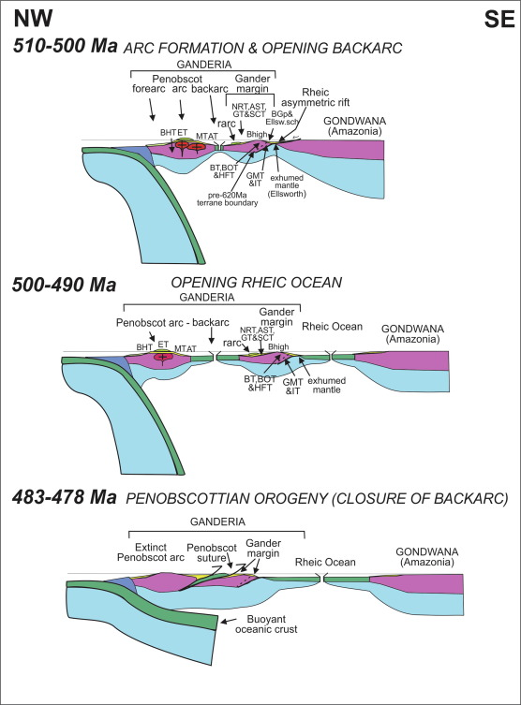
Fig. 3. Tectonic model for the evolution of the Penobscot arc-backarc system and associated opening of the Rheic Ocean between 515 and 478 Ma modified from van Staal and Barr (2012).. AST: Aspy terrane; AT: Annidale terrane; BHT: Bronson Hill terrane; BOT: Bras d’Or terrane; BT: Brookville Terrane; Bhigh: basement high; Ellsw. Sch.: Ellsworth schist; ET: Exploits terrane; GT: Gander terrane; GMT: Grand Manan terrane; HFT: Hermitage Flexure terrane; IT: Isleboro terrane; MT: Miramichi terrane; rarc: remnant arc; SCT: St. Croix terrane.
Deposition of the Gander Zone in the metaclastic-dominated terranes was followed by an orogenic episode or episodes, known as Penobscottian, Cambrian arc to backarc igneous rocks termed the Penobscot arc which resulted in emplacement of Penobscot arc ophiolitic and rift-related rocks above Gander zone during the Early Ordovician

Slide 50
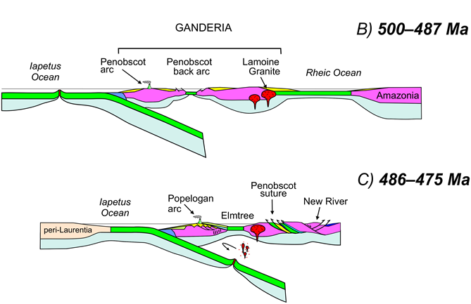
The Popelogan-Victoria arc was built upon Ganderian basement.
Gander
SE-directed subduction (present coordinates) of Iapetan oceanic lithosphere in the Cambrian to Early Ordovician led to construction of the Penobscot (ca. 515–483 Ma) and Popelogan–Victoria (ca. 476–453 Ma) arc systems (Fig. 1A), and associ ated backarc basins, on Ganderia’s leading

Slide 51
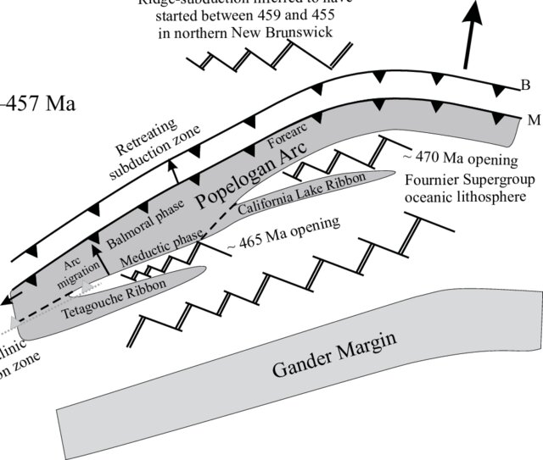
Tetagouche backarc basin
Popelogan arc was built on the leading edge of Ganderia and represents a predominantly continental calc-alkaline arc.
Arctrench migration and backarc basin opening were caused by a retreating subduction zone. Slab retreat prior to 467 Ma was at least partially accommodated by arc migration, but thereafter, it was mainly accommodated by extension and spreading in the associated Tetagouche backarc basin

Slide 53
Figure 1. First-order architecture of the Appalachian orogen depicting distribution of the major, mainly preSilurian, lithotectonic divisions. BVBL = Baie VerteBrompton line; CPSZ = central Piedmont shear zone; HLPGF = Hollins line-Pleasant Grove fault system; RIL = Red Indian line.

Slide 55
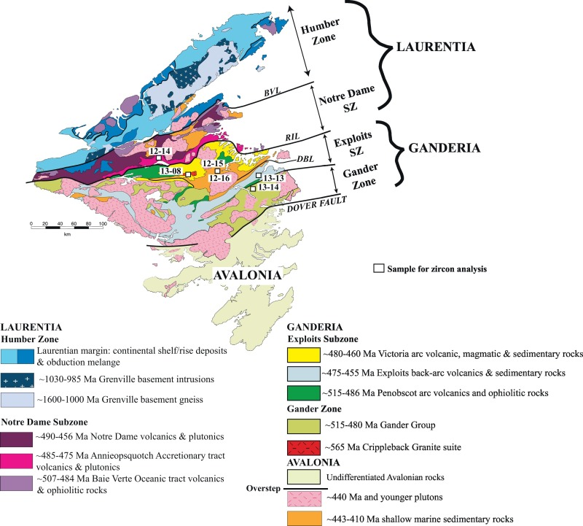
Fig. 2. Geology map of Newfoundland with sample locations.
Detailed geology map of Newfoundland, Canada showing the division into the major tectonic terranes of the Appalachian Orogen. Included within “Laurentia” are the Humber Zone and Notre Dame Subzone, and in “Ganderia” the Exploits Subzone and Gander Margin. The Notre Dame Subzone and Exploits Subzones are considered to be the Iapetan Oceanic realms developed on either side of the Iapetus Ocean. Sample locations are shown by the filled white boxes with accompanying sample number

Slide 56
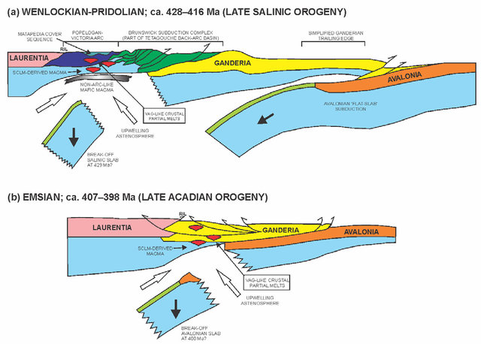
ig. 13. tectonic models for the northern Appalachian orogen in the Silurian-Devonian and post-closure slab break-offrelated magmatism within the Popelogan-Victoria arc. (a) Salinic to late Salinic orogeny showing the already accreted Popelogan-Victoria arc (PVA), amalgamation of the Brunswick Subduction Complex (BMC) and Ganderia. (b) Devonian Acadian orogeny showing the collision of the leading-edge of Avalonia with composite Ganderia (including PVA and BMC). Diagrams are modified after van Staal et al. (2008, 2009) and Whalen et al. (2006). Abbreviation: Ril; Red indian line, SClM; sub-continental lithospheric mantle, VAG: volcanic-arc granite.

Slide 57
Terány skupiny IV a V
Terány Gander, Avalon a Meguma byly původně součástí Gondwany. Terán Gander se oddělil od Gondwany na konci neoproterozoika, Na rozdíl od ostatních postrádá krystalinické podloží a jeho další vývoj byl úzce spjat s vulkanickými oblouky Iapetu. Proto je diskutován v rámci Ganderie.
Avalonský terán se oddělil v kambriu. Avalonie se vyvinula jako vulkanický oblouk na okraji Gondwany a je tvořena především neoproterozoickými magmatickými horninami kontinentálního okraje a fosiliferními kambrickými sedimenty. Má jinou předsilurskou historii než terán Gander a obzvláště odlišnou kambrickou trilobitovou faunu. Terán Meguma je tvořen hlavně flyšoidnímim metasedimenty kambria a ordoviku a ordovickými až devonskými mělkovodními sedimenty a bimodálními riftovými vulkaknity.
Ganderia kolidovala s Laurentii během salinické fáze v siluru, Avalonie s Ganderii na hranici siluru a devonu a Meguma s Avalonii během spodní části devonu (akadské fáze). V karbonu potom došlo během alleghanské orogeneze ke kolizi Laurentie a Gondwany. Podle některých názorů ale Meguma představovala okraj Gondwany.

Slide 58
Figure 7. Highly schematic cartoon showing possible terrane relationships of selected peri-Gondwanan terranes in Cambrian time, based on Murphy et al. (Reference Murphy, Waldron, Schofield, Barry and Band2014), Waldron et al. Reference Waldron, Schofield, Murphy and Thomas(2014b) and Pothier et al. (Reference Pothier, Waldron, Schofield and DuFrane2015a,b).

Slide 59
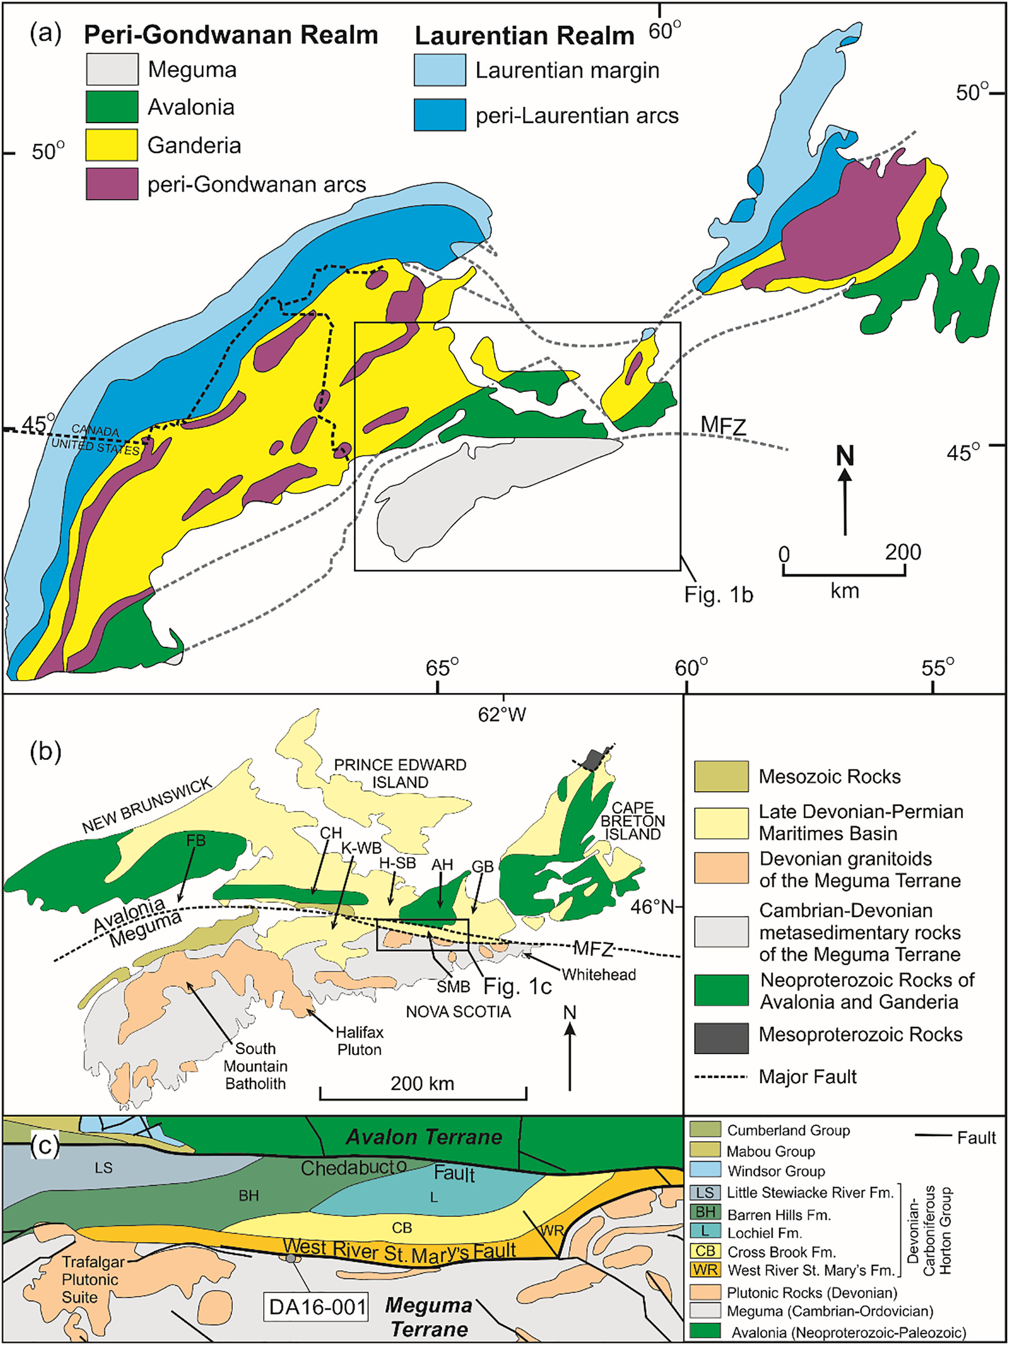
Fig. 1. (a) Regional map of the northern Appalachian Orogen showing the location of Minas Fault Zone (MFZ) and its relationship to the Meguma and Avalon terranes, modified after Hibbard et al. (2006). (b) A general map of the MFZ that separates the Avalon terrane to the north and the Meguma terrane to the south. AH, Antigonish Highlands; CH, Cobequid Highlands; FB, Fundy Basin; SMB, St. Mary's Basin; K-WB, Kennetcook-Windsor Basin; GB, Guysborough Basin; H-SB, Hopewell and Stellarton Basins (modified after Murphy et al., 2011b). (c) Summary geological map of the St. Mary's Basin and surrounding geology showing the sampling location (modified after Murphy and Rice, 1998).

Slide 60
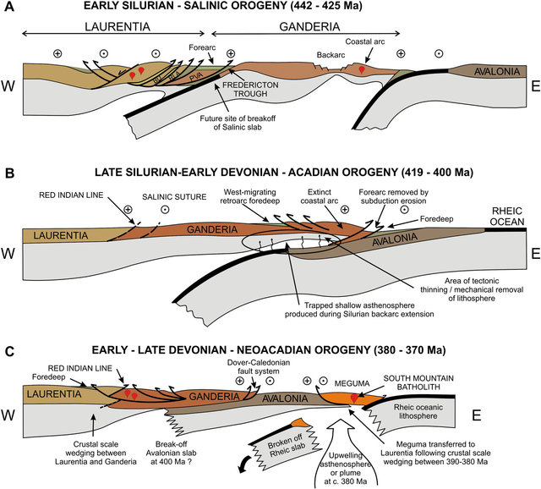
Fig. 3. Accretion of peri-Gondwanan terranes (based on van Staal et al., 2009). A. Late Ordovician-Silurian Salinic orogeny due to closure of a backarc basin. B. Silurian closure of the seaway that separated Ganderia and Avalonia, which led to the Acadian orogeny. C. Accretion of Meguma, which is interpreted to have been accompanied by wedging and breakoff of the downgoing Rheic slab. A new west-dipping subduction zone was probably established outboard of Meguma, necessary to accommodate convergence of Laurussia with Gondwana.

Slide 61
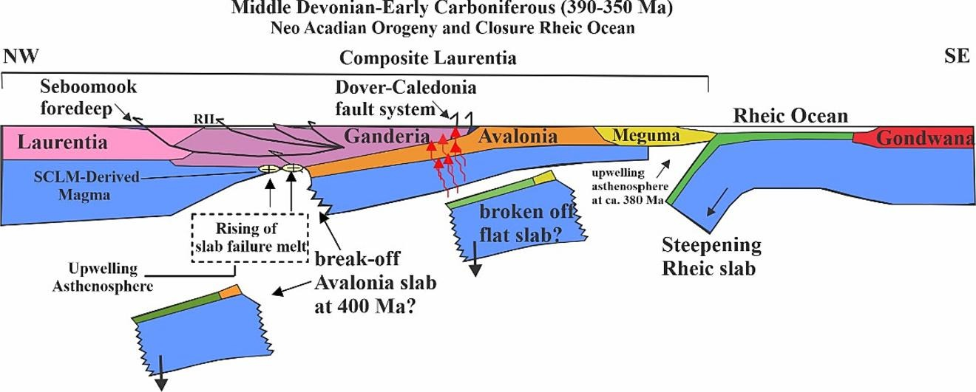
Fig. 20. Schematic geotectonic diagram for southwestern New Brunswick (modified after van Staal and Barr, 2012) highlighting the regional geodynamic setting for the emplacement of the Evandale Granodiorite.

Slide 62
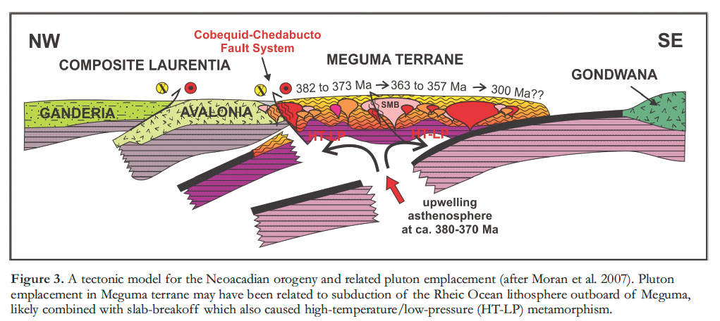

Slide 63
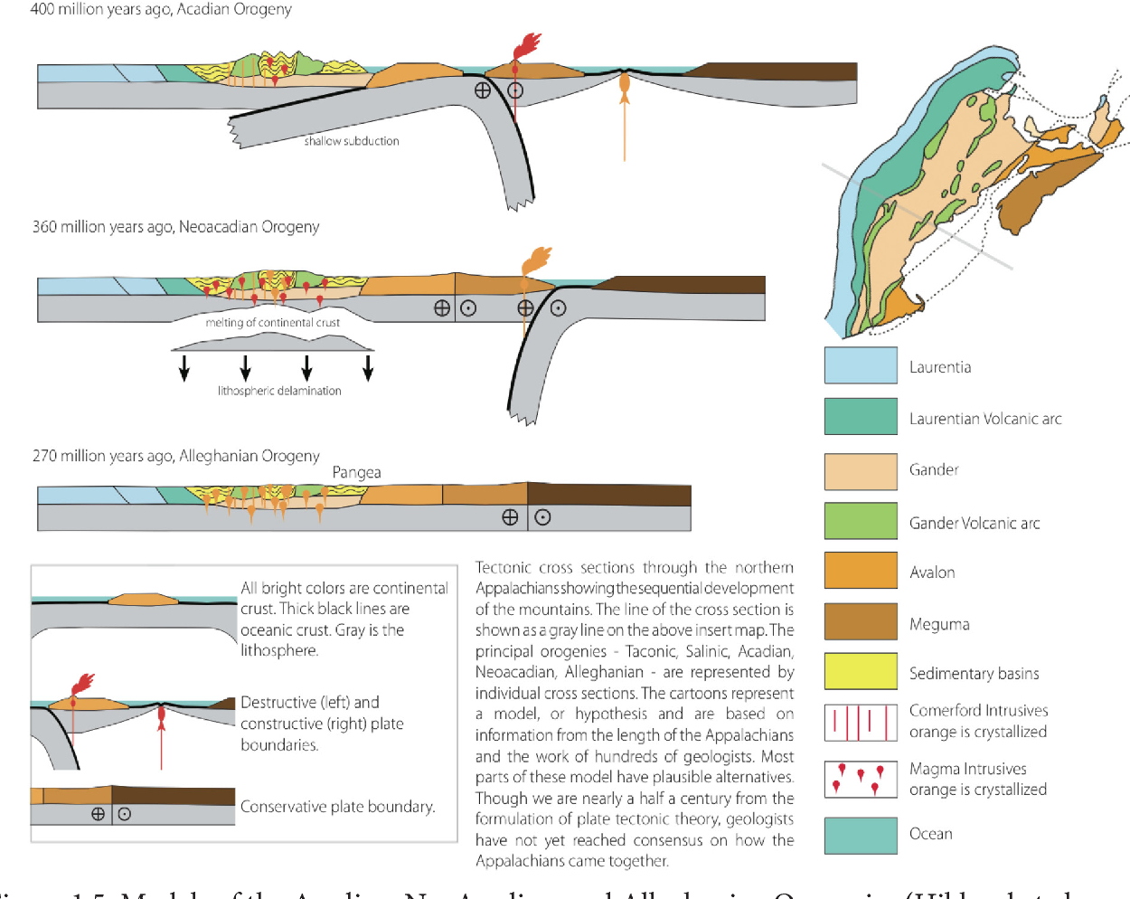
Gander
Avalon
Meguma
Gondwana

Slide 64
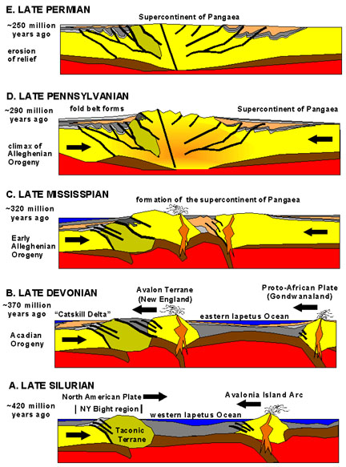

Slide 65
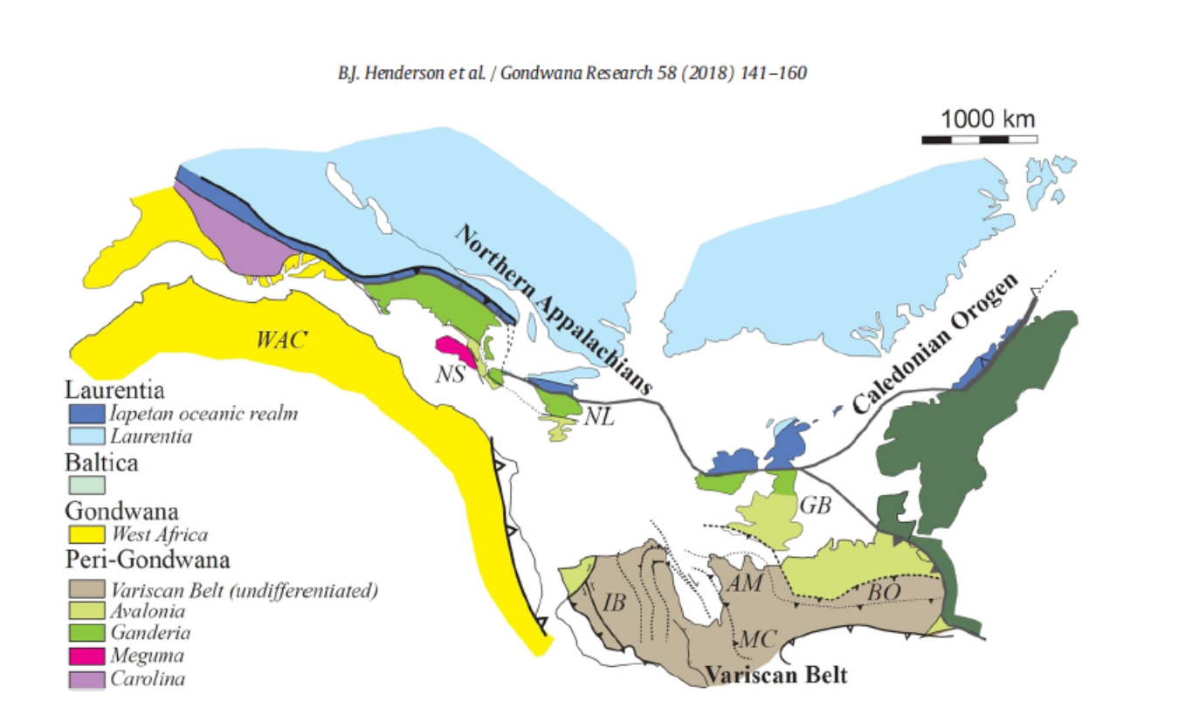

Slide 66
Hlavní tektonické jednotky Apalačí
Okraje Laurentie – skupina I, Humber, more to the south Valley and Ridge, Blue-Ridge
teranes
Centrální zóna – terány II. a III. skupiny složitá akreční melanž teránů různé povahy situvaných v oceánu Iapetus a při jeho okrajích. Kontinentálních fragmenty, vulkanické oblouky, oceánické sedimenty. V podstatě se dají rozlišit terány, které vznikaly při okraji Laurentie a terány, které vznikaly při okraji perigondwany.
Perilaurentské terány skupiny II
V severní části Apalačí to je zejména zóna Notre Dame, vznikající na fragmentu Humberu. V jižní části zóna Inner Piedmont vznikající na fragmentu Blue Ridge okraje Laurentie. Fragmenty Laurentie a vulkanické oblouky Iapetu
Perigonwanské terány skupiny III – fragmenty Gondwany a přilehlé vulkanické oblouky Iapetu
Je to perigondwanská Ganderie tvořená fragmentem Gondwany (Gander) a vulkanickými oblouky oceanické a kontinentální povahy (Popelogan arc – fragment Ganderu) a horninami zaobloukové pánve. V jižní části Apalačí je to perigondwanský superterán Carolina
Perigondwanské terány – terány IV a V -Avalonia,, Meguma-původně součástí Gondwany
Gondwana - Atlantic coastal plain

Slide 67
Southern Appalachians
The major provinces include the Blue Ridge, Inner Piedmont, and Carolina terranes, though there are important internal boundaries within each terrane. The present configuration of the terranes is largely a product of the Alleghanian collision,
Valley and Ridge
Blue Ridge
Perilaurentia
Brevard faukt
Inner Piedmont
Piedmont
central Piedmont suture
Carolinia
Perigondwana
Suwannee suture
African part of Gondwana - Atlantic coastal plain

Slide 68
The major provinces include the Blue Ridge (Laurentia margin), Inner Piedmont, and Carolinia terranes, Inner Piedmont was acreted to Laurentia during Taconic orogeny in Ordovician, Carolinia to the Laurentian margin probably during the Salinic orogeny in Silurian. Collision with African Gondwana was during Alleghanian orogeny. The present configuration of the terranes is largely a product of the Alleghanian collision.
Figure 1. First-order architecture of the Appalachian orogen depicting distribution of the major, mainly preSilurian, lithotectonic divisions. BVBL = Baie VerteBrompton line; CPSZ = central Piedmont shear zone; HLPGF = Hollins line-Pleasant Grove fault system; RIL = Red Indian line.

Slide 69
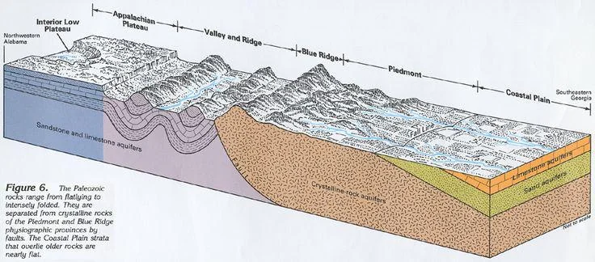

Slide 70
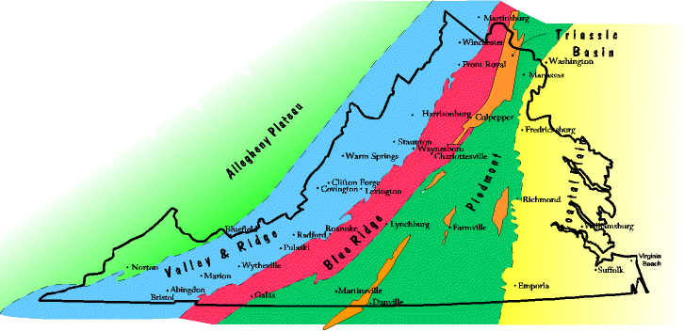
Tektonicky modifikované okraje Laurentie zahrnují na západě provincii Valley and Ridge tvořenou spodnopaleozoickými sedimenty okraje Laurentie a na východě provincii Blue Ridge tvořenou především mesoproterozoickým krystalinikem (metamorfity, granitiody) a méně neoproterozoickými a spodnopaleozoickými sedimenty. Od Inner Piedmont je Blue Ridge oddělen zónou Brevard

Slide 71
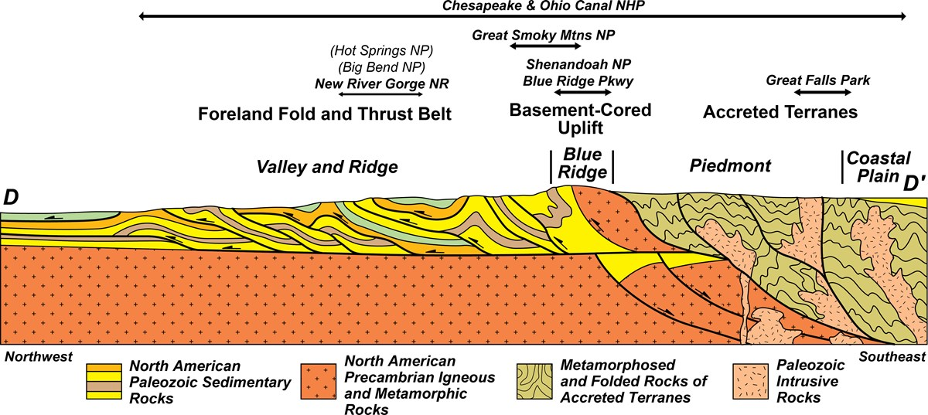
The Blue Ridge province lies east of the Appalachian foreland basin and is bounded by the Brevard zone on its eastern flank

Slide 72
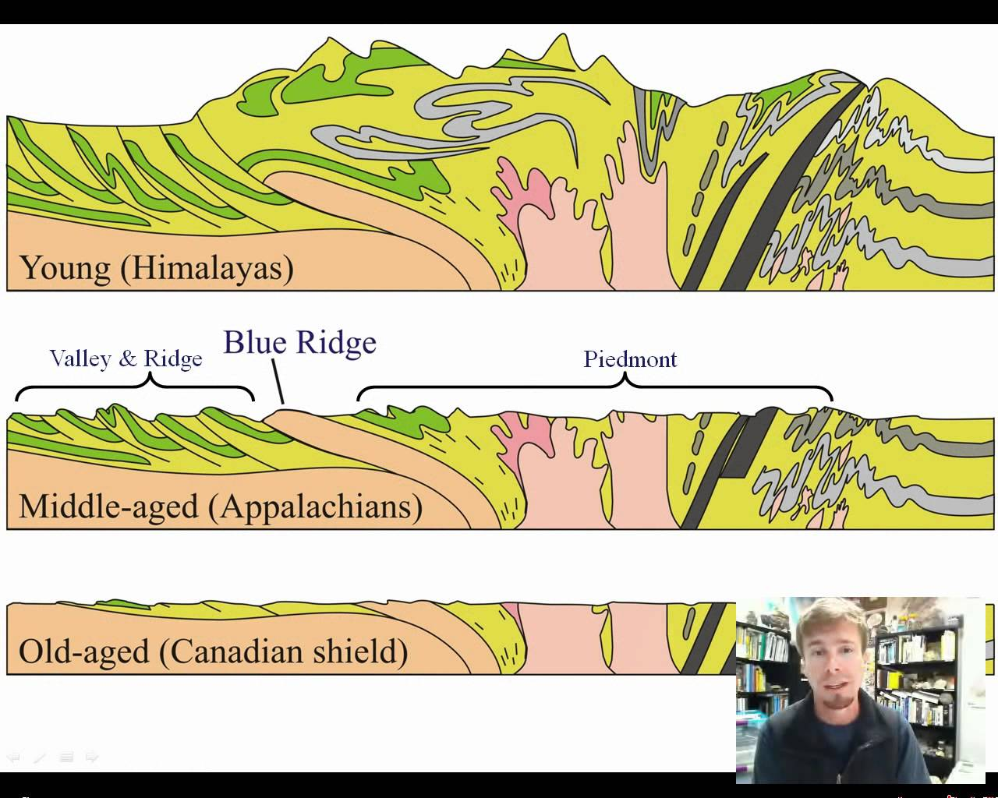
The central Blue Ridge (BR) recorded burial depths of 33 km (9.8 kb, pyx granulite) during the Taconian orogeny (480�450 Ma); the Inner Piedmont (IP) 23 km (7.1 kb, sill II) during the Acadian�Neoacadian orogeny (407�350 Ma);

Slide 73
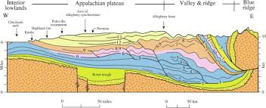
The commercial coal beds occur only in strata deposited during the Pennsylvanian Period of geologic time, while oil and gas deposits are found in strata from throughout the Paleozoic Era.

Slide 74
https://www.youtube.com/watch?v=fJZy_BCKrIU

Slide 75
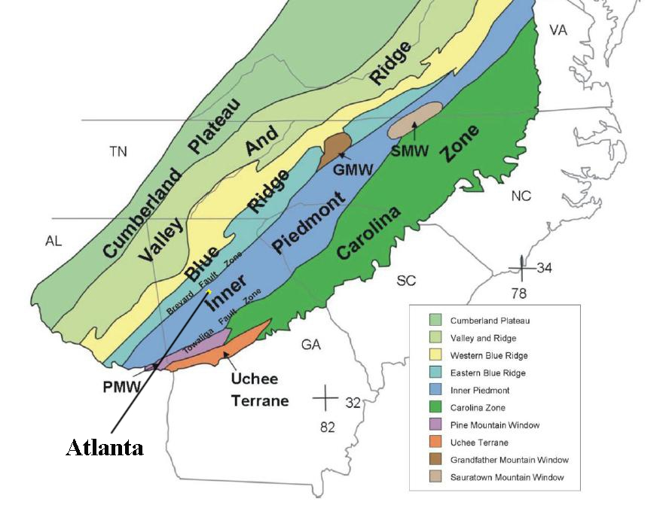
Terány II a III jsou v jižní části Apalačí tvořeny perilaurentským superteránem (zónou) Inner Piedmont a superteránem (zónou) Carolinia vzniklou v blízkosti jihoamerické části Gonwany. Carolinia je řazena mezi perigondwanské terány, je to ale složený vulkanický oblouk, který obsahuje fragment Gondwany podobně jako Gander v podobě metasedimentů.
Coastal plane

Slide 76
Inner Piedmont
The Inner Piedmont is bound to the west by the Brevard zone and to the east by the Central Piedmont suture zone. It contains a Laurentian component (eastern Tugaloo terrane) and an internal terrane (Cat Square) that contains both Laurentian and Gondwanan detrital zircons, separated by the Brindle Creek fault. Cat Square terrane rocks likely accumulated in a Devonian remnant ocean that closed beginning c. 400 Ma.
Inner Piedmont was overthrusted on the Laurentian margin during the Ordovician Taconic event

Slide 77
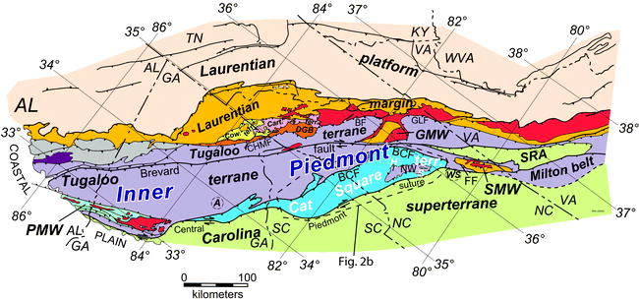
Zóna(superterán) Inner Piedmont je tvořena hlavně perilaurentským teránem Tugaloo a taránem Cat Square, Je oddělen od zóny Blue Ridge zlomem Brevard. Tugaloo zahrnuje riftovaný fragment Laurentie (východní Blue Ridge) tvořený metamorfovanými sedimenty a akreční melánž a vulkanity. Na jih od něj je situovám další menší fragment Blue Ridge, vulkanický oblouk Dadeville. Cat Square terán reprezentuje silurodevonské akreční prizma sedimentů, které se ukládaly v mělkém oceánu mezi Piedmontem a blížící se Carolinou (jeho sedimenty obsahují jak laurentské tak perigodwanské zirkony). Během takonské orogeneze v ordoviku Tugaloo kolidoval s Laurentii podobně jako Notre Dame v severních Apalačích.
.

Slide 78
Fig. 15 Retrodeformed tectonostratigraphic terranes in the southern Appalachians with arrows indicating broad kinematics of assembly. Arrows shown are color-coded to show accretion timing (after Hatcher et al. 2007). Included are approximate positions of both the RLA and the SSR prior to thrusting of the SSR onto Tugaloo terrane and the RLA on the Carolina terrane due to terrane collision during final assembly of Pangea

Slide 79
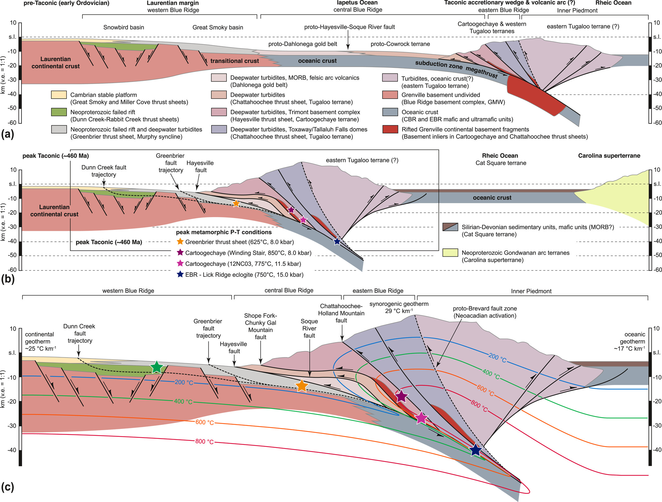
Tugaloo terane

Slide 80
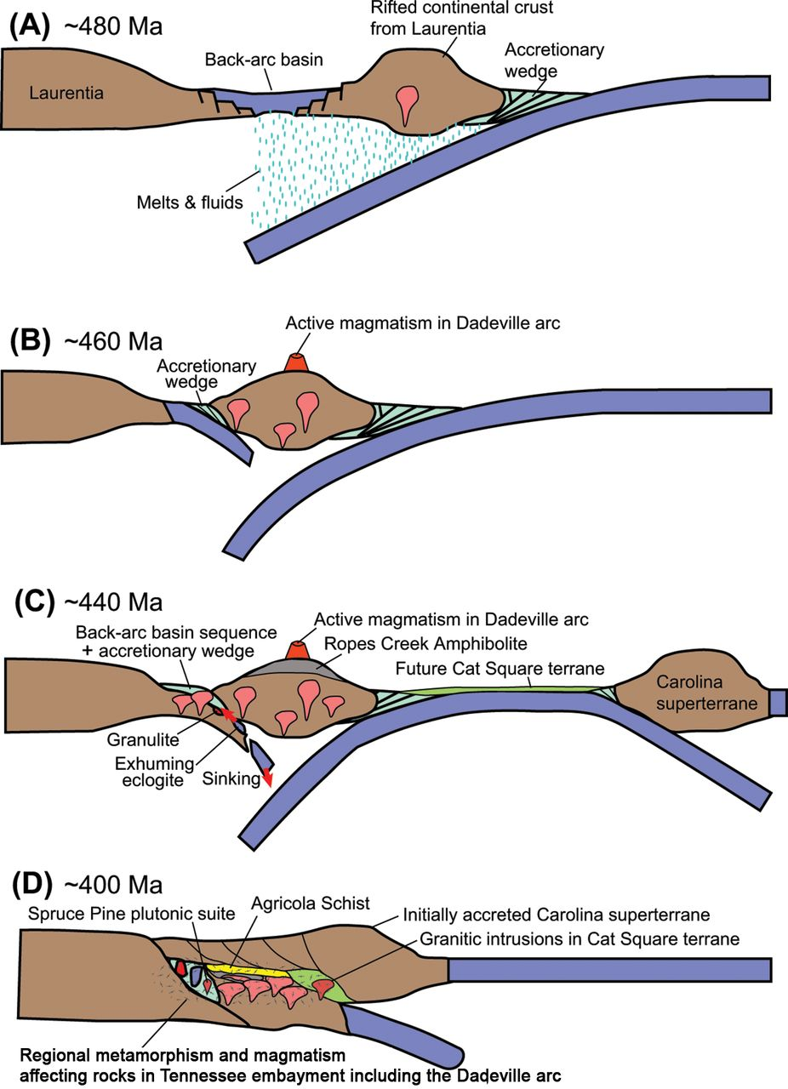
Fig. 10. Tectonic model for the formation and metamorphism of the Dadeville arc and associated back-arc in the Tennessee embayment region during and after the Taconian orogeny, prior to the orogen-parallel translation of Dadeville arc to Alabama promontory. (A) Westward subduction of oceanic crust under a rifted continental margin and back-arc basin (for example, Anderson and Moecher, 2009). (B) Partial subduction of the back-arc basin to high-pressure conditions (subduction direction is after Miller and others, 2006; Merschat and others, 2017) and active magmatism on the Dadeville arc. (C) Closure of the back-arc basin, exhumation of continental crust incorporating eclogites, and continued magmatism on the Dadeville arc. (D) Regional metamorphism affecting the Dadeville arc and eastern Blue Ridge rocks due to the tectonic burial by the approaching Carolina superterrane (Merschat and others, 2017).

Slide 81
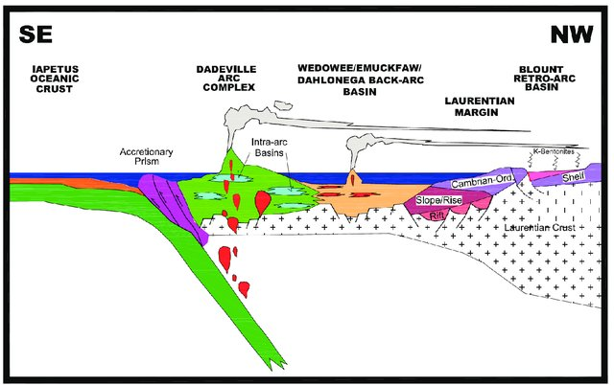
Figure 2.8. Schematic tectonic reconstruction of the Laurentian margin at 445-465 Ma at the current latitude of Georgia and Alabama. The Dadeville complex is interpreted as a fringing arc built on extended Laurentian continental crust. Also note the intra-arc basins interpreted from the Agricola Schist and Ropes Creek metasedimentary rocks. The Dadeville complex formed just outboard of the Wedowee/Emuckfaw basin in this reconstruction.

Slide 82
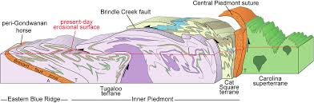

Slide 83


Slide 84
Carolinia
Carolinia is Neoproterozoic island arc system which was created at ca. 550 Ma during stitching of the two largest components, the Carolina and Charlotte terranes.
The terrane comprises Neoproterozoic to Early Cambrian felsic-to-mafic metaplutonic and metavolcanic rocks, intruded by later Paleozoic plutons. There is consensus among workers that these sequences collectively represent a long-lived, suprasubduction zone (SSZ) magmatic arc system. SSZ ophiolites form during the initial stages of subduction prior to the development of any volcanic arc.
These rocks underwent at least four metamorphic/deformation events, and so their original textures and mineralogies have been significantly altered
Carolinia terrane likely experienced significant translation in a Middle Paleozoic dextral shear system along the Laurentian margin prior to the Alleghanian continental collision

Slide 85

Supra-subduction zone (SSZ) ophiolites have the geochemical characteristics of island arcs but the structure of oceanic crust and are thought to have formed by sea-floor spreading directly above subducted oceanic lithosphere.
Fig. 6.1 (a) Simplified section of an early supra-subduction (infant arc) setting showing ophiolite formation and key related mineral deposits. (b) Section of maturing arc setting showing fore-arc and back-arc rifting and possible magma source regions. Subduction of continent derived sediment enters subduction channel and yields components to metasomatise the sub-arc mantle wedge. (compiled from various published sources including Winter 2001; Garson and Mitchell 1977; Robb 2005).

Slide 86
The Carolina terrane forms the heart of Carolinia, one of the largest accreted peri-Gondwanan crustal tracts within the Appalachian Orogen. The Carolina terrane consists of two major lithotectonic elements, the older Neoproterzoic Hyco magmatic arc, ca. 633-612 Ma, and the younger Neoproterozoic-early Paleozoic Albemarle magmatic arc, ca. 555-<528 Ma. A third lithotectonic unit consisting of clastic sedimentary rocks with subordinate volcanics, the Virgilina sequence, intervenes between them. The Carolina terrane appears to have departed from its peri-Gondwanan source area in the Early to Middle Cambrian. Two major tectonothermal events have overprinted rocks of the terrane. The Neoproterozoic Virgilina deformation, ca. 578-545 Ma, appears to overlap in time with the stitching of the two largest components of Carolinia, the Carolina and Charlotte terranes at ca. 550 Ma. The second event, the Cherokee orogeny, started in the Late Ordovician and likely continued into the Early Silurian. The Cherokee orogeny most likely marks the accretion of Carolinia to Laurentia.

Slide 87

Fig. 2. Distribution of the major tectonic elements of Carolinia and adjoining terranes (Hibbard et al. 2002). CPsz, Central Piedmont shearzone; GHF, Gold Hill fault; PMB, Pine Mountain Belt.

Slide 88

Simplified lithotectonic map of the southern Appalachians showing the superterranes and other rock units (after Hibbard et al. 2006, 2007). Abbreviations: HLPVF, Hollins Line-Pleasant Valley fault system; CPSZ, Central Piedmont shear zone; LR, Laurentian realm; PMT, Pine Mountain terrane; SMW, Sauratown Mountain window. Location of Fig. 2 is also shown.

Slide 89

Figure 2. First-order components and events of the Carolina terrane in North Carolina.

Slide 90

Figure 10. A possible schematic lithosphere-scale model for the Ediacaran-Ordovician plate tectonic evolution of the Carolina terrane. Red box in each time frame indicates approximate location of corresponding time frame in Figure 9.

Slide 91

Carolinia zahrnuje terán Carolina, složený vulkanický oblouk, který se vytvořil poblíž jihoamerické části Gondwany a vulkanický oblouk Charlotte a další vulkanické oblouky, které byly do stavby zóny začleněny na počátku paleozoika. O datování kolize s Inner Piedmont se vedou diskuse, pravděpodobně to bylo v siluru během salinické fáze, Inner Piedmont byl začleněn do stavby Laurentie během takonské fáze. Kolizi s africkou částí Gondwany během alleghanské orogeneze v karbonu odpovídají Coastal Plains

Slide 92

Souhern Appalachians
Cherokee. Late Ordovician - Early Silurian

Slide 93
Fig. 15 Retrodeformed tectonostratigraphic terranes in the southern Appalachians with arrows indicating broad kinematics of assembly. Arrows shown are color-coded to show accretion timing (after Hatcher et al. 2007). Included are approximate positions of both the RLA and the SSR prior to thrusting of the SSR onto Tugaloo terrane and the RLA on the Carolina terrane due to terrane collision during final assembly of Pangea

Slide 94


Slide 95

Piedmont = Inner Piedmont+Carolinia
Blue Ridge
Piedmont

Slide 96

Fig. 2. Distribution of the major tectonic elements of Carolinia and adjoining terranes (Hibbard et al. 2002). CPsz, Central Piedmont shearzone; GHF, Gold Hill fault; PMB, Pine Mountain Belt.

Slide 97

Alleghanian orogeny

Slide 99

Atlantic Ocean Opens. Ancient ocean rocks are left behind as the Piedmont Province, along with a sliver of Africa that now lies beneath the Coastal Plain of Florida and offshore regions of Georgia and the Carolinas (purple).

Slide 100
Atlantic coastal plain
Atlantic coastal plain – z velké části tvořená africkou částí Gondwany překrytou mladšími mezozoickými a tercierními sedimenty. Probíhá zde sutura Suwanee, detekovaná geofyzikálně. Odděluje gondwanský terán Charleston, Suwanee a další od zóny Carolinia

Slide 101


Slide 102


Slide 103

Older interprettaion od Suwanee suture

Slide 104
Sutura Suwanee oddělující zónu Carolina od africké části Gondwany, která po otevření Atlantiku zůstala součásti Severní Ameriky.
Terranes Charleston, Brunswick, Suwannee, Northern Florida, Uchee, Savanah were continuous piece of Gondwanan continental crust

Slide 105

In the Mesozoic, continental rifting and break-up of Pangea resulted in the development of onshore Triassic-Jurassic rift basins, emplacement of mafic rocks of the Central Atlantic Magmatic Province (~201 Ma), and ultimately the formation of the Atlantic passive margin leaving a fragment of Gondwana attached to North America.

Slide 106


Slide 108


Slide 109

Figure 4. Interpretation ofcrustal structure observed in the southeastern UnitedStates (see Fig. 2). A:Schematic showing pro -posed progression of final stages of Appalachian orogeny, from late Mis -sissippian (top panel) toend of collision in Permian(bottom panel). (18) (PDF) Reconstructing the end of the Appalachian orogeny. Available from: https://www.researchgate.net/publication/309874824_Reconstructing_the_end_of_the_Appalachian_orogeny [accessed Nov 02 2024].

Slide 110
Terranes Charleston, Brunswick, Suwannee, Northern Florida were continuous piece of Gondwanan continental crust

Slide 111

Cartoon depicting the inferred tectonic evolution of the Gondwanan continental margin (present-day combined Suwannee and Charleston terranes) from mid-Neoproterozoic through Early Devonian time. The Osceola continental margin arc (documented in 40 wells that penetrate the Coastal Plain unconformity) evolved above a south dipping (present-day coordinates) subduction zone, culminating in collision of the Charleston terrane with Gondwana/Suwannee and formation of the Brunswick suture zone. Subsequently, passive margin sediments (Suwannee Basin) buried the margin and suture zone. Data and interpretations presented here constitute a significant departure from previous interpretations of the age and tectonic significance of the southeast dipping crustal-scale reflectivity associated with the Brunswick Magnetic Anomaly.

Slide 112
Fig. 2. Schematic depiction of themajor terranes and structureswithin and adjacent to the Suwannee suture zone in the southern Appalachians compiled fromHeatherington andMueller (1999) and Steltenpohl et al. (2008); and our interpretations. Also shown are the Brunswick (Altamaha)magnetic anomaly (a Paleozoic orMesozoic feature that does notmark the suture) and the Mesozoic South Georgia basin. Abbreviations: PM, Pine Mountain block; EBR, eastern Blue Ridge; WBR, western Blue Ridge; BZ, Brevard zone; Mill, Milledgeville terrane; BF, Barlett's Ferry shear zone; GR, Goat Rock shear zone; andM, Modoc shear zone. The Charleston-Savannah River terrane boundary remains poorly defined and is not included on themap.

Slide 114

Figure 3. Timeline of the Appalachian cycle, showing major episodes of lithospheric growth, modification, and loss; encircled numbers correspond to descriptions cited in text. Patterned boxes = times of major tectonothermal events, balloons = qualitative representation of volume of magmatism, diverging black arrows = rift events, converging black arrows = ocean closure events, opposing black arrows = sense of dominant strike slip component of plate motion.

Slide 115
https://www.youtube.com/watch?v=jzYJVFD0MRo

Slide 116
Pásmo Quachita-Marathon
Orogeneze Quachita-Marathon zahrnovala kolizi Gondwany a jižního okraje Severní Ameriky. Během alleghanské orogeneze v období mezi 325 až 260 Ma se uzavřel Rheický oceán a laurentská deska subdukovala pod na sever se sunoucí jihoamerický kontinentální oblouk.

Slide 117
South America approached Laurentia as the intervening oceanic crust was subducted. The collision of South American and Laurentian continental crust compressed and uplifted the region to form the Ouachita Mountains. The Ouachita Mountains were extensively eroded between the Permian and the Jurassic, and much of the Ouachita system was subsequently buried beneath Mesozoic and Cenozoic sediments to the southeast and southwest. The structures there have only been revealed through deep drilling in petroleum exploration

Slide 118


Slide 119

Interpretations vary for the exact placements and relative positions of these peri-Gondwanan
Mexican terranes
FIG. 8.—Map depicting terranes accreted and uplifted by Permian time in the Ouachita orogenic belt and terranes of Mexico and Central America. Modified from Dickinson and Lawton (2001), Centano-Garcia (2005), Vega-Granillo et al. (2008), and Weber et al. (2008). Note that, on the basis of our new provenance data (see text), we suggest that the Yucatan–Maya terrane may have been closer to the Ouachita suture than these previous authors depicted. Top inset shows larger tectonic context of these terranes in the Central Pangean suture (modified from Keppie et al. 2004).

Slide 120


Fig. 1. Simplified geologic map of A) southern North America showing the locations of Peri-Gondwana terranes, the Ouachita-Marathon-Sonora fold and thrust belt, the Permian Basin. C) Paleogeographic map of southern Laurentia and northern Gondwana at ∼299–290 Ma.

Slide 121

Figure 4. (A) Paleogeographic reconstruction at 330-317 Ma showing location of the Gondwana arc and rock units described in this paper, modified after Lawton et al. (2021). (B) Tectonic model for Late Mississippian magmatic activity in northern Gondwana. AR-Aserradero Rhyolite; LD-Las Delicias arc; MG-granitoids from the Chicxulub Scientific Drilling Project (https://www.icdp-online. org/projects/world/northand-central-america/ chicxulub-2-mexico/) in the Maya block.

Slide 122
Fig. 9. Schematic diagram showing stages of the evolution of the Marathon thrust belt.

Slide 123
Figure 4. Interpretation ofcrustal structure observed in the southeastern UnitedStates (see Fig. 2). A:Schematic showing pro -posed progression of final stages of Appalachian orogeny, from late Mis -sissippian (top panel) toend of collision in Permian(bottom panel). (18) (PDF) Reconstructing the end of the Appalachian orogeny. Available from: https://www.researchgate.net/publication/309874824_Reconstructing_the_end_of_the_Appalachian_orogeny [accessed Nov 02 2024].

Slide 124

Ouachita Mobile Belt
Incipient continental collision between
North America and Gondwana began during the Mississippian to Pennsylvanian
South America

Slide 125

Ouachita Mobile Belt
Continental collision continued during the
Pennsylvanian Period
South America

Slide 126




Slide 127

Orogeneze Quachita-Marathon reaktivovala starší zlomové struktury v předpolí, kde se vytvořily v Texasu a Novém Mexiku významné permské pánve s důležitými ložisky nafty a plynu
The Permian Basin is a complex sedimentary system located in the foreland of the Marathon–Ouachita orogenic belt
Fig. 1. The Permian Basin and its tectonic setting, after Pioneer Natural Resources.

Slide 128


