Slide 1
English for Mathematicians I
Week 11 – Functions

Slide 2
Unit 11
Functions – definition, vocab
Periodic functions
  Listening
  Reading
  Useful phrases
  Practice
Revision and Language Focus
  however, whatever
HW check – gap-fill, spoken X written language

Slide 3
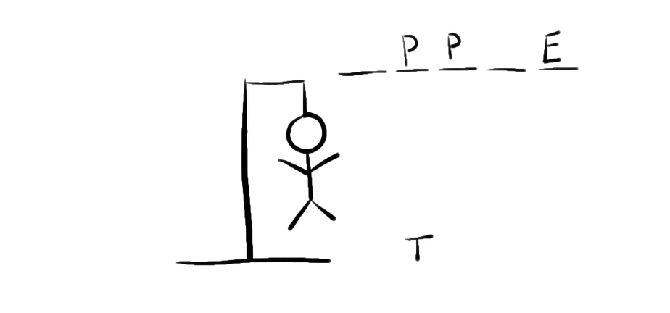
What is a function?
A rule that assigns to every _ _ _ _ _ _ _ x of a set X a unique element y of a set Y, written y=f(x) where f _ _ _ _ _ _ _ the function. X is called the _ _ _ _ _ _ and Y the _ _ _ _ _ (or codomain).

Slide 4
What is a function?
A rule that assigns to every element x of a set X a unique element y of a set Y, written y=f(x) where f denotes the function. X is called the domain and Y the range (or codomain).

Slide 5
Articles - ex. 2 – fill in the gaps individually
In mathematics, a function is (1)___ relation between a set of inputs and a set of permissible outputs with (2)___ property that each input is related to exactly one output. (3)___ example is the function that relates each real number x to its square x². (4)___ output of a function f corresponding to an input x is denoted by f(x) (read "f of x"). In this example, if the input is −3, then (5)___ output is 9, and we may write f(−3) = 9. The input variable(s) are sometimes referred to as the argument(s) of the function and (6)___ output is called the value. There are many ways to describe or represent a function. Some functions may be defined by (7)___ formula or algorithm that tells how to compute the output for (8)___ given input. Others are given by (9)___ picture, called the graph of the function. In (10)___ science, functions are sometimes defined by a table that gives the outputs for selected inputs.

Slide 6
In mathematics, a function is (1)_a_ relation between a set of inputs and a set of permissible outputs with (2)_the_ property that each input is related to exactly one output. (3)_An_ example is the function that relates each real number x to its square x². (4)_The_ output of a function f corresponding to an input x is denoted by f(x) (read "f of x"). In this example, if the input is −3, then (5)_the_ output is 9, and we may write f(−3) = 9. The input variable(s) are sometimes referred to as the argument(s) of the function and (6)_the_ output is called the value. There are many ways to describe or represent a function. Some functions may be defined by (7)_a_ formula or algorithm that tells how to compute the output for (8)_the_ given input. Others are given by (9)_a_ picture, called the graph of the function. In (10) _-_ science, functions are sometimes defined by a table that gives the outputs for selected inputs.

Slide 7
Listening and watching
How are the yellow and blue points related?
2) What are possible answers to the question “What is sine?”
3) What is the difference between sine and cosine wave?
4) What is the property of things going in circles or cycles?
6:30
5) Which other trigonometric functions are mentioned in the video?
What does the final simulation show?

Slide 8
Listening and watching
How are the yellow and blue points related?
The yellow points are coordinates of the blue point.
2) What are possible answers to the question “What is sine?”
A ratio (opp/hypotenuse), function (output/input), y-coordinate of a point moving in a circle
3) What is the difference between sine and cosine wave?
cosine wave is shifted along
4) What is the property of things going in circles or cycles?
They repeat themselves
5) Which other trigonometric functions are mentioned in the video? What are their properties?
Tangent (tan), sec, cosec, and cot
What does the final simulation show?
Wave-like motion, illusion of moving in circles, but in fact the points move in straight lines

Slide 9
4. Look, read and underline key verbs and nouns
Figure 6.1 is a graph of the function y=sin x. As x goes from 0° to 90°, sin x increases from 0 to 1. As x goes from 90°to 270°, sin X decreases from 1 to =1, crossing the x-axis at 180°. As x goes from 270°to 360°, sin x increases from -1 to 0. When x reaches 360° the graph repeats itself. The sine function is a periodic function, with a period of 360°, i.e. the graph repeats itself every 360°.

Slide 10
4. Look, read and underline key verbs and nouns
Figure 6.1 is a graph of the function y=sin x. As x goes from 0° to 90°, sin x increases from 0 to 1. As x goes from 90°to 270°, sin x decreases from 1 to -1, crossing the x-axis at 180°. As x goes from 270°to 360°, sin x increases from -1 to 0. When x reaches 360° the graph repeats itself. The sine function is a periodic function, with a period of 360°, i.e. the graph repeats itself every 360°.

Slide 11
4. Look, read and underline key verbs and nouns
Figure 6.2 is a graph of the function y=tan x. As x approaches 90°, tan x tends to infinity. After 90°, tan x reappears on the negative side. As x goes from 90°to 180°, tan x increases to 0. As x approaches 270°, tan x again tends to infinity, reappearing again after 270°on the negative side. The tangent function is a periodic function, with a period of 180°, i.e. the graph repeats itself every 180°.

Slide 12
4. Look, read and underline key verbs and nouns
Figure 6.2 is a graph of the function y=tan x. As x approaches 90°, tan x tends to infinity. After 90°, tan x reappears on the negative side. As x goes from 90°to 180°, tan x increases to 0. As x approaches 270°, tan x again tends to infinity, reappearing again after 270°on the negative side. The tangent function is a periodic function, with a period of 180°, i.e. the graph repeats itself every 180°.

Slide 13
5. Now use these verbs and nouns to write a short description

Slide 14
Group work - posters
study your graph and start writing a description (in the poster)
when the teacher says stop, they stop writing (even in the middle of a sentence) → forward the poster to another group → read a new poster, checks if everything is correct (you can make changes) → continues in the description → …
check your original poster – you are responsible for the content → present the description

Slide 15
What type of a function is this?
Imagine that you had the information shown in the table about some function f. What would you expect the output f(1) to be? What would a graph of this function look like?
x | 0.9 | 0.99 | 0.999
f(x) | 2.93 | 2.9954 | 2.9999997

Slide 16
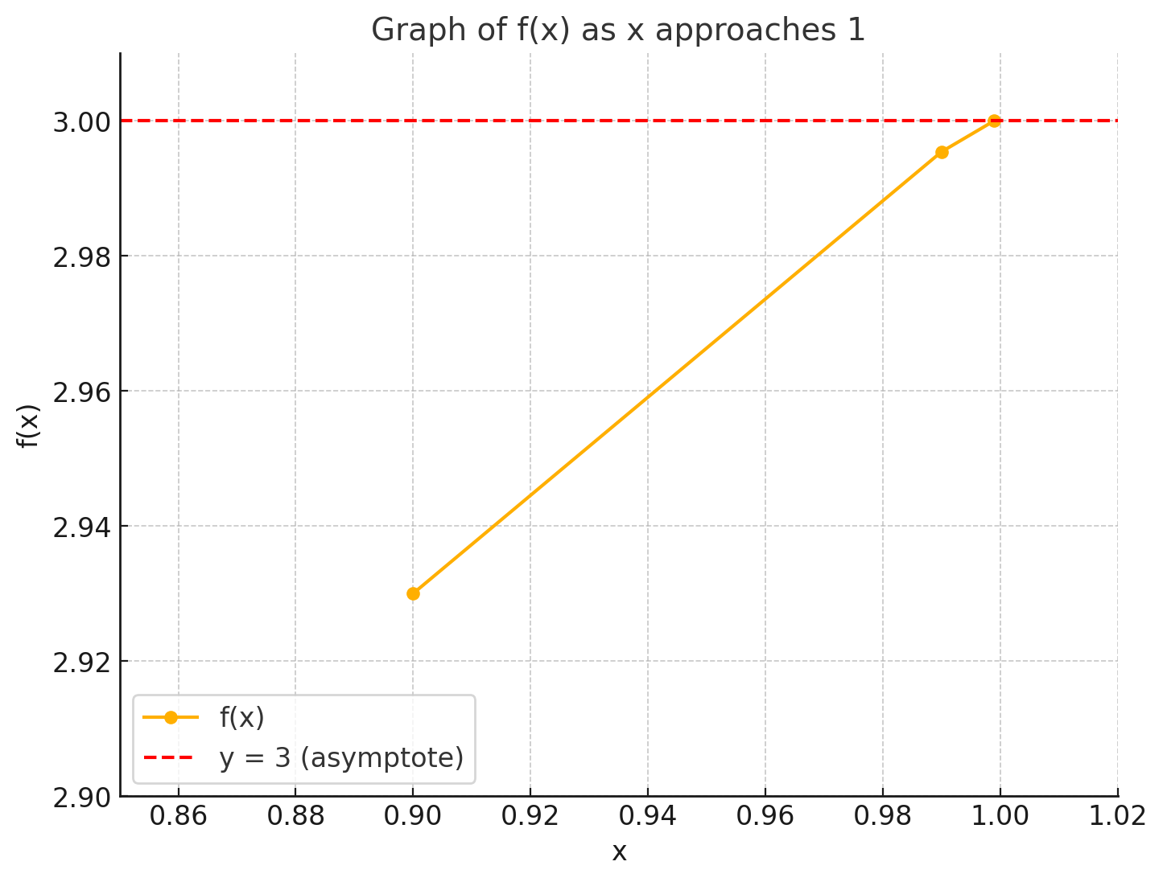

Slide 17
Definition Continuous function. Let f be a function whose domain is the x axis or is made up of open intervals. Then f is a continuous function if it is continuous at each number a in its domain.
Thus x² is a continuous function. So is 1/x, whose domain consists of the intervals (-∞, 0) and (0, ∞). Although this function explodes at 0, this does not prevent it from being a continuous function. The key to being continuous is that the function is continuous at each number in its domain. The number 0 is not in the domain of 1/x.
Only a slight modification of the definition is necessary to cover functions whose domains involve closed intervals. We will say that a function whose domain is the closed interval [a,b] is continuous if it is continuous at each point in the open interval (a,b), continuous from the right at a, and continuous from the left at b. Thus √1-x² is continuous on the interval [-1, 1].
In a similar spirit, we say that a function with domain (a, ∞) is continuous if it is continuous at each point in (a, ∞) and continuous form the right at a. Thus x is a continuous function. A similar definition covers functions whose domains are of the form (-∞, b).
Many of the functions met in algebra and trigonometry are continuous. For instance, 2^{x}, sin x, tan x and any polynomial are continuous. So is any rational function (the quotient of two polynomials). Moreover, algebraic combinations of continuous functions are continuous. For example, since x³ and sin x are continuous, so are x³ + sin x, x³ – sin x, and x³ sin x. The function x³/sin x, which is not defined when sin x=0, is continuous on its domain.

Slide 18
Definition Continuous function. Let f be a function whose domain is the x axis or is made up of open intervals. Then f is a continuous function if it is continuous at each number a in its domain.
Thus x² is a continuous function. So is 1/x, whose domain consists of the intervals (-∞, 0) and (0, ∞). Although this function explodes at 0, this does not prevent it from being a continuous function. The key to being continuous is that the function is continuous at each number in its domain. The number 0 is not in the domain of 1/x.
Only a slight modification of the definition is necessary to cover functions whose domains involve closed intervals. We will say that a function whose domain is the closed interval [a,b] is continuous if it is continuous at each point in the open interval (a,b), continuous from the right at a, and continuous from the left at b. Thus √1-x² is continuous on the interval [-1, 1].
In a similar spirit, we say that a function with domain (a, ∞) is continuous if it is continuous at each point in (a, ∞) and continuous form the right at a. Thus x is a continuous function. A similar definition covers functions whose domains are of the form (-∞, b).
Many of the functions met in algebra and trigonometry are continuous. For instance, 2^{x}, sin x, tan x and any polynomial are continuous. So is any rational function (the quotient of two polynomials). Moreover, algebraic combinations of continuous functions are continuous. For example, since x³ and sin x are continuous, so are x³ + sin x, x³ – sin x, and x³ sin x. The function x³/sin x, which is not defined when sin x=0, is continuous on its domain.

Slide 19
Definition Continuity __________________. Assume that f (x) is defined at a and in some open interval (a, b). Then the function f is continuous at a from the right if lim_{x→a+} =f(a). This means that
1 lim_{x→a+} f (x) exists and
2 that limit is f (a).
Definition Continuity ___________________. Assume that f(x) is defined at a and in some open interval (c, a). Then the function f is continuous at a from the left if lim_{x→a-} f(x) = f(a). This means that
1 lim_{x→a-} f(x) exists and
2 that limit is f(a).
The next definition applies if the function is defined in some open interval that includes the number a. It essentially combines the first two definitions.
Definition Continuity _______________. Assume that f(x) is defined in some open interval (b,c) that contains the number a. Then the function f is continuous at a if lim_{x→a} f(x) = f(a). This means that
1 lim_{x→a} f(x) exists and
2 that limit is f(a).
This third definition amounts to asking that the function be continuous both from the right and from the left at a.

Slide 20
Definition Continuity from the right at a number a. Assume that f (x) is defined at a and in some open interval (a, b). Then the function f is continuous at a from the right if lim_{x→a+} =f(a). This means that
1 lim_{x→a+} f (x) exists and
2 that limit is f (a).
Definition Continuity from the left at a number a. Assume that f(x) is defined at a and in some open interval (c, a). Then the function f is continuous at a from the left if lim_{x→a-} f(x) = f(a). This means that
1 lim_{x→a-} f(x) exists and
2 that limit is f(a).
The next definition applies if the function is defined in some open interval that includes the number a. It essentially combines the first two definitions.
Definition Continuity at a number a. Assume that f(x) is defined in some open interval (b,c) that contains the number a. Then the function f is continuous at a if lim_{x→a} f(x) = f(a). This means that
1 lim_{x→a} f(x) exists and
2 that limit is f(a).
This third definition amounts to asking that the function be continuous both from the right and from the left at a.

Slide 21
6. Revision & Language Focus. Read the following:
In the set of real numbers, how large is the highest number? However large a number is, there is always a higher number.
In the set of numbers ˂ 1, what number is the highest member of the set? Whatever number we choose, there is always a higher number in the set.
How many points are there on a line? However many points we choose, there are always more points.
What is the difference in usage between whatever and however?

Slide 22
7. Now make correct statements from the table:
In the set of real numbers | however whatever | large we make one angle, | there is always a smaller value.
On a line |  | distance we take between two points, | the sum does not reach one.
In the set x ˃ 0 |  | small a number is, | there is always a shorter distance.
In the series ½+1/4+1/8+… |  | many values we add, | it cannot be more than 180°.
In the series √2, ³√2, ⁴√2, ⁵√2… |  | root of 2 is taken, | there is always a smaller number.
In a triangle |  | value of x we take, | its value is always greater than one.

Slide 23
7. Now make correct statements from the table:
In the set of real numbers | however whatever | large we make one angle, | there is always a smaller value.
On a line |  | distance we take between two points, | the sum does not reach one.
In the set x ˃ 0 |  | small a number is, | there is always a shorter distance.
In the series ½+1/4+1/8+… |  | many values we add, | It cannot be more than 180°.
In the series √2, ³√2, ⁴√2, ⁵√2… |  | root of 2 is taken, | there is always a smaller number.
In a triangle |  | value of x we take, | its value is always greater than one.

Slide 24
7. Now make correct statements from the table:
In the set of real numbers | however whatever | large we make one angle, | there is always a smaller value.
On a line |  | distance we take between two points, | the sum does not reach one.
In the set x ˃ 0 |  | small a number is, | there is always a shorter distance.
In the series ½+1/4+1/8+… |  | many values we add, | It cannot be more than 180°.
In the series √2, ³√2, ⁴√2, ⁵√2… |  | root of 2 is taken, | there is always a smaller number.
In a triangle |  | value of x we take, | its value is always greater than one.

Slide 25
7. Now make correct statements from the table:
In the set of real numbers | however whatever | large we make one angle, | there is always a smaller value.
On a line |  | distance we take between two points, | the sum does not reach one.
In the set x ˃ 0 |  | small a number is, | there is always a shorter distance.
In the series ½+1/4+1/8+… |  | many values we add, | It cannot be more than 180°.
In the series √2, ³√2, ⁴√2, ⁵√2… |  | root of 2 is taken, | there is always a smaller number.
In a triangle |  | value of x we take, | its value is always greater than one.

Slide 26
7. Now make correct statements from the table:
In the set of real numbers | however whatever | large we make one angle, | there is always a smaller value.
On a line |  | distance we take between two points, | the sum does not reach one.
In the set x ˃ 0 |  | small a number is, | there is always a shorter distance.
In the series ½+1/4+1/8+… |  | many values we add, | It cannot be more than 180°.
In the series √2, ³√2, ⁴√2, ⁵√2… |  | root of 2 is taken, | there is always a smaller number.
In a triangle |  | value of x we take, | its value is always greater than one.

Slide 27
7. Now make correct statements from the table:
In the set of real numbers | however whatever | large we make one angle, | there is always a smaller value.
On a line |  | distance we take between two points, | the sum does not reach one.
In the set x ˃ 0 |  | small a number is, | there is always a shorter distance.
In the series ½+1/4+1/8+… |  | many values we add, | It cannot be more than 180°.
In the series √2, ³√2, ⁴√2, ⁵√2… |  | root of 2 is taken, | there is always a smaller number.
In a triangle |  | value of x we take, | its value is always greater than one.

Slide 28
7. Now make correct statements from the table:
In the set of real numbers | however whatever | large we make one angle, | there is always a smaller value.
On a line |  | distance we take between two points, | the sum does not reach one.
In the set x ˃ 0 |  | small a number is, | there is always a shorter distance.
In the series ½+1/4+1/8+… |  | many values we add, | it cannot be more than 180°.
In the series √2, ³√2, ⁴√2, ⁵√2… |  | root of 2 is taken, | there is always a smaller number.
In a triangle |  | value of x we take, | its value is always greater than one.

Slide 29
Video task
Thank you for your videos
HW - prepare for sharing in week 11:
  summarize why you have chosen it
  be ready to explain the vocabulary
  choose the best 30 seconds ☺ (bring an online device)

