Slide 1
Multivariate functions = simple generalization of a functions with one real variable to more real variables
Meaning of the words „more variables“ or „multivariate“ ?
Everything will be about the so-called mutlivariate functions
Does not answer what the word „multivariate“ actually means
Example: take $f\left(x\right)=x^{2}.$ Here we have 1 input: $x$ and one output $x^{2}$
Then a function of multiple variables have „more“ variables in its argument, as $f\left(x,y\right)=x^{2}+y$. Here, the output corresponds to a number or it can also be vector
$$f\left(x,y\right)=\left(\begin{matrix}5x \\ 7y\end{matrix}\right)$$
Interpretation or convention?

Slide 2
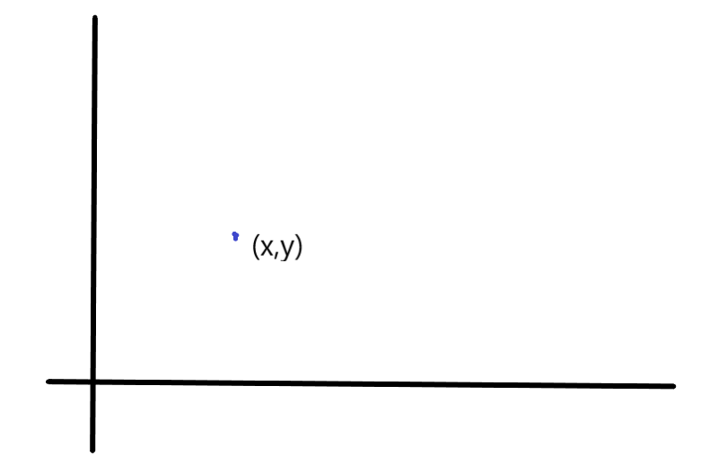
Consider $f(x,y)$, where we can understand the inputs $x$ and $y$ as separate real numbers
Really not the case – consider the pair $(x,y)$ as a point in space
Reformulate the name as the multi – dimensional calculus

Slide 3
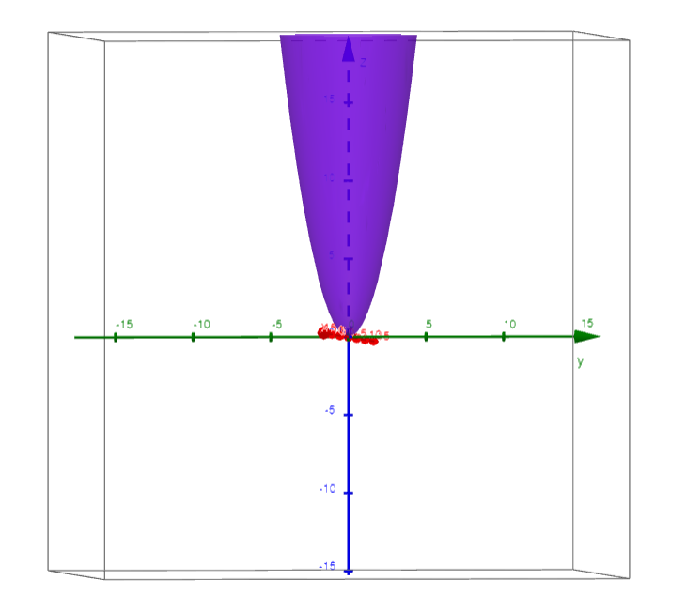
Point $→$ Number
Point $→$ Vector
How to visualize them?

Slide 4
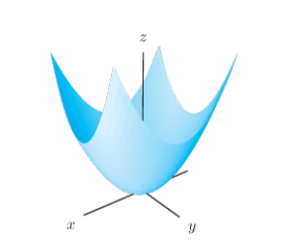
Transformations: reflection, translation, rotation, composition…

Slide 5
Possible to visualize $3D$ graphs with their cross-sections in $2D$
Space of all inputs $→$ color for each point
Contour lines, where the size of the output is proportional to the given color

Slide 6
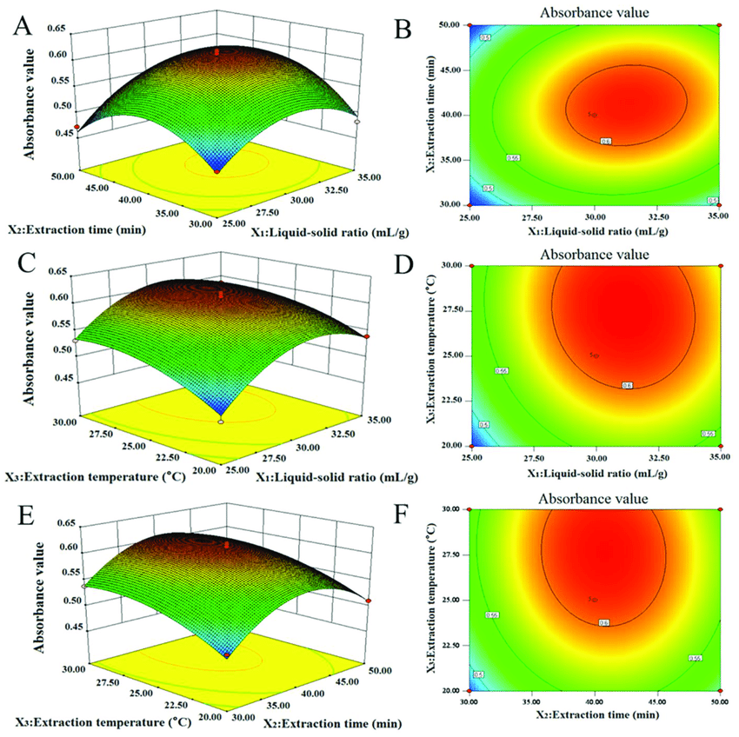
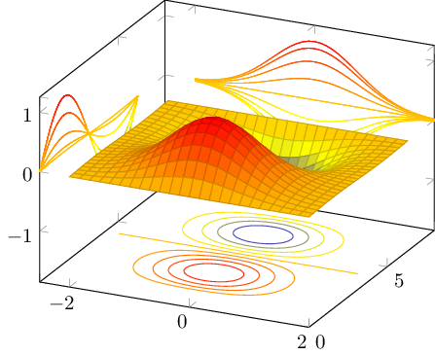

Slide 7
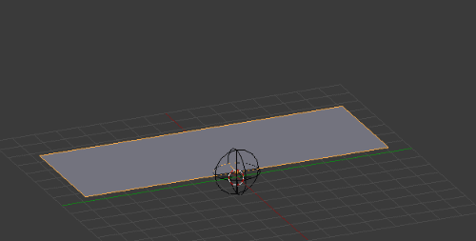
Plots in $3D$ can be also visualized as a mapping of some other $2D$ objects (surfaces)
Mapping of $2D$ onto $3D$ output
Parametric surfaces

