Slide 1
Methods of field research in human geography Ondřej Šerý

Slide 2
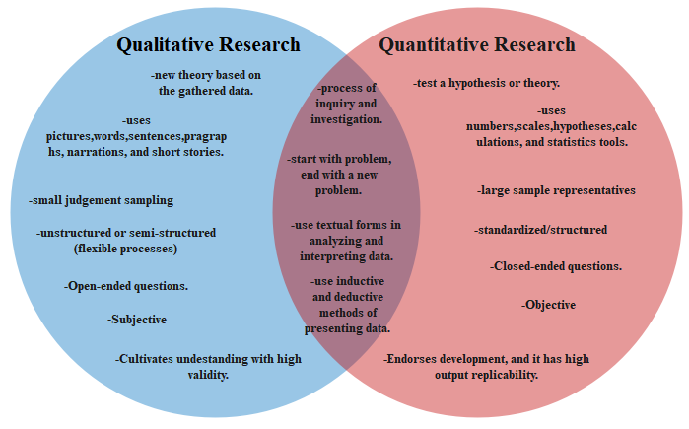
Introduction: quantitative x qualitative
quantitative research methods
– primarily number-based,
– more generalizable,
– less in-depth on a large number of cases,
– used to test or confirm.
qualitative research methods
– primarily text-based,
– less generalizable,
– more in-depth on a few cases,
– used to understand.

Slide 3
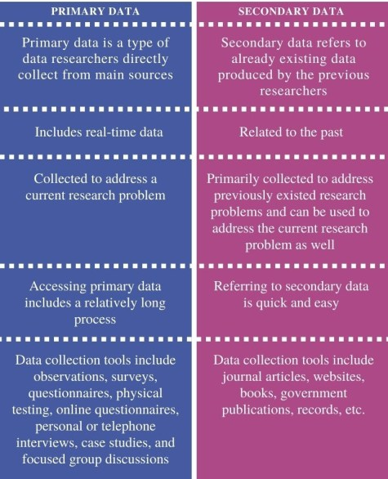
Introduction: primary x secomdary data
primary data
– generated by the researcher himself/herself
secondary data
– existing data generated by the institutions
(for example the statistical office)

Slide 4
Field research
example of methods for field research in human geography
questionnaire surveys
semi-structured interviews
focus groups
mental maps
observations

Slide 5
Questionnaire surveys
instrument that consists of a set of questions
– purpose: gathering information from respondents
representative sample
– sufficient number of respondents (usually tens or hundreds of respondents)
– corresponding structure of respondents (gender, age, highest level of education...)
– if the survey is really representative, the results can be applied to the whole population
– identification questions only at the end of the questionnaire
– rule of anonymity

Slide 6
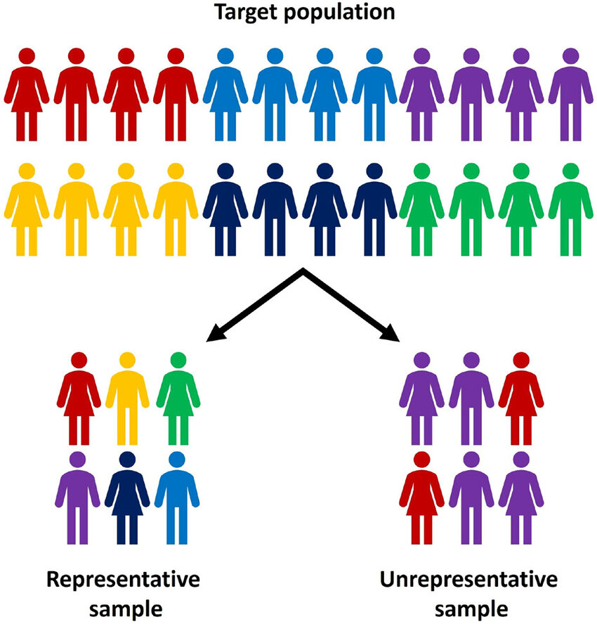
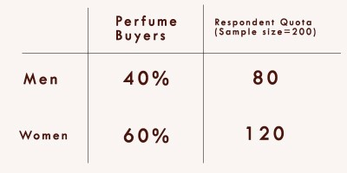
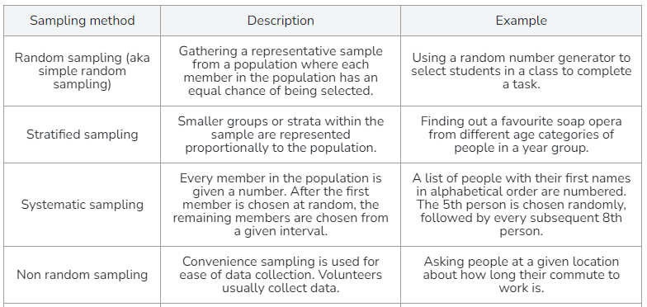

Slide 7
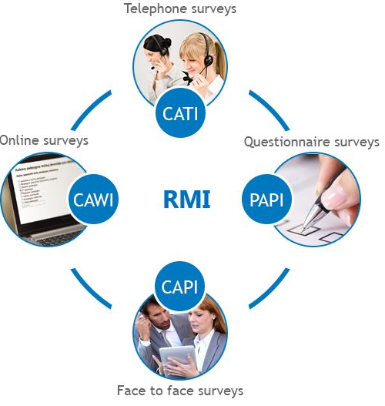
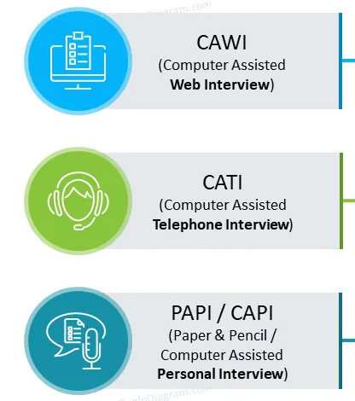
Questionnaire surveys

Slide 8
Questionnaire surveys
types of questions
– open-ended questions = no options, free space for the respondent, more demanding (harder) to evaluate
– close-ended questions = predefined options, respondent must select one or more of them
– semi-closed questinss = several predefined options, plus option "other" that can be specified
– specific questions
a) dichotomous questions (for example options "yes" or "no"),
b) Likert scale ("strongly agree", "agree", "neutral", "disagree", "strongly disagree"),
c) scoring on a scale (for example grades in school),
d) ranking the options (for example, from best to worst from the respondent's point of view)

Slide 9
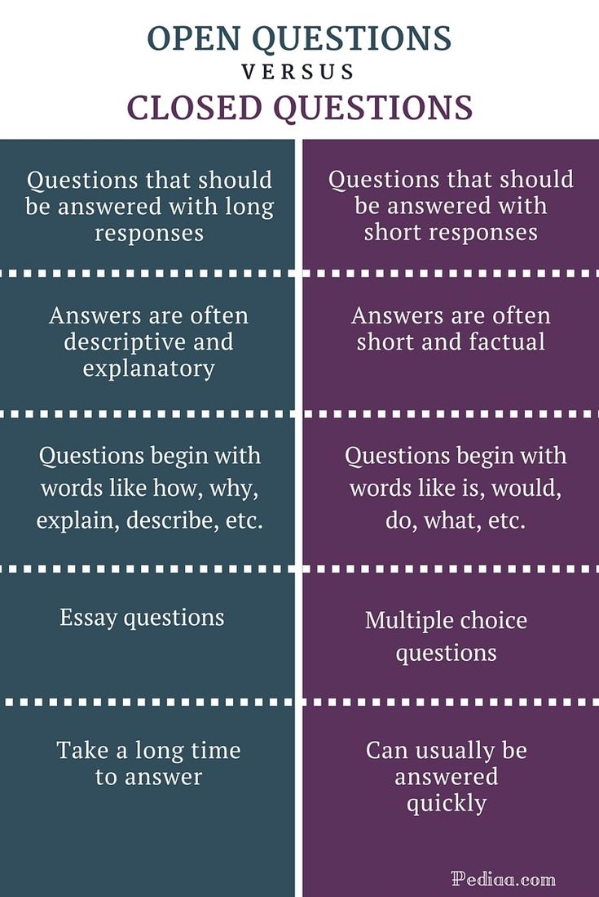
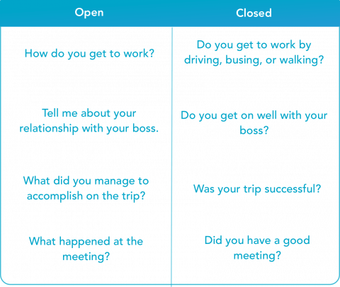
Open-ended and close-ended questions
mix of both types of questions
– there are usually fewer open-ended questions

Slide 10
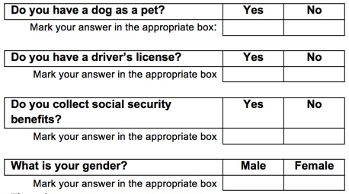
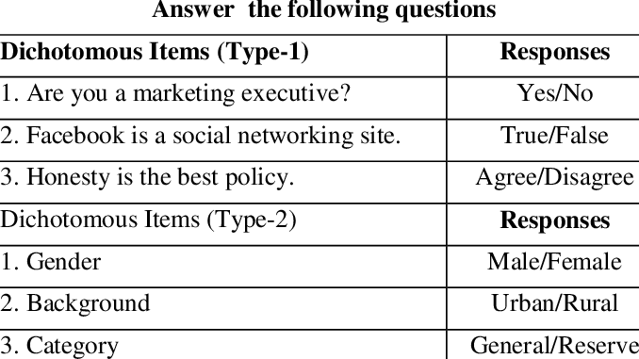
Dichotomous questions
only offer two possible answers
they are typically presented in the following format:
Yes or No, True or False, Agree or Disagree, Fair or Unfair etc.

Slide 11
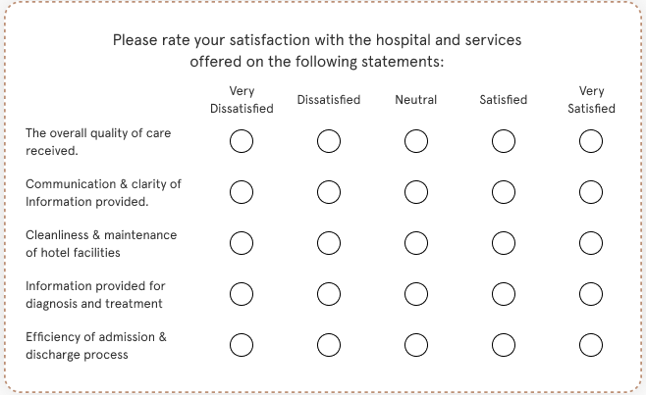
Likert scale
rating scale used to measure opinions, attitudes or behaviors
– it consists of a statement or a question, followed by a series of five or seven answer statements,
– respondents choose the option that best corresponds with how they feel about the statement or question.

Slide 12
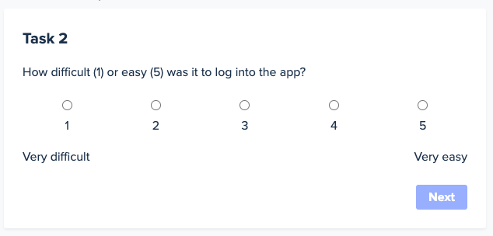
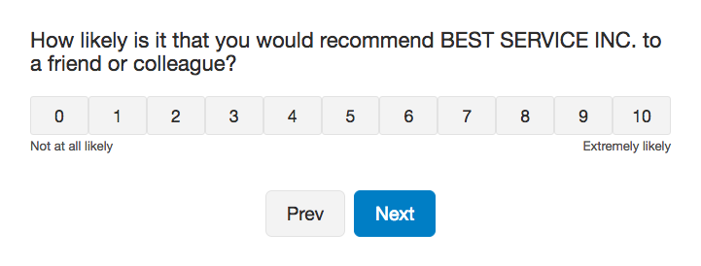
Scoring on a scale
how survey responders feel about a particular product or statement
– rating scale,
– evaluation by grades in school.

Slide 13
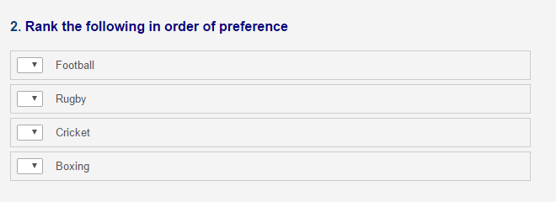
Ranking the options
ask respondents to compare and arrange multiple options based on their preferences
– key element = respondent's point of view,
– strongly subjective assessment.

Slide 14
Questionnaire surveys
questionnaire evaluation
– tables, graphs
– interpretive text

Slide 15
Interviews
structured interviews
– unchanging order of questions
– all communication partners receive the same questions
– almost identical to a questionnaire survey with only open-ended questions
semi-structured interviews
– only predefined topics and example questions
– the interviewer continuously responds to the communication partner's answers
– not all topics and questions may be used
– the important thing is to answer the research question

Slide 16
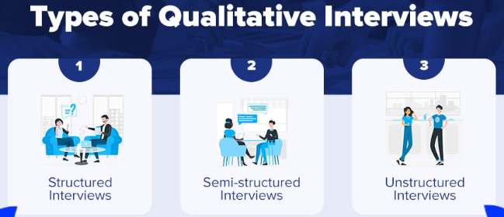
Interviews
unstructured interviews
– only the topic is predefined
– very difficult for interviewers
– can be used for „hard topics" that the communication partner wants to talk about

Slide 17
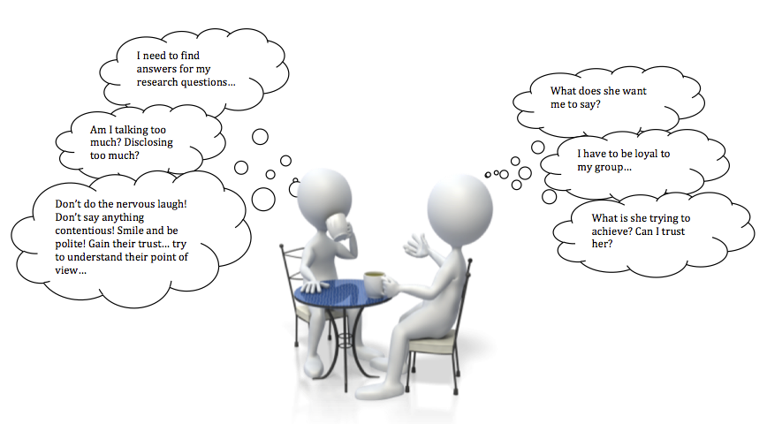
Interviews
practical advice
– listen more, talk less
– follow what the communication partner says
– not interrupt the communication partner
– try to ask open questions
– don't give examples (immediately)
– try not to ask leading questions
– not to evaluate the communication partner's answers,
even if I do not agree with them

Slide 18
Interviews
communication partners
– fewer communication partners compared to survey respondents
– the interview is on average longer (at least tens of minutes)
– not a representation of individuals, but a representation of the problem (people with different experiences relative to the topic)

Slide 19
Interviews
principles of interviewing (Seidman 2005)
listen more, talk less
follow up on what the participant says
a) ask questions when you do not understand
b) ask to hear more about a subject (gather details and circumstances)
c) explore, don´t probe (communication partner should feel safe and comfortable)
listen more, talk less, and ask real questions
a) avoid leading questions (try to ask neutral questions, don't prompt an answer)
b) ask open-ended questions
follow up, but don´t interrupt (don't jump into the conversation, take notes)
two favorite approaches
a) ask participants to talk to you as if you were someone else
b) ask participants to tell a story

Slide 20
Interviews
principles of interviewing (Seidman 2005)
ask participants to reconstruct, not to remember (this is not a test)
keep participants focused and ask for concrete details
do not take the ebbs and flows of interviewing too personally (don't bring in your opinions and emotions, they will not help you understand the communication partner)
limit your own interaction
a) only share experiences occasionally (you are “only” a questioner)
b) avoid reinforcing your participants' responses (do not rate the answers)
explore laughter (non-verbal communication is also important)
follow your hunches (and intuition, be natural)
use an interview guide cautiously (it is only a guide, not an exact and unchanging script)
tolerate silence (short silence usually means thinking)

Slide 21
Focus groups
thematic group interview
– uses group interaction, people react to each other
– it arises spontaneously, it cannot be prepared in advance
types of groups for focus groups
I.) natural groups = the researcher does not create the group, but only takes it over (e.g. participants of a certain course)
II.) formed groups = members selected according to pre-defined criteria with regard to the research question, an effort to include people with different opinions on the given topic

Slide 22
Focus groups
practical advice
– the question of group size, smaller groups produce few opinions, larger groups are poorly managed
– there may be more researchers (main researcher, assistant, silent observer)

Slide 23
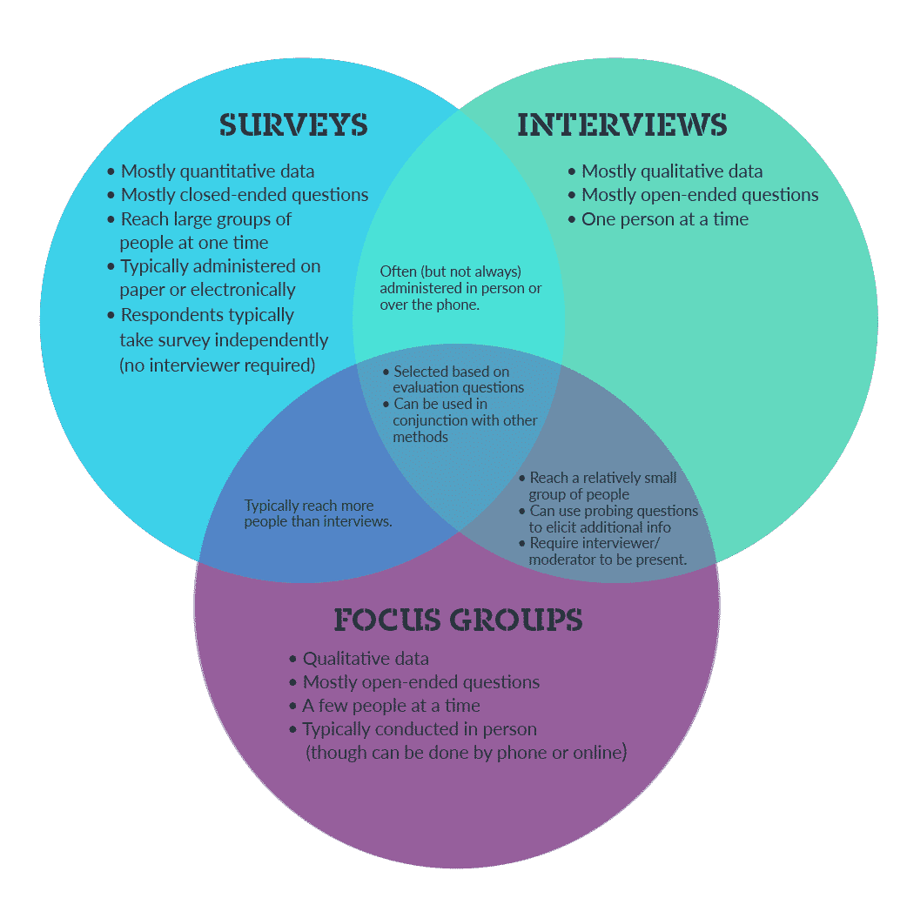

Slide 24
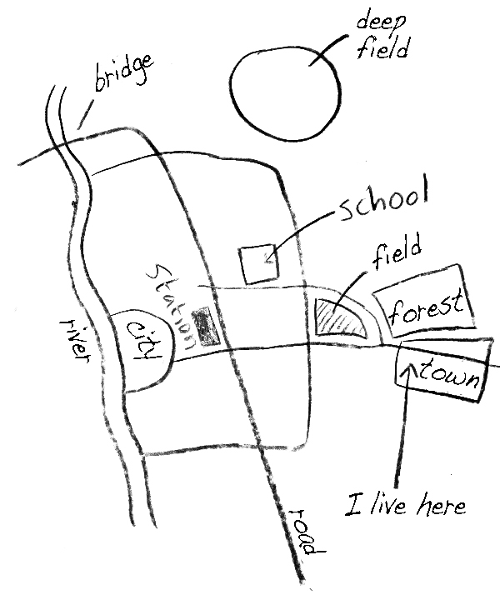
Mental maps
basic information
– no mind map (text bubbles)
– a person's point-of-view perception of their
area of interaction
mental maps according to Lynch
– Kevin Lynch (1960): The Image of The City
– the result is a sketch / picture / scheme / map
representing the individual's vision of space
– 5 key elements: paths (lines), edges (where space ends),
areas (surface elements), nodes (crossroads / intersections),
landmarks (significant elements)

Slide 25
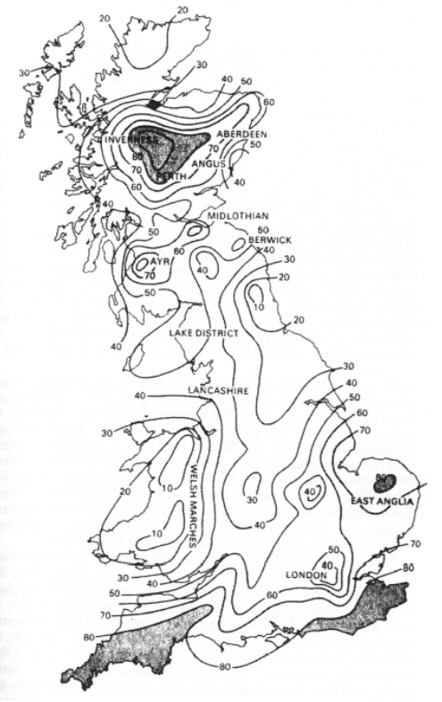
Mental maps
mental maps according to Gould
– Peter Gould and Rodney White (1974):
Mental Maps
– drawing on the underlying map (e.g. where you
would like to live or which place you prefer for your
summer vacation)
– blind or blank map with borders
Lynch = maps about perception
Gould = maps about preference

Slide 26
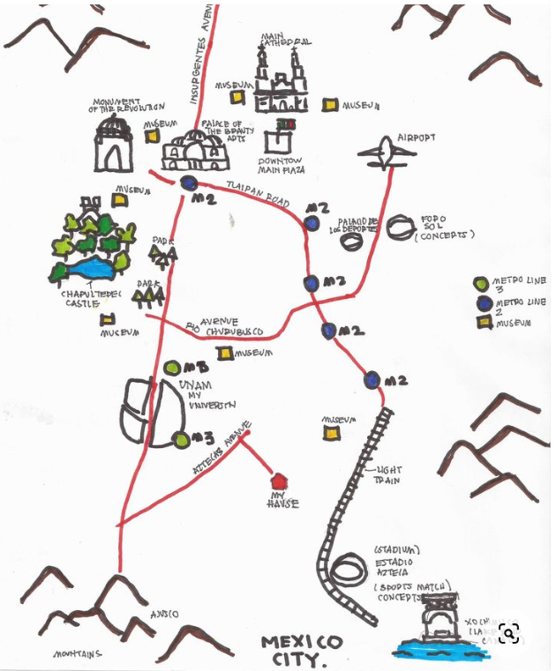
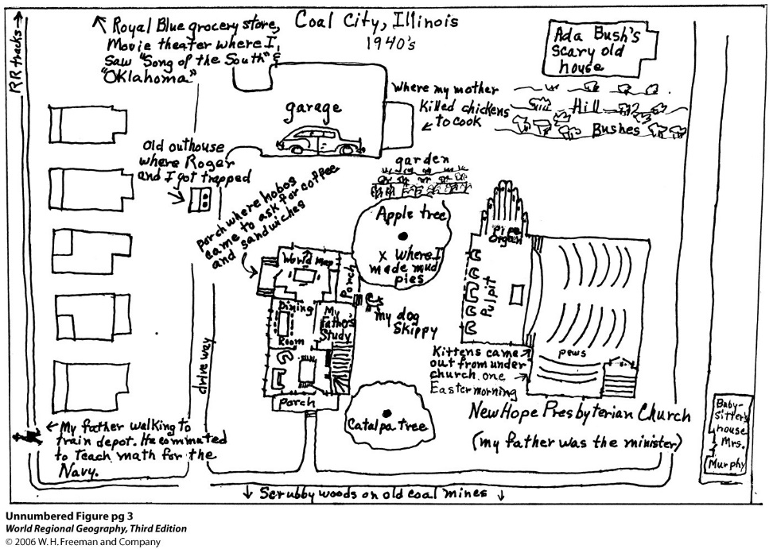
Mental maps
practical advice
– inaccuracy does not matter, on the contrary, it is beneficial
– suitable for children and people who do not like to express themselves in words or text
– basic drawing ability and basic spatial imagination are required

Slide 27
Observations
tracking (monitoring), recording and
analyzing space and its elements (including people)
– traditional method, very typical and natural for people
structured and unstructured observation
I.) unstructured = only the general objective of the observation is specified
How do people behave in the park?
II.) structured = observer concentrates on previously defined phenomena in more detail
How do people (not) form a queue at the bus stop while waiting for the bus?

Slide 28
Observations
participant and non-participant observation
I.) participant = observer is a part of the situation he observes
a participant in a demonstration for higher wages
II.) non-participant = observer is separated from the situation he observes
observer of the demonstration for higher wages
disguised and undisguised observation
I.) disguised = physically hidden or socially hidden observer
a researcher playing the role of a supermarket employee
II.) undisguised = the observer does not hide that he is a researcher
the researcher not hiding the fact that he observes supermarket employees

Slide 29
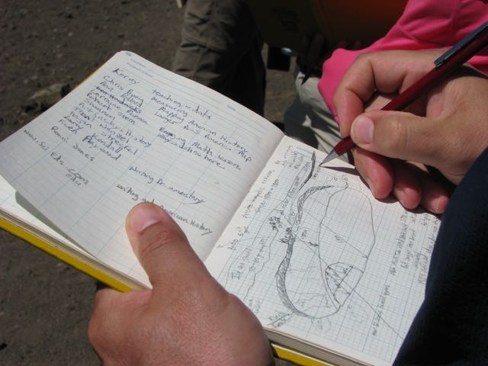
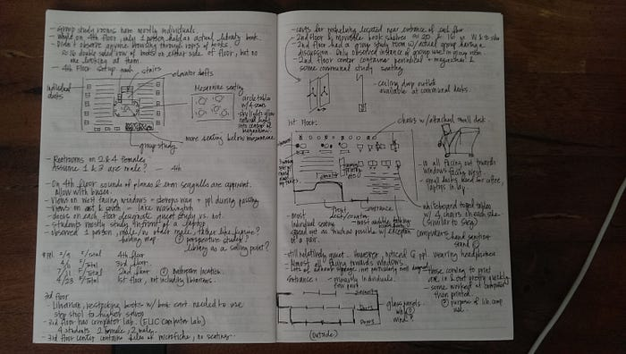
Observations
field notes
– conducted during the observation or after the end of the observation
– previously often handwritten notes, this may have affected the observations
– today the possibility to use a mobile phone or other technology, it is easier to hide

Slide 30
Thank you for your attention !
Questions ?
RNDr. Ondřej Šerý, Ph.D.
Department of Geography
Faculty of Science
Masaryk University
Kotlářská 2, 611 37 Brno
e-mail: ondrej.sery@mail.muni.cz

Slide 31
Task 1
questionnaire survey
– create 7 to 10 questions for the questionnaire on the topic “Quality of life in the city XY”
– identification questions (gender, age, education) do not count
– use a combination of different question types (open-ended, closed-ended, Likert scale, scoring, ranking etc.)
– test your questionnaire survey in practice and interview your classmate

Slide 32
Task 2
semi-structured interview
– create a structure for the interview: main topic, individual subtopics and basic questions
– topic: “Exploring a new city”
– create pairs or trios and conduct this interview, then evaluate what you have found out
– give your interviewer constructive feedback

